Slide 1
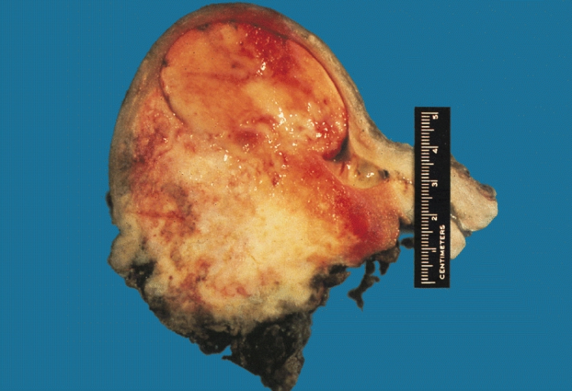
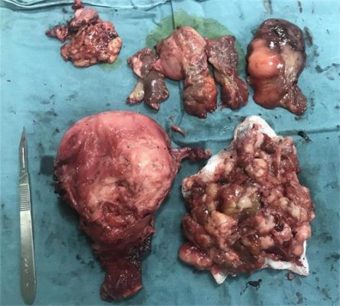
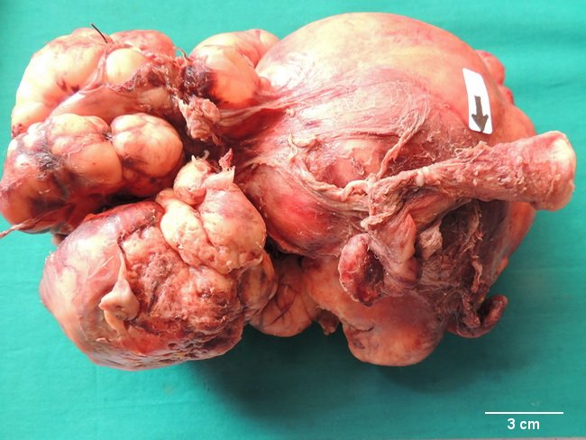
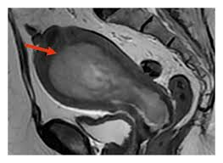
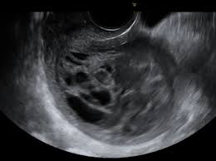
Preoperative Diagnosis of Uterine Sarcomas Dr Hüseyin Akıllı. MD Başkent University School of Medicine

Slide 2
Uterine sarcomas
0.5-1% of malignant gynecologic tumors
3-7% of malignant uterine tumors

Slide 3
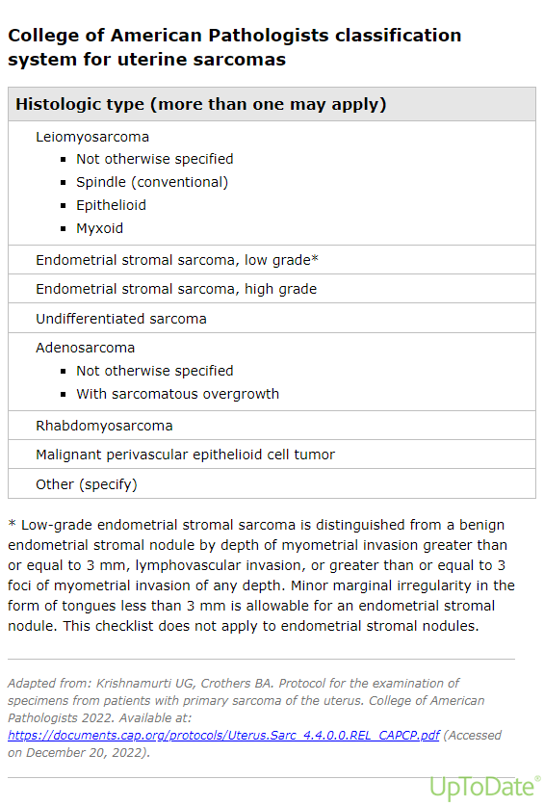
WHO 2020

Slide 4
Diagnosis
Adenosarcoma
►► morphology (IV, B).
►► The following aggressive prognostic factors should be taken into account (IV, B):
–– Sarcomatous overgrowth
–– High-grade component
–– Lympho-vascular invasion
–– Myometrial infiltration
PEComa
►► The diagnosis is made based on a combination of morphology (perivascular epithelioid cells) and melanocytic markers (HMB45, Melan A) (IV, B).
NTRK
►► Confirmation of NTRK fusion status by molecular methods is essential given pan-Trk expression in other uterine sarcoma subtypes (HG-ESS and uLMS) (IV, B).
uLMS
►► morphology (2020 WHO and ICCR criteria) and mmunohistochemistry (IV, B).
HG-ESS
►► morphology (atypia, mitotic count and necrosis, frequent lymphovascular invasion) and immunohistochemistry (frequent Cyclin D1 and/or BCOR overexpression and/or altered ER/PR expression). (IV, C).
►► Molecular analysis is indicated and encouraged to detect BCOR, YWHAE, or BCORL1 alterations (IV, B).
UUS
►► immunohistochemistry and molecular studies (RNA sequencing) are indicated to exclude other tumor types (IV, B).
LG-ESS
►► An endometrial stromal tumor with permeative (tongue-like) infiltration of the myometrium (>3 finger-like projections measuring> 3 mm from tumor periphery) and/or lympho-vascular invasion is diagnostic of LG-ESS. Detection of LG-ESS Associated fusions may be helpful (IV, C).
Ray-CoquardI, et al. Int J Gynecol Cancer 2024;0:1–23. doi:10.1136/ijgc-2024-005823

Slide 5
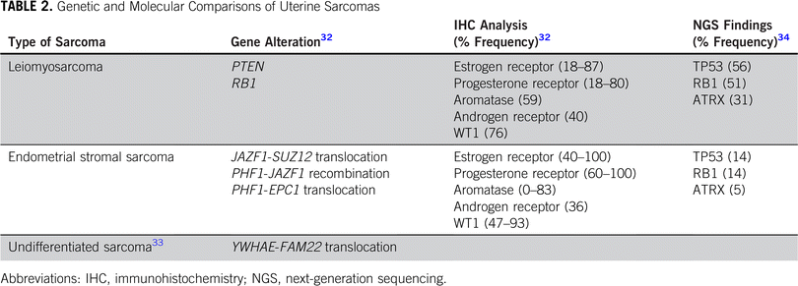
Genetic and Molecular Comparisons of Uterine Sarcomas
Published in: Molly Roy; Fernanda Musa; Sarah E. Taylor; Marilyn Huang Am Soc Clin Oncol Educ Book 2022 04-26
DOI: 10.1200/EDBK_350955
Copyright © 2022 American Society of Clinical Oncology

Slide 6
Staging
Leiomyosarcomas and endometrial stromal sarcomas
I Tumor limited to the uterus
IA Less than 5 cm
IB More than 5 cm
II Tumor extends beyond the uterus, within the pelvis
IIA Adnexal involvement
IIB Involvement of other pelvic tissues
III Tumor invades abdominal tissues (not justprotruding into the abdomen)
IIIA One site
IIIB More than one site
IIIC Metastasis to pelvic and/or para-aortic lymph nodes
IV
IVA Tumor invades bladder and/or rectum
IVB Distant metastasis
Adenosarcomas
I Tumor limited to the uterus
IA Tumor limited to endometrium/endocervix with no myometrial invasion
IB Less than, or equal to, half myometrial invasion
IC More than half myometrial invasion
II Tumor extends to the pelvis
IIA Adnexal involvement
IIB Tumor extends to extra-uterine pelvic tissue
III Tumor invades abdominal tissues (not just protruding into the abdomen)
IIIA One site
IIIB More than one site
IIIC Metastasis to pelvic and/or para-aortic lymph nodes
IV
IVA Tumor invades bladder and/or rectus
IVB Distant metastasis

Slide 7
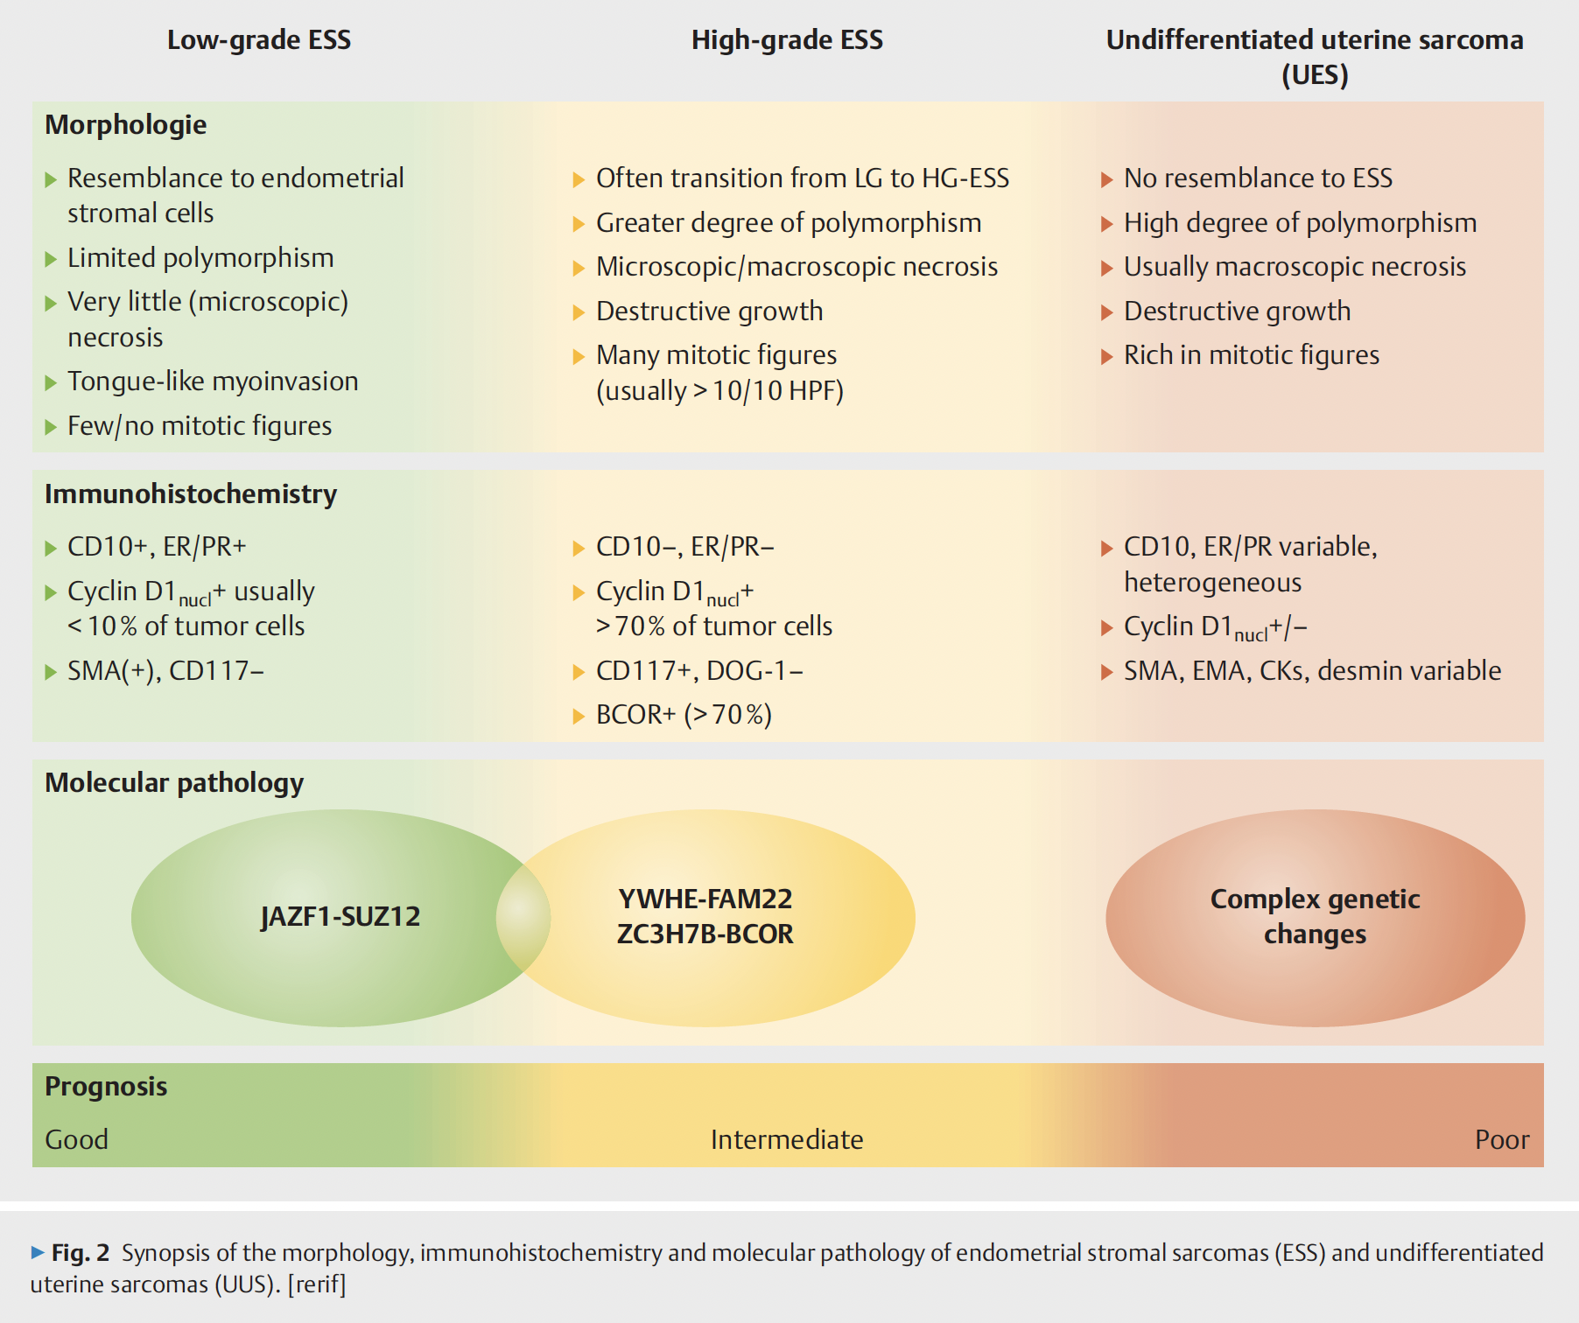

Slide 8
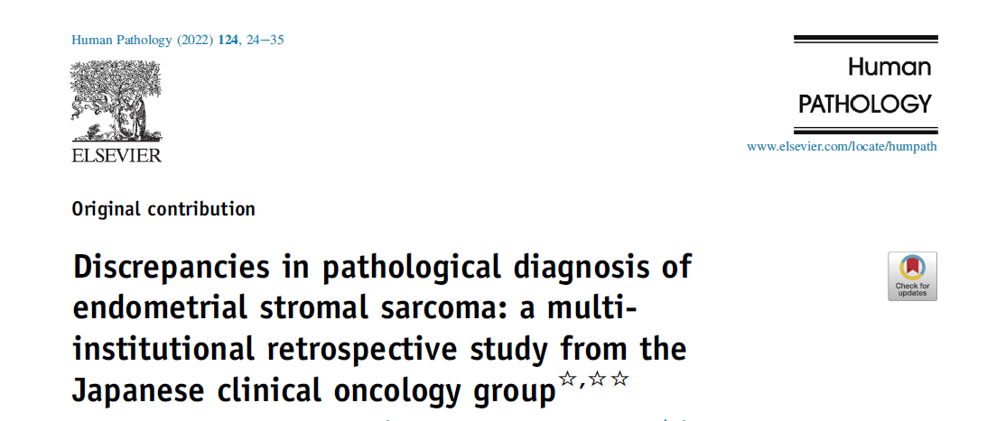
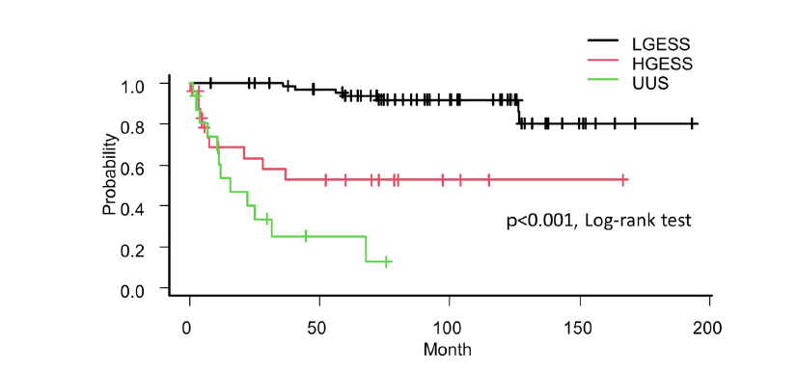
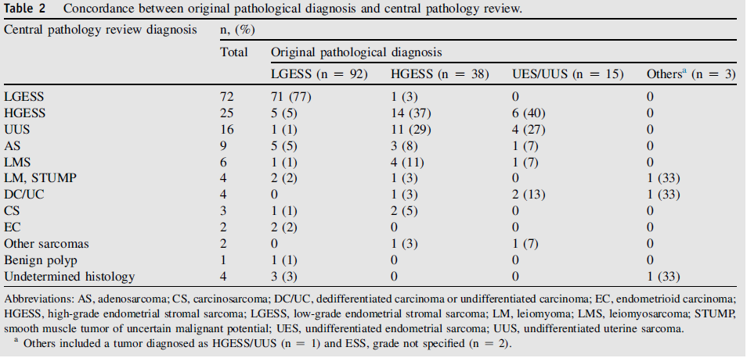

Slide 9
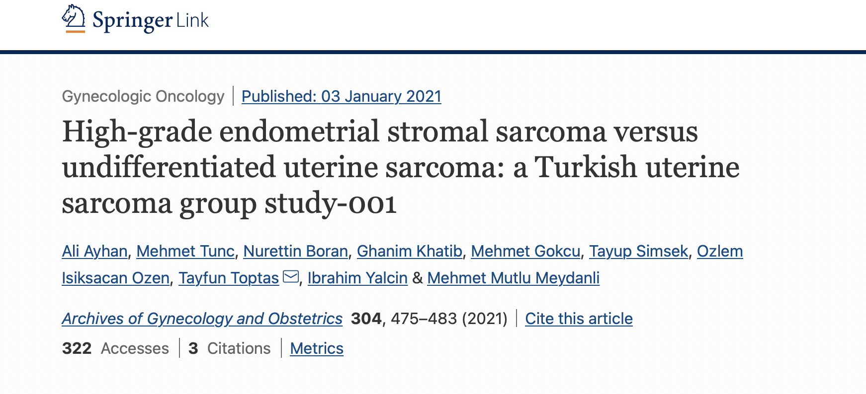
A multi-institutional, retrospective, cohort study
13 Centers
71 patients: 26 patients with HG-ESS and 45 patients with UUS
UUS had a significantly poorer DFS than those with HGESS (p = 0.016), although OS did not differ between the groups (p = 0.135)

Slide 10
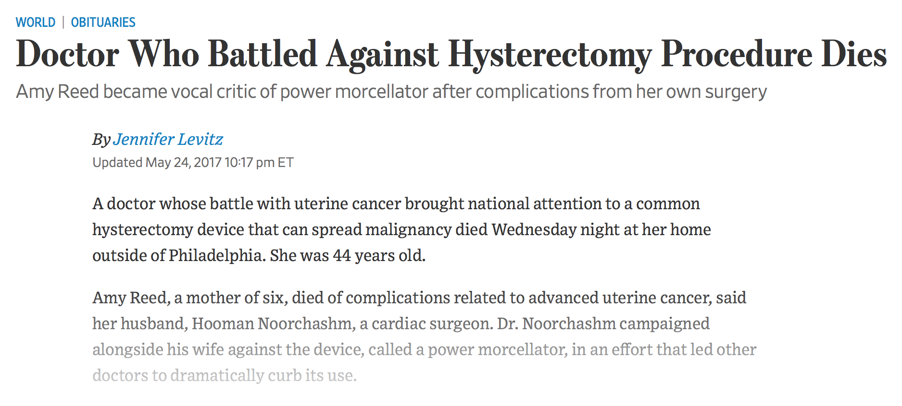
In December 2013, a high-profile patient experienced disseminated uterine sarcoma after morcellation of a presumed fibroid uterus
This case received popular media attention
Morcellation of presumed myomas was called into question
Notes:
In December two thousand thirteen, an anesthesiologist underwent laparoscopic hysterectomy with power morcellation of a presumed fibroid uterus and experienced disseminated uterine sarcoma. This case received popular media attention and morcellation of presumed myomas was called into question.

Slide 11
Morcellation
In April 2014, the Food and Drug Administration (FDA) released a safety communication, discouraging the use of power morcellation of presumed myomas for oncological safety
More than two-thirds of minimally invasive surgeons declared that they had changed their surgical approach after the FDA warning
DeSai VB. Am J Obstet Gynecol 2015
This has led to a shift from minimally invasive surgery (MIS) to open surgery
Increased economic burden
Morbidity for patients with myomas
Notes:
In April 2014, the FDA released a safety communication, discouraging the use of power morcellation of presumed myomas for oncological safety. After the FDA warning, more than two-thirds of minimally invasive surgeons changed their surgical approach.

Slide 12
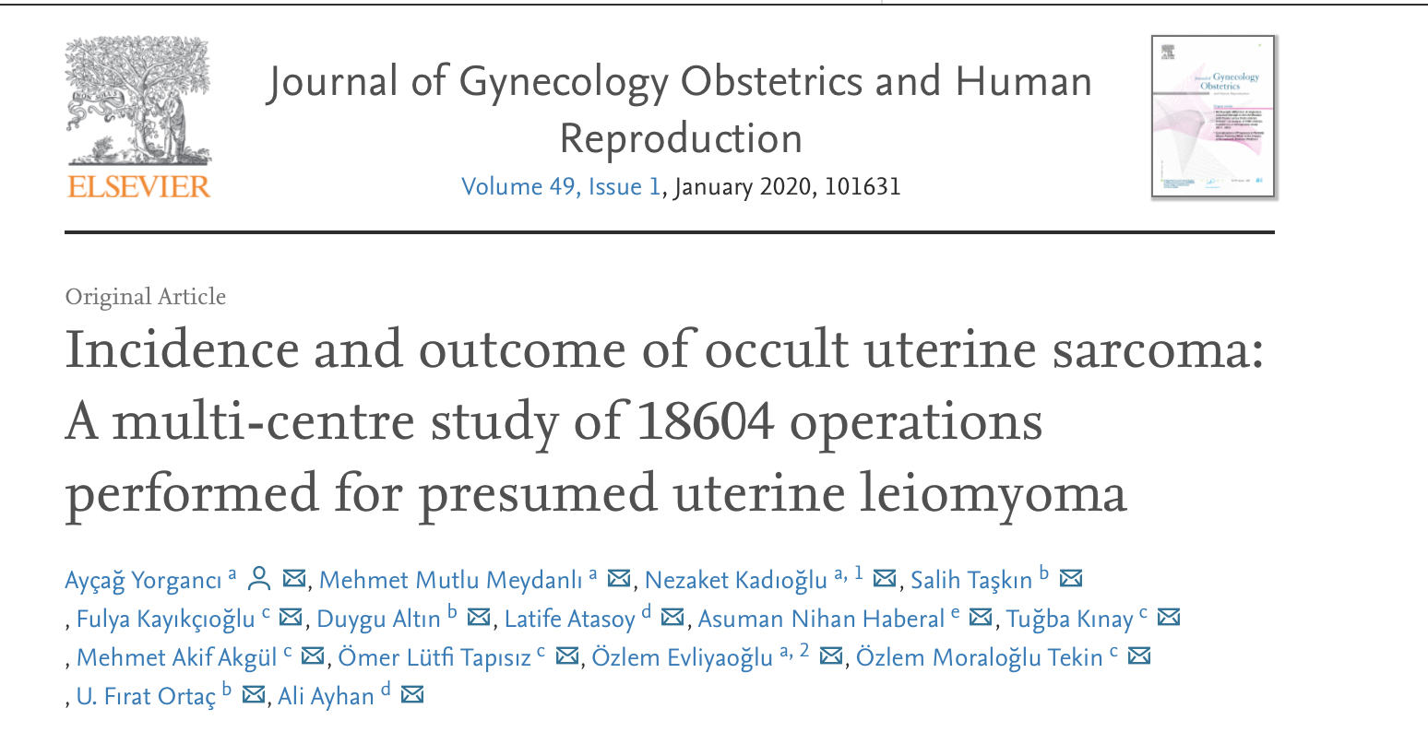
Rate of occult uterine sarcoma: 1/332 (0.3%)
Rate of occult uterine leiomyosarcoma (LMS): 1/364

Slide 13
Incidence of occult uterine sarcoma
*Author | Publication year | Incidence of occult sarcoma
FDA | 2014 | 1/352
Raine-Benett T | 2016 | 1/278
Paul G | 2016 | 1/335
Desai VB | 2019 | 1/333
Yorganci A | 2020 | 1/332
Multinu F | 2019 | 1/256
*All studies focus on women with presumed uterine fibroids regardless of the surgical approach
(both hysterectomies and myomectomies included)
Notes:
However, when the most recent studies are taken into account, the incidence seems to be fixed at approximately one over three hundred and thirty surgeries corresponding to 0.3 percent. This incidence is nearly identical to that of the original incidence reported by the FDA.

Slide 14
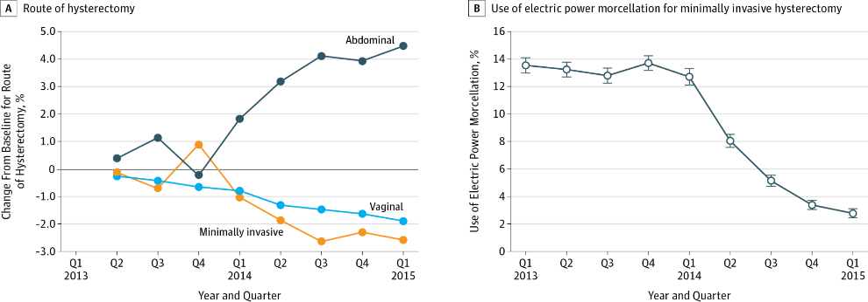
From: Trends in Use and Outcomes of Women Undergoing Hysterectomy With Electric Power Morcellation
JAMA. 2016;316(8):877-878. doi:10.1001/jama.2016.9432
Change Over Time in the Route of Hysterectomy and Use of Electric Power Morcellation for Minimally Invasive Hysterectomy, by Quarter and YearError bars indicate 95% CIs
Notes:
After the FDA warning, the rate of laparoscopic hysterectomies dramatically decreased whereas the rate of abdominal hysterectomies increased. On the right side, you can observe a dramatic decrease in the rate of utilizing power morcellation for minimally invasive surgery.

Slide 15
meta-analysis of 60 studies
morcellation was an independent negative prognostic factor for survival.
increase the Recc rate (62% vs. 39%; OR: 3.16 (95% CI: 1.38, 7.26))
intra-abdominal rec (39% vs. 9%; OR: 4.11 (95% CI: 1.92, 8.81))
Death rate (48% vs. 29%; OR: 2.42)

Slide 16
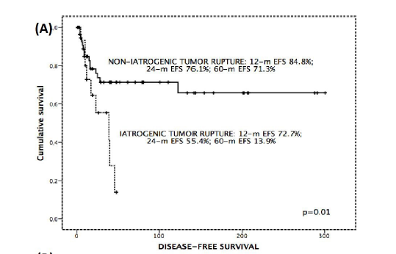
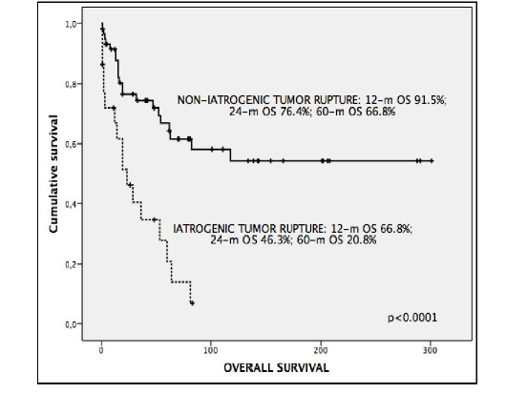

Slide 17
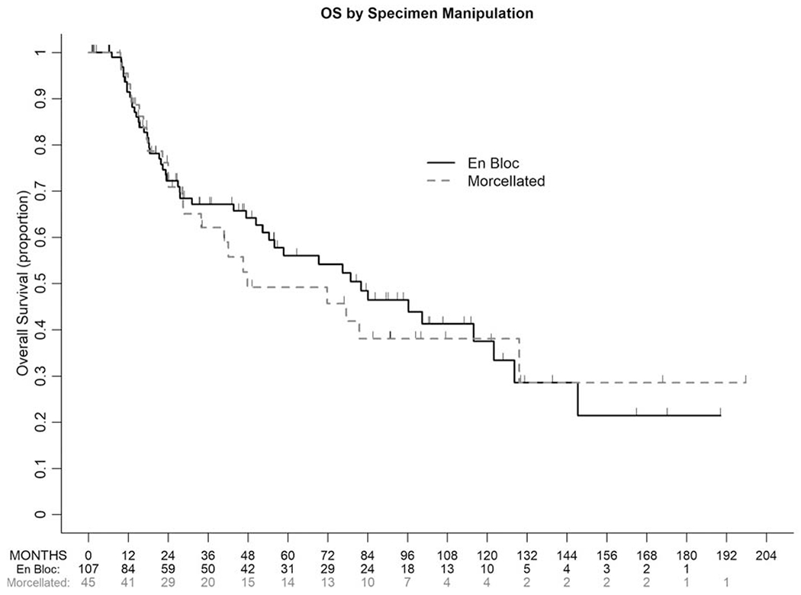
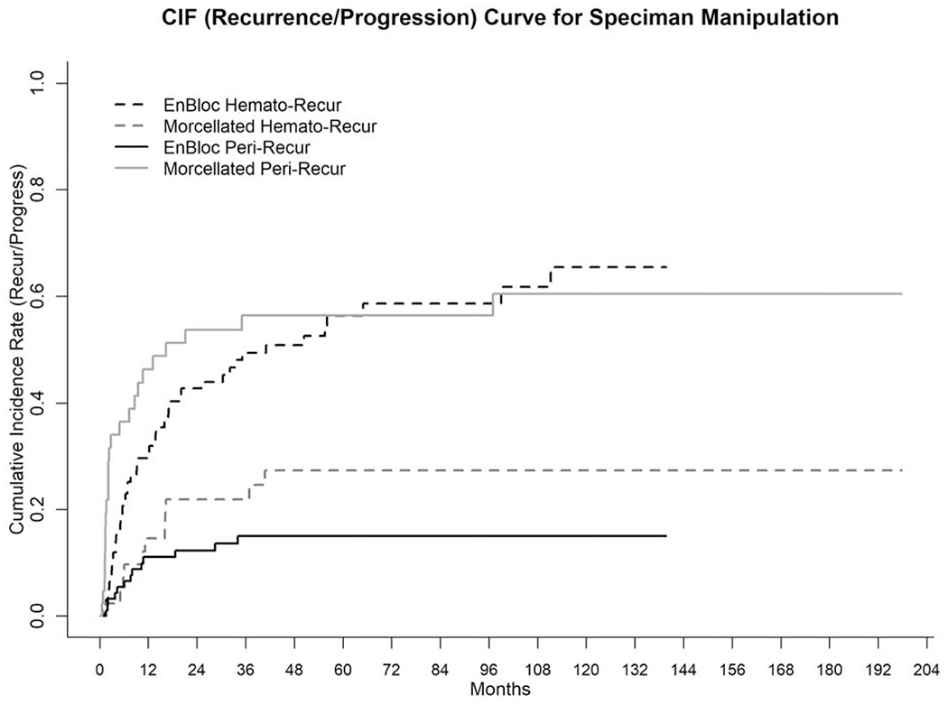
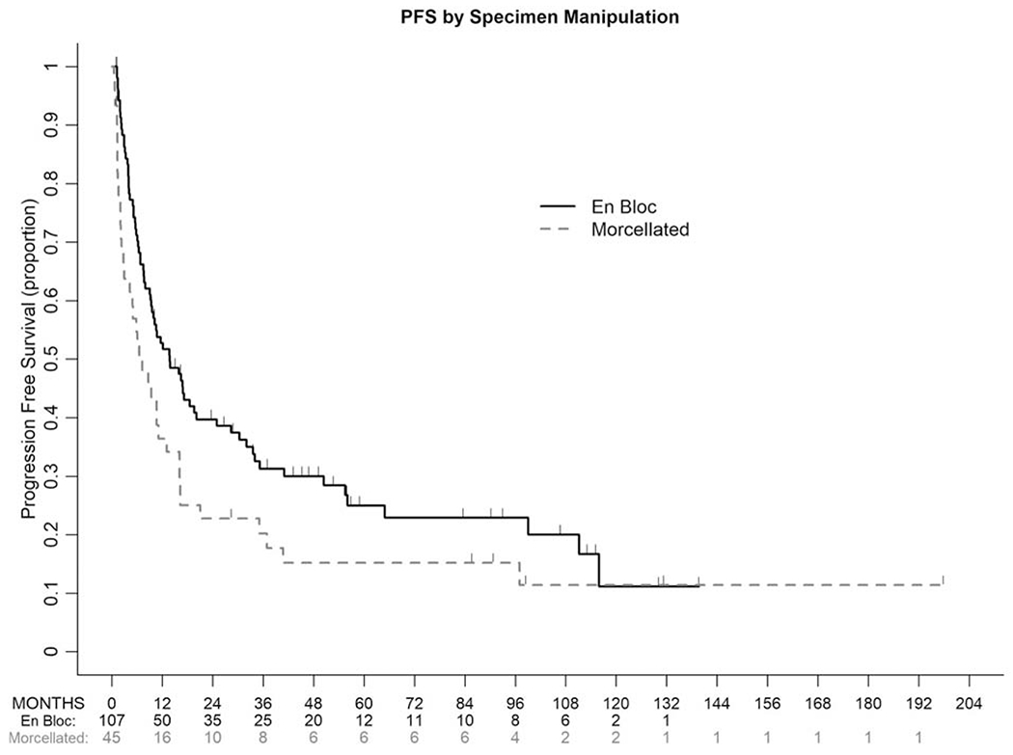
The impact of tumor fragmentation in patients with stage I uterine leiomyosarcoma on patterns of recurrence and oncologic outcome
Tumor fragmentation/morcellation was associated with significantly higher risk of recurrence and a nearly 4-fold increase in peritoneal recurrence
Gynecol Oncol 2021 Jan;160(1):99-105.doi: 10.1016/j.ygyno.2020.10.020. Epub 2020 Nov 4.

Slide 18
UPDATE: On May 26, 2023, the FDA issued the final guidance
The FDA recommends health care providers share this information with patients and warn against using laparoscopic power morcellators
suspected or confirmed cancer
in women over 50 years of age having a myomectomy or hysterectomy for uterine fibroids.

Slide 19
In a nationwide study including 212 LMSs over a period of 10 years in Norway, LMS was histopathologically verified in only 23% of the cases pre-operatively.
Approximately 54% of uterine LMSs were unidentified prior to surgery
Skorstad M. Acta Obstet Gynecol Scand 2016
Notes:
In a nationwide study including two hundred and twelve leiomyosarcomas in Norway, leiomyosarcoma was histopathologically verified in only twenty-three percent of the cases in the pre-operative setting. Fifty-four percent of them were unidentified prior to surgery.

Slide 20
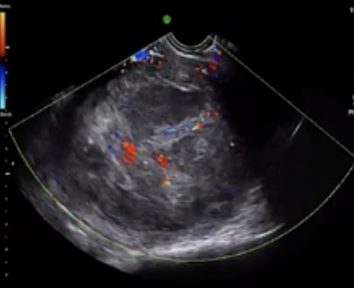
Preoperative diagnosis
Transvaginal sonography
No pathogonomic signs
What may help:
 | Myoma | LMS
Shape | Round | Oval
Echogenicity | Frequent calcifications | Inhomogeous
Central necrosis | Rare | Yes
Doppler | Circular flow | Irregular distrubution blood vessels, low resistance, high velocity

Slide 21
Sonographic features suggestive of uterine sarcoma;
central necrosis
cystic changes
heterogeneous echotexture
hypervascularity;
however, many of these characteristics may be found in leiomyomas
Oh J, Park SB, Park HJ, et al. Ultrasound features of uterine sarcomas. Ultrasound Q. 2019 ; 35 : 376 - 384.

Slide 22
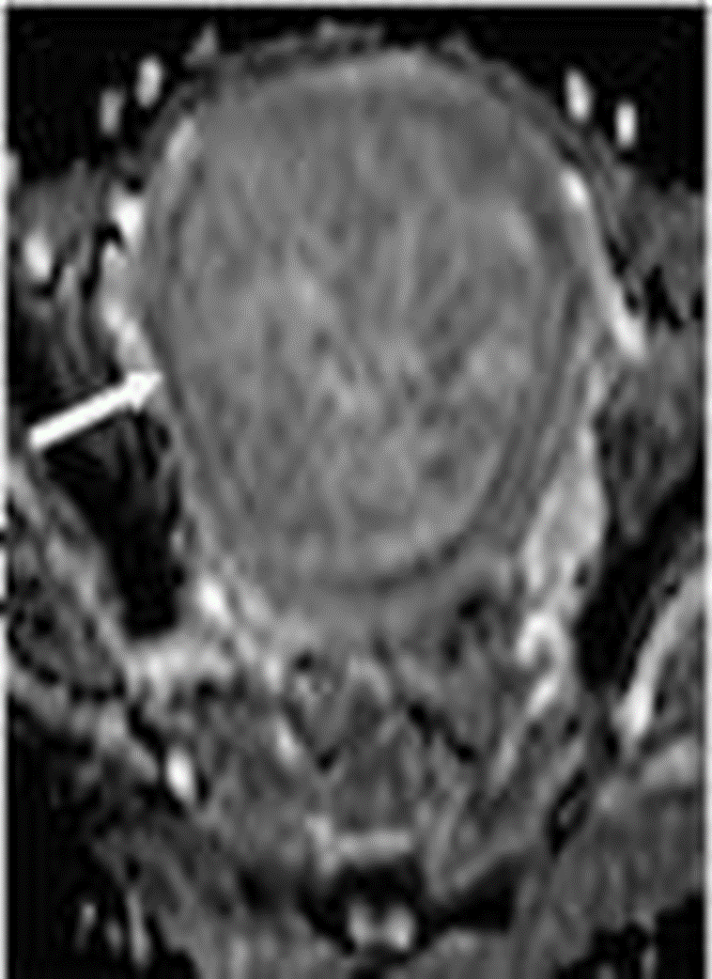
Suspicious masses on transvaginal ultrasound can be evaluated further with MRI ;
Aid in tumor localization, identify irregular or nodular margins
Characterize depth of invasion
Areas of necrosis
Intralesional hemorrhage
Diffusion Weighted MRI
Gynecol Oncol. 2008 ; 110 : 43 - 48. Samuel A. Fertil Steril 2008 Van Den Bosch T. Best Prac Res Clin Obstet Gynaecol 2012

Slide 23
MRI
expensive,
MRI is the best in the pre-operative setting
Barral M. Abdom Radiol 2017
In clinical practice, there is usually no difficulty in diagnosing ordinary myomas as well-circumscribed, hypointense masses on T2-weighted imaging
A problem arises when atypical myomas present hyperintensity on T2-weighted imaging
myomas with red degeneration
cellular myomas
mixoid myomas
Notes:
Despite being expensive, MRI is the best and the most reliable imaging technique that can help to differentiate uterine sarcoma from benign uterine fibroids in the pre-operative setting. In clinical practice, there is usually no difficulty in diagnosing ordinary myomas with well-defined borders, as hypointense masses on T2-weighted images. However, the diagnosis becomes problematic when atypical myomas show high signal intensity on ti two weighted images.

Slide 24
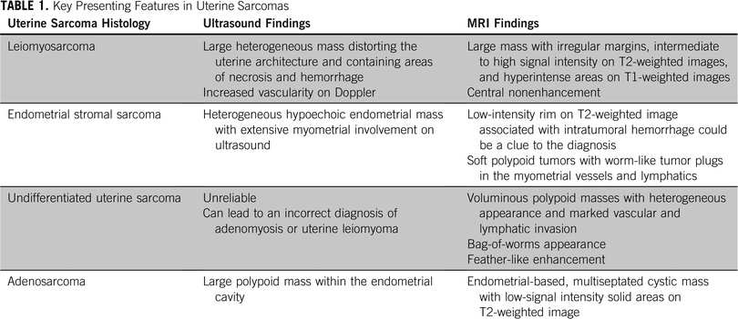
Presenting Features in Uterine Sarcomas
Published in: Molly Roy; Fernanda Musa; Sarah E. Taylor; Marilyn Huang Am Soc Clin Oncol Educ Book 2022 04-26
DOI: 10.1200/EDBK_350955
Copyright © 2022 American Society of Clinical Oncology

Slide 25
-Endometrial Biopsy
Endometrial biopsy will only detect uterine LMS in 30-35% of the time
Schwartz L. Am J Obstet Gynecol 1993
Hinchcliff EM. J Min Invasive Gynecol 2016
The sensitivity for endometrial stromal sarcoma (ESS) ranges between 25-33%
Sagea S. Oncology 2004
Bansal N. Gynecol Oncol 2008
A negative biopsy does not rule out uterine sarcoma
Skorstad M. Acta Obstet Gynecol Scand 2016
Notes:
Because of the intramural localization of uterine leiomyosarcomas, endometrial biopsy can only detect thirty to thirty five percent of them. The sensitivity for endometrial stromal sarcoma ranges from twenty-five to thirty-three percent. I would like to emphasize that a negative biopsy does not rule out uterine sarcoma.

Slide 26
Endometrial Biopsy
Endometrial biopsy is still the best test to diagnose uterine sarcoma pre-operatively
Chalas A. Curr Opin Obstet Gynecol 2018
Endometrial biopsy should be performed for all women with any abnormal bleeding and presumed myomas
Lynam S. Womens Health 2015
If morcellation is planned, biopsy should be used
Chalas A. Curr Opin Obstet Gynecol 2018
Notes:
Endometrial biopsy is still the best test to diagnose uterine sarcoma pre-operatively. Endometrial biopsy should be performed for all women with any abnormal bleeding and presumed myomas. If morcellation is planned, a low threshold to biopsy should be used

Slide 27
Serum lactate dehydrogenase (LDH)
Serum LDH is often elevated in LMSs secondary to coagulative-type cell necrosis
Seki K. Gynecol Obstet Invest 1992
Serum LDH may be a marker of aggressive behavior reflecting tumor growth exceeding vascular supply
Takeuchi S. Japan Assoc Rural Med 1995
Combination of
patienst Age
degenerative changes within the uterine mass
increased LDH level, should raise the suspicion of uLMS
Goto A. Int J Gynecol Cancer 2002
Nagei T. SpringerPlus 2014
Nagei T. SpringerPlus 2015
Notes:
Serum LDH is often elevated in leiomyosarcomas secondary to coagulative necrosis. LDH has been accepted as the most relevant serum marker for the pre-operative diagnosis of uterine sarcomas

Slide 28
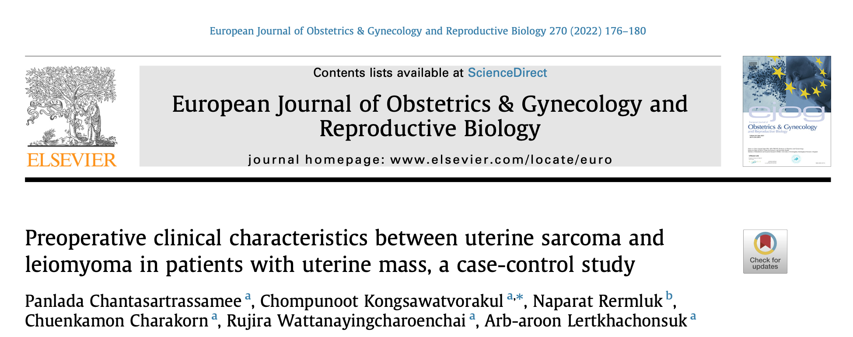
 | HR (95% CI)
Age older 40 years old | 3.30 (1.29–8.43),
Postmenopause | 8.57 (2.38–30.82),
Postmenopausal bleeding | 35.35 (2.94–425.13),
abnormal uterine bleeding | 3.39 (1.40–8.23)
Palpable mass | ,4.50 (1.78–11.36),
Recognition of rapid growing mass | 6.91 (2.08–22.91)
Single uterine mass identified byUSG | 4.70 (1.91–11.60),
18,218 patients with uterine mass undergoing Surgery
Uterine sarcoma was diagnosed in 68 patients.
the incidence of uterine sarcoma was 0.37%.
strong association with uterine sarcoma

Slide 29
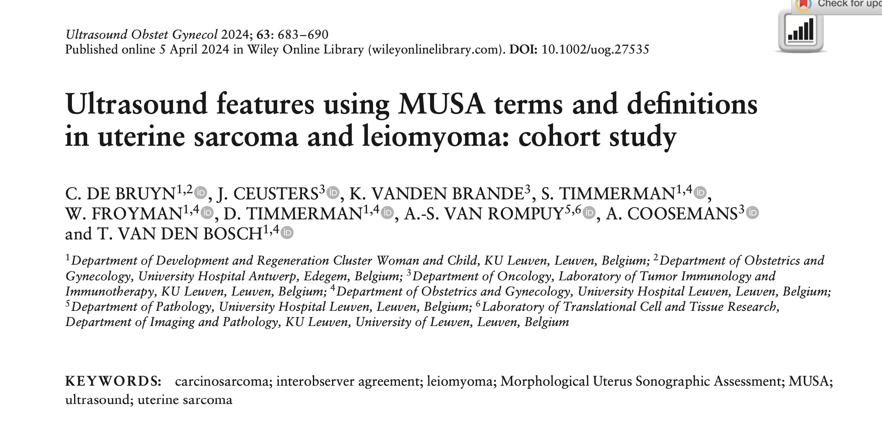
Morphological Uterus Sonographic Assesment
Uterine sarcoma patients:
tend to be older
Postmenopausal
present with abnormal uterine bleeding.
On ultrasound evaluation:uterine sarcoma
has irregular tumor borders
non-uniform echogenicity
cystic areas, central necrosis
an absence of calcifications and high intralesional vascularity

Slide 30
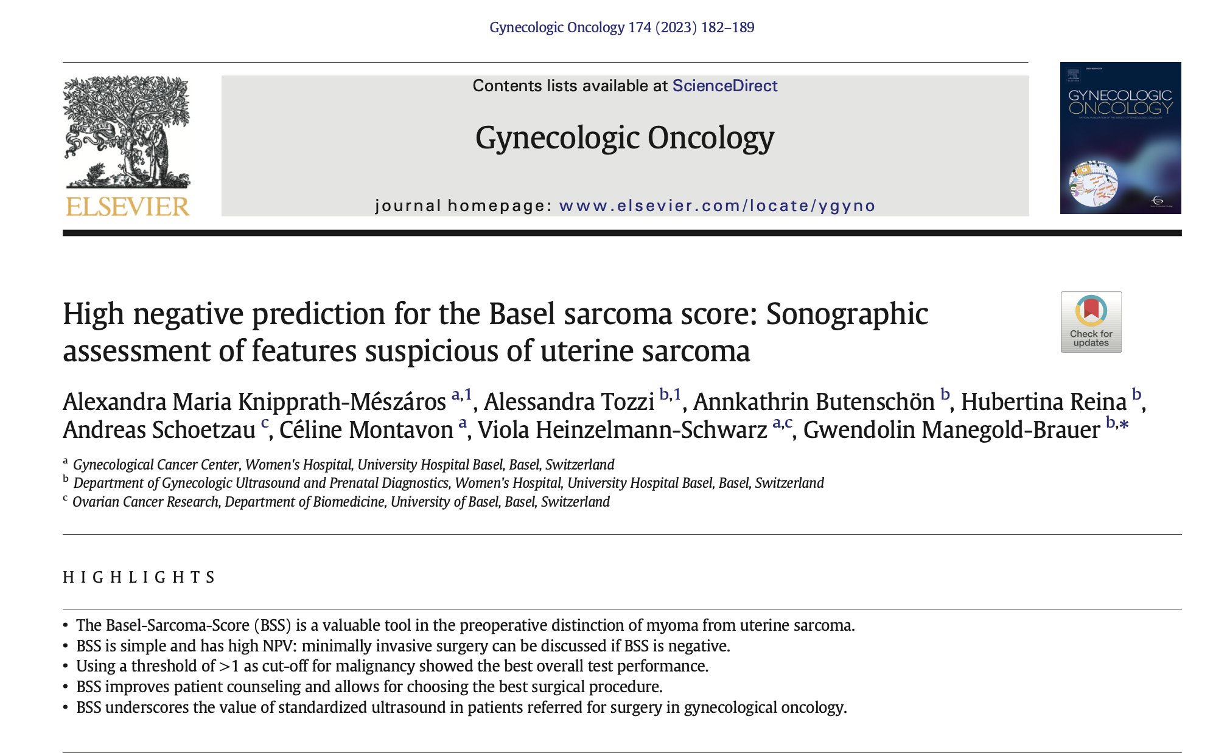
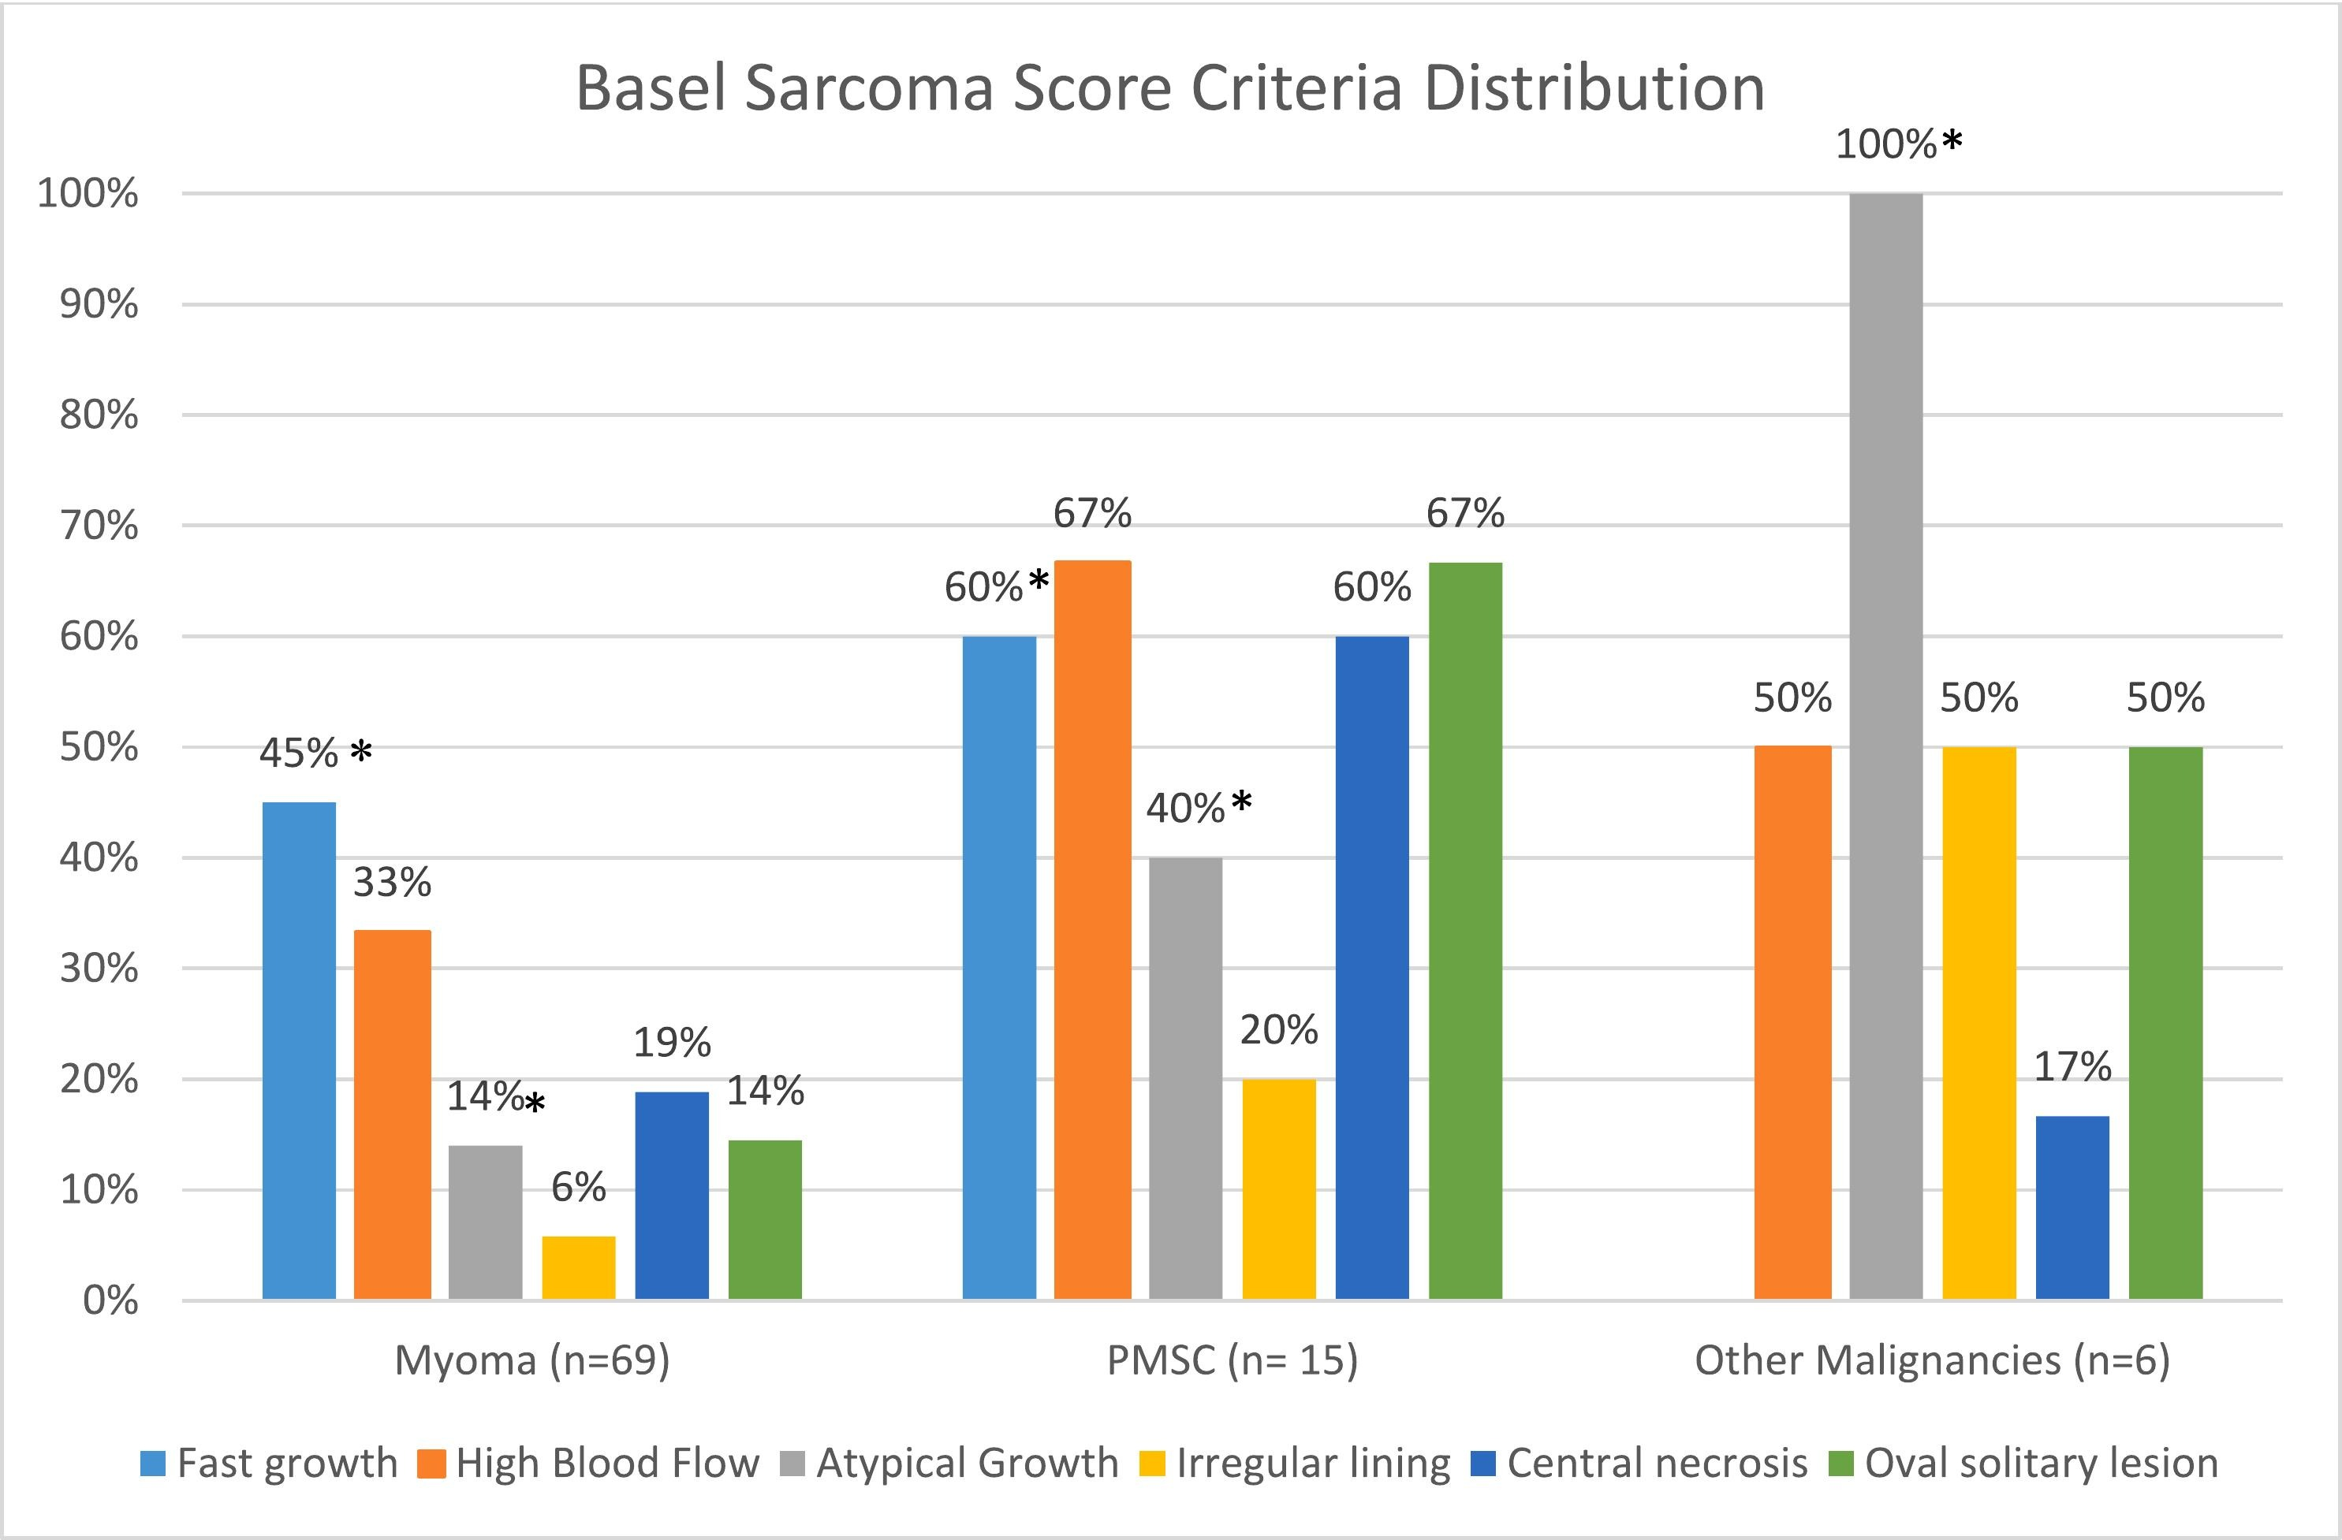
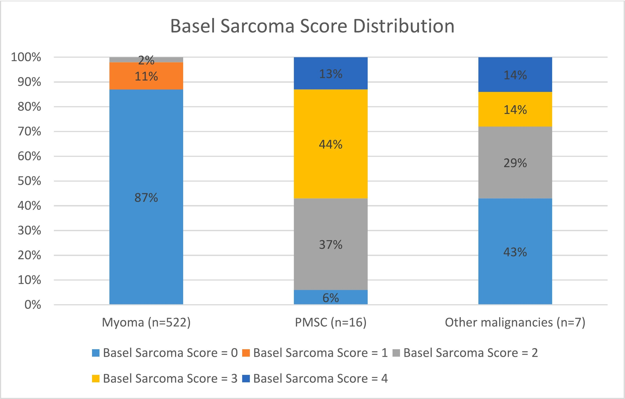
Basel Sarcoma Score
Rapid growth in past three months
High blood flow
atypical growth
Irregular lining
Central necrosis
Oval solitary lesion.
For each criterion, a score 0/1 was given. BSS (0–6) equals the sum of all given scores. Histological diagnosis was used as reference
BSS threshold of >1,
sensitivity was 93.8%, specificity 97.9%, and positive predictive value (PPV) and negative predic- tive value (NPV) were 57.7% and 99.8%, respectively (AUC 0.95).

Slide 31
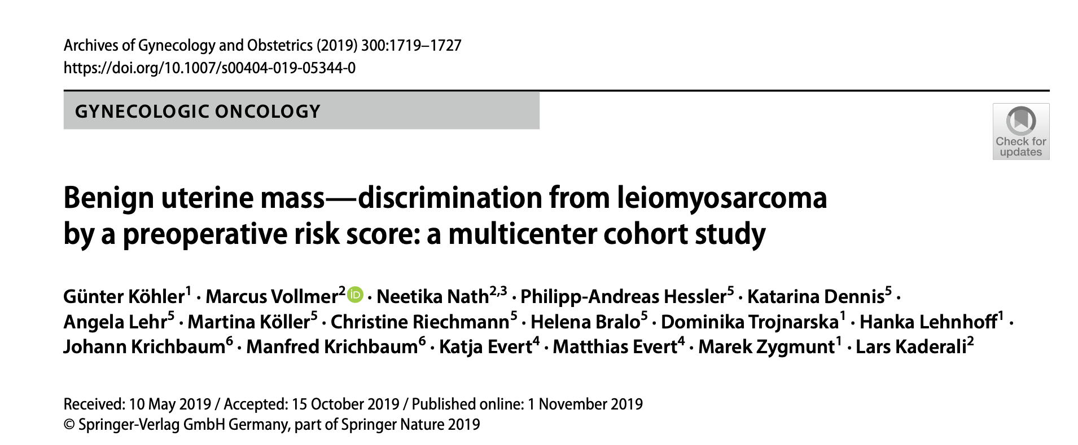
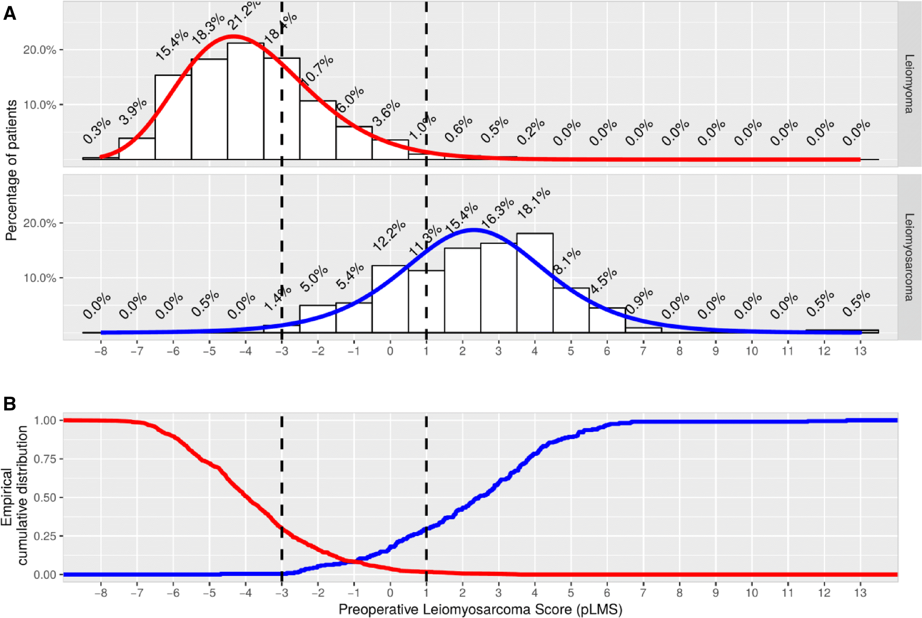
intermenstrual bleeding [RR_{c} = 2.71, CI = (1.90–3.49), p < 0.001],
hypermenorrhea [RR_{c} = 0.28, CI = (0.15–0.50), p < 0.001],
dysmenorrhea [RR_{c} = 0.22, CI = (0.10–0.51), p < 0.001]
postmenstrual bleeding [RR_{c} = 2.08, CI = (1.30–2.75), p < 0.001],
suspicious sonography [RR_{c} = 1.21, CI = (1.19–1.22), p < 0.001]
tumor diameter (each centimeter difference: β = 0.24, SD = 0.04, p < 0.001)
In case pLMS is between −3 and +1, we suggest subsequent diagnostics,

Slide 32
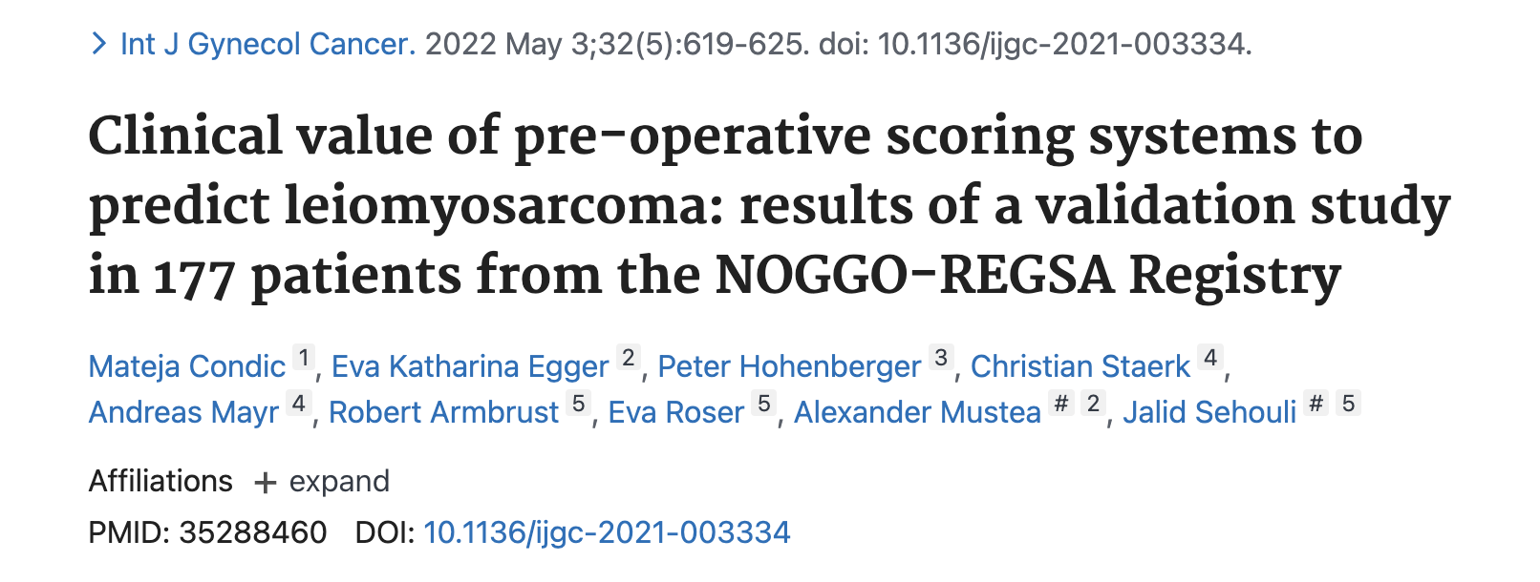

Slide 33
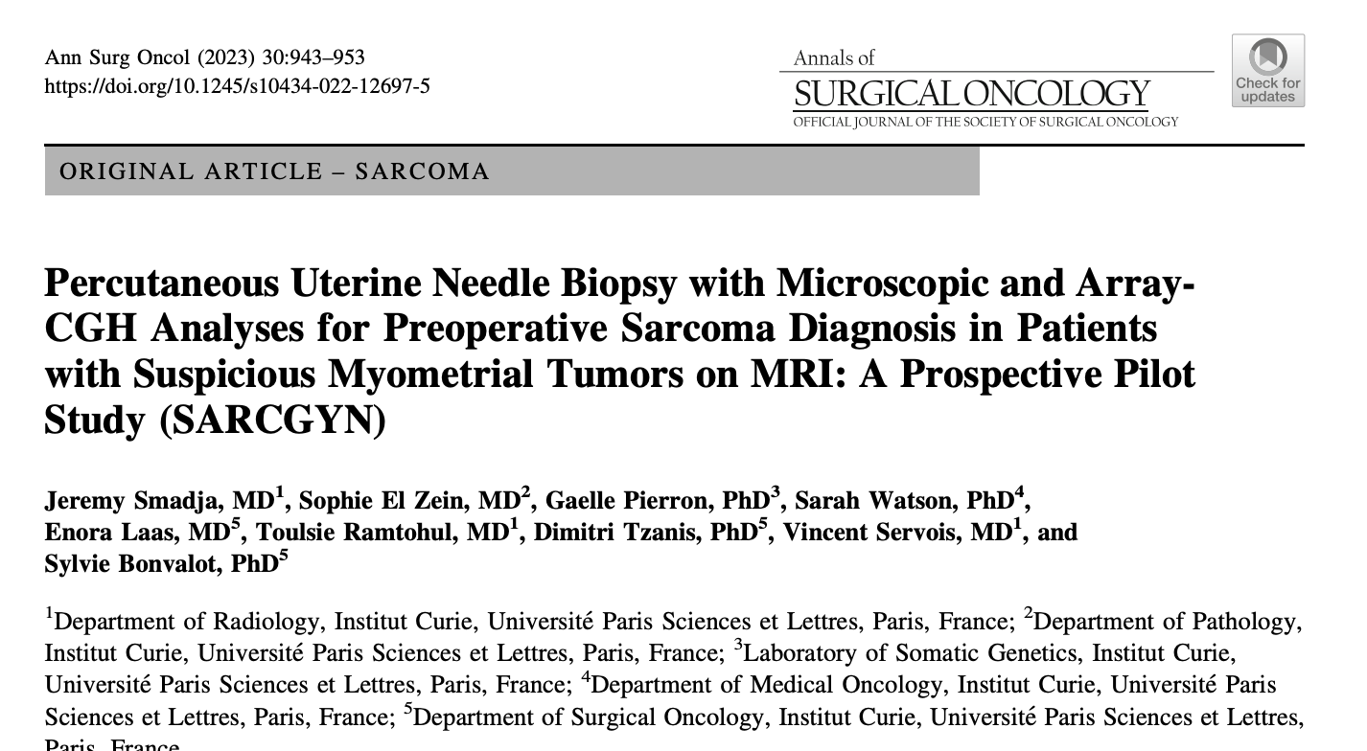
Preoperative Needle Bilopsy
34 patients
Based on the surgical specimen (N = 23) or follow-up (N = 11), final diagnoses were 11 sarcomas and 23 non-sarcomas.
The median follow-up was 12 months ().
The diagnostic accuracies of M-PUB and MCGH-PUB were 94% and 100%, respectively.
The sensitivity, specificity, and negative predictive value of MCGH-PUB were 100%, 100%, and 100%, respectively.
A high GI was significantly associated with malignancy (P \ 0.001
There were no complications and no dissemination along the biopsy track.
preoperative percutaneous uterine needle biopsy (PUB) with microscopic examination (M-PUB)
array-comparative genomic hybridization (MCGH-PUB).

Slide 34
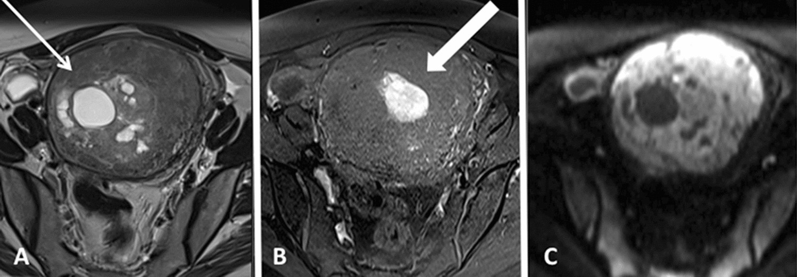
Suspicious tumor. unique well circumscribed myometrial mass 10 cm,
(A), inhomogeneous content, and cystic/necrotic areas
(B)intra-tumoral bleeding),
(C) high diffusion signal with low ADC value (0.88 x 10⁻³ mm²/s).
MCGH-PUB: leiomyosarcoma

Slide 35
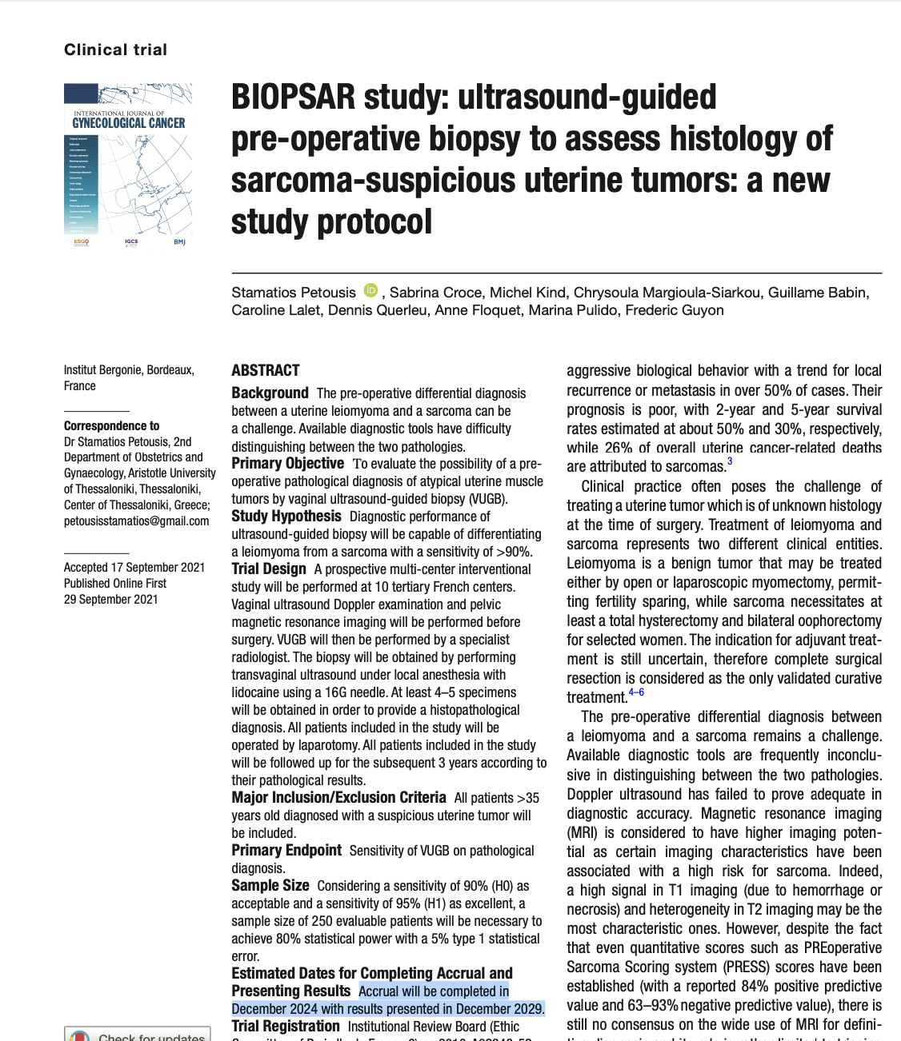
► Rapid tumor growth
► Symptomatic tumors in post-menopausal women
► Tumors characterized by certain suspicious ultrasound criteria such as
size >8 cm
presence and distribution of vascularization, presence of intra-tumoral lesions,
heteroge-neity,
necrosis,
cystic components,
presence of calcification.
► Treatment with tamoxifen.
► Genetic predisposition to cancer syndromes such as Lynch syndrome, hereditary leiomyomatosis, or others.
Results will be presented in December 2029

Slide 36
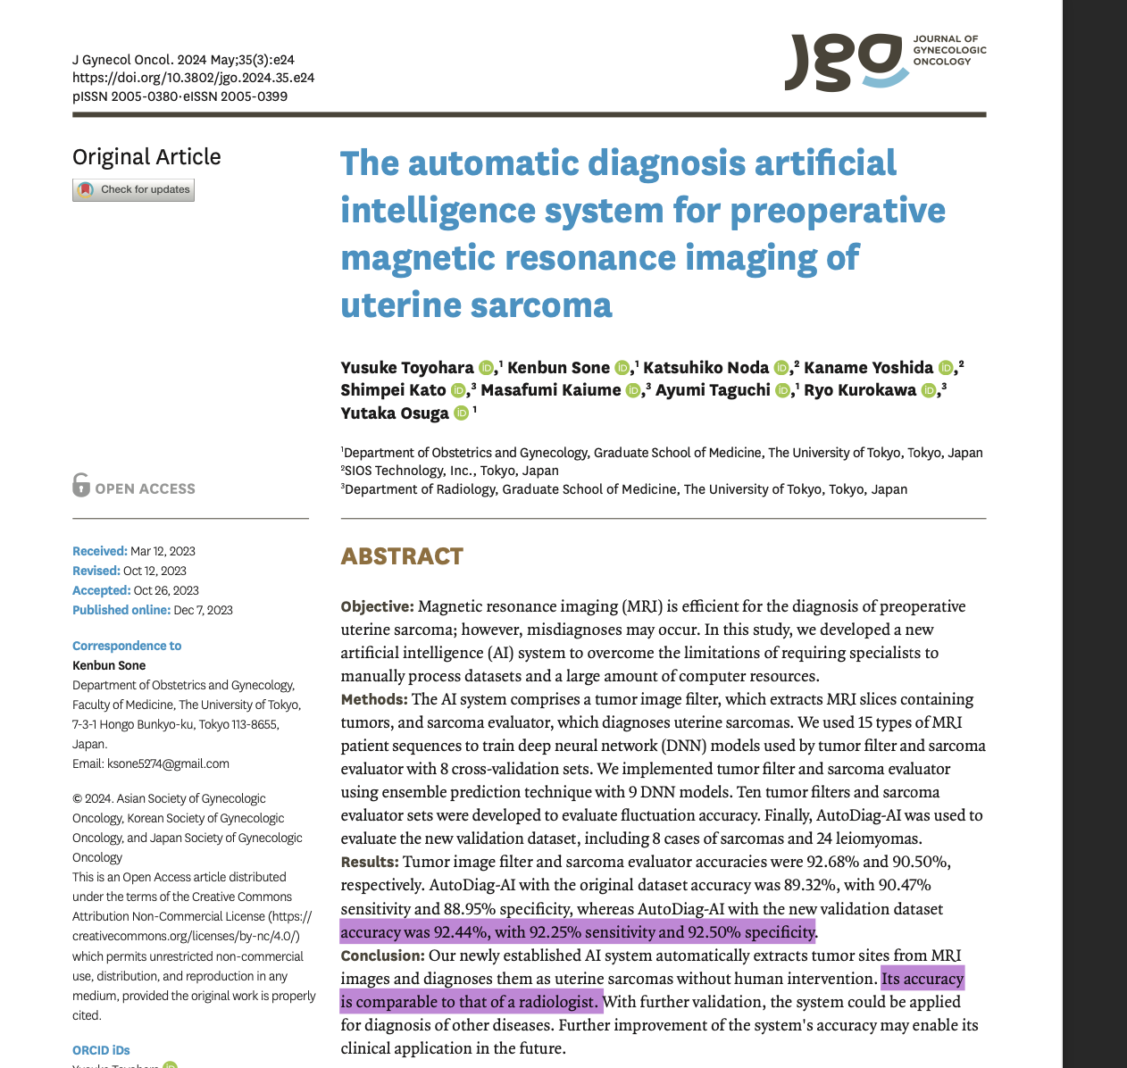
Artificial intelligence

Slide 37
Ray-CoquardI, et al. Int J Gynecol Cancer 2024;0:1–23. doi:10.1136/ijgc-2024-005823

Slide 38
ESGO/EURACAN/GCIG guidelines for the management of patients with uterine sarcomas General Diagnosis
Pathological diagnosis should be confirmed by a pathologist with expertise and experience in the diagnosis of gynecologic mesenchymal tumors, preferably at a sarcoma reference center (IV, A).
► Molecular testing may be required to confirm pathological diagnosis and to identify therapeutic targets (IV, C).
►► Sampling should be based on a careful macroscopic examination (V, B).
Ray-CoquardI, et al. Int J Gynecol Cancer 2024;0:1–23. doi:10.1136/ijgc-2024-005823

Slide 39
ESGO/EURACAN/GCIG guidelines :General Recommendations
Atypical uterine fibroid findings on baseline pelvic ultrasound scans, should be referred to MRI or specialized ultrasound (V, B).
Specialized cancer center by an experienced sonographer fully dedicated to the imaging of gynecological cancers (V, A).
Should be performed by subspecialist radiologists evaluating specific MRI features (V, A).
Ray-CoquardI, et al. Int J Gynecol Cancer 2024;0:1–23. doi:10.1136/ijgc-2024-005823

Slide 40
ESGO/EURACAN/GCIG guidelines :Tailoring Surgery in Patients with Symptoms, High-risk Factors, Fertility Needs, Suspicion on Ultrasound or Pelvic MRI
İf hysterectomy is not immediately feasible, pre-operative image-guided biopsy is an option (IV, B).
Pre-operative ultrasound guided transuterine cavity (in-organ) core-needle biopsy (≥14–16G)
Expert pathologic review using microscopic and molecular analysis as needed (IV, B).
Percutaneous biopsy using coaxial needle (for less accessible masses) may be an option but should be used with caution in a specialized center (IV, C).
Ray-CoquardI, et al. Int J Gynecol Cancer 2024;0:1–23. doi:10.1136/ijgc-2024-005823

Slide 41
ESGO/EURACAN/GCIG guidelines: For indeterminate masses
Positron emission tomography can be considered as a second-line of imaging evaluation.
Mean standardized uptake value of uterine sarcomas has in general been shown to be higher than that of uterine leiomyomas
False positives can occur with cellular or very vascular leiomyomas
Ray-CoquardI, et al. Int J Gynecol Cancer 2024;0:1–23. doi:10.1136/ijgc-2024-005823
Diagn Interv Imagin2019;100:61934doi:10.1016/j.diii.2019.07.007

Slide 42
ESGO/EURACAN/GCIG guidelines :General Recommendations
Ray-CoquardI, et al. Int J Gynecol Cancer 2024;0:1–23. doi:10.1136/ijgc-2024-005823

Slide 43
Conclusion
Diagnosis
Experinced Pathologist
Moleculer assesment
Experienced Radiologist
Preoperative Findings and chacteristics in imaging are guide forthe choice of treatment
Radiologist should encouage to use MUSA termination
Enblock resection in suspected myomas

Slide 44
with endless respect and gratitude

