Slide 1
MIS in ovarian cancer surgery, Debate
Basel Refky,MD,MRCS
European board of surgical oncology
EGOS general secretary
MEMAGO board member
PARSGO steering committee
ESGO Council member
Ass. professor of surgical oncology,
Oncology center, Mansoura University (OCMU)

Slide 2
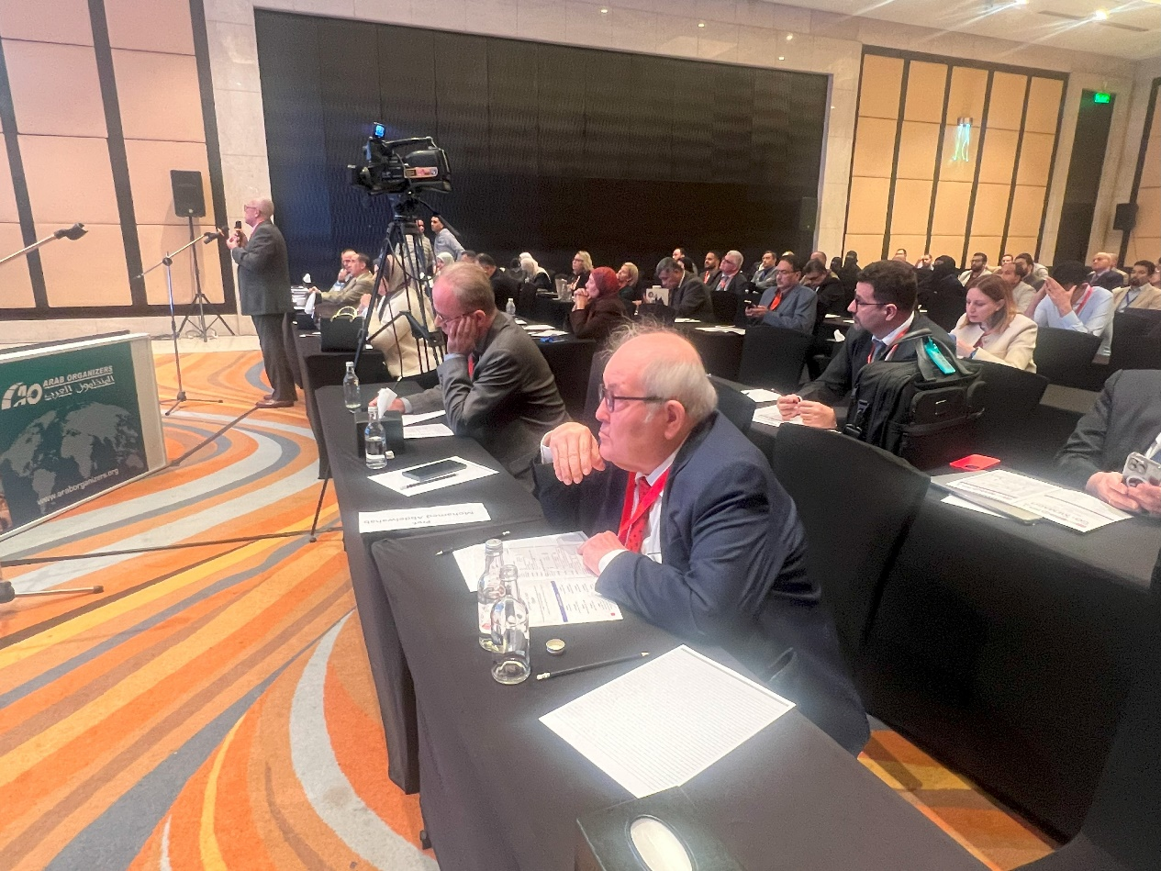
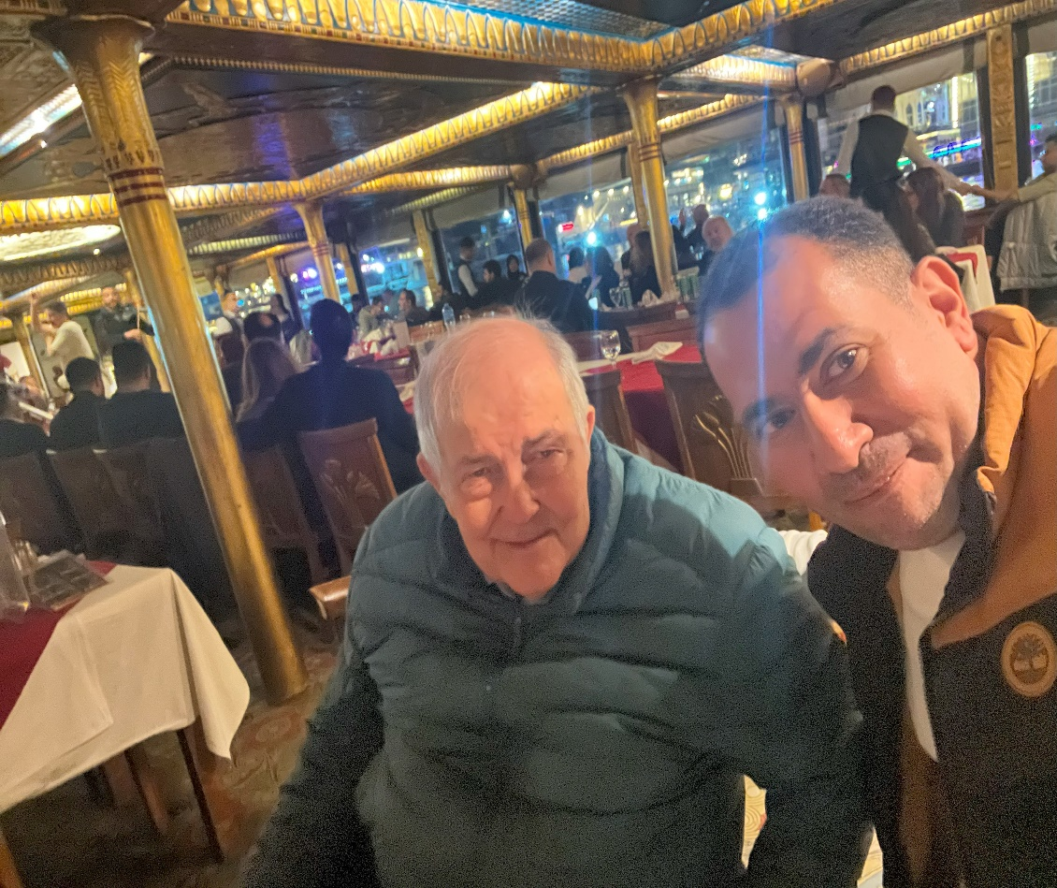

Slide 3
Conflicts of interest
Abvisory board, honorariums from : MSD,GSK, AstraZeneca, Roche, Sanofi

Slide 4
Lands of history

Slide 5
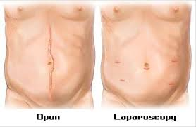
Laparoscopy is a tool not a goal
Using all our available tools for the best benefit of the patient .

Slide 6
Why MIS?

Slide 7
Why not MIS ?
Large masses .
Most cases presented in stage III-IV with high PCI , heavy disease load.
Complex surgeries , Multiorgan resections.
Challenging Lymphadenectomy ( Mainly para-aortic).
HIPEC ?

Slide 8
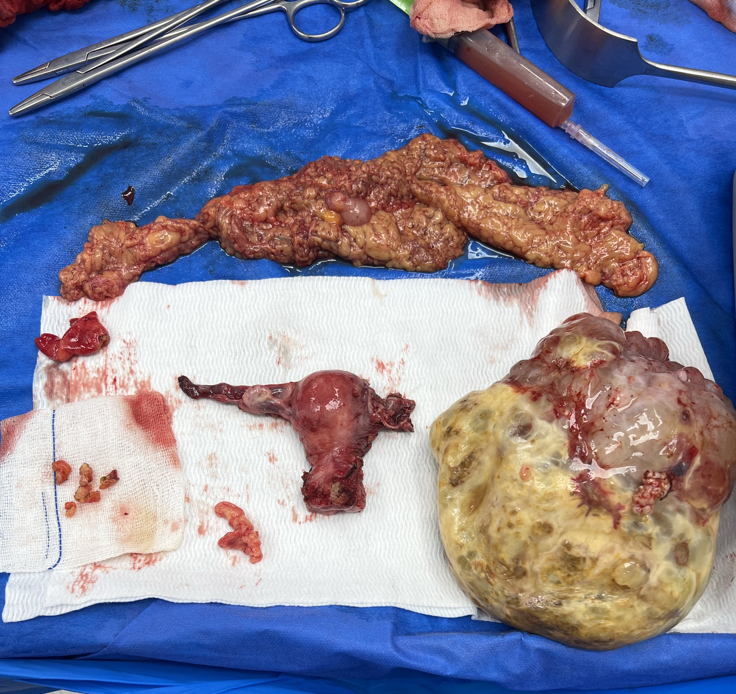
Ovarian cancer
Suspected .
Borderline .
Early .
Advanced .
Recurrent.

Slide 9
Stage I -II

Slide 11
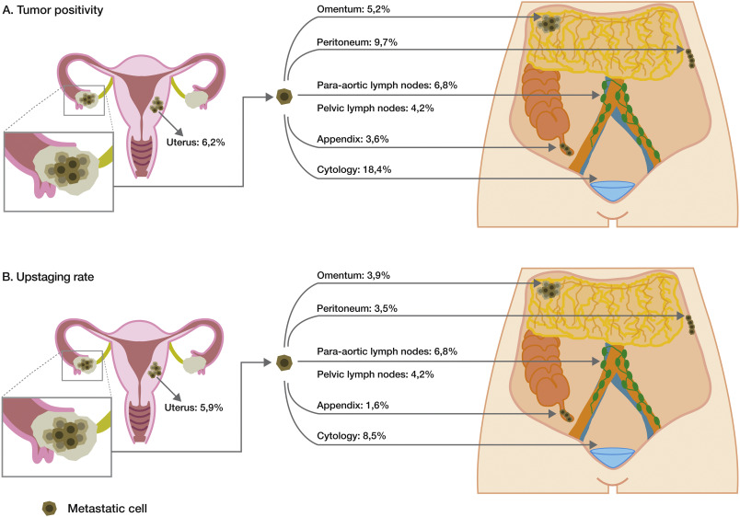
Tips for early ovarian cancer:
Complete surgical staging .
Lymphadenectomy ( Para-aortic )
Retrieval bags .
Ideal sometimes for Completion of staging after previous oophorectomy

Slide 12
Courtesy from Mohamed Hamdy, OCMU

Slide 13
Suspicious masses
The choice of surgical approach depends upon the
Degree of suspicion of malignancy
Surgeon and patient preference.
Size of the cyst or mass
Ovarian cancer staging can be performed using an open or laparoscopic approach, although the majority of surgeons in current practice prefer laparotomy if there is a high degree of suspicion of malignancy.

Slide 14
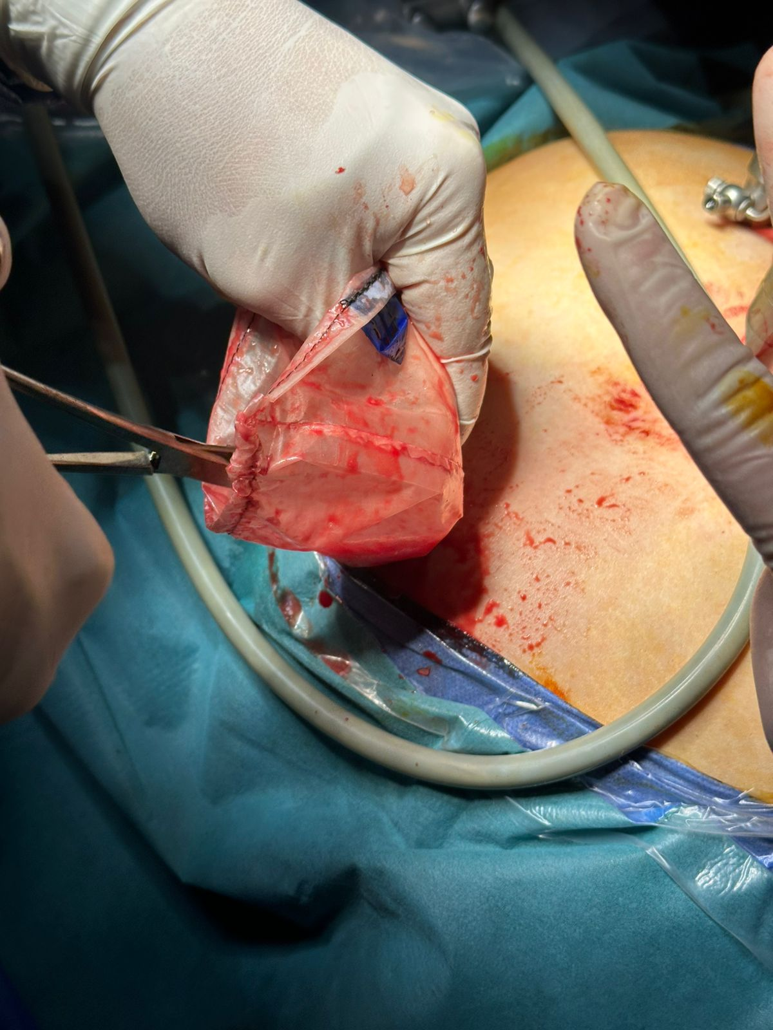
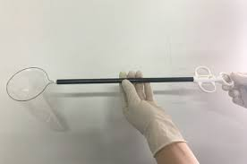
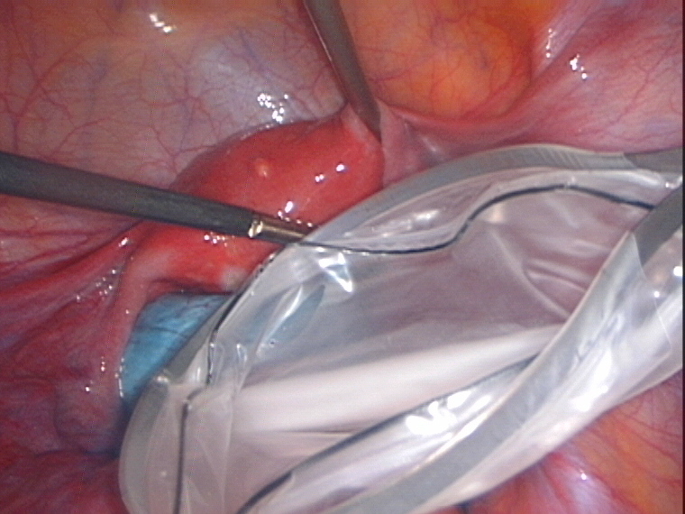

Slide 16
In our locality ? Specialized radiology teams !
Unfortunately, neither preoperative clinical and sonographic evaluation nor the laparoscopic appearance of the ovary can reliably predict which masses are malignant.
However, with appropriate patient selection, these risks can be minimized

Slide 17
Advanced Ovarian cancer
Laparoscopic assessment
PDS.
IDS

Slide 18
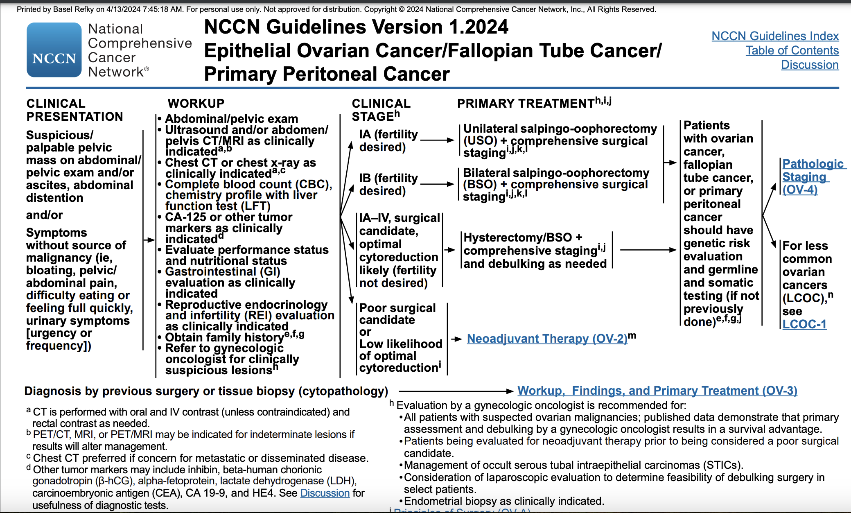
Laparoscopic assessment

Slide 19
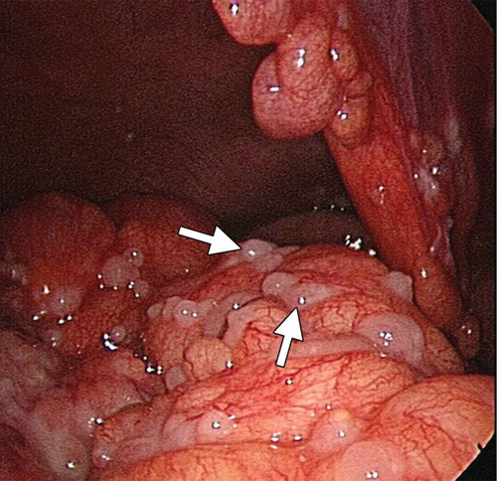
Laparoscopic assessment
It is now accepted that not cytology, but a biopsy (Tissue) is fundamental for the correct histological diagnosis of ovarian cancer
In the same way, a histological diagnosis made with laparoscopy also allows a rapid start of chemotherapy.
Allows early BRCA/HRD testing.
Laparoscopic assessment gives a good solid data about the peritoneal tumor load especially in locally advanced cases.

Slide 20
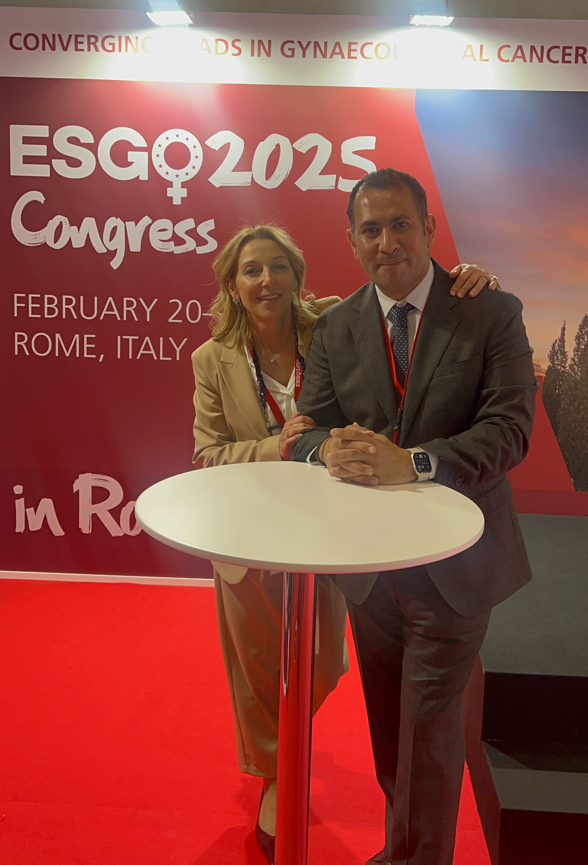

Slide 21
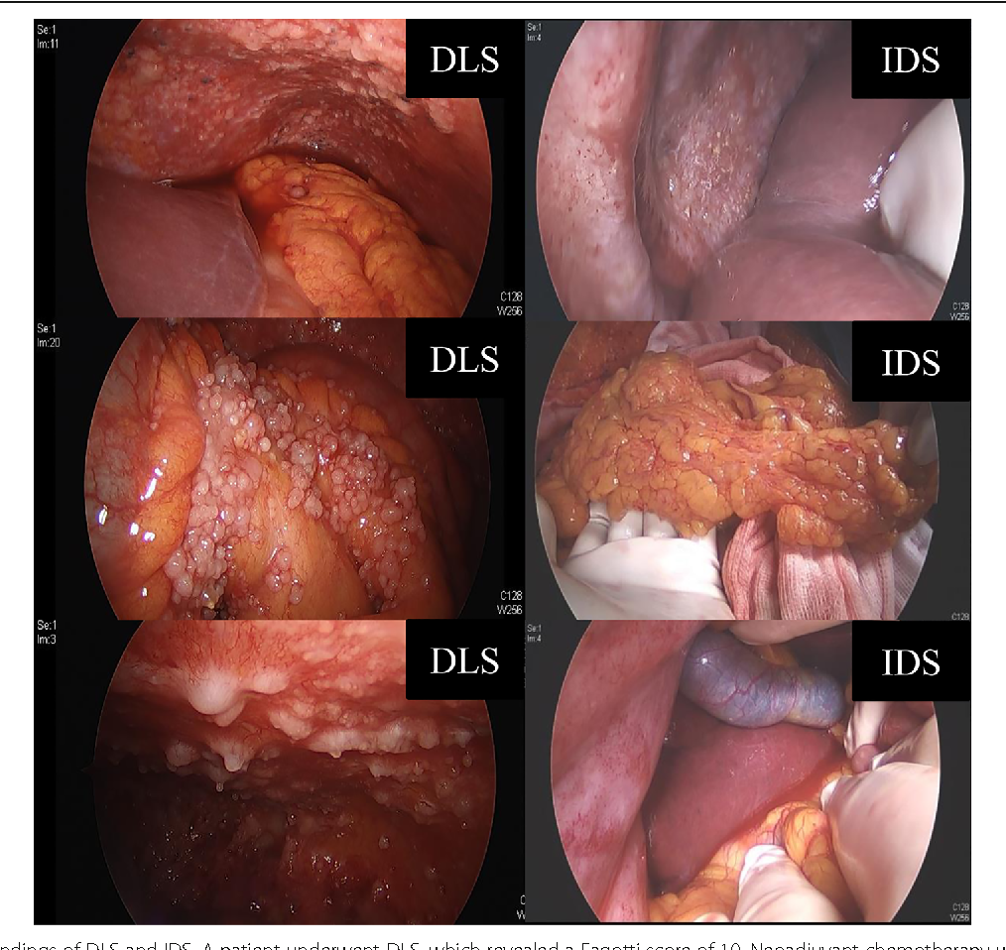

Slide 22
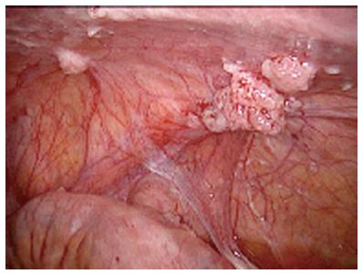
A predictive index score ‡8 identified patients undergoing suboptimal surgery with a specificity of 100%.
The positive predictive value was 100%, and the negative predictive value was 70%.

Slide 23
I do not give radiologists except one chance .
Step ladder approach for invasive techniques respected .
Do not waste time to start ttt.

Slide 24
Interval debulking surgery (IDS)
( 3-4 cycles)
No phase III trial that compares standard laparotomy with MIS for ovarian cancer after NAC.

Slide 25
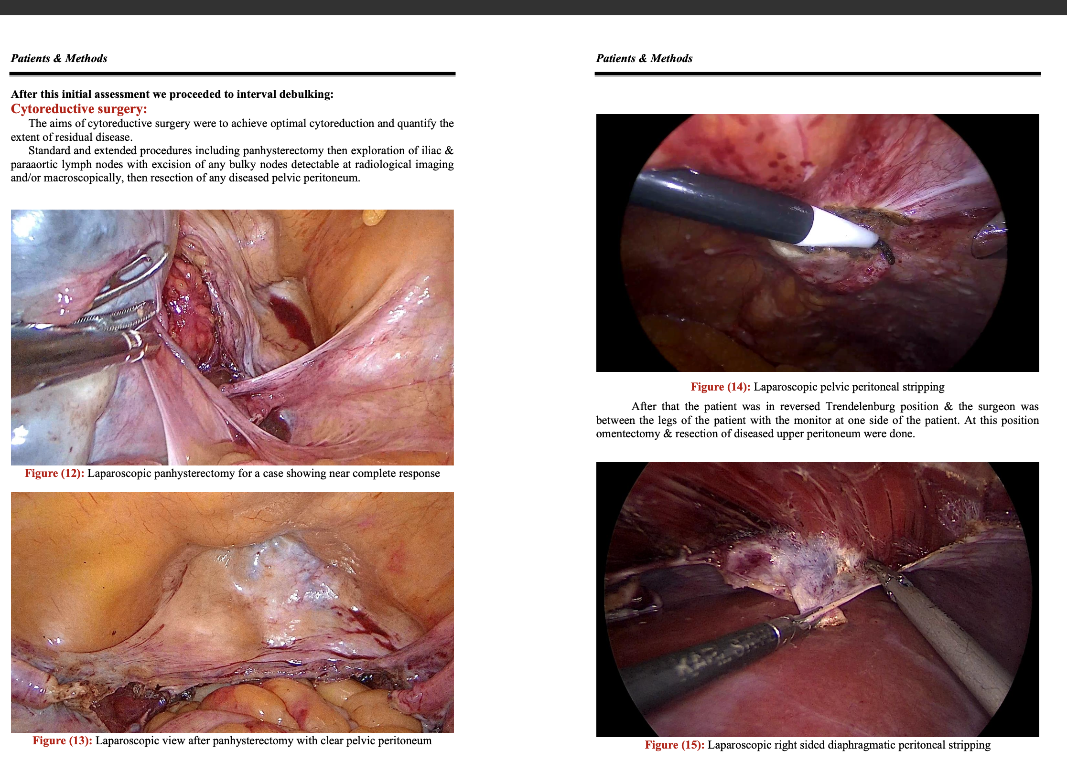
Courtesy from Ahmed Eid, OCMU

Slide 26
IDS

Slide 29
127 patients were enrolled
122 (96.1%) patients had no residual tumor. Median time to discharge was 2 days (1–33) and estimated median time to start chemotherapy was 20 days (range 15 – 60).
Median follow-up time was 37 months (range 7 – 86): 74 of 127 patients recurred (58.3%) and 31 (24.4%) patients died from disease. Median progression-free survival was 23 months and survival at 5 years was 52 % (95% CI: 35 to 67).

Slide 31
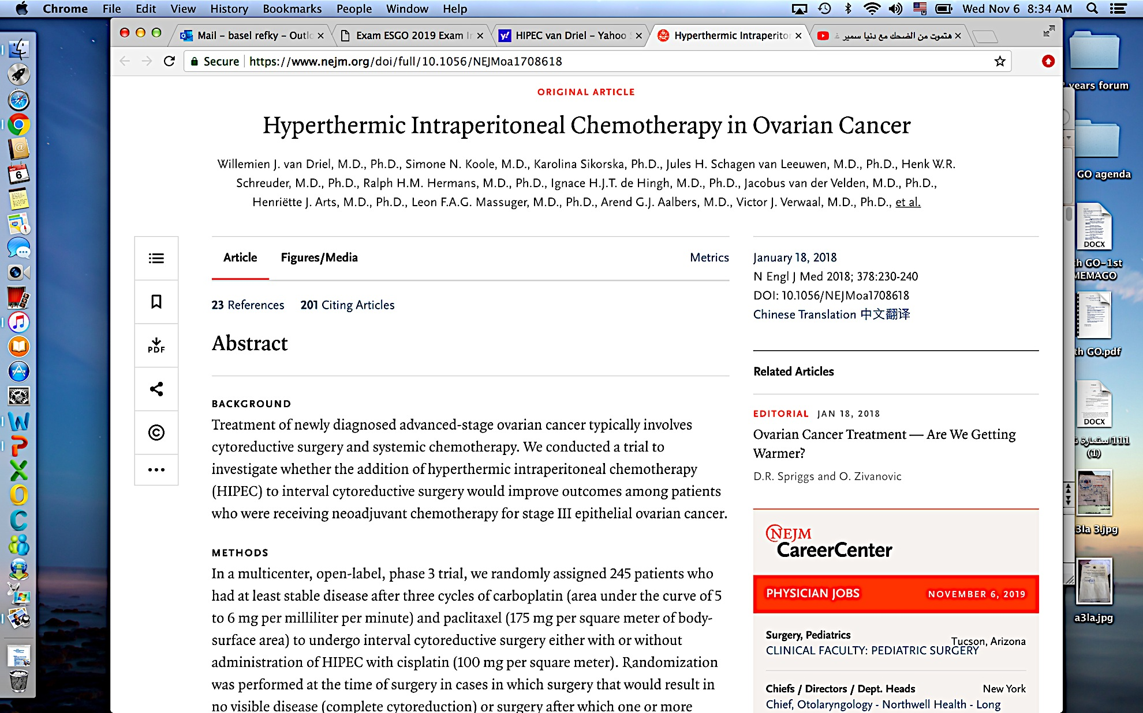
HIPEC ?

Slide 32
Primary Debulking Surgery
At present, primary laparotomic debulking surgery represents the gold standard in the treatment of advanced ovarian cancer and few data are present on laparoscopic PDS in AOC.

Slide 33
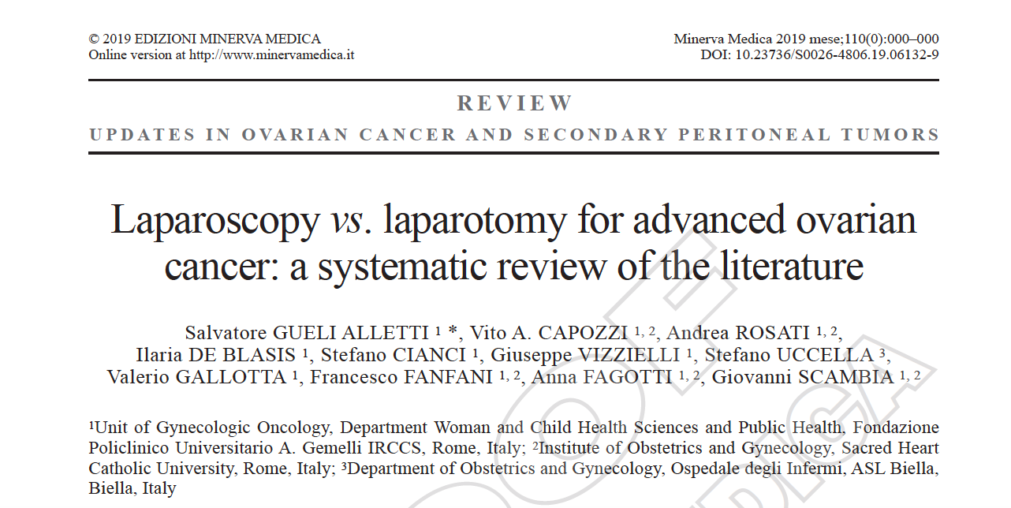

Slide 34
There were 6 studies (3 prospective, 3 retrospective) that met the criteria for meta-analysis with a total of 3231 patients, 567 were in the MIS group and 2664 in the laparotomy group.
Complete cytoreductive surgery was achieved in 74.50% (95% CI 40.41–97.65%) and 53.10% (95% CI 4.88–97.75%) of patients in the minimally invasive and laparotomy groups (p = 0.52).

Slide 35
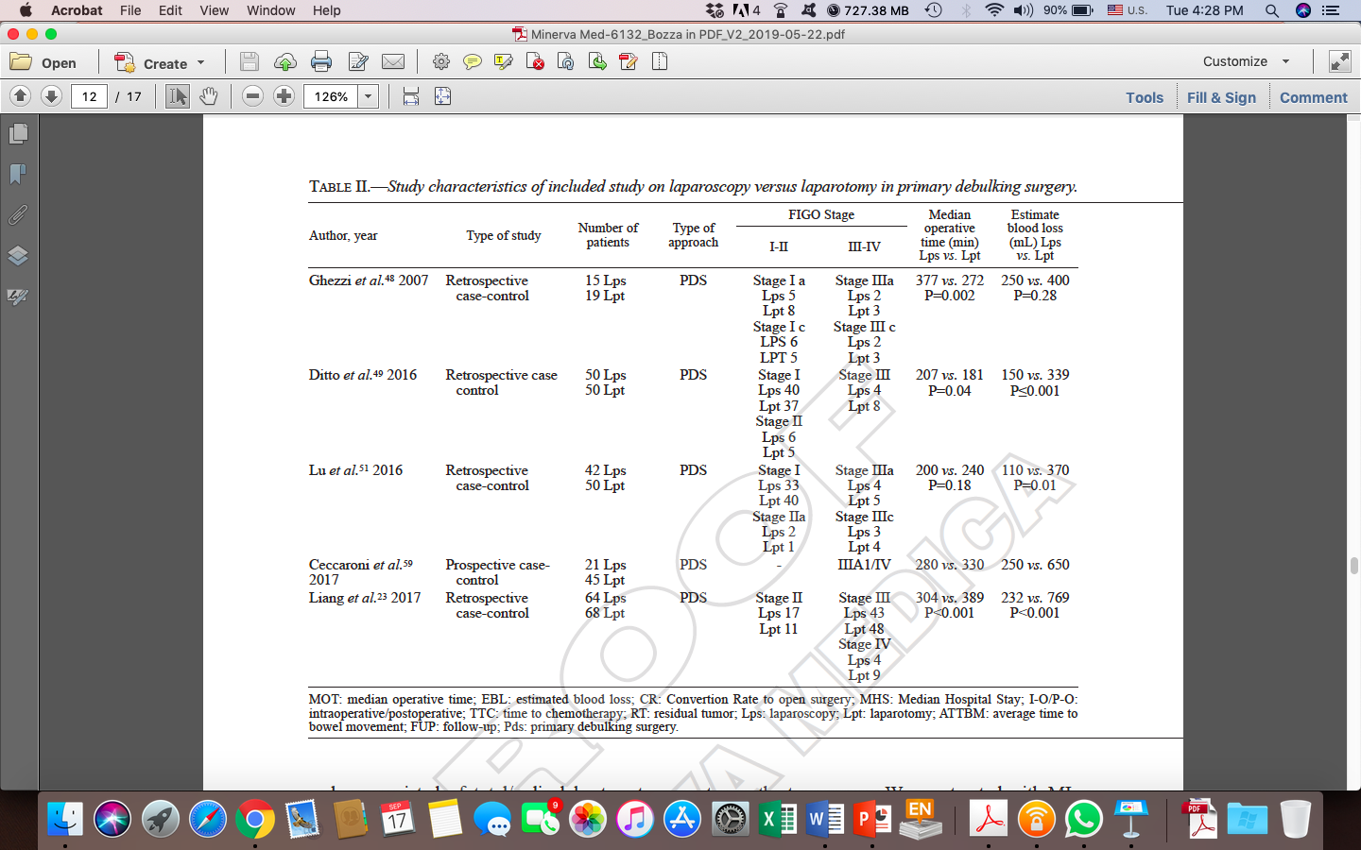

Slide 37
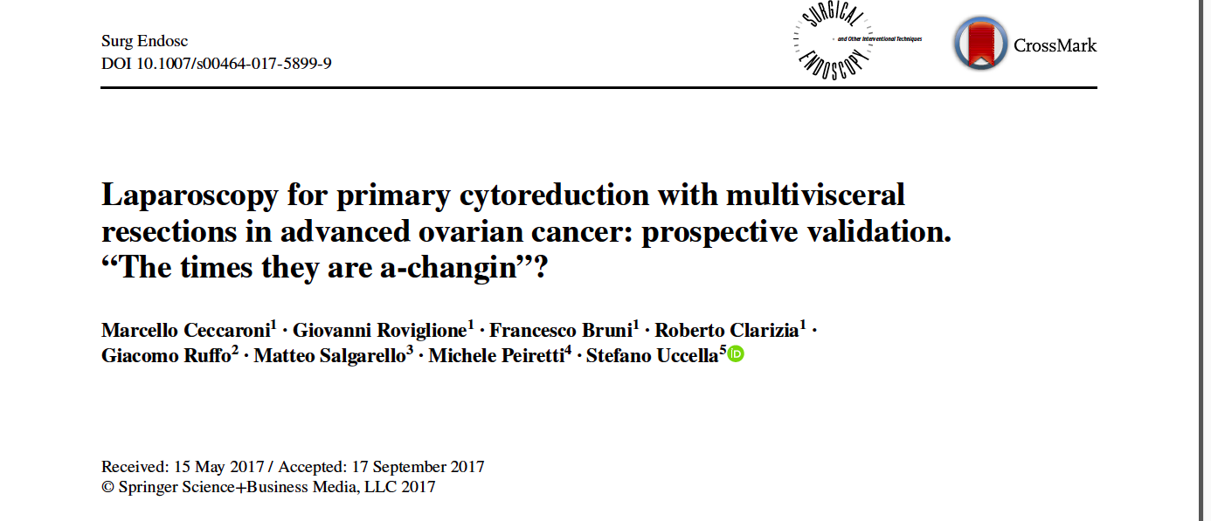

Slide 38
Laparoscopic Cytoreduction Exclusion Criteria (LCEC)
presence of “massive omental cake,”
obliterated Morison’s pouch,
the need of more than two liver resections,
involvement of the retrohepatic diaphragm, multiple and/or bilateral diaphragmatic carcinomatosis.

Slide 39
massive infiltration of more than three organs,
bulky upper abdominal masses >5 cm,
pelvic bulky disease >20 cm,
the necessity of more than two bowel resections,
>2 bulky nodes, and obliterated splenocolic ligament.

Slide 40
Optimal cytoreduction was obtained in 95 and 88.4% in the LPC and APC groups, respectively.
No intra-operative complication and 4 (19%) early postoperative complications were observed among patients

Slide 41
With a median follow-up time of 47.3 months for LPC , 52 months for APC population,
Recurrence rates were 33.3% and 35.5%, respectively.
PFS and OS were comparable between groups with 100% of overall survival in the LPC group.

Slide 42
The 2 study groups were not comparable also in terms of initial tumor load and localization, due to the presence of strict exclusion criteria for laparoscopic debulking (LCEC).
The authors underlined the importance of their research like a pioneer experience representing a milestone in the treatment of advanced ovarian cancer and possibly the origin of a profound rethinking in the approach to this disease.

Slide 43
Recurrent ovarian cancer

Slide 45
Take home message
MIS role has been gaining significant advancements in gynecologic oncology
Laparoscopy has not been the gold standard in treatment of ovarian cancer to date, but it is widely accepted in carefully selected cases of lap assessment, IDS and early stage ovarian cancer patients
Careful patient selection and counseling.
Laparoscopy is a tool not a goal .

