Slide 1
Cervical cancer screening strategies in the MEMAGO region
Nadine EL KASSIS, MD, MSc
Gynecologic Oncology
Hotel Dieu de France hospital, Beirut
Saint Joseph University

Slide 2
A Preventable
Cancer
In Canada, 8,3/100.000 women are diagnosed with cervical cancer
In Manitoba, about 50 cases per year
Goal: < 4/100.000
Dr. Erin Dean sharing her #WorldCancerDay message on cervical cancer prevention #EndCervicalCancer @CancerCareMBFdn
Notes:
Cervical cancer is preventable through secondary and primary measures
This slide is borrowed from Dr erin Dean from mannitoba who is working on lowering the cervical cancer incidence in Canada to less than 4/100000. note that the actual incidence of CC in Canada is 8.3/100000 and there is 50 cases per year in mannitoba

Slide 3
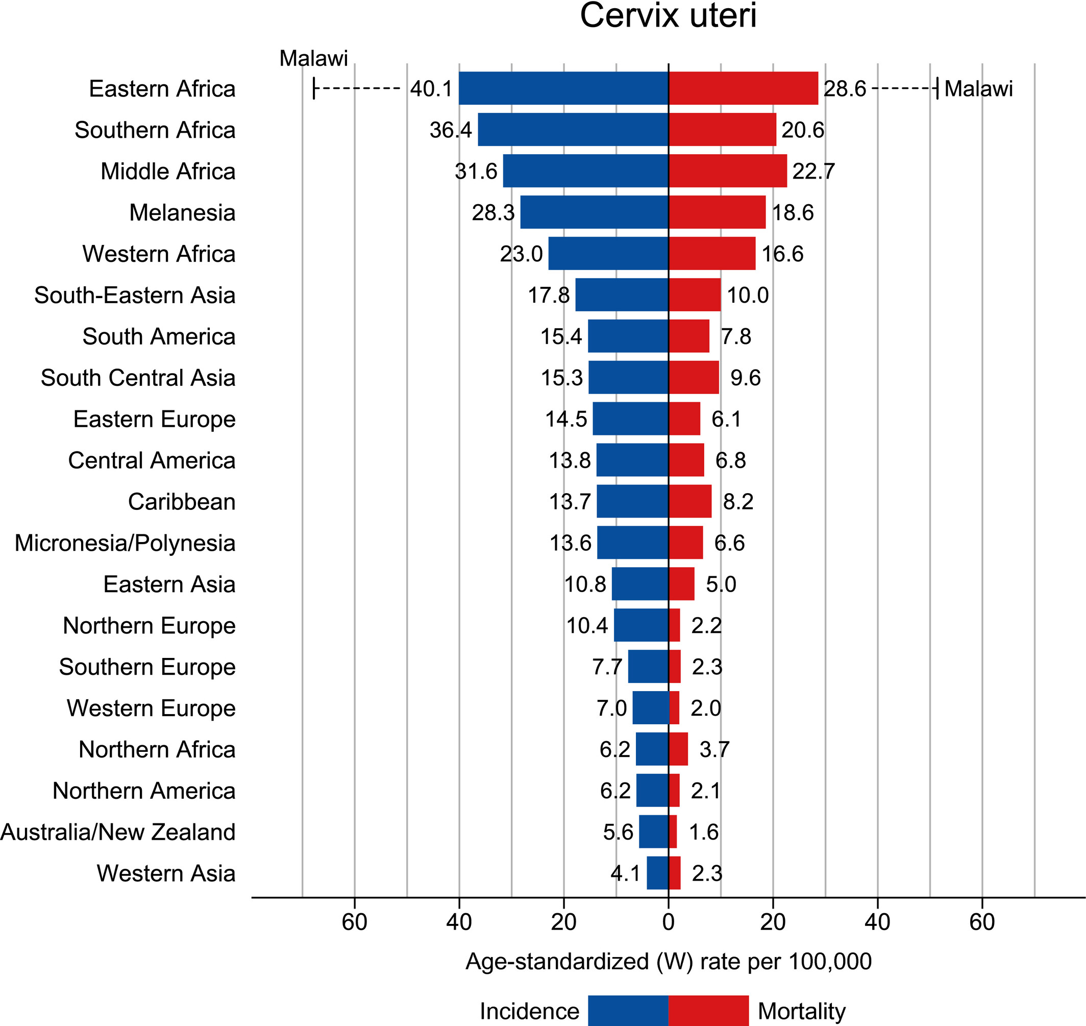
Global Cancer Statistics 2020: GLOBOCAN Estimates of Incidence and Mortality Worldwide for 36 Cancers in 185 Countries
CA A Cancer J Clinicians, Volume: 71, Issue: 3, Pages: 209-249, First published: 04 February 2021, DOI: (10.3322/caac.21660)
Notes:
THIS AIMED INCIDENCE IS EXACTLY THE ACTUAL INCIDENCE FOUND IN WESTERN ASIA THAT IS 4.1 PER 100000, however in northern Africa wich is a part in the memago region is higher

Slide 4
HPV Prevalence In Normal PAP Smear(%)
Bruni L, J Infect Dis. 2010;202(12):1789-1799.
Notes:
In this slide, we see the prevalence of HPV in normal pap smears, in the world the prevalence is 11,7, in our region it’s 1,7. these numbers are in 2010

Slide 5
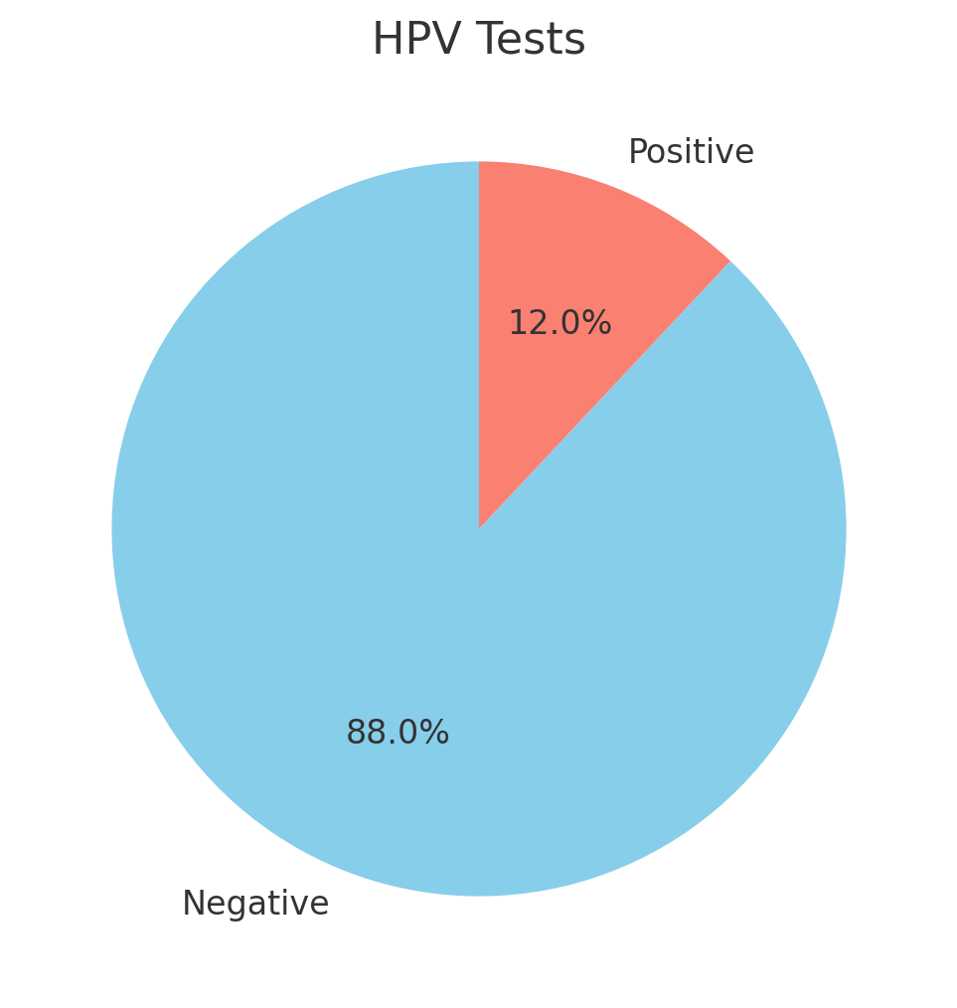
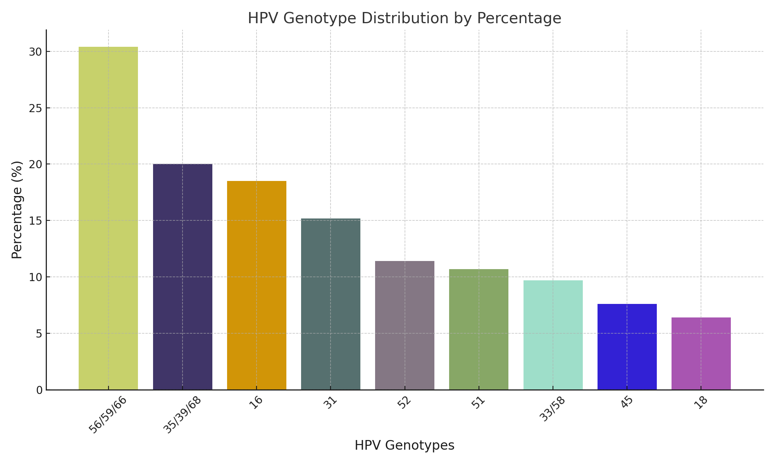
Hotel Dieu de France Data
3500 patients

Slide 6
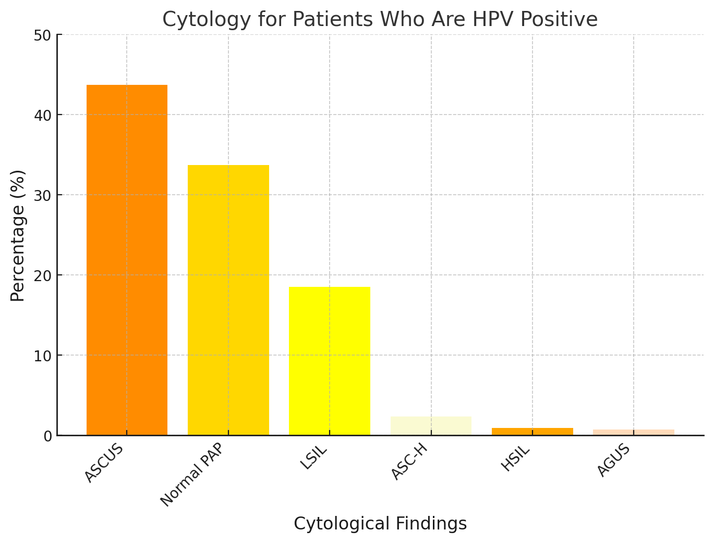
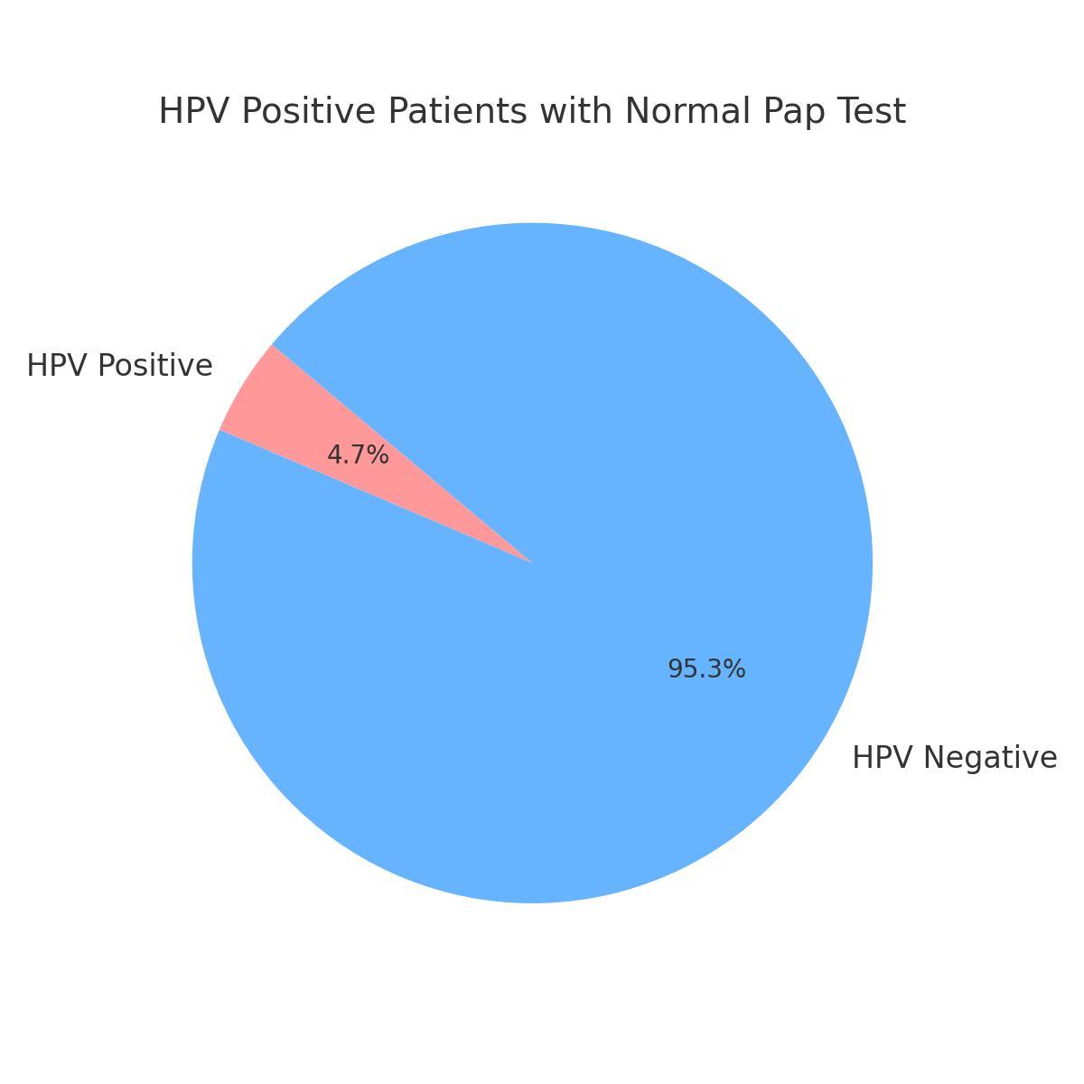
Hotel Dieu de France Data

Slide 7
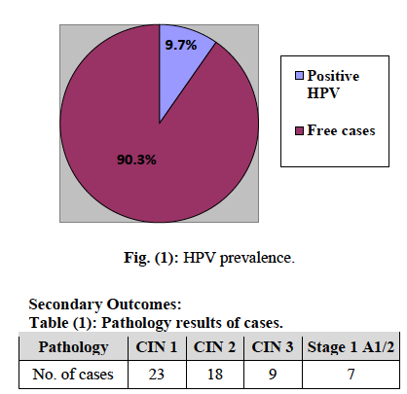
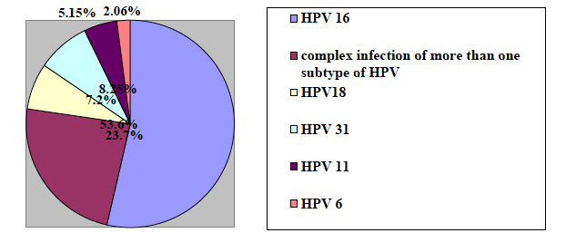
97 HPV +/1000 patients
23 women (23.7%) had many subtypes

Slide 8
Cervical cancer screening by HPV testing Pilot study in Tunisia 2022-2023
3264 tests: 136 HPV pos :4,5%
Type | HPV 16 | HPV 18/45 | HPV 31,33,35,52,58 | HPV 51,59 | HPV 39,56,66,68 | HPV mixte | Total
number | 31 | 15 | 34 | 10 | 24 | 22 |  | 136
- 38 (30,8%) normal pap smear
85 (69,1%) abnormal pap smear
Cervical cancer rate: 5,3/100000

Slide 9
Geographic distribution of the world ASIR of cervical cancer , by country , estimated for 2008
Annals of Oncology 22: 2675–2686, 2011
Notes:
These are the geographic distribution of the world age standardized incidence of cervical cancer by country estimated in 2008. u can see our region : western asia and part of the northern africa in dark green : means very low incidence of cervical cancer, but in other parts of northern africa, the incidence is higher: lighter green

Slide 10
HPV AND CERVICAL CANCER IN MIDDLE EAST
WESTERN ASIA
WESTERN ASIA SHOWS UNEXPLAINABLY LOW
CERVICAL CANCER INCIDENCE DESPITE THE LACK Of PROACTIVE
NATIONAL SCREENING OR VACCINATION PROGRAMS
THE RATE OF HPV INFECTION IN CANCER SAMPLES, WE FOUND RELATIVELY LOWER RATE (77%) OF INFECTION COMPARED TO WORLDWIDE ESTIMATE (85-99%).
+ GENETIC POLYMORPHISMS
Asian Pac J Cancer Prev. 2018
Notes:
In western asia, we notice low cervical cancer rate despite lack of proactive national screening or vaccination programs, and also low HPV infection in cancer samples compared to the worldwide estimates. Is it a problem in sampling or is it genetic polymorphism?

Slide 11
IN LEBANON
WE ARE IN A LOW PREVALENCE SETTING

Slide 12
The lowest ASIR values (<5/100 000) Estimates 2008
Gaza and West Bank (ASIR < 1)
Syrian Arab Republic (2.0/100 000)
Saudi Arabia (2.1/100 000)
Yemen (3.0/100 000),
Iraq (3.1/100 000),
Jordan (3.6/100 000),
Lebanon (3.8/100 000),
Turkey (4.2/100 000)]
Annals of Oncology 22: 2675–2686, 2011
Notes:
This is a paper from Marc Arbyn published in 2011, stating numbers from 2008. he shows that the lowest ASIR are in the middle east: gaza, syria, yemen, iraq, saudi arabia,…in lebanon it was 3,8, but most of the cases were locally advanced

Slide 13
Age-Standardized incidence rates of cervical cancer of Lebanon (estimatesfor2018)
Notes:
10 years later, the age standardized incidence rate has increased to 5,7 compared to 3,8 in 2008, and it’s the 3rd highest number in the arab countries after UAE and oman and in front of turkey where the sreening strategies are proactive and efficient unlike lebanon where even before the economical crisis, the screening was still opportunistic.

Slide 14
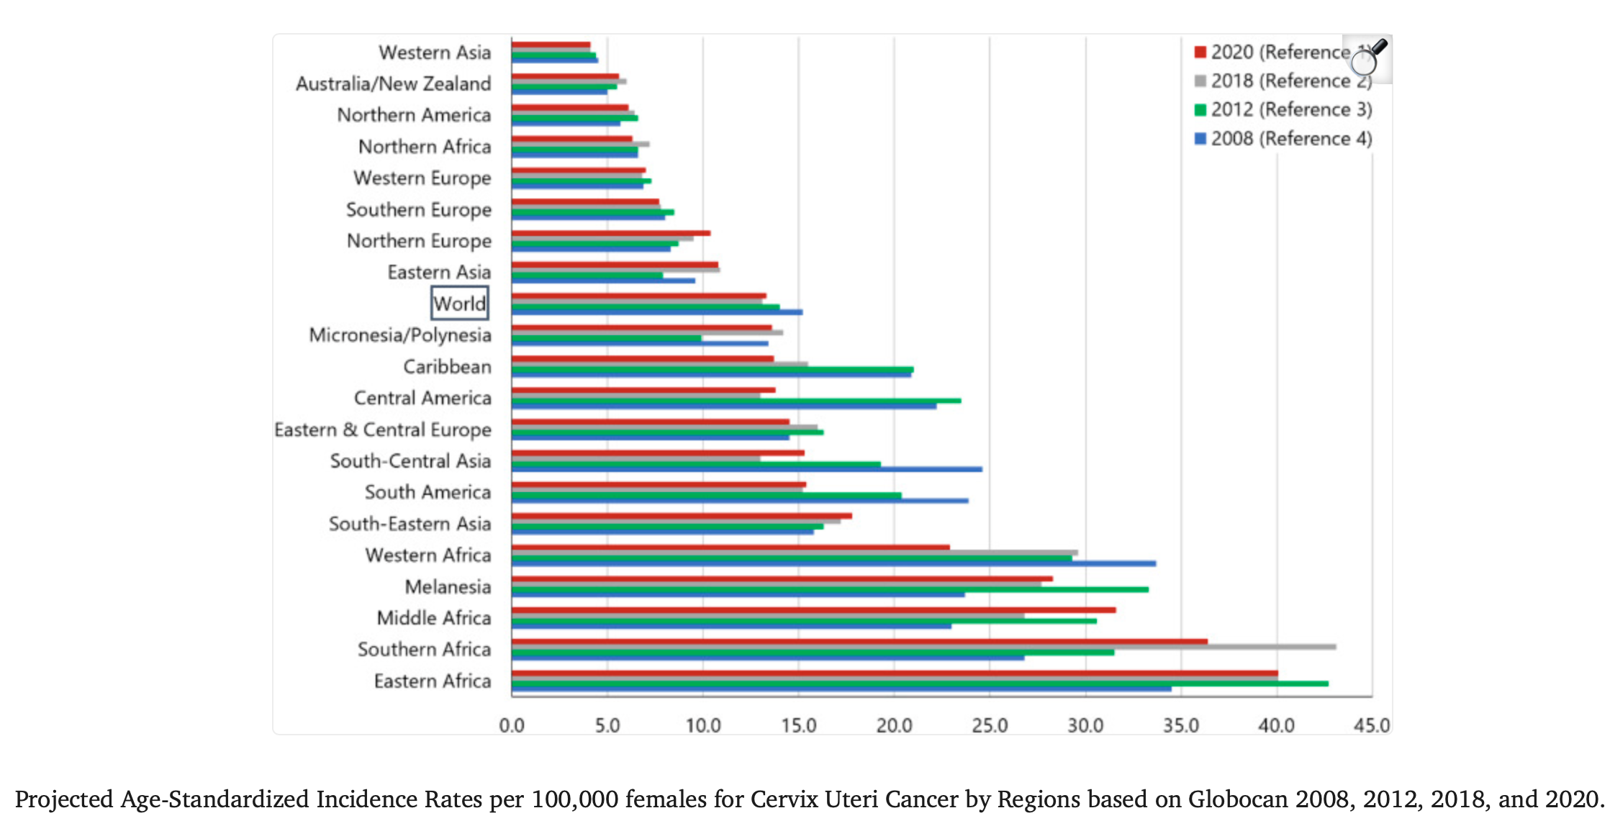
Cancer Control . 2022 Jan 10;29
Notes:
In this slide borrowed from my friend reem abdallah, we show the evolotion of ASIR in the world between 2008 and 2020.

Slide 15
Trend since 2005
Slide David Atallah MD, MSc
New cases according to MOPH and IARC
Notes:
These are the data about cervical cancer cases gathered from lebanese ministry of public health, showin the increasing number starting from 2005, and the sharp increase starting from 2014, and 2018 , 192 cases were diagnosed and this is worrisome

Slide 16
Annual number of new cases of cervical cancer by age group in Lebanon (estimates for 2018)
ICO/IARC HPV Information Centre
Notes:
These are the number of new cases by age group: you can notice that the group above 75 has the highest number of new cases in Lebanon compared to other lebanese groups;
Moreover, if you do the ratio between new cases by age group in Lebanon and new cases in western asia respectively you notice that the ratio is alarming . WHERE the incidence GROUP is the highest that means between 45 and 49yo. The ratio is 3 per cent in this younger age compared to 9 PER CENT IN THE OLDER AGE
THAT means these LEBANESE women were never screened or improperly screened
That is why taking the whole screening history of the patient is essential

Slide 17
Cervical cancer Incidence/Death in Lebanon (2018)
Indicator | Lebanon | Western Asia | World
Annual Number of New Cases Death | 192 125 | 5092 2995 | 569847 311365
Crude Incidence Rate Crude Mortality Rate | 6.3 4.1 | 3.9 2.3 | 15.1 8.2
Age-Standardized Rate Age-Standardized Mortality Rate | 5.7 3.6 | 4.1 2.5 | 13.1 6.9
Cumulative Risk (%) at 75 years Cumulative Risk (%) at 75 years | 0.6 0,4 | 0.4 0.3 | 1.4 0.8
Notes:
When we look deeper in the numbers, we see that death number is high compared to western asia. The causes are multiple: opportunistic screening, diagnosis at late stage, inadequate treatment? The age standardized incidence rate and mortality are higher than the recommended ASIR and the incidences in western asia. We are in a bad place , because of lack of awareness, lack of national screening policies, and we must find solutions

Slide 18
HPV And Cervical Cancer in Middle East
COMPARISON OF CERVICAL CANCER INCIDENCE TO OTHER CANCERS IN WOMEN OF ALL AGES IN THE MIDDLE EAST (ESTIMATES FOR 2018)
HPV-RELATED CANCER INCIDENCE IN THE UNITED ARAB EMIRATES (ESTIMATES FOR 2012)
Human Papillomavirus and Related Diseases Report in Emirates, 2019
Notes:
These are numbers from the united arab emirates, where the incidence of cervical cancer is quite high: 9,4/100000 because of the high number of foreigners coming from europe, africa ans east asia, india, where the incidence of HPV is high

Slide 19
Incidence of Gynecologic Cancers in Egyptian Women with cancer: 2,8 (globocan 2022)
25
20
Percent
15
10
5
0
Breast Cancer
Cervical Cancer
Ovarian Cancer
Uterine Cancer
Source: GLOBOCAN 2000. Abou Bakr el Nachar
Notes:
The incidence of cervical cancer is not very low as written in the litterature, probably numbers are higher but underreported. Here in this study in 2000, the incidence of cervical cancer is almost 10 % of the cancers in women

Slide 21
Distillation
New ASCCP guidelines:
Change in paradigm of screening
Screening has to predict ahead of time the risk of developing cancer
Developing cancer is a continuum starting by infection happening long time ago
So taking patients holistically is essential in order to predict a risk
Notes:
Saying all that , developing new guidelines is necessary and every practitioner must be aware of the newest Asccp guidelines

Slide 22
Distillation
A patient with negative pap or HPV history
ASCUS with HPV – : won’t have anymore colposcopy
NILM with HPV+ : won’t have anymore immediate colposcopy
Reducing by that mean (psychologic and physical) morbidity of colposcopy
Notes:
In new asccp guidelines, patients with ascus and negative HR hpv and patientes with normal pap and positive HPV have lower calculated risks than the threshold of action, thus they wont have a colposcopy reducing by that mean psychological and physical morbidity of this procedure

Slide 23
Screening – low incidence setting
Lower incidence of CIN2+ due to reduced incidence of HPV type induced lesions
Decreased PPV
True positives decreased – false positives unchanged
Decreased sensitivity for cytology
Abnormalities rarer, loss of concentration
Notes:
Pap cytology would no longer function as a suitable primary test for cervical cancer screening

Slide 24
Screening – low incidence setting
Screening less cost effective
Objective, automated methods of HPV testing will be even more important for low prevalence setting
Notes:
The reduction in precancerous lesions already observed in many vaccinated populations
underscores the urgency to adopt an alternative primary screening test

Slide 25
Need for more colposcopies !
A potential concern regarding HPV-based screening is that the lower CIN2+ specificity of HPV testing vs cytology will result in higher screen positive rates and the need for more colposcopies and biopsies.
Unnecessary colposcopies may cause unintended harm to women and increased costs to healthcare systems.
But this is addressed by the new ASCCP Screening guidelines
Notes:
Medscape

Slide 26
IN LEBANON
WE ARE IN A « LOW PREVALENCE SETTING », but an alert has to be triggered because of an alarming increase of incidence
How can we reduce more knowing that our acutal rate is comparable to the projected rate in Australia after vaccination?
Here….. HPV primary screening is the solution
We have limited resource
We need to choose a pragmatic way

Slide 27
Notes:
highest specificity for evolution towards cancer

Slide 28
World Health Organization . Global Strategy to Accelerate the Elimination of Cervical Cancer as a Public Health Problem; 2020. Geneva, Switzerland: World Health Organization.
The World Health Organization (WHO) Cervical Cancer Elimination Modeling Consortium aims at reducing the ASR of CUca to less than 4.0 per 100 000 women worldwide by 2030, through following the 90-70-90 targets. This means vaccinating 90% of all girls by age 15 years, screening 70% of women with a high-performance test at least twice (at age 35 and 45 years) and treating at least 90% of all precancerous lesions detected during screening.

Slide 29
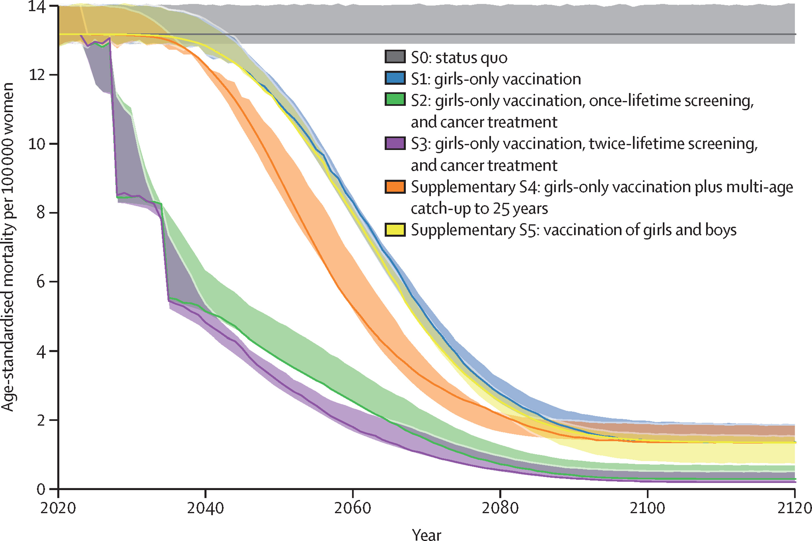
Figure 1
Mortality impact of achieving WHO cervical cancer elimination targets: a comparative modelling analysis in 78 low-income and lower-middle-income countries
The Lancet 2020 395591-603DOI: (10.1016/S0140-6736(20)30157-4)
Copyright © 2020 The Author(s). Published by Elsevier Ltd. This is an Open Access article under the CC BY-NC-ND 4.0 license Terms and Conditions
Notes:
Age-standardised cervical cancer mortality over time for all 78 LMICs
The solid lines represent the median outcome of the three models; the shading represents the range of model outputs. HPV=human papillomavirus. LMICs=low-income and lower-middle-income countries. S0=status quo (no scale-up of vaccination, screening or treatment). S1=female-only vaccination at 9 years with multi-age cohort catch-up to age 14 years in 2020. S2=female-only vaccination and once-lifetime HPV testing at age 35 years with cancer treatment scale-up. S3=female-only vaccination and twice-lifetime HPV testing at age 35 years and 45 years with cancer treatment scale-up. Supplementary S4=female-only vaccination at 9 years with extended multi-age cohort catch-up to age 25 years in 2020. Supplementary S5=female and male vaccination at age 9 years with multi-age cohort catch-up to age 14 years in 2020. All scenarios assume the use of a broad-spectrum HPV vaccine with protection against seven oncogenic types.

Slide 30
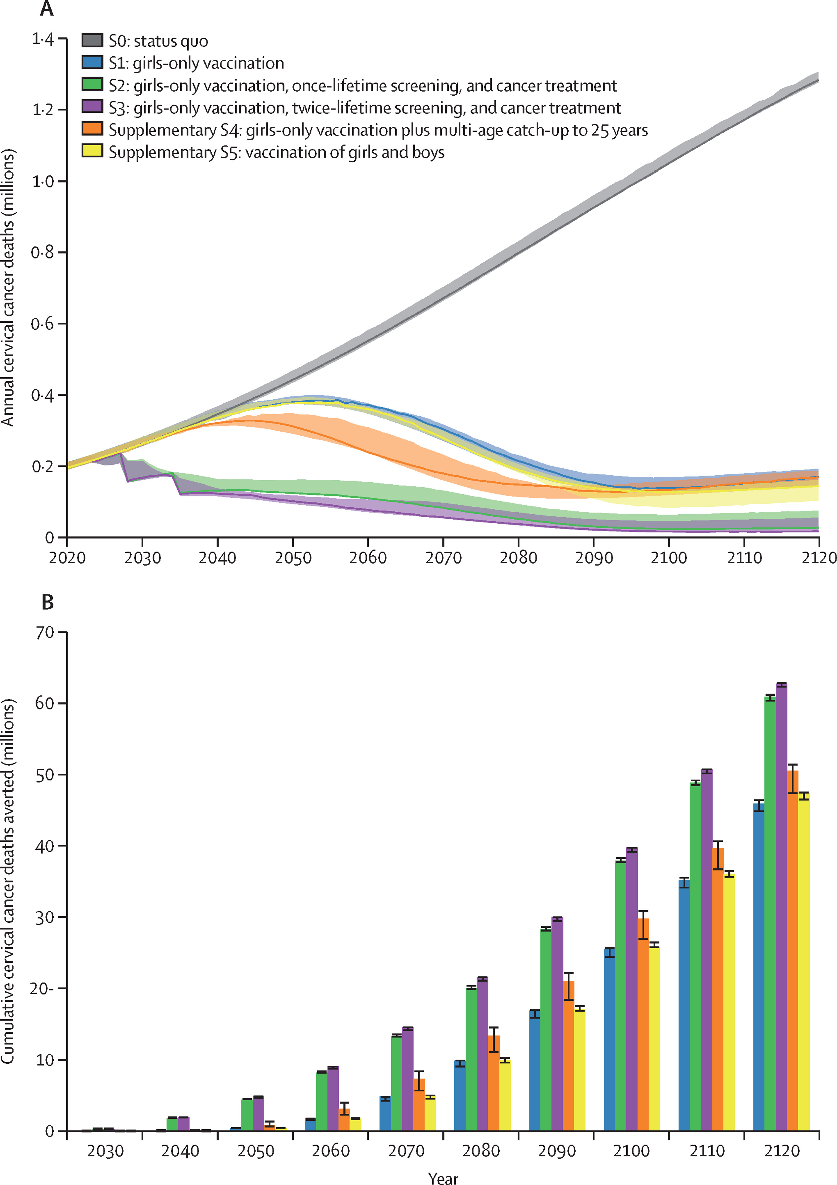
Figure 2
The Lancet 2020 395591-603DOI: (10.1016/S0140-6736(20)30157-4)
Copyright © 2020 The Author(s). Published by Elsevier Ltd. This is an Open Access article under the CC BY-NC-ND 4.0 license Terms and Conditions
Notes:
Projected cervical cancer deaths across all 78 low-income and lower-middle-income countries
(A) Annual cervical cancer deaths. (B) Cumulative cervical cancer deaths averted. The solid lines in panel A represent the median of the three models and the shading represents the range of the model outputs. In panel B the column height represents the median of the three models and the error bars represent the range of the three models. HPV=human papillomavirus. S0=status quo (no scale-up of vaccination, screening, or treatment). S1=female-only vaccination at age 9 years with multi-age cohort catch-up to age 14 years in 2020. S2=female-only vaccination and once-lifetime HPV testing at age 35 years with cancer treatment scale-up. S3=female-only vaccination and twice-lifetime HPV testing at age 35 years and 45 years with cancer treatment scale-up. Supplementary S4=female-only vaccination at age 9 years with extended multi-age cohort catch-up to age 25 years in 2020. Supplementary S5=female and male vaccination at age 9 years with multi-age cohort catch-up to age 14 years in 2020. All scenarios assume the use of a broad-spectrum HPV vaccine with protection against seven oncogenic types.

Slide 31
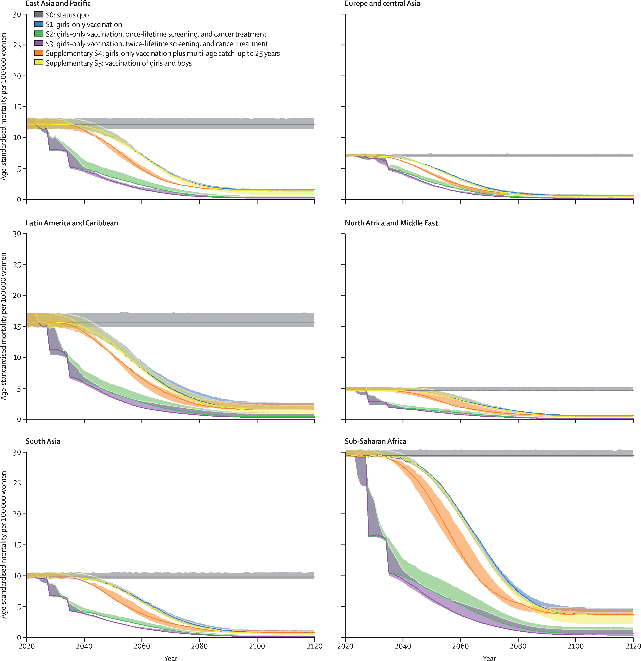
Figure 3
The Lancet 2020 395591-603DOI: (10.1016/S0140-6736(20)30157-4)
Copyright © 2020 The Author(s). Published by Elsevier Ltd. This is an Open Access article under the CC BY-NC-ND 4.0 license Terms and Conditions
Notes:
Age-standardised cervical cancer mortality over time for LMICs in each region
The solid lines represent the median outcome of the three models; the shading represents the range of model outputs. HPV=human papillomavirus. LMICs=low-income and lower-middle-income countries. S0=status quo (no scale-up of vaccination, screening or treatment). S1=female-only vaccination at 9 years with multi-age cohort catch-up to age 14 years in 2020. S2=female-only vaccination and once-lifetime HPV testing at age 35 years with cancer treatment scale-up. S3=female-only vaccination and twice-lifetime HPV testing at age 35 years and 45 years with cancer treatment scale-up. Supplementary S4=female-only vaccination at 9 years with extended multi-age cohort catch-up to age 25 years in 2020. Supplementary S5=female and male vaccination at age 9 years with multi-age cohort catch-up to age 14 years in 2020. All scenarios assume the use of a broad-spectrum HPV vaccine with protection against seven oncogenic types.

Slide 32
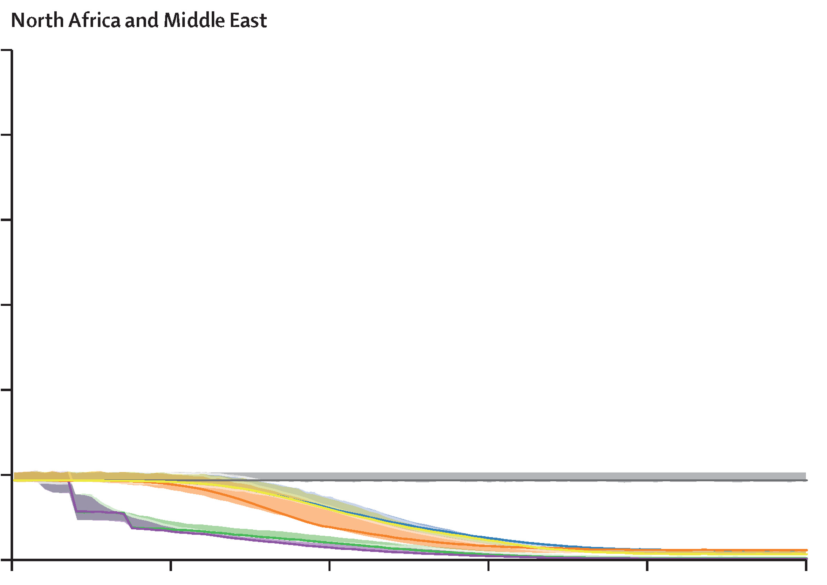
2120

Slide 33
Conclusion
Combining one dose HPV vaccination to girls at 12 years and 2 times hr HPV screening may be the best strategy to eradicate cervical cancer in low incidence setting and low income countries.
Treating precancerous/cancer
Awareness
National programs

Slide 34
Thank you

