Slide 1



Primary management of advanced EOC
Up front surgery with primary cytoreduction
Dr Kostas Lathouras PhD
Consultant Gynaecological Oncologist
Honorary Senior Clinical Lecturer in Department of Cancer and Surgery at Imperial College London

Slide 2



Nothing to declare
Dr Kostas Lathouras PhD
Consultnat Gynaecological Oncologist

Slide 3
PDS – Primary Debulking Surgery
IDS – Interval Debulking Surgery
DPS – Delayed Primary Surgery

Slide 4

SURGERY
CHEMOTHERAPY
MAINTANCE
CCN, Ovarian Cancer, Version 1.2020, https:// www.nccn.org/professionals/physician_gls/pdf/ovarian_blocks.pdf 2020 (Updated 3/11/2020. Accessed 5/2020)

Slide 5
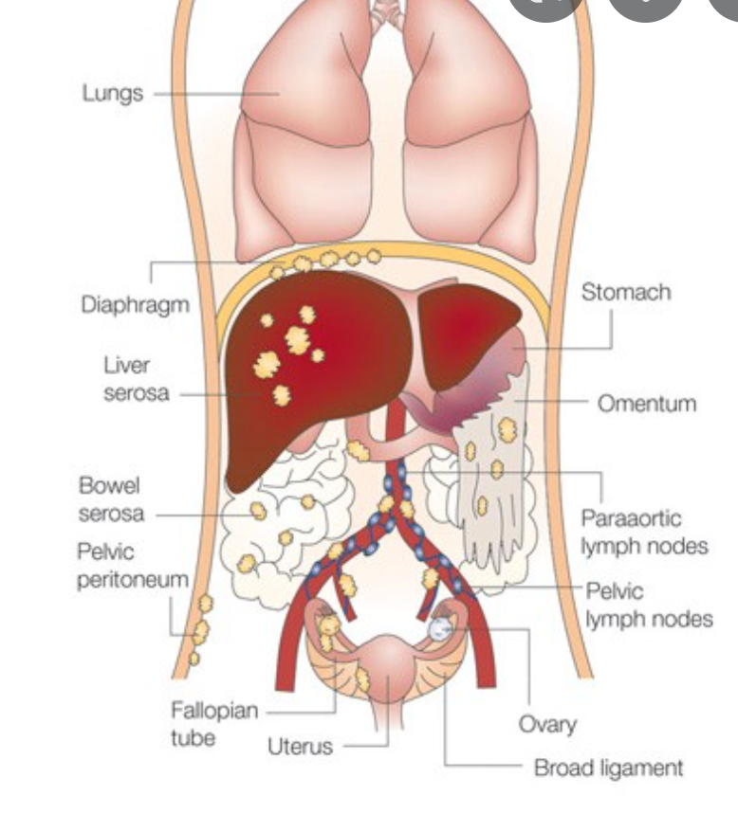
Ovarian Cancer Treatment
PS
Age
Medical comorbidities
Stage
Grade
Histological subtype
Volume of residual disease after surgery
Benedet 2000

Slide 6
Facts

Slide 7

Epedimiology
Age
Women over the age of 50 have a higher risk, and most cases of ovarian cancer occur in women who have already gone through the menopause
> 50% the cases of ovarian cancer diagnosed are women over 65 years
1000 women under the age of 50 develop ovarian cancer every year which is why it is important that all women should be aware of the symptoms of ovarian cancer.
This is especially important if women have a family history of ovarian or breast cancer.
Very rare in women < 30

Slide 8


Family history
80% – 85% of ovarian cancer cases are 'sporadic‘
15% – 20% BRCA1 or BRCA2 gene.
Women who inherit a mutated copy of the BRCA1 or BRCA2 gene have a much higher risk of developing breast and/or ovarian cancer than the general population. 30% - 60%
Other genes which have also been linked to ovarian cancer such as RAD51C and RAD51D, STK11, BRIP1 (FABCJ) and those linked to Lynch Syndrome (also known as hereditary non polyposis colorectal cancer, HNPCC).
Notes:
Japan has a low incidence ? Dietary causes(animal fat) / protectants (vegetable fibre)
Japanese women who emigrate to USA, and their daughters have an increased incidence
Age-specific mortality curve becomes parallel with general population at 15-20 years post diagnosis

Slide 9
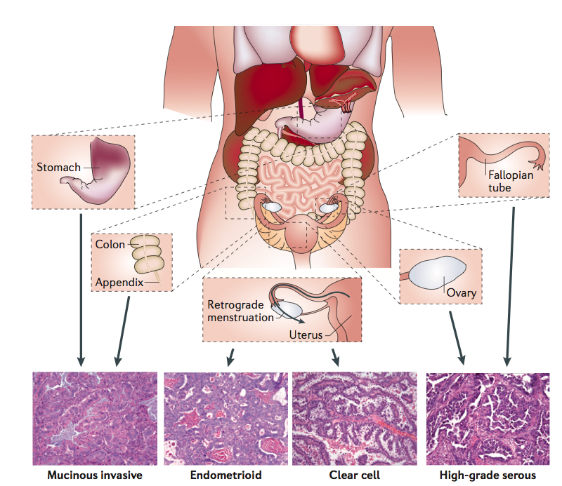
Ovarian cancer is many diseases
Vaughan S. et.al., Nat Rev Cancer. 2011

Slide 10
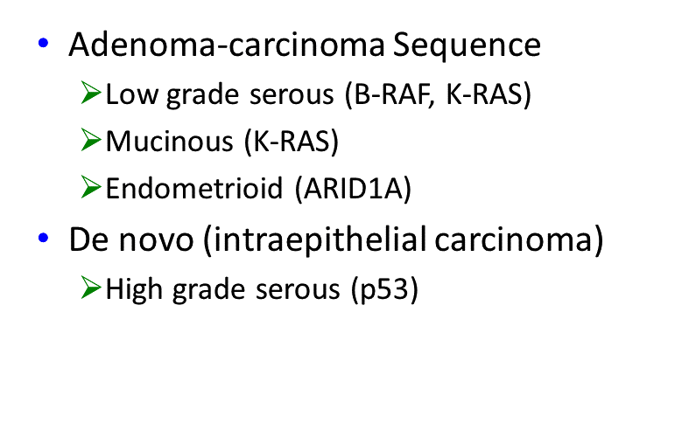
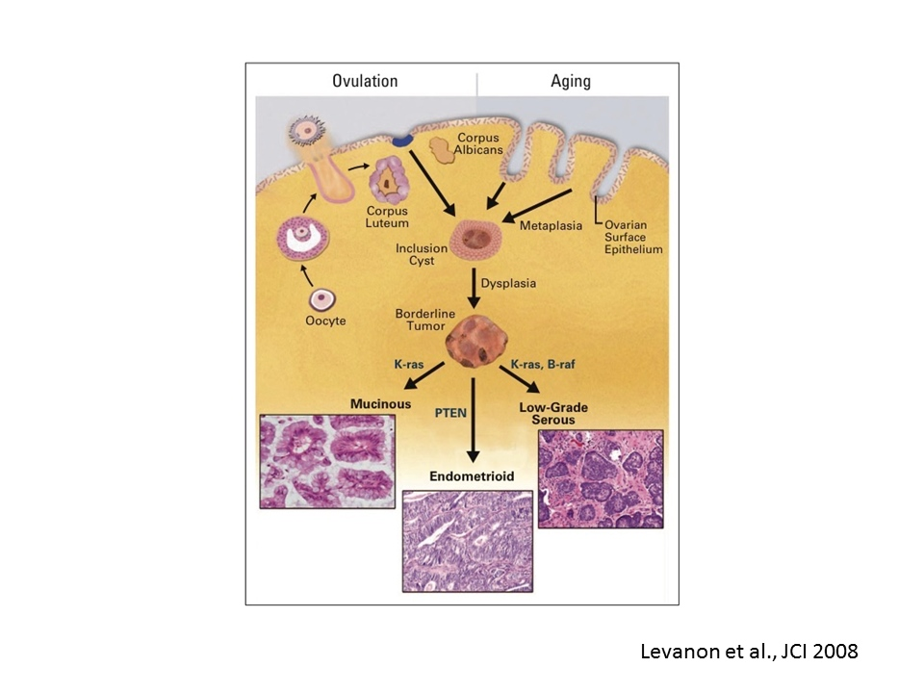

Pathogenesis of ovarian carcinomas

Slide 11

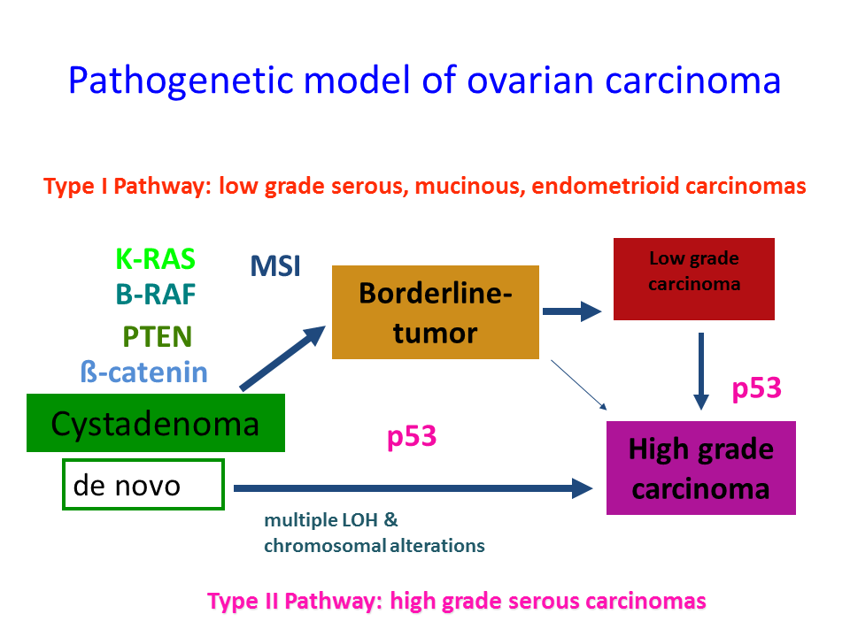

Slide 12
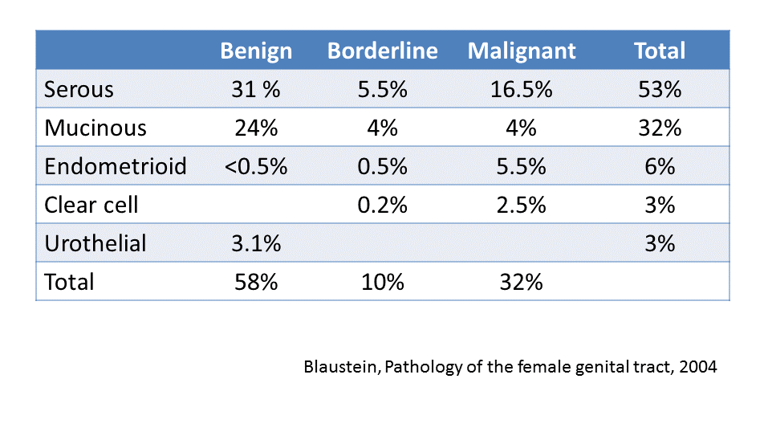
Distribution of EPITHELIAL ovarian tumours

Slide 13
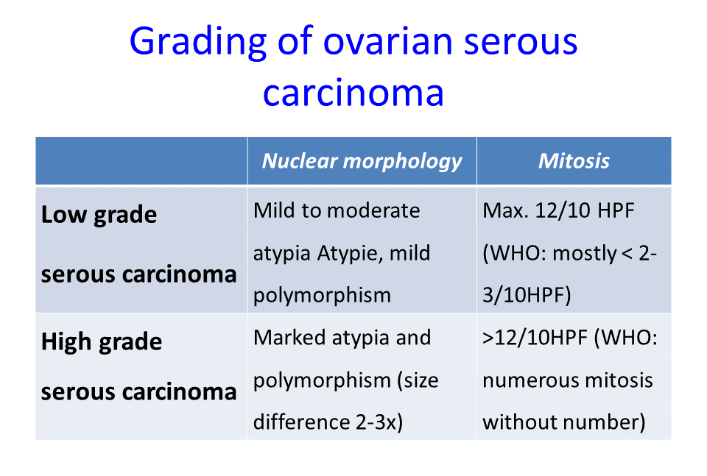
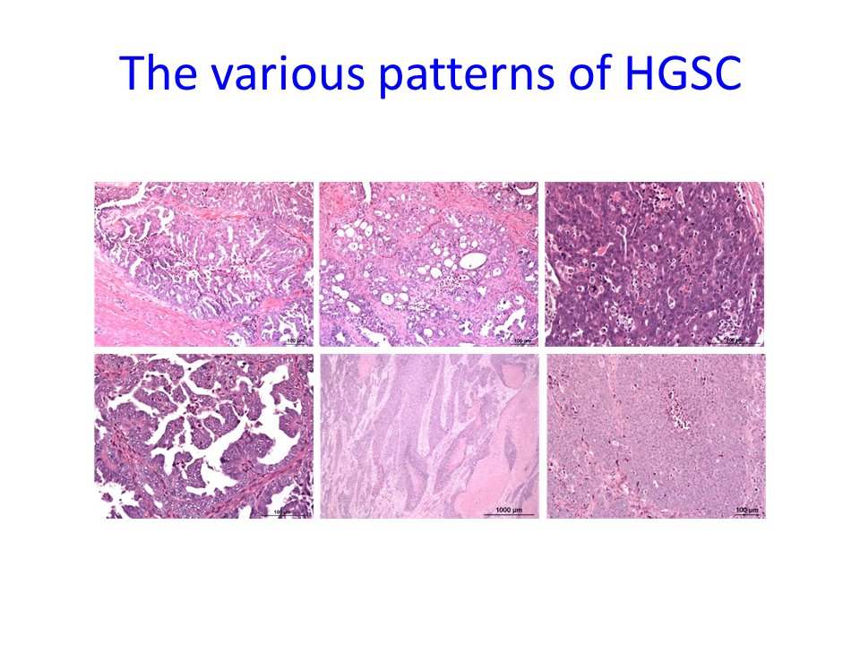
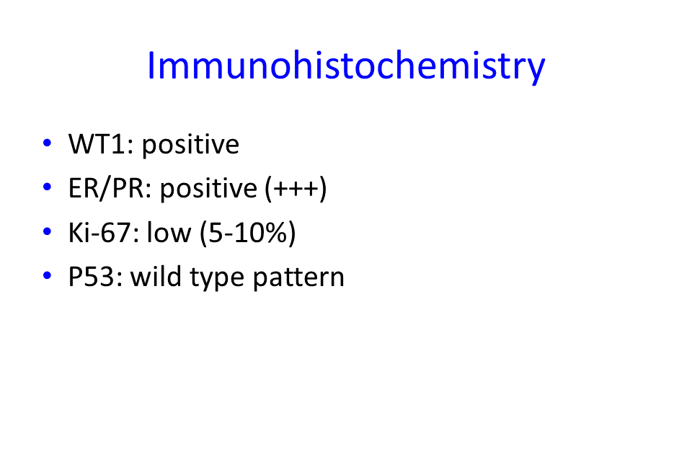

Slide 14
Epidimiolgy
2% OC in general population
7,300 new diagnosis / year in UK
Approximately 4430 deaths / year
60% - 80% diagnosis in FIGO stage ΙΙΙ – IV
40% - 50% 5 year Overall Survival

Slide 15
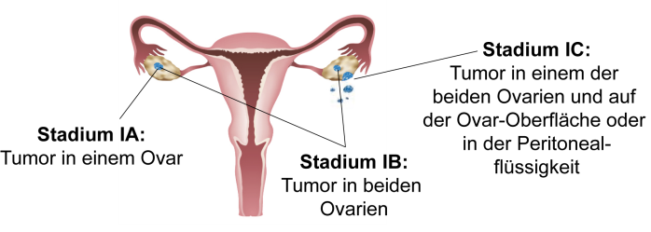
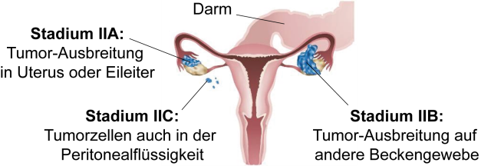
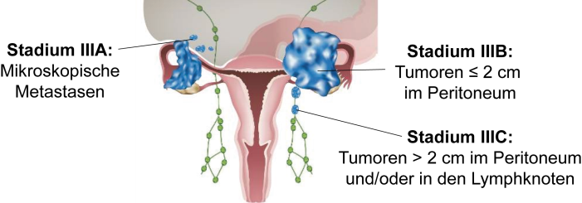
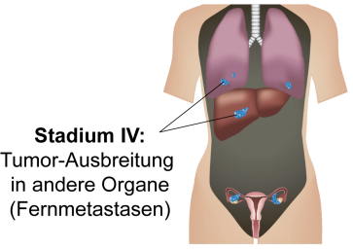
„The Silent Killer“
Vaughan S. et.al., Nat Rev Cancer. 2011

Slide 16
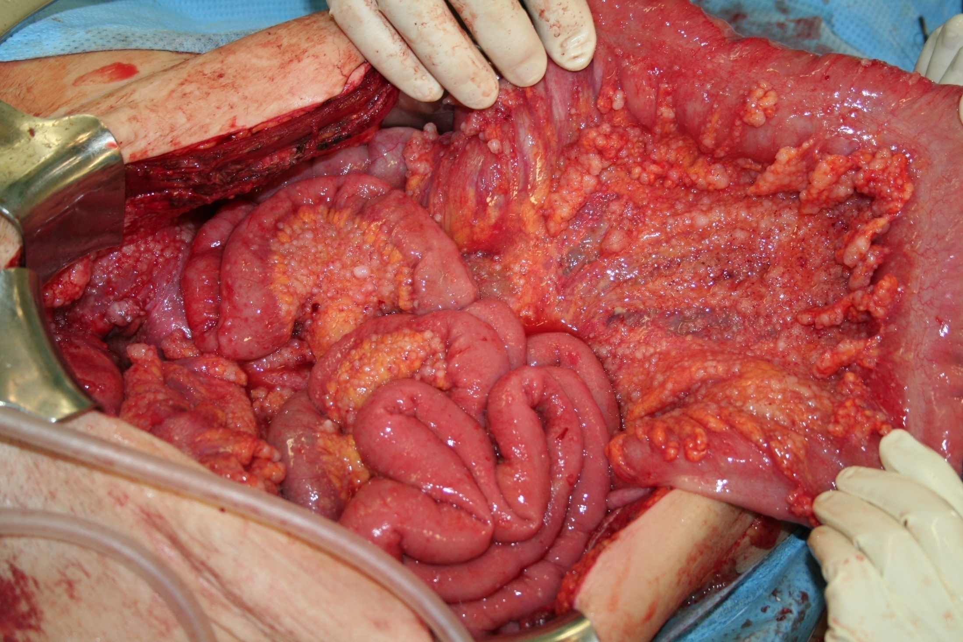
This is the problem !
It is NOT METASTATIC DISEASE !!!
It is a LOCOREGIONAL PERITONEAL DISSEMINATION

Slide 17
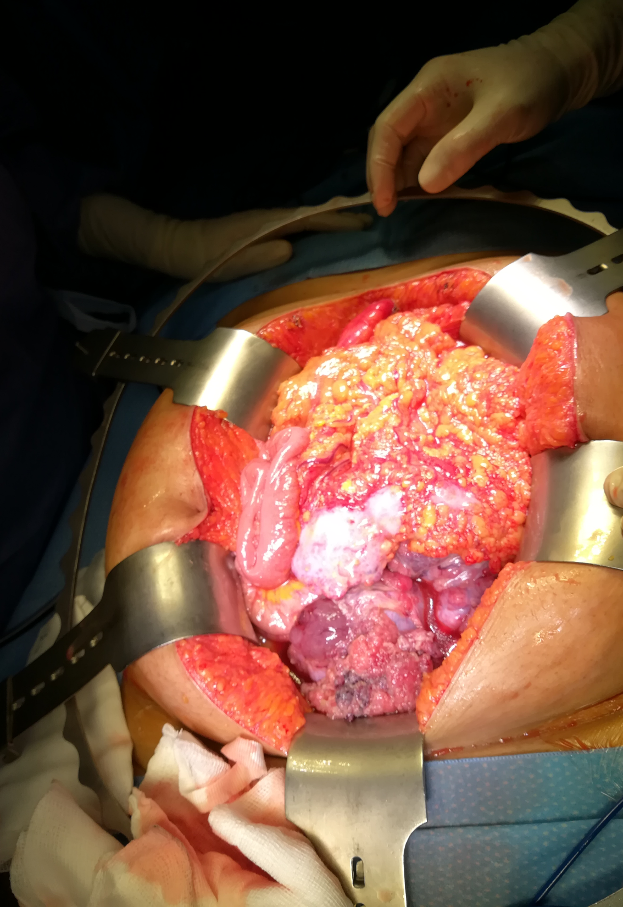
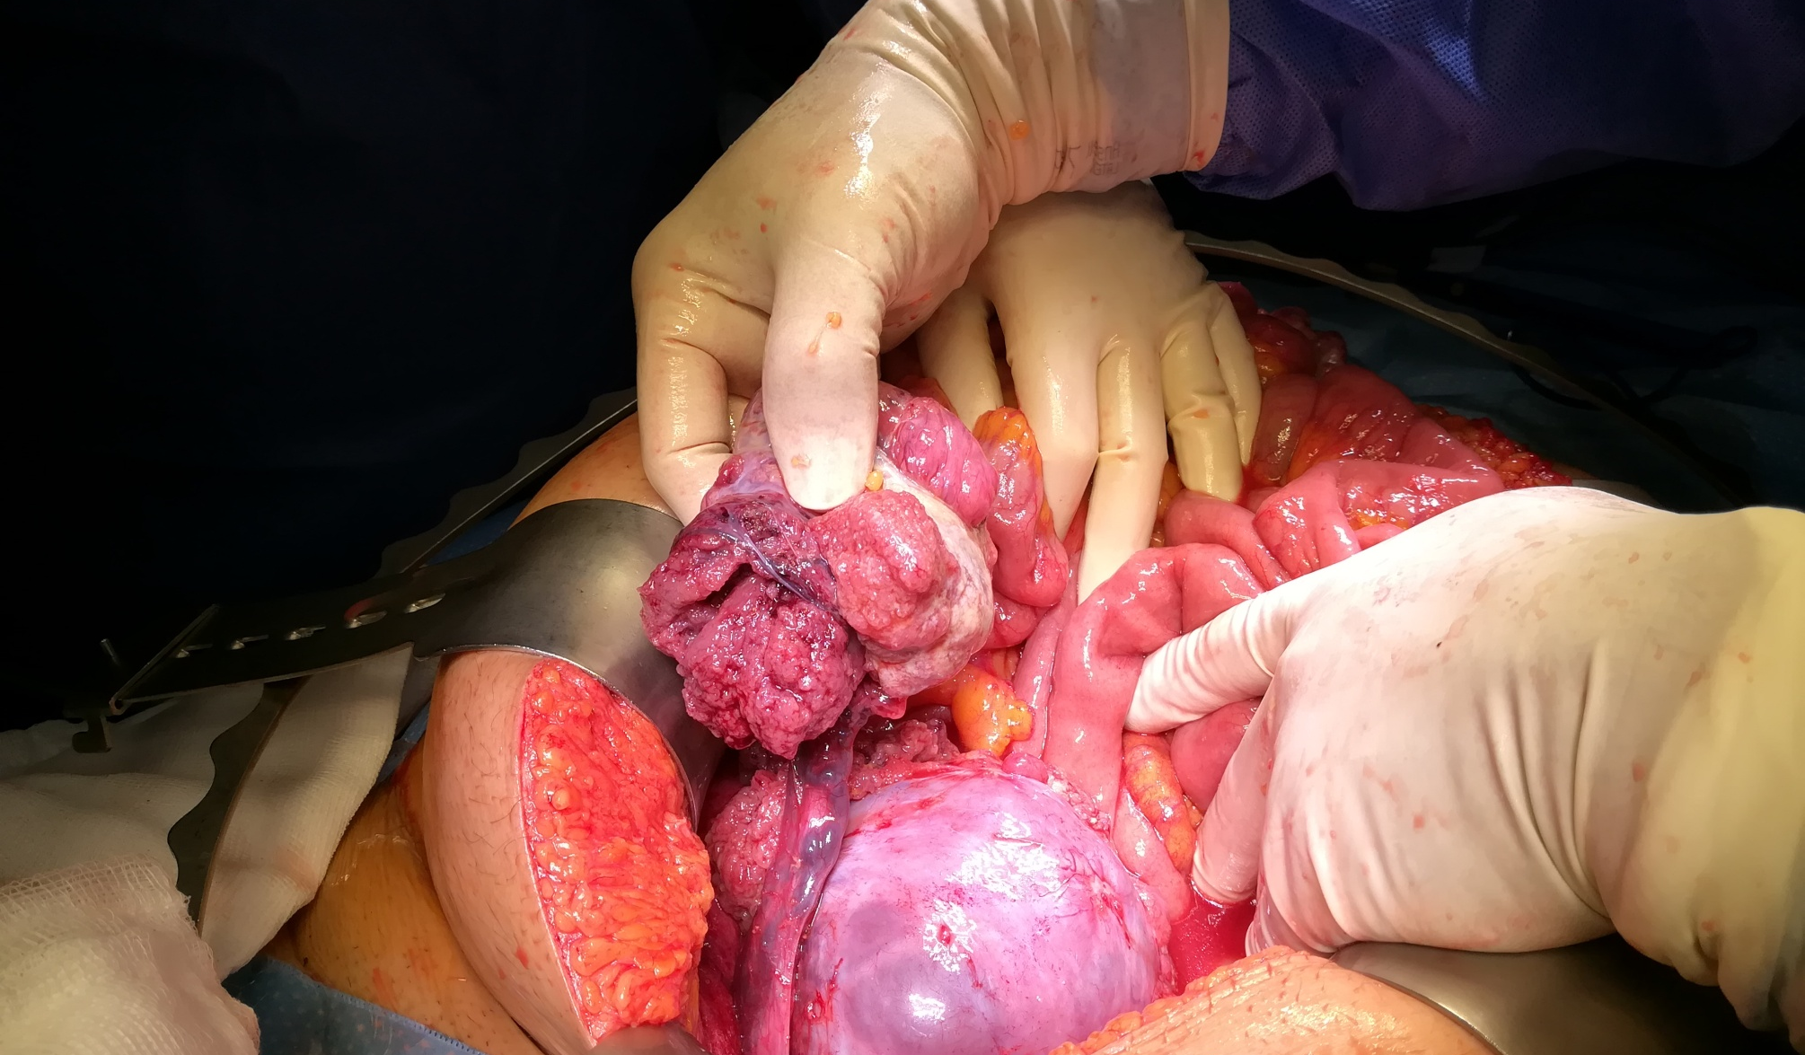
Locoregional Peritoneal Dissemination

Slide 18
SURGERY
CHEMOTHERAPY
MAINTANCE
CCN, Ovarian Cancer, Version 1.2020, https:// www.nccn.org/professionals/physician_gls/pdf/ovarian_blocks.pdf 2020 (Updated 3/11/2020. Accessed 5/2020)

Slide 19
Brief history of significance of residual disease
Meigs (1934) / Mannel (1968) Μaximal tumor reduction
Griffith (1975) ”Debulking-surgery”
tumor residuals and survival:
0.5cm 40 months
1.5 cm 18 months
>1.5cm 6 months
Hoskins (1994) tumor residual < 2cm: significant benefit
Lichtenegger (1998) Radical multivisceral surgery is feasible, safe and efficient in PDS and SDS

Slide 20

Ø <2cm
Bristow et al. JCO 2002

Slide 21

Postoperative residual disease has the strongest impact on survival
AGO-OVAR Meta-database (OVAR 3, OVAR 5, OVAR 7)
2,924 Pat with OC FIGO IIB-IV and post-OP Carbo/Taxol (+)
No Tumor residuals
1-10 mm
>10 mm

Slide 22
Significance of residual disease
The survival benefit associated with resection of bulky tumors during frontline treatment has been recognized since the 1970s
C.T. Griffiths, Surgical resection of tumor bulk in the primary treatment of ovarian carcinoma, Natl. Cancer Inst. Monogr. 42 (1975) 101–104
Based on data from cooperative group trials, the goal of cytoreductive surgery has evolved
first towards a goal of <1 cm of residual cancer
and more recently to complete gross resection (CGR) of all macroscopic disease
G.A. Omura, The influence of cytoreductive surgery on recurrence-free interval and survival in small-volume stage III epithelial ovarian cancer: a Gynecologic Oncology Group study, Gynecol. Oncol. 47 (2) (1992) 159–166.
R. Kimmig, et al., Prognostic factors for complete debulking in advanced ovarian cancer and its impact on survival. An exploratory analysis of a prospectively randomized phase III study of the Arbeitsgemeinschaft Gynaekologische Onkologie ovarian Cancer study group (AGO-OVAR), Gynecol. Oncol. 106 (1) (2007) 69–74
R.E. Bristow, Survival effect of maximal cytoreductive surgery for advanced ovarian carcinoma during the platinum era: a meta-analysis, J. Clin. Oncol. 20 (5) (2002) 1248–1259§
C. Tian, et al., Prognostic factors for stage III epithelial ovarian cancer: a gynecologic oncology group study, J. Clin. Oncol. 25 (24) (2007) 3621–3627

Slide 23
Why is it important to operate?
Amelioration of PFS and OS through optimal cytoreduction due to:
    Reduction of tumor induced immunosupression
    Improves host‘s immune response
  Enhance of responce to chemotherapy through:
  Reduction of tumor load responsible for the development of future chemoresistance
  Resection of preexistant chemotherapy resistant clones
  Resection of bulky tumours that have reduced perfusion
  Optimizes perfusion of the cancer for systemic therapy
Notes:
“The hypothesis that platinum-resistant clones are generated by clonal diversity from the outset of the disease and co-exist in the chemonaive state, and represent a slowly growing chemoresistant “second disease” that eventually recurs clinically well after the dominant presenting clone has been thoroughly controlled”

Slide 24
Ovarian Cancer is typically a Chronic Disease
Primary
Surgery
Platinum +
Other drugs
Relapse
Therapy
Treatment
PFS 1
PFS 2
?
Tumour
volume
CA-125
?
?
?
Chronic survivability ends with drug resistance

Slide 25
The problem of platinum resistance in HGSOC
70% of patients responded to platinum, will relapse
80% relapse within 10 years
All of these patients die of ovarian cancer due to platinum resistance
Cure rates have not changed at all
5 year survival (OS) has improved from 20% to 50% over 20 years

Slide 26
PDS + Chemotherapy

Slide 27
Primary surgery - Patient selection
PS 0 or 1
No multiple cancer sites above diaphragm, or multiple parenchymal liver cancer sites
No recent thromboembolic episode or MI or significant cardiopulmonary disease.
Resectable carcinosis (carcinosis at the entire small bowel serosa or gastric serosa)
Patients MUST understand this type of surgery(COMPLEXITY + COMPLICATIONS)

Slide 28
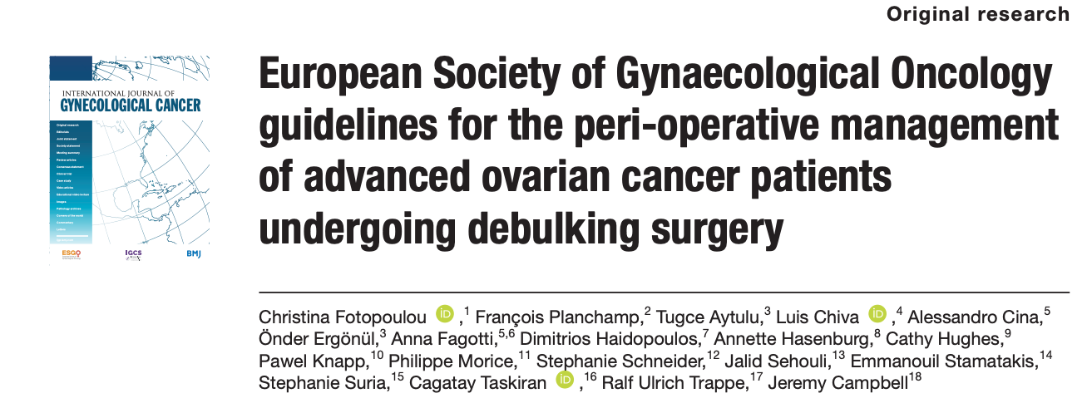

Primary Debulking Surgery
Pretreatment work up
Gynaecological Oncology MDT
Management in GO Centers

Slide 29
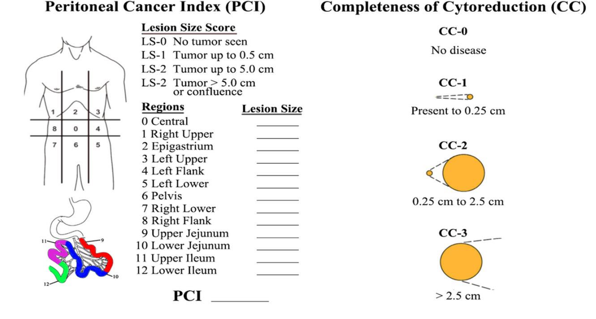
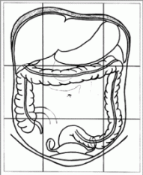
Intraoperative tumor dissemination pattern and sites of tumor residual disease according to
“IMO” (= Intraoperative Mapping of Ovarian Cancer”)
83.1%
95.8%
97.5%

Slide 30
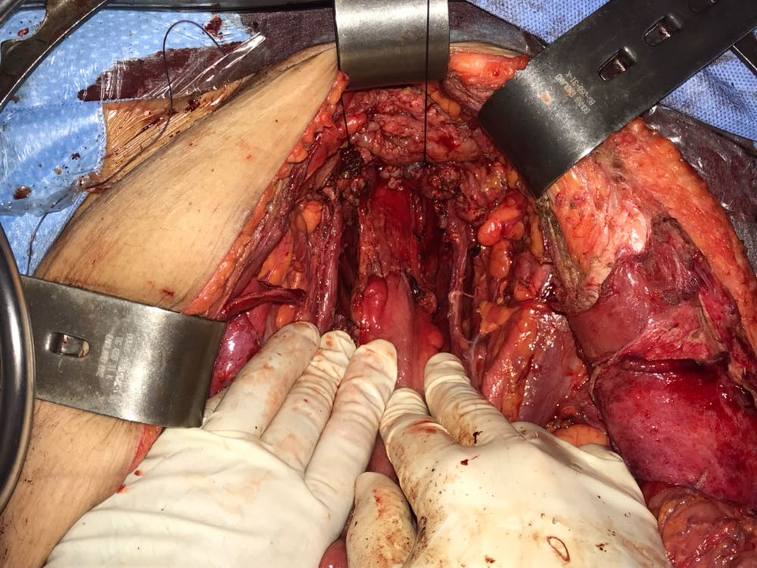
Peritonectomy
Infragastric Omentectomy
Intestinal resection
Pelvic / paraaortic
Lymph node dissection
Extrafascial hysterectomy and salpingoophorectomy
Exploration of all
four abdominal fields

Slide 31
Surgical procedures outside of the
“standard” hysterectomy
BSO and omentectomy
Splenectomy n=23 (19.5%)
Resection in stomach/lesser sack n=31 (26.3%)
Diaphragmatic stripping/resection n=79 (67%)
Large bowel resection n=81 (68.6%)
Small bowel resection n=32 (27.1%)
Liver/ liver capsule resection n=46 (39%)
Pelvic LND n=47 (40%)
Paraaortic LND n=47 (40%)
Cholecystectomy n=3 (2.5%)
Partial pleura resection n=20 (17%)
Peritoneal stripping n=115 (98%)
Coeliac trunc/subdiaphragmatic LN removal n=9 (8%)
Fotopoulou C et al Primary radical surgery in elderly patients with epithelial ovarian cancer: analysis of surgical outcome and long-term survival. IGC 2010
Fotopoulou CPrimary radical surgery in elderly patients with epithelial ovarian cancer: analysis of surgical outcome and long-term survival. IGC 2010.
Fotopoulou C et al. Surgical outcome and survival analysis of young patients with primary epithelial ovarian cancer. Anticancer Res. 2009
Nasser S, Lathouras K, Impact of right upper quadrant cytoreductive techniques with extensive liver mobilization on postoperative hepatic function and risk of liver failure in patients with advanced ovarian cancer. IGC 2018
Lathouras K. Diagnostic value of post-operative platelet-to-white blood cell ratio after splenectomy in patients with advanced ovarian cancer. Int J Gynecol Cancer. 2019 Oct

Slide 32
1 month Surgical Morbidity/Mortality
22 patients (18.6%) → at least one major surgical complication
28 days surgical mortality: 1.7% (N=2; one patients from fulminant sepsis and one patient from fulminant liver failure, both on day 3 postoperatively)
Systemic sepsis (n=4; 3.4%)
Fulminant liver failure (n=1; 0.8%)
Renal failure (n=2; 1.7%)
Deep venous thrombosis (n=2; 1.7%) / pulmonary embolism (n=4; 3.4%)
Anastomotic leak (n=1; 0.8%)
Myocardial infarction (n=1; 0.8%)
Intraabdominal abscess formation (n=1; 0.8%)
Persistent lymphorrhea (n=7; 5.9%)
Nerve compression injury (n=3; 2.5%)
Fistula/bowel perforation (n=4; 3.4%)
Secondary wound healing needing vacuum dressing and/or surgical intervention (n=2; 1.7%)
Fotopoulou C et al. Surgical outcome and survival analysis of young patients with primary epithelial ovarian cancer. Anticancer Res. 2009
Nasser S, Lathouras K, Impact of right upper quadrant cytoreductive techniques with extensive liver mobilization on postoperative hepatic function and risk of liver failure in patients with advanced ovarian cancer. IGC 2018
Lathouras K. Diagnostic value of post-operative platelet-to-white blood cell ratio after splenectomy in patients with advanced ovarian cancer. Int J Gynecol Cancer. 2019 Oct

Slide 33
Reoperation and readmission rates
4 patients had to be reoperated (3.4%)
Reasons for reoperation were as follows:
  n=2: postoperative haemorrhage
  n=2: GI- fistula/perforation outside of any bowel anastomosis.
Readmission rate within the first 28 days postoperatively was 10% (n=12).
Reasons for readmission were as follows:
  n=3 due to lymphorrhea/lymphocyst
  n=1 for diarrhea
  n=1 for social issues
  n=1 for preoperatively existent hyponatriemia
  n=1 fistula formation
  n=1 massive progress
  n=1 superficial wound dehiscence.
Fotopoulou C et al Primary radical surgery in elderly patients with epithelial ovarian cancer: analysis of surgical outcome and long-term survival. IGC 2010
Fotopoulou CPrimary radical surgery in elderly patients with epithelial ovarian cancer: analysis of surgical outcome and long-term survival. IGC 2010.
Fotopoulou C et al. Surgical outcome and survival analysis of young patients with primary epithelial ovarian cancer. Anticancer Res. 2009
Nasser S, Lathouras K, Impact of right upper quadrant cytoreductive techniques with extensive liver mobilization on postoperative hepatic function and risk of liver failure in patients with advanced ovarian cancer. IGC 2018
Lathouras K. Diagnostic value of post-operative platelet-to-white blood cell ratio after splenectomy in patients with advanced ovarian cancer. Int J Gynecol Cancer. 2019 Oct

Slide 34
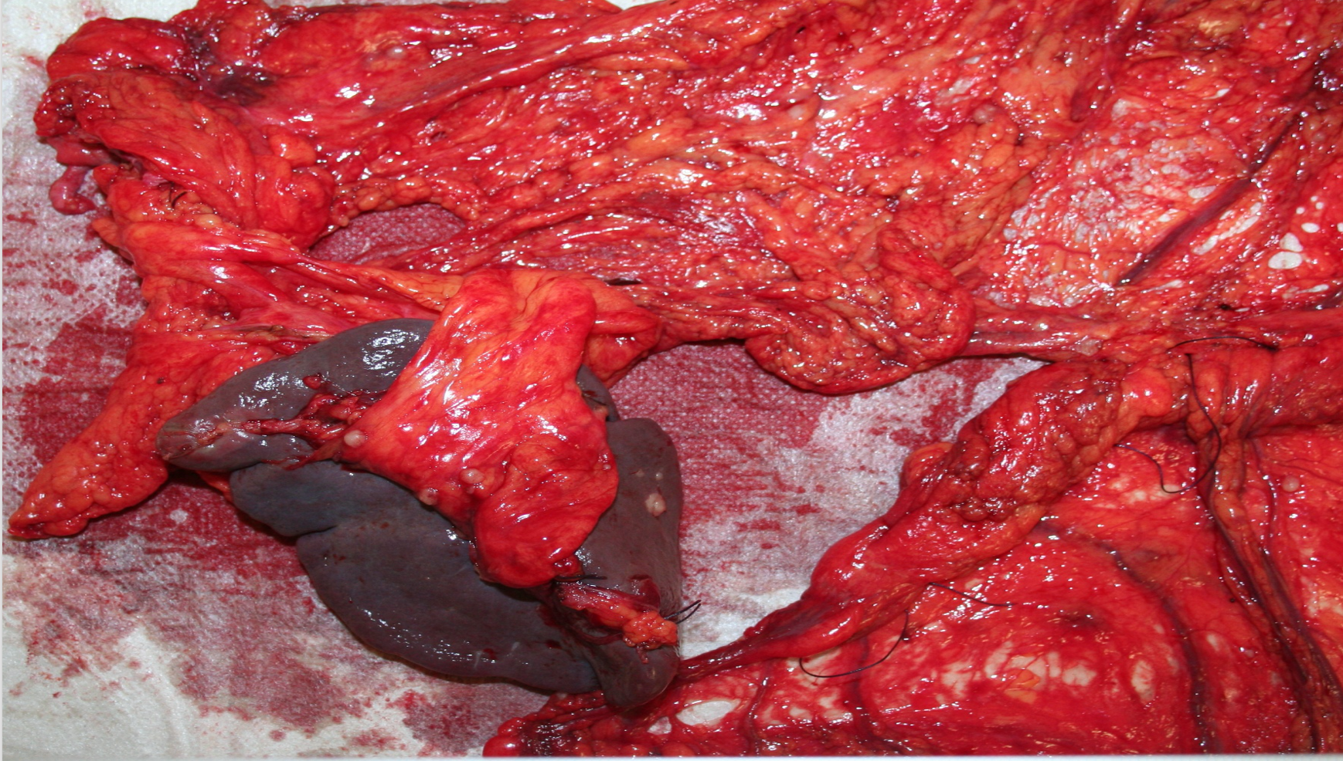
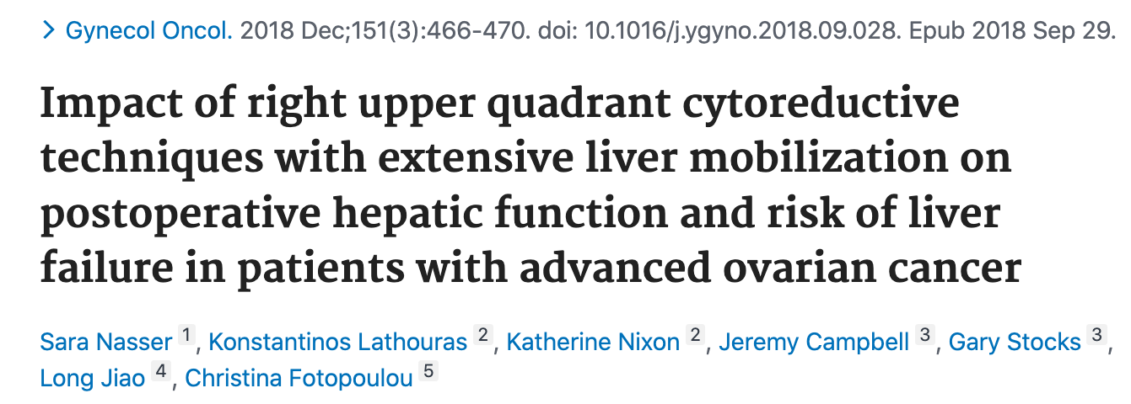
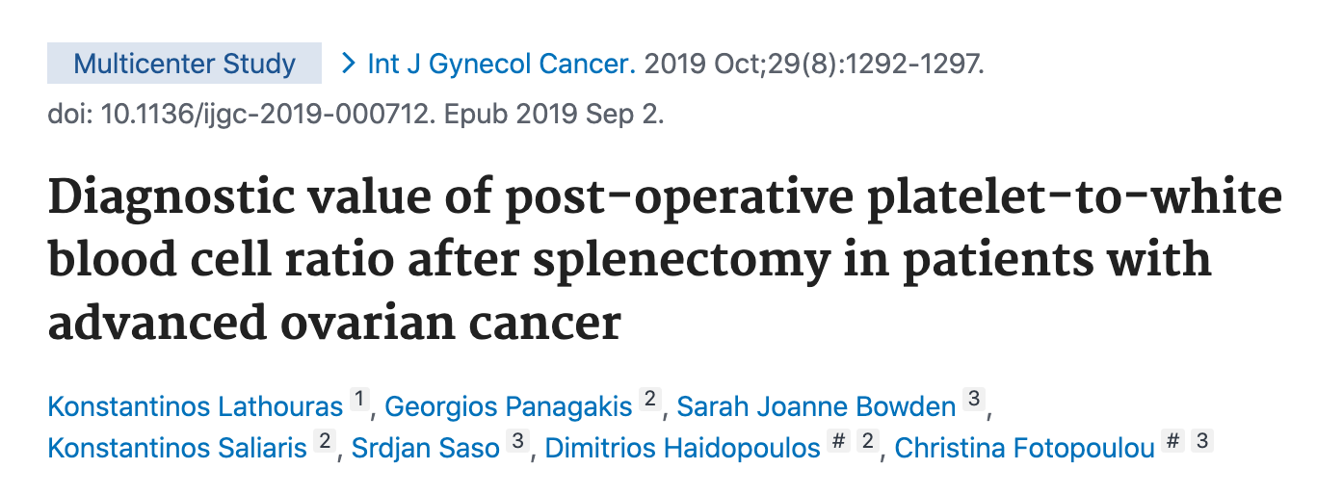
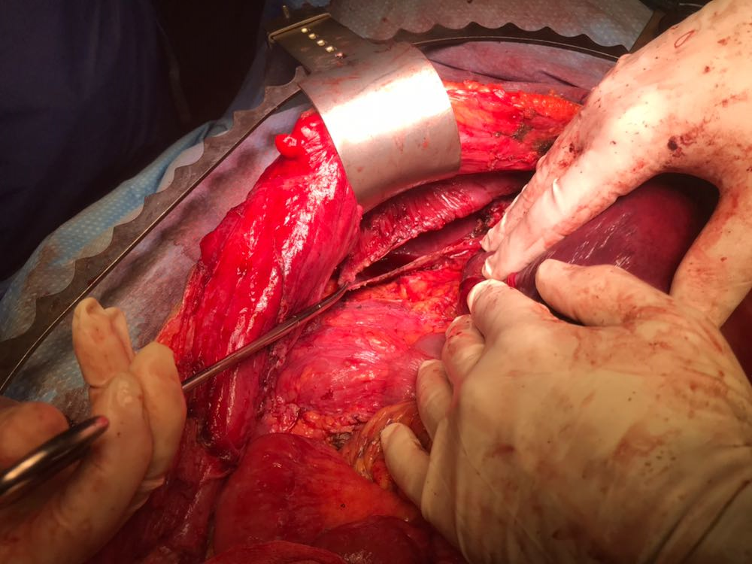
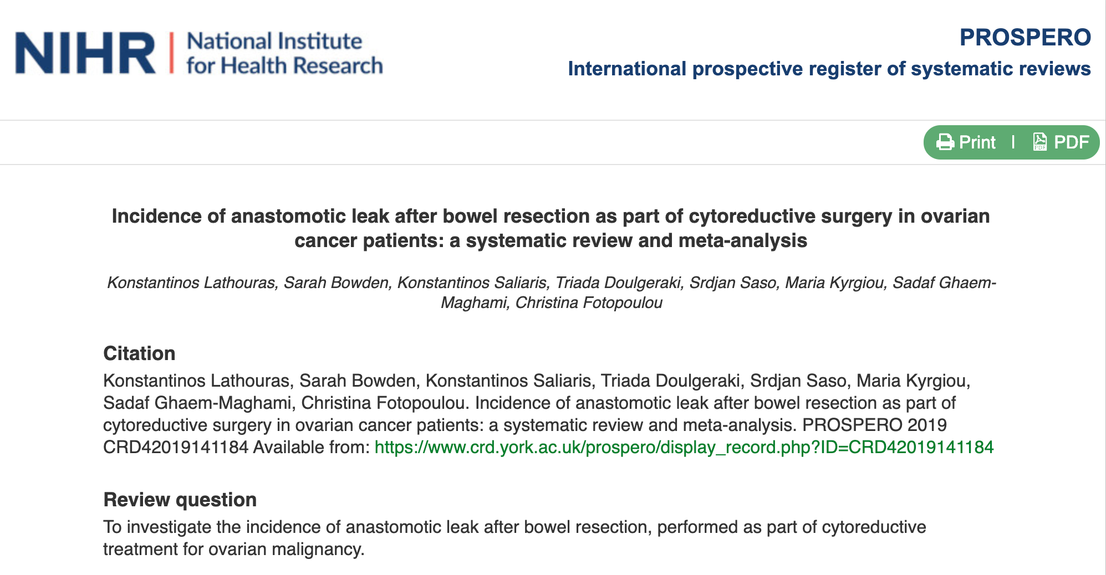
Ultra – radical Debulking Cytoreductive Surgery
Complications

Slide 35
Neoadjuant Chemotherapy + IDS

Slide 36
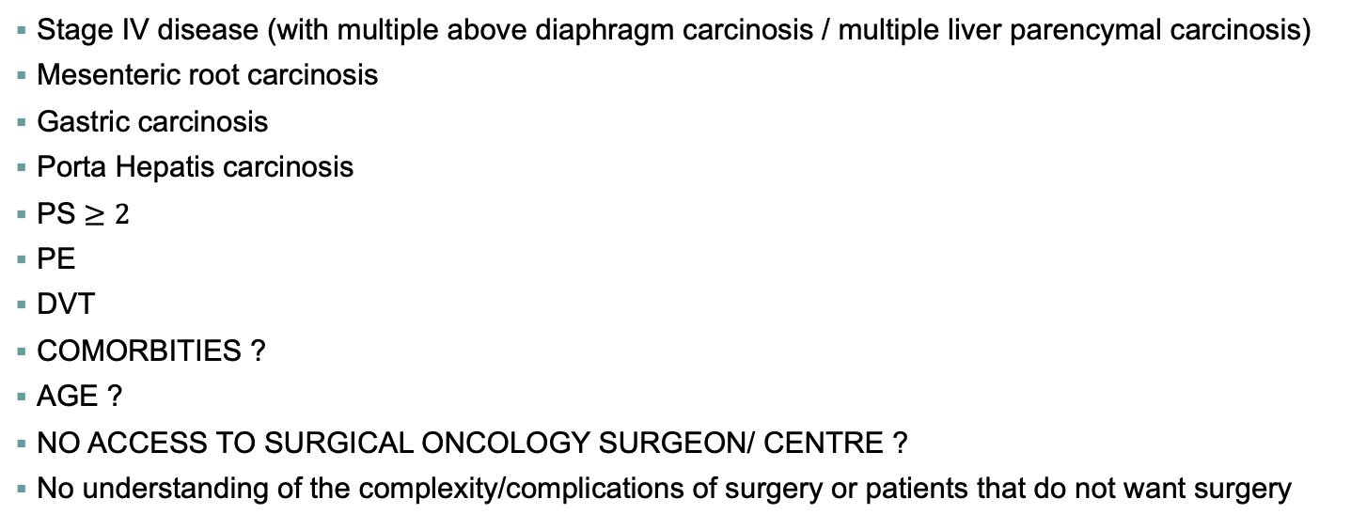
Neo adjuvant Chemotherapy + IDS
Stage IV disease (with multiple above diaphragm carcinosis / multiple liver parencymal carcinosis)
Mesenteric root carcinosis
Gastric carcinosis
Porta Hepatis carcinosis
PS $≥2$
PE
DVT
COMORBITIES ?
AGE ?
NO ACCESS TO SURGICAL ONCOLOGY SURGEON/ CENTRE ?
No understanding of the complexity/complications of surgery or patients that do not want surgery

Slide 37
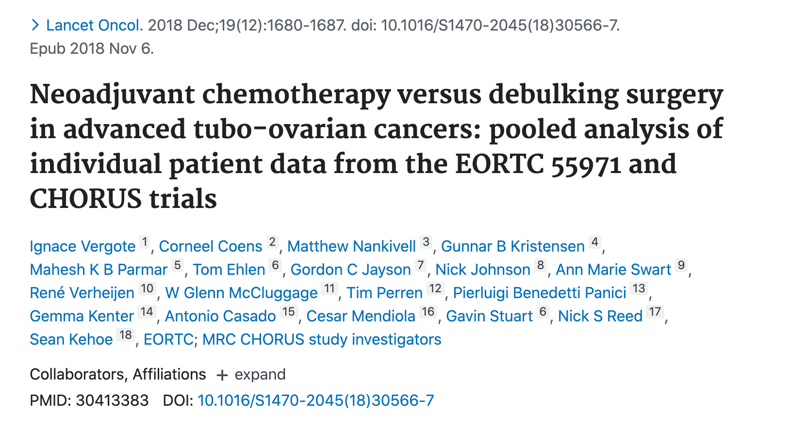
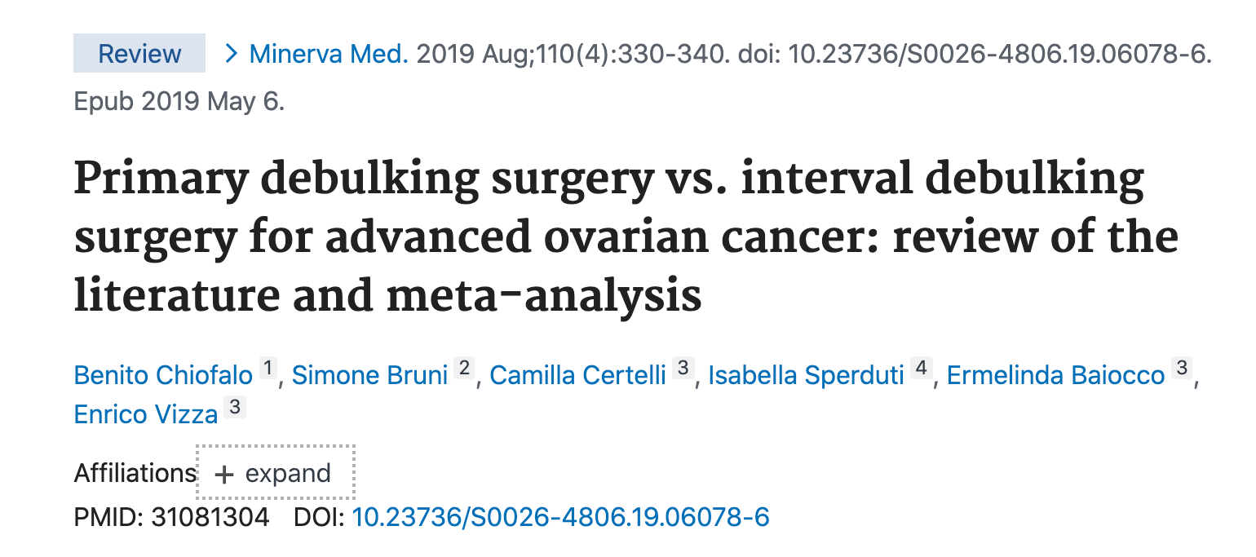
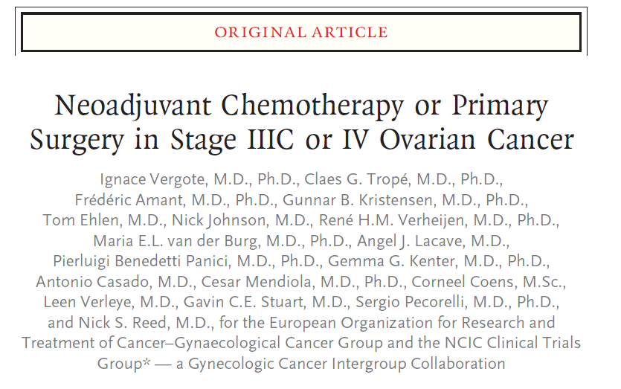
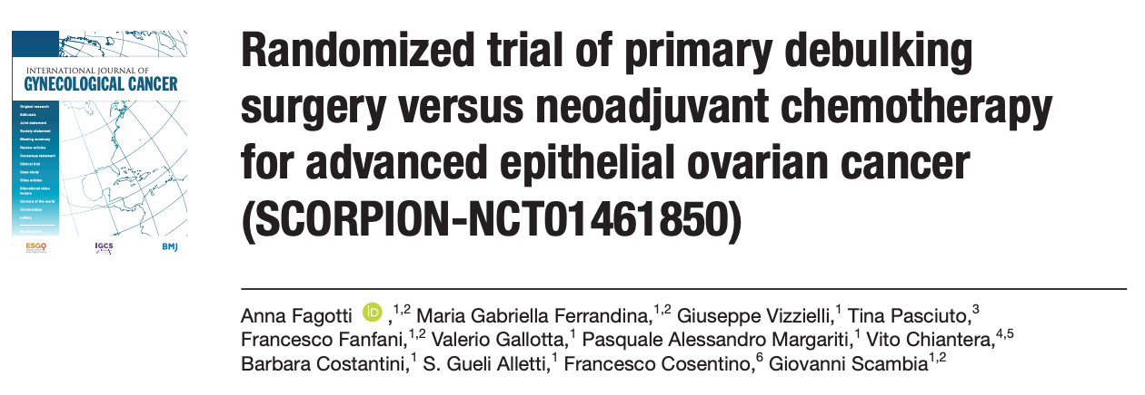
Postoperative rates of adverse effects and mortality tended to be higher after primary debulking than after interval debulking.
… but: Complete resection of all macroscopic disease (at primary or interval surgery) was the strongest independent variable in predicting overall survival.

Slide 38

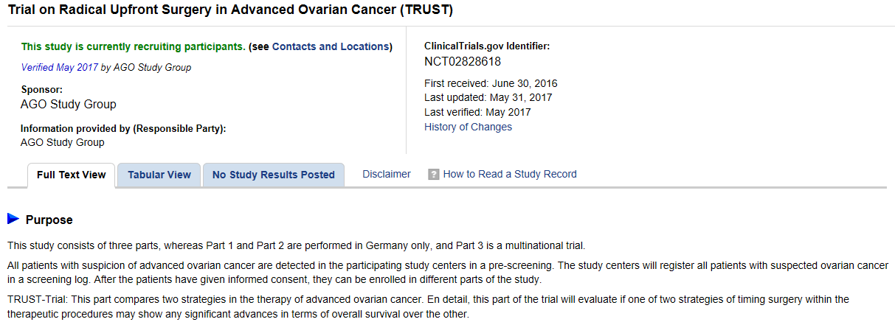

Slide 39
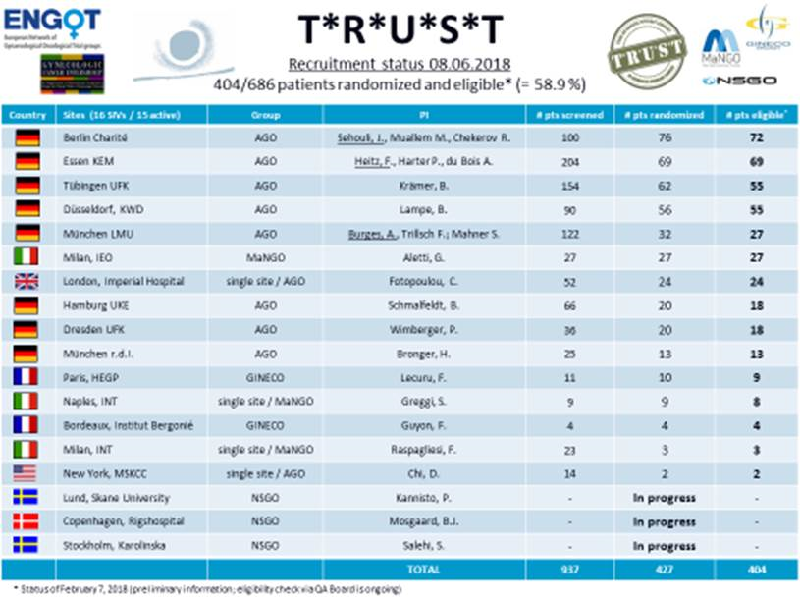

Slide 40
Conclusions
Individualized medical treatment
“Right treatment to the right patient”

Slide 41
Conclusions
Research in tumour biology

Slide 42
Conclusions
Antiangiogenic therapy
Bevacizumab
PARP inhibitors
Olaparib, Niraparib, Rucaparib

Slide 43
Conclusions
Multidisciplinary approach and management
Improve Quality of Life

Slide 44
Conclusions
Subspecialised surgeons
Subspecialised medical oncologists
Specialized centers

Slide 45

Conclusions
Moving from PFS 1 towards PFS 2…PFS 3…
Transforming a lethal disease to a chronic problem…
and maybe find the solution to the problem…
Notes:
More recently, the approach to secondary, tertiary, and later recurrence has been changed by the introduction of PARP inhibitors, which resulted effective as maintenance monotherapy in both platinum-sensitive and platinum-resistant recurrence when the genetic background of the tumor allows their application with a significant improvement of oncological outcomes.

Slide 46
Primary management of advanced EOC
Up front surgery with primary cytoreduction
Dr Kostas Lathouras PhD
Consultnat Gynaecological Oncologist
info@lathouras.gr

