Slide 1
Vasileios D. Sioulas MD, PhD
www.sioulas-gyn.gr
Management of borderline ovarian tumors (BOTs)
Gynecologic Oncologist (MSKCC/ESGO)
Chairman of the 1st Department of Gynecologic Oncology and the Scientific Board
MITERA Hospital (HHG)

Slide 2
www.sioulas-gyn.gr
Management of BOTs
Conflict of Interest
Nothing to declare

Slide 3
Management of BOTs Agenda
www.sioulas-gyn.gr
Introduction
Surgery for BOTs
Standard surgery
Fertility sparing surgery (FSS)
Special issues
Oncologic and reproductive outcomes
Conclusions

Slide 4
Management of BOTs Introduction
www.sioulas-gyn.gr
BOTs
Are marked by lack of stromal invasion
Account for 10-20% of epithelial ovarian tumors
1.8-4.8 new cases/ 100000 women annually
1/3 of cases are diagnosed in patients <40 yo
Du Bois et al. Ann Oncol 2016;27 (Supp; 1):i20-i22
Morice et al. Lancet Oncol 2012;13:e103-15
Fischerova et al. Oncologist 2012;17:1515-33
UpToDate 2024

Slide 5
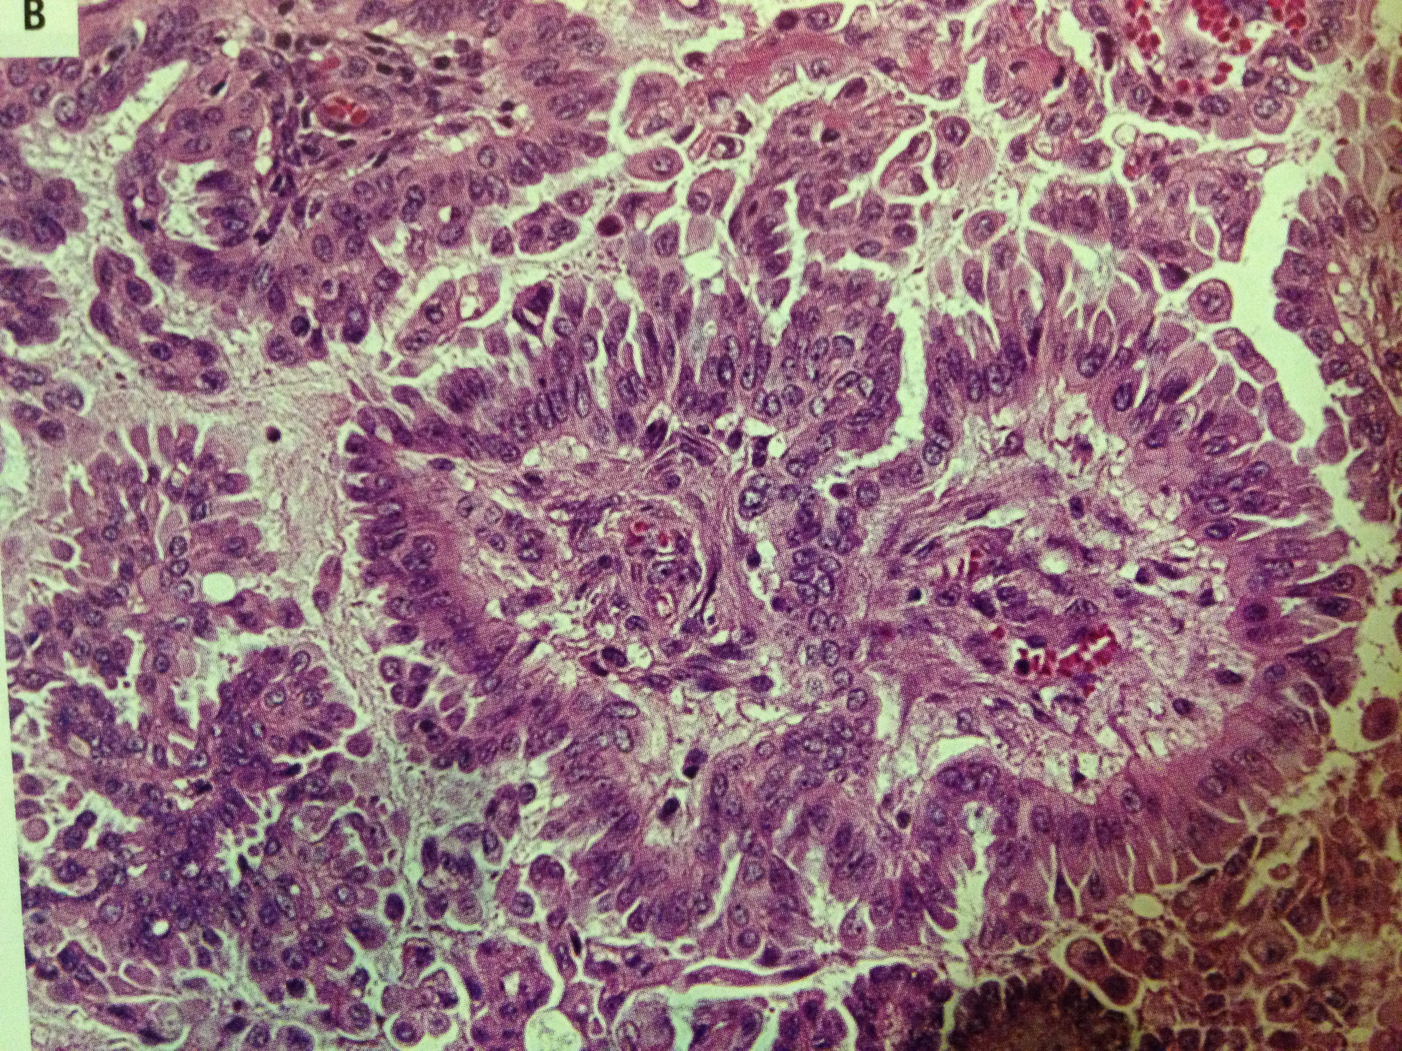
Management of BOTs Introduction
www.sioulas-gyn.gr
BOTs histology
Serous
Mucinous
Endometrioid / Clear cell
Brenner
Mixed
Fischerova et al. Oncologist 2012;17:1515-33
UpToDate 2024

Slide 6
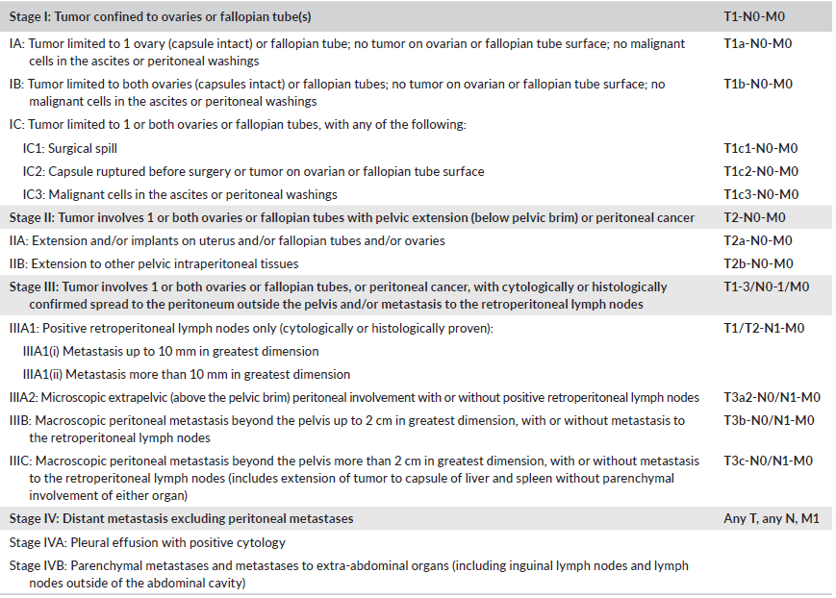
Management of BOTs Introduction
www.sioulas-gyn.gr
Berek JS et al. Int J Gynecol Obstet 2021;155 (Suppl. 1):61-85

Slide 7
Management of BOTs Introduction
www.sioulas-gyn.gr
Serous BOTs
Presence of extraovarian peritoneal implants in 14-30% of cases
Non-invasive vs. invasive -> worse prognosis
Micropapillary features increase the risk of invasive implants
Implants in the context of mucinous BOTs should be considered as metastatic disease from ovary or elsewhere
Ledermann JA et al. Ann Oncol 2024;35:248-66
ESMO/ESGO. Int J Gynecol Cancer 2019

Slide 8
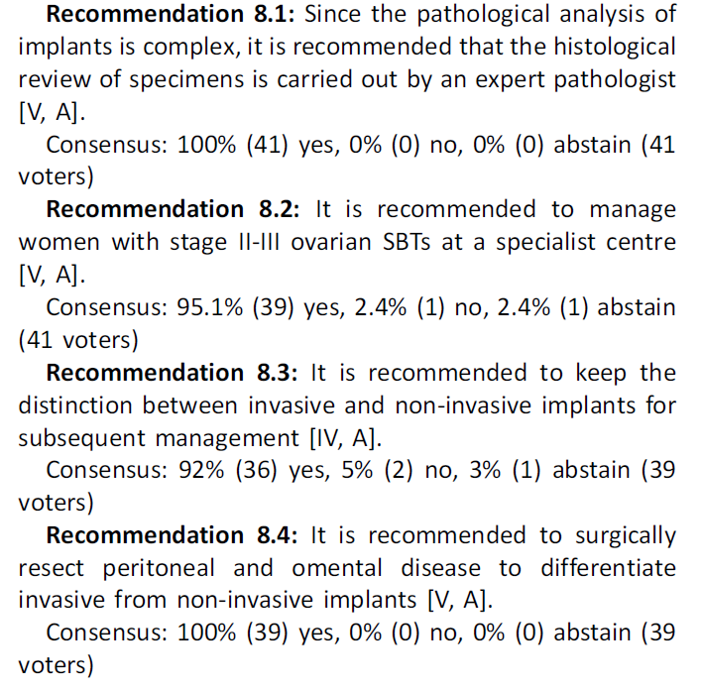
Management of BOTs Introduction
www.sioulas-gyn.gr
Ledermann JA et al. Ann Oncol 2024;35:248-66

Slide 9
Management of BOTs Surgery for BOTs
www.sioulas-gyn.gr
Surgery is the primary treatment of BOTs
Follows the rules of ovarian cancer surgery (staging vs. debulking)
Fertility-sparing surgery in young patients
MIS avoiding tumor rupture is acceptable for early-stage disease
Ledermann JA et al. Ann Oncol 2024;35:248-66
NCCN 2024

Slide 10
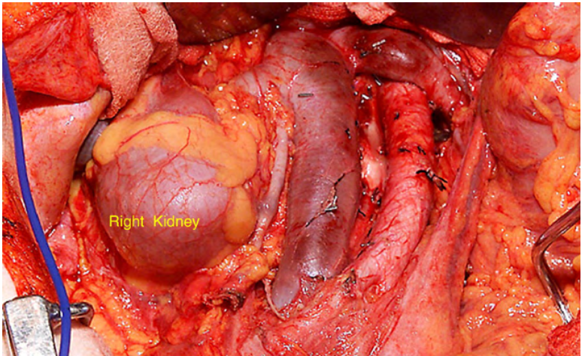
Management of BOTs Surgery for BOTs
www.sioulas-gyn.gr
Role of lymphadenectomy (LND) in standard surgery of BOTs
LNs are involved in 25% of patients with advanced stage disease
Women with (+) LNs have 98% survival rates
If no enlarged LNs, LND should not be carried out
ESMO/ESGO. Int J Gynecol Cancer 2019
UpToDate 2024
Morice et al. Lancet Oncol 2012;13:e103-15
Menczer et al. Gynecol Oncol 2012;125:372-5

Slide 11
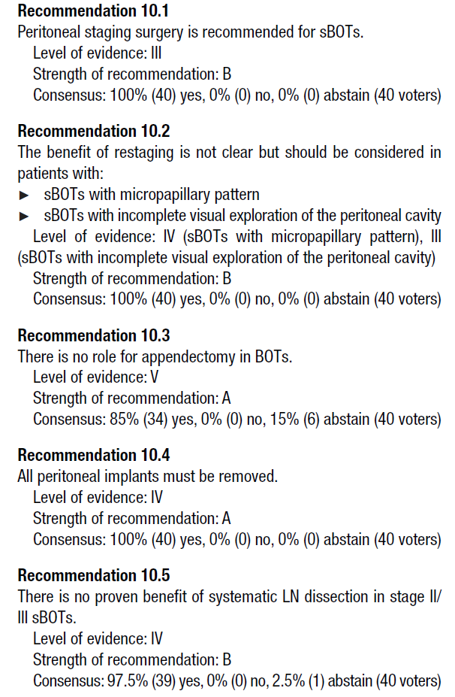
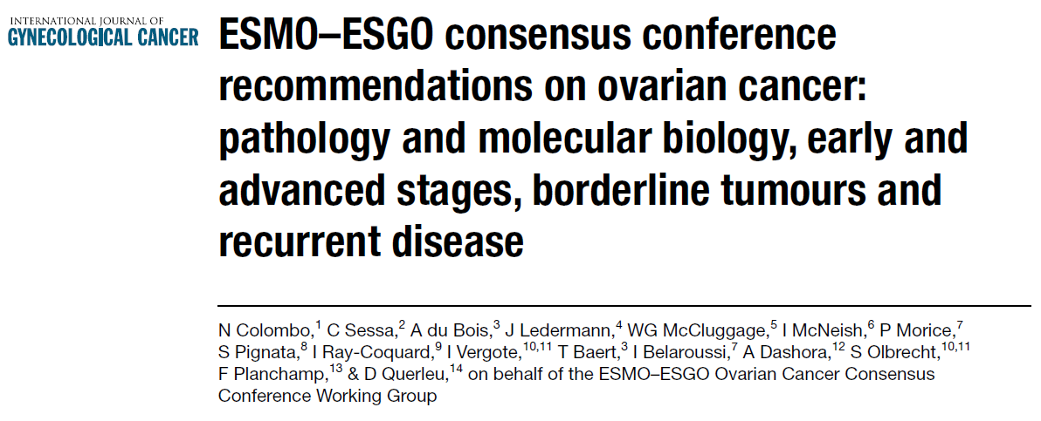
Management of BOTs Surgery for BOTs
www.sioulas-gyn.gr
ESMO/ESGO. Int J Gynecol Cancer 2019
UpToDate 2024
Morice et al. Lancet Oncol 2012;13:e103-15
Menczer et al. Gynecol Oncol 2012;125:372-5

Slide 12
Management of BOTs Surgery for BOTs
www.sioulas-gyn.gr
Fertility sparing surgery (FSS) is the standard of care in young women
Serous BOTs -> cystectomy is acceptable
Mucinous BOTs - USO
No biopsies from contralateral, normal-appearing ovary
If bilateral ovarian involvement, preserve of at least part of one ovary and the uterus
ESMO/ESGO. Int J Gynecol Cancer 2019
ESGO/ISUOG/IOTA/ESGE Int J Gynecol Cancer 2021;31:961-82

Slide 13
Management of BOTs Surgery for BOTs
www.sioulas-gyn.gr
Serous BOTs – bilateral involvement in 15-25% of cases
Palomba et al. Hum Reprod 2010;25:1966-72

Slide 14
Management of BOTs Surgery for BOTs
www.sioulas-gyn.gr
BOTs of all stages (without invasive implants) can be offered FSS, independently of the presence of microinvasion
All peritoneal implants should be removed
Reproductive Medicine consultation before treatment is mandatory
Morice P et al. Lancet Oncol 2024;25:e602-e610

Slide 15
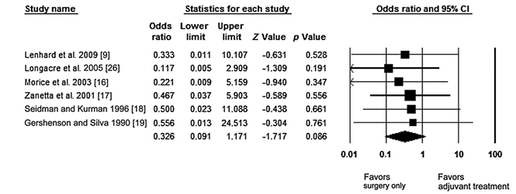
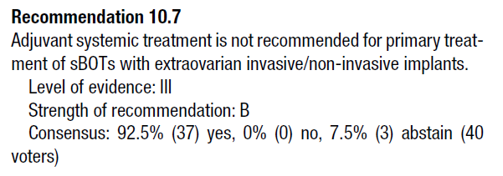
Management of BOTs Special issues
www.sioulas-gyn.gr
There is no benefit in adding adjuvant chemotherapy to upfront surgery even in cases with invasive implants
Vasconcelos I et al. The Oncologist 2015;20:151-8
ESMO/ESGO. Int J Gynecol Cancer 2019

Slide 16
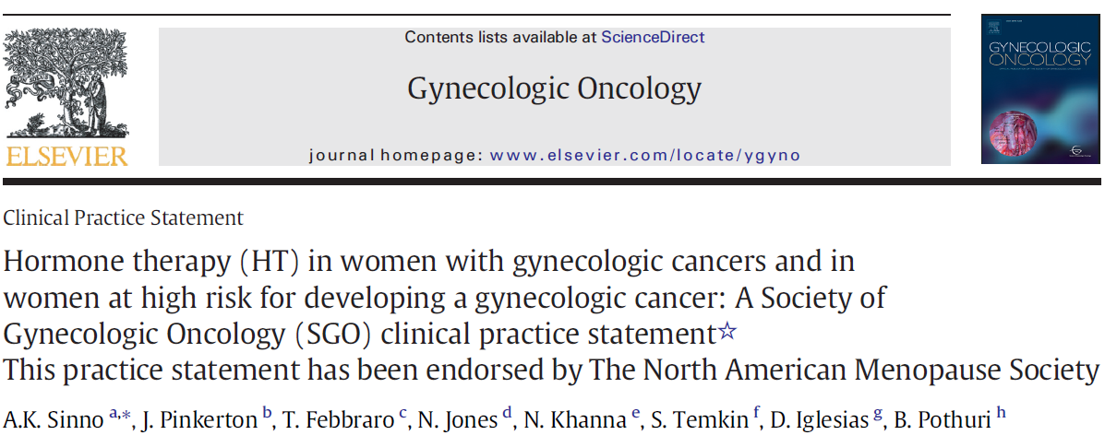
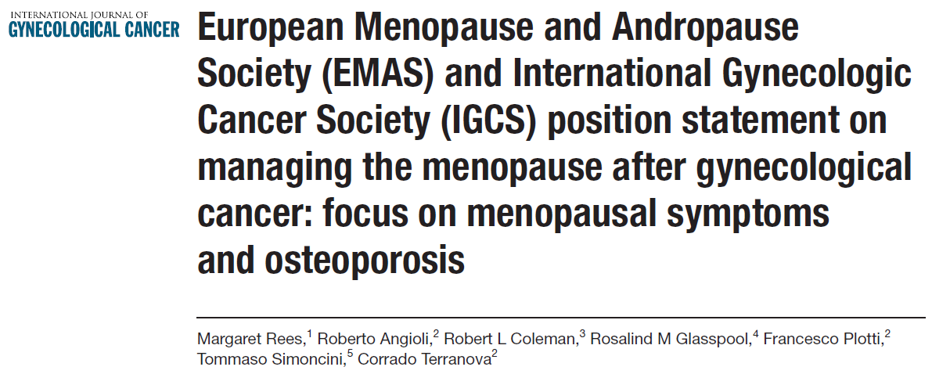
Management of BOTs Special issues
www.sioulas-gyn.gr
Current guidelines on the use hormone therapy in patients with BOTs
Insufficient data to provide robust recommendations
May consider it in case of completely resected disease
Take into account ER/PR status and patient’s preferences
Sinno AK et al. Gynecol Oncol 202;157:303-6
Rees M et al. Int J Gynecol Cancer 2020;30:428-33

Slide 17
Management of BOTs Special issues
www.sioulas-gyn.gr
NCCN 2024

Slide 18
Management of BOTs Oncologic and reproductive outcomes
www.sioulas-gyn.gr
The recurrence rates following FSS for BOTs range from 10% to 20% (vs. 5% in cases undergoing standard surgery)
Conservative treatment of advanced disease is associated with higher risk of recurrence
Du Bois et al. Ann Oncol 2016;27 (Supp; 1):i20-i22
ESMO/ESGO. Int J Gynecol Cancer 2019
Uzan et al. Ann Oncol 2014;25:1312-9

Slide 19
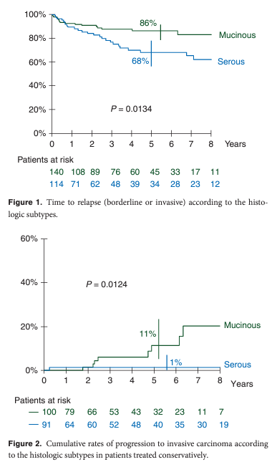
Management of BOTs Oncologic and reproductive outcomes
www.sioulas-gyn.gr
The risk of invasive recurrence following FSS is 0.5%, but is greater in cases of mucinous BOTs
ESMO/ESGO. Int J Gynecol Cancer 2019
Uzan et al. Ann Oncol 2014;25:1312-9

Slide 20
Management of BOTs Oncologic and reproductive outcomes
www.sioulas-gyn.gr
BOTs
126 women underwent COH (104 with early-disease)
80% pregnancy rate
23% recurrence rate
1 patient ended up with invasive disease
Magnili G et al. Cancer Treat Rev 2016;49:13-24

Slide 21
Management of BOTs Oncologic and reproductive outcomes
www.sioulas-gyn.gr
ART -> if indicated, proceed only postoperatively
Avoid spillage during egg retrieval
Confirm histology and stage of the disease
Avoid growth of the disease in case of ER(+)
Ovarian tissue freezing and immature oocytes retrieval in case of bilateral oophorectomy may be offered
Groen RS et al. Gynecol Oncol 2015-136:373-83
Xu W et al. Crit Rev Oncol Hematol 206;102:26-36
Magnili G et al. Cancer Treat Rev 2016;49:13-24
Morice P et al. Lancet Oncol 2024;25:e602-e610

Slide 22
Management of BOTs Oncologic and reproductive outcomes
www.sioulas-gyn.gr
ART
May be offered after complete resection of non-invasive implants
ER(+) is not a contraindication postoperatively
In case of recurrence, COH may be offered prior to surgery, as far as no peritoneal implants are identified on imaging
If natural conception is feasible and immediate pregnancy is desired, at least 6 months of attempts are advised
Morice P et al. Lancet Oncol 2024;25:e602-e610

Slide 23
Management of BOTs Conclusions
www.sioulas-gyn.gr
Patients with suspicious adnexal masses should be referred to specialized centers for further evaluation and treatment
FSS in young women with BOTs is the standard of care, as it is associated with excellent oncologic and reproductive outcomes
In case of advanced disease, complete cytoreduction remains a crucial prognostic factor

Slide 24
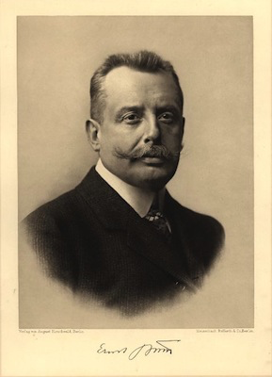
Thank you
www.sioulas-gyn.gr
“Surgery is craft,
Indication is science”
Prof. Ernst Bumm
1904 Head of Department Gynaecology, Charité, Berlin, Germany
Concin N. ESGO 2019

