Slide 1
Less radical surgery for early-stage cervical cancer: Efficacy and safety
Nikolaos Thomakos
Associate Professor of Obstetrics & Gynecology and Gynaecological Oncology
National and Kapodistrian University of Athens “Alexandra” Hospital

Slide 2
No conflict of interest

Slide 3
Radical Surgery / Morbidity
Concept / Philosophy of Less Radical Surgery
Oncological Safety
Simple Hysterectomy
Cone Biopsy
Simple trachelectomy
Lymph Node Assessment
Minimally Invasive Surgery
Conclusions
Less radical surgery

Slide 4
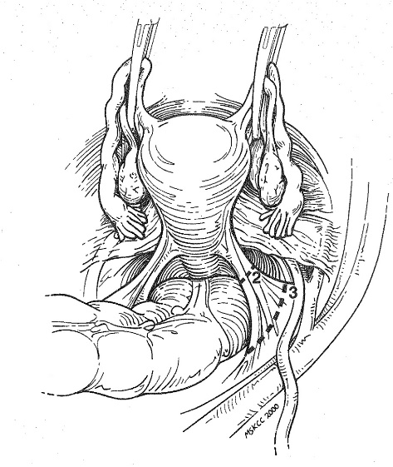
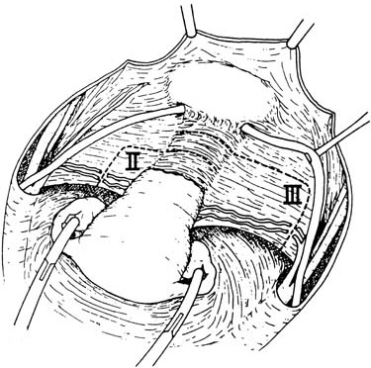
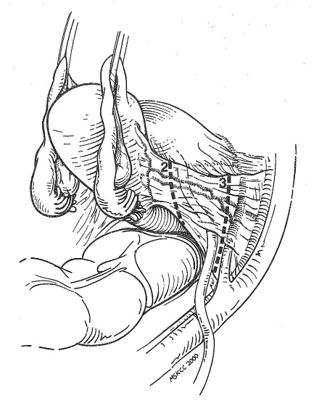
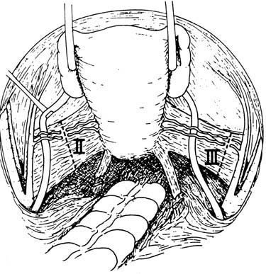
early st. Cacx → standard treatment → Radical hysterectomy + BPLN
Siegel RL, et al. CA Cancer J Clin, 2018.
Cibula D, et al. ESGO / ESTRO / ESP Guidelines, 2018, 2023.
5 year overall survival rates 73 to 98%
Park JY, et al. Ann Oncol, 2011.

Slide 5
- Radical surgery → significant morbidity → 25% of pts
Landoni F, et al. Lancet, 1997
- QoL
Long term bladder dysfunction
Lymphedema
Bowel dysfunction
Sexual dysfunction
Psychological dysfunction
Quality of partner relationship
Huang L, et al. J Obstet Gynaecol, 2022
Brooks RA, et al. Gynecol Oncol, 2009
Sood AK, et al. J Am Coll Surg, 2002
Frumovitz M, et al. J Clin Oncol, 2005
Bergmark K, et al. Int J Gynecol Cancer, 2006
Pieterse Q, et al. Int J Gynecol Cancer, 2006

Slide 6
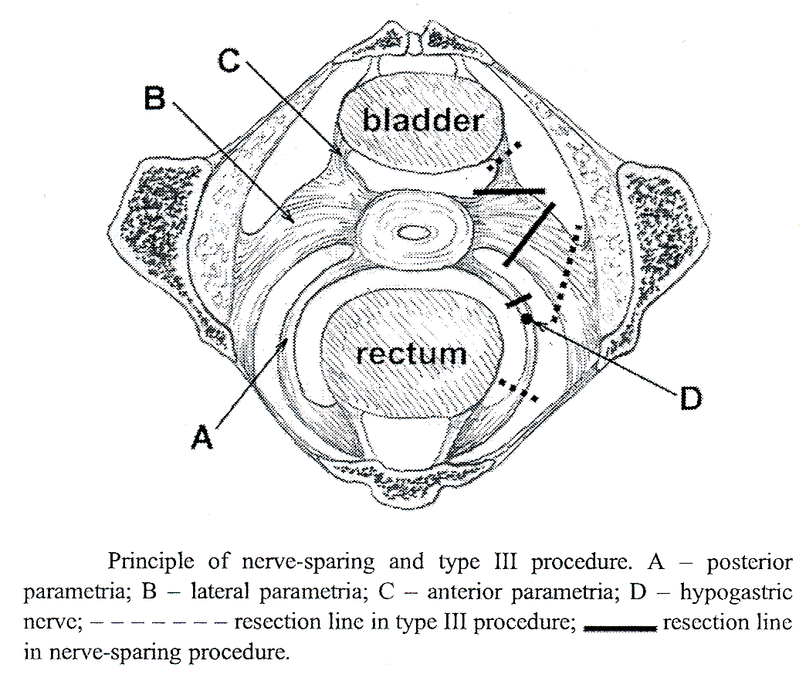
Nerve-sparing RH → it is not clear whether it helps reduce morbidity
Kjetpeerakool et al. Cochrane Syst Rev, 2019

Slide 7
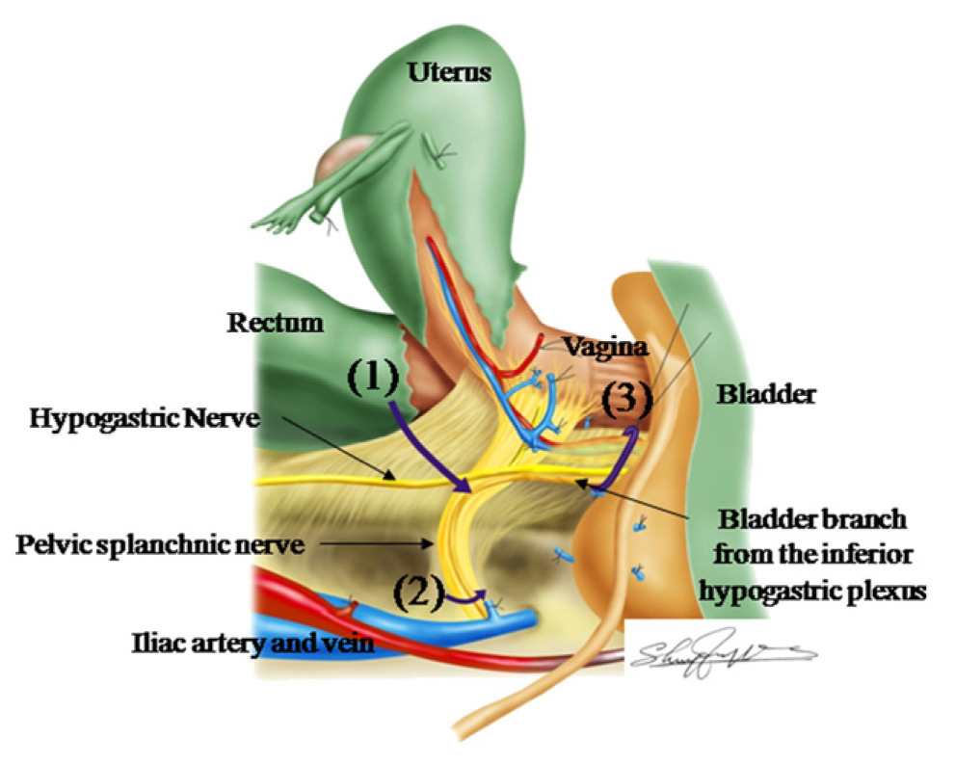
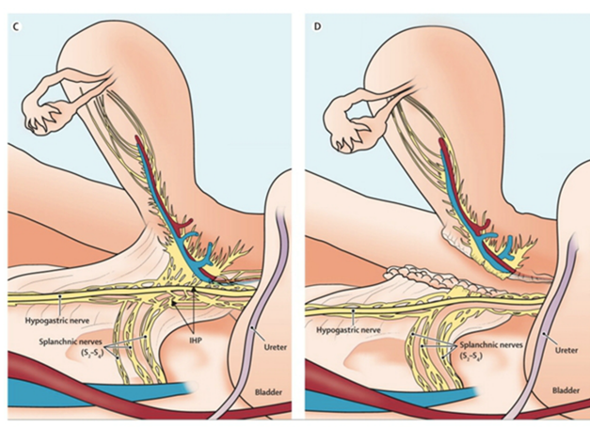
Resection of the parametrial tissues adjacent to the cervix
Critical gastrointestinal / genitourinary autonomic fibers
Sartori E, et al. Int J Gynecol Cancer, 1995
Anatomic identification and functional outcomes of the nerve
sparing Okabayashi radical hysterectomy.
Fuji S. et al, 2007.

Slide 8
Parametrial resection – early Cacx → Controversial
Covens A, et al. Gynecol Oncol, 2002
Tumor size < 2 cm
LVSI
LN(+)
< 1% risk of parametrial spread
Absence
Schmeler ΚΜ et al. Gynecol Oncol, 2011.
Covens A, et al. Gynecol Oncol, 2002.
Stegeman M, et al. Gynecol Oncol, 2007.
Frumovitz M et al. Obstet Gynecol, 2009.
Steed H, et al. Gynecol Oncol, 2006.
Wright JD, et al. Cancer, 2007.
Zigras T, …, Covens A. Curr Oncol Rep, 2017.

Slide 9
OBJECTIVE
Identify a cohort of patients at low risk for parametrial spread who may benefit from less radical surgery.
CONCLUSION
Less radical surgery—such as simple hysterectomy, simple trachelectomy, or conization—with pelvic lymphadenectomy may be a reasonable therapeutic option for women with primary tumors 2 cm or smaller and no lymphovascular space invasion.

Slide 10
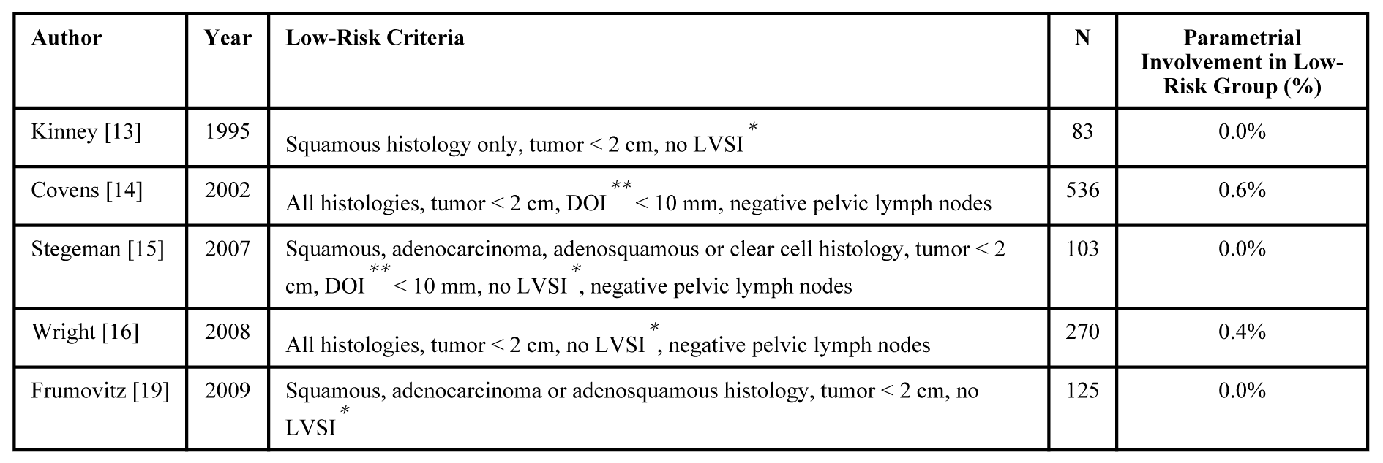
Parametrial involvement rates in women with early cervical cancer with favorable pathologic characteristics
Schmeler ΚΜ et al. Gynecol Oncol, 2011.

Slide 11
Impact of the type of surgery on recurrence and DFS
The extent of parametrectomy had no influence on survival in tumors of 20 mm or less. For larger tumors, a more radical hysterectomy might be associated with better DFS.
Objectives
Define parameters associated with a low risk for parametrial spread
Conclusion
Patients with a tumor depth of invasion of ≤10 mm, no LVSI, and aged ≤50 years, could be considered for less radical surgery such as modified radical hysterectomy or simple hysterectomy with pelvic lymphadenectomy.

Slide 12
Less radical surgery possible in patients with stage IB1 cervical cancer N. Thomakos, D. Zacharakis, D. Louradou, A. Rodolakis, N. Skampardonis,
M. Sotiropoulou, D. Haidopoulos, G. Vlachos, A. Antsaklis
Gynecol Oncol 2013;130(1):e54
Tumor size< 2 cm
DOI < 10mm
LVSI (-)
Parametrial involvement < 0,6%
Covens A, et al. Gynecol Oncol, 2002.
Stegeman M, et al. Gynecol Oncol, 2007.
Steed H, et al. Gynecol Oncol, 2006.
Wright JD, et al. Cancer, 2007.

Slide 13
Decreasing Radicality
Parametrectomy may not be necessary
Incidence of parametrial tumor involvement in selected pts with early CaCx is too low to justify parametrectomy
↓ Importance of parametrectomy in the surgical management of early stage CaCx
Conization
Simple trachelectomy
Covens A, et al. Gynecol Oncol, 2002.
Stegeman M, et al. Gynecol Oncol, 2007.
Frumovitz M et al. Obstet Gynecol, 2009.
Steed H, et al. Gynecol Oncol, 2006.
Wright JD, et al. Cancer, 2007.

Slide 14
Results
5-year PFS and OS was 97.9% and 97.6%, respectively.
Conclusion
Simple trachelectomy/conization and lymph node assessment is an oncologically safe fertility-preserving surgery in well-selected patients with low-risk early-stage cervical cancer (<2 cm).

Slide 15
Up to now RCTs have been performed, showed no difference in recurrence rate or 5-year OS between pts. undergoing SH or RH

Slide 16
Objective
The objective was to determine the role of class I radical hysterectomy compared to class III radical hysterectomy in terms of morbidity, overall survival, DFS and patterns of relapse in patients undergoing primary surgery.
Materials and methods
125 patients with stage IB1 and IIA cervical cancer ≤ 4 cm were randomized between type I and type III hysterectomy
Results
Morbidity rates were higher after class III surgery (84% versus 45%).
Conclusions
No significant differences in terms of both recurrence rate and overall survival among patients with stage IB-IIA cervical cancer undergoing simple extrafascial hysterectomy (class I) or radical hysterectomy (class III).

Slide 17
Design: Prospective cohort study.
Results: SVT (n = 15) or RVT (n = 51), with pelvic lymphadenectomy, for stage IA2 or IB1 cervical cancer.
No recurrences in SVT group (F/U 96 months)
No residual disease in 53% in SVT vs 29% RVT

Slide 18
Similarly prospective cohort studies observed
low number of recurrences following LRS (0 – 6%)

Slide 19
Cervical loop biopsy or simple hysterectomy combined with negative pelvic lymphadenectomy for small-volume stage 1B1 cervical cancer offers excellent prognosis in terms of survival.
Cervical conization stage IB1 cervical cancer
low risk of relapse
Conization would be suitable to treat stage IB lesions smaller than 15-20mm with pathologic negative lymphnodes.

Slide 20
Simple Hysterectomy or Cone Biopsy + LN assessment
Non-radical surgery in appropriately selected early-stage cervical cancer patients results in a low complication rate and excellent oncologic outcomes. This approach seems to be a reasonable option in well-selected patients.

Slide 21
Results
The difference in recurrence rate between the class I and class III groups was not statistically significant (p > 0.05). The 5-year overall survival rate was 93% and 91%, respectively (p > 0.05). There were no significant differences in terms of recurrence rate or overall survival among patients with stage Ia2-Ib1 cervical cancer < 2 cm who underwent class I or radical (class III) hysterectomy. Morbidity was proportional to the extent of radicality.
Conclusions
These data confirm the need for reducing surgical radicality in the treatment of patients with early cervical cancer, by tailoring the extent of resection according to the extent of disease.
Class I hysterectomy oncological safe alternative to Class III radical hysterectomy in treatment of stage IB1 cervical cancer (tumor ≤ 2 cm)

Slide 22
SEER Database, n = 2571 pts
This study assesses survival outcomes of those treated with less radical surgery (LRS; conization, trachelectomy, simple hysterectomy) compared to more radical surgery (MRS; modified radical, radical hysterectomy).
In a select group of young women with stage IB1 cervical cancer, LRS compared to MRS does not appear to compromise DSS.

Slide 23
Conclusion
This meta-analysis suggested there are no significant differences in terms of both recurrence rate and overall survival among patients with stage IA2-IB1 cervical cancer undergoing SH or RH, while the SH group has better surgery-related outcomes. These data confirm the need to narrow the indication for RH in early-stage cervical cancer.

Slide 24
In contrast one retrospective population based study
SH vs RH for women with early-stage cervical cancer.
Although there was no association between surgical radicality and survival for women with stage IA2 tumors, there was a 55% increase in mortality for women with stage IB1 neoplasms who underwent simple compared with radical hysterectomy. Radical hysterectomy is the treatment of choice for women with stage IB1 cervical cancer.

Slide 25
RESULTS
A total of 21 studies were included, of which 3 were randomized control trials, 14 retrospective studies, 2 prospective studies, and 2 population-level data sets. The cohort included 2662 women who underwent simple hysterectomy, of which 36.1% had stage IA2 disease and 61.0% stage IB1 disease.
CONCLUSION
The use of less radical surgery for women with stage IA2 and small volume IB1 cervical cancers appears favorable. However, there is concern that simple hysterectomy in women with stage IB1 tumors may adversely impact survival. Overall, the quality of studies available is modest, limiting the conclusions that can be drawn from the available literature.
A death rate of 5.8% after simple hysterectomy as compared with 4.5% after radical hysterectomy.

Slide 26
Conization CaCx ≥ IA₂
Cold knife cone
LLETZ
Laser conization
Reade CJ et al. Gynecol Oncol, 2013.

Slide 27
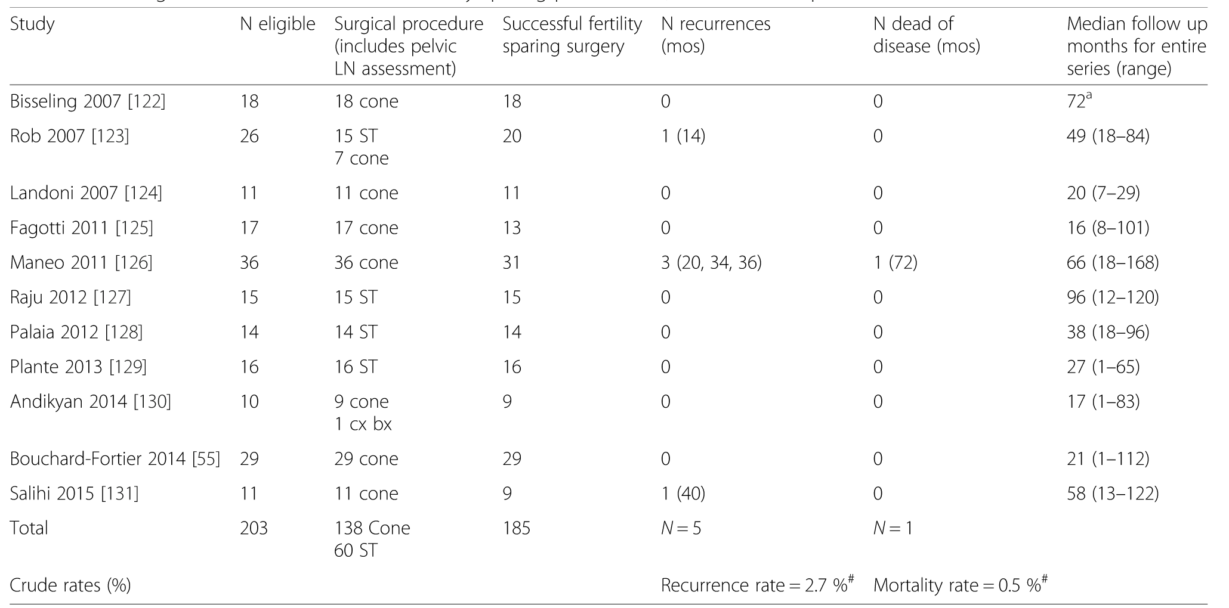
Simple Trachelectomy
Conization
Willows K, Lennox G, Covens A. Gynecol Oncol Res Pract, 2016.

Slide 28
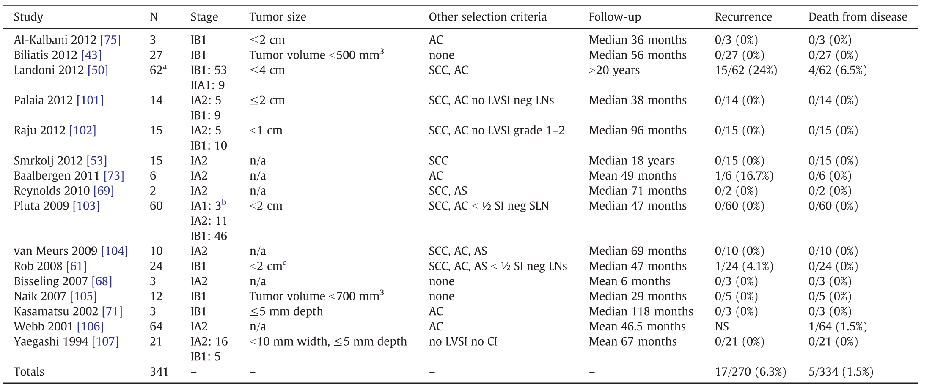
Simple Hysterectomy
Simple Trachelectomy
CaCx ≥ IA₂
Reade CJ et al. Gynecol Oncol, 2013.

Slide 29
ConCerv: A prospective trial of conservative surgery
for low-risk early stage cervical cancer

Slide 30
Int J Gynecol Cancer, 2021
Primary Objective: Safety and feasibility of conservative surgery in early st. CaCx?
Conservative Surgery Options:
Future Fertility Desired: Cone Bx + PLN assessment (SLN or full PLND)
Future Fertility NOT Desired: Simple hyst + (PLN assessment ± SLN biopsy)
Single arm, International Prospective Study
Early Stage IA2-IB1
Low risk :
LVSI (-)
Negative cone margins n =100 < 2cm
< 10 mm DOI

Slide 31
Int J Gynecol Cancer, 2021
Conservative surgery was associated with a 3,5% recurrence rate and a LN (+) rate 5% (LN assessment is required)
Conservative surgery is well tolerated and feasible in specific women with early stage low risk CaCx
Further F/U is needed to determine if the long term oncologic outcomes of conservative surgery are equivalent to radical surgery

Slide 32
SHAPE Trial
Simple Hysterectomy And Pelvic node dissection in Early CaCx
CaCx IA₂, IB₁
≤ 2 cm
DOI < 10mm
n = 700 pts
Assessing the oncologic outcomes of less radical procedures
Large multicenter non-inferiority randomized phase III study comparing
Radical Hysterectomy + LN assessment
vs
Simple Hysterectomy + LN assessment
Plante M. The SHAPE trial.

Slide 33
2.17% RH group
2.52% in SH group
F/u 4.5 years, pelvic recurrence at 3 years was
Patients with low-risk cervical cancer, simple hysterectomy was not inferior to radical hysterectomy with respect to the 3-year incidence of pelvic recurrence
Radical Hysterectomy → Simple Hysterectomy

Slide 34
Int J Gynecol Cancer, 2023
Methods
Randomized phase II non-inferiority trial
Results
F/U 52.1 months
3-year DFS 95% after SH, 100% after modified RH
5-year OS rates were 90% and 91% respectively
Conclusions
Simple hysterectomy is safe and potentially non-inferior to the radical surgery in patients with early-stage cervical cancer ≤2 cm.

Slide 35
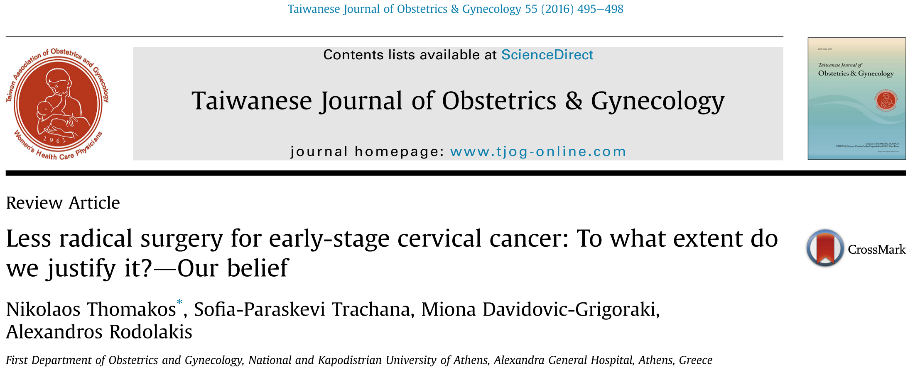

Slide 36
The potential of less radical surgery without parametrectomy. Are we safe?
Ntzeros K, Thomakos N, Papapanagiotou I, Rodolakis A.
J Exp Ther Oncol. 2018 Nov;12(4):261-266

Slide 37
Lymph Node Assessment – Important Prognostic Indicator
Positive lymph node rates of 3-8% despite low risk features
Schmeler KM, et al. Con Cerv, Int J Gynecol Cancer, 2018
Plante M, et al. Int J Gynecol Cancer, 2020
Smith ES, et al. Obstet Gynecol, 2020.

Slide 38
In pts. with tumor size > 2 cm → incidence of LN(+) → 33%
Selection of patients with stage I cervical carcinoma>2cm, eligible for fertility preservation should include histopathologic evaluation of lymph node status before any further treatment.
LN assessment represents an important prognostic indicator

Slide 39
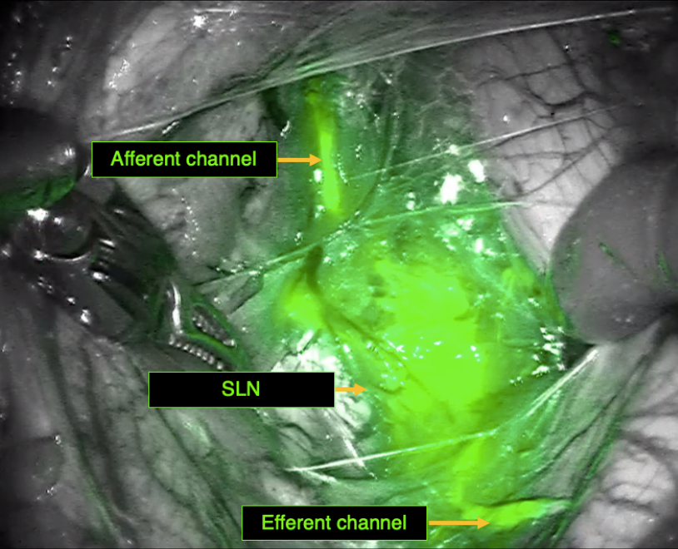
Given the surgical morbidity associated with lymphadenectomy, several studies have investigated the use of SLN biopsy.

Slide 40
Results
67 studies
Pooled detection rate was 89.2%
Pooled sensitivity was 90%
SLN biopsy appears to be a safe and accurate method for LN assessment

Slide 41
Materials and methods
Early cervical carcinoma (FIGO 2009 stage IA2 to IIA1)
SN resection alone (SN arm)
SN and pelvic lymph node dissection (SN + PLND arm).
Results
The 3-year recurrence-free survival was not significantly different (92.0% in SN arm and 94.4% in SN + PLND arm).
Conclusion
SN resection alone is associated with early decreased lymphatic morbidity when compared with SN + PLND in early cervical cancer.

Slide 42
SLN biopsy can achieve high bilateral SLN detection in patients with tumours of 4 cm or smaller.

Slide 43
Ongoing multicenter randomized controlled trial
Primary objective
To comprehensively compare the oncological outcomes of SLN biopsy with pelvic lymphadenectomy in patients with and without SLN metastasis.
Primary endpoint
The primary endpoint is disease-free survival.
Estimated dates for completing accrual and presenting results: As of May 2020, more than 600 eligible patients have been enrolled. Enrollment is expected to be completed by December 2022, and presentation of results is expected in 2026.
Trial design: In each cohort of this trial, patients will be randomized in a 1:1 ratio into the experimental (SLN biopsy alone) or reference (pelvic lymphadenectomy) arm. Radical hysterectomy will be performed for all patients, and adjuvant treatments will be planned according to post-operative pathological factors.
Sample size
Estimated sample sizes of 830 and 250 are required to fulfill the study objectives of PHENIX-I and II, respectively.

Slide 44
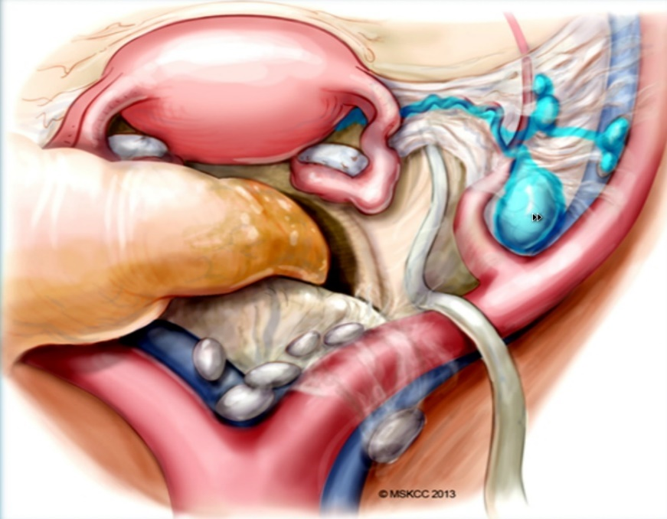
SLN - Ultrastaging
SLN procedure in early stage CaCx may be well tolerated for the detection of LNs “M”

Slide 45
Another important topic on the extent for cervical cancer surgery is the comparison between MI and ARH
Radical Hysterectomy used to be performed by laparotomy but from the 90’s onwards, the laparoscopic approach was introduced.
Less intraoperative bleeding
shorter hospital stay
less morbidity
shorter convalescence period
obvious advantages of laparoscopic in comparison with abdominal hysterectomy.

Slide 46
Laparoscopic surgery is associated with:
Intraoperative morbidity
Intra-op blood loss
Risk of wound infection duration of hospital stay
Improved reconvalescence after surgery

Slide 47
Comparable DFS and OS following Abdominal RH vs MI Rad Hyst

Slide 48
However, the general consensus on safety of MI RH changed dramatically in 2018, when the results of the recently published multicenter randomized LACC trial demonstrated.

Slide 49
CONCLUSIONS
In this trial, minimally invasive radical hysterectomy was associated with lower rates of disease-free survival and overall survival than open abdominal radical hysterectomy among women with early-stage cervical cancer.

Slide 50
N Engl J Med. 2018
CONCLUSIONS
In an epidemiologic study, minimally invasive radical hysterectomy was associated with shorter overall survival than open surgery among women with stage IA2 or IB1 cervical carcinoma.

Slide 51
Higher recurrence rate and worse overall survival with minimally invasive surgery, an open approach should be standard of care.

Slide 52
Recently published meta-analyses demonstrated decreased OS and DFS in pts undergoing MIS RH compared with pts undergoing Abd. RH in early st. Cacx
Int J Gynaecol Obstet. 2022

Slide 53
Chiva L et al, SUCCOR Study Group
A European, multicenter, retrospective, observational cohort study, to evaluate disease-free survival in patients with stage IB1 (FIGO 2009) cervical cancer undergoing open vs minimally invasive radical hysterectomy.
Conclusions
Minimally invasive surgery in cervical cancer increased the risk of relapse and death compared with open surgery. In this study, avoiding the uterine manipulator and using maneuvers to avoid tumor spread at the time of colpotomy in minimally invasive surgery was associated with similar outcomes to open surgery. Further prospective studies are warranted.

Slide 54
Evaluate DFS of cervical conization prior to RH in patients with stage IB1 cervical cancer
Patients who underwent minimally invasive surgery without prior conization had a 5.63 times higher chance of relapse compared with those who had an open approach and previous conization.
Increased DFS of pts undergoing conization prior to RH compared with pts without conization
(conization protective effect with regard to recurrence prior to MIS RH)

Slide 55
Another interesting ongoing trial is the RACC trial
Prospective, multi-institutional, international, open-label randomized clinical trial.
Int J Gynecol Cancer 2019
Investigate the oncologic safety of robot-assisted surgery for early-stage cervical cancer as compared with standard laparotomy.
Primary end point: Recurrence-free survival at 5 years between women who underwent robot-assisted laparoscopic surgery versus laparotomy for early-stage cervical cancer.
Trial launch is estimated to be May 2019 and the trial is estimated to close in May 2027 with presentation of data shortly thereafter.

Slide 56
Conclusions
Radical Surgery → standard of care for early stage Cacx
In carefully selected pts → non-radical surgery → without sacrificing oncologic outcomes
tumors ≤ 2 cm
low risk histology
LVSI (-)
risk of parametrial invasion very low
Less radical surgery – is promising
Several unanswered questions

Slide 57
LACC trial → further study may shed more light on the oncologic safety of MIS
Various trials (prospective and RCTs) are ongoing →
→ results will further determine the safety and feasibility of new surgical treatments in early stage Cacx
3. Oncological safety (DFS) of SLN biopsy vs pelvic lymphadenectomy
(PHENIX trial)
4. Neoadjuvant chemotherapy prior to surgery – as a way to offer
fertility-sparing treatment with tumors 2-3 cm (CONTESSA trial)

Slide 58
Evaluation of Physical Function and Quality of Life (QOL) Before and After Non-Radical Surgical Therapy (Extra Fascial Hysterectomy or Cone Biopsy with Pelvic Lymphadenectomy) for Stage IA1 (LVSI+) and IA2-IB1 (≤ 2 cm) Cervical Cancer
CaCx IA₁, LVSI +
IA₂ , IB₁ ≤ 2 cm
SCC, adenoCa,
Adenosquamous
Any grade
DOI < 10mm
Large prospective Cohort Study
Extrafascial hysterectomy
or
Cone biopsy + pelvic lymphadenectomy
(impact of non-radical surgery on bladder, bowel, sexual function, lymphedema)
Secondary objectives : site of recurrence, OS, RFS
Covens A, GOG Protocol 278.

Slide 59
Evaluation of Physical Function and Quality of Life (QOL) Before and After Non-Radical Surgical Therapy (Extra Fascial Hysterectomy or Cone Biopsy with Pelvic Lymphadenectomy) for Stage IA1 (LVSI+) and IA2-IB1 (≤ 2 cm) Cervical Cancer
If non-radical surgery for early-stage cervical cancer can offer a safe and effective treatment, it can change clinical care guidelines
Non-radical surgery for early-stage cervical cancer was associated with small decreases in sexual function and bladder/bowel function at 4–6 weeks postoperative but quickly improved to baseline after 6 months
An improvement in QoL and decreased cancer worry postoperatively was also seen.
A lymphedema diagnosis with a GCLQ score change ≥4 was uncommon and equal in both groups
Gynecologic Oncology, vol. 190, Suppl 1, Nov. 2024.

Slide 60
ΕRA OF PERSONALIZED SURGERY
Low risk Cacx
Time to change → Less radical surgery
Parametrectomy not necessary
Thomakos N, et al. Controversies and advances in the Personalized Surgical Treatment of cervical cancer. J Pers Med, 2024

Slide 61
Welcome to Athens!!
Thank you!

Slide 62
Tumor-free distance (TFD)
The minimum distance of uninvolved stroma between the tumor and the pericervical ring
Καλύτερη πρόβλεψη της διήθησης του παραμητρίου

Slide 63
Br J Cancer, 2021
The best predictive model for the whole cohort entailed a combination of tumour-free distance (TFD) ≤ 3.5 mm and LN positivity.
ΤFD ≤ 3,5mm → ανεξάρτητος προγνωστικός παράγοντας για υποτροπή
Inverse relationship between TFD and presents of LN + suggesting its implementation for recurrence risk stratification and primary treatment triage
Kaplan–Meier recurrence-free survival (RFS) curve for Model 2 in the whole cohort.

Slide 64
0% of women with tumor size ≤ 2 cm
LVSI (-)
had parametrial involvement
0,7% of pts. had a (+)LN with negative parametrius

Slide 65
st. IA2 – IB1
Ριζική υστερεκτομή / Ριζική τραχηλεκτομή
Κωνοειδής εκτομή
Απλή υστερεκτομή
60% Ριζική Τραχηλεκτομή → χωρίς υπολειπόμενη νόσο
Λιγότερο Ριζικό χ/ο ?
Schmeler ΚΜ et al. Gynecol Oncol, 2011.

Slide 66
St IA2 – IB1, Cacx
low risk <10 mm invasion on diagnostic path
≤ 2 cm
Radical Hysterectomy + BPLND
vs
Simple Hysterectomy + BPLND
Assessing the oncologic outcomes of less radical procedures

Slide 67
F/u 4.5 years, pelvic recurrence at 3 years was 2.17% RH group
2.52% in SH group
Patients with low-risk cervical cancer, simple hysterectomy was not inferior to radical hysterectomy with respect to the 3-year incidence of pelvic recurrence
Ριζική Υστερεκτομή → Απλή Υστερεκτομή

Slide 68
NCCN also recommends consideration of SLN mapping at the time of surgery for early stage Cacx
Cervical Cancer, NCCN, 2021

Slide 69
Ριζική Υστερεκτομή
Aυτόνομη νεύρωση πυέλου
Anatomic identification and functional outcomes of the nerve
sparing Okabayashi radical hysterectomy.
Fuji S. et al.

Slide 70
Aim
To determine the efficacy of class I radical hysterectomy compared with class III radical hysterectomy in terms of morbidity, overall survival, and patterns of relapse in patients with Ia2-Ib1 cervical cancer undergoing primary surgery.
Results
The difference in recurrence rate between the class I and class III groups was not statistically significant (p > 0.05). The 5-year overall survival rate was 93% and 91%, respectively (p > 0.05).
Conclusions
Need for reducing surgical radicality in the treatment of patients with early cervical cancer, by tailoring the extent of resection according to the extent of disease.

Slide 71
SHAPE trial → did not clearly specify the extent of parametrectomy in RH
→ RH + Tailored parametrectomy (to reduce morbidity)
(extent of parametrectomy adjusted considering the size and DOI)

Slide 72
Cone biopsy: Excision of a cone -or wedge- shaped piece of the uterine cervix including the transformation zone
Simple Trachelectomy
Removal of the uterine cervix without parametrial resection (difference from conization is a matter of degree of excision)
Conization
Simple trachelectomy
Cibula D, et al, 2023.

Slide 73
Whether a simple hysterectomy – parametrium is not removed
alternative treatment for tumors ≤ 2 cm

Slide 74
Comparing LRS with RH comparable DFS, OS rates

Slide 75
50 studies
MIS RH was associated with worse PFS than open RH for early-stage cervical cancer.

Slide 76
Collaborative, international retrospective study (International Radical Trachelectomy Assessment Study) of patients treated during 2005-2017 at 18 centers in 12 countries.
646 patients, 358 underwent open surgery, and 288 underwent minimally invasive surgery.
The 4.5-year disease-free survival rates did not differ between open radical trachelectomy and minimally invasive radical trachelectomy.

Slide 77
Parametrial resection – early Cacx → Controversial
Covens A, et al. Gynecol Oncol, 2002

Slide 78
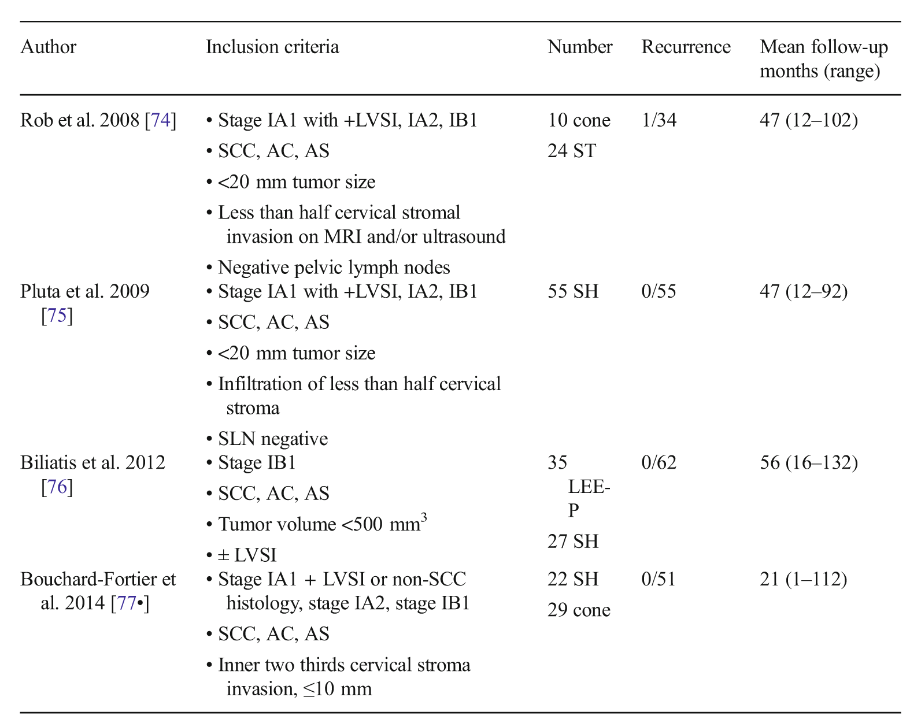
Less Radical Surgery
Prospective studies
Zigras T, …, Covens A. Curr Oncol Rep, 2017.

Slide 79
Question
Development of models for less radical surgery with the aim of reducing morbidity and improve QoL

Slide 80
Low risk Cacx
Time to change surgery → Simple Hysterectomy
If parametrectomy is omitted → ? Decrease in survival rate?
Low risk disease – Difficult / inaccurate to dx low risk disease before surgery (LVSI, DOI)

Slide 81
Low Risk Cervical Cancer
(↓ surgical radicality)
Prospective study
St IB CaCx
n = 210 pts
Werheim’s vs Te Linde hyst
* limitations / criticism
randomization was not performed / alternative matter
many pts underwent adjustment treatment
Similar recurrence
and survival rates

