Slide 1


Genetic testing and counselling for EOCs
Dr: Sarah Alrubaish
Consultant Gynecology Oncology
Dr-suliman Alhabib Hospital –AL-KHOBER
KSA

Slide 2
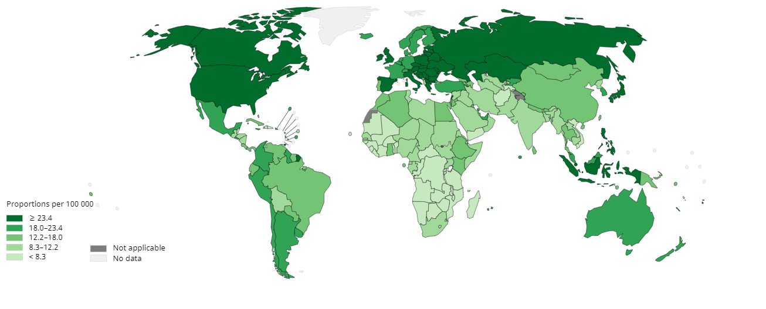
Epidemiology of ovarian cancer
Ovarian cancer is the eighth most common cancer amongst females worldwide, affecting over 295,000 women a year^{1,2}
Estimated number of new cases in 2018, females, all ages¹
Estimated number of prevalent cases (5-year) as a proportion in 2018, all ages¹
Notes:
This slide highlights the global epidemiology of ovarian cancer, showing its significant burden among women worldwide.""Ovarian cancer is the eighth most common cancer in females, affecting over 295,000 women annually, as shown here in the pie chart.
we see that ovarian cancer accounts for approximately 3.4% of all female cancer cases, significantly lower than breast cancer, which is the most common at 24.2%."However, what makes ovarian cancer particularly concerning is not just its incidence but its high mortality rate, as it is often diagnosed at advanced stages.”
Regions with higher prevalence, such as Eastern Europe and parts of Asia, may reflect late diagnoses or population-specific risk factors.""In contrast, regions with lighter colors may indicate underreporting or lower access to diagnostic services.”
such as those with genetic predispositions like BRCA mutations."
"Finally, this underscores the urgent need for improved awareness, genetic testing, and personalized treatment strategies, especially in high-prevalence regions."

Slide 3
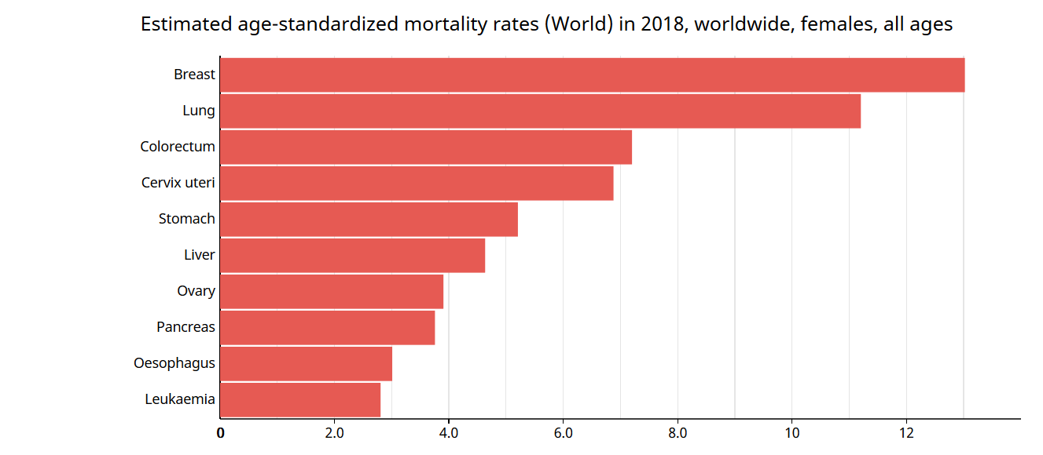

Ovarian cancer is one of the leading causes of cancer mortality amongst women
Ovarian cancer has the seventh highest rate of mortality and the eighth highest number of cancer-related deaths worldwide^{1,2}
Estimated 2018 age-standardised mortality rates per 100,000, all ages^{1,2}
The age-standardised incidence rate of OC worldwide in 2018 was
6.6 per 100,000 patient years²
184,799 deaths worldwide in 2018^{1,2}
Notes:
Ovarian cancer ranks as the seventh leading cause of cancer mortality worldwide and accounts for over 184,799 deaths annually, as indicated by the 2018 data."Why does ovarian cancer, with a relatively lower incidence, rank so high in mortality? The answer lies in late-stage diagnoses."These numbers remind us why early genetic evaluation and personalized therapies are vital."

Slide 4
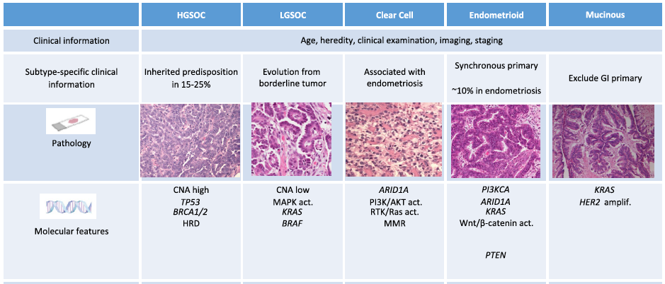
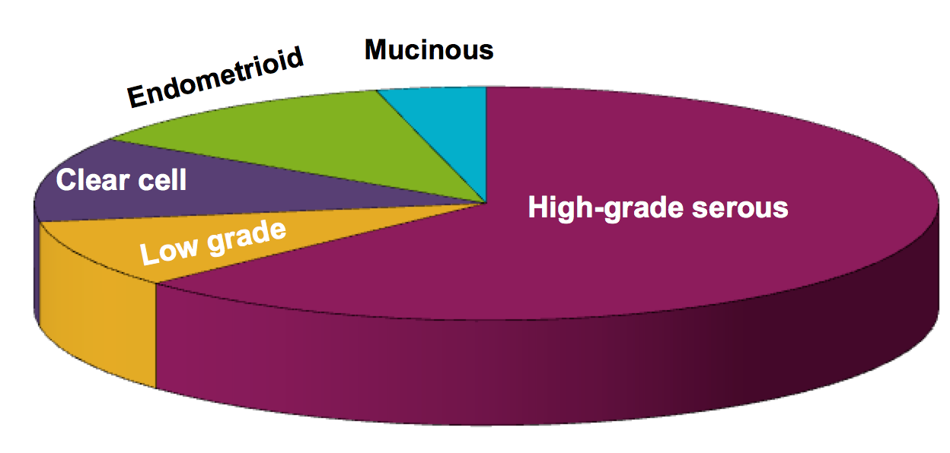
Subtypes of ovarian cancer
Soslow. Int J Gynecol Pathol 27:161-174 (2008)
McCluggage. Pathology 43: 420-32( 2011)
Notes:
Ovarian cancer is not a single disease but rather a group of distinct subtypes, each with unique features and implications for treatment."HGSOC, classified as a Type II tumor, is associated with mutations in BRCA1/2 and p53, as well as homologous recombination deficiencies (HRD).""It is often diagnosed at an advanced stage and linked to hereditary predispositions in 15%-25% of cases."
LGSOC:
"LGSOC evolves from borderline tumors and has distinct features like mutations in the RAS and BRAF pathways."
Clear Cell:
"Clear cell carcinoma often arises in the context of endometriosis and is associated with ARID1A mutations."
Endometrioid:
"Similar to clear cell, endometrioid cancers can also be linked to endometriosis and show mutations in PIK3CA and ARID1A."
Mucinous:
"Mucinous tumors are distinct in origin and exhibit KRAS mutations.”
In summary, ovarian cancer is a heterogeneous disease with distinct clinical and molecular profiles. By understanding these subtypes, we can tailor treatment strategies and improve patient survival."

Slide 5
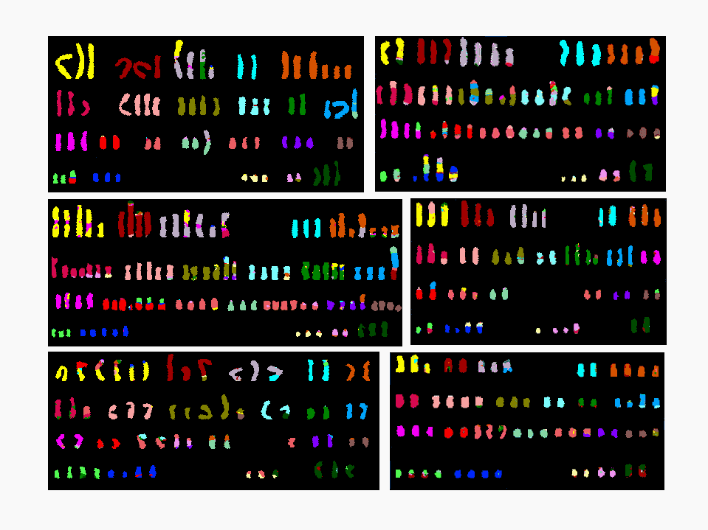
Genetic Disorder in High Grade Ovarian Cancer
Why do these mutations matter clinically?
A
B
Cancer Genome Atlas
Mutations in High Grade serous Ovarian Cancer
1 2 3 4 5
6 7 8 9 10 11
6 7 8 9 10 11
12 13 14 15 16 17 18
12 13 14 15 16 17 18
19 20 21 22 X
19 20 21 22 X
C
D
1 2 3 4 5
1 2 3 4 5
P53 and nine others, including:
NF1, BRCA1, BRCA2, RB1……..
6 7 8 9 10 11
6 7 8 9 10 11 12
12 13 14 15 16 17 18
13 14 15 16 17 18
19 20 21 22 X
19 20 21 22 X
E
1 2 3 4 5
1 2 3 4 5
F
6 7 8 9 10 11
6 7 8 9 10 11
12 13 14 15 16 17 18
12 13 14 15 16 17 18
19 20 21 22 X
19 20 21 22 X
Bell et al Nature 2011
Notes:
ocuses on the genetic alterations in high-grade serous ovarian cancer (HGSOC), which is the most common and aggressive subtype of ovarian cancer."
"HGSOC is characterized by extensive genomic instability, as shown in the images on the left, and mutations in key tumor suppressor genes and oncogenes."
his chromosomal instability is a hallmark of HGSOC and contributes to tumor progression and therapeutic resistance."high-grade serous ovarian cancer is driven by mutations in multiple genes, including p53, which is mutated in over 96% of cases.""Other significant mutations include genes involved in DNA repair and tumor suppression, such as BRCA1, BRCA2, NF1, and RB1.""BRCA1/2 mutations are particularly important as they lead to homologous recombination deficiency (HRD), which increases sensitivity to platinum-based chemotherapy and PARP inhibitors."
ear-universal presence of p53 mutations makes it a defining feature of HGSOC. These mutations disrupt cell cycle control and allow unchecked tumor growth."
BRCA1/2 and HRD:"Mutations in BRCA1/2 impair DNA repair, creating a vulnerability that can be exploited therapeutically with PARP inhibitors."
"HRD-positive tumors, including those with non-BRCA HRD mutations, also show better responses to DNA-damaging agents."
Other Mutations:"Mutations in NF1 and RB1 further disrupt cell signaling and tumor suppression, contributing to the aggressive nature of HGSOC

Slide 6
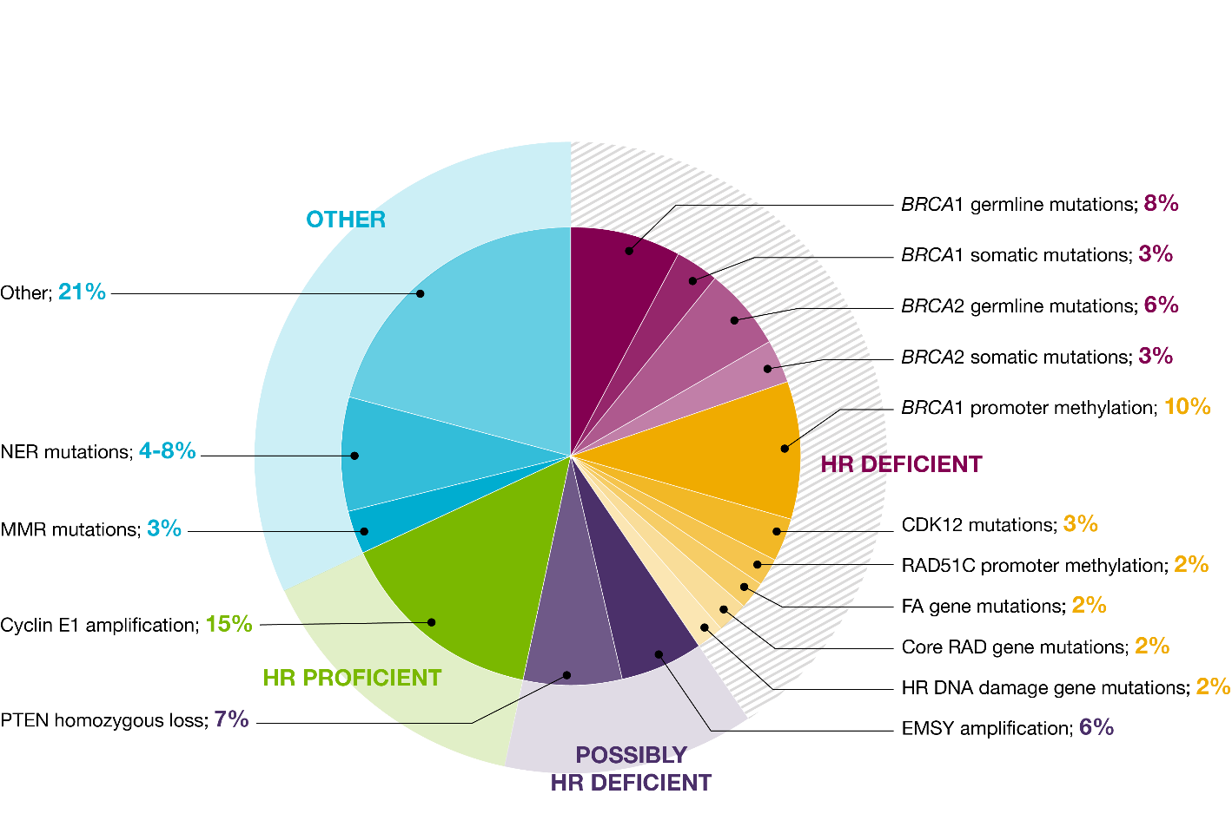
Biomarkers ovarian cancer
Notes:
Approximately 50% of high grade serous EOC have alterations in HR repair genes and the numbers to the right represent the frequency of genetic and epigenetic changes involving HR pathway genes.
BRCA1 and 2 mutations of course are found in a large number of ovarian cancers but also other genes that are involved in the homologous recombination.
These defects can be identified using different clinical and molecular biomarkers and the gene mutations are those detected by gene panel-based approaches
This category includes genes with indirect or partial contributions to HRR impairment, such as:
NER mutations (4%-8%), which affect nucleotide excision repair.
MMR mutations (3%), involved in mismatch repair.”
Approximately 15% of cases show Cyclin E1 amplification, while 7% involve PTEN homozygous loss, indicating intact HRR pathways but alternative drivers of cancer progression."
Why is this classification important? Because it directly influences how we treat ovarian cancer."

Slide 7

Germline vs Somatic Mutations
Germline mutation
Somatic mutation
Parental gametes
Parental gametes
Embryo
Embryo
Entire organism carries mutation
Mutation only in affected area
©Medscape, LLC
©Medscape, LLC
Half of gametes carry mutation
No gametes carry mutation
Organism
Offspring gametes
Organism
Offspring gametes
Germline mutations are inherited and found in all cells
Somatic mutations are not inherited and are found within the tumor

Slide 8






Blood testing identifies only germline BRCAm patients, whereas tumour testing identifies both somatic and germline
Normal BRCA gene
BRCA mutated gene
Blood testing
(germline)
BRCAm detected
BRCAm NOT detected
Cancer patient (germline BRCA in origin)
Cancer patient (somatic BRCA in origin)
BRCAm detected
BRCAm detected
Tumour testing
(somatic & germline)
A tumour test in isolation cannot definitively determine whether a mutation is somatic or germline in origin
BRCA = BReast CAncer gene 1 (BRCA1) and/or 2 (BRCA2); BRCAm = BRCA mutation.
1. Endris V et al. Virchows Arch. 2016;468:697-705. 2. Capoluongo E et al. Semin Oncol. 2017;44:187-197.
Notes:
Blood Testing:
"Blood testing detects only germline BRCA mutations."
"A negative result does not rule out the presence of somatic BRCA mutations, which may still influence treatment."
Tumor Testing:
"Tumor testing can identify both somatic and germline BRCA mutations."
"However, tumor testing alone cannot differentiate whether a mutation is inherited or acquired, requiring further confirmation via blood testing if a mutation is found."

Slide 9

Gene Testing
HRD genomic instability test (includes BRCA)
≈50% of women
Effect
Tumour sample
Cause
HRRm gene panel test
(includes BRCA)
≈35% of women
Cause
Tumor BRCA testª
≈22% of women
Blood sample
Cause
Germline BRCA test
≈15% of women
Approximate percent (%) of women “positive” by testing modality
ªTumor testing can detect both germline and somatic BRCA mutations but cannot distinguish between them.³
BRCA=breast cancer susceptibility gene; HRD=homologous recombination deficiency; HRRm=homologous recombination repair mutation.
1. Konstantinopoulos PA, et al. Cancer Discov. 2015;5(11):1137-1154. 2. da Cunha Colombo Bonadio RR, et al. Clinics (Sao Paulo). 2018;73(suppl 1):e450s. 3. Capoluongo E, et al. Semin Oncol. 2017;44(3):187-197.
Notes:
Tumor Testing:"Approximately 50% of women with ovarian cancer have HRD positivity, detected through genomic instability tests like LOH, TAI, or LST, which include BRCA."
"About 35% of women are identified as HRR-mutated via gene panel testing, and 22% test positive for BRCA mutations in tumor samples."
Blood Testing:"Around 15% of women have germline BRCA mutations, detectable through blood testing."
"This lower percentage underscores the importance of tumor testing for somatic mutations that blood tests cannot identify."

Slide 10
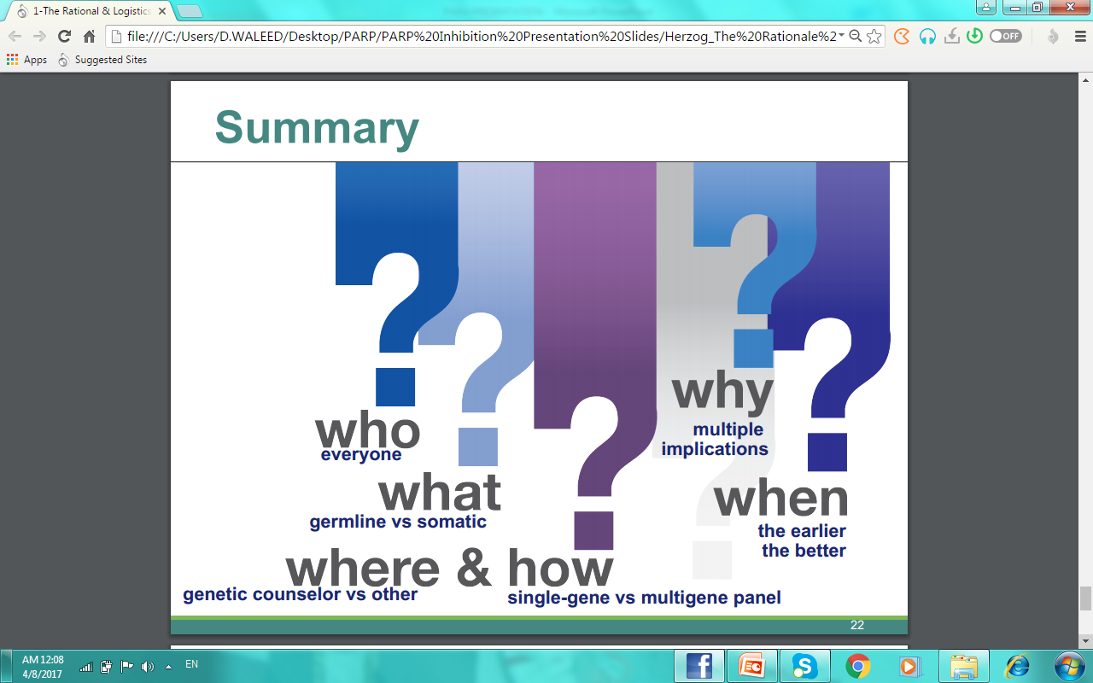
Notes:
Explanation of Each Question:
Who:
"Genetic testing is recommended for all women diagnosed with ovarian cancer, regardless of family history, as mutations can occur even in the absence of a known hereditary link."
What:
"Testing focuses on distinguishing between germline mutations, inherited and present in all cells, versus somatic mutations, which are acquired and confined to tumors."
Where:
"Genetic testing should be conducted in collaboration with a genetic counselor or a qualified healthcare provider to ensure proper interpretation and care."
When:
"The earlier, the better—testing should ideally occur at the time of diagnosis or before starting treatment to guide therapeutic decisions."
Why:
"Identifying mutations has multiple implications, including prognosis, treatment selection, and familial risk assessment."
How:
"Testing can range from single-gene tests like BRCA1/2 to broader multigene panels, which also assess other DNA repair genes."
Closing Statement:
"This framework ensures a comprehensive approach to genetic testing, maximizing its impact on patient outcomes and family risk management."

Slide 11




Genetic Testing in Ovarian Cancer: Who Should Be Tested?
Genetic counseling and testing should be considered in women with a history of ovarian carcinoma, fallopian tube cancer, or primary peritoneal cancer¹
Women diagnosed with epithelial ovarian, tubal, and peritoneal cancers should receive genetic counseling and be offered genetic testing, even in the absence of family history²
Genetic counseling and
testing should be considered in women with epithelial ovarian, fallopian tube, or primary peritoneal cancer even in the absence of family history³
Patients with high-grade tumors should be tested for a germline BRCA mutation.
Consideration should be given to testing tumors for a somatic BRCA mutation⁴
Leading oncology societies recommend testing ALL women with ovarian cancer
1. NCCN Clinical Practice Guidelines: Genetic/Familial High-Risk Assessment (v1.2021). 2. SGO Clinical Practice Guidelines: Genetic testing for ovarian cancer. 2014. 3. ASCO Genetics Toolkit. 2021. 4. ESMO Newly Diagnosed and Relapsed Epithelial Ovarian Carcinoma Treatment Recommendations. 2020.
Notes:
How can these guidelines improve care? By ensuring no patient is missed and precision therapies are widely accessible."

Slide 12
BRCA Mutations: Basic Concepts
Germline BRCA mutations
Germline non-BRCA mutations in HR pathway proteins
Mutations in HR pathway
↓
HR deficiency
Sporadic (somatic) BRCA mutations
Sporadic non-BRCA mutations in HR pathway proteins
Notes:
his slide explains the basic concepts of BRCA mutations and how they relate to homologous recombination (HR) deficiency."
"BRCA mutations are a key driver of genomic instability in ovarian and other cancers."
2. Key Explanation:
Germline BRCA Mutations:
"Inherited mutations in BRCA1 or BRCA2, present in all cells, significantly increase the risk of ovarian and breast cancer."
Germline Non-BRCA Mutations:
"Inherited mutations in other HR pathway genes, such as RAD51 or CDK12, can also lead to HR deficiency."
Sporadic (Somatic) BRCA Mutations:
"Acquired mutations found only in tumor cells also contribute to defective DNA repair mechanisms."
Sporadic Non-BRCA Mutations:
"Somatic mutations in non-BRCA HR-related genes add another layer of complexity in understanding HR deficiency."
3. Clinical Relevance:
"Together, these mutations contribute to HR deficiency, making tumors more sensitive to therapies like PARP inhibitors that exploit DNA repair vulnerabilities."
4. Takeaway:
"Understanding the different types of BRCA and HR pathway mutations helps guide therapeutic decisions and genetic counseling for both patients and their families."

Slide 13
cancer specific cell death in tumours with homologous recombination deficiencies (HRD)
PARP inhibitor
Increase in double-strand breaks in replicating cells
Trapped PARP on single-strand breaks
Double-strand breaks
Normal cell
Cancer cell with HRD
DNA repair proteins
DNA double-strand break persists
NHEJ
MMEJ
DNA double-strand break repair
High-fidelity DNA repair
Genomic instability, cell death
Error-prone DNA repair,
genomic instability,
cell death
Error-prone DNA repair,
genomic instability,
cell death
DNA, deoxyribonucleic acid; HRD, homologous recombination deficiency; MMEJ, microhomology-mediated end joining; NHEJ, non-homologous end joining; PARP, poly (ADP-ribose) polymerase
¹O'Connor MJ. Mol Cell 2015;60:547–560; Konecny GE, et al. Br J Cancer 2016;115:1157–1173
Notes:
Normal Cells:"In normal cells, double-strand DNA breaks are repaired efficiently by HR, preventing genomic instability."
"When PARP inhibitors are introduced, DNA repair proteins still ensure high-fidelity repair."
When homologous recombination (HR), the high-fidelity DNA repair pathway, is non-functional (as in HR-deficient cancer cells), the cell is forced to rely on error-prone repair mechanisms, which are less precise and lead to genomic instability. These mechanisms include:
1. Non-Homologous End Joining (NHEJ)
Process:
NHEJ directly joins the broken ends of DNA without requiring a homologous template.
This process is quick but lacks the accuracy of HR, often resulting in small insertions or deletions at the repair site.
Consequences:
NHEJ introduces mutations at the site of the DNA break, contributing to genomic instability.
Accumulation of errors can disrupt critical genes or regulatory elements, accelerating tumor progression.
2. Microhomology-Mediated End Joining (MMEJ)
Process:
MMEJ uses short homologous DNA sequences (microhomologies) near the break site to guide repair.
This process is a backup mechanism activated when both HR and NHEJ are compromised.
Consequences:
MMEJ frequently causes large deletions and rearrangements, further increasing genomic instability.
These alterations can drive oncogenesis or make cells more vulnerable to DNA-damaging therapies.
Why These Pathways Are Important in HRD Contexts
Cancer cells with homologous recombination deficiency (HRD) lack the ability to perform accurate DNA repair via HR.
They become dependent on NHEJ and MMEJ, which leads to:
Accumulation of mutations.
Widespread chromosomal instability.
A tipping point where the cell cannot survive, especially when treated with PARP inhibitors.
Clinical Implications
Therapeutic Targeting:
By blocking PARP with inhibitors, single-strand breaks (SSBs) are converted to double-strand breaks (DSBs) during replication.
In HRD cells, the reliance on NHEJ and MMEJ to repair these DSBs results in catastrophic genomic instability and cell death.
Selectivity:
This approach spares normal cells, which retain functional HR repair mechanisms, making PARP inhibitors both effective and safe for HRD-positive cancers.
How HRP Cells Handle PARP Inhibition
Homologous Recombination Repair (HRR):
HRP cells have intact HRR, allowing them to repair double-strand breaks (DSBs) effectively.
When SSBs persist due to PARP inhibition, they are converted into DSBs during replication.
HRP cells use the high-fidelity HR pathway to repair these DSBs, maintaining genomic stability.
Clinical Implications
Reduced Effectiveness:
PARP inhibitors are not typically effective as monotherapy in HRP tumors.
Combining PARP inhibitors with other treatments, such as radiation or chemotherapy, can increase DNA damage beyond the HRR capacity of HRP cells, leading to cell death.
Therapeutic Resistance:
Tumors initially responsive to PARP inhibitors (e.g., HRD tumors) can develop resistance by restoring HRR functionality, effectively converting into an HRP phenotype.

Slide 14
DNA double stranded breaks are typically repaired by homologous recombination repair (HRR)
DSB
p53
Cell cycle
Checkpoints
NBS1
ATM
CHK2
Detection
Rad50
HRR is:
Slow
Specific
Accurate
BRCA1
BARD1
5’ to 3’ resection
Mre11
Rad52
RPA
ATR
MDC1
yH2AX
Strand invasion
BRCA2
PALB2
Rad51
Branch migration and
new DNA synthesis
FANC
Rad54
Polymerases
Holliday junction resolution
Resolvases
No crossing over
Crossing-over of
flanking markers
Notes:
The Homologous recombination repair pathway as shown here utilizes an intricate array of proteins –
Repair of a DNA double-strand break by homologous recombination takes place by means of replication, using the homologous strand as template (see Figure 1). Homologous recombination therefore requires extensive regions of DNA homology in another DNA duplex, and no loss of genetic information normally results. And for these reasons, homologous recombination repair is considered to be slow but also highly specific and accurate.
Process of HRR:
"HRR is a slow, specific, and accurate process, as outlined in the diagram."
Detection: Double-strand breaks (DSBs) are detected by proteins like NBS1 and MRE11.
Resection: DNA ends are resected to create single-stranded overhangs.
Strand Invasion: RAD51 facilitates the invasion of the single-stranded DNA into a homologous template.
Branch Migration and New DNA Synthesis: This step rebuilds the damaged region.
Holliday Junction Resolution: The repair can occur with or without crossing over of DNA strands.
3. Clinical Relevance:
"Mutations in key HRR proteins, such as BRCA1/2, impair this process, leading to homologous recombination deficiency (HRD), which is central to many cancers."

Slide 15
Non-homologous end-joining (NHEJ) repairs double-strand DNA breaks if HRR is non-functional but this is error-prone
Core mechanism
Stress
NHEJ is:
Fast
Universal
Error-prone
NHEJ results in genomic instability
Double-strand break
Ku
DNA-PKcs
End binding
P
P
End processing
Artemis
Ligation and fill-in
More rounds of end processing and ligation
Pol µ
DNA ligase IV
XRCC4:XLF
Repaired DSB
Frequent microhomology
Variable extent of deletion
Junctional nucleotides added
Notes:
In contrast to homologous recombination, nonhomologous end joining requires no homology with a second DNA duplex and no, or only a few base pairs of, homology between the two broken DNA ends. Therefore, non-homologous end-joining is considered to be fast, universal but also error-prone.
When homologous recombination repair as shown in the previous slide is defective, as a result on muations in BRCA1 or BRCA2 for instance, the cells becomes more reliant on NHEJ, which is
It is this inefficiency in accurately correcting double-stranded breaks that leads to genomic instability.
We discussed DNA damage and the response pathways to address such damage, now let’s look at the mutational status of these genes in cancer.
Outcomes:
"NHEJ often introduces small insertions or deletions, leading to loss of genetic information or mutations."
3. Clinical Implications:
"In cancers with HRD, NHEJ is the only available repair mechanism, making these cells more susceptible to further genomic instability and targeted therapies like PARP inhibitors."

Slide 16
There are several types of biomarkers that measure homologous recombination repair deficiency
HRR Gene Panel
HRD Genomic Scar
Look for the Cause of HRR deficiency
What genomic changes can cause defects in the homologous recombination repair pathway?
Assess the cause of HRR deficiency by looking for loss of function of key HRR genes
Look for the Effect of HRR deficiency
What is the result in the genome of defects in the homologous recombination repair pathway?
Identify the consequences of HRR deficiency by looking for patterns of genomic damage
Causes
Promoter
Methylation*
Effects
Genetic
Mutation
HRR
Deficiency
Inability to
repair DNA
Genome
Instability
Genomic
Scars
Undetermined
Causes*
Notes:
Biomarkers That Measure Homologous Recombination Repair Deficiency can be classified into main categories looking at either the cause or the effect/
For example, assays that look for the causes of the HRR deficiency (shown on the left), typically utilize gene panels to look for mutations in specific HRR genes for examples. But there are other causes of HRR deficiency such as promoter methylation or undetermined causes, which together lead to an inability to repair DNA. The effect, which is of defects in DNA repair result in shown on the right hand side. In general, assays that measure the effect of HRR deficiency are so called genomic scar tests that identify the consequences of HRR deficiency by looking for patterns of genomic damage
Two Types of Biomarkers:
HRR Gene Panel (Cause):
"Identifies genetic mutations or promoter methylation that cause HRD, such as BRCA1/2, ATM, and RAD51."
HRD Genomic Scar (Effect):
"Assesses the consequences of HRD by measuring genomic instability patterns like LOH, TAI, and LST."
2. Relevance:
"Both tests are complementary—gene panels identify the underlying defect, while genomic scars measure its functional impact."

Slide 17
BRCA testing is a core measure in both HRR and HRD approaches
HRR Gene Panel
HRD Genomic Scar
Genomic scar assays may not detect all BRCAm cases
Consequently, HRD genomic scar tests often measure both BRCA status and genomic scar status
(e.g. AZ 15 gene panel)
ATM
CDK12
PALB2
etc.
BRCA1
BRCA2
Genomic scar measure
  HRD positive = BRCAm and/or genomic scar score above threshold (cut-off)
Notes:
HRD-associated genomic instability can occur in non-BRCA1/2 mutated tumours, and conversely, not all BRCA mutations are associated with high levels of genomic instability. Genomic scar assays may not detect all BRCAm cases. As mutations in BRCA1/2 are the archetypal basis for HRD and genomic instability. For this reason, tumours harbouring deleterious BRCA1/2 mutations are automatically considered as being HRD positive.
Consequently, HRD genomic scar tests often measure both BRCA status and genomic scar status and use below ‘algorithm’ to determine HRD positive
Therefore, as we will see in for the Myriad Mychoice assay, HRD positivity is defined as being BRCA1/2 mutated and/or having a genomic scar score above a pre-defined threshold.
Venn Diagram Explanation:
"BRCA testing is central to both HRR gene panels and HRD genomic scar assays."
"Gene panels cover BRCA1/2 and other HRR-related genes like ATM and CDK12."
"Genomic scar assays evaluate BRCA mutations and broader patterns of genomic instability."
2. Clinical Use:
"Patients with BRCA mutations or HRD-positive scores are more likely to benefit from PARP inhibitors."
3. Closing Statement:
"Integrating both gene panels and genomic scar assays ensures comprehensive HRD detection and optimal therapy selection."

Slide 18
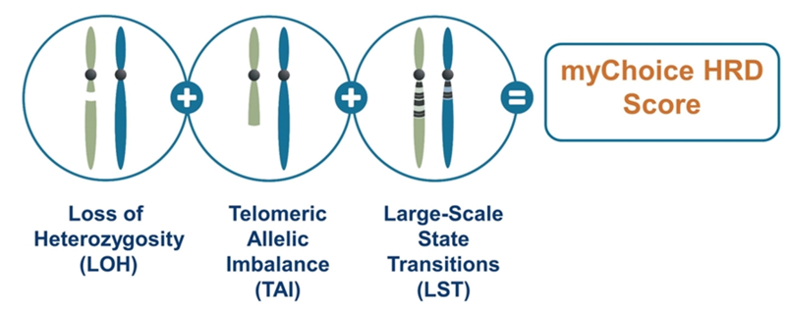
As an alternative to detecting the causal mutations, HRD can be identified on the basis of its genome-wide effects
These effects are called “HRD genomic scars”
A genomic scar has been defined as a genomic aberration with a known origin¹
The following genomic aberrations are characteristic of HRD:
Notes:
We previously discussed the causes and the effects of homologous recombination repair deficiency.
Mutations in BRCA 1 and 2 genes can be considered as a cause of homologous recombination repair deficiency. Alternatively, tests have been developed that measure genome-wide effects of HRR deficiency. Collectively these are known as genomic scar assays.
A genomic scar has been defined as a genomic aberration with a known origin. Genomic changes or instability come in various forms, and the three genomic aberrations listed below have been found to be characteristic of HRD. And these are:
Loss of heterozygosity (LOH)
Telomeric allelic imbalance (TAI)
Large-scale state transition (LST)
What are Genomic Scars?
"A genomic scar is defined as a genomic aberration with a known origin, indicative of defective homologous recombination repair."
Types of Genomic Scars:
Loss of Heterozygosity (LOH): Loss of a single allele in certain chromosomal regions.
Telomeric Allelic Imbalance (TAI): Discrepancies in allele balance near telomeric regions.
Large-Scale State Transitions (LST): Chromosomal transitions that span large regions.
3. Takeaway:
"These scars collectively generate an HRD score, such as the myChoice HRD score, which helps identify patients who may benefit from PARP inhibitors."

Slide 19


Clinically validated methods to detect HRD in newly diagnosed OC require BRCAm testing and scoring of genomic instability
Testing in newly diagnosed ovarian cancer
Tumour BRCA mutation
Genomic instability
Example: Myriad myChoice® genomic instability
Presence of
BRCA mutation
Loss of heterozygosity
(LOH)
Presence of a single allele
Telomeric allelic imbalance
(TAI)
A discrepancy in the 1:1 allele ratio at the end of the chromosome (telomere)
Large-scale state transitions
(LST)
Transition points between regions of abnormal and normal DNA or between two different regions of abnormality
Yes
No
Score out of 100³
BRCA, breast cancer gene; HR, homologous recombination.
https://myriad-oncology.com/mychoice-cdx/#result (Accessed: Jul 2020).
Notes:
his slide summarizes the clinically validated methods for detecting HRD in newly diagnosed ovarian cancer, emphasizing both BRCA mutation testing and genomic instability scoring."
2. Key Processes:
BRCA Mutation Testing:
"Tumor BRCA mutation testing identifies whether a BRCA mutation is present, which is the first step in determining HRD."
Genomic Instability Testing:
"For patients without a BRCA mutation, genomic instability testing evaluates HRD based on three markers:
Loss of Heterozygosity (LOH).
Telomeric Allelic Imbalance (TAI).
Large-Scale State Transitions (LST)."
"These markers are combined into a score, with a threshold indicating HRD positivity."
3. Takeaway:
"Both BRCA mutation testing and genomic instability testing are essential for comprehensive HRD evaluation in ovarian cancer."

Slide 20
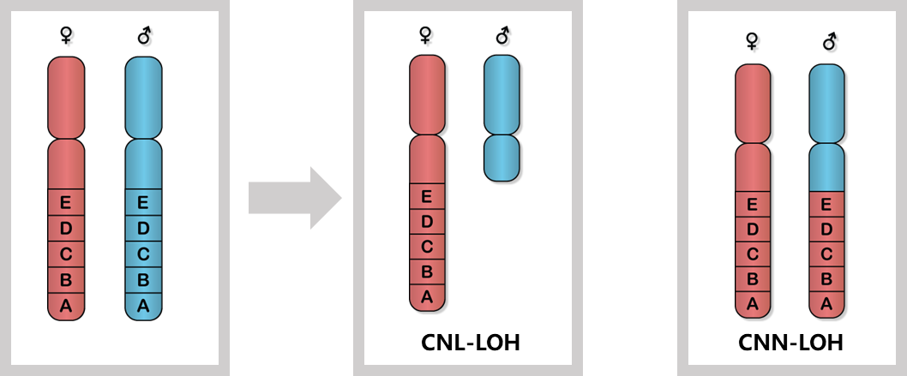
Loss of heterozygosity (LOH)
LOH: Loss of heterozygosity is a cross chromosomal event that results in loss of the entire gene and the surrounding chromosomal region. LOH: >15 Mb <chromosome arm
1. Timms KM, et al. Breast Cancer Research volume 16, Article number: 475 (2014)
Notes:
Loss of heterozygosity (LOH) is a common genetic event in many cancer types
The term refers to the transition from a heterozygous state in the germline to an apparently homozygous state in the tumour
LOH can occur through copy number loss, in which all or part of one parental chromosome is deleted
LOH can also occur in a copy-neutral fashion, in which both parental alleles become identical
Definition:
"LOH is a chromosomal event where one allele is lost, resulting in the absence of heterozygosity in that region."
Clinical Implications:
"LOH is indicative of chromosomal instability and is a hallmark of HRD-positive tumors."
3. Takeaway:
"LOH is a critical marker in genomic instability testing, contributing to the overall HRD score."

Slide 21
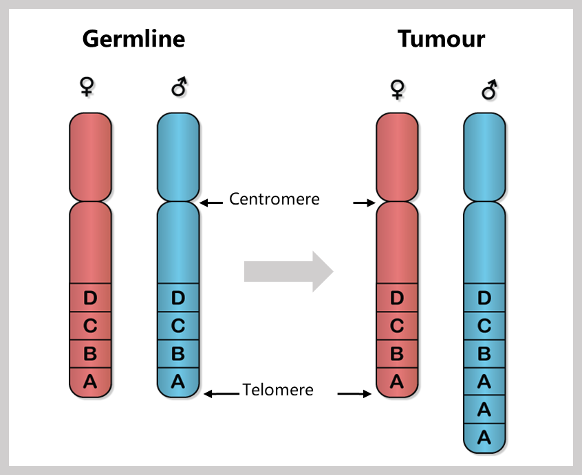
Telemeric Allelic Imbalance (TAI)
TAI: Allelic imbalance (AI) is a phenomenon where the two alleles of a given gene are expressed at different levels in a given cell, either because of epigenetic inactivation of one of the two alleles, or because of genetic variation in regulatory regions. Accumulation of AI in telomeric region is a marker of platinum sensitivity and suggest impaired DNA repair
1. Birkbak NJ, et al. Cancer Discov 2012;2:366-375.
Notes:
TAI occurs when there is an imbalance in allele expression or structure near the telomeres of chromosomes."
Clinical Implications:
"It is a marker of DNA repair deficiency and is associated with sensitivity to platinum-based chemotherapy and PARP inhibitors."
3. Takeaway:
"TAI reflects impaired DNA repair and contributes to the HRD genomic scar score."

Slide 22
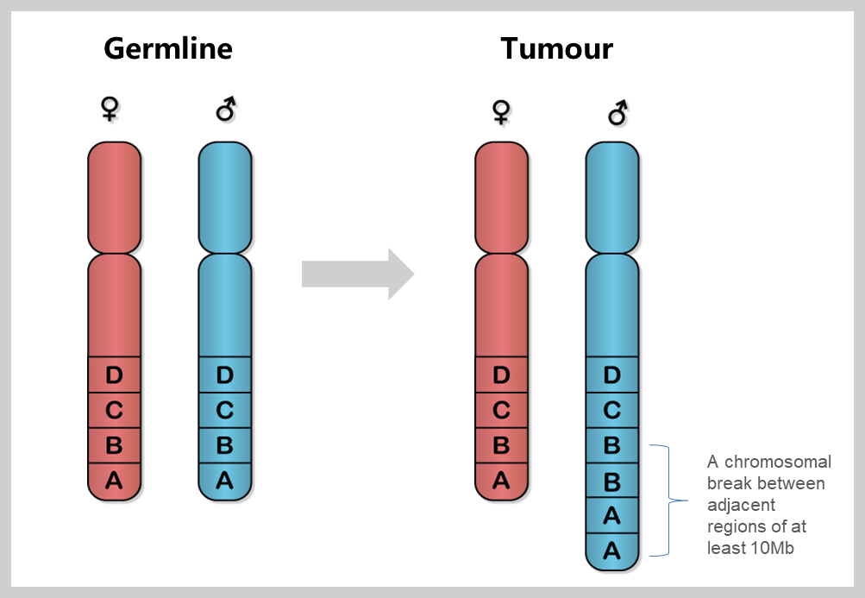
Large-Scale State Transitions (LST)
LST: A chromosomal break between adjacent regions of at least 10Mb; the number of LSTs in the tumor genome was estimated for each chromosome arm independently
1. Popova T, et al. Cancer Res 2012;72:5454-5462
Notes:
"LSTs refer to chromosomal breaks or rearrangements spanning large regions, typically greater than 10 Mb."
Clinical Implications:
"LSTs are another indication of genomic instability, highlighting defective DNA repair mechanisms."
3. Takeaway:
"LSTs are integral to calculating the HRD score, providing another measure of tumor genomic instability."

Slide 23
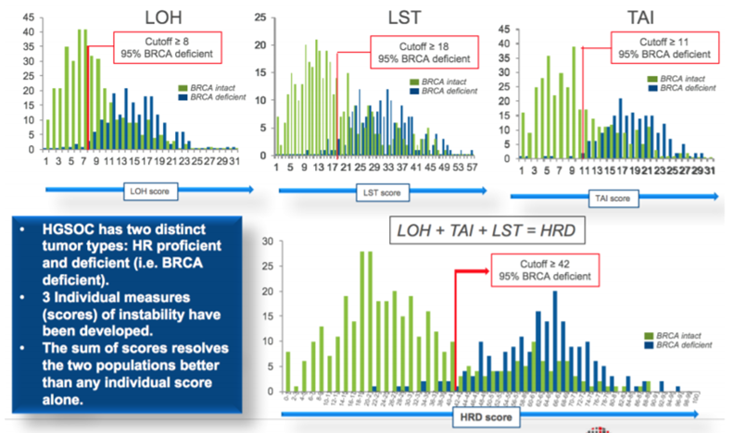
A combination of three scores of genomic instability separates HRD+ and HRD- tumors
Source: Myriad website
Notes:
ntroduction:
"This slide shows how combining three genomic instability scores—LOH, LST, and TAI—helps differentiate HRD-positive and HRD-negative tumors."
2. Key Explanation:
Individual Scores:
LOH (Loss of Heterozygosity): Tumors with LOH scores above the cutoff of 8 are 95% BRCA-deficient.
LST (Large-Scale State Transitions): Scores above 18 are associated with BRCA deficiency.
TAI (Telomeric Allelic Imbalance): A cutoff of 11 indicates HRD positivity.
Combined HRD Score:
"The combined score integrates LOH, LST, and TAI, with a cutoff of 42 separating HRD-positive from HRD-negative tumors."
"This comprehensive approach provides greater accuracy in identifying HRD-positive cases than any individual score."
3. Clinical Relevance:
"By identifying HRD-positive tumors, we can select patients likely to respond to PARP inhibitors and platinum-based therapies."

Slide 24
How are patients classified as being HRD test positive by the Myriad HRD genomic scar test?
Myriad HRD genomic scar test positive
BRCA mutation (germline or tumour)
Genomic scar result above pre-defined threshold (42)
OR
BRCAm
HRD scar positive
HRD scar negative
Non-BRCAm
By definition these are HRD+
  Reminder: HRD positive = BRCAm and/or genomic scar score above threshold (cut-off)
Notes:
And this is this just a summary slide as a reminder of how are patients classified as being HRD test positive by the Myriad MyChoice assay? Introduction:
"This slide explains how the Myriad HRD genomic scar test determines whether a patient is HRD-positive."
2. Pathways to HRD-Positive Status:
BRCA Mutation:
"Patients with germline or somatic BRCA mutations are automatically classified as HRD-positive."
Genomic Scar Testing:
"Patients without BRCA mutations can still be HRD-positive if their genomic scar score exceeds the threshold of 42."
3. Takeaway:
"The Myriad test combines BRCA mutation status with genomic instability scores to provide a comprehensive HRD classification."
An HRD test positive would be a patient that a BRCA1/2 mutation and or a Genomic scar result above pre-defined threshold (42). This also ties into how the clinical data is presented in that it is generally presented in the intent to treat population, then the HRD genomic scar test patient subgroup which includes BRCA1/2 mutated patients, HRD scar test positive patients excluding BRCA1/2 mutated patients and lastly HRD scar negative patients.

Slide 25
Myriad myChoice “Cut-Off”
HRD Negative
HRD Positive
  HR status is determined by the following:
  HR deficient tumours:
    Tissue test score ≥42 OR
    A BRCA mutation
  HR proficient tumours:
    Tissue test score <42
  HR not-determined
100
80
BRCA intact (n=790)
BRCA deficient (n=268)
60
Number of samples
40
20
0
[0,5]
[10,15]
[20,25]
[30,35]
[40,45]
[50,55]
[60,65]
[70,75]
[80,85]
[90,95]
HRD score
Telli ML et al. Clin Cancer Res. 2016;22:3764–3773
Notes:
Myriad myChoice Cutoff for HRD Positivity
1. Introduction:
"This slide illustrates how HRD positivity is determined using the Myriad myChoice assay."
2. Key Points:
Score Distribution:
"Samples are categorized as HRD-positive if their genomic instability score is ≥42 or if a BRCA mutation is present."
"HRD-negative tumors have scores <42 and no BRCA mutation."
Clinical Relevance:
"This cutoff ensures that patients likely to benefit from targeted therapies are accurately identified."
3. Takeaway:
"The cutoff score of 42 is critical for stratifying patients for personalized treatment approaches."

Slide 26
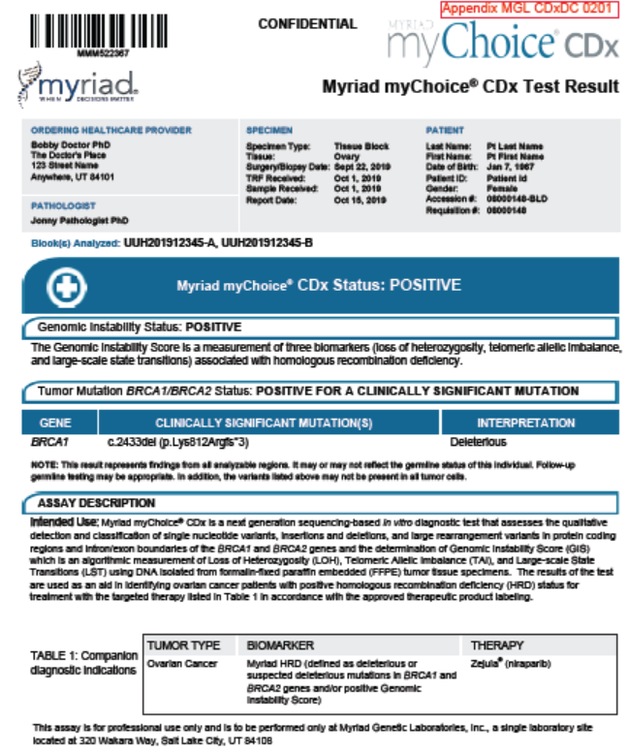
myChoice CDx report format
Notes:
This slide presents the format of a MyChoice CDx test report, highlighting the key components."
2. Key Sections:
Genomic Instability Status:
"The report indicates whether the genomic instability score is positive or negative."
BRCA Status:
"Identifies clinically significant BRCA1 or BRCA2 mutations."
Therapeutic Implications:
"Includes recommended therapies, such as PARP inhibitors, based on HRD status."
3. Takeaway:
"The MyChoice CDx report is a comprehensive tool for guiding treatment decisions in HRD-positive patients

Slide 27
In PAOLA-1, approximately 50% of newly diagnosed ovarian cancer patients were HRD positive
Around half of HRD positive patients were tBRCAm
HRD positive
n=387; 48%
Notes:
19. What was the breakdown of the HRD Plus test status in PAOLA-1?
In the presented analysis, 48% of patients (n=387) were considered HRD positive (tBRCAm or HRD test score ≥42) based on the results of the Myriad myChoice^{® HRD Plus assay:7}
29% of patients were tBRCAm (n=235)
19% were HRD positive (score ≥42), non-tBRCAm (n=152)
Overall 52% of patients (n=419) were considered HRD negative/unknown:
34% of patients (n=277) were HRD negative (non-tBRCAm, HRD test score <42)
18% of patients (n=142) were HRD status unknown⁷
These data will be published at a later date
This slide summarizes HRD status findings from the PAOLA-1 study, which evaluated newly diagnosed ovarian cancer patients."
2. Key Points:
HRD-Positive Patients:
"Approximately 50% of patients were HRD-positive, including 29% with tumor BRCA mutations (tBRCAm) and 19% HRD-positive without BRCA mutations."
HRD-Negative and Unknown Status:
"34% of patients were HRD-negative, while 18% had an unknown HRD status."
3. Clinical Relevance:
"Identifying HRD status helps in selecting patients who are more likely to benefit from PARP inhibitor therapy."

Slide 28
In PAOLA-1, prespecified subgroup analyses showed a substantial PFS benefit with olaparib in HRD-positive patients
HRD positive, including tBRCAm
(48% of patients)
HRD positive, excluding tBRCAm
(19% of patients)
HRD negative/unknown
(52% of patients)
100
89%
90
83%
80
70
71%
66%
69%
60
52%
Patients free from disease
progression and death (%)
50
40
30
29%
26%
20
10
0
0
3
6
9
12
15
18
21
24
27
30
33
36
39
42
45
0
3
6
9
12
15
18
21
24
27
30
33
36
39
42
45
0
3
6
9
12
15
18
21
24
27
30
33
36
39
42
45
Months since randomisation
Months since randomisation
Months since randomisation
No. at risk
Olaparib
255
252
242
236
223
213
169
155
103
85
46
29
11
3
0
97
96
90
86
79
75
54
48
30
29
16
12
4
2
0
282
261
219
197
180
161
110
85
38
27
9
8
1
0
Placebo
132
128
117
103
91
79
54
44
28
18
8
5
1
1
0
55
54
48
41
37
32
19
15
11
8
3
2
0
137
124
109
102
81
72
55
39
22
17
7
4
0
HR 0.33 (95% CI 0.25–0.45)
HR 0.43 (95% CI 0.28–0.66)
HR 0.92 (95% CI 0.72–1.17)
Notes:
What were the results according to HRD test status?
• PAOLA-1 met its primary endpoint, showing a statistically significant and clinically meaningful improvement in PFS in the ITT population
• In the HRD positive subgroup (approximately 50% of patients) olaparib vs. placebo added to bevacizumab reduced the risk of progression or death by 67%
89% vs. 71% of patients were progression-free at 12 months for olaparib vs. placebo added to bevacizumab, and 66% vs. 29% were progression-free at 24 months. The HR was 0.33with mPFS of 37.2 months vs. 17.7 months
• In the HRD positive subgroup, when excluding tBRCAm patients, olaparib vs. placebo added to bevacizumab reduced the risk of progression or death by 57% with a HR of 0.43 (95% CI 0.28–0.66),with mPFS of 28.1 months vs. 16.6 months for olaparib vs. placebo added to bevacizumab
In the HRD negative/unknown subgroup, the hazard ratio for olaparib vs. placebo added to bevacizumab was 0.92 with a mPFS of 16.9 months vs.16.0 months for olaparib vs. placebo added to bevacizumab⁷
In the HRD negative subgroup the hazard ratio for olaparib vs. placebo added to bevacizumab was 1.00 (95% CI 0.75–1.35)¹⁰
In the HRD unknown subgroup the hazard ratio for olaparib vs. placebo added to bevacizumab was 0.71 (95% CI 0.46–1.10)¹⁰
"This slide presents the progression-free survival (PFS) benefits observed in HRD-positive patients treated with olaparib in the PAOLA-1 study."
2. Key Points:
HRD-Positive, Including tBRCAm:
"A significant PFS benefit was observed (HR 0.33; 66% vs. 29% at 36 months)."
HRD-Positive, Excluding tBRCAm:
"A notable PFS improvement was seen in HRD-positive, BRCA wild-type patients (HR 0.43; 52% vs. 26%)."
HRD-Negative or Unknown:
"No substantial PFS benefit was observed in this group (HR 0.92)."
3. Takeaway:
"HRD-positive patients, especially those with BRCA mutations, derive the most benefit from PARP inhibitors like olaparib."

Slide 29
Similar to PAOLA-1, in PRIMA, approximately 50% of newly diagnosed ovarian cancer patients were HRD positive
More than half of HRD positive patients were tBRCAm
HRD positive
n=373; 51%
Notes:
Similar to PAOLA-1 in regards to prevalence, in PRIMA, approximately 50% of newly diagnosed ovarian cancer patients were HRD positive with 30% of patients having deleterious BRCA mutations and 21% were HRD positive (score ≥42), non-tBRCAm (n=152).
The HRD negative subgroup represented 34% of the patient population, while 15% of patients were HRD status unknown or not determined
This slide highlights HRD status findings from the PRIMA study, similar to PAOLA-1."
2. Key Points:
HRD-Positive Patients:
"51% of patients were HRD-positive, with 30% having tBRCAm and 21% HRD-positive without BRCA mutations."
HRD-Negative and Unknown Status:
"34% of patients were HRD-negative, and 15% had unknown HRD status."
3. Takeaway:
"Like PAOLA-1, HRD status played a critical role in stratifying patients for treatment in PRIMA."

Slide 30
In PRIMA, pre-specified subgroup analysis showed PFS benefit in HRD-positive newly diagnosed patients
HRD positive, including BRCAm
(30% of patients)
HRD positive, excluding BRCAm
(20% of patients)
HRD negative
(34% of patients)
100
100
100
90
90
90
80
80
80
70
70
70
60
Niraparib
60
Niraparib
60
Progression-free Survival (%)
50
50
50
40
40
40
30
30
Placebo
30
Niraparib
20
Placebo
20
20
10
10
10
Placebo
0
28
0
0
0
2
4
6
8
10
12
14
16
18
20
22
24
26
28
0
2
4
6
8
10
12
14
16
18
20
22
24
26
28
0
2
4
6
8
10
12
14
16
18
20
22
24
26
28
Months since Randomisation
Months since Randomisation
Months since Randomisation
HR 0.40 (95% CI 0.27–0.62)
HR 0.50 (95% CI 0.31–0.83)
HR 0.68 (95% CI 0.49–0.94)
Note: PRIMA was stratified by HRD status (HRD positive vs. HRD negative/unknown combined). However the results presented did not include patients with HRD-unknown status
Notes:
Within the HRD positive population including BRCAm patients, the median duration of progression free survival was 22.1 months in the niraparib group and 10.9 months in the placebo group with a (hazard ratio, 0.40; 95% CI, 0.27 to 0.62)
For the HRD positive subgroup excluding BRCA mutated patients the median PFS was 19.6 months and 8.2 months with an HR of 0.50.
In the HRD negative , the median duration of progression-free survival was 8.1 months in the niraparib group and 5.4 months in the placebo group with a hazard ratio of 0.68.
One additional point, as covered in previous training by Richard Davidson, this HRD negative data is not a KM curve. It is an adjusted analysis for which we do not know the methodology used. It’s also interesting to note that the HRD unknowns (n=111) do not behave like the negatives (HR = 0.85). We still don’t know the real data for this population. More information can be covered in a separate training.
If we come back to the question of HRD scar test performance in PAOLA-1 versus PRIMA, it important to note that PAOLA-1 is the only PARP inhibitor maintenance study to include patients receiving bevacizumab, where the inclusion of bevacizumab maintenance increases the performance of the control arm (vs. placebo as in PRIMA) and sets a higher bar for comparison to the treatment arm, which may lead to dilution of marginal clinical effect of PARP inhibition in the HRD negative population.
In summary, it is plausible that in a more heterogenous population in PAOLA-1 (vs. a platinum enriched population in PSR OC), the ability of the Myriad HRD test to discriminate between those who benefit is improved
This slide shows progression-free survival (PFS) benefits observed with niraparib in HRD-positive patients in the PRIMA study."
2. Key Points:
HRD-Positive, Including BRCAm:
"A significant PFS benefit was observed (HR 0.40; median PFS improvement of 13.6 months vs. placebo)."
HRD-Positive, Excluding BRCAm:
"HRD-positive patients without BRCA mutations also benefited (HR 0.50)."
HRD-Negative:
"HRD-negative patients showed a modest PFS benefit (HR 0.68)."
3. Clinical Relevance:
"HRD status is a key biomarker for identifying patients who will respond to niraparib."

Slide 31




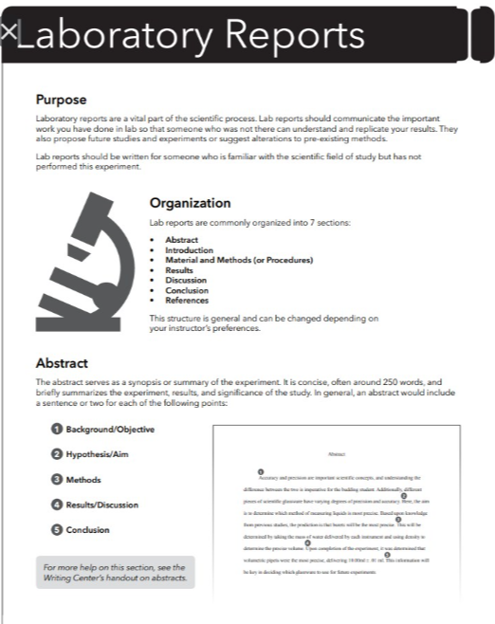
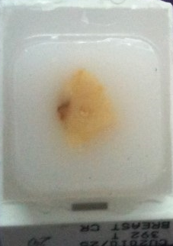
IDEAL sample pathway
Consent for germline BRCA
Orders gBRCA
Germline NGS
Ordering physician
Advanced OC patient eligible for testing
Samples received for Genomic analysis
Combined report
Ordering physician
NGS for tBRCA and HRD
Orders HRD +
tBRCA
Pathologist prepares slides
1-2 days
<2 weeks
Lab report - Myperfectwords.com
Notes:
This slide outlines the ideal pathway for collecting and processing samples for HRD testing."
2. Key Steps:
Sample Collection:
"Physicians obtain consent and collect blood or tumor samples for BRCA and HRD testing."
Analysis:
"Pathologists prepare slides, and samples are analyzed using next-generation sequencing (NGS) for BRCA and HRD status."
Report Generation:
"Results are compiled into a comprehensive report for clinical decision-making."
3. Takeaway:
"Efficient processing ensures timely and accurate HRD status determination for treatment planning."

Slide 32
Summary
Among women with ovarian cancer, individuals with homologous recombination repair deficient tumours may be identified either through sequencing of genes involved in the HRR pathway (cause) or through genomic scar tests (effect/phenotype), which are characteristics of homologous recombination repair deficiency (HRD)
The Myriad HRD genomic scar test includes tumour BRCA analysis for an assessment of both tumour BRCA1 and BRCA2 status as well as the tumour’s Genomic Instability Status, evaluated by three biomarkers associated with homologous recombination deficiency (HRD): LOH (loss of heterozygosity), LST (large-scale state transitions), and TAI (telomeric allelic imbalance).
Among the ~50% of newly diagnosed patients in PAOLA-1 and PRIMA who were HRD positive, PARPi treatment resulted in a substantial PFS benefit.
Among the ~50% of patients in PAOLA-1 who were HRD positive, Olaparib added to bevacizumab resulted in a substantial PFS benefit vs placebo plus bevacizumab (HR 0.33; 95% CI 0.25-0.45; PFS rate at 2 years 66% vs. 29%)
Notes:
"This summary slide consolidates the key findings about homologous recombination deficiency (HRD) testing and its clinical relevance in ovarian cancer."
2. Section 1: Identification of HRD Tumors
"First, HRD tumors in ovarian cancer can be identified through two approaches:
Sequencing of genes involved in the HRR pathway, such as BRCA1 and BRCA2, which identifies the cause of HRD.
Genomic scar tests, which assess the genomic instability resulting from HRD and reflect its phenotype."
3. Section 2: Myriad HRD Genomic Scar Test
"The Myriad HRD genomic scar test is a comprehensive tool for assessing HRD. It includes:
Tumor BRCA analysis for germline and somatic mutations.
Genomic Instability Status, which is based on three biomarkers:
Loss of Heterozygosity (LOH),
Large-Scale State Transitions (LST),
Telomeric Allelic Imbalance (TAI)."
4. Section 3: Key Findings from PAOLA-1 and PRIMA Studies
"The clinical impact of HRD status was clearly demonstrated in two key studies—PAOLA-1 and PRIMA:
About 50% of newly diagnosed ovarian cancer patients were HRD-positive, and these patients derived a substantial progression-free survival (PFS) benefit from PARP inhibitor therapy.
In PAOLA-1, HRD-positive patients treated with olaparib and bevacizumab had an HR of 0.33 compared to placebo, with a 2-year PFS rate of 66% versus 29%."
5. Closing Takeaway
"These findings highlight the critical role of HRD testing in stratifying ovarian cancer patients for targeted therapies, optimizing outcomes by identifying those most likely to benefit from PARP inhibitors."
Tips for Delivery:
Emphasize Key Figures:
Highlight the 50% HRD-positive rate and the significant PFS improvements with PARP inhibitors.
Connect to Clinical Application:
Explain how these insights can guide oncologists in personalizing treatment plans.
Use a Logical Flow:
Start with how HRD is identified, then discuss the Myriad test, and finally tie it to the clinical outcomes from major trials.

Slide 33

Patients counselling
Why are we discussing genetic testing?
How does the test work?
What are the benefits of testing?
Does this affect my family?
What if the test is negative?
We’re here to guide you?
Notes:
where the tumor is depicted as a lock, and the treatments are represented as keys. The glowing key signifies finding the correct treatment through genetic testing, making therapy more targeted and effective. Let me know if you need any adjustments!

Slide 34



