Slide 1



HPV DNA - mRNA - self testing
Alexandros Daponte (Greece)
M.D. (Thessaloniki), Dr Med (LMU Munich), FCOG (SA)
Professor of Obstetrics & Gynecology,
Chairman of the Obstetrics & Gynecology Clinic,
University of Thessaly,
University Hospital of Larissa, Larissa
SCHOOL OF HEALTH SCIENCES FACULTY OF MEDICINE
DEPARTMENT OF OBSTETRICS AND GYNAECOLOGY Accredited European Training Centre in Obstetrics and Gynaecology by the European Board and College of Obstetrics and Gynaecology (EBCOG) Head: Professor ALEXANDROS I. DAPONTE M.D., Dr Med (LMU Munich) F.C.O.G. (S.A.)

Slide 2
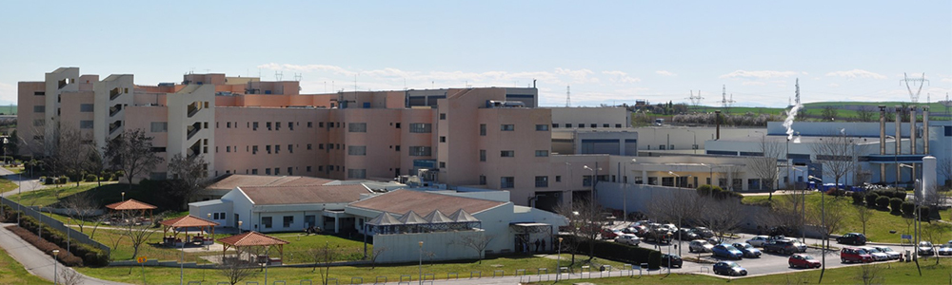

University Hospital of Larisa
Καλημέρα από τη Μαιευτική &Γυναικολογική Κλινική στο Πανεπιστημιακό Νοσοκομείο Λάρισας
University of Thessaly
Ευρωπαϊκή Πιστοποίηση
EBCOG ACCREDITED
2009-2027

Slide 3

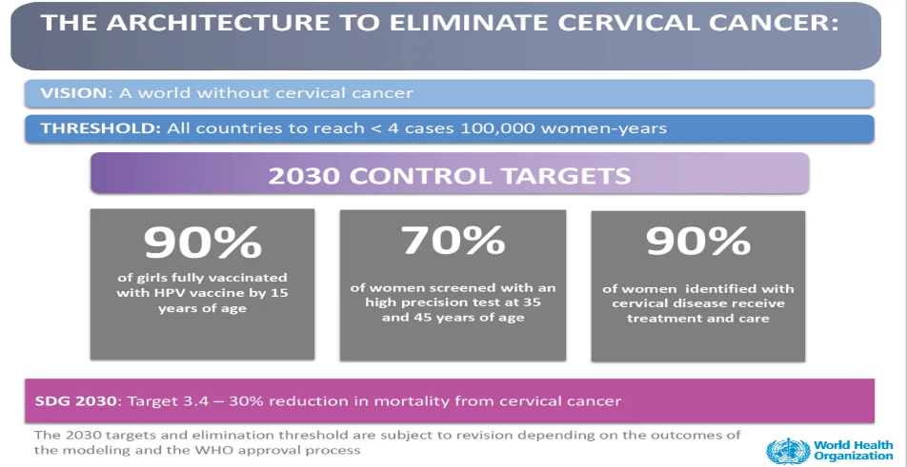
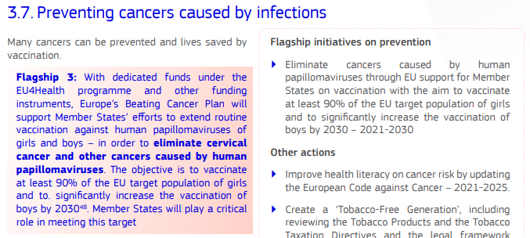
70% screened with HPV test
Eliminating cervical cancer and other HPV related cancers is one of the priorities of EC’s Beating Cancer Plan

Slide 4
Screening Ca Cx-identify CIN3 and Cancer
ΣΚΟΠΟΣ ΤΡΑΧΗΛΙΚΟΥ SCREENING: Η ΑΝΑΓΝΩΡΙΣΗ ΚΑΙ ΑΝΤΙΜΕΤΩΠΙΣΗ ΠΡΟΔΙΗΘΗΤΙΚΗΣ ΝΟΣΟΥ
HPV DNA HPV mRNA
Screening approved
TESTS OF RISK
TESTS OF DISEASE
Manage & Treat Disease
PPV: Θετική Προγνωστική Αξία
Specificity -Υψηλή ειδικότητα
Management algorithms-Καθορίζει το πρωτόκολλο διαχείρισης
Routine Screening
NPV: Αρνητική Προγνωστική Αξία
Sensitivity- Υψηλή ευαισθησία
Defines screening intervals -Καθορίζει τα μεσοδιαστήματα επανελέγχων
O’ Leary J, BSCCP 2022 Belfast

Slide 5
HPV self-sampling is an acceptable method of cervical cancer screening
Systematic reviews clearly demonstrated that
HPV self-sampling is an acceptable method of cervical cancer screening in reaching never screened and under-screened women as it
overcomes those barriers in conventional cytology, namely psychological distress, discomfort, inconvenience and privacy.
Arbyn M, Castle PE. Offering self-sampling devices for HPV testing to reach women who do not attend in the regular cervical cancer screening program. Cancer Epidemiol Biomarkers Prev. 2015;24(5):769–72.
Verdoodt F, Jentschke M, Hillemanns P, et al. Reaching women who do not participate in the regular cervical cancer screening programme by offering self-sampling devices: a systematic review and meta-analysis of randomized trials. Eur J Cancer. 2015;51(16):2375–85.

Slide 6
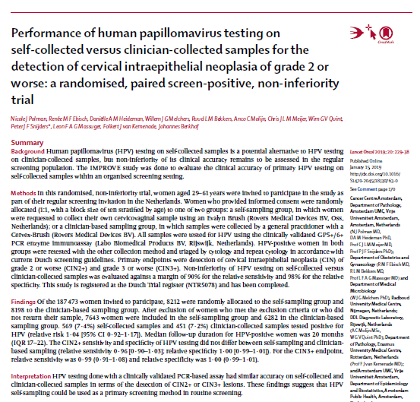
Lancet Oncol 2019;
187 473 women
HPV testing done with a clinically validated PCR-based assay had similar accuracy on self-collected and clinician-collected samples in terms of the detection of CIN2+ or CIN3+ lesions. HPV self-sampling could be used as a primary screening

Slide 7
2024 !!!!!
Results: Data from 497 women’s specimens were analyzed. Both samplings had 86.8% concordance rate in detecting hr-HPV (Kappa 0.670; 95% confidence interval [CI] 0.599-0.746, P value < 0.001). The sensitivity (95% CI) of self-collected specimen HPV DNA and clinician- collected specimen HPV-mRNA to detect high-grade lesions were 91.8% (85.4%-96.0%) and 90.2% (83.6%-94.9%) respectively. The corresponding negative predictive values (95% CI) were 91.9% (85.6%-96.0%) and 91.7% (86.0%-95.7%) respectively. Conclusion: HPV DNA testing from self-collected specimen to detect HR-HPV demonstrates high concordance with HPV mRNA testing from clinician-collected specimen. The sensitivity and negative predictive value of both tests to detect high-grade lesions are comparable.

Slide 8
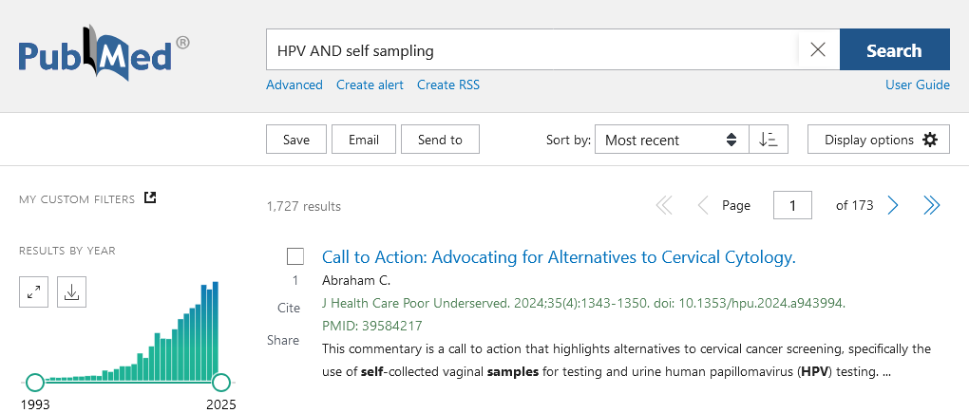
Pubmed search 1727 results 26/11/2024

Slide 9
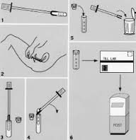
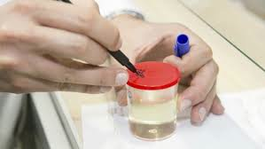
HPV DNA Self sampling
Δείγμα αυτοληψίας
VAGINA
URINE

Slide 10
HPV 16 DNA screening και self sampling δείγμα κόλπου University Hospital Larissa 2004-2005
.
Self sampling με τυποποίηση για HPV 16 σε δείγμα κόλπου
έχει ευαισθησία παρόμοια με του τραχήλου

Slide 11

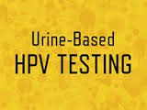
HPV 16 DNA screening και self sampling δείγμα ούρων- FIRST VOID URINE
University Hospital Larissa 2004-2005
Self sampling ούρων με τυποποίηση για HPV 16 έχει ικανοποιητική ευαισθησία στις σοβαρότερες βλάβες
(καρκίνος 88.8%,
βαριά δυσπλασία 76.5% ε ήπια δυσπλασία 45.5%)

Slide 12
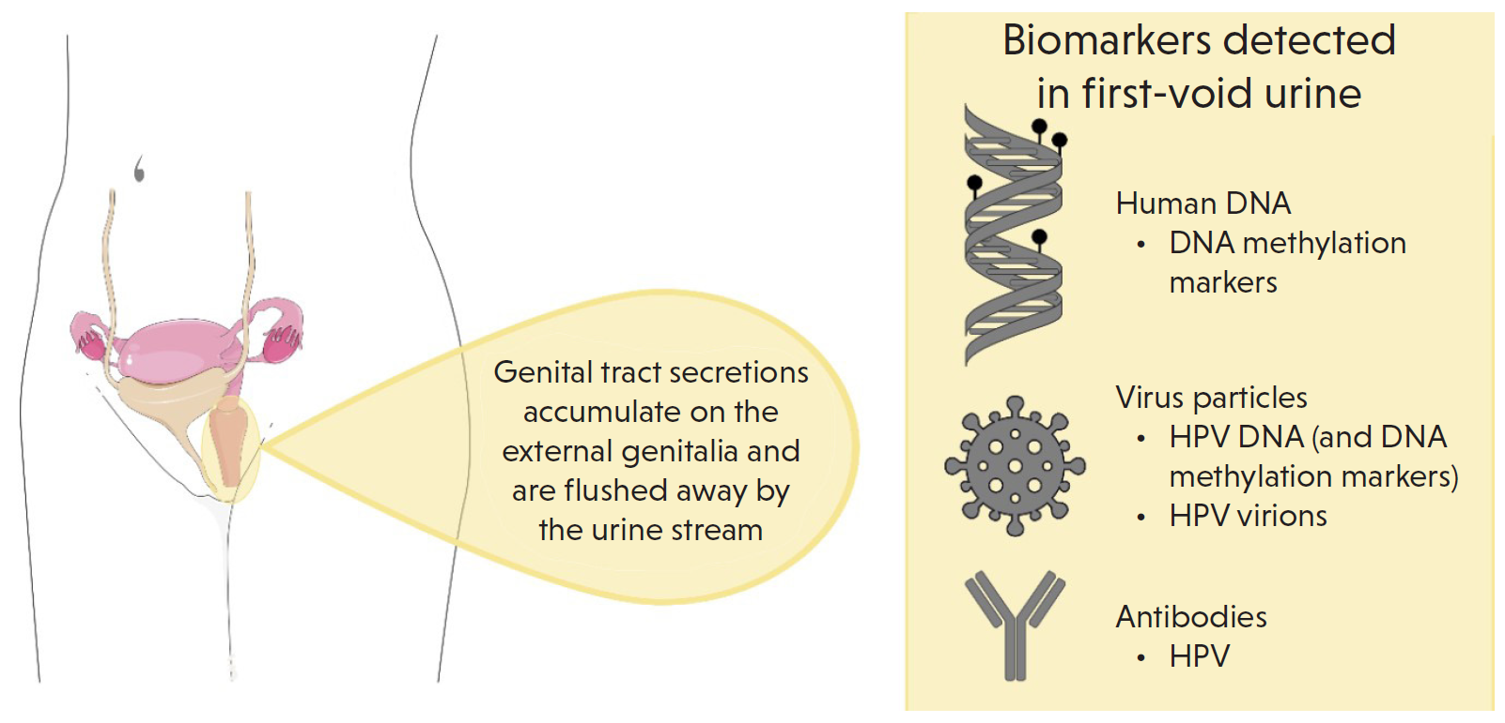
HPV DNA Self sampling in urine and biomarkers
Van der Borst E et al, HPVWorld269 2024

Slide 13
HPV DNA Self sampling in urine and biomarkers
2021
The following points should be considered in the clinical application of hrHPV urine measurements;
(i) use of first-void urine (FVU) and purpose-designed collection devices;
(ii) using a preservation medium to avoid human/HPV DNA degradation during extraction and storage;
(iii) using polymerase chain reaction (PCR) based assays, ideally with genotyping capabilities;
(iv) processing of a sufficient volume of whole urine; and (v) the use of an analytically sensitive HPV test/recovery of cell-free HPV DNA in addition to cell-associated DNA.

Slide 14
SS implementation has been globally boosted during the COVID-19 pandemic. In pragmatic terms, social distancing, local lockdowns, discontinuation of clinics and reallocation of human and financial resources challenged established
clinician-based screening; self-collection strategies apparently surpassed most obstacles, representing a viable and flexible alternative. With time, sufficient reassuring data has accumulated regarding specially designed SS devices, aspects of sample preparation, transport and storage and, importantly,
optimization of validated PCR-based HPV testing platforms for self-collected specimens.
Suboptimal rates of clinical follow-up post-SS screening, as well as overtreatment with reliance solely on molecular
assays, have both been documented and remain concerning.
Therefore, effective strategies are still required to ensure linkage to follow-up testing and management following positive SS results by trained health professionals with knowledge of HPV biology and management algorithms.

Slide 15
Because of the prolonged SS screening intervals, implementation data are limited regarding subsequent
screening rounds of SS-screened individuals; however, these are accumulating gradually.
With further refinement of assays and validation of novel biomarkers in self-collected samples, there is a clear
potential for increasing SS accuracy and PPV. The potential differentiation of self-collection protocols
for vaccinated versus non-vaccinated individuals also represents an open issue.
In conclusion,
HPV based self-collection techniques can effectively address limited uptake alongside other conventional cervical screening drawbacks; however, assays, logistics and infrastructures need further optimization
to increase the efficacy, effectiveness and cost-effectiveness of SS approaches.

Slide 16
VAGINAL SELF SAMPLING HPV DNA EUROPE 2024

Slide 17
SELF SAMPLING HPV DNA EUROPE 2024

Slide 19
Which HPV Tests?
Currently, HPV assays based on polymerase chain reaction (PCR) are mostly implemented in SS; this is predominantly attributed to the lower specificity of signal amplification tests in self-samples.
Based on the suboptimal sensitivity of mRNA assays for detecting underlying CIN2+ in self-collected samples compared with clinician-collected samples, DNA assays are preferred

Slide 20
Preheating step may improve m RNA tests performance. More studies needed !!
Comment on Arbyns publication
The age of the studies may have influenced this observation;
technology evolves as does pre-analytical processing all of which can confer benefits to technical and clinical performance.
The pre-analytical approach followed in the scotish study was based on that reported by Borgfeldt et al , which included a heating step and which was applied in a recent study of self sampling in the Finnish population .

Slide 21

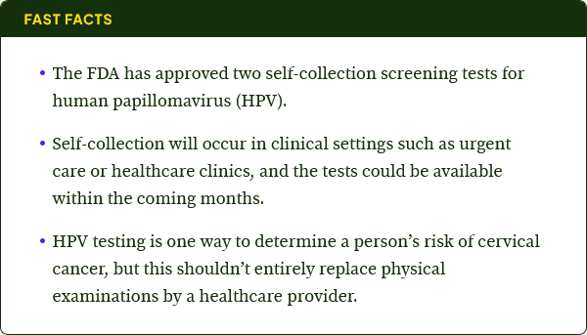
The new tests—cobas HPV, made by biotechnology company Roche, and Onclarity HPV from medical technology firm BD—were approved by the FDA on May 14. But these tests could be available in healthcare providers’ offices as early as this fall

Slide 22
VAGINAL SELF SAMPLING PRIMARY SCREENING Vaginal
PCR – based assays για ανίχνευση hrHPV DNA λόγω μειωμένης ειδικότητας των signal amplification tests (π.χ. HC2)
May 2024, FDA approved for self sampling
Onclarity HPV (Becton Dickinson-BD)
Cobas HPV (Roche Molecular Systems) d
Reported Sensitivity -ευαισθησίας (51%-95.2%) και Specificity ειδικότητας (61.4%-97.3%) (Colonetti et al EJOG 2024)

Slide 23
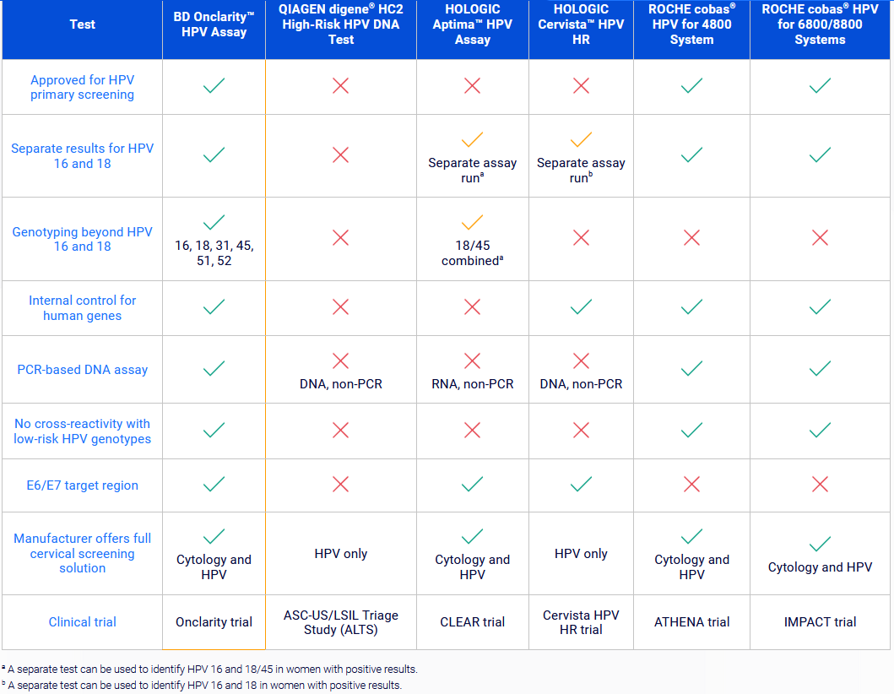

https://womens-health-solutions.bd.com/cervical-cancer/bd-onclarity-hpv-assay/compare-fda-approved-hpv-assays

Slide 24
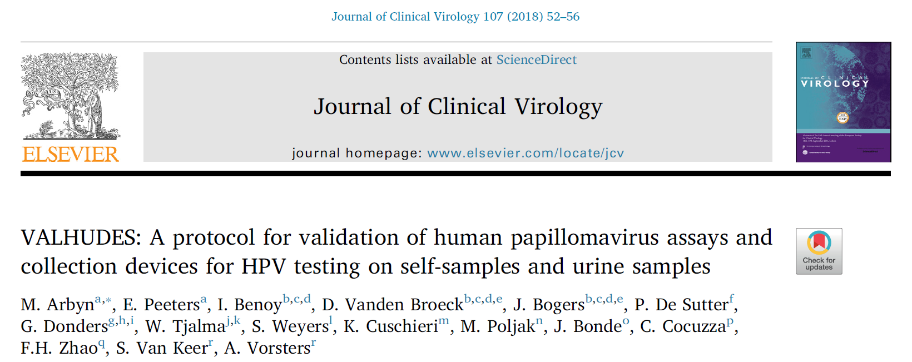
TESTS OF RISK
Το πρωτόκολλο VALHUDES αφορά διηνεκή πλατφόρμα αξιολόγησης της ακρίβειας διαγνωστικών εξετάσεων, συγκρίνοντας την κλινική ευαισθησία & ειδικότητα επιμέρους βιοδεικτών hrHPV σε δείγματα αυτοδειγματοληψίας (VSS/USS), συλλεχθέντων βάσει τυποποιημένων πρωτόκολλων, με αντίστοιχα δείγματα που λαμβάνονται από τον κλινικό
TESTS OF DISEASE

Slide 25
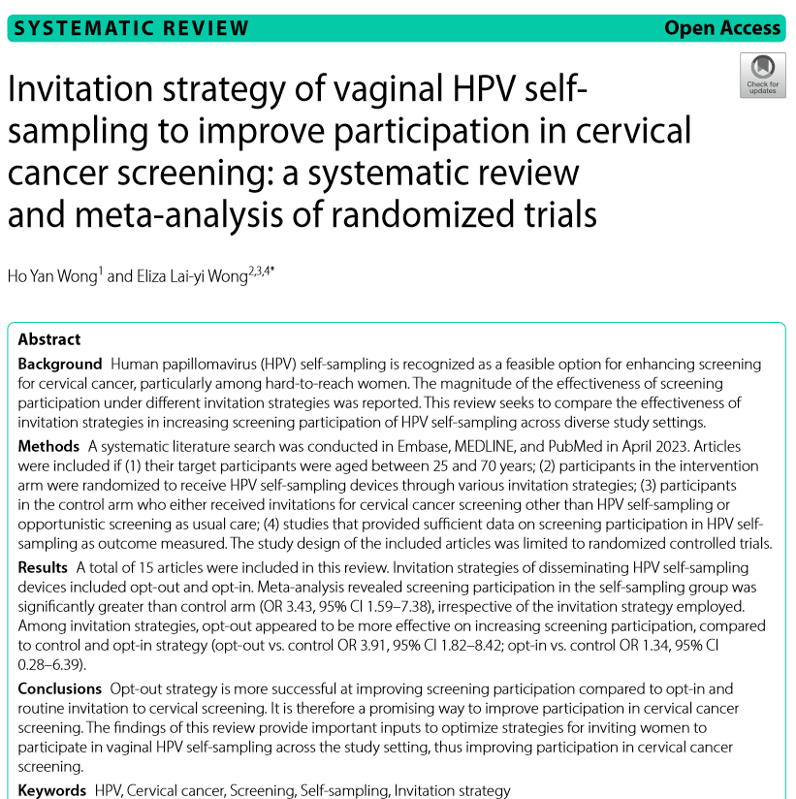
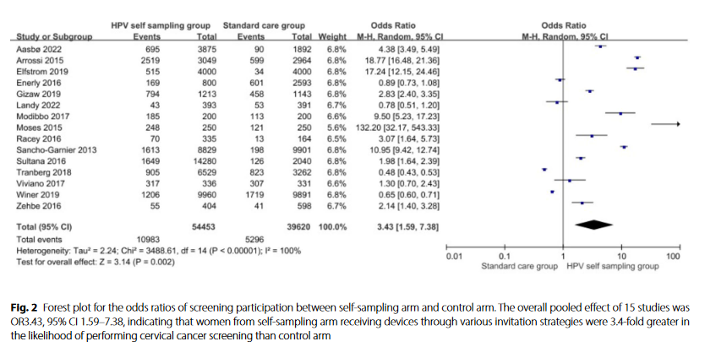

Slide 26
OPT OUT !!Women from self-sampling arm receiving devices through various invitation strategies were 3.4-fold greater in the likelihood of performing cervical cancer screening than control arm

Slide 27
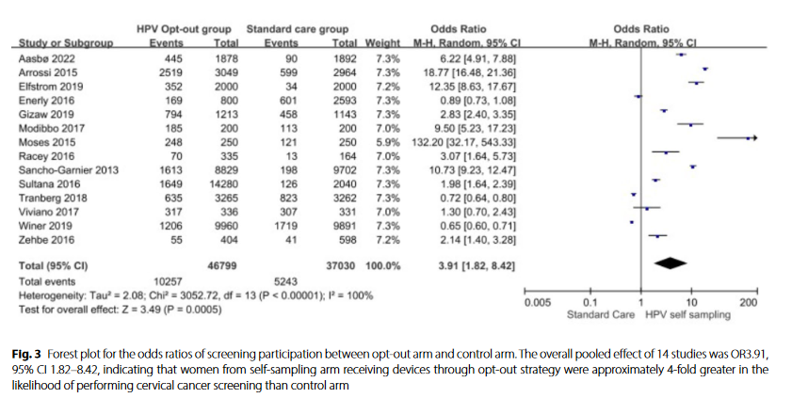
Women from self-sampling arm receiving devices through opt-out strategy were approximately 4-fold greater in the likelihood of performing cervical cancer screening than control arm

Slide 28
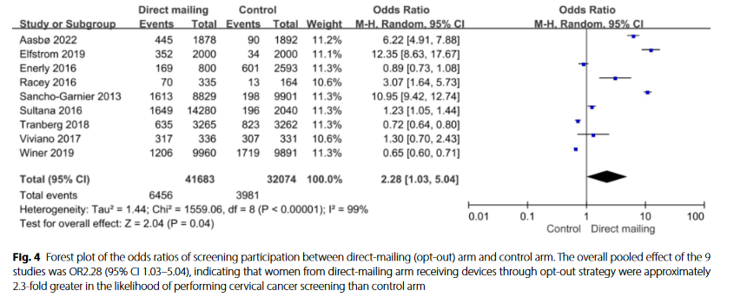
Women from direct-mailing arm receiving devices through opt-out strategy were approximately 2.3-fold greater in the likelihood of performing cervical cancer screening than control arm

Slide 29
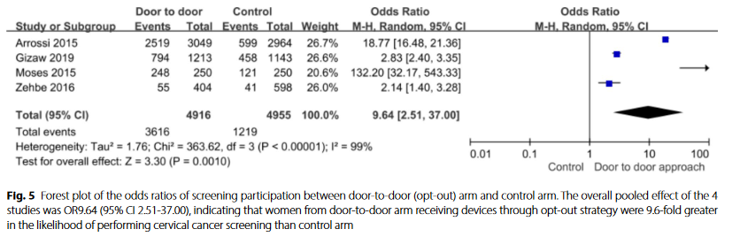
women from door-to-door arm receiving devices through opt-out strategy were 9.6-fold greater in the likelihood of performing cervical cancer screening than control arm

Slide 30
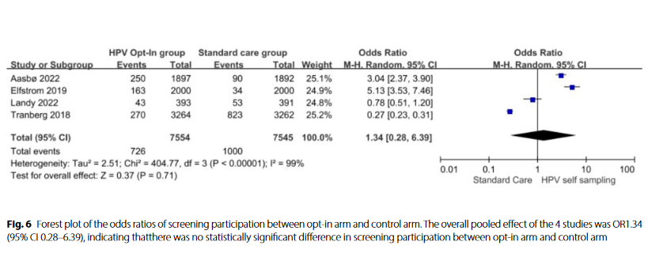
Odds ratios of screening participation between opt-in arm and control arm. The overall pooled effect of the 4 studies was OR1.34
(95% CI 0.28–6.39), indicating that there was no statistically significant difference in screening participation between opt-in arm and control arm

Slide 32
Which Self-Sampling Device?
In the Di Gennaro et al. meta-analysis, a higher relative uptake was shown for brushes (RR: 1.6; 95% CI: 1.5–1.7) and swabs (RR: 2.5; 95% CI: 1.9–3.1) over clinician-collected samples (RR: 1.8; 95% CI: 1.7–2.0), the authors concluded that since no significant difference in acceptability and preference of device type was demonstrated among women and swabs and brushes exhibited a potential stronger effect in improving SS performance, these devices could be therefore adopted.

Slide 33
Opt-out strategy
Screening participation in HPV self-sampling arms was generally greater than control arms when women were provided with self- sampling devices, regardless of the invitation strategy employed (compared to control and opt-in).
Opt-out strategy, direct mailing of self-sampling devices was found as the most common approach in high-income settings.
Studies conducting in LMICs, women in self-sampling arm were offered devices through door-to-door approach. It can be explained by their collected specimens rely on the assistance of healthcare workers for transportation in the rural settings.
The highest screening participation was observed when women received self-sampling devices from outreach workers providing onsite instruction with standard script and diagram through door-to-door approach

Slide 34
Conclusion
opt-out appears to be more effective on increasing screening participation, compared to control and opt-in strategy.
pilot intervention studies should be conducted to address the viability and appropriateness of the invitation strategy of vaginal HPV self-sampling to the target population and study setting.
future qualitative studies exploring the experience and attitudes towards HPV self-sampling among the end-users are valuable.

Slide 35
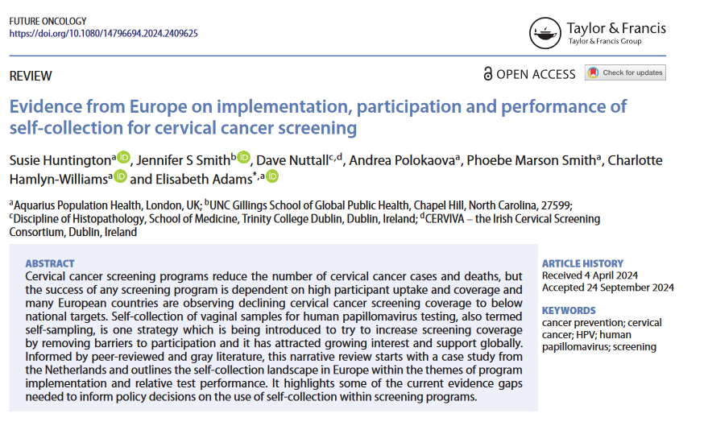

Slide 36
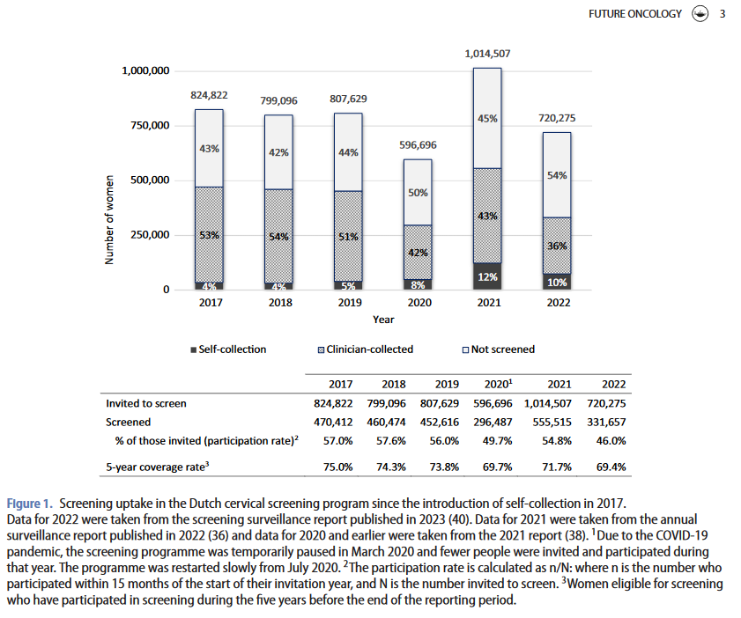

Slide 37
High-risk HPV mRNA testing on self-samples offered to those who do not attend for organised cervical screening real world data from the Dumfries and Galloway region in Scotland
William Forson1, Ramya Bhatia 2,3, Heather Currie4, Hana Elasifer3, Linzi Connor2, Allan Wilson5 and Kate Cuschieri*2,3
Cervical screening in Scotland is currently performed through clinician-based collection in primary care.
The programme is organised and an mRNA based test is offered to women aged 25 - 64y, with a negative result leading to 5 yearly recall.
Coverage for screening in Scotland was 68.7% in the year 2021/2022 (8) reducing to 62.4% in those from the most deprived areas.

Slide 38
High-risk HPV mRNA testing on self-samples in Scotland William Forson1, Ramya Bhatia 2,3, Heather Currie4, Hana Elasifer3, Linzi Connor2, Allan Wilson5 and Kate Cuschieri*2,3
Methods: Self sampling kits were mailed to women who had defaulted from routine screening resident in an entire territorial health board in Scotland. Kit return rates and compliance to colposcopy follow up in those who were HPV mRNA positive were assessed. Concordance of the self- sample with samples taken later at colposcopy was measured alongside PPV of an mRNA positive result for CIN2+.
Results: Of 4173 women invited to participate, 20.5%, returned their kit and a greater return rate with increasing age was observed.
HPV mRNA positivity was 12.0%, and invalidity rate was approximately 3%. Compliance to colposcopy follow up was 88.3% and the PPV for an mRNA test for CIN2+ on a self sample was 25.6%.
hr-HPV concordance on the initial swab and the follow up swab and liquid based cytology (LBC) sample taken at colposcopy was 67.1% and 30% respectively.
Conclusions: HPV self sampling using a mail to all approach is feasible in Scotland although only 1 in 5 actively responded to the offer. Future work to monitor screening behaviours in those who were invited but did not engage initially will help quantify any additional benefit(s) incurred.

Slide 39
Conclusion HP V Self SamplingWhich HPV Tests?
Currently, HPV assays based on polymerase chain reaction (PCR) are mostly implemented in SS; this is predominantly attributed to the lower specificity of signal amplification tests in self-samples.
HPV DNA - mRNA - self testing
Based on the suboptimal sensitivity of mRNA assays for detecting underlying CIN2+ in self-collected samples compared with clinician-collected samples, DNA assays are preferred. BUT !!

Slide 40
HPV DNA - mRNA - self testing
Further, well designed studies that compare head to head performance of DNA vs mRNA tests on self samples
using optimised protocols
will provide insight into the magnitude of any difference between these targets for the detection of clinically significant HPV infection.

Slide 41
Thank you for your attention

Slide 42

Ερωτήσεις

Slide 43
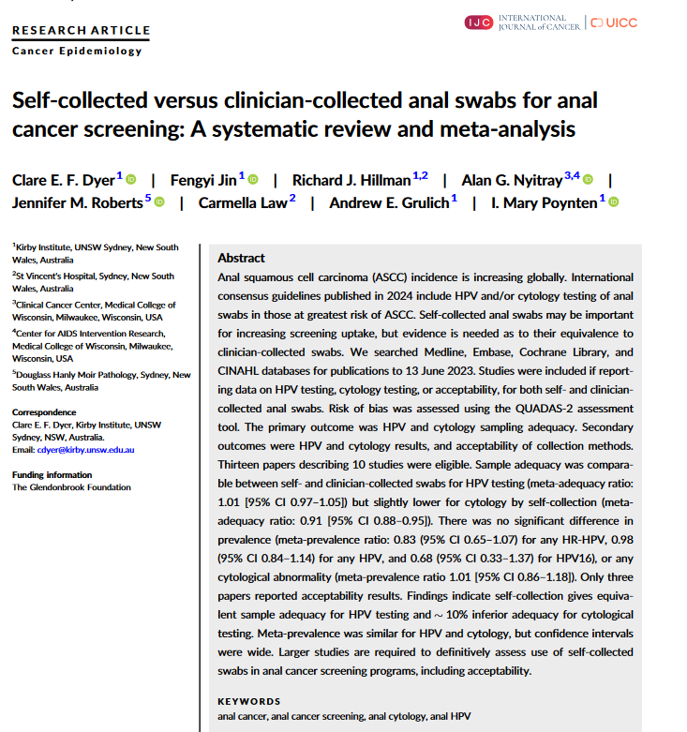

Slide 44
2023
Therefore, effective strategies are still required to ensure linkage to follow-up testing and management following positive SS results by trained health professionals with knowledge of HPV biology and management algorithms. Because of the prolonged SS screening intervals, implementation data are limited regarding subsequent screening rounds of SS-screened individuals; however, these are accumulating gradually. With further refinement of assays and validation of novel biomarkers in self-collected samples, there is a clear potential for increasing SS accuracy and PPV.
The potential differentiation of self-collection protocols for vaccinated versus non-vaccinated individuals also represents an open issue. In conclusion, HPV-based self-collection techniques can effectively address limited uptake alongside other conventional cervical screening drawbacks; however, assays, logistics and infrastructures need further optimization to increase the efficacy, effectiveness and cost-effectiveness of SS approaches.

