Slide 1
Management of Advanced and Recurrent Endometrial Cancer : The Emerging Role of Immunotherapy
Roland EID, MD, MSc, MPH
Hematology-Oncology
Hôtel-Dieu de France University Medical Center
Saint Joseph University of Beirut

Slide 2
Introduction
Key statistics: Incidence and mortality trends for advanced and recurrent endometrial cancer.
Treatment challenges: Late diagnosis, resistance to therapies, and limited options for recurrent disease.
Notes:
Endometrial cancer remains the most common gynecologic malignancy in developed countries, with rising incidence linked to obesity and aging populations. While early-stage disease has favorable outcomes, advanced and recurrent cases represent a significant therapeutic challenge, particularly due to resistance to conventional therapies.
In this section, we examine the global burden of endometrial cancer. According to GLOBOCAN 2020, there were over 417,000 new cases worldwide, with a mortality rate approaching 100,000 annually. While early-stage disease boasts a five-year survival rate exceeding 90%, the prognosis drops dramatically for advanced-stage or recurrent cases, where survival is often less than 30%. These data underscore the urgent need for innovative approaches, particularly for patients with advanced and recurrent disease.

Slide 3
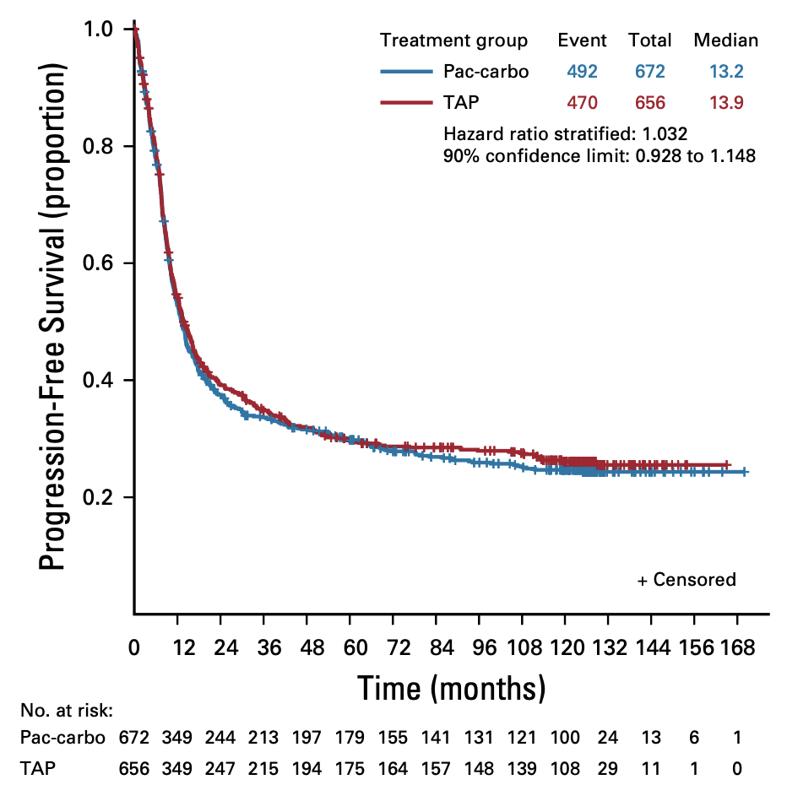
Advanced Endometrial Cancer (GOGO209) :
Carboplatine-Paclitaxel verus Cisplatine-Paclitaxel-Doxorubicin ?
Miller, JCO 2020
Notes:
With demonstrated noninferiority to TAP, TC is the global first-line standard for advanced endometrial cancer.
The current standard for first line advanced disease involves carboplatin and paclitaxel. Although effective initially, recurrence rates remain high.

Slide 4
Immunotherapies in endometrial cancer ?
Signatures of mutational processes in human cancer
Alexandrov, Nature 2013
Notes:
This article that was published in Nature highlights that tumors with a high mutational burden (TMB), particularly those with mismatch repair deficiency (dMMR) or microsatellite instability-high (MSI-H), exhibit increased neoantigen formation. This boosts tumor immunogenicity, making them more likely to respond to immune checkpoint inhibitors.
Tumor mutation rate predicts response to immunotherapies in melanoma or lung
In endometrial cancer, dMMR/MSI-H tumors are a key subset with enhanced sensitivity to therapies like anti-PD-1 antibodies, offering significant therapeutic potential.

Slide 5
Why do some cancers have a high mutation rate (TMB-high)?
Due to an “extrinsic” mutagen: the sun or cigarettes
Or
An “intrinsic” deficit: an inability to repair spontaneous mutations

Slide 6
Immunotherapies in endometrial cancer
Integrated genomic characterization of endometrial carcinoma
25-30% of EC vs <5% of Colorectal Cancer → Hypermutated and sensitive to immunotherapy
Levine, Nature 2013

Slide 7
Among all MSI cancers, MSI endometrial cancers are the most frequent
Landscape of Microsatellite Instability Across 39 Cancer Types
UCEC, uterine corpus endometrial carcinoma; COAD, colon adenocarcinoma; STAD, stomach adenocarcinoma; READ, rectal adenocarcinoma; ACC, adrenocortical carcinoma
Bonneville, JCO 2017

Slide 8
Evaluation of an anti-PD1 in first line in endometrial cancer
Published simultaneously in NEJM, on MARCH 27th 2023

Slide 9
Notes:
RUBY : a phase III trial evaluating the addition of Dostarlimb to 1st line chemotherapy

Slide 10
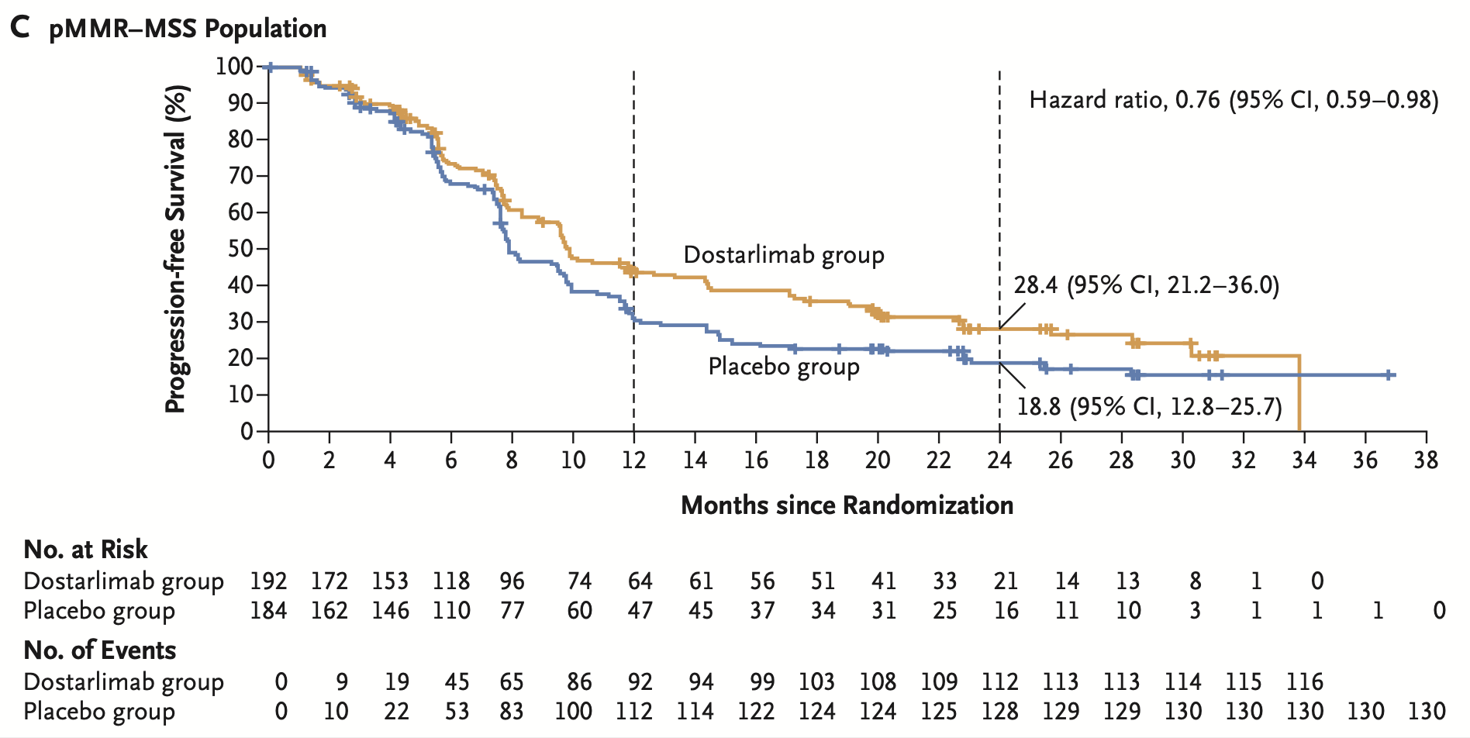
Undeniable benefit in patients with
MSI-H/dMMR endometrial cancer
More modest profit among pMMR - MSS
Mirza, NEJM 2023

Slide 12
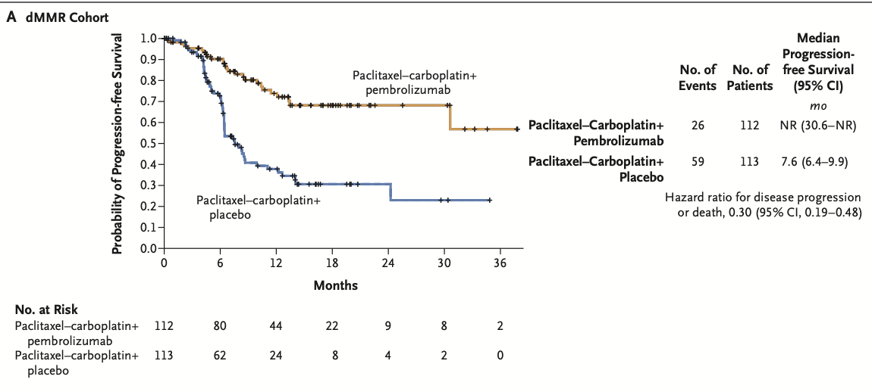
Significant PFS benefit in both dMMR and pMMR
Eskander, NEJM 2023

Slide 13
Phase III DUO-E Trial

Slide 14
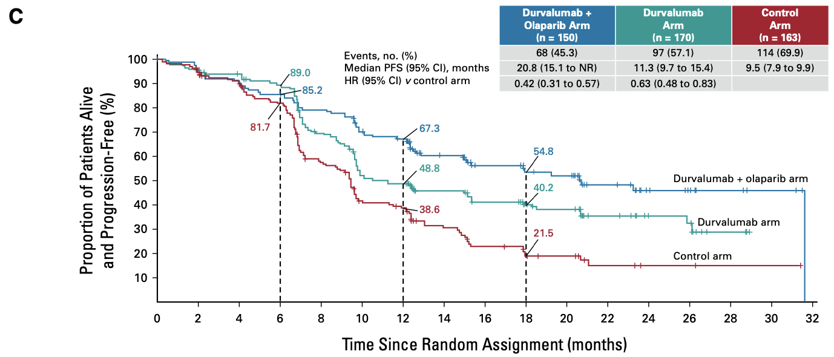
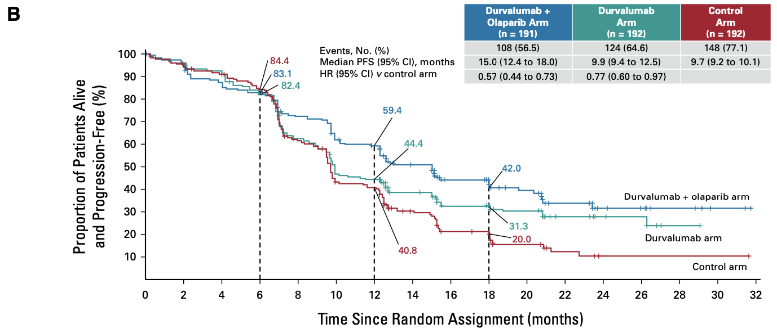
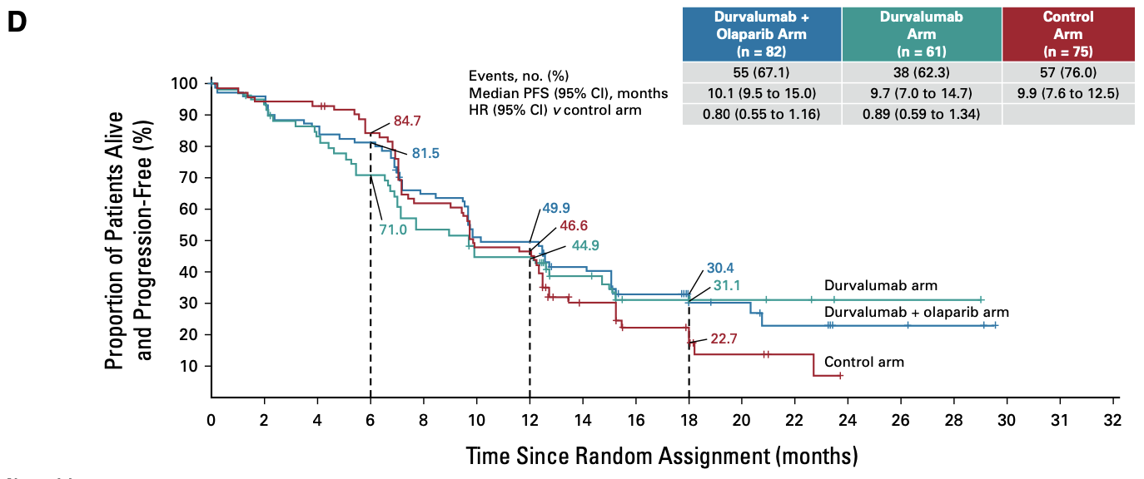
dMMR
pMMR
PDL1+
PDL1-

Slide 15
First line without chemotherapy ?
DOMENICA trial in France dedicated to MSI EC
Chemotherapy alone
1st line metastatic dMMR EC
R
Dostarlimab alone

Slide 16
Second line ?
Chemotherapy of 2nd line (doxorubine, paclitaxel, etc.)
RR 15%, PFS 2.5 months
Best option in chemotherapy, if free interval since Carboplatine in first line is more than 6/12 months, is to re-introduce Carboplatin (RR 30-50%).

Slide 17
Immunotherapy in second line ?
Phase II KEYNOTE-158 : Pembrolizumab (FDA) approved for relapsed MSI EC post-platinum.
Patients with noncolorectal MSI
EC : most frequent (21%), best RR (57.1%) and PFS (25.7 months)
Marabelle, JCO 2019

Slide 18
The GARNET Study
Dostarlimab in patients with advanced or recurrent EC.
Dostarlimab (FDA & EMA) approved for relapsed MSI EC post platinum.
ORR in TP53mut or POLEmut molecular subgroups was 18.1% (17/94) and 40% (2/5) respectively.
Oaknin, ESMO 2020

Slide 19
pMMR post-platine ?
Alexandra Leary

Slide 21
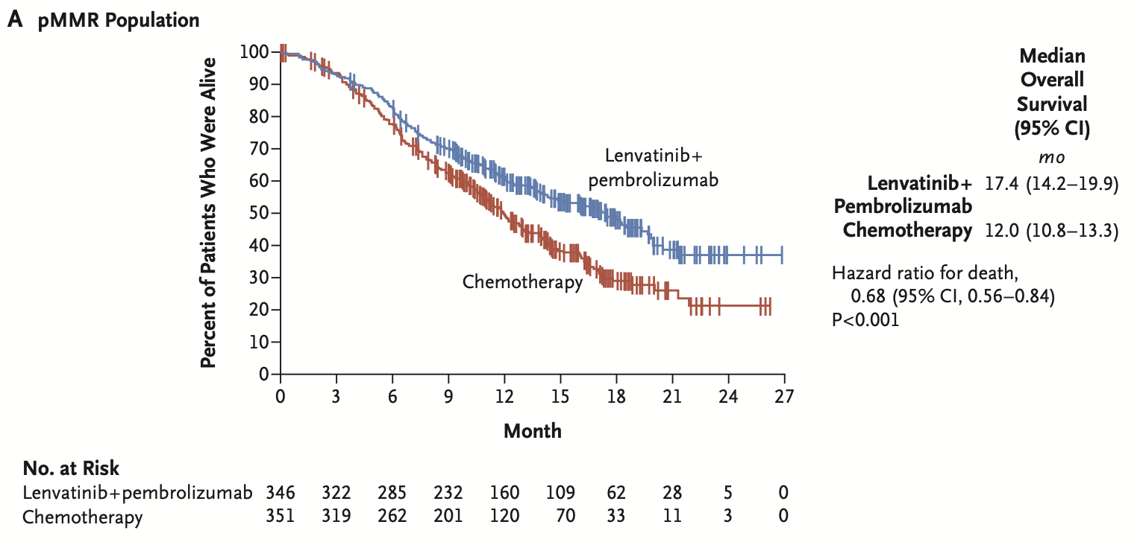
ORR 30% vs 15%
Pembrolizumab + Lenvatinib :
New standard of treatment for EC in progression after platinum and MSS ?
Do MSI EC need Lenvatinib ?

Slide 22
Can we use Pembrolizumab + Lenvatinib in 1st line to get rid of chemotherapy ?
LEAP-001
Chemotherapy alone
1st line metastatic or recurrent EC
R
Pembrolizumab + Lenvatinib
Statistical significance for noninferiority OS endpoint was not achieved for LEN/PEMBRO vs chemo in the pMMR population
HR, 1.02 [95% CI, 0.83–1.26]

Slide 23
Conclusion : IO in endometrial cancer after platinum or IO naïve
MSI EC : excellent results
50% of patients respond, long duration of response
Complete remissions are maintained
MSS EC, progression after platinum
Pembrolizumab + Lenvatinib : better PFS, OS and RR vs chemotherapy
Do not underestimate toxicities

Slide 25
Thank you
roland.eid@hdf.usj.edu.lb

