Slide 1
Managment of advanced vulvar cancer: Primary surgical managment
Montassar Ghalleb, MD , MBA
Assistant professor in surgical oncology, Institute Salah Azaiez Of oncology Tunis Tunisia ,
8th MEMAGO congress & 2nd Athens Ovarian Cancer Synposium
29 November 2024
Notes:
Dear professors and colleagues i am really thrlled to be here with you and discuss the primary surgical mangament of advanced vulvar cancer

Slide 2
Definition
➔
Notes:
AT first when we strated preaparing for this presentation the fisrt definition we found is

Slide 3
Daedalus maze

Slide 4
Ariadne's thread

Slide 5
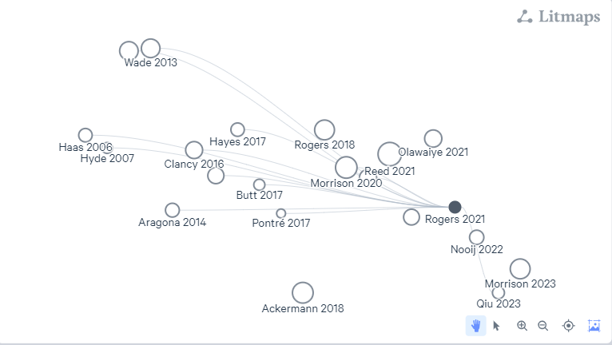
Litmaps
Notes:
We founbd alot of threads from our research assitant litmaps

Slide 6
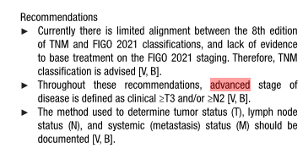
Notes:
We found a more practical definition in the ESGO 2023 update they defined advanced vulvar cancer as tumors staged T3 and higher or N2

Slide 7
Is Ultraradical surgery an option?

Slide 8
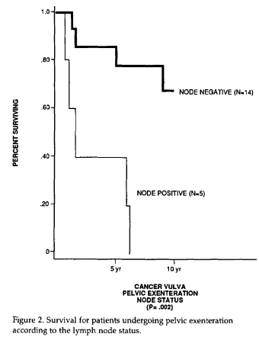
The cumu- lative 5-year survival was 60%.
Notes:
From 1950 through 1989, 19 patients un- derwent pelvic exenteration for advanced or recurrent squamous cell cancer of the vulva. The mean age was 53 years (median, 50 years; range, 40-74 years). The cumu- lative 5-year survival was 60%. Fourteen patients had posterior exenteration; 2 had anterior exenteration; and 3 had total exenteration. The survival was significantly influenced by lymph node status. When lymph nodes were not involved, 10 of 14 patients survived, whereas all 5 patients with lymph node involvement died of disease (P = 0.002). When exenteration was performed as pri- mary therapy, 7 of 11 patients survived, whereas 3 of 8 survived when exenteration was performed for recur- rent disease (P = 0.4). The extent of vulvar involvement did not influence survival (P = 0.99). There was no mor- tality, but ten patients had complications, including vesi- covaginal fistula (three): stoma1 hernia (two): abscess (one); stress urinary incontinence (one); deep venous thrombosis (one);conduit leak (one);enterocutaneous fis- tula (one);and small intestinal obstruction (one).
Conclusions. Acceptable survival for advanced or recurrent vulvar cancer can be achieved with pelvic ex- enteration, but the presence of metastatic disease to lymph nodes markedly decreases survival

Slide 9
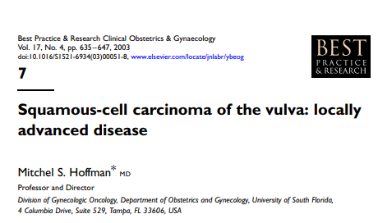
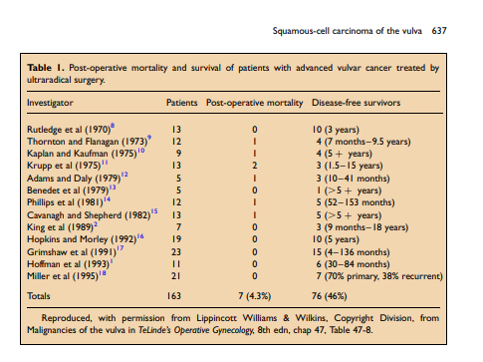
Notes:
The cumulative literature since 1970 includes 163 exenteration patients (Table 1).2,8–18 The post-operative mortality rate ranges from 0 to 20%, with a mean of about 4%. The cumulative disease-free survival rate for these patients is 46%. In those series that have included an analysis, the survival has correlated well with the status of the regional lymph nodes. Most studies have, however, not differentiated inguinal and pelvic lymph nodes. There have been very few survivors with positive groin (and pelvic) nodes, either in our series or elsewhere

Slide 10
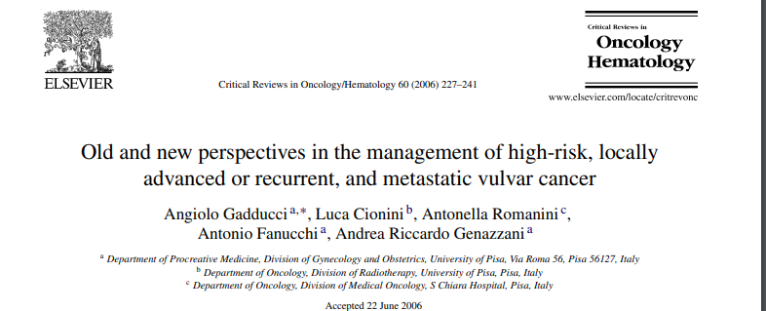
Approximately 30–40% of squamous cell carcinomas of the vulva are in stages III–IV at presentation, and can be surgically managed by en-block radical vulvectomy and bilateral inguinal-femoral lymphadenectomy plus partial resection of urethra, vagina or anum, or by exenteration
Postsurgical complications are relatively high, the quality of life is poor especially in patient with stoma,

Slide 11
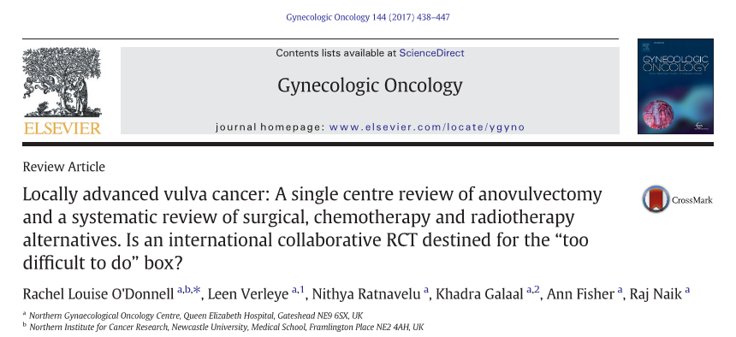
Case series, 57/70 (81%) patients were treated in the primary setting with anovulvectomy and 13 patients underwent anovulvectomy for recurrent disease
The median overall survival (OS) was 69 months (1–336) with disease speciﬁc survival of 159 months (1–336).
Post-surgical complications were observed in 36 (51.4%), the majority of which were Grade I/II infections. There was one peri-operative death.
Notes:
Methods. In this retrospective study we provide the largest published series of LAVC patients treated with anovulvectomy, reporting oncological outcomes and morbidity. Additionally, a systematic literature review was performed for all treatment options 1946–2015

Slide 12
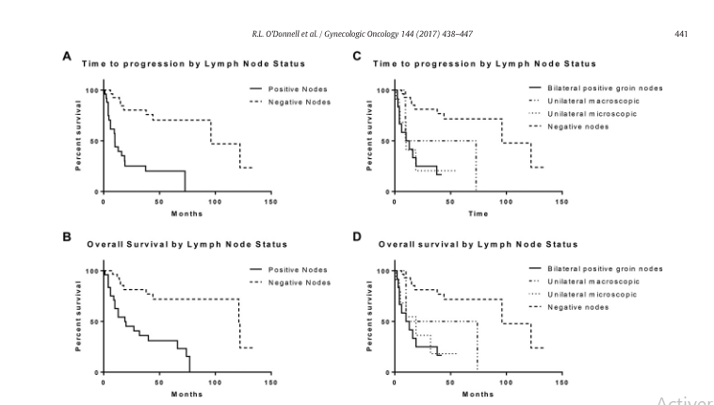
Notes:
Following anovulvectomy for primary disease, time to progression and OS were signiﬁcantly higher in node negative disease (10 vs. 96 months; 19 vs. 121 months, p b 0.0001).

Slide 14
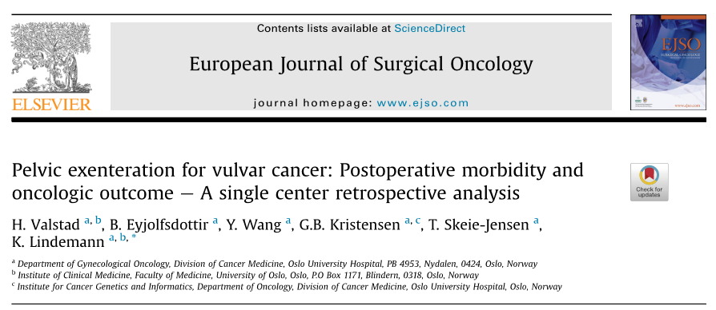
The 30 patients were followed for a median of 4.94 years
Free histopathological margins were achieved in 28 (93%) patients.
The 90 days morbidity for grade 3 complications was 63%, predominantly wound/surgical flap infections 90 days mortality was 3%.
Five-year RFS was 26% OS was 50% and CSS was 64%
OS in the literature 60-70%
Notes:
Due to the rarity of this procedure in vulva cancer and the limited sample size of all published series, it is difficult to compare the point estimates of survival between the studies

Slide 15
PE is recommended in selected cases, especially when radiotherapy is not an option,
Acceptable oncologic outcomes after pelvic exenteration for primary and recurrent vulvar cancer can be achieved if surgery is centralized. Careful patient selection is imperative due to significant postoperative morbidity and considerable risk of relapse.
Notes:
Due to the rarity of this procedure in vulva cancer and the limited sample size of all published series, it is difficult to compare the point estimates of survival between the studies. We report numerically lower overall survival at 5 years (50%) compared to the 60e70% in other reports

Slide 16
The extent of lymphnode dissection

Slide 17
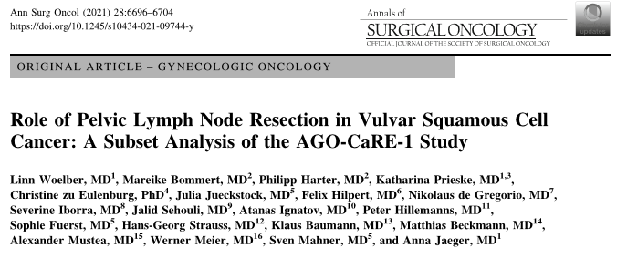
In view of the poor prognosis, the relatively low incidence of pelvic nodal involvement, and the associated increase in surgeryrelated morbidity, surgical staging of the pelvis appears unnecessary for the majority of patients with inguinal node-positive VSCC.
A specific subset of patients, (multiple affected groin nodes, high grade), may have a higher likelihood of benefiting from pelvic lymphadenectomy (LAE) due to an increased risk of pelvic metastasis

Slide 18
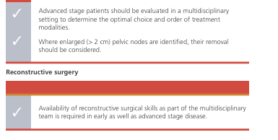
Conclusions

Slide 19
Tunisian experience

Slide 20
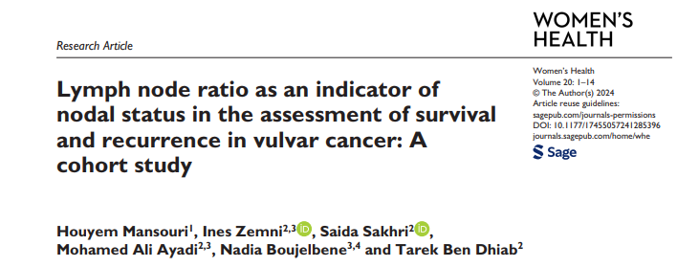
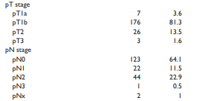

Slide 21
Patient’s selection
Who to operate ? Who to radiate?

Slide 22
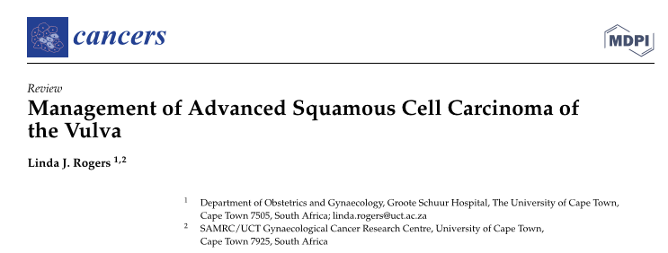

Slide 23
Relative Contraindication to radiation therapy
Uncontrolled Infection
Fistulas
Prior Pelvic Radiation Therapy
Tumor Characteristics
Notes:
Contraindications for Radiation Therapy in Advanced Stage Vulvar Cancer
Severe Comorbidities:Patients with significant comorbid conditions that could be exacerbated by radiation therapy may be considered unsuitable candidates. For example, severe cardiovascular or pulmonary diseases can increase the risk of complications during treatment.
Uncontrolled Infection:The presence of uncontrolled infections in the treatment area or systemically can pose a significant risk. Radiation can impair healing and exacerbate infections, making it contraindicated until the infection is resolved.
Prior Radiation Therapy:Patients who have previously received radiation to the pelvic area may have limited options for additional radiation due to the risk of cumulative toxicity and damage to surrounding healthy tissues.
Tumor Characteristics: Large tumor size (e.g., >4 cm) and certain histological features (such as lymphovascular invasion) may indicate a higher risk of local recurrence, complicating the decision to use radiation as a primary treatment modality. In some cases, aggressive surgical management may be prioritized instead of radiation.
Fistulas:The presence of fistulas (e.g., vesicovaginal or rectovaginal) can complicate the use of radiation therapy. While radiation can sometimes be utilized in these cases, it may be contraindicated if there is significant concern about worsening the fistula or if it poses an immediate health risk.
Poor Performance Status:Patients with a poor performance status (e.g., Eastern Cooperative Oncology Group [ECOG] score ≥ 3) may not tolerate the side effects of radiation well, leading to a recommendation against its use.
Psychosocial Factors:Patients who are unable or unwilling to comply with treatment schedules, including follow-up appointments and supportive care, may also be deemed unsuitable for radiation therapy.

Slide 24
Unavailibility of radiation
Poor country
Notes:
➔ Countries with limited resources find themselves forced to resort to surgery, even if it is major surgery

Slide 25
Reconstructive surgery

Slide 26
Lotus Petal Flap

Slide 27
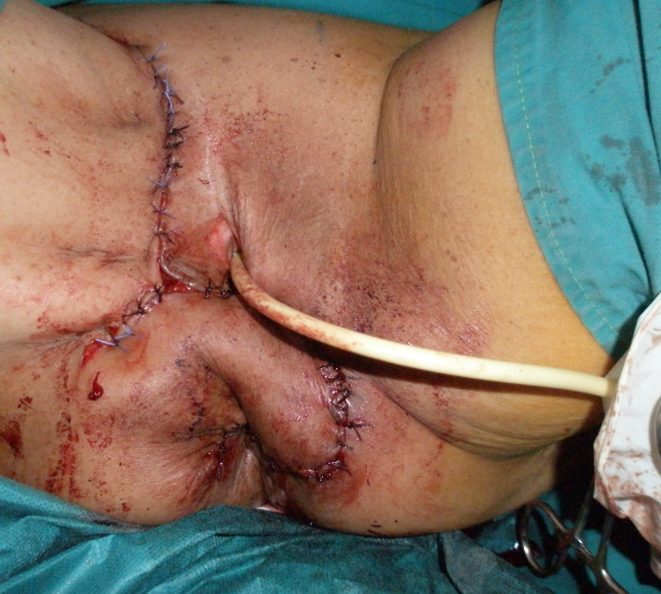
Singapor FLAP

Slide 28
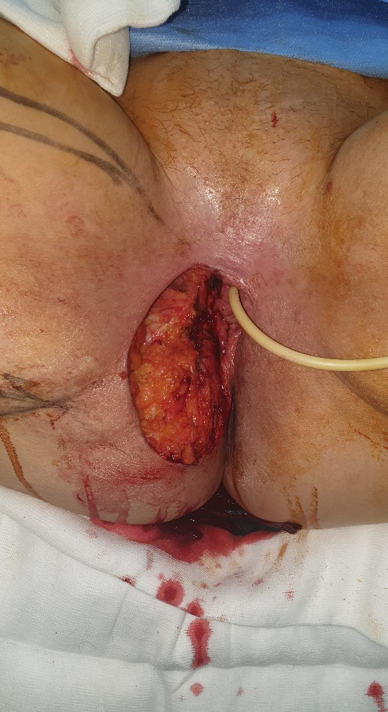
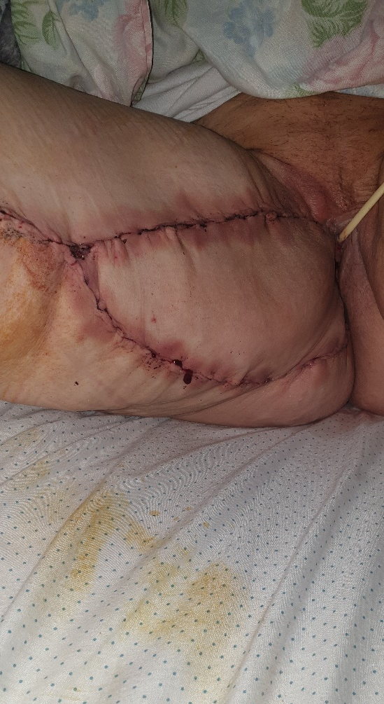
Unilateral gracilis flap

Slide 29
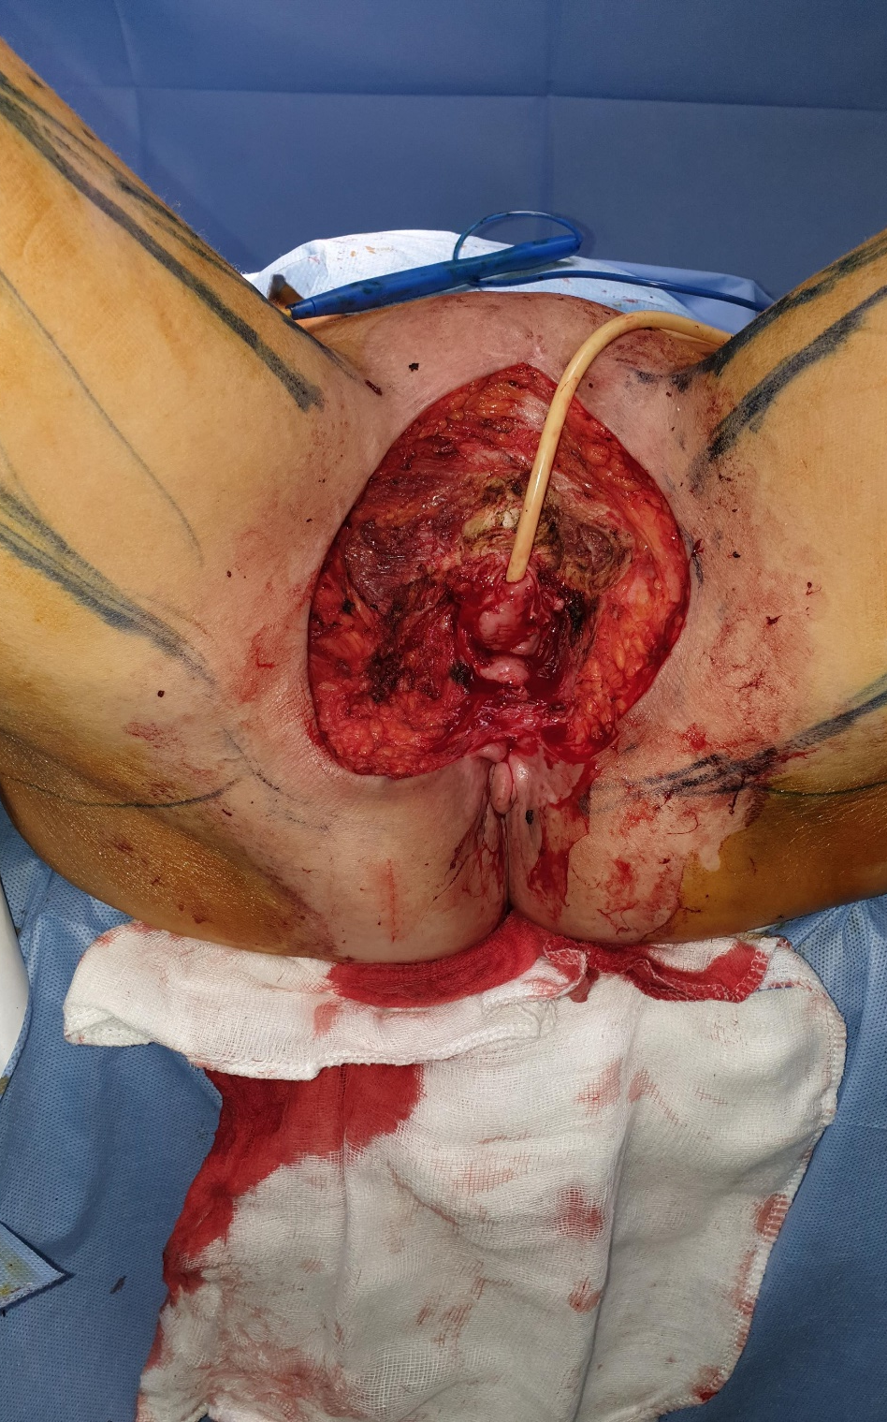
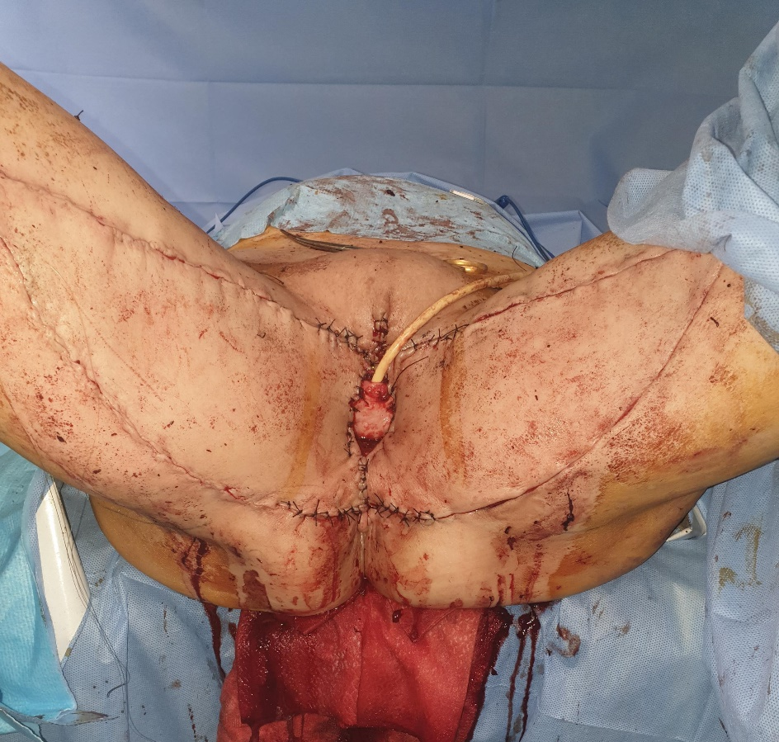
Bilateral gracilis flap

Slide 30
VRAM FLAP

Slide 31
ESGO Guidlines
Multidisciplinary setting is needed to optimize treatment planning
Notes:
Treatment of advanced-stage vulvar cancer often involves multiple treatment modalities. Primary chemoradiotherapy can prevent the need for exenterative surgery, but in some cases surgery may be the treatment of choice. Treatment planning is individualized in advanced-stage disease and depends on primary tumor characteristics and presence of regional and/or distant metastases. Also, co- morbidity and/or frailty of the patient influ- ences treatment planning. Therefore, a multidisciplinary setting is needed to optimize treatment planning.
Several studies have been published on different reconstructive techniques for closure of large vulvar wounds.62–74 The working group concluded that no preferred technique can be recommended, but it is important to consider reconstruction in cases where wound closure will be challenging but also in those cases where recon- struction will give better cosmetic and/or functional outcome (for example, to preserve sexual functioning). Therefore, availability of reconstructive surgical skills as part of the multidisciplinary team is required in early as well as advanced-stage disease

Slide 32
Take home message
Advanced-stage patients should be evaluated in a multidisciplinary setting to determine the optimal choice and order of treatment modalities
Primary chemoradiotherapy is the treatment of choice in patients with unresectable disease and should be considered for tumours which would otherwise need exenterative surgery with stoma formation
Extensive surgery is recommended in selected cases, especially when radiotherapy is not an option
Notes:
However, because of delayed symptoms and consecutive late diagnoses, approximately 40% of the cases show an advanced stage (FIGO III or IV)

