Slide 1
MIS for early stage cervical cancer :
is it safe ?
28-30 November 2024
SLIMANE Maher
Associate professor Surgeon Oncology

Slide 2
Introduction
Incidence, mortality declined
Treatment of early stages is radical hysterectomy with pelvic lymphadenectomy open surgery or radiotherapy
1990’s: Increased uptake of Minimally Invasive Surgery (MIS) by surgeons
MIS associated with decreased treatment-related morbidity
Survival outcomes between open and MIS similar
Notes:
Cervical cancer incidence and mortality has declined over the past few decades in developed countries as a result of screening programs and vaccination
However, it is still a significant cause (koz) of cancer-related mortality in young women
. Early-stage cervical cancer, which is defined as disease limited to the cervix, has traditionally been treated with abdominal radical hysterectomy via laparotomy
Since the early 1990s, minimally invasive surgery has been explored for the treatment of this disease, with the goal of minimizing the morbidity associated with open surgery as has been reported for endometrial cancer surgery

Slide 3
The rise of MIS
Yonsei Med J 2008
Notes:
After the introduction of robot-assisted laparoscopy, MIS (gained widespread acceptance) for the treatment of early-stage CC during the past decade
However, the oncologic safety of MIS was supported only by retrospective and non-randomized studies and meta-analyses based on the retrospective data
in 2006
.8 MIS (has become increasingly popular )due to its reported benefits, including less blood loss, shorter hospital stay, fewer postoperative complications, and less analgesic need.

Slide 4
The Trial
Notes:
The world was at peace with minimally invasive radical hysterectomy for early cervical cancer until the Laparoscopic Approach to Cervical Cancer (LACC) trial
However, major concerns were raised regarding the final results of the LACC tria
Some of the concerns included the lack of a central pathology review, missing data for almost 30% of the patients, short median follow-up time (2.5 years), inclusion of patients by physical examination only without any advanced imaging methods, and inherent heterogeneity of expertise among surgeons participating in the study

Slide 5
The Trial
Notes:
In the present trial, the Laparoscopic Approach to Cervical Cancer (LACC) Trial, tested this hypothesis by prospectively assigning patients to minimally invasive (conventional laparoscopic or robotic) or open abdominal radical hysterectomy and comparing the diseasefree survival rate, the rate of recurrence, and the overall survival rate between the two groups.
A total of 631 patients were enrolled; 319 patients were randomly assigned to minimally invasive surgery and 312 to open surgery.

Slide 6
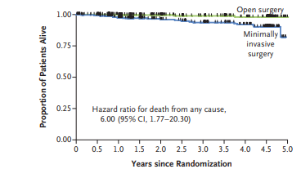
DFS 86% vs 96.5%
lower rate of OS at 3 years
93.8% vs. 99%
Notes:
1/ The DFS at 4.5 years in the intention-to-treat population was 86% in the MIS group compared with 96.5% in the open surgery group (difference: - 10.6% points; 95% confidence interval [CI], - 16.4 to - 4.7; P = 0.87 for noninferiority)
The rate of overall survival at 4.5 years was 90.6% versus 96.2% for the minimally invasive and open surgery groups, respectively (HR for death of any cause 5 2.71 [95% CI, 1.32 to 5.59]; P 5 .007). A
invasive surgery was also associated witha lower rate of overall survival than open surgery(3-year rate, 93.8% vs. 99.0%; hazard ratio fordeath from any cause, 6.00; 95% CI, 1.77 to20.30)
2/ Death occurred in 19 of 319 patients in the minimally invasive surgery group and 3 of 312 patients in the open-surgery group
.3/ Inferior DFS in both subgroups of the MIS surgery arm that had robot-assisted (n = 45) or laparoscopic (n = 244) radical hysterectomy

Slide 7
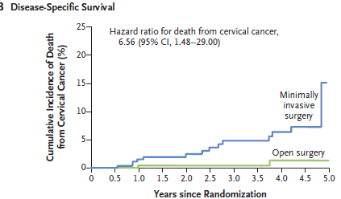
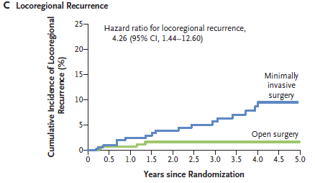
Rate Locoregional recurrence free survival
94.3% vs. 98.3%
MIS :18 of 319 patients
Open : 4 of 312 patients
Death
3-year rate: 4.4% vs. 0.6%
MIS 19 of 319 patients
Open 3 of 312 patients
Notes:
(Fig. 2A), a higher rate of death from cervical cancer (3-year rate, 4.4% vs. 0.6%; hazard
ratio, 6.56; 95% CI, 1.48 to 29.00) (Fig. 2B),
Most recurrences occurred in the
vaginal vault or pelvis (41% of the recurrences in the minimally invasive surgery group and 43%
of those in the open-surgery group).
anda higher rate of locoregional recurrence (3-year rate of locoregional recurrence–free survival,
2/ Death occurred in 19 of 319 patients in the minimally invasive surgery group and 3 of 312 patients in the open-surgery group
A total of 48 participants developed a recurrence (37 in the minimally invasive group and 11 in the open surgery group). Rate of locoregional recurrence at 4.5 years was 4.9% versus 1.8% in the minimally invasive versus open surgery group
rate of recurrence as carcinomatosis for open surgery was 9% (1/11) and for minimally invasive was 23% (8/35).
. 4/ The inferior survival outcomes associated with MIS persisted after adjustment for age, body mass index (BMI), stage of disease, lymphovascular invasion, lymph node involvement, and performance status score

Slide 8
Rate of locoregional recurrence at 4.5 years
MIS 4.9%
OPEN 1.8% P 0 .001
rate of recurrence as carcinomatosis
OPEN 9%
MIS 23%
J Clin Oncol 2024
Notes:
. Rate of overall survival at 4.5 years was 90.6% versus 96.2% for the minimally invasive and open surgery groups, respectively (HR for death of any cause 5 2.71 [95% CI, 1.32 to 5.59]; P 5 .007
A higher proportion of vault (vot) vagina recurrences occurred in the open-surgery group (43%, as compared with 15% in the minimally invasive surgery group),
and all non–vaginal vault pelvic recurrences occurred in the minimally invasive surgery group +++++++++++++++++++++++++

Slide 9
N Engl J Med 2018
Notes:
The controversy grew when the New England Journal of Medicine published the LACC trial in the same issue with the observational retrospective study of Melamed et al.39 using national databases, demonstrating a higher mortality rate among women undergoing MIS compared with open radical hysterectomy (9.1% vs 5.3% mortality risk in 4 years; HR, 1.65; 95% CI, 1.22–2.22) in the United States
2,461 patients who received radical hysterectomy for stage IA2 or IB1 cervical cancer from 2010 to 2013 based on the Surveillance, Epidemiology, and End Results (SEER) program database

Slide 10
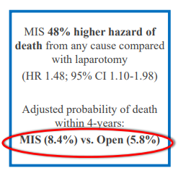
94 deaths MIS
70 deaths OPEN
mortality rates 9.1% Vs 5.3% HR 1, 65
N Engl J Med 2018
Notes:
1/ A total of 94deaths occurred in the minimally invasive surgery group and 70 in the open-surgery group. Weighted survival functions for the minimally invasive surgery group and the open-surgery group are plotted in Figure.
2/ Women who underwentminimally invasive surgery had shorter overall survival than those who underwent open surgery (P = 0.002 by the log-rank test).
3/ the mortality rates were 9.1% and 5.3% among patients who performed minimally invasive surgery and open surgery, respectively (hazard ratio, 1.65; 95% CI, 1.22 to 2.22; P=0.002 by the log-rank test)
4/ An important limitation of the present study is our inability to explain why minimally invasive surgery was associated with shorte
1/may be limits to the extent of resection that can be achieved that are inherent to MIS
2/disseminate tumor cells with MU (yooderen)
3y/ surgeons who were more experienced with open radical h
Women who underwent minimally invasive surgery had shorter overall survival th
,

Slide 11
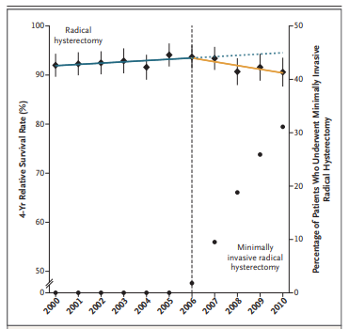
N Engl J Med 2018
Notes:
Adoption of MIS coincided with a decline in 4-year (relative survival rate) of 1% per year after 2006 ???
In exploratory subgroup analyses, robot-assisted radical hysterectomy was associated with (a higher risk of death) than open surgery (hazard ratio, 1.61; 95% CI, 1.18 to 2.21), as was traditional laparoscopic radical hysterectomy
. Before the adoption of minimally invasive radical hysterectomy in the United States (i.e., in the 2000–2006 period), a nonsignificant trend toward longer survival over time was noted among women who underwent radical hysterectomy for early-stage cervical can
The adoption of minimally invasive surgery was associated with a significant change of trend (P=0.01) and coincided with the beginning of a decline in the 4-year relative survival rate of 0.8% (95% CI, 0.3 to 1.4) per year between 2006 and 2010

Slide 12
The Change
Notes:
The LACC study and the following observational studies have caused a major change in the treatment of early-stage CC
The rate of MIS radical hysterectomy for CC (dropped by half)
The NCCN [51], FIGO [52] and the European Society of Gynaecological Oncology (ESGO) [53] (revised their guidelines), (stating that) open abdominal radical hysterectomy is the standard approach for the treatment of early-stage CC.

Slide 13
The Critics
Notes:
However, major concerns were raised regarding the final results of the LACC trial.55
LACC trial was planned at 90% power, but the final power will be only 80% to 85% due to the appropriate early termination of the tria
Some of the concerns included the lack of a central pathology review,
missing data for almost 30% of the patients,
short median follow-up time (2.5 years),
inclusion of patients by physical examination only without any advanced imaging methods, and
inherent heterogeneity of expertise among surgeons participating in the study

Slide 14
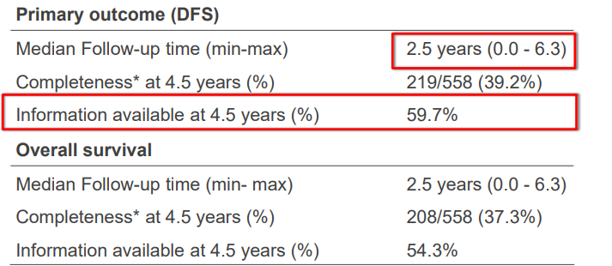
The Critics
Data Completion
Notes:
. However, at the time of analysis, 59.7% of the patients had reached (-the 4.5-year time point_ (median followup, 2.5 years)
, and it was stopped early by the data and safety monitoring committee after enrolling 631 of a planned 740 patients

Slide 15
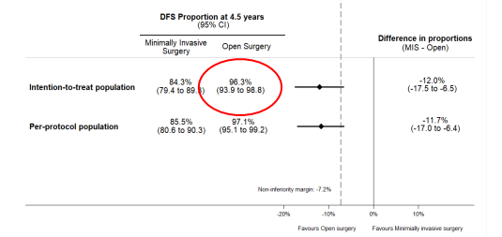
The Critics
Open Arm Excellent Results
92% stage IB1 disease
2% positive vaginal margins
13% nodal metastases
Notes:
The first recurrence rate in the OPEN arm was only 2.2%, with a 4.5-year DFS rate of 96.5%. This seems low for a cohort of patients in whom 92% had stage IB1 disease, 2% had positive vaginal margins, and 13% had nodal metastases

Slide 16
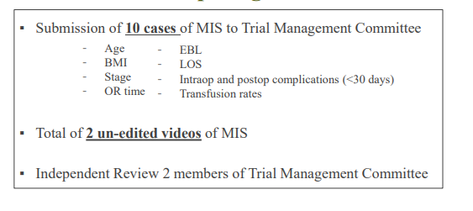
The Critics
Surgical proficiency
Notes:
/ 10 cases performed, surgeons are still in the early phase of the learning curve, which is associated with a poorer prognosis
4
The adequacy of the laparoscopic radical hysterectomy was subjective and based on a review of 2 unedited videos of only type III (not type II, why?
How many videos were submitted but not accepted as adequate because of the lack of radicality?
1

Slide 17
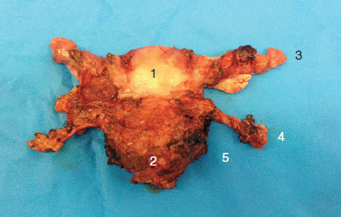
The Critics
Parametrial measurements ?
Lack of central pathology review
Notes:
2/ 3/ An important way to objectively assess the radicality of a radical hysterectomy is to measure the length of the removed parametrial tissue
However, in the LACC trial, parametrial measurements were not measured
(mostly due to ( dooto) the lack of CENTRAL pathology review
, the large amount of missing data regarding pathological characteristics,
4/ The exact locations of these recurrences (peritoneal, lymph nodes, port sites, and others) and the methods used to avoid spread during surgery (use of intrauterine manipulator, early closure of vagina, and prevention of intraperitoneal spillage) remain unanswered

Slide 18
The Critics
Cancer recurrences 14/33
Number of patients?
Wrong Type of radical hysterctomy?
Expertise of the surgeon ?
Notes:
all cancer recurrences in the LACC trial were grouped into 14 of the 33 participating cancer centers. We do not know whether it was due to the number of patients entered at each center, the wrong type of radical hysterectomy performed for the tumor size, or the expertise (eks perteez) of the surgeon in laparoscopic radical hysterectomy, or all of above
If you participate in a 4X100 meter relay race, the 4 runners must perform well gold medal

Slide 19
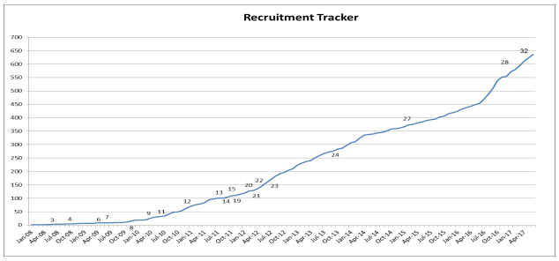
The Critics
Patients per Site
Notes:
eKSSperiiiencccccccc

Slide 20
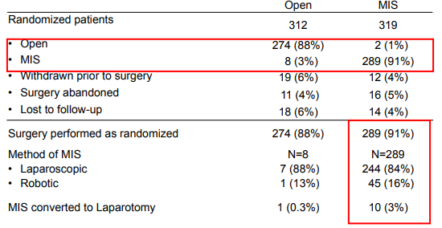
The Limitations
Unequal balance laparoscopy vs robotics
Notes:
l robotic technology was introduced. There were only 45 patients operated on by robotics.

Slide 21
The Limitations
Type II or type III RH ?
Notes:
In the LACC trial, laparoscopic radical hysterectomy included type II and type III, and the choice was left to the operating surgeon, because there were no protocol guidelines indicating which type of surgery should be performed for which tumor size (without preoperative magnetic resonance imaging [MRI] measurement, which is more accurate than visual estimates); accordingly, there are no results provided for each type. We do not know the criteria considered by each surgeon for each type

Slide 22
The Critics
Power ?
Notes:
In the LACC trial, even if the two groups (MIS vs. open surgery) were equally balanced regarding tumor size (≥2 cm: open =121; MIS = 123 and and
results could not be extended to patients with “low-risk” cervical cancer (tumor size,
because the current results are insufficient to compare the survival outcomes of low-risk patients in two surgical procedures
Although not statistically relevant, we have to point out that 7 and 0 events occurred in 75 and 65 patients with tumor <2 cm, having minim
In the prespecified subgroup analysis (Appendix Table A2) for tumor size, we were unable to test for interaction because of no DFS events in patients with
Moreover, it is important to highlight that the study was not powered to test this correlation in this subgroup population
the authors also suggested that such
Furthermore, the power is automatically even lower when it comes to evaluating tumors smaller than 2 centimeters.

Slide 23
< 2 cm : so safe !
5-year OS 97.4% vs. 97.3%, P = 0.894
DFS 93.9% vs. 93.0%, P = 0.393
International Journal of Clinical Oncology (2020)
Notes:
This multicenter retrospective study
Subsequently, in cervical squamous carcinoma with tumor size ≤ 2 cm, the laparoscopic and abdominal groups (724 cases, respectively)
showed comparable 5-year overall survival and disease-free survival rates
MIS does not affect the PFS of patients with stage IB1 cervical cancer with a tumor diameter ≤2 cm, which also supported that the feasibility and safety of MIS surgery for tumor size smaller than 2 cm

Slide 24
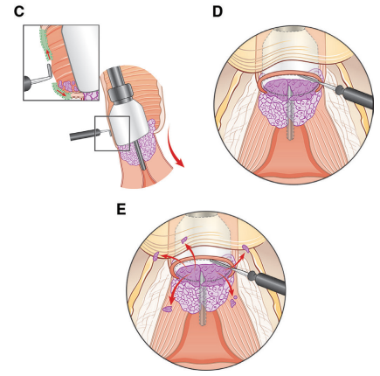
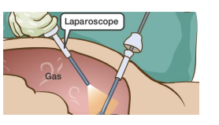
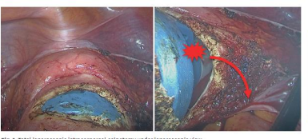
Hypotheses
Routine use of a uterine manipulator : propensity for tumor spillage ↑
Effect of the insufflation gas (CO2 ) on tumor cell growth or spread
Acidosis
Notes:
2/Among the most plausible reasons for the findings of the LACC trial was the issue of tumor contamination, as suggested by the fact that with the minimally invasive surgery approach the uterine manipulator was used in the majority of patients, thus leading to (potential tumor spillage) and exposure to the abdominal and pelvic cavity.
3/ the vaginal cuff is opened laparoscopically above the manipulator rim and, thus, tumor cells may be spread within the peritoneal cavity by circulating carbon dioxide
Several theories could explain the role of CO2 in carcinogenesis
1/. suggested that intraperitoneal tumor spread may be connected to the presentation of cancerous tumor cells to the circulating CO2 pneumoperitoneum associated with the disturbance of the superficial mesothelial layer by high CO2 pressure, leading to tumor cell implantation
2/t the cell colony formation increased significantly after stimulation by CO2
3/t the acidosis of the intraabdominal environment suppresses the peritoneal immune system [43]. The acidic environment also induces damage to the peritoneum, making the adhesion and implantation of tumor cells easier

Slide 25
75% Intraperitoneal contamination
Instrument contamination
Rüdiger Klapdor Acta Obstet Gynecol Scand. 2019
Notes:
). Recently, prospective proof-of-principle study was performed to try to assess this issue
, patients un‐ dergoing routine laparoscopic or robot‐assisted hysterectomy were selected.
ICG was specifically applied to the cervical surface and routine surgery was performed.
During colpotomy, pictures under white and fluorescence light were taken to evalute frequency of contamination
Peritoneal contamination with cervical secretion frequently occurs dur‐ ing (doorin) intracorporal (intercorppro) colpotomy‐
ate frequency of contamination(E) Intraperitoneal contamination of a tissue fragment at the right pelvic wall and (F) an example of isolated contamination of the laparoscopic instrumen

Slide 26
The reasons ?
The steep learning curve of minimally invasive radical hysterectomy
The non-standardized technique and radicality of hysterectomies
Mesothelial cell hypoxia due to CO2 pneumoperitoneum
Tumor contamination at the time of colpotomy, directly worsened by the flow of CO2
Notes:
The real reasons why minimally invasive surgery is correlating with worse outcomes in ( kemperessen) comparison to open surgery are still unknown and controversial.

Slide 27
Specific precautions
Low pressure
Uterine manipulation
Vaginal colpotomy
conization
Surgical Expertise/Learning Curve
Good assessment of tumor size ( MRI)
Notes:
One of the solutions to overcome the possible negative consequences of CO2 could be to use low-pressure pneumoperitoneum combined with an abdominal wall lift

Slide 28
Specific precautions
Low pressure
Surg Endosc (2006)
Notes:
One of the solutions to overcome the possible negative consequences of CO2 could be to use low-pressure pneumoperitoneum combined with an abdominal wall lift
Abdominal wall lifting by anchoring (encrin) sutures around the camera port in addition to low-pressure pneumoperitoneum is a simple, safe, and effective method for laparoscopic colorectal procedure.

Slide 29
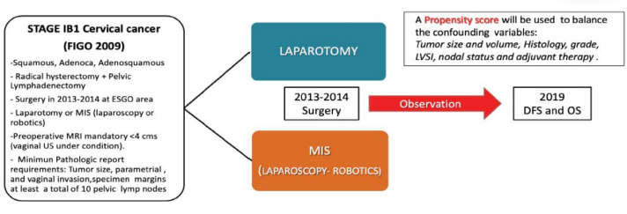
Uterine manipulator
Specific precautions
Chiva L. Int J Gynecol Cancer 2020

Slide 30
Specific precautions
Uterine manipulator
Risk of recurrence was twice
T≤ 2 cm HR 1.63
Risk of death was 2.42 times higher
DFS 4.5years MIS 79% open 89% (P=0.0003)
Notes:
a European, multicenter, observational, retrospec
1 primary goal (goo) of comparing disease-free survival at 4.5 years in patients who underwent a laparoscopic or robotic radical hysterectomy vs abdominal 1hysterectomy for FIGO 2009 stage IB1 cervical cancer
2
.2 More specifically, we aimed to determine (if the use of a uterine manipulator and protective vaginal closure over the cervix ) to avoid tumor spread at the time of the colpotomy might impact the outcome
3 we investigated the influence of tumor diameter on oncologic outcomes
Disease-free survival at 4.5years was 79% in the minimally invasive group and 89% in the open surgery group (P=0.0003).
The risk of recurrence for patients who underwent minimally invasive surgery was twice that of the open surgery group (HR, 2.07; 95%CI, 1.35 to 3.15; P=0.001)
patients with tumors smaller or equal than 2cm those differences were not significant (HR, 1.63; 95%CI, 0.79 to 3.40; P=0.19)
e risk of death was 2.42-times higher than
hese differences were significant in patients with tumors greater than 2cm (HR, 2.26; 95%CI, 1.18 to 4.36; P=0.014) but not in patients with tumors smaller or equal to 2cm

Slide 31
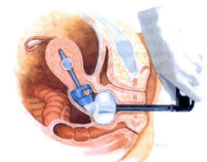
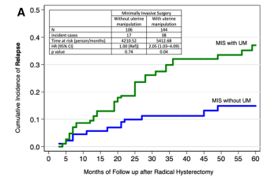
Specific precautions
Uterine manipulator
Impact of uterine manipulator in minimally invasive surgery
2.6 times higher chance of a relapse
T>2 cm HR 3.05
Notes:
1/ The patients that underwent minimally invasive surgery with a uterine (yooterin) manipulator (menipilayder) had a 2.76-times higher chance of a relapse compared with those in the open approach (HR, 2.76; 95%CI, 1.75 to 4.33; P<0.001
2/ The adverse effect of the uterine manipulator significantly impacted patients with tumors greater than 2cm (HR, 3.05; 95%CI, 1.73 to 5.38; P

Slide 32
Vaginal colpotomy, vaginal closure
Specific precautions
Protective vaginal closure (PVC) in minimally invasive surgery
Relapse: 25%(52/207) vs 7% (3/43)
DFS: 93% (PVC) vs 74%
(P< 0:001)
Notes:
the three groups of patients: minimally invasive surgery patients with and without protective vaginal closure, and those with open surgery
52 (25%) of 207 patients had a relapse among those without protective vaginal closure, while only 3 (7%) of 43 recurred amid those that underwent this protective surgical maneuver (P<0.001).
1/ Disease-free survival at 4.5 years was 93% with protective vaginal closure and 74% in those without (P<0.001)
2/ . Moreover, those who underwent minimally invasive surgery with vaginal closure had similar rates of relapse to those who underwent open surgery (HR, 0.63; 95%CI, 0.15 to 2.59; P2cm (HR, 2.99; 95%CI, 1.78 to 5.00; P<0.09).

Slide 33
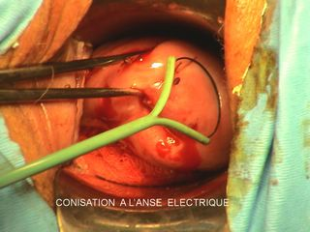
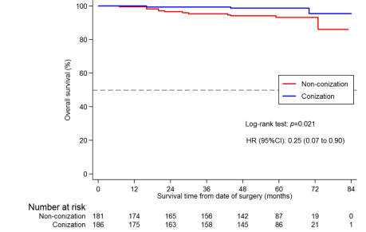
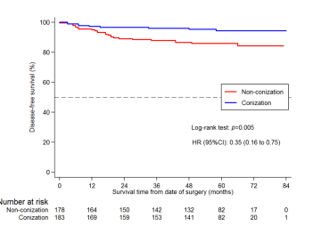
Specific precautions
Conization
65% reduction in the risk of relapse
5.63 times higher chance of relapse
75% reduction in the risk of death
Chacon E, Int J Gynecol Cancer 2022
Notes:
cohort of 374 patients (187 patients with prior conization and 187 nonconization patients).
We found a 65% reduction in the risk of relapse for patients who had cervical conization prior to radical hysterectomy (hazard ratio (HR) 0.35, 95% confidence interval (CI) 0.16 to 0.75, p=0.007) and a 75% reduction in the risk of death for the same sample (HR 0.25, 95%CI 0.07 to 0.90, p=0.033
, patients who underwent minimally invasive surgery without prior conization had a 5.63 times higher chance of relapse compared with those who had an open approach and previous conization
Manipulation of macroscopic tumors during the surgery and tumor leakage could play a substantial role in the increased risk of recurrence associated with MIS.
the role of conization as a protective factor for patients undergoing a radical hysterectomy. After homogenizing the population using the Propensity Matching Score (PMS), they showed that preoperative conization could have a protective effect, with the risk of relapse reduced by 65% (HR: 0.35 CI 95% (0.16–0.75) p = 0.007) and the risk of death reduced by 75% (HR: 0.25 95% CI (0.07–0.90) p = 0.033)
we believe that cervical conization, especially in small tumors (up to 2 cm, conization has no role in large tumors), may be used for tailoring the surgery and the choice of surgical approach in cervical cancer patients

Slide 34
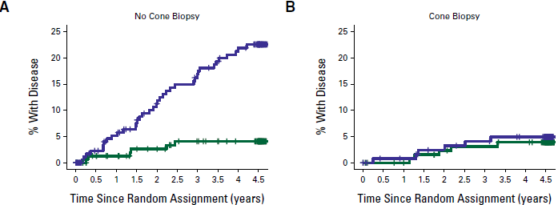
Specific precautions
Recurrence rate
MIS
open
HR 5.85 P < .0001
HR 1.27 P = .69
Notes:
(A) In patients who had no previous conization,
minimally invasive surgery was associated with higher recurrence rate (HR, 5.85 [95% CI, 2.47 to 13.9]; P < .0001the effect of treatment differed between those who had a previous conization
compared with those who did not (P-interaction 5 .042) for DFS.
There was no difference between treatment groups in those who had a previous conization (HR, 1.27 [95%
CI, 0.39 to 4.17]; P 5 .69),
while in those participants who had not had a previous conization, minimally invasive surgery was associatedwith higher recurrence rate

Slide 35
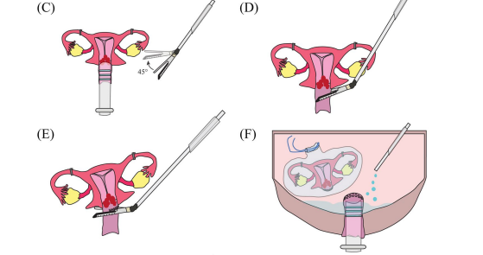
Specific precautions
Vaginal closure
Park . BMC Cancer (2022)

Slide 36
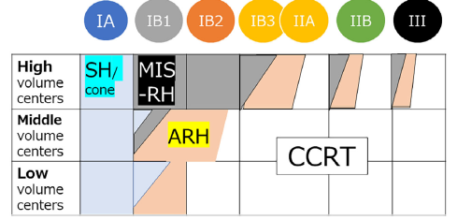
Selection options
Learning curve and volume center
Technical skills and abilities
13 cases for LRH
21 cases for RRH
Sipmle hystrectomy
Robot assisted or laparoscopic
Abdominal RH
Notes:
Scheme of reasonable treatment selection options for cervical cancer of each stage in
high, middle, low volume centers.
Blue tiles indicate simple hysterectomy (SH) or conization (cone),
gray tiles indicate robot-assisted or laparoscopic RH (MIS-RH),
orange tiles indicate abdominal RH (ARH), and white tiles indicate CCRT

Slide 37
Ongoing trials
Notes:
Three large studies are ongoing to assess the impact of minimally invasive techniques in managing cervical cancer [37].
The Robot-assisted Approach to Cervical Cancer (RACC) trial is focusing on the role of robotic-assisted surgery. The RACC study is randomizing patients to robotic-assisted and open surgery. The estimated enrollment is 800 patients. The estimated study completion date is February 2027 [
The RWS-01 trial is a multicenter, prospective, non-randomized study aiming to enroll 2000 participants having minimally invasive and open abdominal radical hysterectomy in China. The estimated study completion date is May 2024.
The Minimally Invasive Therapy Versus Open Radical Hysterectomy (MITOR) for the management of early-stage cervical cancer aims to compare laparoscopic and open radical hysterectomy. The MITOR study is a prospective, randomized controlled trial. The estimated enrollment is 820 participants. The estimated study completion date is July 2033 [

Slide 38
Conclusions
We need to constantly reflect and treat the early stage minimally invasive surgery for cervical cancer
Laparoscopic surgery requires a long learning curve, in many cases, not minimally invasive surgery is inferior to open surgery, but the surgeon's laparoscopic skills are not mature enough
MIS radical hysterectomy may still be the best approach for patients with tumors less than 2 cm in size
NOT…. ALL or none………………

Slide 39
THANK YOU

