Slide 1
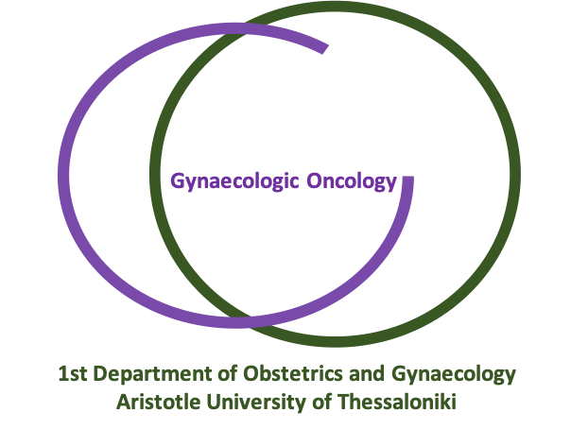
The role of MIS in the management of ovarian cancer - PRO open surgery
Τsolakidis Dimitrios
Assistant Professor, Aristotle University of Thessaloniki Head of Gynecological Oncology Unit of 1st Dept Obstetrics and Gynecology

Slide 2
Disclosures
Astra Zeneca: Paid speaker 2023, 2024

Slide 3
UpToDate Results of minimal invasive surgery in gynecological oncology
Stage of disease and type of cancer | Laparoscopy vs Laparotomy Randomized Trial | Results
Stage I-IIA endometrial cancer Stage I endometrial cancer | LAP2, Walker J et al JCO 2009, 2012 LACE Janda M et al JAMA 2017 | Non- inferiority of recurrence Identical 5y OS
Stage IA1-IB1 | LACC, Ramirez P et al NEJM 2018 | MIS is associated with lower of DFS and OS
Stage III-IV EOC | LANCE, Nitecki R et al IJGC 2020 up to 580 patients will be randomized | Non-inferiority of DFS
Notes:
Endoscopy was accepted as surgical approach in patients with stage I endometrial cancer. rarelyspreads to lymph nodes an d shows very late peritoneal metastases. LACC MULTICENTER PHASE III TRIAL NON INFERIORITY RANDOMIZED TRIAL 319 LAP VS 312OPEN
LAPAROSCOPY IS NOT A SAFE PROCEDURE.

Slide 4
Advantages of laparoscopy
Limitations of laparoscopy
Advantages of Robotic
Minimal scarring
Shorter hospital stay
Reduced pain and discomfort
Faster recovery
Shorter hospital stay
Enhanced visualization
Reduced blood loss
Lower risk of hernias
Faster onset of chemotherapy
Technical expertise and training is required
Longer Operative times
Limited Surgical Access
Specialized equipment, instrumentation
Absence of feeling tissues
Trocar injuries
Patients with pulmonary disorders cannot tolerate gas
3 dimensional view
Improved vision
Increased dexterity
Tremor filtration
More favorable learning curve compared with laparoscopy
Nezhat et al, Am J Obstet Gynecol 2009
Lee M et al, Int J Gynecol Cancer 2011
Robinovich A, Int J Med Robot 2015
Patil M et al, Cureus 2024
Antoniou S et al, Surg Endosc 2012
Krill L et al, Cancer Journal 2013
Notes:
MINIMAL INVASIVE SURGERY HAS NUMEROUS BENEFITS INCLUDING . However limitations of vision and instruments using traditional laparoscopy, it is difficult to achieve satisfactory cytoreductive in advanced ovarian cancer. Laparoscopy is not suitable for huge ovarian masses. Robotic assisted laparoscopic surgery Lack of technical expertise requires extensive training to perform advanced laparoscopic surgeryEquipment that are not always be accessible at healthcare facilities.
The surgeon has limited range of movement from a tiny hole and poor depth perception
Hence unable to judge the force needs to be applied due to less tactile feedback
People having low BMI or history of prior abdominal surgeries are more prone to such injuries that are life threating
Unfavorable medical conditions
Certain patient factor such as obesity, severe scarring or certain medical conditions make laparoscopic surgery more difficult or less feasible.

Slide 5
EARLY OVARIAN CANCER

Slide 6
CONCLUSIONS: Laparoscopic surgery shows favorable prognostic outcomes in terms of postoperative complication rates and postoperative hospital stay durations. Further studies with longer follow-up periods are required to confirm recurrence and survival outcomes after laparoscopic surgery in patients with apparent early-stage ovarian tumors.
Notes:
. It seems laparoscopy has better short term favorable results. This meta analysis incliuded clinical trials with small sample size of patients in both arms emphasizes the need for further studies with longer follow-up periods are

Slide 7
Meta analysis of 2382 patients with early stage ovarian cancer .
Worse prognosis of patients with preoperative rupture compared to patients with intraoperative or no rupture [ΗR=2.63 (95% CI: 1.11-6.20)]
Intra operative cyst rupture may not decrease PFS when compared with no rupture in patients with early stage ovarian cancer who underwent complete surgical staging operation and adjuvant chemotherapy [HR=1.49 (95%CI: 0.45-4.95)]
Notes:
ΣΥΝΕΠΩΣ ΤΟ ΕΡΩΤΗΜΑ ΠΑΡΑΜΕΝΕΙ ΕΆΝ Η ΧΕΙΡΟΤΕΡΗ ΠΡΟΓΝΩΣΗ ΜΕ ΤΗΝ ΔΙΕΓΧΕΙΡΗΤΙΚΗ ΡΗΞΗ ΤΗΣ ΚΥΣΤΕΩΣ ΕΊΝΑΙ ΕΞΑΙΤΙΑΣ ΤΗΣ ΡΗΞΗΣ Ή ΣΕ ΔΙΑΦΥΓΗ ΔΙΑΓΝΩΣΗΣ ΠΡΟΧΩΡΗΜΕΝΗΣ ΝΟΣΟΥ ΣΤΙΣ ΑΣΘΕΝΕΙΣ ΠΟΥ ΔΕΝ ΣΤΑΔΙΟΠΟΙΗΘΗΚΑΝ ΣΩΣΤΑ.
ΡΗΞΗ ΕΧΟΥΝ ΟΙ ΟΓΚΟΙ grade 2,3 με παρουσια συμφυσεων και λιγότερο εμφανιζουν ρήξη οι βλεννώδεις όγκοι

Slide 8
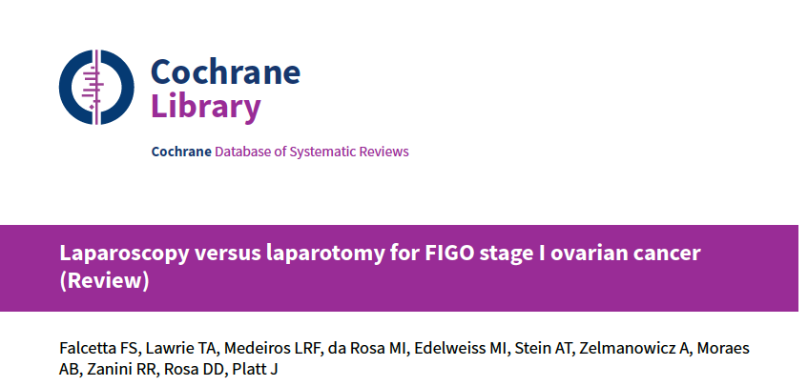
No randomized trials
3 case control studies + 5 retrospective cohort studies
6 report survival data
Follow up varied widely
Small sample size
Absence of statistical adjustments for baseline case
AUTHORS' CONCLUSIONS:
This review has found no good-quality evidence to help quantify the risks and benefits of laparoscopy for the management of early-stage ovarian cancer as routine clinical practice.
Notes:
Three case control studies and five retrospective cohord studies, with absence of survival data higher PFS rates in the laparoscopy group (100% for. laparoscopy versus 91% for laparotomy) and did not report OS,however median follow-up was much shorter in the laparoscopy group compared with the laparotomy group (12 versus 25 months)
and mean tumour size was significantly larger in the laparotomy.

Slide 9
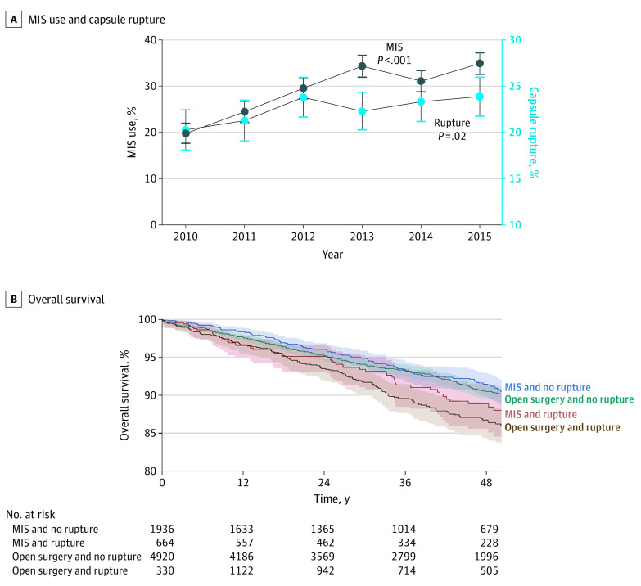
MIS and cyst diameter is associated with increased risk of tumor capsule rupture
Matsuo K et ai, JAMA Oncol, 2020
Multivariable Analysis for MIS Use and Capsule Rupture
Characteristic | No. | MIS (%/row) | aRR (95% CI) | Rupture (%/row) | aRR (95% CI)
MISª
No | 6250 | NA | NA | 1330 (21.3) | 1 [Reference]
Yes | 2600 | NA | NA | 664 (25.5) | 1.17 (1.06-1.29)^{b}
Tumor size, mm
0-20 | 1053 | 420 (39.9) | 1 [Reference] | 187 (17.8) | 1 [Reference]
21-40 | 628 | 250 (39.8) | 1.05 (0.93-1.18) | 135 (21.5) | 1.17 (0.94-1.44)
41-60 | 522 | 230 (44.1) | 1.15 (1.02-1.29)^{b} | 128 (24.5) | 1.27 (1.03-1.56)^{b}
61-80 | 607 | 262 (43.2) | 1.13 (1.00-1.27)^{b} | 176 (29.0) | 1.46 (1.21-1.75)^{b}
81-100 | 722 | 277 (38.4) | 1.01 (0.90-1.13) | 244 (33.8) | 1.74 (1.46-2.08)^{b}
>100 | 4452 | 851 (19.1) | 0.53 (0.48-0.59)^{b} | 946 (21.2) | 1.19 (1.02-1.38)^{b}
Unknown | 866 | 310 (35.8) | 0.97 (0.85-1.10) | 178 (20.6) | 1.13 (0.93-1.38)
Notes:
In a large retrospective analysis of 8850 early ovarian cancer patients from 2010 to 2015 and the deleterious oncological influence The rate of rupture increased from 20.2% (269 of 1330) in 2010 to 23.9% (379 of 1589) in 2015 (18.3% relative increase). In a multivariable analysis, MIS was independently associated with capsule rupture (adjusted relative risk, 1.17; 95% CI, 1.06-1.29; Table). Larger tumor size was also associated with higher risk of capsule rupture. Women with ruptured tumors were more likely than women with non-ruptured tumors to receive chemotherapy

Slide 10
Ronsini C, et al. J Clin Med 2023
11 comperative studies between MIS and Open Surgery
4041 patients
Upstaging Rate >FIGO stage I was statistically significant higher in the Open Surgery group.
Notes:
This meta analysis did not show a statistic signigifcant difference between MIS and Open Surgical Staging. Except from that upstaging rate was significantly higher in the open surgery group.This explained that MIS may be performed by in highly specialized centers by surgeons with extensive experience and with specific tumor features minimizing the risk of spillage

Slide 11
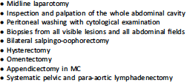
Surgical management of early-stage ovarian carcinoma
Annals of Oncology 2023
Notes:
In cases when the initial ovarian tumor has been removed and there is no risk of rupture of the ovarian lesion and this should be carried out by trained surgeons in expert centers to assure optimal assessment vision of all abdominal quadrants ant to lower the risk of peri and post operative complication

Slide 12
ADVANCED OVARIAN CANCER

Slide 13
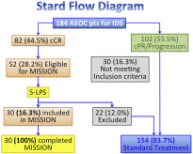
Minimally invasive interval debulking surgery in ovarian neoplasm (MISSION trial–NCT02324595): a feasibility study
Alleti SG, et al, AJOG 2016
2013--2015
Inclusion Criteria:
Age >18 years,
Advanced ovarian cancer submitted to neoadjuvant chemotherapy,
Clinical or serological complete/partial response (RECIST; GCIG),
PS ≤ 2 (ECOG),
Conclusion: Invasive-IDS in patients with clinically complete response to NACT seems to be feasible and safe in terms of perioperative outcomes, psycho-oncological impact, and survival rate. The equivalence between MI surgery and laparotomy needs to be confirmed with a longer follow-up and a larger number of patients.
Notes:
This is a phase II multicentric study in advanced EOC cases with clinical complete response after NACT, was named “MISSION” trial. For patients meeting inclusion criteria, surgical procedures started with diagnostic laparoscopy to confirm preoperative findings and assess surgical complexity.
From December 2013 through February 2015, of 184 advanced EOC patients considered eligible for IDS, 52 (28.2%) met inclusion criteria and were enrolled in the study. For 22 (12%) of them, standard laparotomic approach was preferred because of intraoperative surgeon evaluation. Thirty (16.3%) patients received the planned treatment of MI-IDS. Median age was 61 (range 39-81) years and median body mass index was 24 (range 20-31) kg/m². Median numbers of NACT cycles was 4 (range 3-7). L. A residual tumor of 0 cm was reached in 29 (96.6%) patients and 0.5 cm in only 1 (3.4%) case.. Median time to restart chemotherapy was 20 (10-30) days and all patients successfully completed the cycles. Histological findings showed 3 (10%) complete response, 9 (30%) microscopic residual disease, and 18 (60%) evidence of macroscopic residual disease. With a median follow-up of 10.5 month, 5 peritoneal and 2 lymph nodal recurrences were observed. All patients are still alive.

Slide 14
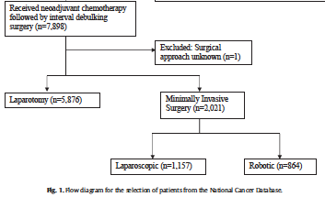
Minimally invasive interval debulking surgery for advanced ovarian cancer after neoadjuvant chemotherapy.
Jorgensen K et al Gyn Onc 2023
Variable | MIS N=2021 | Laparotomy N=2021 | p-value
Additional cytore- ductive procedures | 1190(59.3) | 1428 (70.8) | <0.01
No residual tumor, n (%) | 873 (43.2) | 780 (38.6) | 0.01
Residual | 483 (23.9) | 539 (26.7)
Unknown | 655 (32.9) | 702 (34.7)
Overall survival months (95% CI) | 46.7 (44.7-48.6) | 41.0 (35.5-41.2) | <0.01
5year survival propability % (95% CI) | 38.3% (35.5-41.2%) | 34.8% (32.1-37.5%)
N=7898
N=5876
N=2021
N=1157
N=864
NCD 2013-2018
Notes:
Retrospective national study from USA with inadvertent selection biases. Propensity score matching was used to compare MIS group and Laparotomy for IDS in order to create a cohort in which patients were balanced on the covariates used in the multivariate regression model , as those variates may confound the effect of treatment approach on survival.
Overall patients in the MIS had a 14% decreased hazard of all causes mortality compared with patients in the laparotomy group.
A

Slide 15
Minimally invasive interval debulking surgery for advanced ovarian cancer after neoadjuvant chemotherapy.
Jorgensen K et al Gyn Onc 2023
…we tested the robustness of the overall survival HR to potential unmeasured confounders, and we found that moderate unmeasured confounding would be required to reverse the overall survival finding in this study.
Notes:
Retrospective natioanal study from USA with inadvertent selection biases.
Propensity score matching was used to compare MIS group and Laparotomy for IDS in order to create a cohort in which patients were balanced on the covariates used in the multivariate regression model , as those variates may confound the effect of treatment approach on survival.
Overall patients in the MIS had a 14% decreased hazard of all causes mortality compared with patients in the laparotomy group.
A

Slide 16
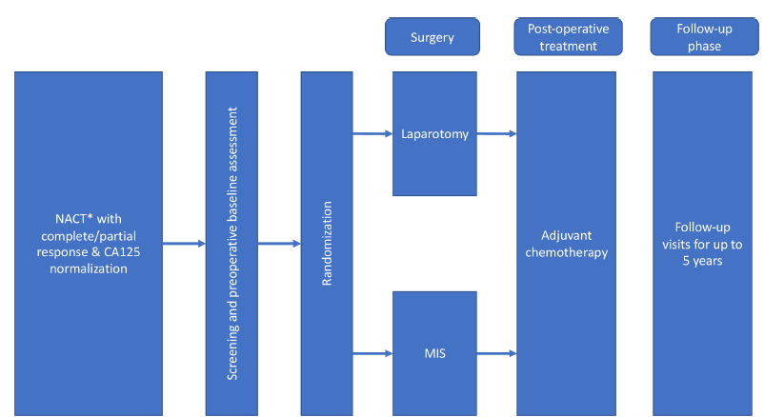
Laparoscopic cytoreduction After Neoadjuvant ChEmotherapy (LANCE)
Nitecki R et al. IJGC 2020
International, prospective, randomized, multicenter non inferiority phase III trial
Age ≥ 18 years old
Stage IIIC or IV EOC.
3 to 4 cycles of platinum-based chemotherapy,
complete radiologic resolution of any disease outside the abdominal cavity
Normalization of CA-125 or
CA-125 value ≤500 and diagnostic laparoscopy prior to debulking surgery.
ECOG performance status 0-2
Up to 580 patients will be randomized
Notes:
the crossover rate in the minimally invasive group is less than 25%;
the difference of complete gross resection between the minimally invasive and open group is less than 20%.
If the study is determined to be feasible, all remaining
participants will be enrolled into the Phase III stage

Slide 17
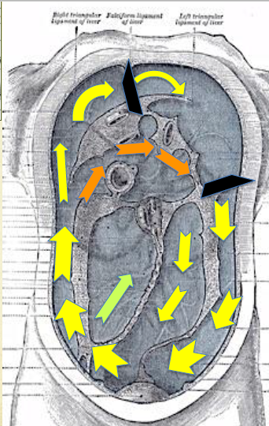
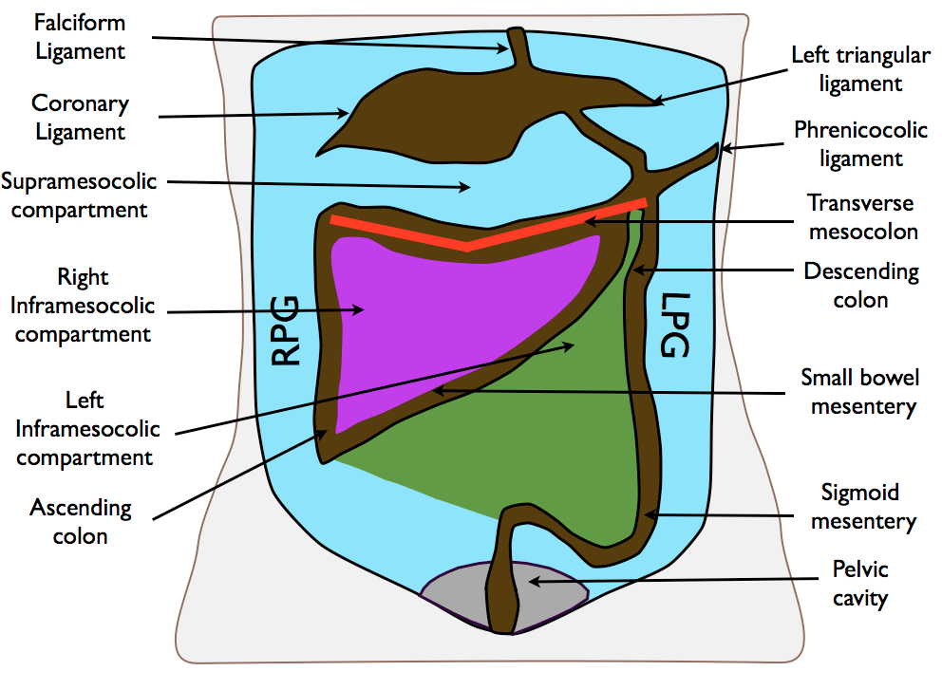
Ovarian Cancer: Disease of the whole peritoneal cavity
Notes:
Exploration of gerota fascia, mesenteric root, the lesser omentum, the omental bursa, omental foramen is much more difficult or cannot be adequately assured using a laparoscopic treatment approach, even though inspection of these structures is of crucial importance for the completeness of surgical staging. Laparoscopy does not allow for digital palpation of the abdominal structures.

Slide 18
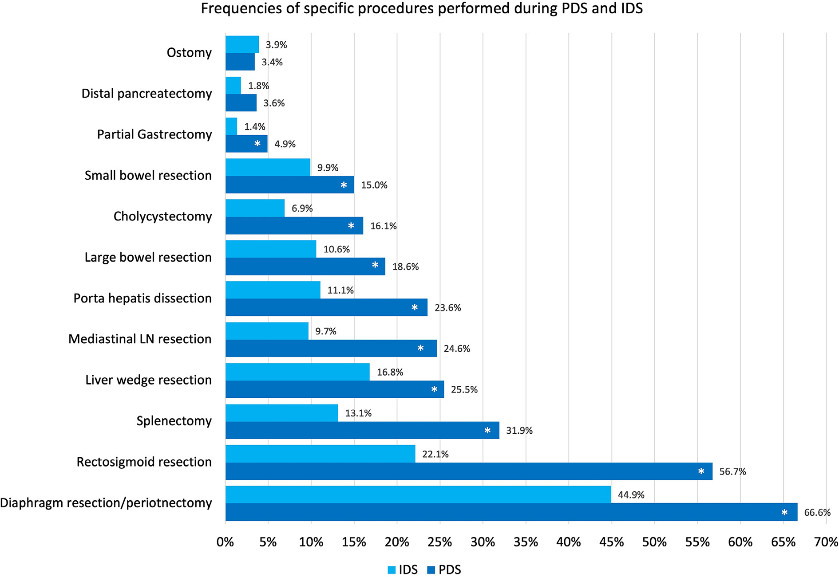
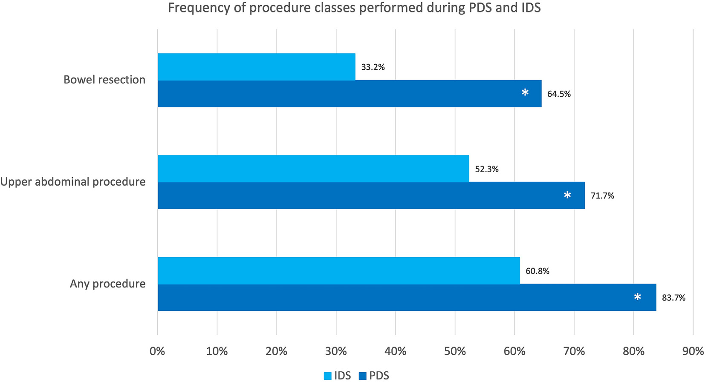
Trends in specific procedures performed at the time of cytoreduction
for ovarian cancer: Is interval debulking surgery truly less radical?
Filippova O et al Gyn Onc 2024
Notes:
Overall, 467 patients underwent PDS and 434 underwent IDS; 76% (PDS) and 71% (IDS) of cases achieved complete gross resection. At least one advanced surgical technique is required in as many. As 50% of interval debulking surgical procedures. Which suggests advanced surgical techniques remain essential and increased training requirements .
During primary debulking 143 procedures (31%) involved a consulting surgeon mainly 61% from hepatopancreaticobiliary service.
During interval debulking 78 cases (18%) involved a consulting surgeon and 65% were from hepatopancreaticobiliary survice. And

Slide 19
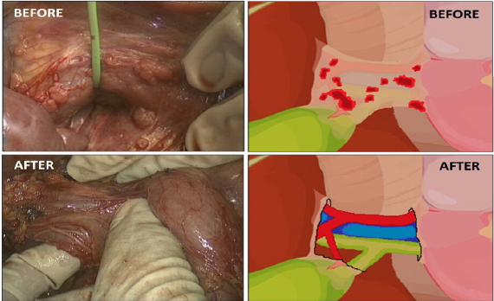
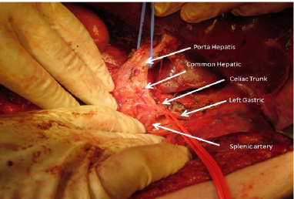
Tozzi R et al. Gynecol Oncol 2016
31/216 (14.3%) patients stage III/IV had tumor at porta hepatis and/ or hepato-celiac lymph nodes
In 8 /31(25.8%) patients it was found at the exploratory laparoscopy
Notes:
All patients had the CT scan reviewed at the Multi-disciplinary team (MDT) meeting and
underwent an exploratory laparoscopy at time of VPD.

Slide 20
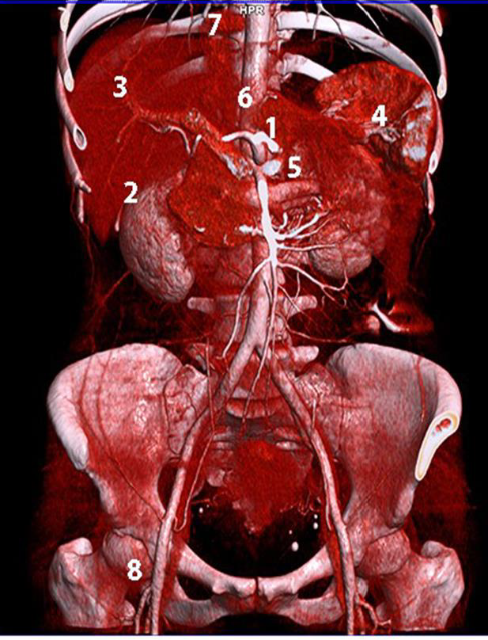
Kostov S, et al Cancers 2024
Notes:
Neglected anatomical areas that may contain residual tumor in advanced ovarian cancer. 1—omental bursa; 2—Morison’s pouch; 3—base of the round ligament and hepatic bridge; 4—splenic hilum; 5—suprarenal lymph nodes; 6—retrocrural lymph nodes;7—cardiophrenic lymph nodes; 8—inguinal lymph nodes. Suprarenal, retrocrural and cardiophrenic lymph nodes should be evaluated in cases of bulky paraaortic lymph nodes

Slide 21
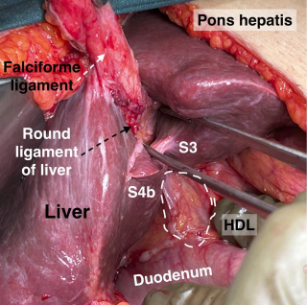
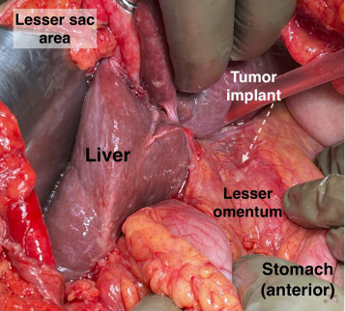
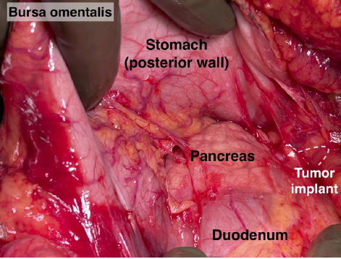
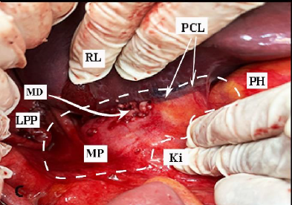
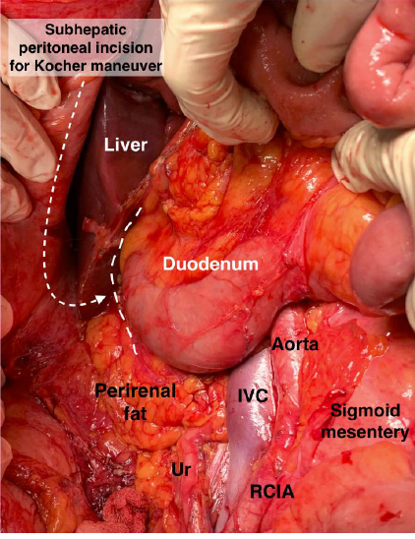
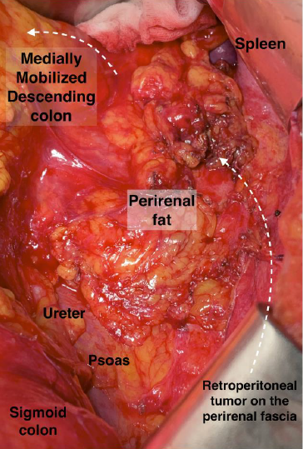
Kostov S, et al Cancers 2014
Notes:
It is difficult to inspect all of the abdominal structures on the small intestine, upper abdominal organs and to the retroperitoneumThe Kocher maneuver allows access to the infrahepatic IVC, duodenum, abdominal aorta, superior mesenteric artery, posterior surface of the head of the pancreas, right renal hilum and HDL

Slide 22
Complete gross resection
Study | Date | Type | MIS | OPEN | CGR
MISSION (multicenter retrospective) | 2019 | Phase II feasibility study | 127 |  | 96.1% in 122pts
Cardenas- Coicoecheat al | 2019 | Systematic review and meta-analysis 3 prospective and 3 retrospective | 567 | 2664 | 74% MIS vs53.1% p=0.52
Zeng et al | 2022 | Systematic review and meta-analysis 3 prospective and 3 retrospective | 643 | 2885 | RR=1.07 (95%CI 0.93-1.23)
Finch L & Chi D J Gynecol Oncol 2023
Notes:
Short term accrual 127 cases from 5 centers from 2009-2017
A meta-analysis by Cardenas-Goicoechea et al. [15] of 3 prospective and 3 retrospective studies examining outcomes in 567 patients who underwent minimally invasive surgery and 2,664 who underwent laparoscopy found no significant difference in the rate of achieving CGR between minimally invasive (74.5%; 95% confidence interval and laparotomy Patients in this meta-analysis were carefully selected for a minimally invasive approach based on complete clinical response to NACT and low tumor burden seen with diagnostic laparoscopy [15].
The limitations of our study are inherent to the studies we included. Second,the patient population was highly selected, which may limit the extrapolation to the general population. The common exclusion criteria were as follows: residual tumor in critical areas such as the porta hepatis and bowel serosa, patients aged > 70 years, elevated tumor marker, BMI > 40 Kg/m2, and ASA scores of III or IV [8, 13–15]. The conversion rate from laparoscopy to laparotomy appears to increase with obesity, so weight may limit the efficacy of its role. Third, there are insufficient data to evaluate the chemotherapy response, operative outcomes, and readmission rates. Only 2 studies reported tumor response with RECIST criteria [8, 15].Fourth, the primary endpoint of complete cytoreductive surgery appears to be subjectively decided by the surgeon. Fifth limited follow up periods.
The completeness of debulking in the open laparotomy group was not statistically higher compared with MIS
In Zeng study, it was also found that MIS had comparable feasibility with laparotomy for debulking OC after NACT with regarding to the OS, completeness of debulking removal, residual disease lesions, and postoperative complications. The differences in the study design, the duration of median follow-up, and the differences in surgical techniques among gynecological oncologists do not allow to draw definitive
conclusions regarding survival.

Slide 23
Complete gross resection
Study | Date | Type | MIS | OPEN | CGR
MISSION (multicenter retrospective) | 2019 | Phase II feasibility study | 127 |  | 96.1% in 122pts
Cardenas- Coicoecheat al | 2019 | Systematic review and meta-analysis 3 prospective and 3 retrospective | 567 | 2664 | 74% MIS vs53.1% p=0.52
Zeng et al | 2022 | Systematic review and meta-analysis 3 prospective and 3 retrospective | 643 | 2885 | RR=1.07 (95%CI 0.93-1.23)
Limitations
Short term accrual 127 cases for 5 centers from 2009-2017
Carefully selected based on clinical complete or near complete response to NACT
Low tumor burden seen with diagnostic laparoscopy
Finch L & Chi D J Gynecol Oncol 2023
Notes:
Short term accrual 127 cases from 5 centers from 2009-2017

Slide 24
Complete gross resection
Study | Date | Type | MIS | OPEN | CGR
MISSION (multicenter retrospective) | 2019 | Phase II feasibility study | 127 |  | 96.1% in 122pts
Cardenas- Coicoecheat al | 2019 | Systematic review and meta-analysis 3 prospective and 3 retrospective | 567 | 2664 | 74% MIS vs53.1% p=0.52
Zeng et al | 2022 | Systematic review and meta-analysis 3 prospective and 3 retrospective | 643 | 2885 | RR=1.07 (95%CI 0.93-1.23)
Limitations
Absence of randomized control trials
Highly selected patients with exclusion criteria:
residual tumor in critical areas such as the porta hepatis and bowel serosa
patients aged > 70 years
elevated tumor marker,
BMI > 40 Kg/m²
ASA scores of III or IV
Finch L & Chi D J Gynecol Oncol 2023
Notes:
. the patient population was highly selected, which may limit the extrapolation to the general population. The common exclusion criteria were as follows: residual tumor in critical areas such as the porta hepatis and bowel serosa, patients aged > 70 years, elevated tumor marker, BMI > 40 Kg/m2, and ASA scores of III or IV [8, 13–15]. The conversion rate from laparoscopy to laparotomy appears to increase with obesity, so weight may limit the efficacy of its role.
The completeness of debulking in the open laparotomy group was not statistically higher compared with MIS

Slide 25
Complete gross resection
Study | Date | Type | MIS | OPEN | CGR
MISSION (multicenter retrospective) | 2019 | Phase II feasibility study | 127 |  | 96.1% in 122pts
Cardenas- Coicoecheat al | 2019 | Systematic review and meta-analysis 3 prospective and 3 retrospective | 567 | 2664 | 74% MIS vs53.1% p=0.52
Zeng et al | 2022 | Systematic review and meta-analysis 3 prospective and 3 retrospective | 643 | 2885 | RR=1.07 (95%CI 0.93-1.23)
Limitations
Case control and cohorts studies. No randomized trials
Subjective surgeon recommended surgical approach
Finch L & Chi D J Gynecol Oncol 2023
Notes:
The differences in the study design, the duration of median follow-up, and the differences in surgical techniques among gynecological oncologists do not allow to draw definitive
conclusions regarding survival.

Slide 26
Survival
Study | Date | Type | MIS patients | LAP patients | PFS | OS | Limitations
INTERNATIONAL MISSION | 2019 | Multicenter retrospective observational | 127 |  | 23m | 5-year 52.6%
Tang al | 2019 | Systematic review and meta-analysis Total 8367 patients | 3871 | 4496 | N/A | NS
Zeng S et al | 2022 | Systematic review and meta-analysis 3 prospective 3 retrospective | 643 | 2885 | Higher in MIS HR=0.73 | NS
Melamed A et al | 2017 | Retrospective National Cancer database 2010-2012 | 450 | 2621 | NA | 3year 47m vs 52.6
Median follow-up 37 months
No standard surgical approach
PFS not evaluated
Included both PDS &IDS
PFS superiority effect disappeared after removing 1 trial
Differences in study design, follow-up, surgical techniques
Laparoscopic surgeons were more likely to omit resection of extrapelvic structures
Underestimation due to limited visualization
Finch L & Chi D J Gynecol Oncol 2023
Notes:
MISSION MEDIAN FOLLOW UP 37 MONTHS
Tang Thirty-eight studies, including 8,367 patients from 2005 to 2020 and three different surgical approaches (robotic-assisted laparoscopy surgery, traditional laparoscopy, or laparotomy approaches), were included in this network meta-analysis. The studies were case control studies and cohort studies. Subjective surgeon recommended surgical approach no standardization. PFS was not evaluated. Included both primary and IDS data. More data on laparoscopy and laparotomy than robotic approach
The PFS advantage disappear with the removal of one study
Melamed median followup 32 months
This finding suggest that patients selected for laparoscopic debulking may have a lower burden than those who underwent laparotomy.
Lack of randomizaton

Slide 27
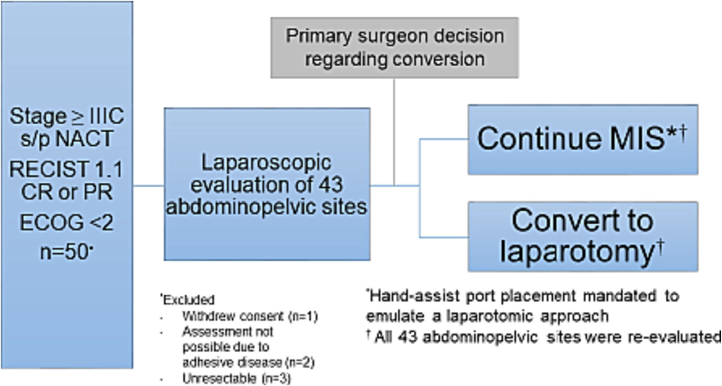
Laparoscopic predictability of minimally invasive interval debulking in advanced ovarian cancer: The MIID-SOC trial
Costales A et al. Gyn Onc 2024
2018-2020
At least one site discovered in 50% of with manual palpation and not with laparoscopy and >18% discordance at
Gastrosplenic ligament
Supracolic omentum
Left mesocolon
Transverse mesocolon
Stomach
Small bowel mesentery
27 pts
17 pts
The surgeon was obligatied to add a hand-assist port, for an additional assessment of potentially non-visible tumor implants on intraabdominal organs and spaces not seen with laparoscopy
Notes:
In this pilot study a laparoscopic predictive index can help to identify candidates for a minimally invasive cytoreduction. 50 patiens enrolled and 44 were included in the analysis.
When evaluating the ability of laparoscopy to detect disease intra- peritoneally, there was noted to be discordance (disease was said to be absent with laparoscopy, but present with manual palpation) in at least 1 site 50% of the time with manual palpation via a hand-assist port. In sites where discordance was >10%, these sites included the gastrosplenic ligament, supracolic omentum, rectum, left mesocolon, transverse mesocolon, stomach, and the small bowel mesentery. In all of these sites, discordance was >18%.

Slide 28
Laparoscopic predictability of minimally invasive interval debulking in advanced ovarian cancer: The MIID-SOC trial
Costales A et al. Gyn Onc 2024
Parameter (point value assigned | Sensitivity | Specificity | PPV | NPV | Accuracy
Gastrosplenic ligament (1) | 5.9% | 100% | 100% | 62.8% | 63.6%
Rectum (2) | 29.4% | 88.9% | 62.5% | 66.7% | 65.9%
Left mesocolon (1) | 23.5% | 88.9% | 57.1% | 64.9% | 63.6%
Transverse colon (1) | 17.6% | 92.6% | 60% | 64.1% | 63.6%
Right colon (1) | 17.6% | 88.9% | 50% | 63.2% | 61.4%
Cecum (2) | 23.5% | 92.6% | 66.7% | 65.8% | 65.9%
Appendix (1) | 23.5% | 88.9% | 57.1% | 64.9% | 63.6%
Liver capsule | 35.3% | 85.2% | 60% | 67.6% | 65.9%
Intrahepatic fossa/Gallblader(1) | 11.8% | 96.3% | 66.7% | 63.4% | 63.6%
Ileum/jejunum (2) | 23.5% | 92.6% | 66.7% | 65.8% | 65.9%
PIV< 2 identified patients able to undergo an optimal MIS cytoreductive surgery with an accuracy 68.2%. The specificity to identify patients who would not be able to undergo an optimal MIS interval cytoreductive surgery, was 66.7%
Notes:
In this pilot study a laparoscopic predictive index can help to identify candidates for a minimally invasive cytoreduction. 50 patiens enrolled and 44 were included in the analysis.
When evaluating the ability of laparoscopy to detect disease intra- peritoneally, there was noted to be discordance (disease was said to be absent with laparoscopy, but present with manual palpation) in at least 1 site 50% of the time with manual palpation via a hand-assist port. In sites where discordance was >10%, these sites included the gastrosplenic ligament, supracolic omentum, rectum, left mesocolon, transverse mesocolon, stomach, and the small bowel mesentery. In all of these sites, discordance was >18%.
PREDICTIVE INDEX SCORE
Senssitivity refers to a test's ability to designate an individual with disease as positive. A highly sensitive test means that there are few false negative results, and thus fewer cases of disease are missed. The specificity of a test is its ability to designate an individual who does not have a disease as negative

Slide 29
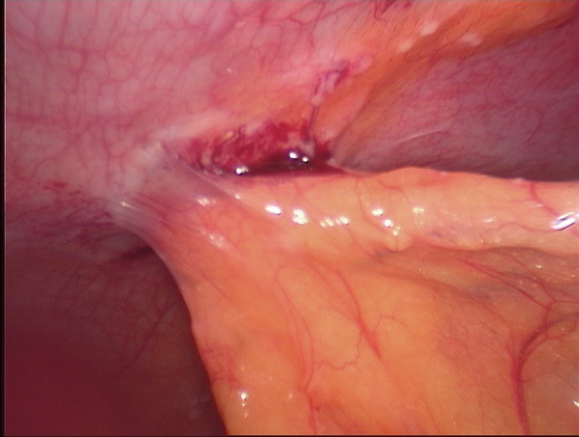
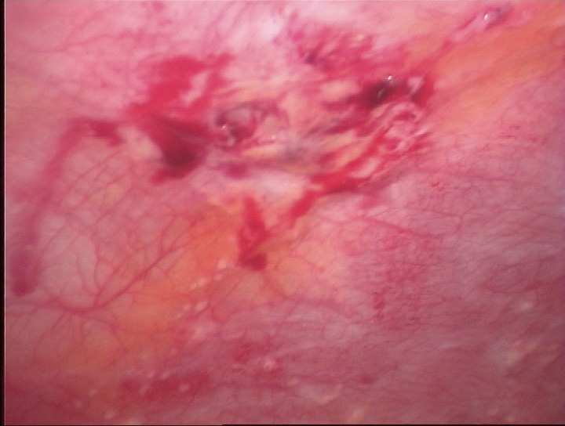
Port site metastases

Slide 30
Conclusions
There are numerous limitations and confounding factors that require further study and examination prior to widespread use of minimally invasive surgery in this setting.
We anticipate the results of LANCE trial.
The perfect trial should include a minimal invasive approach to resect all disease in the upper and lower abdomen followed by immediate laparotomy to confirm the extent of cytoreduction and ability achieve complete gross resection

Slide 31
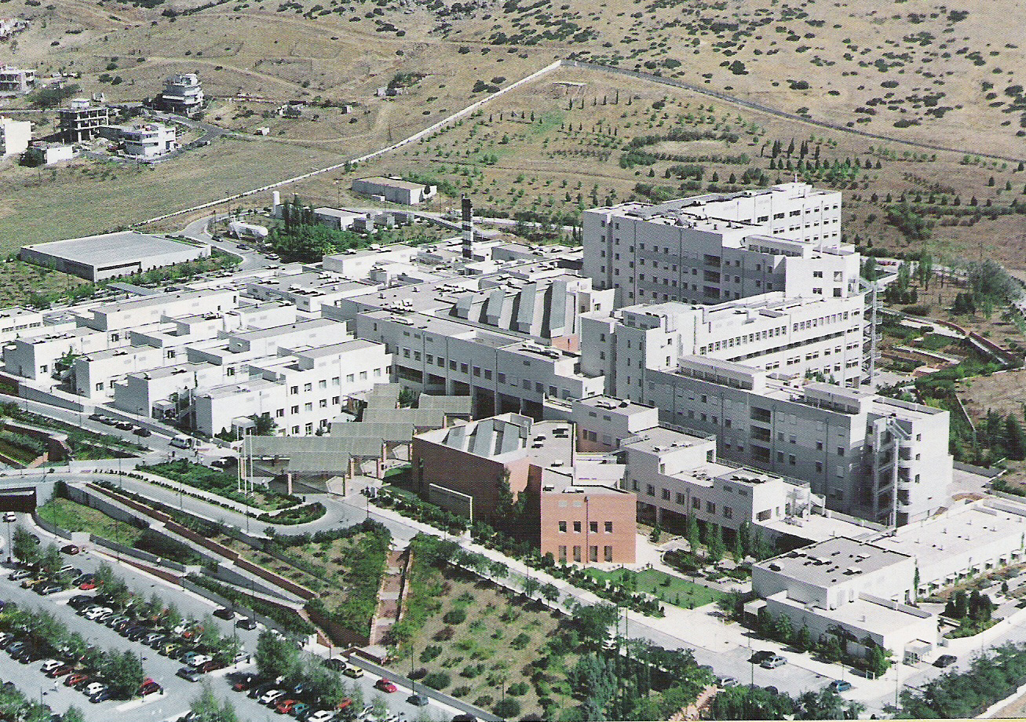
THANK YOU !!!

