Slide 1
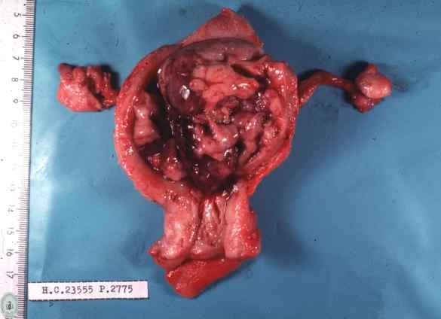
Principles of Surgery in Uterine Sarcoma
Dr. Ignacio Zapardiel
Chief of Ginecologic Oncology
Full Professor ANECA- UAM University
ESGO Council Member 2019-2024
La Paz University Hospital, Madrid, Spain.

Slide 2
Conflicts of interest:
Working group member of the
ESGO/EURACAN/GCIG Sarcoma Guideline
Notes:
El cáncer de cuello de útero representa la cuarta causa de cáncer más frecuente entre las mujeres en Europa, y la séptima de mortalidad.
La diferencia refleja la relativa buena supervivencia de los casos, atribuida en gran parte al diagnóstico precoz y a la eficacia terapéutica en este estadio.

Slide 3
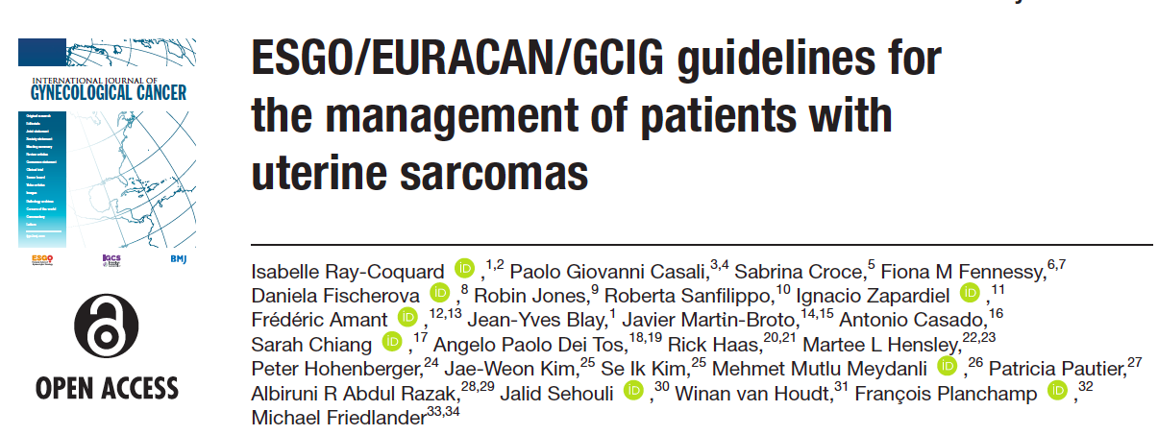
Int J Gyn Cancer june 2024
Notes:
El cáncer de cuello de útero representa la cuarta causa de cáncer más frecuente entre las mujeres en Europa, y la séptima de mortalidad.
La diferencia refleja la relativa buena supervivencia de los casos, atribuida en gran parte al diagnóstico precoz y a la eficacia terapéutica en este estadio.

Slide 4
Uterine Sarcoma
Multidisciplinarity
Gyn Onc
Radiologist
Medical Oncologist
Pathologist
Radiation Oncologist

Slide 5
Surgical
Management
Notes:
El cáncer de cuello de útero representa la cuarta causa de cáncer más frecuente entre las mujeres en Europa, y la séptima de mortalidad.
La diferencia refleja la relativa buena supervivencia de los casos, atribuida en gran parte al diagnóstico precoz y a la eficacia terapéutica en este estadio.

Slide 6
Open approach is the preferred route of surgery
MIS only if integrity of the uterus can be assured
Morcellation should be avoided in suspected sarcomas. When low risk, specific information on unsuspected sarcoma should be provided.
Surgical Management General Concepts

Slide 7
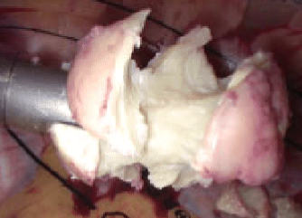
Morcellation worsen prognosis
Increases both abdominal and pelvic relapses
In bag morcellation if very low suspicious cases
Surgical Management
Morcellation
Borella F et al. Front Oncol, 2022
Gitas G, J Turk Ger Gynecol Assoc, 2022
Zapardiel I, J Minim Invasive Gynecol, 2021

Slide 8
Complete removal of the uterus is the gold standard
BSO is the standard approach for postmenopausal women
Ovarian preservation in premenopausal stage I disease could be considered regardless the histological subtype
Routine lymphadenectomy is not recommended but removal of suspicious lesions/nodes should be carried out
Surgical Management
Stages I & II

Slide 9
Meta-analysis on Adnexectomy for Uterine Sarcoma.
17 studies – 3743 patients
No survival improve for Stage I for Adnexectomy including ESS
Surgical Management
Ovarian preservation
ESS
Ovarian
Preservation
Ronsini C et al. Medicina (Kaunas), 2022
Nasioudis D et al. JGO, 2017

Slide 10
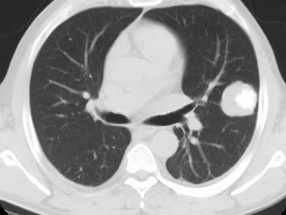
Complete cytoreduction is the standard of care
Metastasectomy in patients with oligometastatic disease could be considered if morbidity is acceptable
Systematic lymphadenectomy not recommended but nodal debulking
Neoadjuvant chemotherapy could be an option for initial unresectable disease
Surgical Management
Stages III & IV

Slide 11
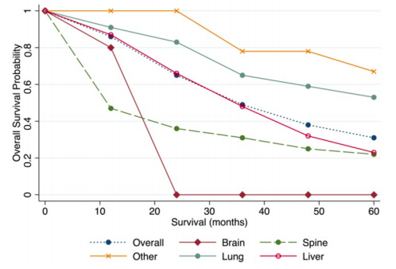
Surgical Management
Extrauterine disease
29 centers – 573 metastasectomies LMS
62% lung vs 29% liver
Overall Median survival 59,6 months
Lung 72,8 months
Liver 34,8 months
Delisle M et al. Cancers, 2022

Slide 12
Leiomyosarcoma 53-71% (only 13% pelvic)
LG-ESS 30% (50% pelvic)
HG-EGG and undifferentiated – worst prognosis
Surgical Management
Recurrent disease
Devaud et al. Surg Oncol Clin North Am, 2022
Ricci S et al, Gynecol Oncol 2017

Slide 13
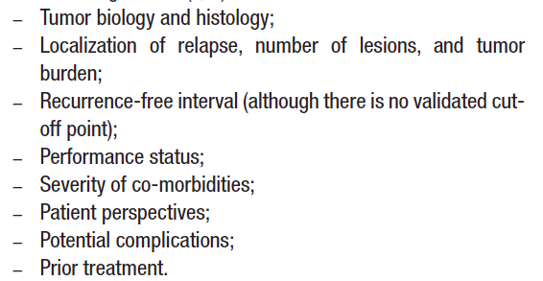
Multidisciplinary approach is mandatory
BSO should be considered in low-grade sarcomas when ovaries are present
Surgery:
Low grade: always if complete cytoreduction is feasible
High grade: no surgery if disseminated or non resectable disease
Surgical Management
Recurrent disease

Slide 14
No established interval to abort surgical resection
For “low grade disease” more agressive and repetitive resections could be a reasonable option
Surgical Treatment
Recurrent disease
ESGO Guideline, 2024
SEGO Guideline, 2022
NCCN guidelines, 2019

Slide 15
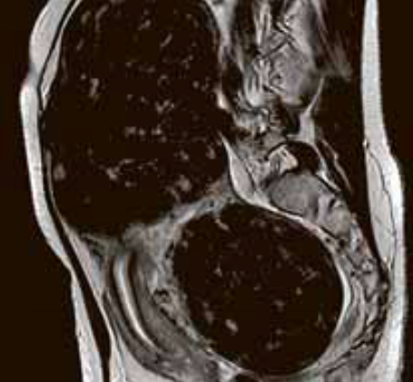
Fertility preservation in Uterine sarcomas

Slide 16
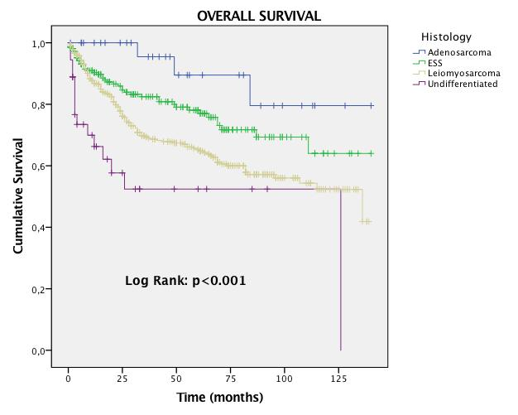
The most significant prognostic factor impacting the overall survival was the RESIDUAL DISEASE
Hazard ratio
Endometrial stromal sarcoma 11.76 (95%CI 5.87-23.55)
Undifferentiated 6.86 (95%CI 1.51-31.09)
Leiomyosarcoma 4.59 (95%CI 2.52-8.40)
Adenosarcoma: no significant impact
Disease Prognosis
SARCUT Study (n=683 uterine sarcomas),
Zapardiel I, Int J Gyn Cancer 2023

Slide 17
5-year overall survival...
Adenosarcoma 89.5%
ESS 78.3%
Leiomyosarcoma 65.3%
Undifferentiated 52.4%
10-year overall survival...
Adenosarcoma 79.5%
ESS 64.8%
Leiomyosarcoma 52.6%
Undifferentiated 52.4%
…in the best scenarios
SARCUT Study,
Zapardiel I, Int J Gyn Cancer 2023
Notes:
El cáncer de cuello de útero representa la cuarta causa de cáncer más frecuente entre las mujeres en Europa, y la séptima de mortalidad.
La diferencia refleja la relativa buena supervivencia de los casos, atribuida en gran parte al diagnóstico precoz y a la eficacia terapéutica en este estadio.

Slide 18
Fertility preservation in uterine sarcoma HAVE to be considered NON-STANDARD

Slide 19
Fertility preservation involves 2 organs
1.OVARIES
2.UTERUS

Slide 20
Ovarian removal did not show altered oncological outcomes
Castration impacts negatively in the QoL
No survival benefit has been demonstrated
Gametes preservation gives opportunity for surrogacy
1. Ovarian preservation
Uterine sarcoma
Seagle, Gynecol Oncol 2017
Kapp, Cancer 2008
Shah, Obstet Gynecol 2008
Chan, Br J Cancer 2008

Slide 21
Ovarian preservation should be considered in those patients who wish fertility preservation if stage I cases
1. Ovarian preservation
Uterine sarcoma
2024

Slide 22
Most of uterine sarcomas grow into uterine corpus
Very high chance of recurrent disease
Resulting in a bad oncological outcome
2. Uterine preservation
Uterine sarcoma
Piatek, J Clin Med 2022
Dondi, Cancers 2021
Laurelli, EJOGRB 2015
Lissoni, Gynecol Oncol 2008

Slide 23
Residual sarcomatous cells after removal of the tumor
Disease spread to peritoneal cavity:
Hysteroscopic pressure
Laparotomy: tumoral rupture
Laparoscopy: morcellation
Obstetrical outcomes after myometrial damage
2. Uterine preservation
Uterine sarcoma – MAIN CONCERNS
The most significant prognostic factor impacting the overall survival was the RESIDUAL DISEASE
SARCUT Study, Zapardiel I, IJGC 2023
Piatek, J Clin Med 2022
Dondi, Cancers 2021
Laurelli, EJOGRB 2015
Lissoni, Gynecol Oncol 2008

Slide 24
High-risk tumors
Few cases reported
Up to 75% recurrences
Up to 60% mortality!!
2. Uterine preservation
Leiomyosarcoma / HG-ESS
SARCUT Study,
Zapardiel I, Int J Gyn Cancer 2023
Tunc et al., EJGO 2019

Slide 25
2. Uterine preservation
Low grade Endometrial Stromal Sarcoma
Author | n | Presentation | Approach | Pregnancy | Relapse
Kostas 2009 | 1 | Polyp | HSC | 1 (100%) | 1 (100%)
Delaney 2012 | 1 | Invasive | Open | 1 (100%) | 0%
Bai 2014 | 19 | Myoma | n.a. | 8 (42.1%) | 15 (78.9%)
Jin 2015 | 5 | Myoma | Laparoscopy | 3 (60%) | 1 (20%)
Laurelli 2015 | 6 | Polyp/Myoma | HSC | 3 (50%) | 0%
Xie 2017 | 17 | Myoma | Lap/HSC | 5 (29.4%) | 10 (58.8%)
Tunc 2019 | 6 | Myoma | n.a. | 1 (16.6%) | 4 (66.6%)
Zapardiel 2023 (unpublished data) | 2 | Myoma | HSC | 0 (0%) | 1 (50%)

Slide 26
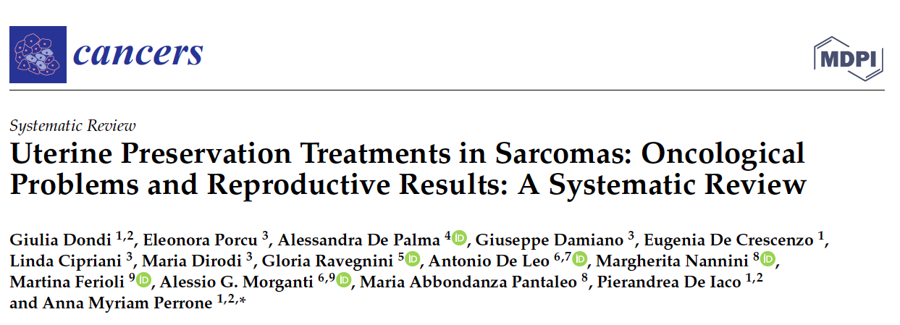
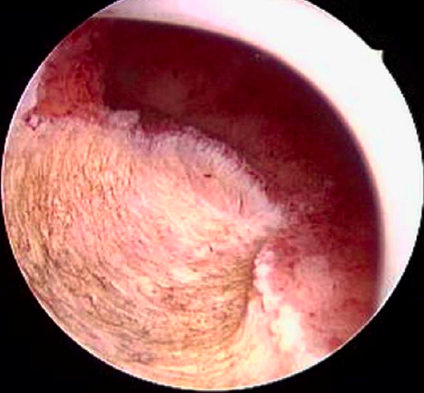
20 cases published
Mainly myomas- hysteroscopic resection
4 (20%) pregnancies
4(20%) relapses
2. Uterine preservation
Adenosarcoma
Dondi G et al., Cancers 2021

Slide 27
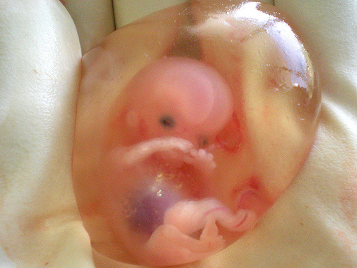
Low-Risk Histologies
Sarcomas on pedunculated polyps (free margins)
EXPERIMENTAL procedure
Considering: biology, stage and childbearing wishes
2. Uterine preservation
Uterine sarcoma – WHEN?

Slide 28
Resection of a uterine sarcoma with preservation of the uterus is a non standard approach and could only be considered in referral centres for very specific cases of low-grade endometrial stromal sarcoma and low-grade adenosarcoma without sarcomatous overgrowth with comprehensive informed consent
2. Uterine preservation
Uterine sarcoma
2024

Slide 29
Conclusions
Open approach is the standard. MIS could be considered without uterine rupture or morcellation
Early stages are treated with hysterectomy + BSO. Ovarian preservation could be considered in premenopausal women
For advanced stages complete cytoreduction is the standard including oligometastatic disease or nodal disease
Fertility preservation could be considered SELECTIVELY in low grade ESS and adenosarcoma without sarcomatous overgrowth

Slide 30
Acknowledgements Multidisciplinary Team
CHAIRS
Isabelle Ray-Coquard
Medical oncologist (France)
Michael Friedlander
Medical oncologist (Australia)
Paolo Casali
Medical oncologist (Italy)
EXPERTS
Frédéric Amant, gynecologic oncologist (Belgium)
Jean-Yves Blay, medical oncologist (France)
Antonio Casado, medical oncologist (Spain)
Sarah Chiang, pathologist (United States of America)
Sabrina Croce, pathologist (France)
Angelo Paolo Dei Tos, pathologist (Italy)
Fiona M. Fennessy, radiologist (United States of America)
Daniela Fischerova, gynecologic oncologist (Czech Republic)
Rick Haas, radiation oncologist (Netherlands)
Martee L. Hensley, medical oncologist (United States of America)
Peter Hohenberger, gynecologic oncologist (Germany)
Robin Jones, medical oncologist (United Kingdom)
Se Ik Kim, obstetrician & gynecologist (Republic of Korea)
Jae-Weon Kim, obstetrician & gynecologist (Republic of Korea)
Javier Martin-Broto, medical oncologist (Spain)
Mehmet Mutlu Meydanli, gynecologic oncologist (Turkey)
Patricia Pautier, medical oncologist (France)
Albiruni R Abdul Razak, medical oncologist (Canada)
Roberta Sanfilippo, medical oncologist (Italy)
Jalid Sehouli, gynecologic oncologist (Germany)
Winan Van Houdt, gynecologic oncologist (Netherlands)
Ignacio Zapardiel, gynecologic oncologist (Spain)
METHODOLOGIST
François Planchamp (France)

Slide 31
Acknowledgements External Reviewers
Nuno Abecasis, surgical oncology (Portugal); Dagmar Adamkova, medical oncology (Czech Republic); Kasimu Adoke, pathology (Nigeria); Roberto Altamirano, gynecologic oncology, obstetrics & gynecology (Chile); Igor Aluloski, gynecologic oncology (North Macedonia); Grazia Artioli, medical oncology (Italy); Giuseppe Badalamenti, medical oncology (Italy); Manel Barahona Orpinell, gynecologic oncology (Spain); Joost Bart, pathology (Netherlands); Mario Beiner, gynecologic oncology (Israel); Margarida Bernardino, gynecologic oncology (Portugal); Marcin Stanislaw Bobinski, gynecologic oncology, obstetrics & gynecology (Poland); Tjalling Bosse, pathology (Netherlands); Katharina Buser, medical oncology (Switzerland); Donato Callegaro-Filho, medical oncology (Brazil); Viktor Cassar, gynecologic oncology (Malta); Wen Yee Chay, medical oncology (Singapore); Abel Cordoba, radiation oncology (France); Ovidiu Florin Coza, medical oncology, radiation oncology (Romania); Bastian Czogalla, gynecologic oncology (Germany); Alessandro D'Amuri, pathology (Italy); Dominik Denschlag, gynecologic oncology (Germany); Palma Dileo, medical oncology (United Kingdom); Johannes Carl Athanasios Dimopoulos, radiation oncology (Greece); Santiago Domingo, gynecologic oncology (Spain); Florence Duffaud, medical oncology (France); Catherine Durdux, radiation oncology (France); Serkan Erkanli, gynecologic oncology, obstetrics & gynecology (Türkiye); Maria Del Pilar Estevez-Diz, medical oncology (Brazil); Henrik Falconer, gynecologic oncology (Sweden); Ana Felix, pathology (Portugal); Annamaria Ferrero, gynecologic oncology (Italy); Gwenael Ferron, surgical oncology (France); Alejandro Gallego, medical oncology (Spain); Silvia Gasperoni, medical oncology (Italy); Catherine Genestie, pathology (France); Christine Gennigens, medical oncology (Belgium); Eelke Gort, medical oncology (Netherlands); Daniela Greto, radiation oncology (Italy); Kenichi Harano, medical oncology (Japan); Sakari Hietanen, gynecologic oncology (Finland); Cathrine Holland, gynecologic oncology (United Kingdom); Toni Ibrahim, medical oncology (Italy); Ibon Jaunarena, gynecologic oncology (Spain); Pearly Khaw, radiation oncology (Australia); Mi Kyung Kim, gynecologic oncology (Republic of Korea); Gurkan Kiran, gynecologic oncology (Türkiye); Alexandra Timea Kirsch Mangu, radiation oncology (Romania); Takahiro Koyanagi, gynecologic oncology (Japan); Gunnar Kristensen, gynecologic oncology (Norway); Joel Laufer, gynecologic oncology (Uruguay); Kim-Seng Law, gynecologic oncology (China); Coriolan Lebreton, medical oncology (France); Mario Mendes Leitao Jr, gynecologic oncology (United States of America); Diana Lim, pathology (Singapore); Chien-Ting Liu, gynecologic oncology, medical oncology (Taiwan); Domenica Lorusso, gynecologic oncology (Italy); Giorgia Mangili, gynecologic oncology, medical oncology (Italy); Aranzazu Manzano, medical oncology (Spain); José María Mariconde, gynecologic oncology (Argentina); Gloria Marquina, medical oncology (Spain); Claudia Mateoiu, pathology (Sweden); Filomena Mazzeo, medical oncology (Belgium); Nadav Michaan, gynecologic oncology (Israel); Miloš Mlynček, gynecologic oncology (Slovakia); Philippe Morice, gynecologic oncology (France); Sabina Murshudova, gynecologic oncology (Azerbaijan); Alexander Mustea, gynecologic oncology (Germany); Eva Myriokefalitaki, gynecologic oncology (United Kingdom); Esten Nakken, radiation oncology (Norway); Eva-Maria Niine-Roolaht, gynecologic oncology, obstetrics & gynecology (Estonia); Esther Oliva, pathology (United States of America); Maja Pakiz, gynecologic oncology (Slovenia); Maria Abbondanza Pantaleo, medical oncology (Italy); Fedro Alessandro Peccatori, medical oncology (Italy); Nicolas Penel, medical oncology (France); Elisabetta Pennacchioli, surgical oncology (Italy); Anna Myriam Perrone, gynecologic oncology (Italy); Sophie Piperno-Neumann, medical oncology (France); Taavi Põdramägi, surgical oncology (Estonia); Peter Reichardt, medical oncology (Germany); Angeles Rovirosa, radiation oncology (Spain); Apostolos Sarivalasis, medical oncology (Switzerland); Tayup Simsek, gynecologic oncology (Türkiye); Shalini Singh, radiation oncology (India); Simona Stolnicu, pathology (Romania); Vladyslav Sukhin, gynecologic oncology, obstetrics & gynecology, medical oncology, radiation oncology (Ukraine); Joanna Szkandera, medical oncology (Austria); Yoshifumi Takahashi, gynecologic oncology (Japan); Olav Tammik, surgical oncology (Estonia); Cagatay Taskiran, gynecologic oncology (Tanzania); Maria Topalidou, radiation oncology (Greece); Mojca Unk, medical oncology (Slovenia); Koen van de Vijver, pathology (Belgium); Ignacio Vazquez, medical oncology (United Kingdom); August Vidal, pathology (Spain); Rohini Vinayak Kulkarni, gynecologic oncology (India); Bruno Vincenzi, medical oncology (Italy); Sarah Watson, medical oncology (France); Anneke Westermann, medical oncology (Netherlands); Jacek Wilczynski, gynecologic oncology, obstetrics & gynecology (Poland); Pauline Wimberger, gynecologic oncology (Germany); Kosuke Yoshihara, gynecologic oncology (Japan); Paolo Zola, gynecologic oncology (Italy).

Slide 33
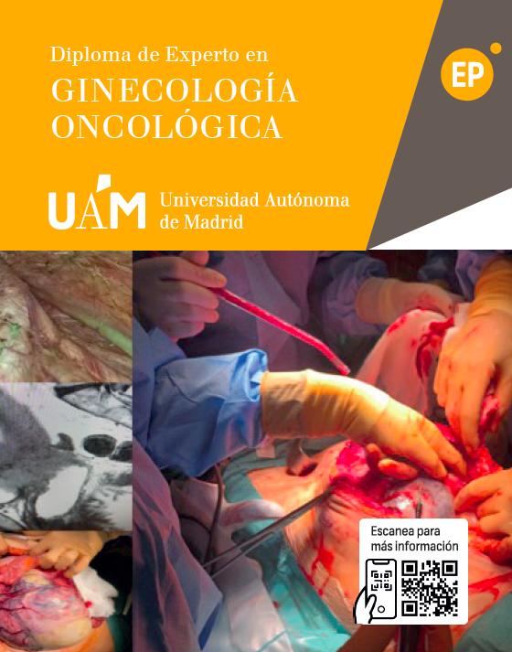
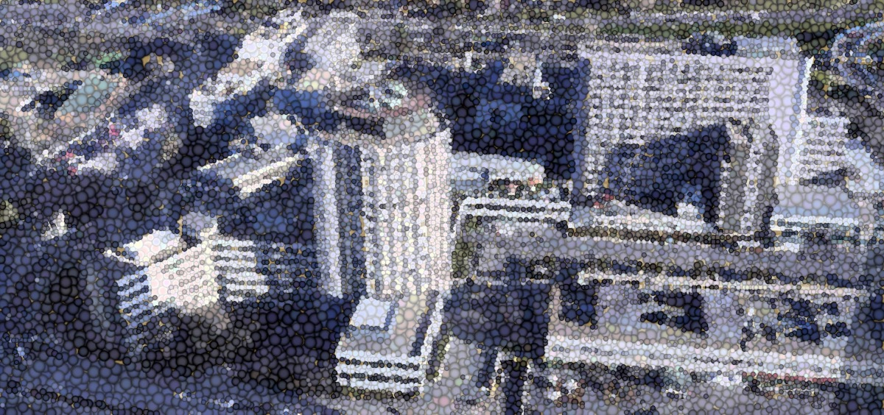
Thank you ignaciozapardiel@hotmail.com

