Slide 1
Fertility Sparing Strategies in Early Endometrial Cancer: How to optimize patient selection
David ATALLAH MD, MSc
Professor of Obstetrics and Gynecology – Saint Joseph University
IGCS Secretary Treasurer Elect, Executive Committee
MEMAGO Secretary General
Chairman Department of Gynecology at Hôtel Dieu de France University Hospital
Head of Gynecologic Oncology, Gynecology and Breast Unit
ESGO accredited center for advanced ovarian cancer surgery
8th MEMAGO & 2nd Athens OVARIAN CANCER Symposium

Slide 2
Disclosures
Nothing to disclose

Slide 3
Introduction
Most common gynecological cancer
Typically: post menopausal women
20-25% before menopause,
7% between 20 and 44 years (obesity, diabetes, sedentarity)
5-10% of premenopausal women have EAH
Young women: good prognosis
Early stage (limited myometrial invasion)
High differentiation at diagnosis
Recommended treatment: total abdominal hysterectomy with staging depending on risk factors
Notes:
It’s a post menopausal cancer
5 per cent before 40
Young age is a good prognosis
Recommanded treatment is tahbso

Slide 4
Conservative Treatment: Therapeutic Challenge.
Risk of disease progression as high as 5-6%
Role of gynecologic oncologist in both treating malignant disease
&
Offering fertility –sparing alternatives when allowed so → Oncofertility
Notes:
It’s a therapeutic challenge when considering conservation
5 to 6 percent of risk of progression

Slide 5
Candidates for conservative treatment
EAH
EEC
Stage IA (without myometrial invasion)
Grade1
Endometrioid cancer
J Natl Compr Canc Netw. 2014 (NCCN)
Int J Gynecol Cancer. 2015 (ESGO)

Slide 6
Rationale for conservative treatment

Slide 7
Rationale behind conservative treatment in Grade 1 Stage 1 patients
Recurrence rate
Five-year survival rate
Nodal disease
Myometrial invasion
Notes:
In these patients who are grade 1stage 1, the rationale is based on the recurrence rate, five year survival, nodal disease, myometrial invasion

Slide 8
Relationship between Depth of Myometrial Invasion and Recurrence in Patients with Stage I Endometrial Carcinoma
Endometrial only | 7/92 | 8%
Superficial myometrium | 10/80 | 13%
Medium myometrium | 2/17 | 12%
Deep myometrium | 5/11 | 45%
Notes:
The more the myometrium is involved the more the recurence rate is high

Slide 9
Frequency of Pelvic and Para-Aortic Nodal Disease
Depth of invasion | Grade
 | I (n=180) | II (n=288) | III (n=153)
Endometrial only (n=86) | 0%/0% | 3%/3% | 0%/0%
Inner one-third (n=281) | 3%/1% | 5%/ 4% | 9%/4%
Middle one-third (n=115) | 0%/5% | 9%/0% | 4%/0%
Outer one-third (n=139) | 11%/6% | 19%/14% | 34%/23%
Notes:
If we dissect this subset of patients we can see that involvement of lymph nodes are dependent on the tumor grade

Slide 10
Relationship between Depth of Myometrial Invasion and Five-Year Survival Rate (Stage I)
Tumors limited to the endometrium: 90,8%
Tumors invading the deep myometrium: 85,4%
Notes:
Thus, the survival rate is quite high in this subclass of patients

Slide 11
Patient selection criteria
Notes:
Saying all that, what kind of Patient would you select for conservation? You had a hint

Slide 12
Selection criteria
A well-differentiated carcinoma
The tumor does not deeply invade the myometrium, demonstrated by MRI, TVUS, HSC
Absence of suspicious pelvic or preaortic nodes
Obesity remains a significant risk factor of endometrial transformation even after primary treatment (approximately 50% of ≥25 BMI patients recur)

Slide 13
Selection criteria (2)
Absence of synchronous ovarian tumor : Ca 125, abdomino-pelvic US, pelvic MRI (consider diagnostic laparoscopy + peritoneal cytology). Risk of occult synchronous ovarian tumour in stage I: 1-5%
No contraindications for medical treatment
The patient understands and accepts that this is not standard treatment
The patient should show her desire to complete the follow-up protocol

Slide 14
Positive diagnosis: imaging and surgery
Notes:
How to do the diagnosis?

Slide 15
Diagnosis and pre-treatment evaluation: imaging
MRI is slightly more sensitive than ultrasound for the evaluation of myometrial invasion (86%–89% vs 66%–79%)
Combination of both transvaginal sonography and MRI could be more accurate in detecting myometrial invasion.
MRI : sensitivity of 80% and specificity of 100% in diagnosing cervical invasion.
Lymph node greater than 1cm in short axis or with central necrosis is considered to be suspicious on MRI
Notes:
Lets speak about imaging:The combination of mri and transvaginal sonogram is more accurate in detecting myometrial involvement

Slide 16
Diagnosis and pre-treatment evaluation: biopsy
Hysteroscopy is the most accurate way for biopsy and evaluation of the cavity
Excludes cervical involvement (NPV 100%, low Sp), complementary to MRI.
Best procedure to estimate the extent of the cancerous spread within the uterine cavity (>50% prognostic factor)
Indirectly predictive of tumoral size (independent prognostic factor of lymph node spread and disease-free survival)
Complication rate of 3%, with 1% of uterine perforation
No prognostic significance for migrant cells outside the cavity
Notes:
The reason is that biopsy or curetage does not sample the entire endometrium and hysteroscopy is needed in order to evaluate the entire cavity

Slide 17
laparoscopic evaluation of the:
adnexa
lymph node
peritoneal cavity
not recommended unless imaging studies suggest a suspicious involvement of these regions in tumor spread.

Slide 18
Treatment modalities
HORMONAL:
Megestrol acetate
Medroxyprogesterone acetate
Levonorgestrel IUD
HYSTEROSCOPIC Tumor Resection and Progesterone therapy

Slide 19
Hormonal treatment

Slide 20
 | Ramirez 2004 | Chiva 2008 | Gunderson 2012
Response | 76% response with a median time of 12 weeks | 51% complete 25% transient | 68% CAH 48% EC
Recurrence | 23% recurrence | 24% | 23% CAH 35% EC
Mean duration of treatment | In responders 24 months In non-responders 12 months | 12- 24 Weeks

Slide 21
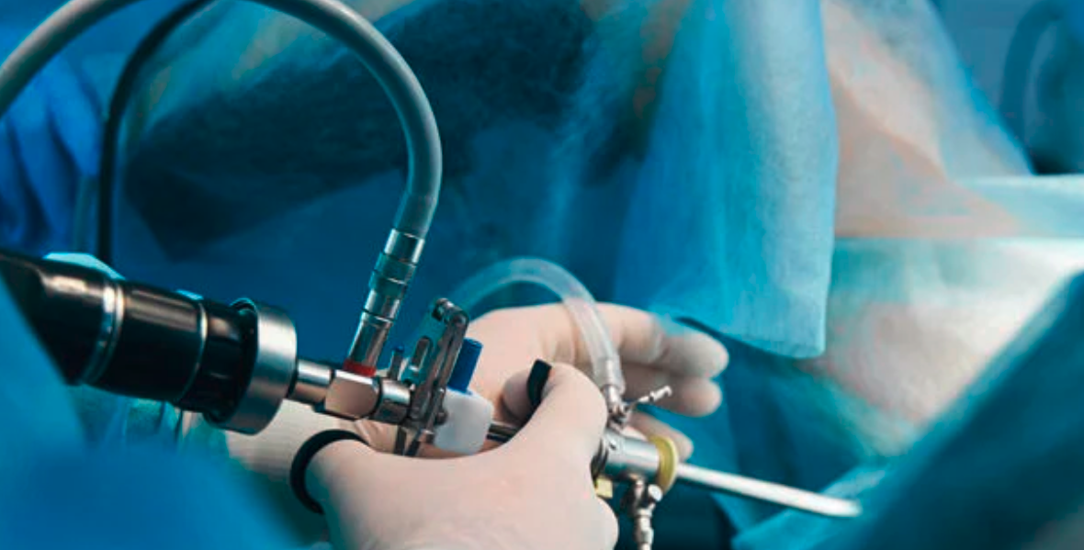
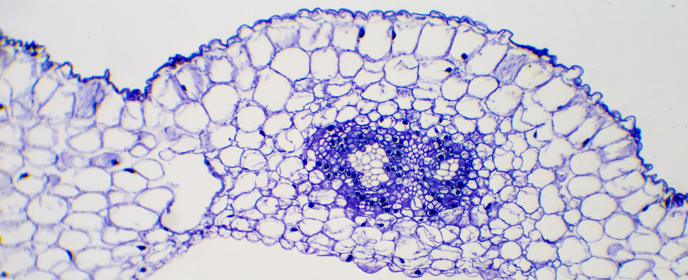
HYSTEROSCOPIC Tumor Resection and Progesterone therapy

Slide 22
 | Mazzon 2010 | Falconi et al., 2011 | Atallah 2021
Response rate | No relapse with 50.5 months | 26/27 sustainable response | 90% CR
Type of treatment | Resection+hormone | Resection+hormone | Resection+hormone

Slide 23
Intrauterine levonorgestrel device

Slide 24
Intrauterine levonorgestrel device: GI EAC,AEH
 | Janda et al | Westin et al | Orbo et al
Response rate | 57-67 % | 67% | 75%
fu | 6m | 12m | 12m

Slide 25
Recurrence rate

Slide 26
Recurrence rate
Recurrence rate = 11.1% (in patients with EC)
Hysteroscopic resection before hormonal treatment
Shan: hysteroscopy then curetage
Alonso et al. ; Hysteroscopic surgery for conservative management in endometrial cancer: a r AAlonso S ecancer 2015, 9:505 eview of the literature ; ecancer 2015
Notes:
In our series, the recurrence rate was 20 % (2/10 cases)
When reviewing the literature, the outcomes of studies on patients who underwent hysteroscopic resection before hormonal treatment for EC showed a recurrence rate of 11 %
Laurelli 2011 : Progestin treatment if no evidence of myometrial involvement. 14 patients. 1 relapse. 40 months mean follow-up
Mazzon 2010 : 6 patients. No relapse with 50.5 months mean follow-up
Shan 2013 : 14 patients . 2 relapses . 34.7 median follow-up
Marton 2014 : 2 cases . 1 relapse . 11 aand 22 months median follow up

Slide 27
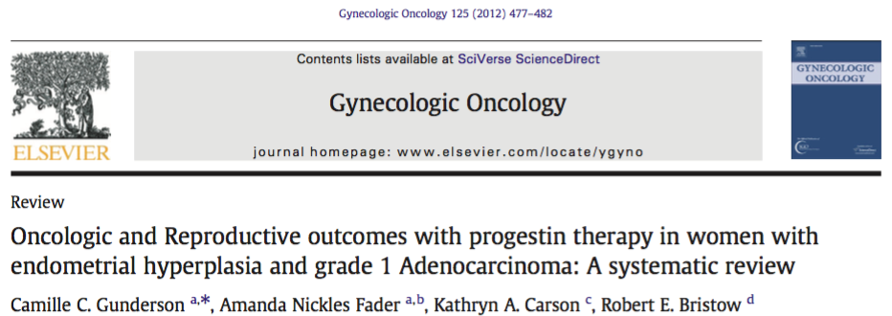
Recurrence rate
Recurrence rate = 35.4% (in patients with EC)
treated with progestin alone
Notes:
11.1 % (with Hysteroscopic Resection ) to be compared with a number of 35.4% when patients with EC received only hormonal treatment as conservtive management

Slide 28
Recurrence factors

Slide 29
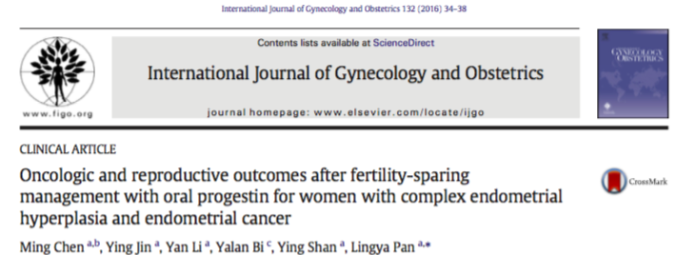
Recurrence factors
Notes:
Those with recurrence were significantly older (P = 0.009), had a higher BMI (P = 0.003), and required a longer time to achieve a CR (P b 0.001) than those without recurrence

Slide 30
Park 2012
Retrospective Korean study
148 patients
Mean Complete Response (CR) rate: 77.7%
Durable CR rate in patients treated with progestin about 51% at 5 years
BMI >25 kg/m2 was the only significant factor associated with a failure to achieve CR
BMI < 25 kg/m2, MPA (compared to MA), maintenance treatment and pregnancy were significantly associated with a lower risk of recurrence on multivariate analysis
BMI, MPA, maintenance, pregnancy
Notes:
Park in the largest retrospective study demonstrated that main factors of sustained response are BMI, Progesterone treatment maintenance therapy and pregnancy
Patients who do not get pregnant or who take weight have more chances of recurrence

Slide 31
Koskas 2012
Compare the survival of patients with grade 1 intramucous endometrial adenocarcinoma according to the extent of surgery
Retrospective cohort study
489 patients (<40 yo). 101 patients who underwent uterine preservation, 184 patients who underwent ovarian preservation, and 204 patients who underwent hysterectomy with oophorectomy
Conservation not associated with an increase in cancer-related-mortality in univariate and multivariate analysis
Conservation not associated with an increase in cancer-related-mortality in univariate and multivariate analysis
Notes:
Koskas in his study addressed an issue on conservative treatment in intra mucous endometrial carcinoma

Slide 32
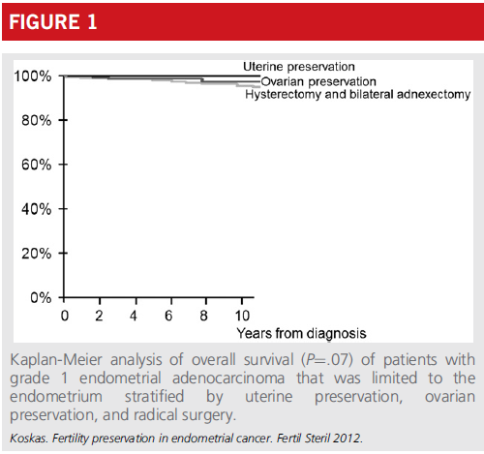

Slide 33
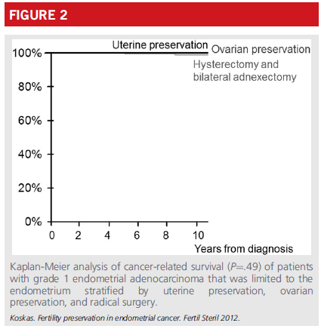

Slide 34
 | Number of patients | Complete Remission Rate (CRR) | Recurrence Rate (ReR) | Pregnancy Rate (PregR)
Progestin only | 456 | 76.3 % | 30.7 % | 52.1 %
Hysteroscopic resection followed by progestin therapy | 73 | 95.3 % | 14.1 % | 47.8 %
Intrauterine progestin therapy | 90 | 72.9 % | 11.0 % | 56.0 %
Notes:
This meta-analysis was to investigate the different efficacies of various fertility-preserving therapies for grade 1 presumed stage IA endometrial cancer.
A total of 619 cases were included in this study.
The existing results show that patients who received hysteroscopic resection followed by progestin therapy achieved the highest CRR. Patients who received oral progestin only might be more likely to recur and have more systemic adverse effects. Recent intrauterine progestin therapy such as levonorgestrel-releasing intrauterine system combined with gonadotropin-release hormone receptor agonist/progestin have a satisfactory PregR and low ReR rate.

Slide 36
SLND in atypical Hyperplasia
 | MSKCC/NY (n=221; 161 with SLN) | Montreal/Canada (n=162)
Upstaging to EC (final Histology) | 45% | 38%
(*bei diesen Pat wäre ohne das Wissen um den Nodalstatus entweder eine sekundäre LND oder eine „erweiterte“ adjuvante Therapie (z.B. EBRT) hinzugekommen)
Mueller et al. GynOncol 2023; Matanes et al GynOncol 2023

Slide 37
How to select patients with higher response rate / less recurrence risk ??
Notes:
But the big question that we look always to answer is :

Slide 38
Response rates
Meta-analyses indicate that
72%–76% of tumors respond to progestins
20%–41% recur after an initial complete response
Baker J, Obermair A, Gebski V, et al. Efficacy of oral or intrauterine device-delivered progestin in patients with complex endometrial hyperplasia with atypia or early endometrial adenocarcinoma: a meta-analysis and systematic review of the literature. Gynecol Oncol 2012;125:263–70.
Gallos ID, Yap J, Rajkhowa M, et al. Regression, relapse, and live birth rates with fertility-sparing therapy for endometrial cancer and atypical complex endometrial hyperplasia: a systematic review and metaanalysis. Am J Obstet Gynecol 2012;207:266. e1–12.

Slide 39
What about combined treatment ?
Several studies using the combined treatment (hysteroscopic resection followed progesterone treatment) reported lower recurrence rate
Low recurrence rate as: 10-11%
Laurelli G, Di Vagno G, Scaffa C, Losito S, Del Giudice M, Greggi S. Conservative treatment of early endometrial cancer: preliminary results of a pilot study. Gynecol Oncol. 2011 Jan;120(1):43-6
Mazzon I, Corrado G, Masciullo V, Morricone D, Ferrandina G, Scambia G. Conservative surgical management of stage IA endometrial carcinoma for fertility preservation. Fertil Steril. 2010 Mar 1;93(4):1286-9. doi: 10.1016/j.fertnstert.2008.12.009. Epub 2009 Aug 22.
Shan BE, Ren YL, Sun JM, Tu XY, Jiang ZX, Ju XZ, Zang RY, Wang HY. A prospective study of fertility-sparing treatment with megestrol acetate following hysteroscopic curettage for well-differentiated endometrioid carcinoma and atypical hyperplasia in young women. Arch Gynecol Obstet. 2013 Nov;288(5):1115-23.
De Marzi P, Bergamini A, Luchini S, Petrone M, Taccagni GL, Mangili G, Colombo G, Candiani M. Hysteroscopic Resection in Fertility-Sparing Surgery for Atypical Hyperplasia and Endometrial Cancer: Safety and Efficacy. J Minim Invasive Gynecol. 2015 Nov-Dec;22(7):1178-82.
Notes:
Better outcomes were actually seen in case of complete hysteroscopic resection prior to medical treatment with progestins

Slide 40
To date
Candidates are:
women of childbearing age with pathologic features indicative of excellent prognosis, such as intramucous, well-differentiated (G1), early stage endometrioid EC
Notes:
The traditional pathologic features, such as histopathologic type, grade, myometrial invasion, and lymphovascular space invasion (LVSI), are important in assessing prognosis.
However ….

Slide 42
However, we have some Pitfalls !!!!

Slide 43
Pitfalls
grade and histo-type assignment is subject to imperfect concordance between diagnostic (biopsy or curetting) versus hysterectomy specimens
Tumor stage can only be assigned after definitive surgery, including hysterectomy and loss of reproductive potential
women who are diagnosed with EC before age 50 years have a heightened risk for hereditary cancer syndrome
What about the molecular classification?
Notes:
In fact, it is acknowledged that: i) grade and histotype assignment is subject to imperfect concordance between diagnostic (biopsy or curetting) versus hysterectomy specimens; ii) tumor stage can only be assigned after definitive surgery, including hysterectomy and loss of reproductive potential; iii) women who are diagnosed with EC before age 50 years have a heightened risk for hereditary cancer syndrome. Therefore, decision making process with respect to a fertility-sparing management must take into consideration the inherent oncologic risk of an inadequately categorized/treated disease and the potential risk of an inherited genetic cancer.

Slide 44
New molecular classification
DEFINITION OF PROGNOSTIC RISK GROUPS INTEGRATING MOLECULAR MARKERS
Concin N et al. ESGO/ESTRO/ESP guidelines for the management of patients with endometrial carcinoma. Int J Gynecol Cancer. 2021 Jan;31(1):12-39.
Notes:
Recent advances have expanded our understanding of the genomic features of ECs, leading to the identification of molecular signatures predictive of individual tumor behaviour
now we know that additional factors like the molecular classification adds another layer of information to the conventional morphologic features and therefore should be integrated in the pathologic report. The new molecular classification provides more Info that should be considered when stratifying the endometrial cancer into risk groups and before opting foe a conservative treatment

Slide 45
Single classifier
León-Castillo A,et al. Molecular Classification of the PORTEC-3 Trial for High-Risk Endometrial Cancer: Impact on Prognosis and Benefit From Adjuvant Therapy. J Clin Oncol. 2020 Oct 10;38(29):3388-3397

Slide 46
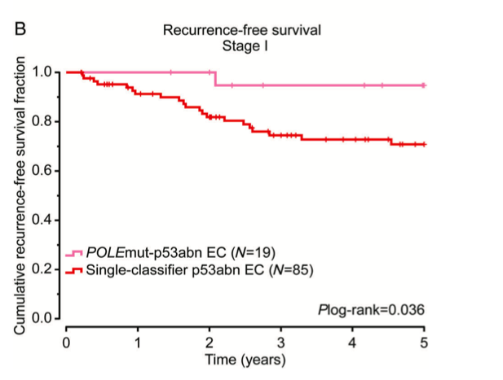
Multiple classifier
León-Castillo A, et al. Clinicopathological and molecular characterisation of 'multiple-classifier' endometrial carcinomas. J Pathol. 2020 Mar;250(3):312-322.
Notes:
Survival analysis of multiple-classifier EC compared with single-classifier p53abn EC. Five-year recurrence-free survival analysis of stage I MMRd–p53abn EC (A) and POLEmut–p53abn EC (B) compared with single-classifier p53abn EC.
These findings support the categorising multiple-classifier POLEmut–p53abn EC as single-classifier POLEmut, and MMRd–p53abn EC as single-classifier MMRd

Slide 48
57 endometrial biopsy specimens
Classification according to the Proactive Molecular Risk Classifier for Endometrial Cancer molecular subtypes (mismatch repair deficiency, DNA polymerase epsilon mutation, wild-type p53, and abnormal p53)
Endpoints: response rate after hormone therapy, recurrence rate after complete response, hysterectomy rate, upstaged diagnosis rate after hysterectomy
Notes:
A total of 57 endometrial biopsy specimens obtained before hormone therapy were evaluated, and patients were classified
according to the Proactive Molecular Risk Classifier for Endometrial Cancer molecular subtypes (mismatch repair deficiency, DNA polymerase epsilon mutation, wild-type p53, and abnormal p53). The primary endpoint was the response rate after hormone therapy. The secondary endpoint was the recurrence rate after the complete response, hysterectomy rate owing to treatment failure, and upstaged diagnosis rate after hysterectomy

Slide 49
MMR status
Overall complete response rate:
75.4%
Need for hysteroscopy
•
Chung YS et al. . Mismatch repair status influences response to fertility-sparing treatment of endometrial cancer. Am J Obstet Gynecol. 2021 Apr;224(4):370.e1-370.e13
Notes:
Patients with mismatch repair deficiency had a significantly lower complete response or partial response rate than those with wild-type p53 in terms of the best overall response (44.4% vs 82.2%) and complete response rate at 6 months (11.1% vs 53.3%)
Among patients with mismatch repair deficiency, 4 underwent immediate hysterectomy because of treatment failure and 3 presented upstaged diagnosis after hysterectomy
From these results, we may conclude that Mismatch repair status could be used as a predictive biomarker for selecting patients who could
benefit from hormone therapy.

Slide 50
 | Characteristic | MMRd (%) | POLE mutated (%) | p53abn (%) | p53wt (%) | Total (%)
Chung et al. | n (EC) | 9 (16) | 2 (4) | 1 (2) | 45 (79) | 57
 | Age at diagnosis (years) | 33 (26–40) | 27, 34 | 33 | 31 (19–45) | 33 (19–45)
 | Treatment | Oral MPA, MA or LNG-IUD plus MPA concurrently
 | Follow-up, median (range), months | 38.4 (2.9–163.5)
 | CR rate | 4 (44) | 1 (50) | 1 (100) | 37 (82) | 43 (75)
 | PR | 0 (0) | 0 (0) | 0 (0) | 0 (0) | 0 (0)
 | SD/PD | 5 (55) | 1 (50) | 0 | 8 (18) | 14 (25)
 | Recurrence after CR | 1 (25) | 1 (100) | 1 (100) | 16 (43) | 19 (44)

Slide 51
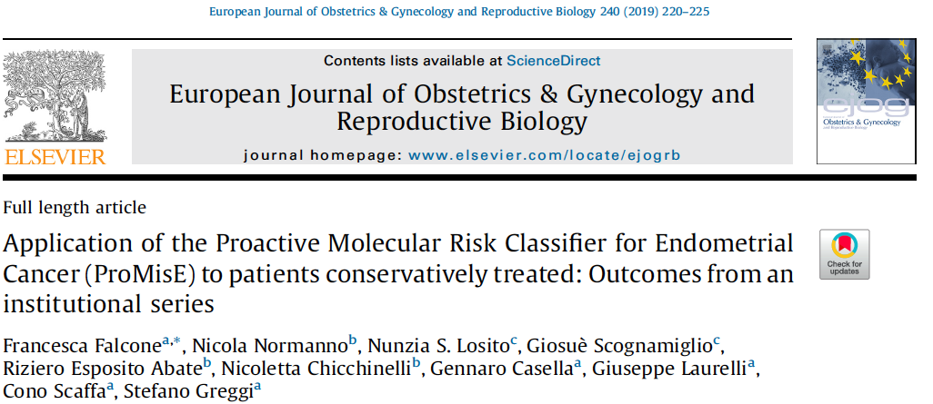
15/25 patients with molecular analysis
Median follow-up : 106 months (range, 24 to 134 months)
Complete regression : 80% and 86.6% at 6 and 9 months
Falcone F et al. Application of the Proactive Molecular Risk Classifier for Endometrial Cancer (ProMisE) to patients conservatively treated: Outcomes from an institutional series. Eur J Obstet Gynecol Reprod Biol. 2019 Sep;240:220-225

Slide 52
Study | Characteristic | MMRd (%) | POLE mutated (%) | p53abn (%) | p53wt (%) | Total (%)
Falcone et al. | n (EC) | 7 (47) | 1 (7) | 0 (0) | 7 (47) | 15
 | Age at diagnosis (years) | 38 (28–39) | 36 |  | 37 (25–40) | 37 (25–40)
 | Treatment | Hysteroscopic resection + LNG-IUD
 | Follow-up, median (range), months | 106 (24–134)
 | CR rate | 5 (71) | 1 (100) | – | 7 (100) | 13 (87)
 | PR | 0 (0) | 0 (0) | 0 (0) | 0 (0) | 0 (0)
 | SD/PD | 2 (29) | 0 (0) | 0 | 0 (0) | 2
 | Recurrence after CR | 1 (14) | 0 | – | 2 (29) | 3 (23)

Slide 53
15 over 25
Falcone F et al. Application of the Proactive Molecular Risk Classifier for Endometrial Cancer (ProMisE) to patients conservatively treated: Outcomes from an institutional series. Eur J Obstet Gynecol Reprod Biol. 2019 Sep;240:220-225
Notes:
Here we will show data of a small cohort (n = 15) analyzed by Falcone et al. reporting in their analysis of biopsy samples of young women with
endometrial cancer, that 46.7% were MMR abnormal, 6.6% POLE EDM, 0% p53 abnormal and 46.7% p53 wild type
Three patients (20%) had more than one molecular feature.
Molecular analysis methods were used in 25 patients (stage IA, G1-2 endometrioid EC), of whom 15 (60%) represented fully evaluable cases.

Slide 54
Patient no. | Molecular analysis | Follow-up
3 | MSH6; PMS2 | Persistence of disease at 6 months
7 | MSH2; MSH6 | Progressive disease at 3 months
4 | PMS2 | After 102 months from complete regression diagnosis of poorly differentiated colon cancer
10 | MSH6 | 81 months from complete regression, metachronous breast cancer
14 | MSH2 | Recurrence after 11 months of complete remission
Notes:
7 out of 15 patients had MMR abnormality
5 out of these 7 presented : progressive or persistence disease, 1 recurrence, diagnosis of metachronous cancers (breast, colon)

Slide 55
MMRd
in young women undergoing hysteroscopic resection plus progestin AEH and EEC, MMR-deficiency
does not appear as a significant predictor of resistance to treatment,
but rather as a predictor of recurrence with 100% specificity.

Slide 59
Molecular characterization of patients with endometrioid endometrial intraepithelial neoplasia (n = 37) and outcome. Puechl, A.M. Cancers 2021, 13, 2847.
Title | MMRd (n = 2) | POLE- Mutated (n = 4) | p53-Abnormal (n = 3) | p53 Wild Type (n = 27) | Total (n = 36)
Progression or required definitive treatment n
(%) No | 1 (50.0) | 3 (75.0) | 2 (66.7) | 25 (92.6) | 31 (86.1)
Yes | 1 (50.0) | 1 (25.0) | 1 (33.3) | 2 (7.4) | 5 (13.9)
Type of definitive therapy, n (%) | n = 1 | n = 1 | n = 1 | n = 2 | n = 5
Surgery | 1 (100.0) | 0 (0) | 1 (100.0) | 2 (100.0) | 4 (80.0)
Radiation | 0 (0.0) | 1 (25.0) | 0 (0.0) | 0 (0.0) | 1 (20.0)
Final diagnosis on hysterectomy specimen, n (%) | n = 1 | n = 0 | n = 1 | n = 2 | n = 4
No residual disease | 0 (0.0) | - | 0 (0.0) | 0 (0.0) | 0 (0.0)
EIN | 0 (0.0) | - | 1 (100.0) | 0 (0.0) | 1 (25.0)
Cancer | 1 (100.0) | - | 0 (0.0) | 2 (100.0) | 3 (75.0)

Slide 60
Study | Characteristic |  | MMRd (%) | POLE mutated (%) | p53abn (%) | p53wt (%) | Total (%)
Puechl et al. | n (EC/EIN/EAH) |  | 6* | 4 | 4 | 44** | 58
 | Age at diagnosis |  | 71.7 (51.9–86.8) | 55.5 (52.1–68.3) | 67.0 (48.1–89.0) | 53.1 (24.3–91.1) | 56.4 (24.3–91.1)
 | Diagnosis | ECC | 4 (67) | 0 (0) | 1 (25) | 17 (39) | 22 (38)
 |  | EAH/EIN | 2 (33) | 4 (100) | 3 (75) | 27 (61) | 36 (62)
 | Treatment |  | LNG-IUD +/− MA, MPA or leuprolide
 | Follow-up, median (range), months |  | 28.8 (3.3–141.5)
 | CR rate |  | 2 (33) | 3 (75) | 2 (50) | 20 (56) | 27 (54)
 | PR |  | 1 (17) | 0 | 0 | 6 (14) | 7 (12)
 | SD/PD |  | 2 (33) | 1 (25) | 2 (50) | 10 (23) | 15 (26)
 | Recurrence after CR |  | 1 (50.0) | 0 (0) | 0 (0) | 1 (5.0) | 2 (7.4)

Slide 63
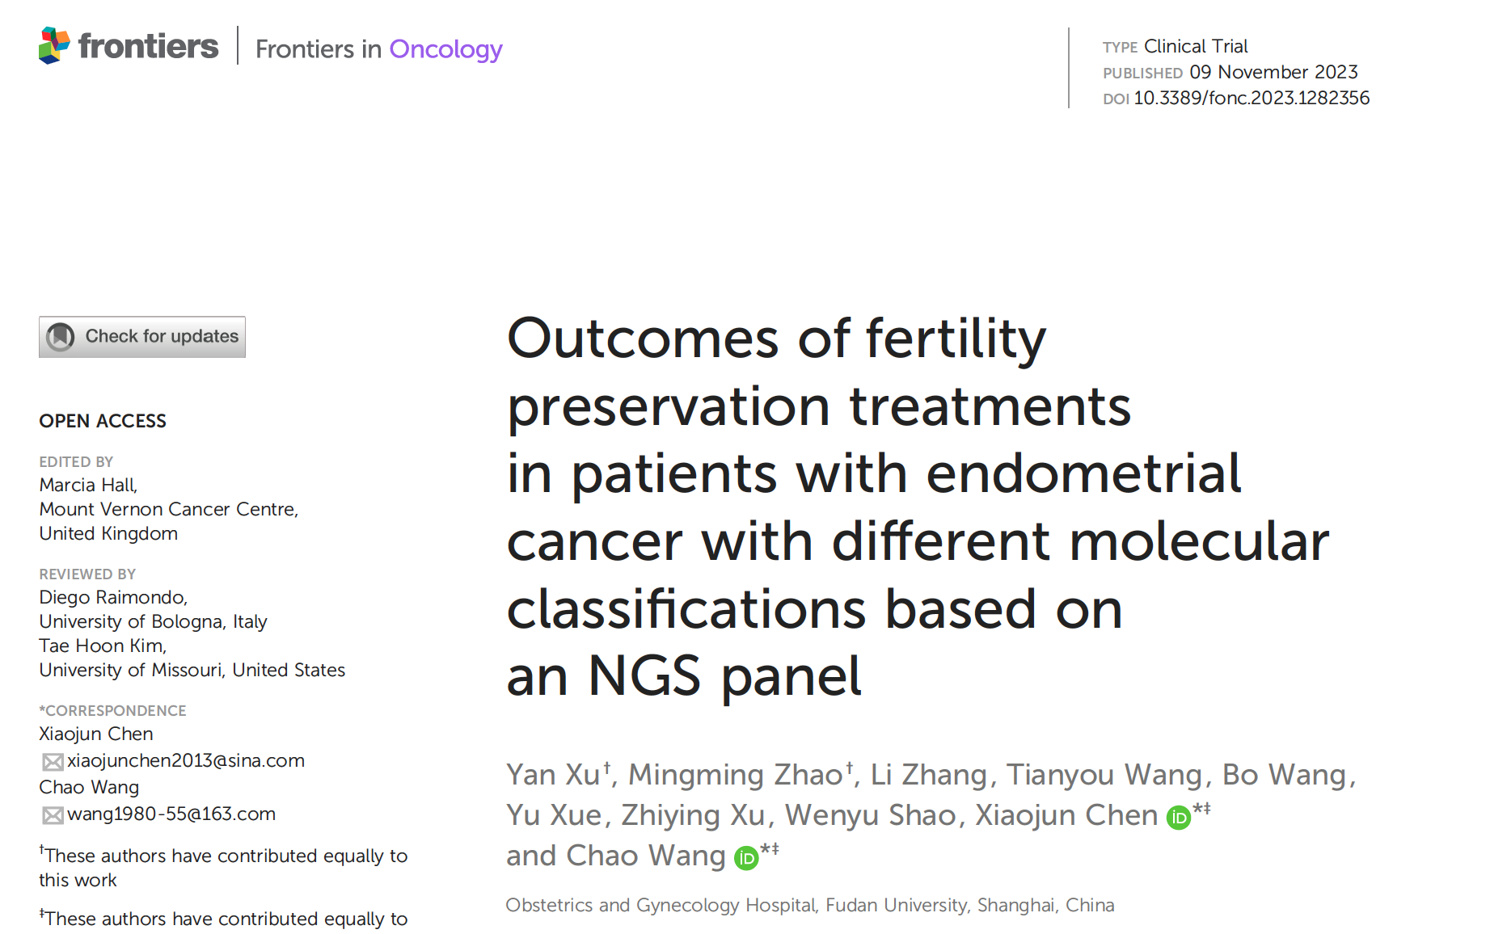
Xu Y, Zhao M, Zhang L, Wang T, Wang B, Xue Y, Xu Z, Shao W, Chen X and Wang C
(2023) Outcomes of fertility preservation treatments in patients with endometrial cancer with different molecular classifications based on an NGS panel. Front. Oncol. 13:1282356.

Slide 64
POLE mutations had the highest disease progression rate (50.0%, P=0.013),
microsatellite instability-high (MSI-H) group had the highest recurrence rate (50.0%, P=0.042).
PIK3CA mutation (hazard ratio (HR): 0.61; Overweight (HR: 0.56; 95% CI: 0.32–0.96; P=0.033) and Obesity (HR: 0.44; 95% CI: 0.20–0.95; P=0.036) were associated with a significantly lower cumulative complete response (CR) rate.

Slide 65
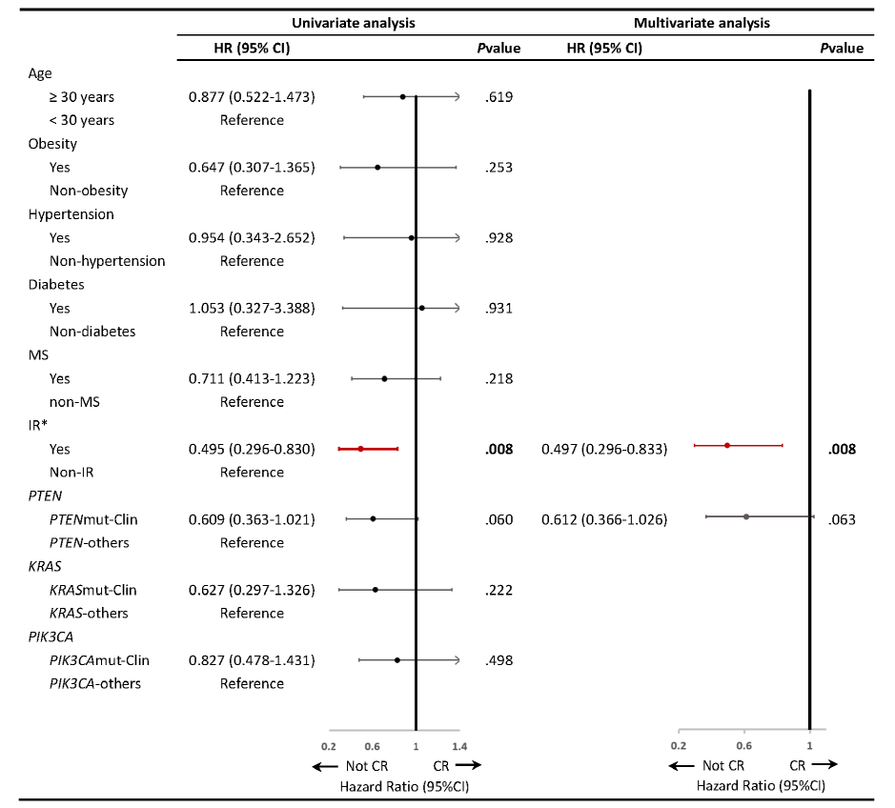
Fig. S3. Risk factors related to CR rate in EEC patients. Univariate and multivariate cox regression models were used to identify risk factors associated with fertility preserving treatment …
J Gynecol Oncol 2023 Jul;34(4):e53. https://doi.org/10.3802/jgo.2023.34.e53
Notes:
Fig. S3. Risk factors related to CR rate in EEC patients. Univariate and multivariate cox regression models were used to identify risk factors associated with fertility preserving treatment outcomes according to CR rates in patients with EEC.
(name of the gene) mut-Clin, genes harboring variants in tiers I and II; (name of the gene) -others, genes with wild-type or variants in tier III or IV; CI, confidence interval; CR, complete response; HR, hazard ratio; IR, insulin-resistance; EEC, endometrioid endometrial cancer; MS, metastatic syndrome.
*Missing data for 1 case for IR.

Slide 69
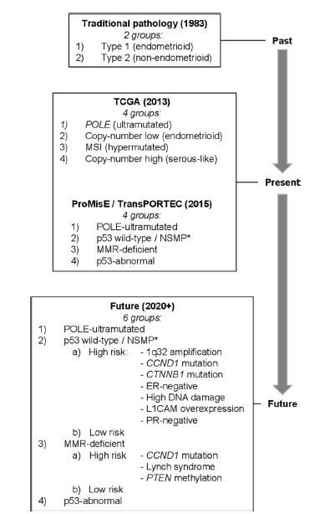
Evolution of the classification of endometrial cancer. Since TCGA classified endometrial cancers into four prognostically distinct molecular subtypes in 2013, stratification of tumors into risk groups using molecular markers has been and continues to be improved.
In this review, the authors examined how response rates to progestin treatment of low-grade endometrial cancer can be improved
Baxter E, et al. Improving response to progestin treatment of low-grade endometrial cancer. Int J Gynecol Cancer. 2020 Nov;30(11):1811-1823
Notes:
In this review, the authors examined how response rates to progestin treatment of low-grade endometrial cancer can be improved. After reviewing 19 studies they concluded that DNA polymerase epsilon (POLE)-ultramutated tumors and a subset of p53 wild-type or DNA mismatch repair (MMR)-deficient tumors with ‘low-risk’ features (eg, progesterone and estrogen receptor-positive) may have improved response rates, though this needs to be validated.
CCND1, cyclin D1; CTNNB1, catenin beta 1; ER, estrogen receptor; L1CAM, L1 cell adhesion molecule; MMR, mismatch repair; MSI, microsatellite instability; *NSMP, no specific molecular profile; POLE, polymerase epsilon; PR, progesterone receptor; PTEN, phosphatase and tensin homolog.

Slide 70
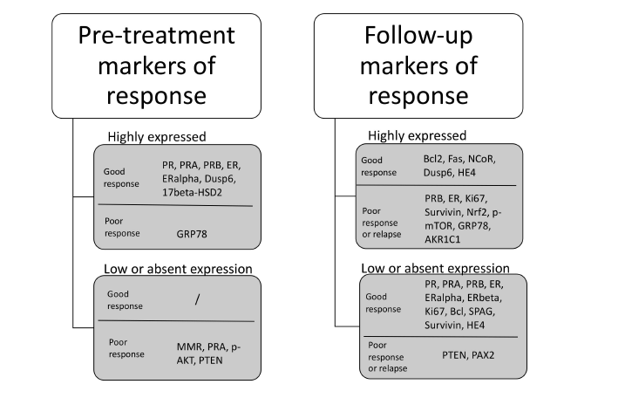
Key message
The most useful markers of response to conservative treatment of endometrial hyperplasia and cancer may be:
- progesterone receptor and estrogen receptor isoforms in the pretreatment phase
- Nrf2, survivin, Bcl2 and Ki67 on follow up
Further studies are needed for several other promising markers.
Summary of statistically significant immunohistochemical markers for conservative management
Travaglino A et al. Immunohistochemical predictive markers of response to conservative treatment of endometrial hyperplasia and early endometrial cancer: A systematic review. Acta Obstet Gynecol Scand. 2019 Sep;98(9):1086-1099
Notes:
A recent review was published on on immunohistochemical markers predicting response to treatment and evaluating treatment
during follow-up period.
The study showed that staining for progesterone and estrogen receptor expression was important prior to treatment, but that an indicator of good response was also Dusp6, a marker of the mitogen-activated protein kinase (MAPK) signaling pathway. An absent expression, deficiency of MMR, was an important sign of potential therapy failure as was the involvement of PTEN, an activator of the mTOR/AKT/PI3K pathway.
This shows that next to understanding of progesterone and estrogen signaling, further focus is needed towards the pathways of MAPK and mTOR/AKT/PI3K.

Slide 71
The Case of MMR
MMR-deficient tumors with wild type CCND1 are:
estrogen receptor and progesterone receptor positive
lack PTEN methylation
and
without Lynch syndrome, and MSI
could be potentially considered low-risk endometrial cancer tumors

Slide 72
need for further investigations
This indicates the need for further investigations of additional molecular markers:
mutational status of beta-catenin (CTNNB1),
L1 cell adhesion molecule (L1CAM),
estrogen receptor and progesterone receptor status,
PTEN methylation status
CCND1, and other markers that could potentially improve the risk stratification models in the future.
POLE ultramutated endometrial carcinoma
AND HOW TO MATCH THESE WITH HISTOLOGY (Grade2???....)

Slide 73
Clinical practice of molecular classification in conservative treatment
Till now, the majority published series on fertility preserving treatment for endometrial cancer examined the traditional pathologic features before deciding about a conservative treatment
Limited data considered the new molecular classification
If we need to extrapolate the prognostic findings of the new molecular classification we may say:
Conservative treatment can be considered with low risk EC patients with POLE mutation?, p-53 wild type
P53 mutated EC patients could not be good candidates for conservative treatment
MMRd shows poor response to progestin treatment unless presence of low risk features (progesterone and estrogen receptor-positive)
Notes:
The current challenge is to identify the group of women with endometrial cancer and low-risk features that would benefit from more conservative treatment options. More focus in management needs to be aimed towards the preservation of quality of life, without jeopardizing oncological outcomes

Slide 74
Role of molecular classification in conservative treatment for endometrial cancer
 | ESGO 2023 | German guidelines (S3-Leitlinie)
Diagnostic procedures | Hysteroscopic resection/curettage (not “blind“) Genetics: MMR-Diagnostic (for Lynch-Syndrom) + HBOC to be ruled out
Inclusion criteria of patients | FIGO IA, G1; without myometrial infiltration ER/PR seems to be predictive for conservative treatment Negative ER/PR are not contraindication for FSS | cT1a, without myometrial infiltration, G1, P53wild type, L1CAM-negative, PR positive
Analyse of 58 Pat. (22 EC, 36 EIN), Progression or response: p53-abn (50%), MMR-d (33%), POL-E mut (25%), NSMP (13%) Puechl et al. Cancers 2021
MMR-Status and CR/PR: 44.4% (MMR-d) vs. 82.2% (MMR-p) (Analyse of 57 Pat.) Chung YS et al, Am J Obstet Gynecol. 2021
CTNNB1 mutation? → 9x risk for recurrence (Meyers et al. β-Catenin mutations in recurrent FIGO IA grade I endometrioid endometrial cancers. GO 2014)
Notes:
Nicht alle Stage IA grade 1 Patientinnen haben die gleiche Tumorbiologie und die entsprechende Outcomes → daher muss man doch diese molekulare Klassifikation nutzen bei Diskussion der fertilitätserhaltende Therapie
Berücksichtigung der p53- und L1CAM-Expression bei der Indikationsstellung zur fertilitätserhaltenden Therapie (S3 Leitlinie)
Aktuelle Daten erlauben keine klinische Applikationen um die potentiziellen Kandidatinnen für FST zu erweitern
Chung YS hormone treatment, EC pats
Puechl: 22 EC, the rest EIN, IUD Levonorgestrel , totatl 58

Slide 75
Mutlu,Cancers 2022, 14, 5187

Slide 77
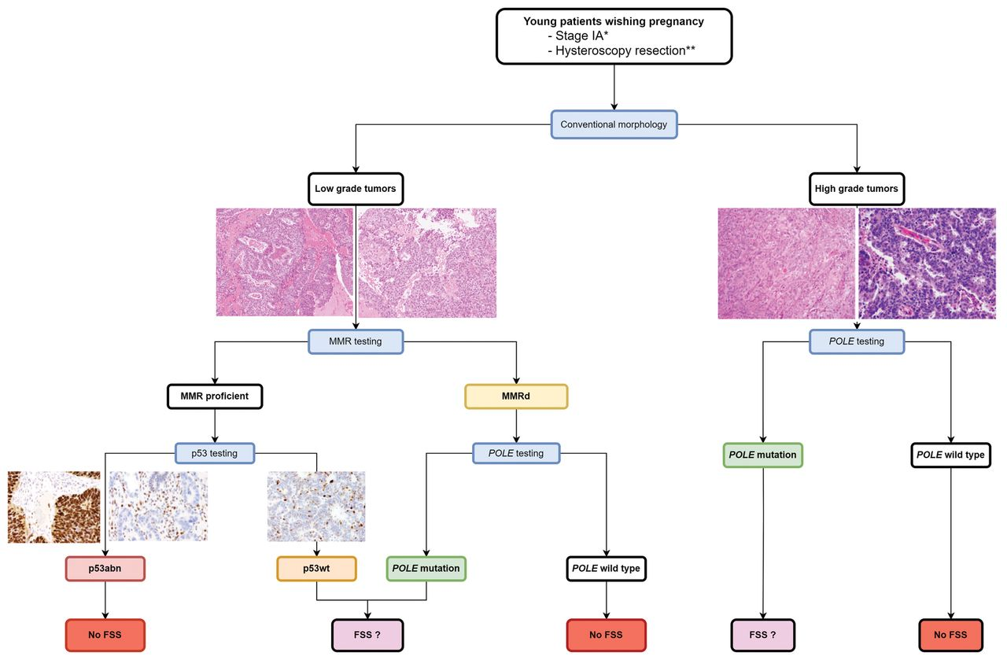
Algorithm for the selection of young patients with endometrial cancer wishing to preserve fertility according to the molecular subtype. *Stage IA was assessed using MRI and/or US. The absence of myometrial infiltration is mandatory. **The hysteroscopic specimen should allow the adequate pathological, immunohistochemical, and molecular assays.
MOHAMED AMINE BANI et al. Anticancer Res 2024;44:445-452
Copyright © 2024 International Institute of Anticancer Research (Dr. George J. Delinasios), All rights reserved.
Notes:
Algorithm for the selection of young patients with endometrial cancer wishing to preserve fertility according to the molecular subtype. *Stage IA was assessed using MRI and/or US. The absence of myometrial infiltration is mandatory. **The hysteroscopic specimen should allow the adequate pathological, immunohistochemical, and molecular assays. POLE: Polymerase epsilon; MMRd: mismatch repair deficiency; FSS: fertility-sparing strategy.

Slide 80
Study | Characteristic |  | MMRd (%) | POLE mutated (%) | p53abn (%) | p53wt (%) | Total (%)
Zhang et al. ∼ | n (EC/EIN/EAH) |  | 4 | 3 | 3 | 49 | 59
 | Age at diagnosis, years (mean ± SD) |  | 31.4 ± 2.9 | 33.1 ± 5.1 | 33.5 ± 3.0 | 31.5 ± 3.1 | 33.4 ± 1.1
 | Diagnosis | ECC | 3 | 2 | 1 | 33 | 39
 |  | EAH/EIN | 1 | 1 | 2 | 16 | 20
 | Treatment |  | High-dose progestin (500 mg daily)
 | Follow-up, median (range), months |  | 16.8 (4–104)

Slide 81
Study | Characteristic |  | MMRd (%) | POLE mutated (%) | p53abn (%) | p53wt (%) | Total (%)
Ran et al. | n (EC/EIN/EAH) |  | 3 (25) | 0 | 1 (8) | 8 (67) | 12
 | Age at diagnosis (years) |  | 35 (31–37) | – | 34 | 29 (23−33) | 30 (23–37)
 | Diagnosis | ECC | 3 (100) | – | 1 (100) | 8 (100) | 12
 |  | EAH/EIN | 0 | – | 0 | 0 | 0
 | Treatment |  | MA, MPA, Goserelin acetate, or LNG-IUD
 | Follow-up, median (range), months |  | 46 (13–138)
 | CR rate |  | 2 (67) | – | 0 | 6 (75) | 8 (67)
 | PR |  | 0 | 0 | 0 | 0 | 0
 | SD/PD |  | 1 (33) | – | 1 (100) | 2 (25) | 4 (33)
 | Recurrence after CR |  | 0 | – | 0 | 1 (16) | 1 (8)

Slide 82
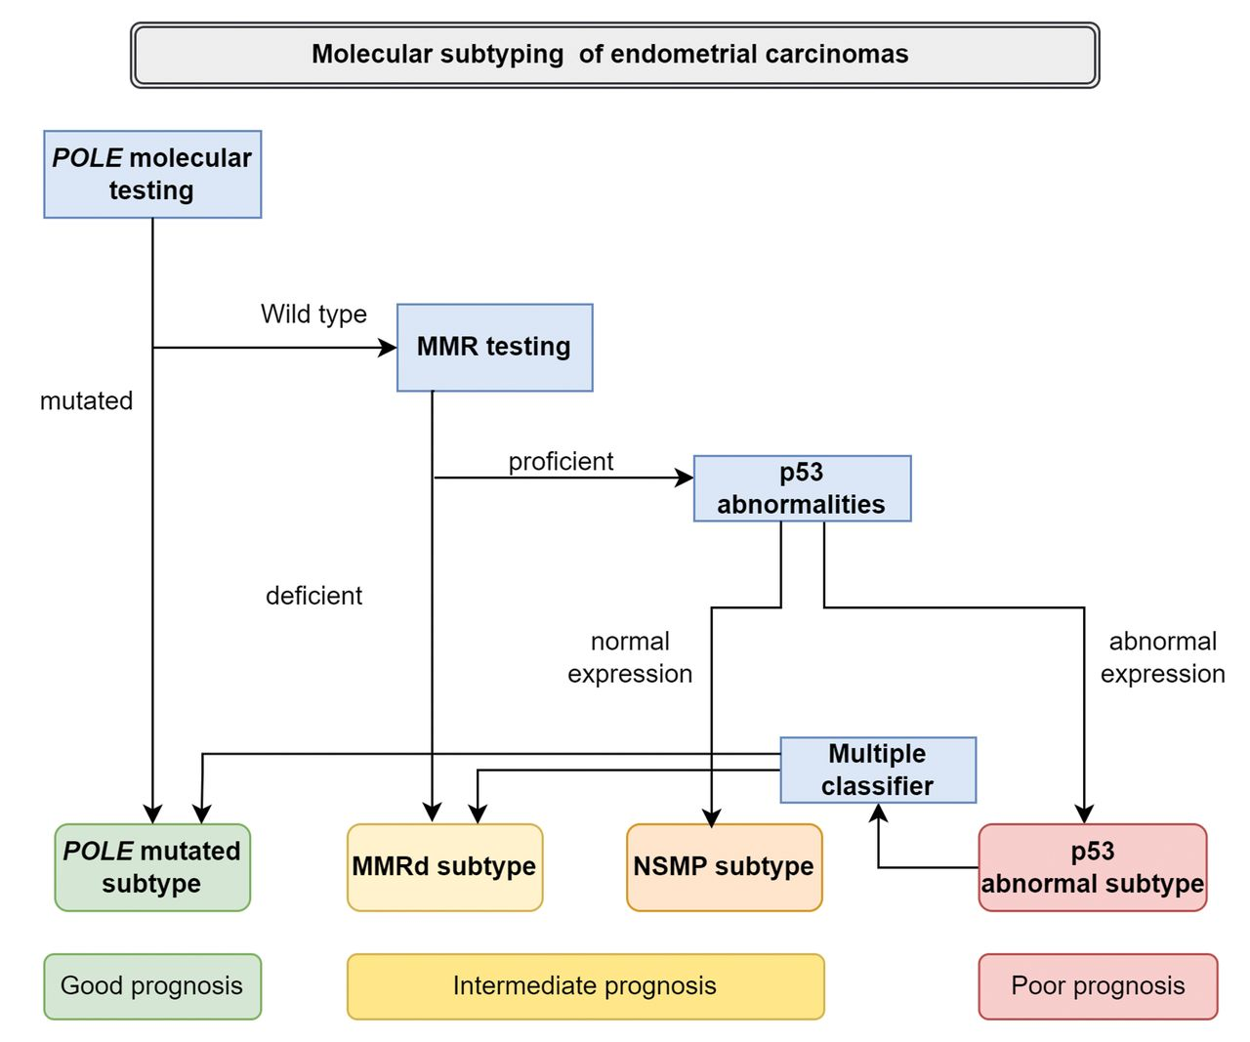
Algorithm for the molecular subtyping of endometrial carcinomas and their corresponding prognosis.
MOHAMED AMINE BANI et al. Anticancer Res 2024;44:445-452
Copyright © 2024 International Institute of Anticancer Research (Dr. George J. Delinasios), All rights reserved.
Notes:
Algorithm for the molecular subtyping of endometrial carcinomas and their corresponding prognosis. Molecular testing for POLE mutation can be performed using polymerase chain reaction or next generation sequencing. MMR testing can be performed using immunohistochemistry or polymerase chain reaction. Abnormalities in the expression of p53 are investigated using immunohistochemistry. POLE: Polymerase epsilon; MMRd: mismatch repair deficient; NLMP: non-specific molecular profile.

Slide 83
Algorithm for the selection of young patients with endometrial cancer wishing to preserve fertility according to the molecular subtype. *Stage IA was assessed using MRI and/or US. The absence of myometrial infiltration is mandatory. **The hysteroscopic specimen should allow the adequate pathological, immunohistochemical, and molecular assays.
MOHAMED AMINE BANI et al. Anticancer Res 2024;44:445-452
Copyright © 2024 International Institute of Anticancer Research (Dr. George J. Delinasios), All rights reserved.
Notes:
Algorithm for the selection of young patients with endometrial cancer wishing to preserve fertility according to the molecular subtype. *Stage IA was assessed using MRI and/or US. The absence of myometrial infiltration is mandatory. **The hysteroscopic specimen should allow the adequate pathological, immunohistochemical, and molecular assays. POLE: Polymerase epsilon; MMRd: mismatch repair deficiency; FSS: fertility-sparing strategy.

Slide 84
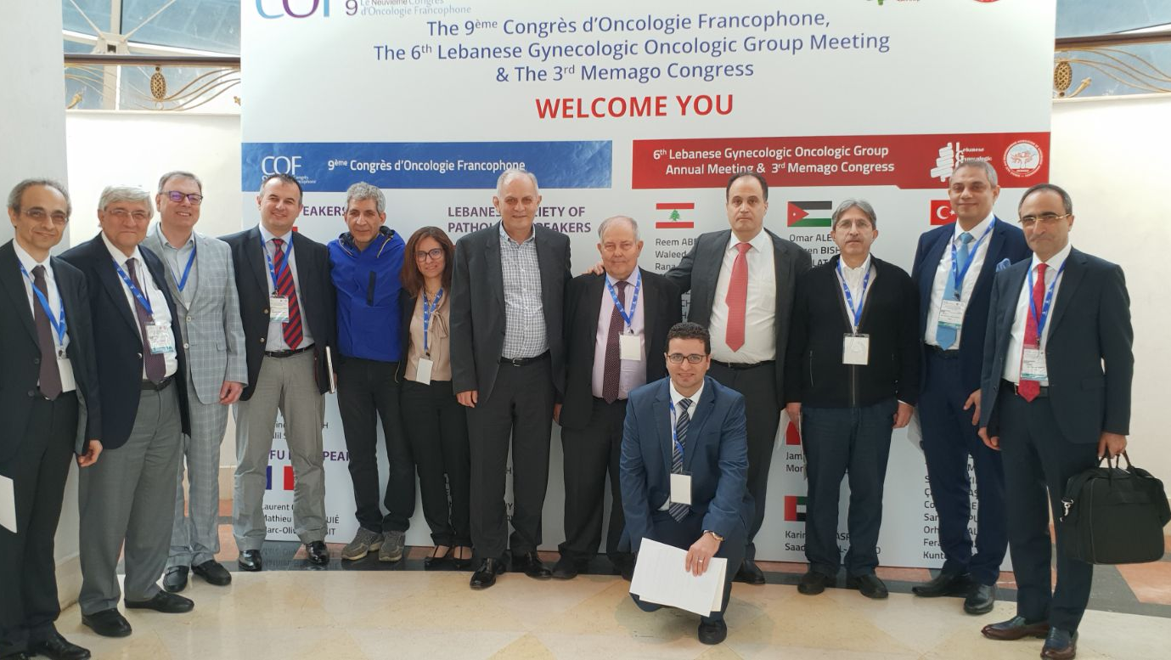
Thank you

