Slide 1
VULVAR CANCER Role of NCT-CRT
Neamat Hegazy
Ass Prof Clinical Oncology
Alexandria University
Egypt

Slide 2
Epidemiology
Vulvar cancer is a rare malignancy
Represents < 1% of all the cancers diagnosed in women and < 5% of all gynecologic neoplasms
More common with increasing age ; Median age – 68 years

Slide 3
Diagnosis
In any patient suspected for vulvar cancer, diagnosis should be established by a punch/incision biopsy.
Excision biopsy should be avoided for initial diagnosis, as this may obstruct further treatment planning.
In patients with multiple vulvar lesions, all lesions should be biopsied separately (with clear documentation of mapping).
All patients with vulvar cancer should be referred to a Gynaecological oncology centre (GOC) and treated by a multidisciplinary gynaecological oncology team.

Slide 4
Preoperative work-up
Clinical examination of lesion and imaging of the groins (either by ultrasound, PET-CT or magnetic resonance imaging (MRI)) are required to identify potential lymph node metastases.
✓ Suspicious nodes (at palpation and/or imaging) should be analyzed by FNA or core biopsy when this would alter primary treatment.

Slide 6
Treatment

Slide 10
Adjuvant radiotherapy
primary risk factors include: close tumor margins, lymphovascular invasion (LVSI), tumor size, depth of invasion, and pattern of invasion (spray or diffuse). Nodal involvement (as an indicator of LVSI) may also impact selection of adjuvant therapy to the primary site.
In case of close but clear pathological margins, postoperative vulvar radiotherapy may be considered to reduce the frequency of local recurrences.

Slide 11
Adjuvant radiotherapy (close surgical margins or positive margins)
on multivariate analysis,
adjuvant radiation was a significant prognostic predictor for local control
adjuvant radiation therapy significantly improved actuarial 5-year survival for patients with positive margins (p = 0.001), but not for those with close margins (p = 0.63).

Slide 12
Adjuvant radiotherapy
Postoperative radiotherapy to the groin is recommended for cases with > 1 metastatic lymph node and/or presence of extracapsular lymph node involvement.
the addition of concomitant, radiosensitising chemotherapy to adjuvant radiotherapy should be considered.

Slide 13
Adjuvant radiotherapy (single positive node)
the benefit of adjuvant radiation in patients with a single lymph node metastasis and micrometastatic disease to the lymph nodes is controversial.
In multivariate subanalysis performed as part of the AGO-CaRE-1 study, adjuvant radiotherapy was associated with a not statistically significant better PFS compared to patients without adjuvant treatment

Slide 14
Adjuvant radiotherapy (multiple positive nodes)
a randomized trial compared pelvic radiotherapy with pelvic lymphadenectomy in 114 patients with inguinofemoral lymph node metastases after radical vulvectomy and bilateral inguinofemoral lymphadenectomy
The difference in regional (groin) recurrence was significant, favoring the adjunctive radiation therapy group
Survival proved also to be better in the patients who received postoperative radiotherapy
In this study, the most dramatic survival advantage for radiation therapy was in patients who had either of the two major poor prognostic factors present: 1) clinically suspicious or fixed ulcerated groin nodes, and 2) two or more positive groin nodes.

Slide 15
ESGO Guidelines

Slide 16
Definitive chemoradiation
Chemoradiation is the treatment of choice in patients with unresectable disease.
In advanced stage disease neoadjuvant chemoradiation should be considered in order to avoid exenteration surgery.
Radiosensitising chemotherapy, preferably with weekly cisplatin, is recommended.

Slide 17
Definitive chemoradiation
In the retrospective study, Landrum et al. compared outcomes of 63 patients with LAVC treated by primary surgery (N = 30) of by primary chemoradiation (N = 33).
The general schema for chemoradiation involved weekly cisplatin (40 mg/m²) or two cycles of cisplatin (50 mg/m²) plus 5-FU (1,000 mg/m²) concurrent with external beam radiation.
The radiation fraction size was generally 180 cGy delivered in a once-daily fraction with a median dose of 4,760 cGy (range 3,690-6,300 cGy) to the whole pelvis and primary vulvar site, with additional radiation to the inguinal regions as directed by nodal status.

Slide 18
Definitive chemoradiation
Patients were managed surgically with radical (N = 11) or modified radical vulvectomy (N = 19) when adequate surgical margins could be obtained without urinary or colonic diversion.
At a median follow-up of 31 months, there was no t difference in the risk of death in patients with LAVC between patients who received primary chemoradiation and those who received primary surgery.
also no statistically significant difference in recurrence rate based on treatment group (5 in the chemoradiation arm versus 7 in the primary surgery arm, p > 0.05).

Slide 19
Definitive chemoradiation
GOG phase II study
including 58 patients with LAVC not amenable to surgical resection (radical vulvectomy), assessed the efficacy and toxicity of radiation therapy and concurrent chemotherapy when used for the primary treatment.
Radiation was given daily, five days per week in 1.8 Gy fractions to a total dose of 57.6 Gy with concurrent cisplatin (40 mg/m² to maximum dose 70 mg) chemotherapy administered weekly throughout radiation therapy.
Patients only underwent radical surgical resection after chemoradiation if they had residual disease present on biopsy.

Slide 20
Definitive chemoradiation
GOG phase II study
After a median follow-up of 24 months, 37 patients (64%) achieved a cCR. Among these patients there were 29 (50%) who underwent surgical biopsy and had a pCR
Twenty-two of these 29 patients continued to have no evidence of disease,
while 7 patients who had persistent disease after chemoradiation , underwent surgical resection, 8 (28%) were alive at last follow-up with no evidence of disease recurrence.
Although acute toxicity was significant, the protocol was considered tolerable.

Slide 21
Neo-Adjuvant ChemoRadiotherapy
Given with the goals of decreasing the sequelae of radical surgery and to maximize functional outcome
After initial concurrent chemoradiation and healing of the reaction, the response to the therapy at the primary site and the lymph nodes is assessed
If there is complete clinical regression of the disease, resection may be omitted for negative biopsies from primary site with groin dissection

Slide 22
RT Planning

Slide 23
Patient position, immobilization & simulation
Pt is positioned supine with frog leg position
“Frog-leg” position helps minimize dose to the medial thigh and groin folds.
Although this may be less important if IMRT used.
Advanced immobilization devices like alpha cradle or vacuum cushion device can be considered.

Slide 24
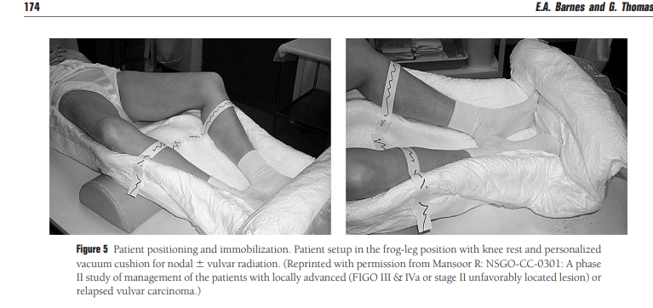
Pt position, immobilization & simulation

Slide 25
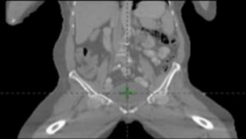
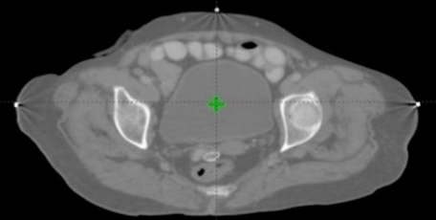
CT Simulation
• Oral contrast
• Bladder protocol
• Frog leg position in a vacuum-evacuated device
• Hands over chest
• Fiducials
• IV contrast
• Customised bolus of 0.5 cm thickness for the vulvar region at simulation
• Images taken from L2 to mid thigh with slice thickness of 3 mm

Slide 26
Contouring
Target Volume :
Entire Vulva / Post-op Bed
B/L Inguinofemoral nodes
Pelvic lymph nodes
Consensus recommendations for radiotherapy contouring and treatment of vulvar carcinoma David K. Gaffney

Slide 27
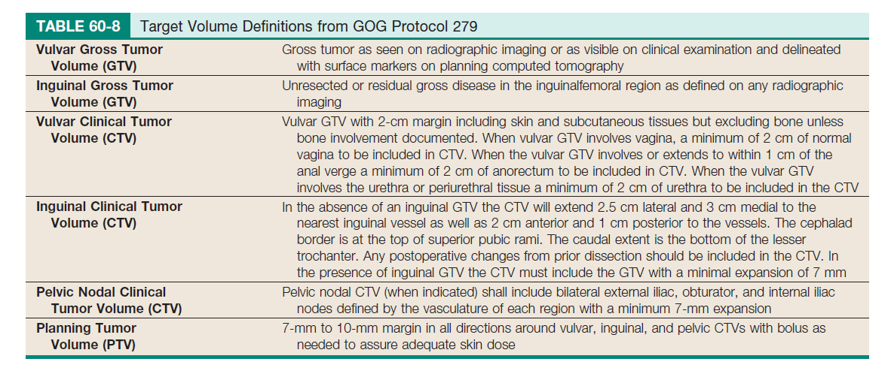

Slide 28
GTV + CTV Primary
GTV :
All gross disease on physical examination and imaging (see above regarding the importance of PET-CT and MRI)
CTV Primary :
GTV + 1 cm including the entire vulva; exclude uninvolved bone, muscle, and adjacent organs
Include entire vagina if vaginal involvement and generate ITV for full and empty bladder if feasible
Include 2 cm of urethra proximal to primary GTV for anterior periurethral lesion or to the bladder neck if extensive urethral involvement
Include a 1–2 cm margin if anal verge is involved or the entire mesorectum if anal canal involvement

Slide 29
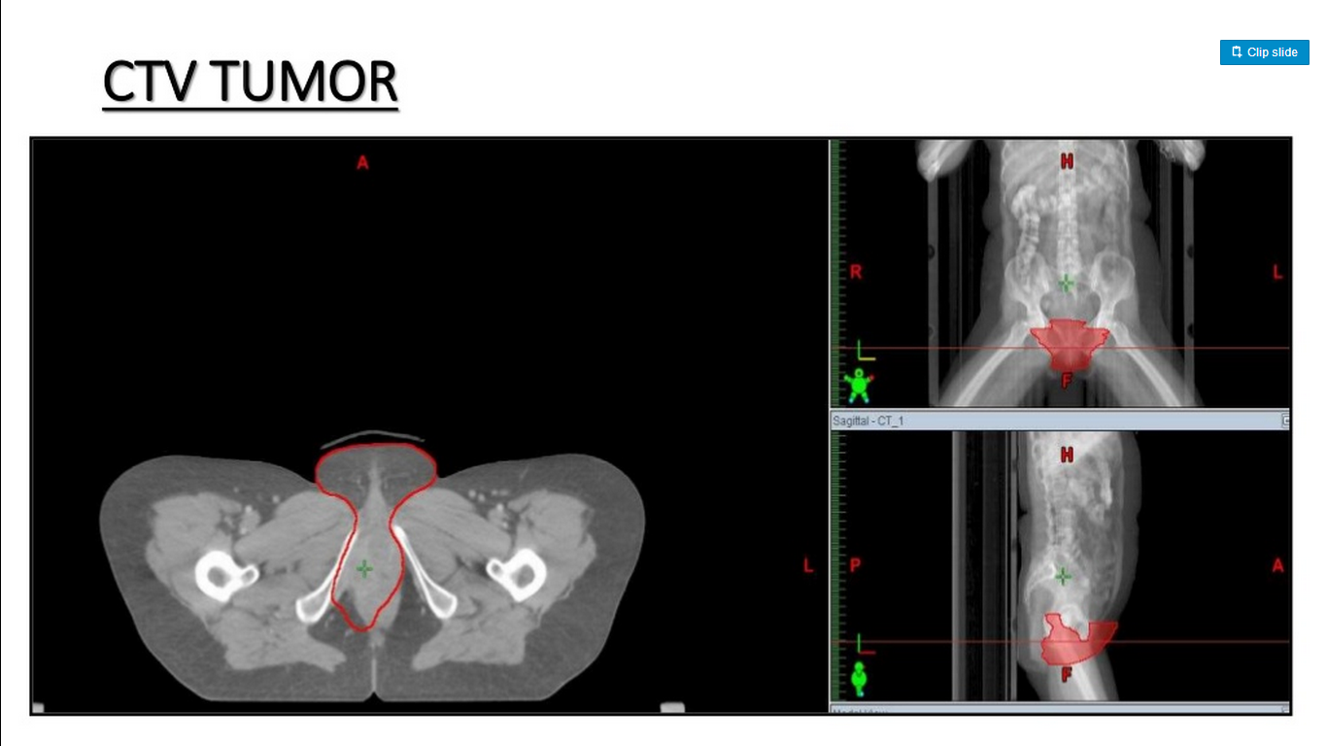
GTV + CTV Primary

Slide 30
CTV Inguinal Node

Slide 31
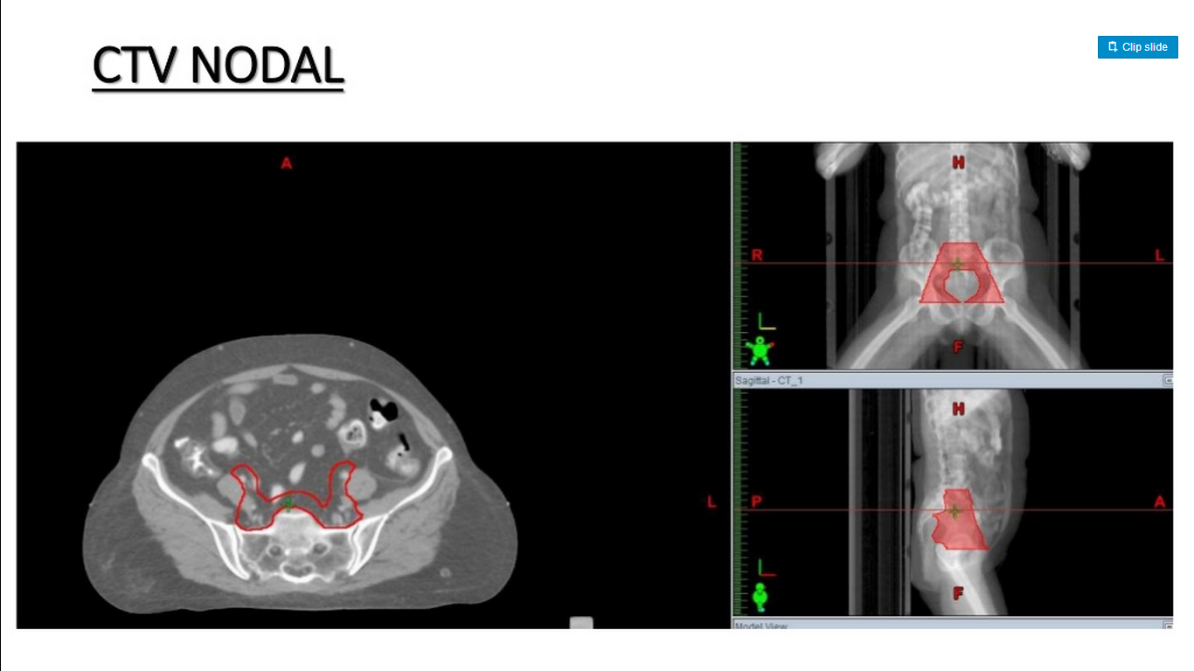
CTV Pelvic Node

Slide 32
CTV Total

Slide 33
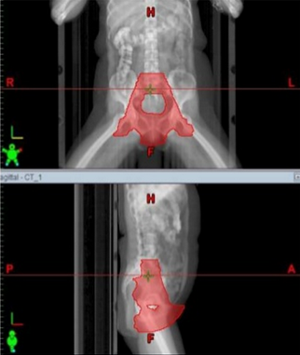
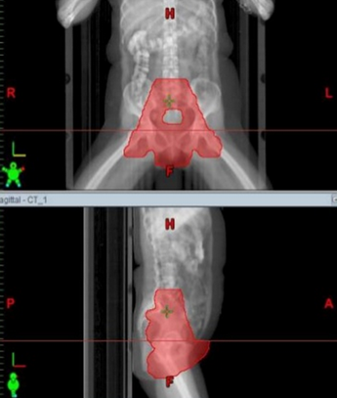
CTV Total to PTV Total

Slide 34
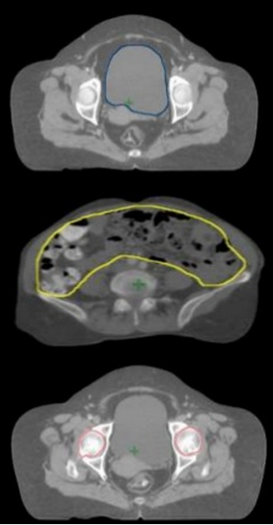
OARs
Bladder
Bowel Bag
Rectum
Head of femur

Slide 35
Conventional Radiotherapy

Slide 36
AP-PA fields with the patient in the supine position are recommended for the delivery of external beam
Depending on whether the inguinofemoral lymph nodes and/or pelvic lymph nodes are to be included in the radiation volume, different field configurations may be used
Although there are no data regarding scar recurrences, it is common practice to include the inguinal node dissection scars in the radiation field

Slide 37
Superior Border-
middle of the sacroiliac joints to cover the external and internal iliac nodes
If a patient has internal or external iliac node involvement, the superior border should be extended to the L3/L4 interspace
Inferior Border –
Should cover the entire vulva and the most superficial, inferior inguinal nodes
Lateral Border -
Posterior field : The pelvic field extends 2 cm laterally to the widest point of the pelvic inlet
Anterior field : The pelvic field extend laterally to lateral edge of lesser trochnter

Slide 38
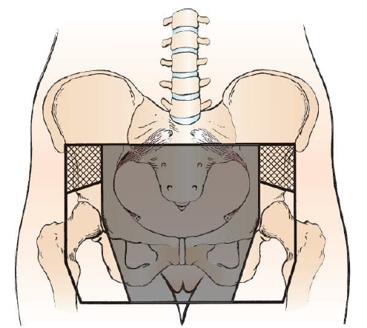
Treatment borders demonstrating the wide anterior field (outer border) and the narrow posterior field (shaded region)

Slide 39
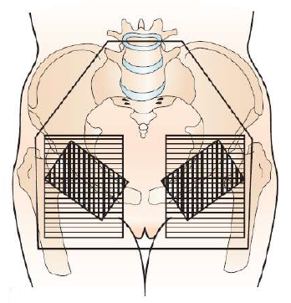
Portal for irradiation of pelvic and inguinofemoral lymph nodes and vulvar area
A final boost to the positive inguinal lymph nodes may be given with a reduced field

Slide 40
3D-CRT Planning

Slide 41
Wide anterior and Wide Posterior Field

Slide 42
Dmax Femoral Head = 56.17 Gy

Slide 43
3D-CRT Planning
Solutions :
Wide anterior field, narrow posterior field, anterior electron field
Narrow anterior and Narrow posterior field and anterior electron field
Wide anterior, Narrow posterior, and anterior inguinal photon fields

Slide 44
Wide Anterior Field, Narrow Posterior Field, Anterior Electron Field

Slide 45
Narrow Anterior and Narrow Posterior Field and Anterior Electron Field

Slide 46
Wide Anterior, Narrow Posterior, and Anterior Inguinal Photon Fields

Slide 47
Challenges with 3DCRT technique
Abutting photon-electron fields at the groin result in significant hotspots and dose inhomogeneity at the match line, which contribute to patient morbidity
The depth of inguinal node necessitates the use of high energy electron that result in severe skin reaction
The irradiation of large volumes of normal tissue, especially small bowel exposes patients to treatment related toxicities and limits the total deliverable dose

Slide 48
IMRT
Often used to treat the pelvis and inguinal nodes
Careful quality assurance is required when using IMRT
In particular, care should be placed to ensure that the surface of the vulvar tumor receives adequate dose
Virtual Flash –
During treatment planning, the PTV is expanded out of the skin by 1 to 2 cm, with additional placement of virtual tissue equivalent to allow for dose buildup
This protects against underdosing the tumor surface if there is displacement of the patient during treatment

Slide 49
Treatment Planning⁸⁻⁹
IMRT ⁸⁻⁹
GTV (only for pre-op) defined by PET, clinical exam, wire markers
CTV primary includes entire vulva and surgical incisions
7mm -2cm around bilateral external iliac, internal iliac, and
inguinofemoral nodes
1 cm around entire vulvar region including post-operative bed
Pre-sacral nodes included if vaginal involvment to S1-2
Peri-rectal nodes included if anal/rectal involvement
PTV=CTV + 7-10mm

Slide 50
IMRT
Dose constraints :
Small bowel : V45 < 195 cc
Rectum : V50 < 50%
Bladder : Dmax < 65 Gy
Femoral heads : <15 % to receive > 35 Gy

Slide 51
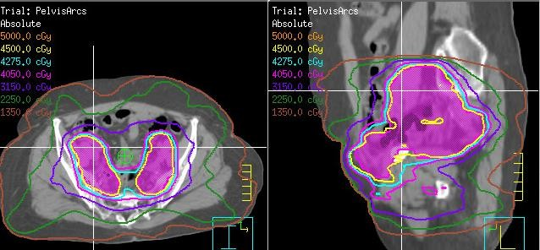
Treatment Plan Summary:
Adjuvant XRT utilizing IMRT with 2 arcs to 45 Gy in 25 fractions of
1.8 Gy with in-vivo dosimetry verification
Target: Vulva, bilateral inguinal, external and internal Iliac lymph nodes to level of bifurcation of internal/external iliac

Slide 52
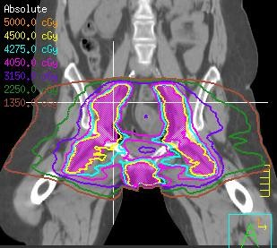

Slide 56
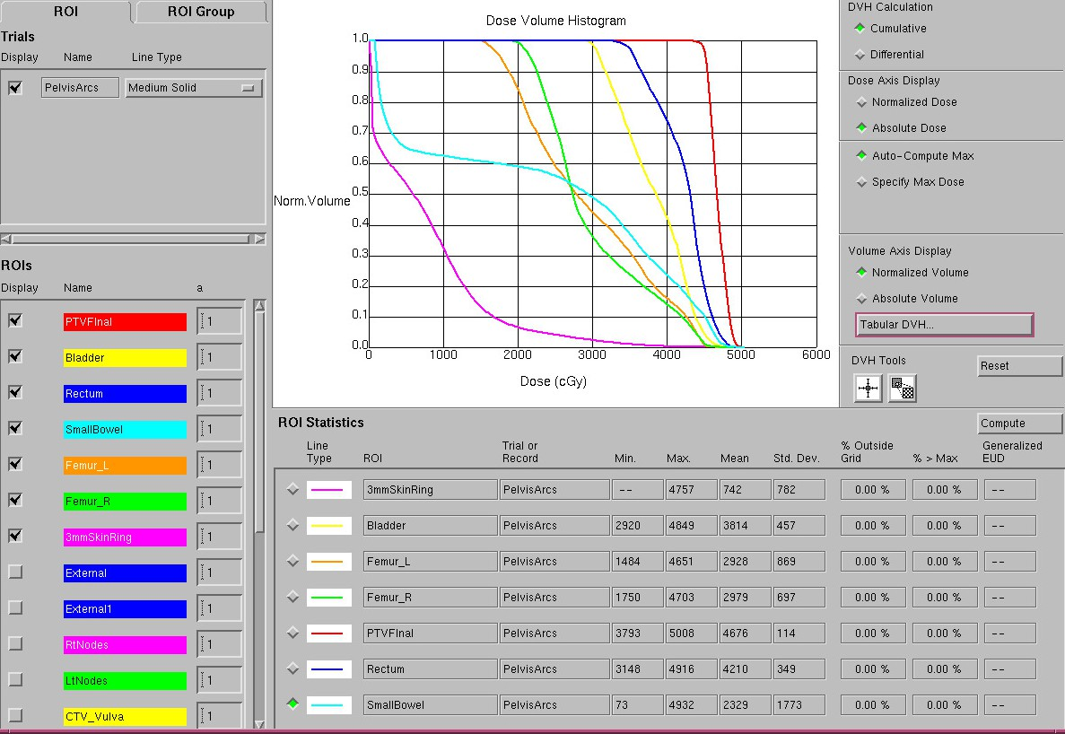

Slide 57
Brachytherapy

Slide 58
Brachytherapy
Brachytherapy has been used for inoperable vulvar cancer, disease recurrence and as a boost to the primary tumor
Advocated for primary vulvar cancer if the patient refuses surgery or if surgery is contraindicated
the use of brachytherapy should be limited to very selected cases and performed by experienced practitioners

Slide 59
Procedure
Procedure performed under spinal or general anesthesia with patient placed in a lithotomy position
After thorough clinical examination under anesthesia and mapping of disease, BT procedure involves insertion of plastic catheters or stainless-steel hollow rigid needles into the vulvar tissues with safety margin
Usually, free-hand implant is done to treat the superficial vulvar lesions while template-based straight or curved needles are employed for treatment of deep vulvar lesions extending into vagina

Slide 60
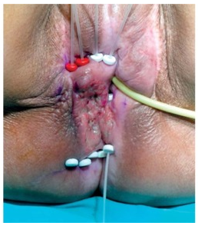
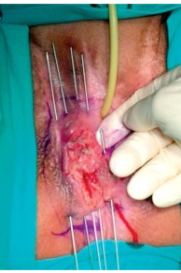
Interstitial Implant

Slide 61
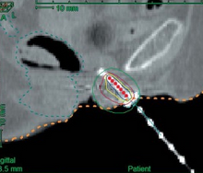
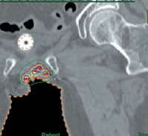
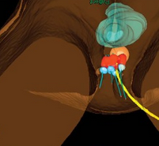
Treatment Planning

Slide 62
Dose –
Definitive :
3.5 to 4 Gy per fraction
10 to 13 fractions atleast 6 hours apart
EQD2 of 30 to 40 Gy
Boost :
3.5 to 4 Gy per fraction
4 to 5 fractions atleast 6 hours apart
EQD2 of 16 to 20 Gy

Slide 64
Thank you

