Slide 1


HPV Vaccination: An Update
M. Faruk Kose, MD
Acibadem MAA University School of Medicine
Department of Gynecologic Oncology

Slide 2
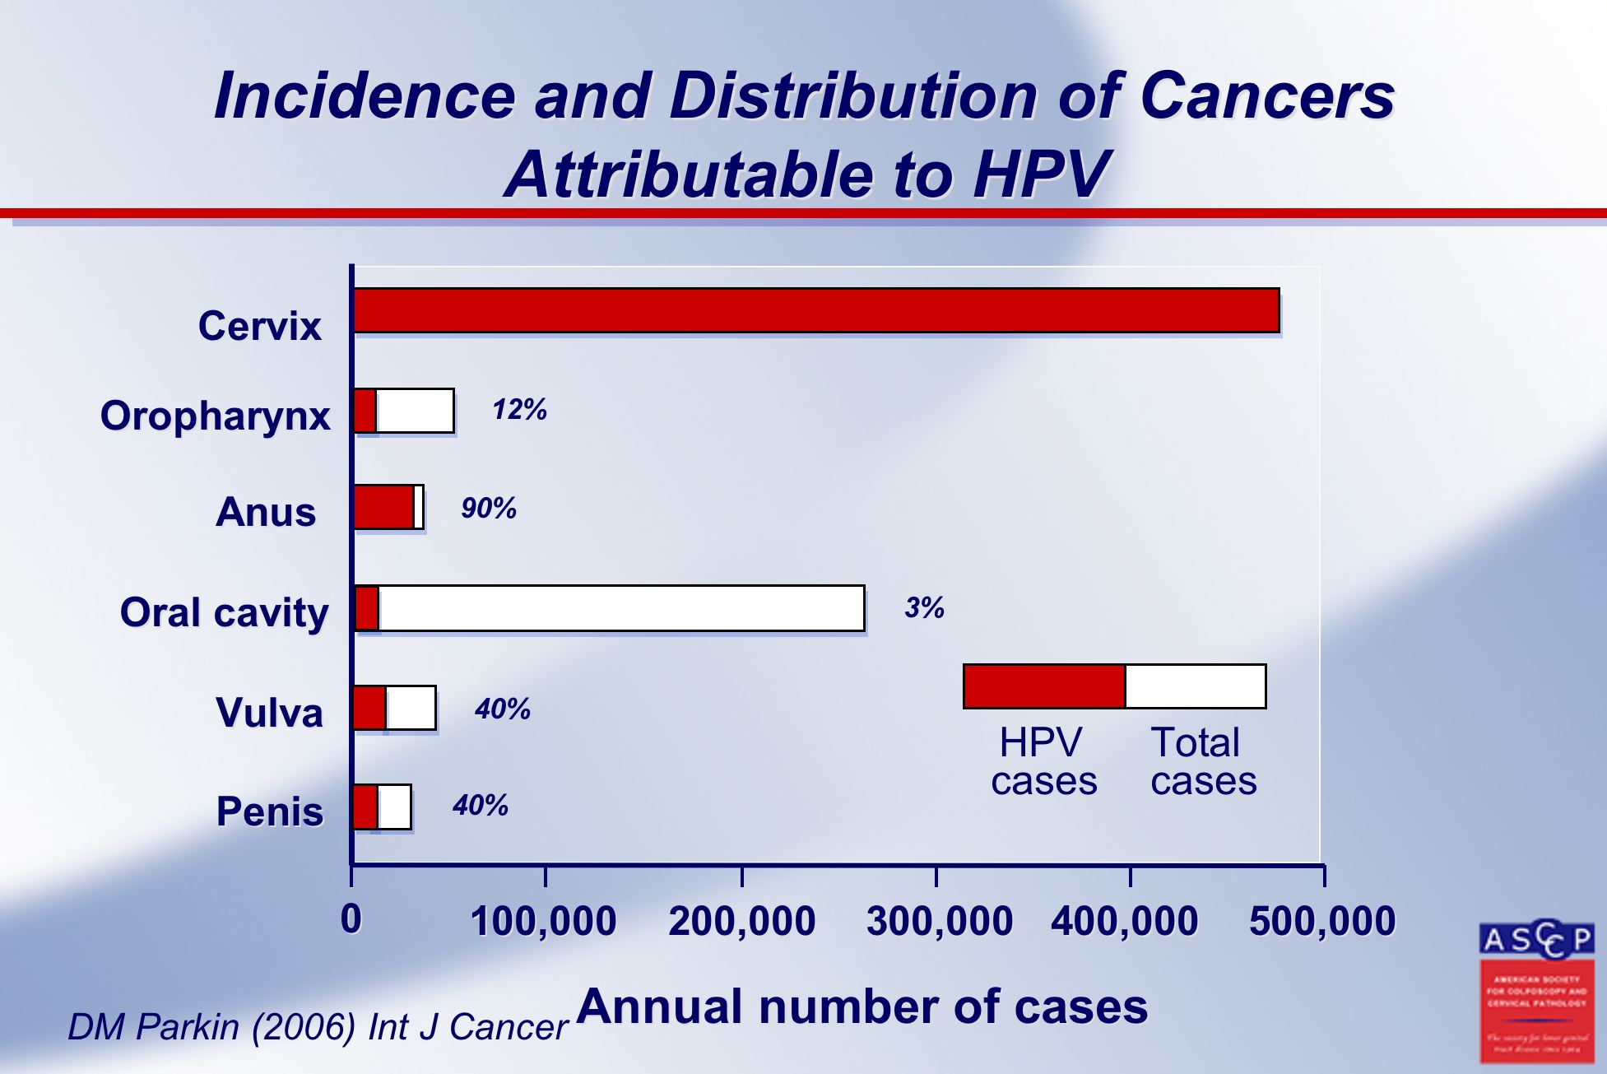
HPV Related Cancer Incidence and Distrubition

Slide 3


Incidence of HPV Related Cancers
Oral Cavity: 5.96/Oropharynx: 1.79
604.127
Anus: 0.49
98.412
50.865
Penis: 0.80
Cervical: 13.3
45.240
Oral Cavity: 2.28/Oropharynx: 0.40
36.068
Vulva: 0.85
17.908
Anus: 0.58
Vagina: 0.36
Standardized incidence: /100.000

Slide 4
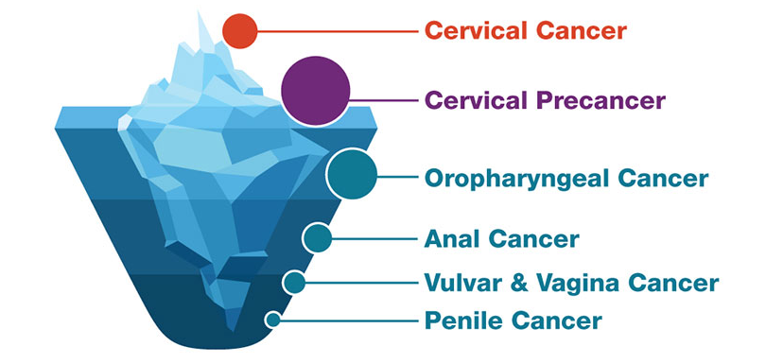
HPV-associated Cancers and Precancers in US

Slide 5
Anal Cancer
Anal cancer accounts for only 0.5% of all new cancer cases
Despite advancements in diagnosis and treatment that have led to declining trends in many other cancer types, anal cancer has been on the rise in recent years
Incidence of anal squamous cell carcinoma (SCC) has increased by 2.7% annually between 2001 and 2015
In individuals over 50 years of age, mortality rates have shown an annual increase of 3.1%
HSIL (AIN2 and AIN3) are most commonly caused by HPV types 16 and 18
HPV vaccines play a critical role in reducing the risk of anal cancer by preventing infections caused by cancer-causing HPV types

Slide 6
Lifetime Probability of HPV Infection
Average lifetime probability of acquiring HPV among those with at least 1 opposite sex partner
For women 84.6% (53.6%–95.0%)
For men 91.3% (%69.5-97.7)
As summary more than 80% of women and men acquire HPV by age 45 years

Slide 7
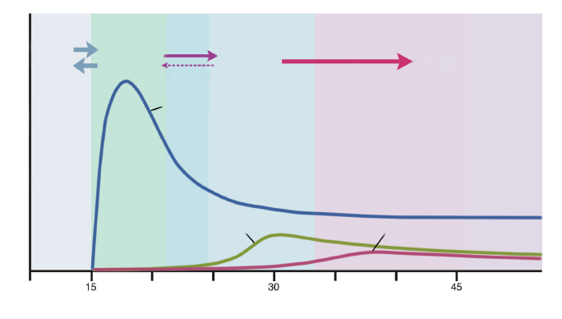
Time Relationship of HPV and Cervical Cancer
HPV infected Cervix
Viral persistance
and progression
Normal cervix
Premalignant lesion
Cancer
Clearance
Regression
Invasion
Insidance
Prekanser
Kanser
Age (Year)

Slide 8
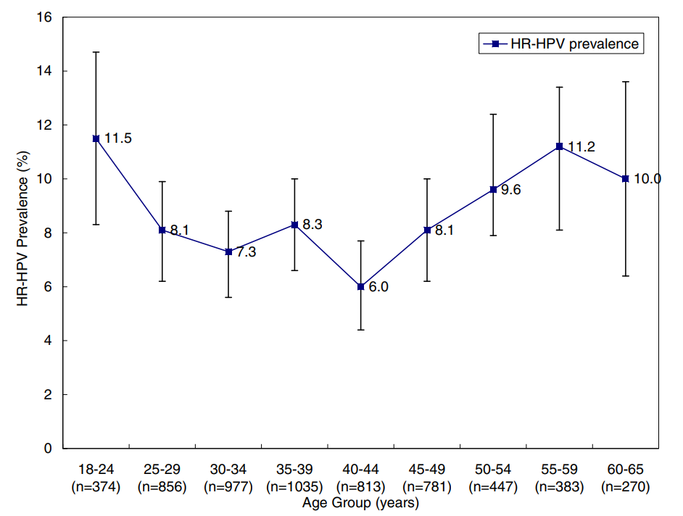
Prevalence for HR-HPV Infection

Slide 9
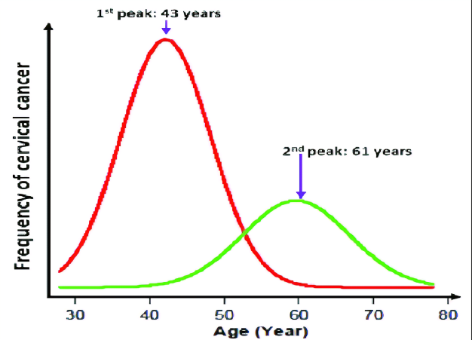
Distribution of Cervical Cancer Frequency
Bimodal Curve of Age-specific Occurrence

Slide 10
Cervical Cancer Progression
Normal cervix
HPV
60% regresses within 2-3 years
HPV infection
LSIL (CIN1)
Cofactors
High risk HPV
(Types 16, 18 etc)
15% progresses within 3-4 years
HSIL (CIN2, 3)
12% progresses within 10 years
Invasive cancer

Slide 11
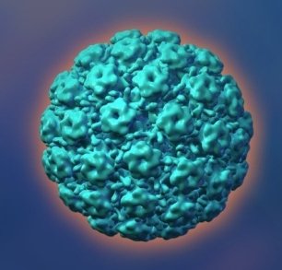
HPV Types and Their Risks
% 96.6
Presence of HPV in cervical cancer (n=1918)
16, 18
6, 11
High risk | 16, 18, 45, 31, 33, 52, 58, 35, 59, 56, 51, 39, 68, 73, 82
Intermediate risk | 26, 53, 66
Low risk | 6, 11, 40, 42, 43, 44, 54, 61, 70, 72, 81, CP6108
Notes:
11

Slide 12
HPV Types in Cervical Cancer (Global)
HPV 16
53.5
HPV 18
17.2 (70.7)
Type specific % (Total %)
HPV 45
6.7 (77.4)
HPV 31
2.9 (80.3)
HPV 33
2.6 (82.9)
HPV 52
2.3 (85.2)
HPV 58
2.2 (87.4)
Women #
2.013.133.000
Case #
469.723
HPV 35
1.4 (88.8)
HPV 59
1.3 (90.1)
HPV 56
1.2 (91.3)
HPV 51
1.0 (92.3)
HPV 39
0.7 (93.0)
HPV 68
0.6 (93.6)
HPV 73
0.5 (94.1)
HPV 82
0.3 (94.4)
Other
1.2 (95.6)
HPV X
4.4 (100)
Modified from Munoz N, Int J Cancer, 2004
20
40
60
80
100
0

Slide 13
HPV Types in Cervical Cancer (Turkey)
HPV 16/18
76%
HPV 16
64.7%
HPV 45
9.9%
HPV 18
9.9%
HPV 31
3.0%
HPV X
2.6%
HPV 33
2.2%
HPV 16, 18, 45, 31, 33, 52=90.6%
HPV 39
1.7%
HPV 68 or 73
0.9%
HPV 35
0.9%
HPV 51
0.9%
HPV 52
0.9%
HPV 59
0.4%
%0
%10
%20
%30
%40
%50
%60
%70
%80

Slide 14
Turkish Ministary of Health Data of HPV Types in CIN3+ Lesions
HPV 16, 18= 90.5%

Slide 15
HPV and Related Diseases Report
Death due to cx ca in Turkey
Death due to cx ca in Turkey
Death due to cx ca in Turkey in 15-44 year old females
Annual average of 1,245
Ranks 12th in cancer-related deaths
Ranks 8th in cancer-related deaths

Slide 16
Prevalence of Anogenital Wart in England and the Wales
100,000
Male
80,000
Female
60,000
Number of diagnoses
40,000
20,000
0
1972
1974
1976
1978
1980
1982
1984
1986
1988
1990
1992
1994
1996
1998
2000
2002
2004
2006
2008
Year

Slide 17
Genital Wart Study in Turkey
This study is one of two published studies showing wart rates in Turkey
Prevalence in women aged 30-65 154/100,000
Recurrence rate 15-37%

Slide 18
Data Weighted to the General Population
Genital Wart | Community Hosp |  | University Hosp |  | Private Hosp |  | Total
 | n | % | n | % | n | % | n | %
Unweighted odds | 13 | 3.4 | 60 | 3.8 | 40 | 4.1 | 114 | 3.8
Values calculated according to the general population
Based on the entire study group | 3.4 (3.4-4) |  | 3.8 (2.2-6.5) |  | 4.1 (2.0-8.1) |  | 3.8* (3.4-4.3)
Based on pregnant women | 3.3 (3.3-3.3) |  | 1.8 (0.3-11.5) |  | 2.8 (0.5-15.2) |  | 2.4* (1.3-4.3)
*Age-adjusted point prevalence

Slide 19
Cervical Cancer Can Be Prevented!
Primary prevention: Preventing the cause of the disease (HPV infection)
Secondary prevention: Identifying the disease
preventive vaccination
Screening and pre-cancer treatment

Slide 20
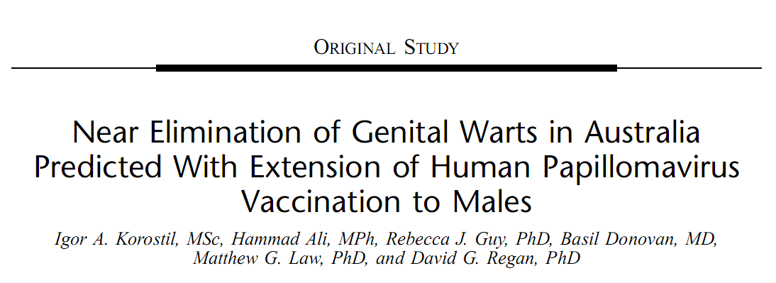
Notes:
20
20
GARDASIL™ is Merck’s quadrivalent HPV L1 VLP vaccine. It is produced in recombinant yeast, like the hepatitis B vaccine, and adsorbed on a proprietary aluminum adjuvant, like the tetanus vaccine.
Background
Merck’s quadrivalent vaccine has the advantage that it targets 4 HPV types (6, 11, 16 and 18).¹ Together, HPV Types 16 and 18 account for about 70% of cervical cancer and high-grade lesions, whereas HPV Types 6 and 11 are associated with approximately 90% of anogenital warts.¹ Together, these 4 types are responsible for over 40% of low-grade cervical lesions,² and HPV 16 and 18 account for over 50% of high-grade lesions.³
The active quadrivalent vaccine is a mixture of 4 recombinant HPV type-specific VLPs consisting of the L1 major capsid proteins of HPV 6, 11, 16, and 18 synthesized in Saccharomyces cerevisiae.¹ Expression of the L1 protein in yeast generates noninfectious VLPs that resemble HPV virions.¹ A similar method is used for hepatitis B vaccine.⁴
The 4 VLP types were purified and absorbed onto amorphous aluminum hydroxyphosphate sulfate adjuvant.¹ The adjuvant dose was 225 micrograms per dose, and the vaccine injection volume was 0.5 mL, given by intramuscular injection at Day 1, Month 2, and Month 6.¹
GARDASIL is a trademark of Merck & Co., Inc., Whitehouse Station, NJ, USA.
References
1. Villa LL, Costa RLR, Petta CA, et al. Prophylactic quadrivalent human papillomavirus (types 6, 11, 16, and 18) L1 virus-like particle vaccine in young women: A randomised double-blind placebo-controlled multicentre phase II efficacy trial. Lancet Oncol. 2005;6:271–278.
2. Clifford GM, Rana RK, Franceschi S, Smith JS, Gough G, Pimenta JM. Human papillomavirus genotype distribution in low-grade cervical lesions: Comparison by geographic region and with cervical cancer. Cancer Epidemiol Biomarkers Prev. 2005;14:1157–1164.
3. Clifford GM, Smith JS, Plummer M, Muñoz N, Franceschi S. Human papillomavirus types in invasive cervical cancer worldwide: A meta-analysis. Br J Cancer. 2003;88:63–73.
4. Recombivax HB® Hepatitis B Vaccine (Recombinant) prescribing information. Merck & Co, Inc. Whitehouse Station, NJ. 1998.

Slide 21

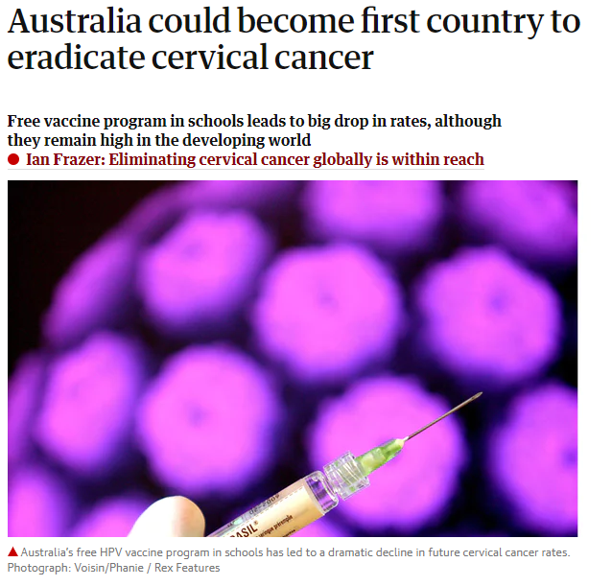
The International Papillomavirus Society has announced that Australia will be the first country to eradicate cervical cancer
New studies have shown that Australia's free vaccination program will dramatically reduce cervical cancer rates in the future
In 2016, 78.6% of 15-year-old girls and 72.9% of 15-year-old boys were vaccinated
As a result, HPV rates in women aged 18-24 decreased from 22.7% to 1.1% between 2005 and 2015
Notes:
21
21
GARDASIL™ is Merck’s quadrivalent HPV L1 VLP vaccine. It is produced in recombinant yeast, like the hepatitis B vaccine, and adsorbed on a proprietary aluminum adjuvant, like the tetanus vaccine.
Background
Merck’s quadrivalent vaccine has the advantage that it targets 4 HPV types (6, 11, 16 and 18).¹ Together, HPV Types 16 and 18 account for about 70% of cervical cancer and high-grade lesions, whereas HPV Types 6 and 11 are associated with approximately 90% of anogenital warts.¹ Together, these 4 types are responsible for over 40% of low-grade cervical lesions,² and HPV 16 and 18 account for over 50% of high-grade lesions.³
The active quadrivalent vaccine is a mixture of 4 recombinant HPV type-specific VLPs consisting of the L1 major capsid proteins of HPV 6, 11, 16, and 18 synthesized in Saccharomyces cerevisiae.¹ Expression of the L1 protein in yeast generates noninfectious VLPs that resemble HPV virions.¹ A similar method is used for hepatitis B vaccine.⁴
The 4 VLP types were purified and absorbed onto amorphous aluminum hydroxyphosphate sulfate adjuvant.¹ The adjuvant dose was 225 micrograms per dose, and the vaccine injection volume was 0.5 mL, given by intramuscular injection at Day 1, Month 2, and Month 6.¹
GARDASIL is a trademark of Merck & Co., Inc., Whitehouse Station, NJ, USA.
References
1. Villa LL, Costa RLR, Petta CA, et al. Prophylactic quadrivalent human papillomavirus (types 6, 11, 16, and 18) L1 virus-like particle vaccine in young women: A randomised double-blind placebo-controlled multicentre phase II efficacy trial. Lancet Oncol. 2005;6:271–278.
2. Clifford GM, Rana RK, Franceschi S, Smith JS, Gough G, Pimenta JM. Human papillomavirus genotype distribution in low-grade cervical lesions: Comparison by geographic region and with cervical cancer. Cancer Epidemiol Biomarkers Prev. 2005;14:1157–1164.
3. Clifford GM, Smith JS, Plummer M, Muñoz N, Franceschi S. Human papillomavirus types in invasive cervical cancer worldwide: A meta-analysis. Br J Cancer. 2003;88:63–73.
4. Recombivax HB® Hepatitis B Vaccine (Recombinant) prescribing information. Merck & Co, Inc. Whitehouse Station, NJ. 1998.

Slide 22
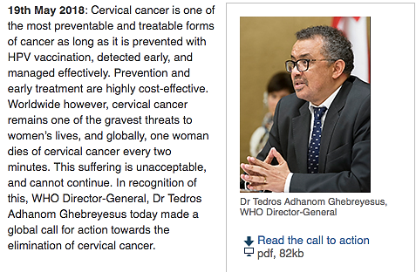
WHO Cervical Cancer Elimination Initiative

Slide 23
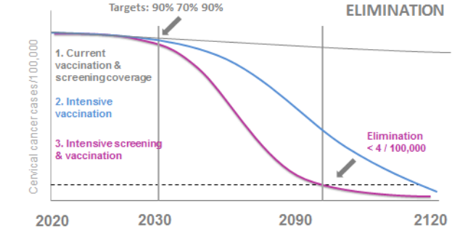
WHO Cervical Cancer Elimination Initiative

Slide 24
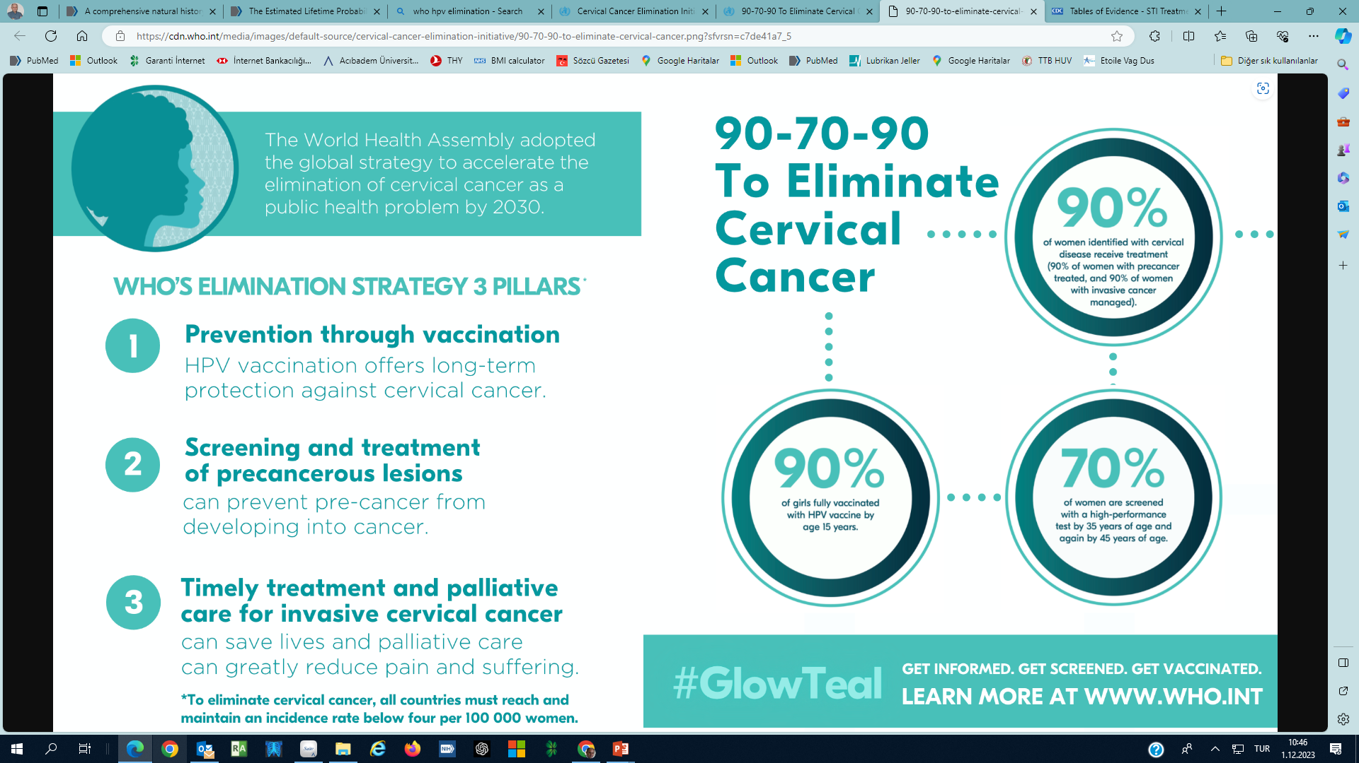
The Future of Cervical Cancer Elimination
90-70-90 targets by 2030
Global elimination of cervical cancer until 2120

Slide 25
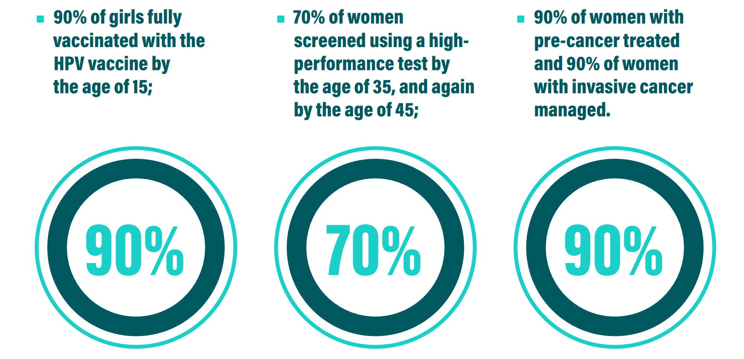
The Future of Cervical Cancer Elimination

Slide 26
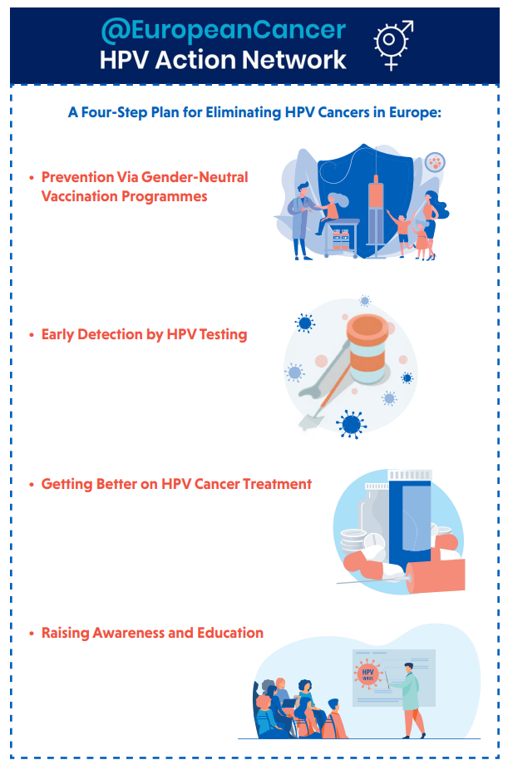
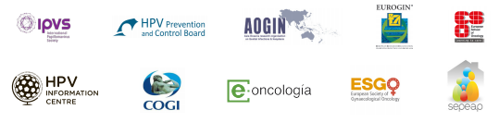
Four-Step Plan for
Eliminating HPV Cancers in Europe

Slide 27
Elimination of HPV-Related Cancers in Europe
Four-step plan to eliminate HPV-related cancers in Europe
Gender-neutral HPV vaccination (boys&girls)
Cervical cancer screening by HPV testing
Appropriate treatment of HPV-associated cancers
Education of the public and professionals for HPV awareness

Slide 28
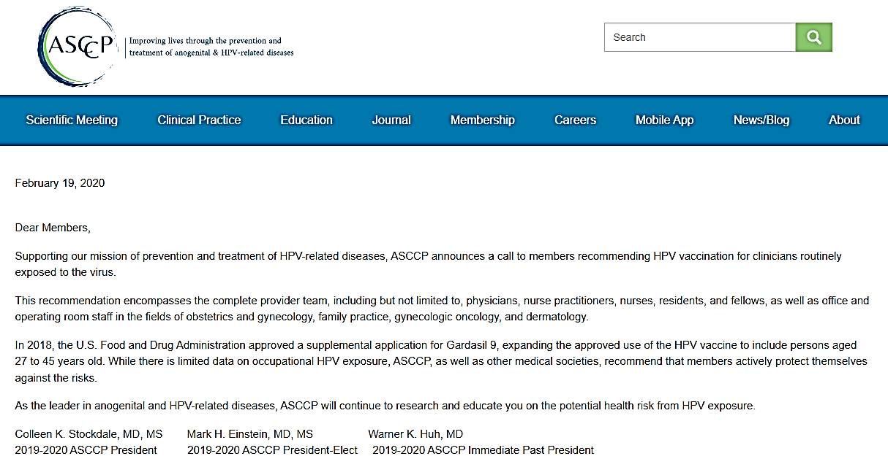
Recommendation of HPV Vaccination for Clinicians

Slide 29
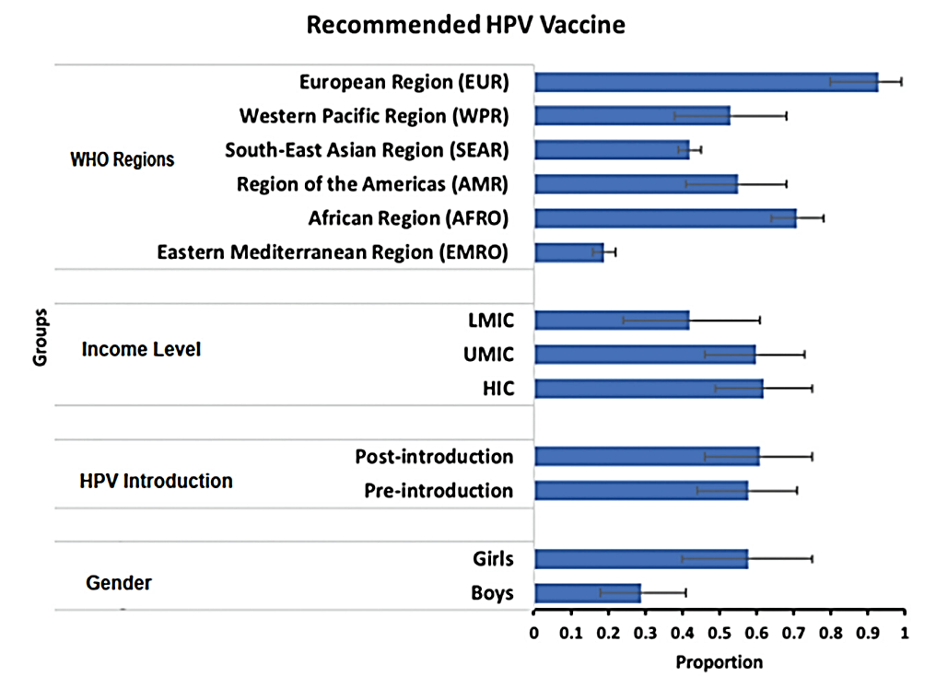
Healthcare Worker Practices for HPV Vaccine Recommendation

Slide 30
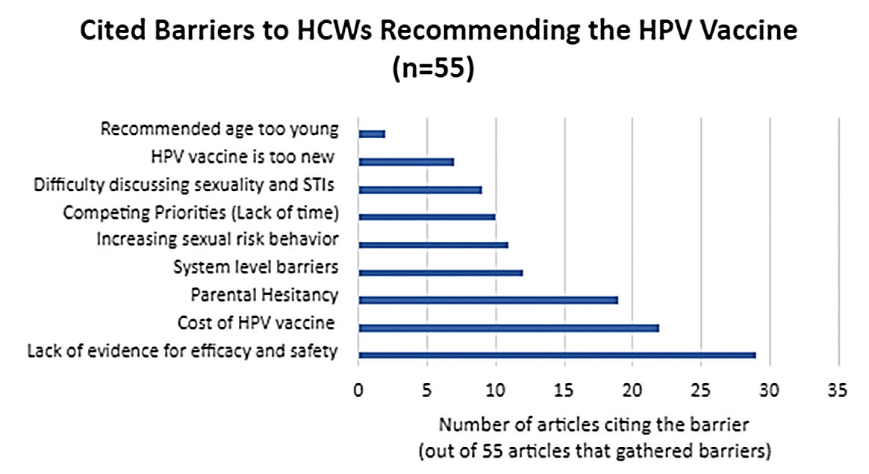
Barriers to Recommending HPV Vaccination
HCWs: Healthcare workers

Slide 31
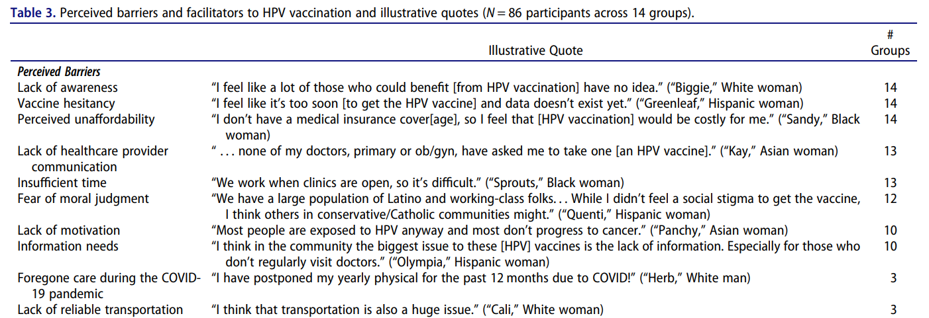
Perceived Barriers and Facilitators to HPV Vaccination

Slide 32
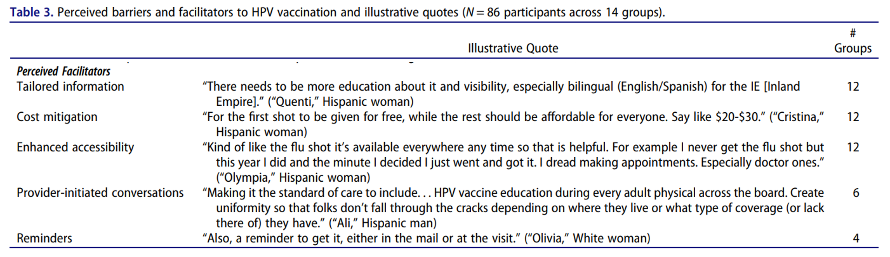
Perceived Barriers and Facilitators to HPV Vaccination

Slide 33
Effectiveness of a 3-component Intervention on HPV Vaccination Coverage (RCT)
In France, 30,739 adolescents aged 11-14 (15,876 boys and 14,863 girls)
  Education and motivation of adolescents and their parents in middle schools
  Training of general practitioners (GPs) on updated HPV information and motivational interview techniques
  Free HPV vaccination in schools
Education and motivation of adolescents did not increase vaccination rates:
-0.08% [95% CI, -2.54 to 2.39]
Training of GPs did not provide additional contribution to vaccination: -1.46% [95% CI, -3.44 to 0.53]
School-based vaccination increased the vaccination rate by 5.50% [95% CI, 3.13 to 7.88]
In school-based vaccination
  When access to GPs was limited: 8.62% [95% CI, 5.37 to 11.86]
  When access to GPs was easy: 2.13% [95% CI, -1.25 to 5.50] (P = .007)
Notes:
Subgroup analyses found a significant interaction between at-school vaccination and access to GPs, with a higher effect when access was poor (8.62 percentage points vs 2.13 percentage points

Slide 34
Need for Vaccine Provision for Healthcare Providers
There is a high level of awareness among healthcare providers regarding occupational exposure to HPV
However, very few are aware of ASCCP's vaccination recommendations for healthcare providers treating HPV-related diseases
Vaccines are considered 100% safe by physicians and allied health professionals
This study emphasizes the lack of awareness of ASCCP's vaccination recommendations and highlights the need to promote vaccination

Slide 35
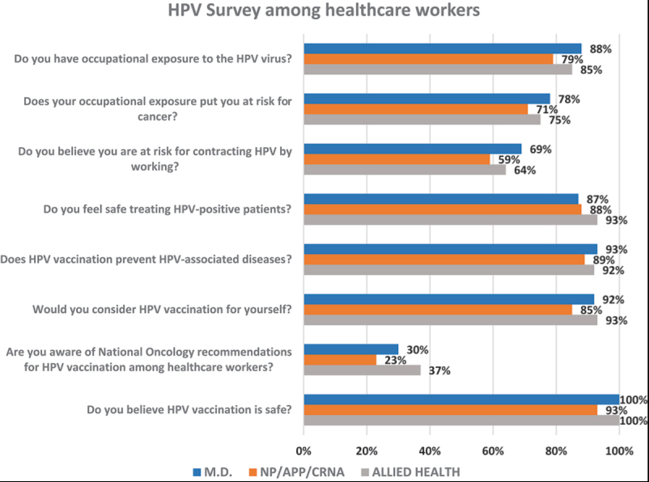
Responses to the HPV Survey Based on Profession
MD: Medical Doctor
NP: Nurse Practitionar
APP: Physician Assistant
CRNA: Certified Registered Nurse Anesthetist

Slide 36
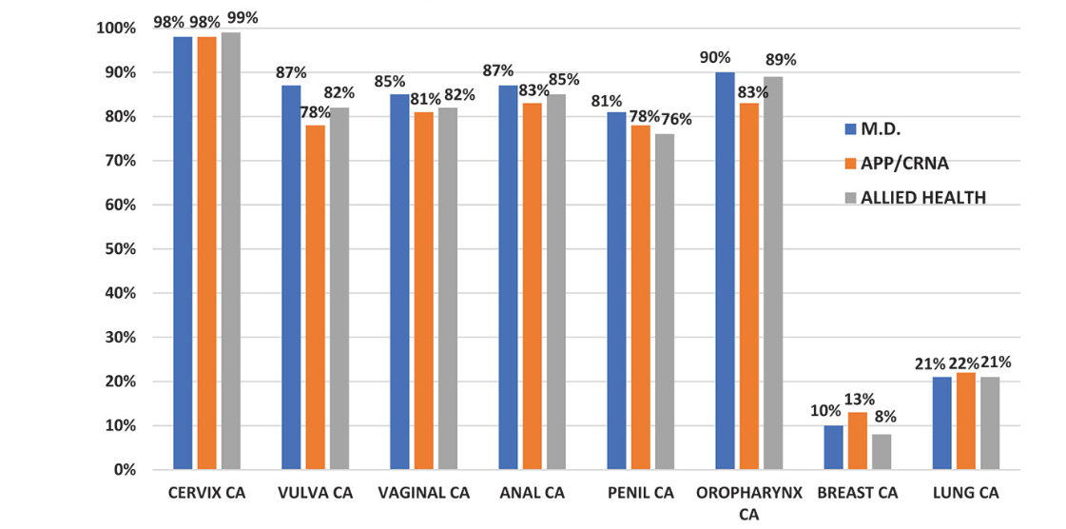
Knowledge about HPV-related Cancers by Profession
MD: Medical Doctor
APP/CRNA: Physician Assistant/Certified Registered Nurse Anesthetist

Slide 37
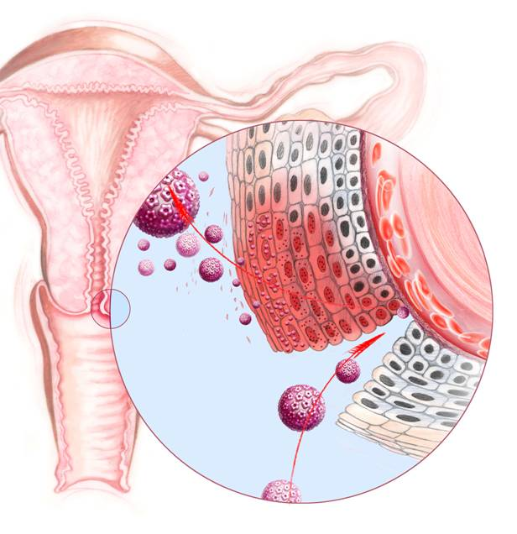
HPV Infection
No inflammation, immune cells are not activated
No Cell Death. Life cycle continues within the epithelium
No Viremia
Notes:
37
Clic No viremia
Clic Local immunosuppression
Clic No inflammation
Animal models have demonstrated the ability of neutralizing Ab to prevent the infection. Given that most of the Ab found at the level of the cervix is coming from the blood,
Clic the vaccine will need to induce a strong and persistent immune response at the site of infection, the cervix, through transudation/exsudation.

Slide 38
Antibody Response Following Natural Infection
10,049 Women Guanacaste, Costa Rica NCI Study
Rate of type-specific HPV infections (%)
HPV-seropositive women have similar rates of HPV infections as HPV-seronegative women

Slide 39


HPV-free Future (#hpvsizgelecek)
#HPV-free
Future
Social Responsibility Project of

Slide 40
Current Data on HPV Vaccines

Slide 41
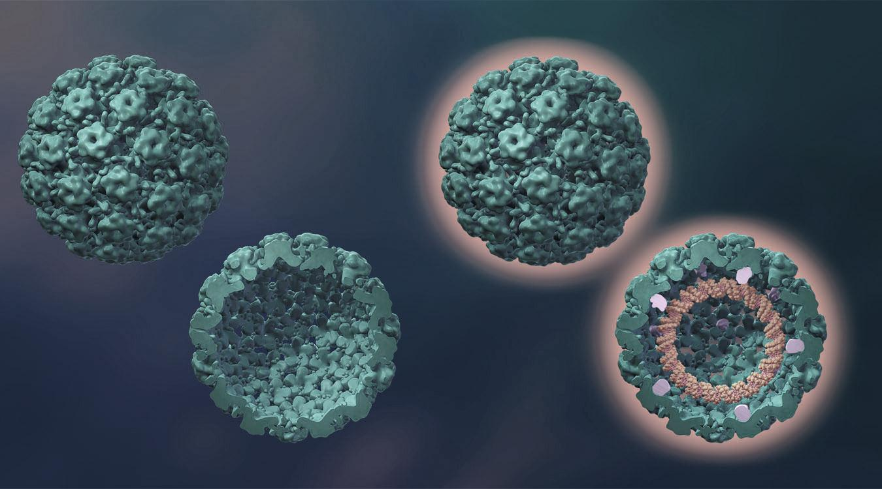
HPV Virus-like Particles (VLPs)
Noninfectious HPV VLP
Infectious HPV
Capsid proteins:
L1
High efficacy
No viral DNA
  No HPV infections
  No cancer formation
Lacks
L2 protein
L2
Lacks viral DNA
Viral DNA
Notes:
3/Villa/p. 277/col 1/¶ 3
4/Harper/p. 1764/col 1/¶ 3
3/Baker/p. 1449/Figure 3; p. 1453/col 2/¶ 2
4/Chen/p. 563/col 2/¶ 2
1/Stanley 2005/p. 5/col 1/¶ 2
2/Berzofsky/p. 457/Figure 3
1/Stanley 2005/p. 5/col 1/¶ 2
2/Berzofsky/p. 457/Figure 3

Slide 42
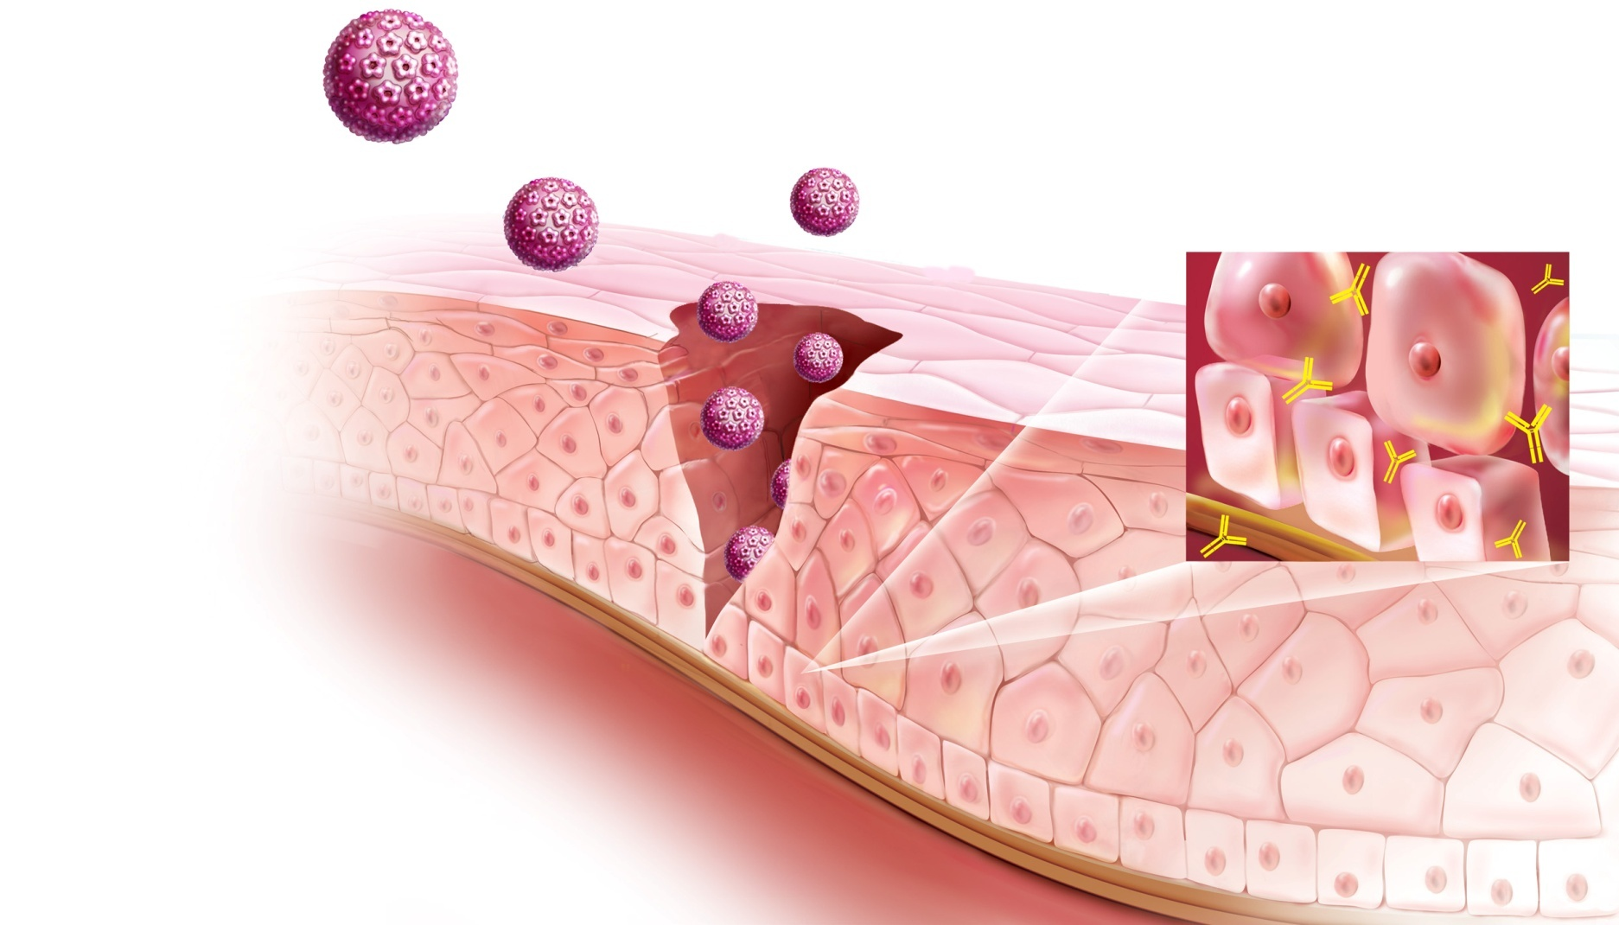
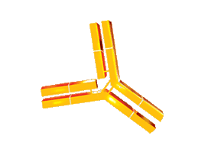



Active Protection through Vaccination
HPV
Neutralizing antibodies
Cervical canal
Cervical epithelium
Vessels
Epithelial tear
Basal membrane
Notes:
42

Slide 43
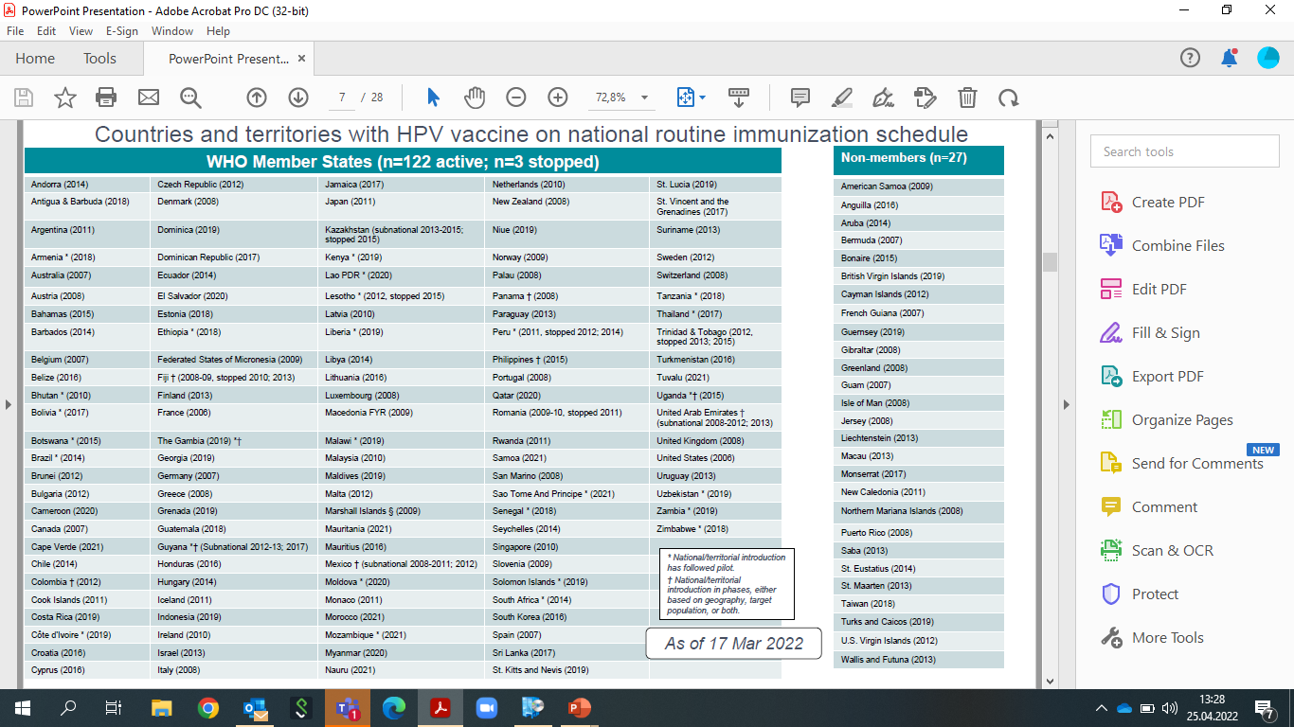
Countries with HPV Vaccine in the National Immunization Program
149 Countries

Slide 44
Why Vaccine?
Primary protection is always more successful than secondary and tertiary protection.
Vaccination is the most effective and cost-effective prevention in medicine.
Vaccination programs can easily reach wider communities
HPV vaccines have high effectiveness in protection against Cx Ca (95-99% against Types 16 and 18)

Slide 45
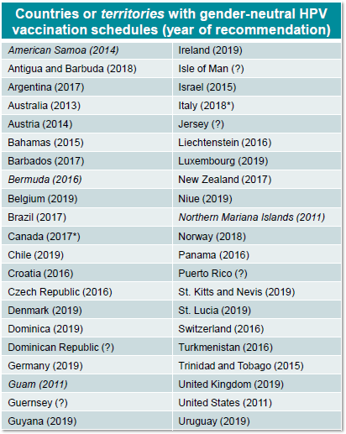
Countries with Multi-cohort HPV Vaccine in the National Immunization Program
52 Countries

Slide 46
Importance of Vaccination
Primary protection has more advantages compared to secondary and tertiery treatment
Vaccination is the most effective and cost-effective implementation in human health
Broader community can utilize from vaccination
HPV vacines have high efficacy in protection of Cx Ca (%95-99 for Serotype 16 and 18)

Slide 47
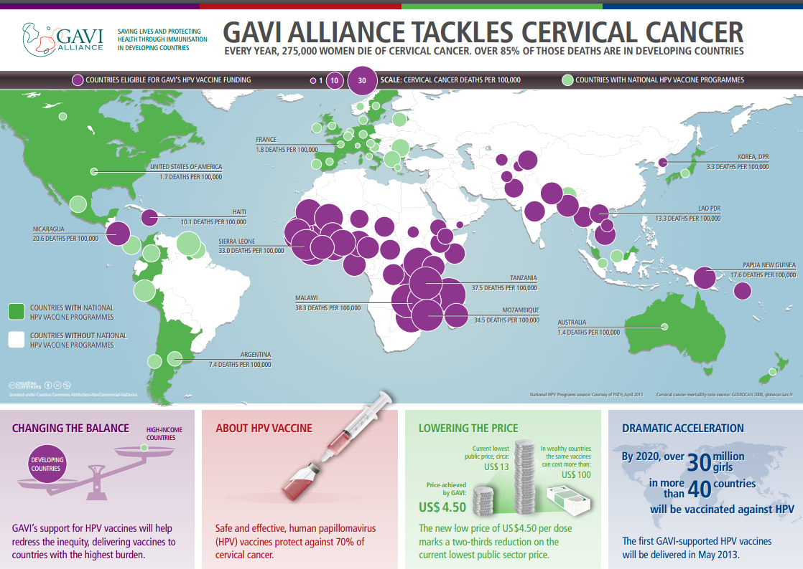
Mortality of Cx Ca and Countries with HPV Vaccine in the NIP

Slide 48
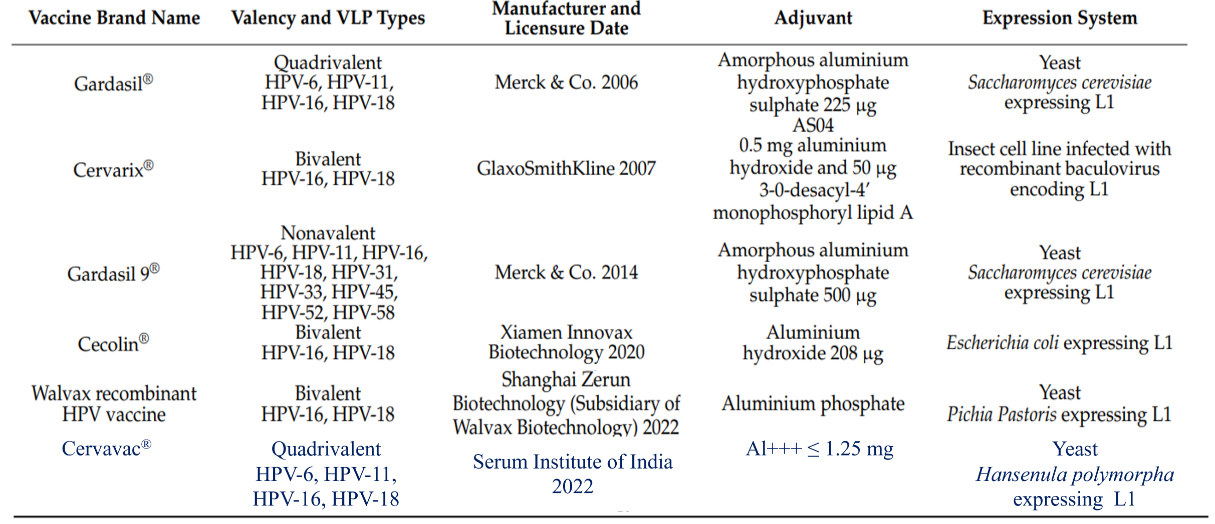
Currently Licensed Prophylactic HPV Vaccines

Slide 49
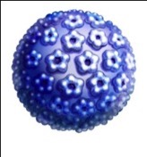
2vHPV Vaccine (Cervarix®) Contents
Antijens
AS04 adjuvant
+
Aluminium salt
(Al(OH)₃)
500 µg
Immun stimulater
MPL
50 µg
+
HPV 16 VLPs
20 µg
HPV 18 VLPs
20 µg
AS04-adjuvant in vaccine
MPL = monophosphoryl lipid A
Notes:
49
Composition of Cervarix® and Gardasil®
Comparison of antigen/adjuvant content of the two Aşıs.

Slide 50
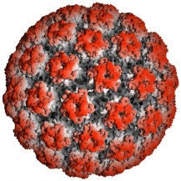
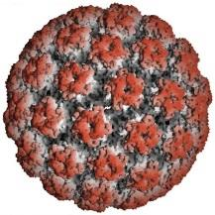
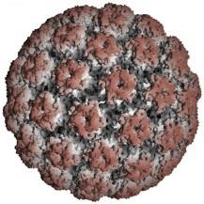
4vHPV (Gardasil™) and 9vHPV (Gardasil®9)
Vaccines Contents
Adjuvant 225 µg
Aluminium salt
(amorphous aluminium hydroxyphosphate sulphate [AAHS])
HPV 6 VLPs
20 µg
HPV 11 VLPs
40 µg
HPV 16 VLPs
40 µg
HPV 18 VLPs
20 µg
Adjuvant 500 µg
Aluminium salt
(amorphous aluminium hydroxyphosphate sulphate [AAHS])
HPV 6 VLPs
30 µg
HPV 11 VLPs
40 µg
HPV 16 VLPs
60 µg
HPV 18 VLPs
40 µg
HPV 31 VLPs
20 µg
HPV 33 VLPs
20 µg
HPV 45 VLPs
20 µg
HPV 52 VLPs
20 µg
HPV 58 VLPs
20 µg

Slide 51
9vHPV Vaccine Content
Gardasil® 9
Antibodies
Adjuvant 500 µg
HPV 6 VLPs
30 µg
HPV 11 VLPs
40 µg
HPV 16 VLPs
60 µg
HPV 18 VLPs
40 µg
+
Aluminium salt
(amorphous aluminium hydroxyphosphate sulphate [AAHS])
HPV 31 VLPs
20 µg
HPV 33 VLPs
20 µg
HPV 45 VLPs
20 µg
HPV 52 VLPs
20 µg
HPV 58 VLPs
20 µg
Notes:
51
Composition of Cervarix® and Gardasil®
Comparison of antigen/adjuvant content of the two Aşıs.

Slide 52
Adjuvants
2vHPV Vaccine
  AS04: 500 micrograms of aluminum hydroxide and 50 micrograms of 3-O-desacyl-4’-monophosphoryl lipid A (MPL) which is a lipopolysaccharide of Salmonella minnesota R595
4vHPV Vaccine
  AAHS: 225 μg of amorphous aluminum hydroxyphosphate sulfate, Yeast expression system in recombinant Saccharomyces cerevisiae
9vHPV Vaccine
  AAHS: 500 μg of amorphous aluminum hydroxyphosphate sulfate, Yeast expression system in recombinant Saccharomyces cerevisiae

Slide 53
Why did Merck Increase the Adjuvant Dose?

Slide 54
Is the adjuvant used in 9vHPV Vaccine the same with the used in Gardasil?
Adjuvants are used in vaccines to enhance the immune response
The adjuvant for the 9vHPV Vaccine is Merck’s proprietary aluminium-based adjuvant, AAHS (aluminum hydroxyphosphate sulfate)
The same adjuvant in Gardasil and hepatitis B vaccine, that have been used in millions of patients
Notes:
Both 2vHPV and 4vHPV vaccines appear to provide some partial cross-protection against persistent infection (≥6 months) and CIN 2+ in HPV-naive individuals
For both vaccines, efficacy for non-VLP-based vaccine types is neither as high nor as consistent as the efficacy against VLP-based HPV16 and 18 because:
VLPs are specifically manufactured for particular HPV types
Quality controlled for potency

Slide 55
Why is the Adjuvant Dose Approximately Twice in 9vHPV Vaccine?
Adjustments to the amounts and/or ratios of vaccine components are often required as we increase the number of components in a multivalent vaccine
  Examples include moving from MMR (measles/mumps/rubella) and Varivax (varicella) to the combination vaccine MMRV (ProQuad) and from Prevnar 7 to Prevnar 13
  Adjuvants are used in vaccines to enhance the immune response. When the amount of protein/antigen is increased, the amount of adjuvant also needs to increase to maintain the appropriate ratio that will provide the desired immune response
The same amount of adjuvant in hepatitis B vaccine that has been used in millions of patients
Notes:
Both 2vHPV and 4vHPV vaccines appear to provide some partial cross-protection against persistent infection (≥6 months) and CIN 2+ in HPV-naive individuals
For both vaccines, efficacy for non-VLP-based vaccine types is neither as high nor as consistent as the efficacy against VLP-based HPV16 and 18 because:
VLPs are specifically manufactured for particular HPV types
Quality controlled for potency

Slide 56
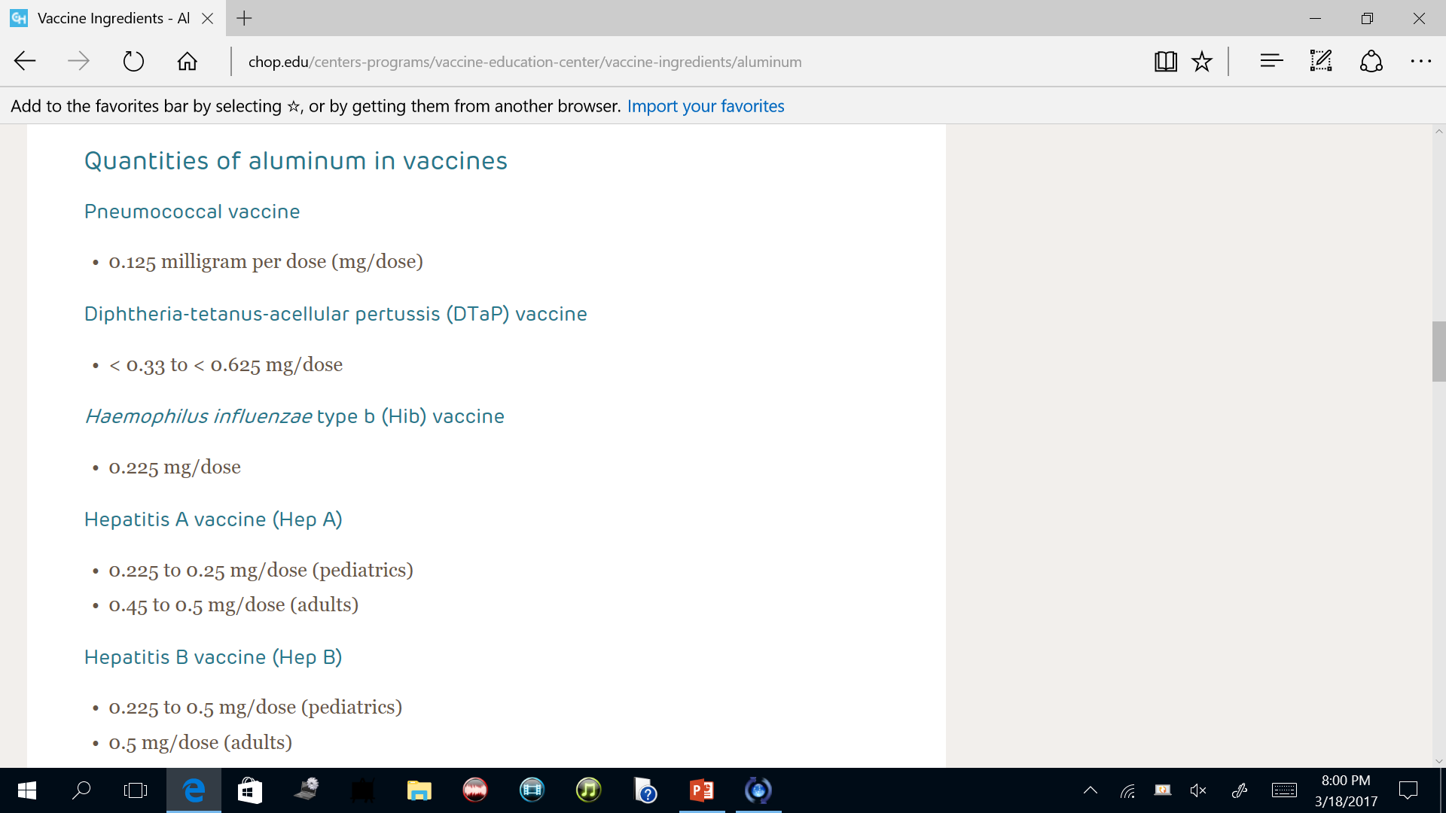
Aluminium Adjuvant

Slide 57
Aluminum in Vaccines:
Does it Pose a Safety Issue?
Aluminium remains the best solution to improve vaccine efficacy
When aluminum is added to vaccines, immunogenicity increases
Aluminum adjuvants have a broad safety margin
There is no data indicating a relationship between aluminum adjuvants and neurotoxicity

Slide 58
Aluminium Sources
Less than 0.2 mg/L in drinking water
Many foods contain less than 5 mg/kg, or aluminum foil
Potatoes, spinach, and tea naturally contain high levels of aluminum
Foods fortified with aluminum food additives
Soy-based foods contain high levels of aluminum, with concentrations ranging from 0.4 to 6 mg/L in ready-to-consume products

Slide 59
Why is the adjuvant dose in 9vHPV Vaccine approximately twice the adjuvant dose in Gardasil?
The formulation of 9vHPV Vaccine tested in Protocol 001 was chosen with the goal of achieving similar immunogenicity for the original four HPV types (types 6, 11, 16, 18) in Gardasil.
The amounts of adjuvant and antigens in 9vHPV Vaccine were chosen based on the dose-ranging study in Protocol 001 that demonstrated that these amounts consistently induced similar immunogenicity for the original four HPV types (types 6, 11, 16, 18) in Gardasil and robust antibody responses for the 5 additional HPV types.
Notes:
Both 2vHPV and 4vHPV vaccines appear to provide some partial cross-protection against persistent infection (≥6 months) and CIN 2+ in HPV-naive individuals
For both vaccines, efficacy for non-VLP-based vaccine types is neither as high nor as consistent as the efficacy against VLP-based HPV16 and 18 because:
VLPs are specifically manufactured for particular HPV types
Quality controlled for potency

Slide 60
Why is the adjuvant dose in 9vHPV Vaccine approximately twice the adjuvant dose in Gardasil?
The mid-dose formulation contains increased amounts of HPV 6, 16, and 18 VLPs than Gardasil and has an adjuvant-to-antigen ratio that is similar to that of Gardasil ***
*** The mid-dose formulation was chosen as the dose for the phase 3 clinical trials
Notes:
Both 2vHPV and 4vHPV vaccines appear to provide some partial cross-protection against persistent infection (≥6 months) and CIN 2+ in HPV-naive individuals
For both vaccines, efficacy for non-VLP-based vaccine types is neither as high nor as consistent as the efficacy against VLP-based HPV16 and 18 because:
VLPs are specifically manufactured for particular HPV types
Quality controlled for potency

Slide 61
2vHPV Vaccine Scotland Results
HPV 16/18 positivity according to 7-year effectiveness results after the 2008 vaccination program
Only ~0.5% (0.26-1.1) in vaccinated cohort
In the pre-vaccination cohort, this rate was 21.4% (18.9-24.0)

Slide 62
HPV Type 16 and 18 Infection Rates
(OCEANS Study)
OCEAN (Osaka Clinical resEArch of HPV vacciNe) study with 2vHPV or 4vHPV vaccines
HPV vaccine inhibited the infection of high-risk HPV and had impacted on the development to CIN2+ in Japan
 | No vaccined (n=877) | Vaccined (n=170) | OR (95% CI)
hrHPV | 173 (19.7%) | 22 (12%) | 0.61 (0.38-0.98)
HPV 16 and 18 | 43 (4.9%) | 0 (0%) | 0.06 (0.002-0.92)

Slide 63
Effectiveness of 2vHPV Vaccine in Thai
Cross-sectional, case-control study evaluated the vaccine effectiveness in schoolgirls 7 years after a two-dose administration
HPV vaccine
100% effective against hrHPV types included in the vaccine (16, 18)
32.8% effective against other HR-HPV types not included in the vaccine
Findings of this study indicated that the 2vHPV vaccine does not provide cross-protection against non-vaccine HPV types

Slide 64
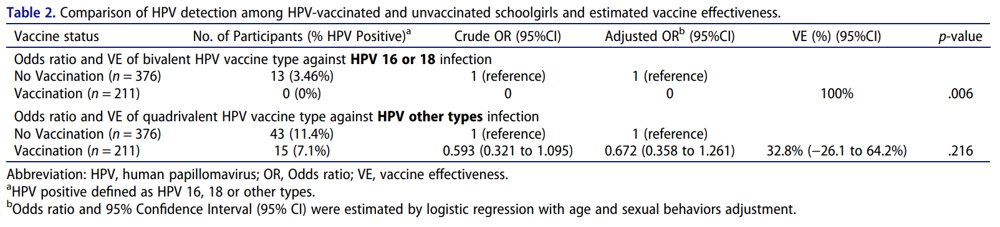
Effectiveness of 2vHPV Vaccine in Thai
Prioritizing vaccines with the highest coverage of HR-HPV types, such as the nonavalent HPV vaccine, is crucial to effectively prevent a broader range of hrHPV infections under the NIP

Slide 65
Pivotal Efficacy Study (Protocol 001): Study Design for Efficacy Evaluation
~14,000 young women were to be randomized 1:1 to receive 4vHPV vaccine or 9vHPV vaccine at 0, 2, and 6 months.
Subjects were to be followed up to month 54 visit (end of study) with intensive screening.ª
Included fixed-event design: primary efficacy analysis performed when at least 30 primary efficacy endpoints^{b} were observed
Females
16–26 years
9vHPV
9vHPV
9vHPV
Follow-up for efficacy
Females
16–26 years
4vHPV
4vHPV
4vHPV
Safety Assessment (all subjects)
Month
0
2
6
54
ªPap test and gynecologic swab (HPV detection) every 6 months during follow-up period (subjects with abnormal Pap tests were to be triaged to colposcopy; ^{b}Confirmed primary cases=subjects in the per-protocol population identified as having a high-grade lesion (as adjudicated by a pathology panel) with detection of at least 1 HPV Type 31, 33, 45, 52, or 58 as determined by PCR test results.
PCR=polymerase chain reaction.
        Joura EA, N Engl J Med., 2015

Slide 66
Cervarix® Efficacy for CIN3
 | Group | N | n | VE (96.1% CI)
 |  |  |  | % | LL | UL | p-value
CIN3+ HPV 16/18 | Vx | 7,344 | 0 | 100 | 36.4 | 100 | 0.0038
 | Control | 7,312 | 8
CIN3+ HPV 16 | Vx | 6,303 | 0 | 100 | 8.8 | 100 | 0.0146
 | Control | 6,165 | 6
CIN3+ HPV 18 | Vx | 6,794 | 0 | 100 | –170.5 | 100 | 0.1236
 | Control | 6,746 | 3
HPV serotype analysis (ATP-E)
Paavonen J, et al. Lancet 2009; 374:301–314.
Notes:
Cervarix® etkinlik against CIN3+: final analysis of Phase III trial (34.9 aylar)
In the primary analysis, detection of HPV DNA in the tissue biopsies was regarded as associated with the CIN lesion. Cervarix® etkinlik against CIN3+ caused by HPV 16/18 was 80.0% in this analysis (ATP-E cohort).
An additional analysis, using the HPV type assignment algorithm, was conducted to attribute a likely causal association between a lesion and the HPV type. If more than one HPV type was found in a lesion, causality was attributed on the basis of detection of the same HPV type in the preceding cytological sample. Following HPV type assignment analysis, Cervarix® etkinlik against CIN3+ caused by HPV 16/18 was 100.0% (ATP-E cohort).

Slide 67
Cervarix® Efficacy for Abnormal PAP Test and Procedures
TVC-naïve
Reduction | Vx N = 5,449 | Control N = 5,436 | VE% (96.1% CI) | p-value
Colposcopy results | 354 | 476 | 26.3 (14.7–36.4) | < 0.0001
Cervical excision interferences | 26 | 83 | 68.8 (50.0–81.2) | < 0.0001
TVC
Azalma | Vx N = 8,667 | Control N = 8,682 | VE% (96.1% CI) | p-value
Colposcopy results | 1,107 | 1,235 | 10.4 (2.3–17.8) | 0.0055
Cervical excision interferences | 180 | 240 | 24.7 (7.4–38.9) | 0.0035
Paavonen J, et al. Lancet 2009; 374:301–314.
Notes:
Cervarix® etkinlik: final analysis of Phase III trial (39.4 aylar)
Reduction in colposcopy referrals and cervical excision procedures are shown on this slide from the TVC-naïve cohort and the TVC.
In the TVC-naïve cohort, Aşı etkinlik against reduction in colposcopy referrals was 26.3% and in cervical excision procedures was 68.8%.
In the TVC, Aşı etkinlik against reduction in colposcopy referrals was 10.4% and in cervical excision procedures was 24.7%.

Slide 68
Cervarix® FDA Approvals
Cervical Cancer
CIN 2+
Cervical AIS
CIN 1

Slide 69
Cervarix® EMA* Approvals
Cervical cancer
CIN
VIN
VaIN

Slide 70
Gardasil® Efficacy for HPV 6/11/16/18 Related CIN and AIS
Per-protocol group; median for monitoring: 3.7 years (16–26 ages)
Target* | Gardasil® cases (n = 9,075) | Placebo (n = 9,075) | VE% | 95% CI
HPV 6-/11-/16-/18 related CIN or AIS | 9 | 225 | 96 | 92–98
Serotype specific HPV 6-related HPV 11-related HPV 16-related HPV 18-related | 0 0 8 1 | 47 12 137 61 | 100 100 94 98 | 92–100 65–100 89–98 91–100
Clinical CIN1 CIN2/3 AIS | 7 2† 0 | 170 110 7 | 96 98 100 | 91–98 93–100 31–100
AIS = adenocarcinoma in situ.
Notes:
Gardasil® has shown etkinlik against HPV 6/11/16/18- ilişkili CIN and AIS (Phase III)
The table shows etkinlik of Gardasil® against HPV 6/11/16/18-ilişkili CIN and AIS in a per-protocol population aged 16–26 years after 44 aylar of follow-up.
etkinlik against HPV 16- or 18-ilişkili CIN and AIS is shown in the highlighted box.
Note: there were nine breakthrough CIN olguları, eight of which were HPV 16 ilişkili and one of which was HPV 18 ilişkili, two CIN2/3 olguları showed evidence of multiple HPV infection.
Overall etkinlik against HPV 6/11/16/18-ilişkili CIN and AIS was 92%.

Slide 71
Gardasil®Efficacy for Abnormal PAP Tests and Procedures
 | Vx group (n = 4,616) | Placebo (n = 4,679) | Reduction, % | 95% CI
Pap test results
ASCUS HR-positive or higher | 1,002 | 1,205 | 17 | 10–24
ASCUS HR-positive | 276 | 357 | 22 | 9–34
LSIL | 813 | 980 | 17 | 9–24
ASC-H | 55 | 87 | 36 | 10–55
HSIL | 22 | 40 | 45 | 4–69
AGC | 3 | 4 | NA | NA
Procedures
Colposcopy | 850 | 1061 | 20 | 12–27
Cervical biopsi | 728 | 935 | 22 | 14–29
Definitive treatment | 131 | 229 | 42 | 28–54
Notes:
Impact of Gardasil® on abnormal Pap tests and procedures
Reports from end-of-study data from two pivotal Phase III clinical trials of Gardasil®.
17,622 women were enrolled in one of two randomized, Plasebo-Kontrolled etkinlik trials.
Population approximated a primary target population for HPV vaccination: sexually-naïve girls and women shortly post-sexual debut.
Aşı or Plasebo was given at Day 1, Month 2 and Month 6.
Cervicovaginal sampling was carried out at day 1.
Pap testing occurred at Day 1 and every 6–12 aylar thereafter.
Analyses were regardless of causal HPV type and performed in women who, on Day 1, had a negative Pap test, were negative to 14 common HPV types.
Average follow-up was 3.6 years post-Day 1.
Results showed:
17% reduction in atypical squamous cells of undetermined significance high risk (ASCUS HR)-pozitif or worse.
22% reduction in ASCUS HR-pozitif.
17% reduction in low-grade squamous intraepithelial lesion (LSIL).
36% reduction in atypical squamous cell-cannot rule-out high grade lesion (ASC-H).
45% reduction in high-grade squamous intraepithelial lesion (HSIL).
20% reduction in colposcopy.
22% reduction in cervical biopsy.
42% reduction in definitive therapy.

Slide 72
Approvals
FDA Approvals
Vaccine type | Female | Male | Age
Cervarix | Cervix | No indication | 9 – 25 years
Gardasil | Cervix, Vulva, Vagina, Anal, Genital Wart | Anal, Genital Wart | 9 – 26 years
9vHPV Vaccine | Cervix, Vulva, Vagina, Anal, Genital Wart | Anal, Genital Wart | 9 – 26 years
EMA Approvals
Vaccine type | Female | Male | Age
Cervarix | Cervix, Vulva, Vagina | No indication | > 9 years
Gardasil | Cervix, Vulva, Vagina, Anal, Genital Wart | Anal, Genital Wart | > 9 years
9vHPV Vaccine | Cervix, Vulva, Vagina, Anal, Genital Wart | Anal, Genital Wart | > 9 years
Notes:
Both 2vHPV and 4vHPV vaccines appear to provide some partial cross-protection against persistent infection (≥6 months) and CIN 2+ in HPV-naive individuals
For both vaccines, efficacy for non-VLP-based vaccine types is neither as high nor as consistent as the efficacy against VLP-based HPV16 and 18 because:
VLPs are specifically manufactured for particular HPV types
Quality controlled for potency

Slide 73
Posologies of HPV Vaccines
Vaccine type | FDA | EMA | Turkey
Cervarix | 3 Doses (0, 1, 6 months) | 9-14 Years: 2 Doses The second dose given between 5 and 13 months after the first dose* +15 Years: 3 Doses (0, 1, 6 months) | 9-14 Years: 2 Doses The second dose given between 5 and 13 months after the first dose* +15 Years: 3 Doses (0, 1, 6 months)**
Gardasil | 3 Doses (0, 2, 6 months) | 9-13 Years: 2 Doses (0, 6 months)*** +14 Years: 3 Doses (0, 2, 6 months)**** | 9-13 Years: 2 Doses (0, 6 months)*** +14 Years: 3 Doses (0, 2, 6 months)****
Gardasil 9 | 3 Doses (0, 2, 6 months) | 9-14 Years: 2 Doses***** The second dose should be administered between 5 and 13 months after the first dose +15 Years: 3 Doses (0, 2, 6 months)**** | Proposed to be in alignment with EMA

Slide 74
Gardasil® Efficacy on CIN and Related HPV 6/11/16/18 Serotypes
Seronegative/PCR-negative
Seropositive/PCR-negative
End Point | Gardasil™ cases (N=8,625) | Placebo (N=8,673)
HPV 6/11/16/18-CIN or AIS | 9 | 143
End Point | Gardasil cases (N=1242) | Placebo (N=1283)
HPV 6/11/16/18-CIN or AIS | 0 | 5
Cases infected by anytype of HPV will be highly protected against other 3 types
Seronegative/PCR-negative
Seropositive/PCR-negative
End Point | Gardasil™ cases (N=797) | Placebo (N=768)
HPV 6/11/16/18-CIN or AIS | 70 | 91
End Point | Gardasil™ cases (N=568) | Placebo (N=580)
HPV 6/11/16/18-CIN or AIS | 94 | 94
No therapeutic potency
Cases in the chart represent CINs vaccinated with HPV types in the first day
Notes:
Key Point
Gardasil™ is a prophylactic Aşı. In subjects with ongoing infection with HPV Types 6, 11, 16, and/or 18 at baseline who received Gardasil, there was no increased incidence of CIN or AIS resulting from this infection, as compared with Plasebo.
Background
An analysis was conducted to determine whether, among subjects who showed evidence of infection with a Aşı HPV type at Day 1, administration of Gardasil reduced the proportion of subjects who were found to have clinical disease due to that type, compared with Plasebo.¹ These results are shown in the upper-right-hand side of this slide.
Individuals who received Gardasil, but had ongoing HPV infection at the time of vaccination had no increased incidence of CIN (all grades) or AIS resulting from this infection, as compared with Plasebo. Ongoing infection was defined as infection with a Aşı HPV type at enrollment, but no evidence of immune response to it.¹
In individuals who had chronic (established) HPV infection at the onset of vaccination (defined as continuing infection despite evidence of an immune response to that infection), the incidence of CIN (all grades) caused by the relevant HPV type was similar in both the Gardasil and the Plasebo recipients.¹
On the upper-left-hand side of the slide, we again note the prophylactic etkinlik of Gardasil among HPV-naïve subjects in the per-protocol combined analysis.² Also shown are etkinlik results in individuals who have evidence for having successfully cleared an infection with 1 of the 4 Aşı HPV types. In this subset, administration of Gardasil was 100% efficacious in preventing CIN due to recurrent infection.¹
These results are in line with expectations for a prophylactic Aşı.
olguları of disease due to non-Aşı types were observed among Gardasil and Plasebo recipients in these studies.²
There was no clear evidence of protection from disease caused by HPV types for which subjects were PCR pozitif and/or seropozitif at baseline.²
References
Data on file, MSD.
2. Gardasil Prescribing Information. Merck & Co., Inc., Whitehouse Station, NJ, USA.
1/VRBPAC final briefing document/p.53/¶1
1/VRBPAC final briefing document/p. 31/¶ 3.
1/Data on file/ Section 2.7.3/Summary of clinical etkinlik/p. 135/Table 2.7.3-cervixcancer: 32.
1/VRBPAC final briefing document/p.54/Table 18.
1/Data on file/ Section 2.7.3/Summary of clinical etkinlik/p. 132/ 2.7.3.1.3.2.3.1Section title; p. 133/ 2.7.3.1.3.2.3.2 Section title; p. 133/¶ 5.
2/Prescribing information/p. 4/Lines 124-126.
2/Prescribing information/p. 3/Table 1.
1/VRBPAC final briefing document/p.52/¶3
1/VRBPAC final briefing document/p.53/¶2
1/VRBPAC final briefing document/p.52/¶2
1/VRBPAC final briefing document/p.36/Fig 5.
2/Prescribing information/p. 3/Lines 103-104.
1/Aug 7, 2006: Data are updated per Athens Investigator Meeting slides/D. Ferris/Filename S2-4-Therapeutic etkinlik
1/Aug 7, 2006: Seronegative, PCR- box is updated to reflect MITT-2 data (not PPE); source is DRAFT VRBPAC briefing document/p32/Table 13
1/Aug 8, 2006: olguları updated (sero-/PCR+ and sero+/PCR-) per S. Stoyanov discussion with statistician/email direction from S. Stoyanov Aug 8 2006.

Slide 75
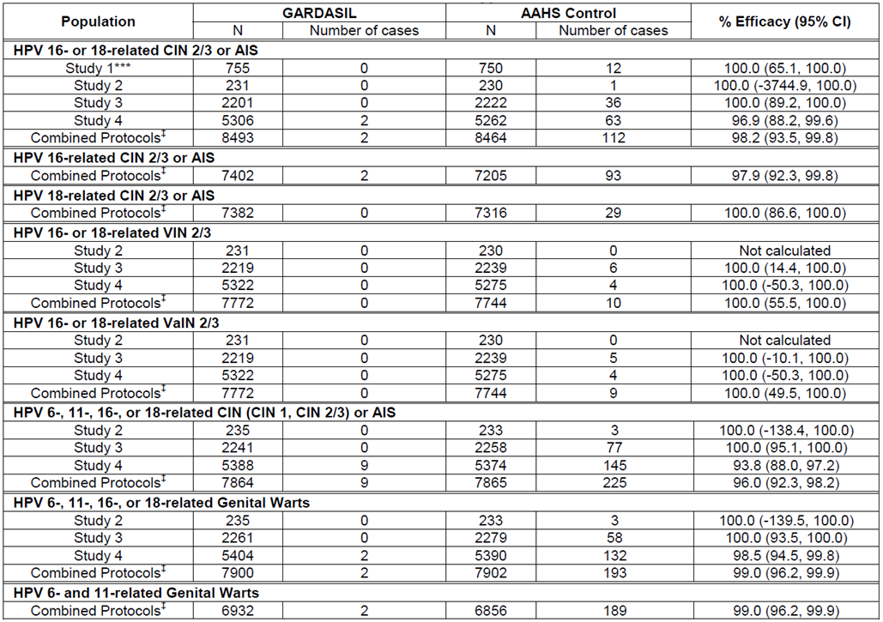
Gardasil®Efficacy for HPV Type Related Genital Diseases

Slide 76
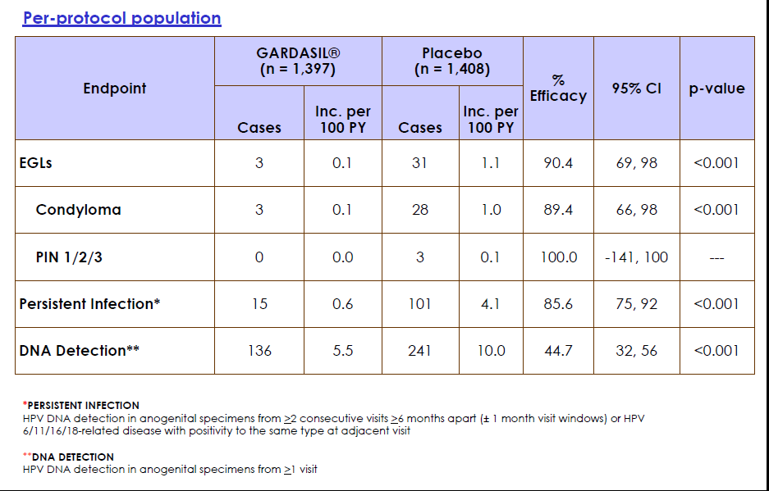
Gardasil® EGL and Efficacy for Infections

Slide 77
Determination of 4vHPV Vaccine Efficacy
Related results
Short term (months)
  HPV infection rates
  Genital wart incidance
Middle term (years)
  Reduction in Cervical lesions incidance
Long term (Decades)
  Reduction in anal, cervical, oropharyngeal, and other anogenital cancers incidance and mortality
Notes:
Brotherton 2011A:
p 631A
P 163B

Slide 78
Proportion of Women of Free-Vaccine-
Eligible Age with Genital Warts
P_{trend}=0.96
P_{trend}=0.84
P_{trend}=0.06
–25%
–73%
P_{trend}<0.001
Prevaccine period
Vaccine period

Slide 79
Distribution of Genital Warts in Women Under 21 Years of Age Born in Australia
Percent

Slide 80
Proportion of Men With Genital Warts, by Gender of Sexual Partners
–35%
Prevaccine period
Vaccine period

Slide 81
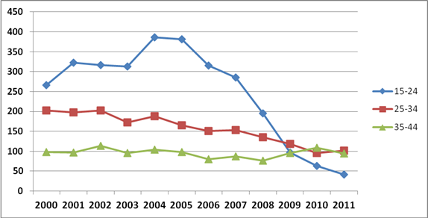
Inpatient Hospital Treatments for Genital
Warts in Women, by Age Groups
Number

Slide 82
Comparison of HPV Genoprevalence
Pre- and Postvaccine Population
Notes:
S Garland Data EUROGIN 2012:
P 4A

Slide 83
New Zealand: Impact on Genital Warts
63% reduction
% First-visit clients
with genital warts
2010ª
ªIn 2010, data were collected only in the first 6 months: 40,793 new clients seen between 2007 and 2010; school-based program for 11–12-year-old girls, with catch-up for adolescents up to 20 years; vaccine coverage rate for Auckland DHB by end of 2009 school year=51.7%.
Notes:
Oliphant 2011:
P 53A
P 53B
P 53C
63=
(13.7-5.1)/13.7
All % values came from
Oliphant 2011: P 53A
Oliphant 2011:
P 53D
P 53E (40,793=9988+11751+12493+6561)
P 52A
P 53C

Slide 84
Incidence of Genital Warts in California Following Introduction of 4vHPV Vaccine
Results
Average annual number of clients served:
  >1,754,000 females
  > 258,000 males
Overall diagnoses of genital warts:
  0.7% of females
  3.3% of males
In males and females, highest rates of genital warts were observed in young adults aged 21 to 25 years
  Lowest rates among those aged >30 years
Among females aged <21 years, diagnoses of genital warts decreased from 0.94% to 0.61% (P_{trend} < 0.001)
Decreases also observed among females aged 21 to 25 years, males <21 years, and males aged 21 to 25 years
Notes:
Bauer 2012 :
p: e1I
Bauer 2012 :
p: e1J
Bauer 2012 :
p: e1K
Bauer 2012 :
p: e1L
Bauer 2012 :
p: e1M

Slide 85
Early Results of HPV Vaccination (NHANES Survey)
HPV types prevelance in 14-19 years girls (United States)
–%56
–%49
n=4,150
n=4,253
Notes:
Markowitz IPV 2012: p1A,B

Slide 86
Incidence of Genital Warts in Sweden Following Introduction of 4vHPV Vaccine
Summary
First published data on genital warts capturing the entire population of a country (aged 10–44 years)
Declines in the incidence of genital warts among young adult females likely due to 4vHPV vaccination program
A separate future analysis will seek to link individual vaccination status with episodes of genital warts

Slide 87
Prevalence of HPV in a Young, Female Population in Germany
Results
The overall HPV prevalence was 26.5%, with no significant difference between the cohorts (25.5% vs 27.5%)
  HPV 16 was the most common high-risk HPV type in both cohorts (7.4%), followed by HPV types 51 (5.9%), 31, 53, 66
  HPV6 was the most common low-risk HPV type (1.9%)
Vaccination series was completed by 6.1% of patients born in 1983/84 versus 21% of patients born in 1988/89
HPV infection is common and disease burden relevant
Disease diagnosis | Percent
Genital warts | 0.63%
History of genital warts | 1.7%
Biopsy-proven CIN2+ | 1.06%
Atypical Pap smear associated with HPV | 3.2%

Slide 88
Incidence of Genital Warts in Belgium Following Introduction of 4vHPV Vaccine
Results
Population analyzed:
  55,193 females aged 16 to 20 years, of whom 13,117 were vaccinated with 4vHPV vaccine
435 cases of genital warts observed
  423 in nonvaccinated females
  12 in vaccinated females
 | Vaccinated | Nonvaccinated | P value
Cumulative incidence estimates for genital warts | 0.12% | 0.93% | <0.0001
Nonvaccinated females aged 16 to 20 years were estimated to have 8 times greater risk of getting genital warts than vaccinated females.
Notes:
Van Tielen 2012:
B

Slide 89
Gardasil® FDA Approvals
Girls and Women
Cervical, vaginal, vulvar ca
Genital warts
CIN 1, 2, 3
cervical AIS
VAIN 2, 3
Undifferantiated VIN (VIN2,3)
AIN and Anal cancer
Boys and Men
Anal warts
AIN and Anal cancer

Slide 90
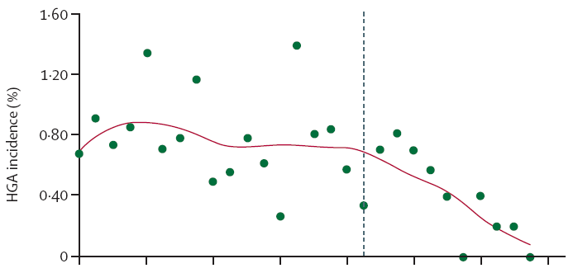
HGAs in Women Aged <18 Years, Before and After Introduction of 4vHPV Vaccine
Vaccination Program Begins
HGA: High Grade Cervical Abnormalities
Notes:
Brotherton: p 2088A,
Brotherton: p 2085A, 2088A,B

Slide 91
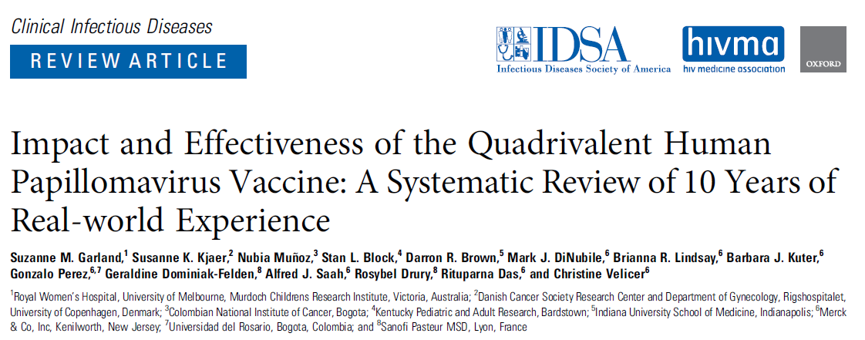
10-Year Data of Countries with 4vHPV Vaccine in Their National Programs

Slide 92
10-Year Data of Countries with 4vHPV Vaccine in
Their National Programs
90%
Reduction in HPV 6, 11, 16, 18 infections
90%
Decrease in the rate of genital warts in men and women
85%
Decrease in histologically documented high-grade cervical cytological anomalies

Slide 93
4vHPV Aşı 25-45 Yaş Kadınlarda 10 Yıllık Takip Verisi
Aşılama sonrası 10. yıl sonuçları
Uzun süreli takip döneminde HPV 6/11/16/18 ile ilişkili CIN veya genital siğil vakası görülmedi Erken Aşılama Grubunda’ (EVG)
Temel Çalışmaya Kıyasla Uzun Süreli Takipte CIN / Genital Siğil İnsidansı
Aşı etkinliğinde azalma görülmemiştir
Kümülatif İnsidans Olasılığı 4-Yıllık Temel Çalışma | Kümülatif İnsidans Olasılığı Uzun Dönem Takip
EVG (n=1602): 1 vaka, 0.0006 (95% CI: 0.0001, 0.0045) | EVG (n=927): 4. Yıl – 8. Yıl: Vaka yok, 0.0
 | EVG (n=599): 6. Yıl – 10. Yıl: Vaka yok, 0.0
4vHPV aşısı 25-45 yaş kadınlarda, 1. dozdan itibaren 10 yıl boyunca etkililiğini sürdürmüştür

Slide 94
4vHPV Aşı 16-26 Yaş Erkeklerde 10 Yıllık Takip Verisi
Aşılama sonrası 11,5 yıla kadar (medyan 9,5 yıl) takip edilen 917 erkekten elde edilen veriler
  0
  1
  >97%
  >90%
Yeni Vaka
(HPV 6/11-ilişkili genital siğil, HPV 6/11/16/18-ilişkili EGL, or HPV 6/11/16/18-ilişkili yüksek-dereceli AIN, per-protocol popülasyonunda 3-10 yıl arası)
Vaka
düşük-dereceli AIN 1
(HPV 6 ve HPV 58 için pozitif PCR sonuçları ile rapor edildi)
Seropozitiflik Oranı
(cLIA ile değerlendirildi)
Seropozitiflik Oranı
10. yılda IgG LIA ile
4 HPV tipinin hepsi için
cLIA: competitive Luminex Immunoassay; IgG LIA: Immunoglobulin G Luminex Immunoassay

Slide 95
3 Doses of 4vHPV Vaccine in Adolescents, 10-Year Follow-Up Data
Long-term follow-up study, total of 1,245 people (821 in EVG and 424 in CVG)
Median follow up
7th months GMT Data
Persistent infection
HPV 6-, 11-, 16- or 18-related disease
EVG
9-12 age
≥6 Month
0
seen
9.9
years
38%–65%
Higher GMT data
10
People with the types in the vaccine
Severe adverse effects
CVG
13-15 age
≥12 Ay Süreyle
Also at 10th year
0
reported
(10 year follow-up)
7.4
years
2
People with the types not in the vaccine
16%–42%
Remained higher

Slide 96
4vHPV Vaccine 14-Year Follow-Up Data in Women Aged 16-26
​
24,099 person-years of FU data from 2,121 women living in Denmark, Iceland, Norway and Sweden in the 14th year of vaccination
During 14 years post-vaccination, in the PPE population
No new cases of CIN 2+ associated with HPV 16/18 were observed
  100% vaccine efficacy (95% CI: 94.7, 100) sustained for ≥12 years tended to persist at 14 years of vaccination
Immunogenicity Results
  Seropositivity Rates in the 14th Year
  4vHPV vaccine produced antibody responses against HPV 6, 11, 16, and 18 that persisted for up to 14 years postvaccination
>90%
IgG LIA for all 4 HPV types

Slide 97
Long-term Effectiveness of 9vHPV Vaccine:
12 Years of Follow-up
Pivotal study in Nordic countries’ women aged 16–26 years (n = 2.029) demonstrated that the 9vHPV vaccine was efficacious against HSIL related to the HPV types covered by the vaccine
During LTFU, there were no cases of HPV16/18/31/33/45/52/58-related HSIL over 10.396,2 person-years’ FU in the per protocol effectiveness population (n = 1,628)
No signals indicated vaccine effectiveness decreasing below 90%

Slide 98
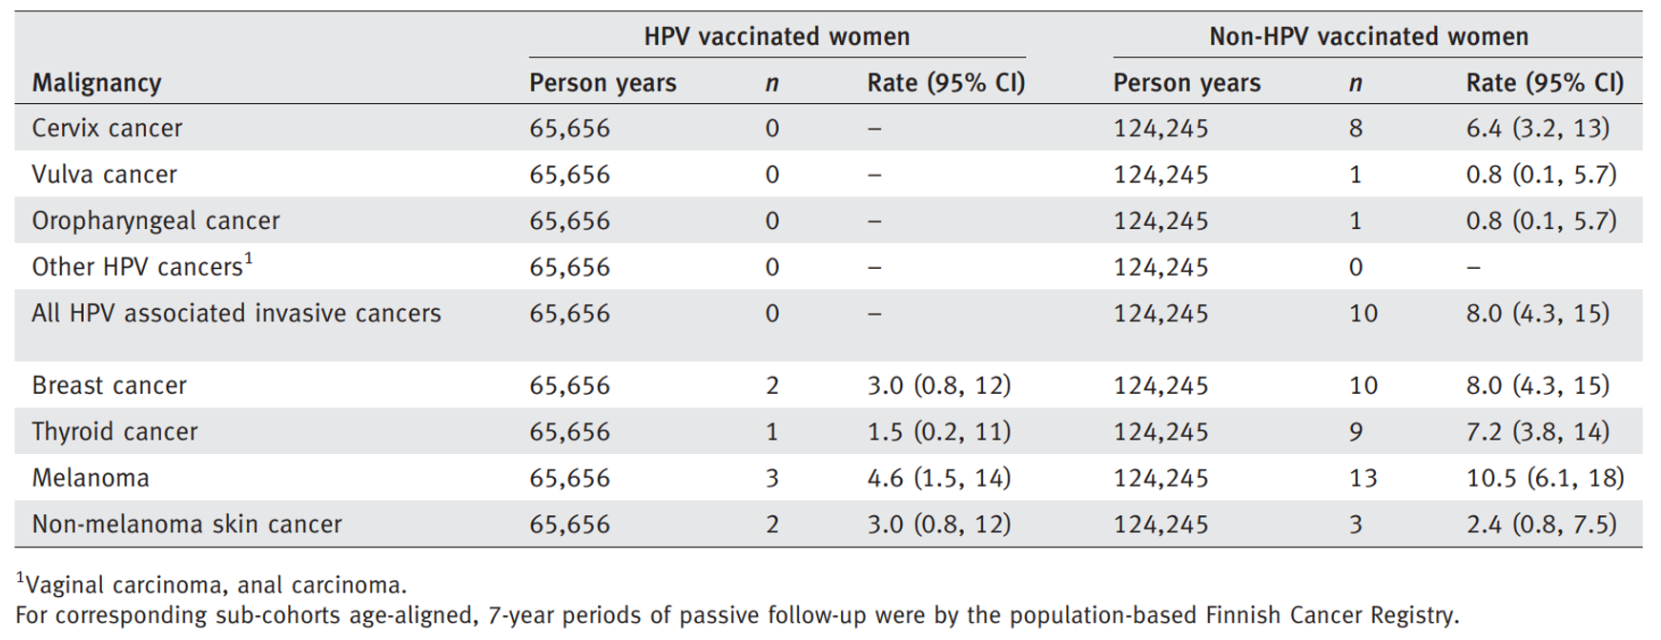
Cancer Prevention Results
2vHPV and 4vHPV vaccinated group: 9,529, unvaccinated: 17,838

Slide 99
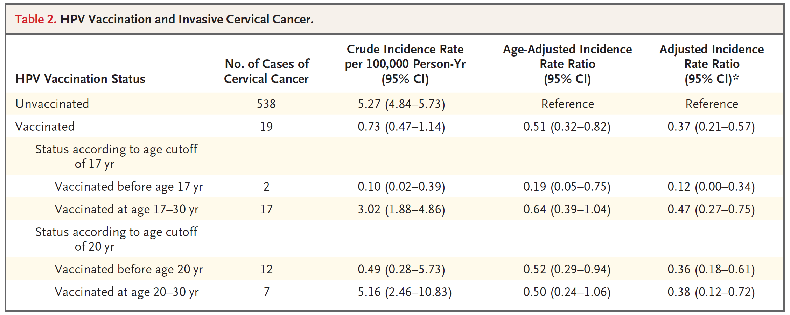
Cancer Prevention Results
Case #: Unvaccinated: 1.145.112, Vaccinated: 527.871, < 17 years Vaccinated: 438.939 (Swedish Study)
88% reduction in cancer cases in the vaccinated group

Slide 100
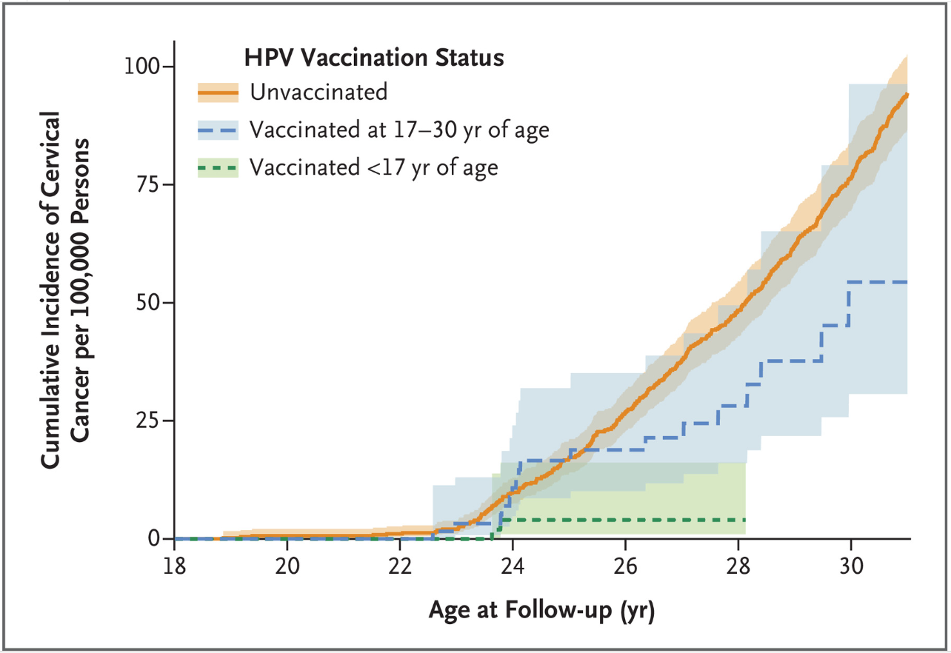
Cancer Prevention Results

Slide 101
Impact of HPV Vaccination Programmes
(Updated Systematic Review and Meta-analysis
Prevalence of HPV 16 and 18 decreased significantly
By 83% (RR 0·17, 95% CI 0·11-0·25) among girls aged 13-19 years
By 66% (RR 0·34, 95% CI 0·23-0·49) among women aged 20-24 years
Prevalence of HPV 31, 33, and 45 decreased significantly
By 54% (RR 0·46, 95% CI 0·33-0·66) among girls aged 13-19 years)

Slide 102
Impact of HPV Vaccination Programmes
(Updated Systematic Review and Meta-analysis)
Anogenital wart diagnoses decreased significantly
By 31% (RR 0·69, 95% CI 0·53-0·89) among women aged 25-29 years
By 67% (RR 0·33, 95% CI 0·24-0·46) among girls aged 15-19 years
By 54% (RR 0·46, 95% CI 0.36-0.60) among women aged 20-24 years
CIN2+ decreased significantly
By 51% (RR 0·49, 95% CI 0·42-0·58) among girls aged 15-19 years
By 31% (RR 0·69, 95% CI 0·57-0·84) among women aged 20-24 years

Slide 103
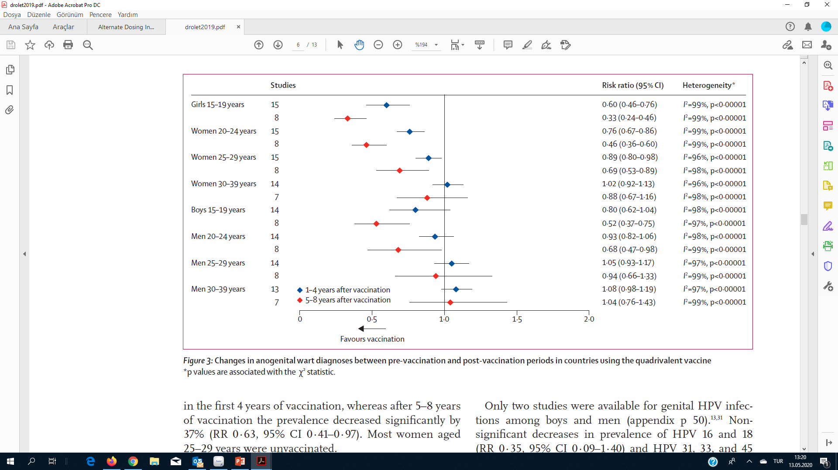
Changes in Anogenital Wart Diagnoses

Slide 104
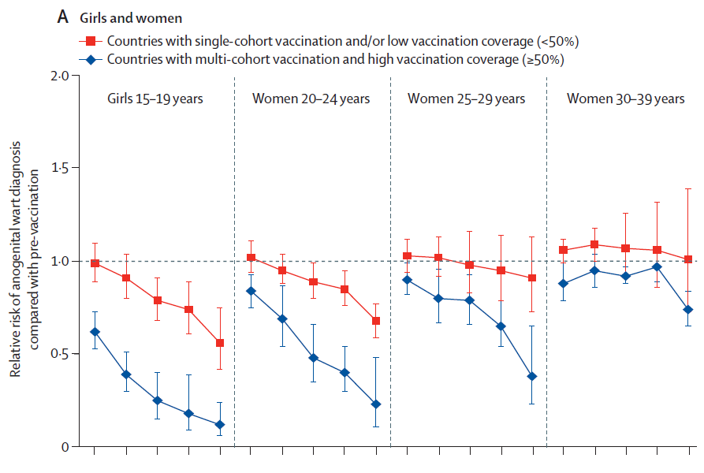
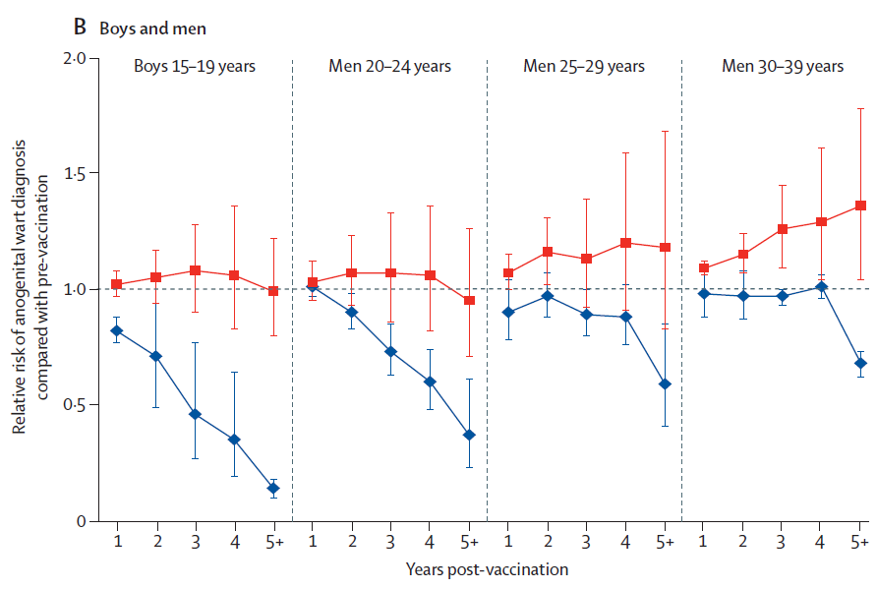
Impact of Vaccine for Anogenital Wart Diagnoses Single-Cohort vs Multi-Cohort
Changes in anogenital wart diagnoses during the 8 years after the introduction of 4vHPV vaccination in countries

Slide 105
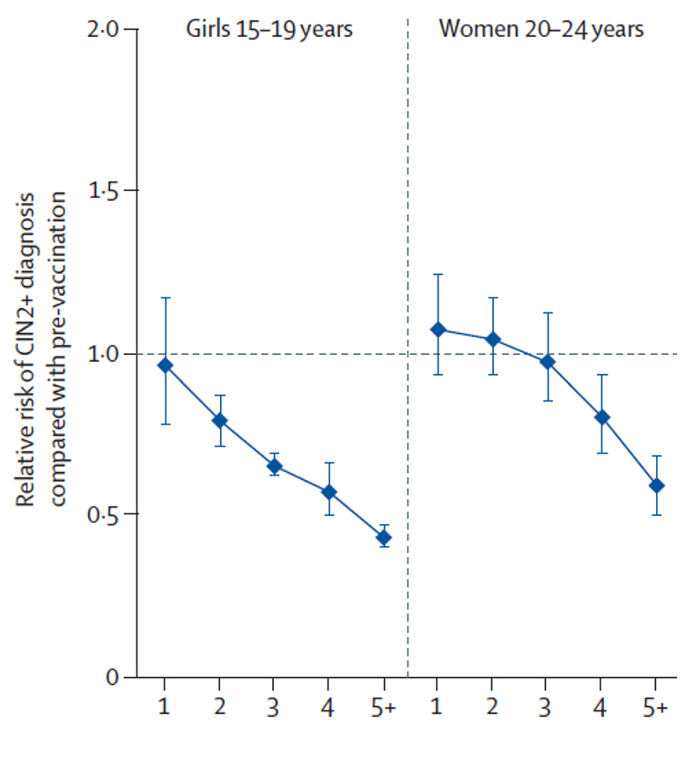
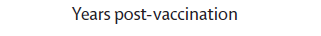
Changes in CIN2+ in Countries with Multi-cohort Vaccination and High Vaccination Coverage
Changes in CIN2+ among screened girls and women during the first 7 years after the introduction of girls-only HPV vaccination, in countries with multi-cohort vaccination and high vaccination coverage

Slide 106
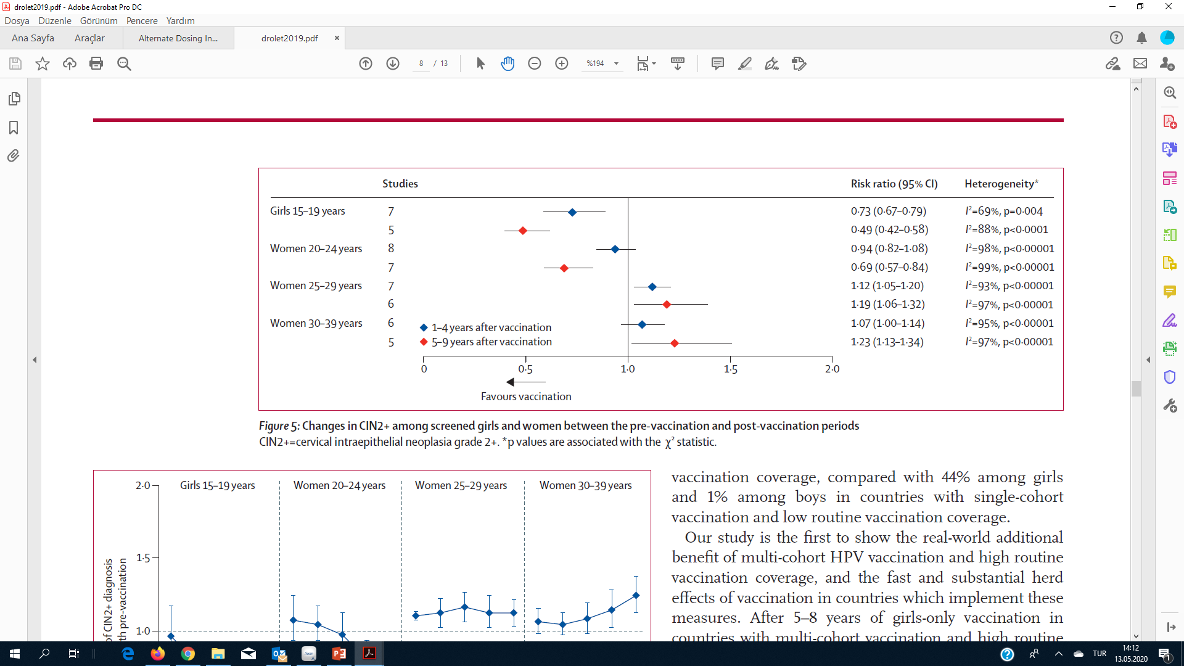
Effect of Vaccine on CIN2+ Lesions

Slide 107
Effectiveness of Vaccines (Metaanalysis)
Our results show compelling evidence of the substantial impact of HPV vaccination programmes on HPV infections and CIN2+ among girls and women, and on anogenital warts diagnoses among girls, women, boys, and men
Additionally, programmes with multi-cohort vaccination and high vaccination coverage had a greater direct impact and herd effects

Slide 108
Early Indicators of the Real World Effectiveness of 4vHPV Vaccine: Summary
Apparent decrease in HPV 16/18 infection among young females in Belgium
Significant population level declines in genital warts have been observed since the 4vHPV vaccine was introduced
Significant declines in the incidence of high-grade cervical abnormalities among young females in Australia
The most significant decreases in disease or HPV infection seen in young females who were vaccinated (or who were likely vaccinated) with 4vHPV vaccine
No evidence of disease reductions in older women or in men who have sex with men
Data strongly suggest population-level impact of 4vHPV vaccination programs

Slide 109
Why a Nonavalent Vaccine has been Designed?

Slide 110
Global Burden of HPV Related Diseases
HPV 6, 11, 16, 18, 31, 33, 45, 52 and 58 are the 9 most common HPV types in male and female HPV-related cancers and diseases
Estimated Type Distribution for HPV-Related Cancer and Disease Cases
 | Responsible 4 HPV (6, 11, 16, 18) types | Responsible 9 HPV types
Cx ca | 70% | 90%
Vulvar ca | 75% | 90%
Vaginal ca | 65% | 85%
Anal ca | 85% | 90%-95%
HSIL | 50% | 80%
LSIL | 25% | 50%
Genital warts | 90% | 90%
20%
30%
Notes:
HPV 16 and 18 cause approximately 70% of cervical cancers worldwide. Approximately 20% of additional cervical cancers are caused by HPV types 31, 33, 45, 52, and 58. The addition of HPV 31, 33, 45, 52, and 58 L1 VLPs to the 4 types already present in GARDASIL will increase overall cervical cancer coverage from approximately 70% to approximately 90%.
Assuming at least 90% vaccine efficacy, this coverage may provide 80% or greater reduction in cervical cancer risk.

Slide 111
Top Ten Most Oncologic HPV Types in the World – Normal Cytology

Slide 112
Top Ten Most Oncologic HPV Types in the World – L-SIL

Slide 113
Top Ten Most Oncologic HPV Types in the World – H-SIL

Slide 114
Top Ten Most Oncologic HPV Types in the World

Slide 115
Why a Nanovalent Vaccine has been Designed?
Gardasil™ protects against 70% of cervical cancers and 90% of genital warts
9vHPV vaccine includes the same four HPV types in Gardasil (6, 11, 16, 18) plus five additional HPV types (31, 33, 45, 52 and 58)
After HPV types 16 and 18, these 5 additional HPV types in 9vHPV vaccine are the most common cervical cancer-causing types worldwide
  HPV types 31, 33, 45, 52, and 58 cause approximately 20% of cervical cancer cases and approximately 30% of high-grade cervical dysplasias

Slide 116
World Distribution of 4 and 9 HPV types in CINs
Relative distribution of the 9 HPV types(%)
HPV 6/11/16/18^{c}
HPV 6/11/16/18/31/33/45/52/58^{c}
ªWomen ages 15 to 26
^{b}Overall contribution of HPV
CIN 1=73%
CIN 2=86%
CIN 3=93%
^{c}HPV 6 and HPV 11 have negligible contributions
CIN 2/3 and CIN 1 ~8% effect
Data in the figure do not reflect any contribution of HPV 6/11
+30%
+35%
+27%
Notes:
In addition, the five additional HPV types in V503 also cause a significant amount of high- and low-grade anogenital lesions About 80% of cases of high-grade cervical diseases (CIN 2, CIN 3 and AIS) are caused by the seven cancer-causing HPV types (an increase from 50% caused by HPV 16 and 18 in GARDASIL), and ~ 50% of cases of CIN 1 are caused by the nine HPV types (an increase from ~25% caused by the original four HPV types in GARDASIL).

Slide 117
Transregional Epidemiology of 5 Additional Types
For any HPV type, there are some differences in different parts of the world
The 7 oncogenic types targeted by the 9vHPV Vaccine account for approximately 90% of cx ca cases worldwide, with some minor geographic variation

Slide 118
Nine HPV Types in Cervical Cancer:
Consistency Across World Regions
HPV 6/11/16/18/31/33/45/52/58
Relative Contribution (%) of 9 HPV Types
(n=8,977)
(n=160)
(n=3,404)
(n=2,058)
(n=544)
(n=2,641)
(n=170)
        Chart represents the relative contribution of the 9 HPV types in HPV-positive cervical cancer cases in an international study of 8,977 HPV-positive cases; the dashed-line highlights the worldwide relative contribution of ~90%

Slide 119
Does 9vHPV Vaccine have Less Efficacy for Additional 5 HPV Types Compared with Previous 4 Types?

Slide 120
Primary Objectives to Support Efficacy of 9vHPV Vaccine Compared With 4vHPV Vaccine
4vHPV Vaccine
6
11
16
18
Demonstrate noninferior immunogenicity (immunobridging as surrogate for efficacy)
Demonstrate efficacy
6
11
16
18
31
33
45
52
58
9vHPV Vaccine

Slide 121
Strategy for Measuring Efficacy of 9vHPV Vaccine Compared With 4vHPV Vaccine for HPV Types 6/11/16/18
4vHPV vaccine is highly efficacious
Therefore, few HPV 6/11/16/18–related disease endpoints were expected in both vaccine cohorts
Used immunobridging studies for comparison
Bridged 4vHPV vaccine efficacy findings to 9vHPV vaccine via demonstration of noninferior immunogenicity for HPV Types 6/11/16/18 (primary analysis)
Collected HPV 6/11/16/18–associated persistent infection and disease endpoints for numerical comparison between the 2 vaccine cohorts (supportive analysis)

Slide 122
No It Does Not!
4vHPV vaccine is highly efficacious
Therefore, few HPV 6/11/16/18–related disease endpoints were expected in both vaccine cohorts
Used immunobridging studies for comparison
Bridged 4vHPV vaccine efficacy findings to 9vHPV vaccine via demonstration of noninferior immunogenicity for HPV Types 6/11/16/18 (primary analysis)
Collected HPV 6/11/16/18–associated persistent infection and disease endpoints for numerical comparison between the 2 vaccine cohorts (supportive analysis)

Slide 123
9vHPV Vaccine
Very high clinical effectiveness
Additional information for the future
Co-administration with other vaccines
9vHPV vaccination in previously vaccinated population
All efficacy and immunogenicity studies have been completed
Equal efficacy as 4vHPV vaccine for HPV 6, 11, 16 and 18
97% effectiveness for HPV 31, 33, 45, 52 and 58 related diseases
Same immunogenicity for adolescents and adults

Slide 124
Key Objectives of 9vHPV Vaccine Clinical Program
Topic | Objective
Women (HPV 6/11/16/18)¹ | Provide similar level of protection as 4vHPV vaccine against infection/disease due to HPV 6/11/16/18
Women (HPV 31/33/45/52/58)¹ | Provide an increased level of protection as compared with 4vHPV vaccine against disease due to HPV 31/33/45/52/58
Adolescents² | Noninferior immunogenicity in adolescents vs young women (immunobridging)
Men³ | Noninferior immunogenicity in young men vs young women (immunobridging)
Safety¹⁻³ | Acceptable safety/tolerability profile

Slide 125
Summary of Completed Clinical Trials
Study | Population | Objective
Pivotal Efficacy Study
Protocol 001¹ | Women, 16–26 years | Dose-ranging, efficacy, immunogenicity, safety
Immunobridging Studies in Adolescents
Protocol 002² | Girls and boys, 9–15 years; women 16–26 years | Adult-to-adolescent immunobridging
Protocol 009³ | Girls, 9–15 years | 4vHPV vaccine-to-9vHPV vaccine immunobridging
Immunobridging Studies in Young Adult Men
Protocol 003⁴ | Men and women, 16–26 years | Male immunogenicity, female-male immunobridging
Joura EA , N Engl J Med, 2015 , Van Damme P, Pediatrics, 2015 , Vesikari T, Pediatr Infect Dis J, 2015 , Castellsagué X, Vaccine. 2015

Slide 126
Summary of Completed Clinical Trials (continued)
Study | Population | Objective
Study in Prior Recipients of 4vHPV Vaccine
Protocol 006¹ | Girls and women, 12–26 years | Safety and immunogenicity in prior 4vHPV recipients
Concomitant Use Studiesª
Protocol 005² | Girls and boys, 11–15 years | Concomitant use: Menactra^{®b}, Adacel^{®c}
Protocol 007³ | Girls and boys, 11–15 years | Concomitant use: Repevax^{®d}
ªMenactra, Adacel, and Repevax are registered trademarks of Sanofi Pasteur Inc; ^{b}Meningococcal (groups A, C, Y, and W-135) polysaccharide diphtheria toxoid conjugate vaccine⁴; ^{c}Tetanus toxoid, reduced diphtheria toxoid, and acellular pertussis vaccine adsorbed⁵; ^{d}Diphtheria, tetanus, pertussis (acellular, component), and poliomyelitis (inactivated) vaccine (adsorbed, reduced antigen(s) content).⁶
1. Garland SM, Vaccine, 2015 2. Schilling A, Pediatrics, 2015 3. Kosalaraksa P, Pediatr Infect Dis J, 2015 4. Swiftwater, Sanofi Pasteur, 2005. 5. Swiftwater, Sanofi Pasteur; 2005 6. Lyon, Sanofi Pasteur, 2012.

Slide 127
Pivotal Efficacy Study (Protocol 001): Study Design for Efficacy Evaluation¹ –
Young Women 16 to 26 Years
~14,000 young women were to be randomized 1:1 to receive 4vHPV vaccine or 9vHPV vaccine at 0, 2, and 6 months.
Subjects were to be followed up to month 54 visit (end of study) with intensive screening.ª
Included fixed-event design: primary efficacy analysis performed when at least 30 primary efficacy endpoints^{b} were observed
Females
16–26 years
9vHPV
9vHPV
9vHPV
Follow-up for efficacy
Females
16–26 years
4vHPV
4vHPV
4vHPV
Safety Assessment (all subjects)
Month
0
2
6
54
ªPap test and gynecologic swab (HPV detection) every 6 months during follow-up period (subjects with abnormal Pap tests were to be triaged to colposcopy; ^{b}Confirmed primary cases=subjects in the per-protocol population identified as having a high-grade lesion (as adjudicated by a pathology panel) with detection of at least 1 HPV Type 31, 33, 45, 52, or 58 as determined by PCR test results.
PCR=polymerase chain reaction.
        Joura EA, N Engl J Med., 2015

Slide 128
Pivotal Efficacy Study (Protocol 001): Key Objectives ^{1,2}
HPV 6/11/16/18 objectives:
  Primary: noninferior immunogenicity of 9vHPV vaccine vs 4vHPV vaccine at month 7
  Exploratory: incidence of HPV 6/11/16/18–related persistent infection and disease
HPV 31/33/45/52/58 objectives:
  Primary: reduction of combined incidence of 31/33/45/52/58–related CIN 2/3+, VIN 2/3+, VaIN 2/3+ with 9vHPV vaccine as compared with 4vHPV vaccine
  Secondary/exploratory: reduction of incidence of HPV 31/33/45/52/58–related cervical, vulvar, vaginal disease, persistent infections ≥6 months, ≥12 months, Pap test abnormalities, and cervical procedures
        Joura EA, N Engl J Med., 2015

Slide 129
Pivotal Efficacy Study (Protocol 001): Incidence of HPV 6/11/16/18–Related Disease Endpoints¹ - Per-Protocol Efficacy Population
The incidence of disease related to HPV 6/11/16/18 was similar in the 9vHPV vaccine and 4vHPV vaccine groups, indicating a similar level of vaccine efficacy for 9vHPV and 4vHPV vaccines against these disease endpoints.
HPV 6/11/16/18–related Endpoint | 9vHPV vaccine (N=7,099) |  | 4vHPV vaccine (N=7,105)
 | Cases/n | Rateª (95% CI) | Cases/n | Rateª (95% CI)
Cervical disease | 1 / 5,823 | 0.1 (0.0, 0.3) | 3 / 5,832 | 0.2 (0.0, 0.5)
CIN 1 | 0 / 5,823 | 0.0 (0.0, 0.2) | 2 / 5,832 | 0.1 (0.0, 0.4)
CIN 2/3 or worse | 1 / 5,823 | 0.1 (0.0, 0.3) | 1 / 5,832 | 0.1 (0.0, 0.3)
VIN 1 or VaIN 1 | 0 / 5,876 | 0.0 (0.0, 0.2) | 2 / 5,893 | 0.1 (0.0, 0.4)
VIN 2/3 or VaIN 2/3 or worse | 0 / 5,876 | 0.0 (0.0, 0.2) | 2 / 5,893 | 0.1 (0.0, 0.4)
Genital warts | 5 / 5,876 | 0.3 (0.1, 0.6) | 1 / 5,893 | 0.1 (0.0, 0.3)
        ªNumber of subjects per 1000 person-years at risk.
        CIN=cervical intraepithelial neoplasia; VaIN=vaginal intraepithelial neoplasia; VIN=vulvar intraepithelial neoplasia.
        Joura EA, N Engl J Med., 2015

Slide 130
Pivotal Efficacy Study (Protocol 001): Efficacy Results¹ - Per-Protocol Efficacy Population
9vHPV vaccine was efficacious in the prevention of cervical, vulvar and vaginal disease related to HPV Types 31, 33, 45, 52 and 58.
Vaccine Efficacy Against HPV 31, 33, 45, 52, or 58–Related Cervical, Vulvar, and Vaginal Disease
VE: 97.4%
(95% CI:
85.0, 99.9)
VE: 97.1%
(95% CI:
83.5, 99.9)
4vHPV vaccine (n=7,105)
9vHPV vaccine (n=7,099)
Number of Cases
VE: 100%
(95% CI:
39.4, 100)
Cervical/Vulvar/Vaginal Diseaseª
CIN 2/3 or AIS
CIN 3
ªIncludes CIN 2/3, AIS, cervical cancer, VIN 2/3, VaIN 2/3, vulvar cancer, and vaginal cancer.
AIS=adenocarcinoma in situ; CI=confidence interval; CIN=cervical intraepithelial neoplasia; VaIN=vaginal intraepithelial neoplasia; VIN=vulvar intraepithelial neoplasia; VE=vaccine efficacy.
Gardasil 9 [summary of product characteristics].

Slide 131
Pivotal Efficacy Study (Protocol 001): Efficacy Results¹ - Per-Protocol Efficacy Population
9vHPV vaccine was efficacious in the prevention of persistent infection related to HPV Types 31, 33, 45, 52, and 58
Infection
VE: 96.0%
(95% CI:
94.6, 97.1)
4vHPV vaccine (n=7,105)
VE: 96.7%
(95% CI:
95.1, 97.9)
9vHPV vaccine (n=7,099)
Number of Cases
≥6-Month Persistent Infectionª
≥12-Month Persistent Infectionª
ªDetection of the same HPV type in samples collected from 2 or more consecutive visits (for >6-month persistent infection) or from 3 or more consecutive visits (for >12-month persistent infection), with an interval of 6 months (±1 month) between visits.
VE=vaccine efficacy.
Gardasil 9 [summary of product characteristics].

Slide 132
Pivotal Efficacy Study (Protocol 001): Efficacy Results¹ - Per-Protocol Efficacy Population
9vHPV vaccine resulted in a reduction in the incidence of HPV 31, 33, 45, 52,
and 58–related Pap test abnormalities and cervical procedures.
Vaccine Efficacy Against HPV 31, 33, 45, 52, or 58–Related Pap Test Abnormalities and Cervical Procedures
VE: 92.9%
(95% CI:
90.2, 95.1)
4vHPV vaccine (n=7,105)
9vHPV vaccine (n=7,099)
Number of Cases
VE: 90.2%
(95% CI:
75.0, 96.8)
n=6,014
n=6,013
n=5,882
n=5,883
Cervical Proceduresª
Pap Abnormalities^{b}
ªDefinitive therapy, loop electrosurgical excision procedure (LEEP) or conization.
^{b}Graded ASCUS HR-HPV+ or worse.
ASCUS=atypical squamous cells of undetermined significance; CI=confidence interval; HR-HPV=high-risk human papillomavirus; VE=vaccine efficacy.
Gardasil 9 [summary of product characteristics].

Slide 133
Pivotal Efficacy Study (Protocol 001): Efficacy Results¹ - Exploratory Analyses in Per-Protocol Efficacy Population
9vHPV vaccine was efficacious against high-grade cervical disease related to all 9 vaccine HPV types compared with 4vHPV vaccine
9vHPV vaccine reduced the number of HPV 6, 11, 16, 18, 31, 33, 45, 52, and 58–related Pap abnormalities and cervical procedures.
Number of Cases of HPV 6, 11, 16, 18, 31, 33, 45, 52, 58–Related
High-Grade Cervical Disease, Pap Abnormalities, and Cervical Procedures
VE: 95.9%
(95% CI:
92.7, 97.9)
4vHPV vaccine (n=7,105)
9vHPV vaccine (n=7,099)
Number of Cases
VE: 94.4%
(95% CI:
78.8, 99.0)
VE: 90.7%
(95% CI:
76.3, 97.0)
VE: 100%
(95% CI:
46.3, 100.0)
n=5,947
n=5,952
n=5,947
n=5,952
n=6,018
n=6,016
n=6,018
n=6,016
CIN 2+
CIN 3
Pap Abnormalities
Cervical Proceduresª
ªIncluding loop electrosurgical excision procedure (LEEP) or conization.
CI=confidence interval; CIN=cervical intraepithelial neoplasia; VE=vaccine efficacy.
Gardasil 9 [summary of product characteristics].

Slide 134
Pivotal Efficacy Study (Protocol 001): Safety Results (Injection Site AEs)¹ – Safety Population
Subjects receiving 9vHPV vaccine were more likely to experience
injection site AEs than subjects receiving 4vHPV vaccine.
The most common (>2%) injection-site AEs were pain, swelling, erythema, and pruritus; most were mild to moderate in intensity.
AE | 9vHPV Vaccine (n=7,071) % (n) | 4vHPV Vaccine (n=7,078) % (n)
Pain | 89.9 (6,356) | 83.5 (5,910)
Swelling | 40.0 (2,830) | 28.8 (2,035)
Erythema | 34.0 (2,407) | 25.6 (1,810)
Pruritus | 5.5 (388) | 4.0 (282)
AE = adverse event.
Joura EA, N Engl J Med., 2015
134

Slide 135
Pivotal Efficacy Study (Protocol 001): Safety Results (Vaccine-Related Systemic AEs)¹ – Safety Population
The frequency of vaccine-related systemic AEs was generally similar between the 2 vaccine groups (29.5% and 27.3% in the 9vHPV and 4vHPV vaccine groups, respectively).
The most common vaccine-related systemic AE in both vaccine groups was headache.
Vaccine-Related Systemic AEs Reported Within Days 1 to 15 After Any Vaccination
AE | 9vHPV Vaccine (n=7,071) % (n) | 4vHPV Vaccine (n=7,078) % (n)
Headache | 14.6 (1,031) | 13.7 (969)
Pyrexia | 5.0 (357) | 4.3 (301)
Nausea | 4.4 (311) | 3.7 (261)
Dizziness | 3.0 (211) | 2.8 (197)
Fatigue | 2.3 (166) | 2.1 (150)
AE = adverse event.
Joura EA, N Engl J Med., 2015
135

Slide 136
Pivotal Efficacy Study (Protocol 001): Conclusions
HPV Types 6, 11, 16, 18¹
  9vHPV vaccine generated anti-HPV 6, 11, 16, and 18 immune responses that were noninferior to those generated by 4vHPV vaccine.
  Efficacy of the 9vHPV vaccine against HPV 6, 11, 16, and 18–related disease was inferred based on noninferior immunogenicity compared to 4vHPV vaccine.
AE = adverse event.
Joura EA, N Engl J Med., 2015
26

Slide 137
Pivotal Efficacy Study (Protocol 001): Conclusions
HPV Types 31, 33, 45, 52, 58
  9vHPV vaccine was efficacious in preventing persistent infection and disease related to these HPV types.¹
    ≥6- and ≥12-month persistent infection
    Cervical/vulvar/vaginal disease (any grade)
  9vHPV vaccine reduced the numbers of Pap test abnormalities
  and cervical procedures.²
Efficacy demonstrated through 54 months postdose 1 (end-of-study analysis)²
The number of reported AEs was generally similar for both vaccines.¹
  The number of injection-site AEs reported for the 9vHPV vaccine was higher compared with the 4vHPV vaccine.
  The majority of injection-site AEs reported were of mild to moderate intensity.
AE = adverse event.
Joura EA, N Engl J Med., 2015
26

Slide 138
4vHPV Vaccine: Declines in Prevalence of Vaccine and Non-Vaccine HPV Types in the Vaccine Era
Vaccinated compared to unvaccinated women;
calculated as (1-relative risk)x100
Study | Countries | Age
Drolet 2015 | Australia, Canada, Denmark, England, Germany, New Zealand, Scotland, Sweden, and the United States | 13–19 y

Slide 139
Cervarix: Declines in Prevalence of Vaccine and Non-Vaccine HPV Types in the Vaccine Era
Vaccinated compared to unvaccinated women;
calculated as (1-relative risk)x100
Study | Countries | Age
Drolet 2015^{b} | Australia, Canada, Denmark, England, Germany, New Zealand, Scotland, Sweden, and the United States | 13–19 y
Notes:
Drolet Lancet 2015:
p570A; p572A
Footnote b:
Drolet Lancet 2015:
p566A,B
Footnote a:
Drolet Lancet 2015:
p566C
Drolet Lancet 2015: p572B/Fig3A;
Calc for reduction in risk for 2vHPV:
16/18:
(1-0.46)*100= 54%;
31/33/35:
(1-0.65)*100=35%;
31/33/45/52/58:
(1-1.12)*100=-12%

Slide 140
4vHPV Vaccine: Declines in Prevalence of Vaccine and HPV Types in the Vaccine Era
Vaccinated vs unvaccinated
Pre-vaccine era vs vaccine era
Tabrizi 2014
Tabrizi 2014
Markowitz 2013
Markowitz 2016
*
*
*
*
*
*
Study | Country | Age | Pre-vaccine Era | Vaccine Era | Vaccination Status
Tabrizi 2014 | Australia | 18–24 y | 2005–2007 | 2010–2012 | 3 doses
Markowitz 2013 | United States | 14–19 y | 2003–2006 | 2007–2010 | Unknown
Markowitz 2016 | United States | 14–19 y | 2003–2006 | 2009–2012 | Unknown
Notes:
Tabrizi Lancet ID 2014: p963A /Table4;
Calc:
16 (Vac vs Unvac):
[1-(2/12)]*100= 83.3%;
18 (Vac vs Unvac):
Fully vaccinated reported as <1%. Calculated actual value: 3/518=0.006
[1-(0.006/7)*100 =99.9%
Tabrizi Lancet ID 2014: p961A/Figure;
16 (era):
[1-(4.2/21.3)]*100= 80.29 round to 80.3%
18 (era):
[1-(1.9/8.4]*100= 77.38 round to 77.4%
Tabrizi Lancet ID 2014: p959A-C; p960A
Markowitz 2013: p2A,B; p3A
Markowitz Peds 2016: p2A,B; p3A
Tabrizi Lancet ID 2014: p963B;
Markowitz 2013: p3A;
Markowitz Peds 2016 suppl: p2B
Markowitz Peds 2016 suppl: p2A;
Calc:
HPV 16:
[1-(2.3/6)]*100= 61.67 round to 61.7%
HPV 18:
[1-(0.9/1.6)]*100= 43.75 round to 43.8%
Markowitz JID 2013 suppl: p1A;
Calc:
HPV 16:
[1-(3/6)]*100= 50%;
HPV 18:
[1-(1/1.6)]*100= 37.5%

Slide 141
4vHPV Vaccine: Declines in Prevalence of
Non-Vaccine and HPV Types in the Vaccine Era
Vaccinated vs unvaccinated
Pre-vaccine era vs vaccine era
Tabrizi 2014
Tabrizi 2014
Markowitz 2013
Markowitz 2016
*
*
*
Study | Country | Age | Pre-vaccine Era | Vaccine Era | Vaccination Status
Tabrizi 2014 | Australia | 18–24 y | 2005–2007 | 2010–2012 | 3 doses
Markowitz 2013 | United States | 14–19 y | 2003–2006 | 2007–2010 | Unknown
Markowitz 2016 | United States | 14–19 y | 2003–2006 | 2009–2012 | Unknown
Notes:
Tabrizi Lancet ID 2014: p959A-C; p960A
Markowitz 2013: p2A; p3A
Tabrizi Lancet ID 2014: p963B;
Markowitz 2013: p3A;
Markowitz Peds 2016 suppl: p2B
Markowitz Peds 2016: p2A; p3A
Markowitz Peds 2016 suppl: p2C;
Calc:
HPV 31:
[1-(1.8/2.8)]*100= 35.7%
HPV 33:
[1-(0.3/0.5)]*100= 40%;
HPV 45:
[1-(0.6/1.4)]*100= 57.1%
Markowitz JID 2013 suppl: p1B-C;
Calc:
HPV 31:
[1-(1.2/2.8)]*100= 57.1%
HPV 33:
[1-(0.3/0.5)]*100= 40%;
HPV 45:
[1-(0.4/1.4)]*100= 71.4%
Tabrizi Lancet ID 2014: p963C /Table4;
Calc:
31 (Vac vs Unvac):
[1-(3/8)]*100= 62.5%;
33 (Vac vs Unvac):
[1-(1/2)]*100=50%;
45 (Vac vs Unvac):
[1-(2/6)]*100=66.7%;
Tabrizi Lancet ID 2014: p961/Figure;
31 (era):
[1-(4/5)]*100=20%;
33 (era)
[1-(1.5/4)]*100=62.5%
Footnote a:
Tabrizi Lancet ID 2014: p961A (Figure)

Slide 142
Cervarix: Declines in Prevalence of Vaccine and HPV Types in the Vaccine Era
Vaccinated vs unvaccinated
Pre-vaccine era vs vaccine era
Kavanagh 2014
Cameron 2016
Mesher 2016
*
*
Study | Country | Age | Pre-vaccine Era | Vaccine Era | Vaccination Status
Kavanagh 2014 | Scotland | 20–21 y | 2009 | 2012 | 3 doses
Cameron 2016 | Scotland | 20–21 y | 2009 | 2013 | 3 doses
Mesher 2016 | England | 16–18 y | 2008 | 2012–2013 | Unknown
Notes:
Kavanagh BJC 2014: p2805A; p2807A/Table2
Cameron EID 2016: p57A,B
Mesher BJC 2016: p2A,3A
Kavanagh BJC 2014: p2807A/Table2;
Calc:
[1-(13.6/29.8)]*100= 54.4%
Cameron EID 2016: p58A,B;
Calc:
[1-(11/29.4)]*100= 62.6%
Mesher BJC 2016: p5A/Table2
Calc:
[1-(4/17.6)]*100= 77.3%
Cameron EID 2016: p58C

Slide 143
Cervarix: Declines in Prevalence of
Non-Vaccine and HPV Types in the Vaccine Era
Vaccinated vs unvaccinated
Pre-vaccine era vs vaccine era
Kavanagh 2014
Cameron 2016
Mesher 2016
*
Study | Country | Age | Pre-vaccine Era | Vaccine Era | Vaccination Status
Kavanagh 2014 | Scotland | 20–21 y | 2009 | 2012 | 3 doses
Cameron 2016 | Scotland | 20–21 y | 2009 | 2013 | 3 doses
Mesher 2016 | England | 16–18 y | 2008 | 2012–2013 | Unknown
Notes:
Kavanagh BJC; p2807A/Table2 2014: p2805A
Cameron EID 2016: p57A,B
Mesher BJC 2016: p2A,3A
Cameron EID 2016: p58C
Kavanagh BJC 2014: p2807B,C/Table2;
Calc:
[1-(6.8/13.1)]*100= 48.1%
Cameron EID 2016: p59A,B;
Calc:
[1-(6.2/12.9)]*100= 51.9%
Mesher BJC 2016: p5B
Calc:
[1-(5.8/8.4)]*100= 31%

Slide 144
4vHPV Vaccine: Declines in High-Grade Cervical Abnormalities in Vaccinated Versus Unvaccinated Women
*
*
Vaccinated vs unvaccinated
*
Study | Country | Age (Unvaccinated) | Age (Vaccinated) | Vaccination Status
Crowe 2014 | Australia | 19–22 y (2007) | 19–22 y (2007) | 3 doses
Baldur-Felskov 2014 | Denmark | 1989–1990 birth cohort^{c} | 1993–1994 birth cohort | ≥1 dose
Herweijer 2016 | Sweden | 13–30 y | 13–30 y^{d} | 3 doses
Notes:
Crowe BMJ 2014: p9A/Table3;
Calc:
(1-0.47)*100=53%
Baldur-Felskov JNCI 2014: p3A
Calc:
(1-0.27)*100= 73%
Crowe BMJ 2014: p2A;3A; p9A/Table3
Baldur-Felskov JNCI 2014: p2A,B; p3A
Herweijer IJC 2016: p2868A; p2869A
Herweijer IJC 2016: p2872A;
Calc:
(1-0.25)*100= 75%
Footnote a:
Crowe BMJ 2014: p9A
Baldur-Felskov JNCI 2014: p3B
Herweijer IJC 2016: p2872B
Crowe BMJ 2014: p4A
Baldur-Felskov JNCI 2014: p3A
Herweijer IJC 2016: p2872A
Footnote b: Baldur-Felskov JNCI 2014: p3C
Footnote c: Herweijer IJC 2016: p2872A

Slide 145
Cervarix: Declines in High-Grade Cervical Abnormalities in Vaccinated Versus Unvaccinated Women
Vaccinated vs unvaccinated
Pollock 2014
*
*
Study | Country | Age (Unvaccinated) | Age (Vaccinated) | Vaccination Status
Pollock 2014 | Scotland | 1988–1989 birth cohort | 1990–1992 birth cohort | 3 doses
Notes:
Pollock BJC 2014: p1825A; p1827A,B
Pollock BJC 2014:
p1827A,B;
Calc:
CIN 2:
(1-0.5)*100= 50%;
CIN 3:
(1-0.45)*100= 55%
Pollock BJC 2014: p1827C

Slide 146
Since Cervarix Shows Cross-protection Effect, is it as Protective as 9vHPV Vaccine?
Clinical studies have shown that licensed HPV vaccines afford some short-lived cross-protection against a few non-vaccine HPV types
However, clinical studies were not designed or powered to evaluate cross-protective efficacy, and the longer-term duration of cross-protection has not been assessed
The most meaningful measure of efficacy is to evaluate prevention of disease endpoints in a well-controlled clinical study rather than from post-hoc analyses

Slide 147
Since Cervarix Shows Cross-protection Effect, is it as Protective as 9vHPV Vaccine?
For 9vHPV Vaccine, clinical studies have been designed to demonstrate efficacy against disease endpoints
Real world population data from the United States for Gardasil and from England for the bivalent HPV vaccine show consistent and high effectiveness for HPV types actually present in both vaccines but show inconsistent and lower effectiveness for the non-vaccine HPV types

Slide 148
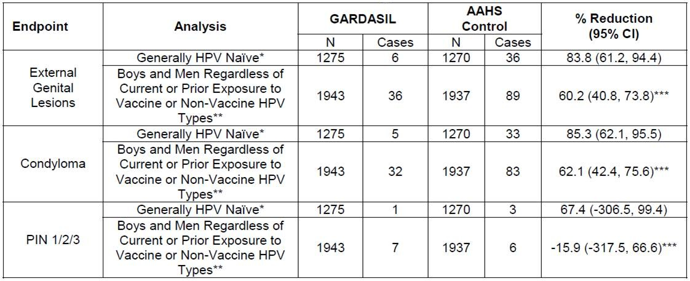
Gardasil® Efficacy for the Diseases with Related HPV Types

Slide 149
Was It Necessary to Add 5 Additional Types When There was Herd Immunity and Cross Protection?
YES!
9vHPV vaccine
Provides protection against HPV types responsible for 80% of cervical precancerous lesions
And HPV types responsible for 90% of cervical cancer

Slide 150
2v and 4vHPV Vaccines have Demonstrated Some Herd and Cross Protection...
Is it necessary to add 5 more types?
Yes, it is...
Because it addresses disease not prevented by the licensed vaccines
9vHPV Vaccine has the potential to prevent 80% of cervical precancers and 90% of cervical cancers as well as other HPV-related cancers

Slide 151
Efficacy Results of 9vHPV Vaccine
HPV Related Diseases and Impact on Cervical Procedures
  The effectiveness of the 9vHPV vaccine against cervical, vulvar and vaginal disease caused by HPV types and prevention of related cervical surgeries was compared to a placebo population
  The analysis included three international, randomized, double-blind studies conducted using the same methodology
Baseline HPV DNA positivity in each arm of the included studies (9vHPV, 4vHPV, and placebo) was comparable
Any grade of cervical disease related to 9 HPV types and HSIL was reduced compared to placebo
Large reductions in disease associated with each of the nine HPV types were observed
No clinically or statistically significant efficacy was observed against lesions associated with non-vaccine HPV types (HPV 35/39/51/56/59)
Vaccine effectiveness against the disease caused by each vaccine type was found to be similar
Study 1
9vHPV
(n=7.106)
4vHPV
(n=7.109)
FUTURE I and II
(4vHPV Vaccine Studies)
4vHPV
(n=8.810)
Placebo
(n=8.812)
Three doses of 9vHPV, 4vHPV vaccines or placebo were compared
Regular cervical cytological tests were performed
HPV DNA evaluated in biopsy or definitive treatment samples
The incidence and percent reduction rate of HPV-associated disease and 9vHPV vaccine procedures versus placebo were analyzed among women who tested negative for HPV at baseline

Slide 152
9vHPV Vaccine 8-Year Follow-Up Persistent Antibodies
8-year follow-up results of 971 girls and 301 boys aged 9-15
Continuous immunity and clinical efficacy

Slide 153
9vHPV Vaccine 8 Years FU
GMTs
High plateau up to 90 months
Seropositivity
9th year positive
Per Protocol
0%
90%
EGL, EGW, CIN

Slide 154
9vHPV Vaccine Long-Term Follow-Up Data:
10-Year Follow-up in Adolescents
Persistent infection and disease associated with HPV incidence 6/11/16/18/31/33/45/52/58
No cases of AIN or genital warts associated with HPV 6/11/16/18/31/33/45/52/58 in men
No cases of CIN or genital warts associated with HPV 6/11/16/18/31/33/45/52/58 in women

Slide 155
9vHPV Vaccine 8-Year Long-Term Follow-Up Results in Women Aged 16-26
During the long-term follow-up study period, 1448 PPE populations participated
No cases of CIN2 or worse associated with HPV 16, 18, 31, 33, 45, 52, 58 were observed
Over total follow-up of at least 6 years after the first dose, no signals indicating reduced vaccine efficacy were observed
 | N | Case Number | Follow Up | Incidence-year follow-up estimate per 100 000 persons (95% CI) | Vaccine Effectiveness Estimate (%95 CI)
HPV 16, 18, 31, 33, 45, 52, 58 associated CIN2, CIN3, AIS and cervical cancer | 1448 | 0 | 4084.2 | 0.0 (0.0, 90.3) | 100 (79.4, 100)
Time since the start of long-term follow-up
>0-2 Years | 1448 | 0 | 2682.5 | 0.0 (0.0, 137.5)
>2-4 Years | 1094 | 0 | 1351.0 | 0.0 (0.0, 273.1)
>4-6 Years | 194 | 0 | 50.8 | 0.0 (0.0, 7266.3)
9vHPV vaccine has shown a trend toward sustained protection for at least 6 years following vaccination and continued efficacy for up to 8 years

Slide 156
9vHPV Vaccine/Gardasil® 9
Individuals aged 9-14
GARDASIL 9 can be administered as a two-dose vaccination schedule (between 0th and 5th-13th months).
If the second dose is administered earlier than the 5th month after the first dose, the 3rd dose should always be administered.
Alternatively, GARDASIL 9 can be administered in three doses (0.5 ml at 0, 2, 6 months).
Individuals aged 15 and over
GARDASIL 9 should be administered in a three-dose vaccination schedule (0.5 ml at 0, 2, and 6 months).
The second dose should be administered at least 1 month after the first dose, and the third dose should be administered at least 3 months after the second dose.
All doses should be administered within 1 year
People vaccinated with 3 doses of Gardasil 4 can receive 3 doses of GARDASIL 9

Slide 157
Does Herd Immunity Work?
In Sweden, the coverage rate for opportunistic vaccination of girls aged 13-17 between 2007 and 2011 was 30%
Condyloma follow-up of women and men aged 15-44
  Average Annual Percent Change (AAPC) in women -8.5%-18.5%
  Men -7%, -16.6%
Despite such a low coverage rate in women, the incidence of condyloma is decreasing similarly in both men and women

Slide 158
Cross-protection?
Actual cross-protection data was obtained from US 4vHPV and UK 2vHPV vaccination results
Cross-protection is unstable and low impact
It lasts 4 years in clinical studies and disappears in the long term

Slide 159
Cross-protection?
2007-2016, Case #3.866 (18-35 Y), 23.3% received at least 1 dose of vaccine
In participants aged 18-22 who were vaccinated before sexual activity AND
  Against 13 non-vaccine-type hrHPV 47% (23%-64%)
  Against hrHPV 35/39/52/58/59 61% (95% CI 36%-77%)
Both direct effect and cross-protection remain effective for 5-10 years after vaccination
It was also found that the prevalence of any timely diagnosed Cx Ca was significantly lower among vaccinated participants compared to unvaccinated participants (0.46% vs 1.27%)

Slide 160
Effect of Additional HPV Types of 9vHPV Vaccine in Men
Epidemiological data have shown that 90% of genital warts, AIN and cancers in men are associated with HPV types 6, 11, 16 and 18
Relationship between the 9vHPV vaccine and the additional 5 types has been shown to be 5-10%

Slide 161
Gardasil has Demonstrated Some Herd Immunity and Some Cross Protection...
Population-based studies and meta-analysis were reviewed to evaluate the impact of vaccination programs with high coverage and high series-completion on
  HPV prevalence
  High-grade disease associated with non-vaccine types
  High-grade lesions irrespective of HPV type
Notes:
Both 2vHPV and 4vHPV vaccines appear to provide some partial cross-protection against persistent infection (≥6 months) and CIN 2+ in HPV-naive individuals
For both vaccines, efficacy for non-VLP-based vaccine types is neither as high nor as consistent as the efficacy against VLP-based HPV16 and 18 because:
VLPs are specifically manufactured for particular HPV types
Quality controlled for potency

Slide 162
Gardasil has Demonstrated Some Herd Protection and Some Cross Protection...
Real-world experience on non-vaccine HPV type prevalence and impact on high-grade disease irrespective of HPV type at the population level is looked for
  Meta-analysis: 20 eligible studies from 9 high-income countries representing more than 140 million person-years of follow-up
  Australia, the United States, Sweden, and Denmark for the 4vHPV vaccine
  Scotland and England for the 2vHPV vaccine
Notes:
Both 2vHPV and 4vHPV vaccines appear to provide some partial cross-protection against persistent infection (≥6 months) and CIN 2+ in HPV-naive individuals
For both vaccines, efficacy for non-VLP-based vaccine types is neither as high nor as consistent as the efficacy against VLP-based HPV16 and 18 because:
VLPs are specifically manufactured for particular HPV types
Quality controlled for potency

Slide 163
Gardasil has Demonstrated Some Herd and Cross Protection. Is it Necessary to Add 5 More Types?
Data suggest that cross-protection observed at 4 years in the clinical trials for the bivalent and quadrivalent vaccines is a short-lived phenomenon of early modest protection that wanes over time
For both vaccines, efficacy for nonvaccine types is neither as high nor as consistent as the efficacy against VLP-based HPV Types 16 and 18, whereby VLPs are manufactured for specific HPV types and quality controlled for potency
Population based data demonstrate weak and inconsistent impact of cross protection against nonvaccine HPV types following introduction of the 4vHPV vaccine or the 2vHPV vaccine
Notes:
Both 2vHPV and 4vHPV vaccines appear to provide some partial cross-protection against persistent infection (≥6 months) and CIN 2+ in HPV-naive individuals
For both vaccines, efficacy for non-VLP-based vaccine types is neither as high nor as consistent as the efficacy against VLP-based HPV16 and 18 because:
VLPs are specifically manufactured for particular HPV types
Quality controlled for potency

Slide 164

Gardasil has Demonstrated Some Herd Protection and Some Cross Protection...
Notes:
Both 2vHPV and 4vHPV vaccines appear to provide some partial cross-protection against persistent infection (≥6 months) and CIN 2+ in HPV-naive individuals
For both vaccines, efficacy for non-VLP-based vaccine types is neither as high nor as consistent as the efficacy against VLP-based HPV16 and 18 because:
VLPs are specifically manufactured for particular HPV types
Quality controlled for potency

Slide 165
Gardasil has Demonstrated Some Herd Protection and Some Cross Protection...
Limitations of the cross-protection evaluation with the 4vHPV vaccine
  Studies were not designed with sufficient power to detect reductions in disease due to nonvaccine types or to measure reductions in individual nonvaccine HPV types
  Efficacy for nonvaccine types was neither as high nor as consistent as the efficacy against VLP-based HPV Types 16 and 18
  Efficacy for CIN2+ excluding HPV16/18 co-infections was not reported
Notes:
Both 2vHPV and 4vHPV vaccines appear to provide some partial cross-protection against persistent infection (≥6 months) and CIN 2+ in HPV-naive individuals
For both vaccines, efficacy for non-VLP-based vaccine types is neither as high nor as consistent as the efficacy against VLP-based HPV16 and 18 because:
VLPs are specifically manufactured for particular HPV types
Quality controlled for potency

Slide 166
Cervarix has Demonstrated Some Herd Protection and Some Cross Protection...
Limitations of the cross-protection evaluation with the 2vHPV vaccine
  Cross-protection was 1 of 7 secondary efficacy endpoints evaluated
  Efficacy for nonvaccine types was neither as high nor as consistent as the efficacy against VLP-based HPV Types 16 and 18
  HPV types present in CIN3+ lesions excluding HPV16/18 co-infections was not reported
  Nonvaccine HPV Types 31, 33, and 45 at 48 months of follow-up in the PATRICIA trial showed statistically significant cross-protective efficacy
  However, by the 6.4-year follow-up of the Phase II Study (Study 007), no significant cross-protective efficacy was seen. The same was true at the 8-year follow-up of the Phase II Study 0236 despite similar numbers of endpoints as VLP-based endpoints for HPV Types 16 & 18
Notes:
Both 2vHPV and 4vHPV vaccines appear to provide some partial cross-protection against persistent infection (≥6 months) and CIN 2+ in HPV-naive individuals
For both vaccines, efficacy for non-VLP-based vaccine types is neither as high nor as consistent as the efficacy against VLP-based HPV16 and 18 because:
VLPs are specifically manufactured for particular HPV types
Quality controlled for potency

Slide 167
Cross-protection?
Clinical studies were not designed or powered to evaluate cross-protective efficacy, and the longer-term duration of cross-protection has not been assessed
By the 6.4-year follow-up, no significant cross-protective efficacy was seen
Clinical studies have shown that licensed HPV vaccines afford some short-lived cross-protection against a few non-vaccine HPV types

Slide 168
Cross-protective effect of 2vHPV vaccine. Can it be as protective as 9vHPV vaccine?
Clinical studies have shown that licensed HPV vaccines provide short-lived cross-protection against several non-vaccine HPV types.
However, clinical studies were not designed or powered to evaluate or enhance cross-protective efficacy and the long-term duration of cross-protection has not been evaluated.
The most meaningful measure of effectiveness is assessing prevention of disease endpoints in a well-controlled clinical trial rather than post-hoc analysis
For the 9vHPV Vaccine, clinical studies were designed to demonstrate efficacy against disease endpoints

Slide 169
Herd Immunity and Cross Protection of 4vHPV Vaccine Has Been Demonstrated…
Real-world experience on the prevalence of non-vaccine HPV types and their impact on high-grade diseases, regardless of HPV type
Meta-analysis
More than 140 million person-years of follow-up, including 20 eligible studies from 9 high-income countries
Australia, United States, Sweden and Denmark for 4vHPV vaccine
For the 2vHPV vaccine, Scotland and England
Notes:
Both 2vHPV and 4vHPV vaccines appear to provide some partial cross-protection against persistent infection (≥6 months) and CIN 2+ in HPV-naive individuals
For both vaccines, efficacy for non-VLP-based vaccine types is neither as high nor as consistent as the efficacy against VLP-based HPV16 and 18 because:
VLPs are specifically manufactured for particular HPV types
Quality controlled for potency

Slide 170
Completed Clinical Trials
Trial | Population | Aim
Pivotal Efficacy Study
Protocol 001 | Women, 16–26 years | Dose-ranging, efficacy, immunogenicity, safety
Immunobridging Studies in Adolescents
Protocol 002 | Girls and boys, 9–15 years; women 16–26 years | Adult-to-adolescent immunobridging
Protocol 009 | Girls, 9–15 years | 4vHPV vaccine-to-9vHPV vaccine immunobridging
Immunobridging Studies in Young Adult Men
Protocol 003 | Men and women, 16–26 years | Male immunogenicity, female-male immunobridging

Slide 171
Completed Clinical Trials
Trial | Population | Aim
Study in Prior Recipients of 4vHPV Vaccine
Protocol 006 | Girls and women, 12–26 years | Safety and immunogenicity in prior 4vHPV recipients
Concomitant Use Studiesª
Protocol 005 | Girls and boys, 11–15 years | Concomitant use: Menactra^{®b}, Adacel^{®c}
Protocol 007 | Girls and boys, 11–15 years | Concomitant use: Repevax^{®d}
ªMenactra, Adacel, and Repevax are registered trademarks of Sanofi Pasteur Inc; ^{b}Meningococcal (groups A, C, Y, and W-135) polysaccharide diphtheria toxoid conjugate vaccine⁴; ^{c}Tetanus toxoid, reduced diphtheria toxoid, and acellular pertussis vaccine adsorbed⁵; ^{d}Diphtheria, tetanus, pertussis (acellular, component), and poliomyelitis (inactivated) vaccine (adsorbed, reduced antigen(s) content).⁶

Slide 172
What is Known About Vaccine Efficacy in Males?

Slide 173
What is Known About 9vHPV Vaccine for Males?
Several HPV-related diseases affect males and Gardasil has been proven to prevent some of them (i.e. genital warts, and anal cancers and pre-cancers)
Epidemiological data suggests that the majority (85-90%) of HPV-related diseases occurring in males are caused by the four HPV types targeted by Gardasil (6, 11, 16 and 18), which are also included in 9vHPV Vaccine, but the additional five HPV types in 9vHPV Vaccine can also cause some cases of anal cancer (approximately 5-10% of HPV-related anal cancers).
Notes:
Both 2vHPV and 4vHPV vaccines appear to provide some partial cross-protection against persistent infection (≥6 months) and CIN 2+ in HPV-naive individuals
For both vaccines, efficacy for non-VLP-based vaccine types is neither as high nor as consistent as the efficacy against VLP-based HPV16 and 18 because:
VLPs are specifically manufactured for particular HPV types
Quality controlled for potency

Slide 174


Efficacy of Prophylactic Vaccines: A Systemetic Review & Meta-Analysis
Notes:
Efficacy and Safety of Prophylactic Vaccines against Cervical HPV Infection and Diseases among WomenA Systemetic Review & Meta-Analysis

Slide 175
Initial Assessment (FUTURE III)
Initial assessment | Gardasil #1911 (%) | Placebo #1908 (%)
4 HPV Types [Serologic/PCR (-)] | 67 | 67
Positive ≥1 HPV (Serologic/PCR) | 33 | 32
1 HPV Type | 25 | 22
2 HPV Type | 6 | 8
3 HPV Type | 2 | 2
4 HPV Type | 0.4 | 0.4
16 and 18 positive | 1.0 | 1.6
Unknown | 0.3 | 0.5

Slide 176
Before Vaccination
Not necessary
Cervical smear
HPV testing or serotyping

Slide 177
HPV Vaccination after HGSIL Treatment
2007-2010 cases# 737
Monitored CIN2-3 after LEEP
  360 cases vaccinated
  377 cases w/o vacination
Recurrent disease with related HPV serotypes
  Vaccinated group 2.5%
  Non-vaccinated group 8.5% (HR=2.840; CI: 1.335-6.042; p<0.01)

Slide 178

HPV Vaccination After SIL Treatment
2011-2015 RCT, case # 312
CIN2-3 Followed up after LEEP
  Vaccined 138 case
  Unvaccined 104 case
Improvement in lesions at two-year follow-up
  Vaccined group 75%
  Unvaccined group 40%
(for CIN2 p<0.01; for CIN3 p<0.03)

Slide 179
Adjuvant HPV Vaccination After HSIL Surgical Treatment:
Meta-Analysis
Meta-analysis of eleven studies
2012-2020 years
Three prospective cohort and case-control studies
One RCT
Case #21.310
Primary outcomes
Recurrences of CIN 2+ lesions (HPV type 16/18 associated)
Recurrences of CIN 1+ lesions (HPV type 16/18 associated)
Secondary outcomes
HPV persistence
CIN 3 recurrence
Abnormal cervical cytology persistence

Slide 180
Adjuvant HPV Vaccination After HSIL Surgical Treatment:
Meta-Analysis
Vaccination was done immediately before or after surgery
The best time for vaccination is within 30 days of surgery
CIN2+ recurrence was statistically significantly lower in the vaccinated group (OR 0.35; 95% CI 0.21–0.56; p < 0.0001)
CIN1+ recurrence was statistically significantly lower in the vaccinated group (OR 0.51; 95% CI 0.31–0.83; p = 0.006)
No difference was observed in HPV persistence

Slide 181

Risk of CIN2+ Recurrence after 9vHPV Vaccine

Slide 182
ASCCP Committee Opinion
ASCCP patients with CIN2+ lesions who have not been previously vaccinated, regardless of whether surgical treatment has been performed or not
For women under 26 years of age
For women aged 27-45, according to patient-physician decision
Recommends HPV vaccination

Slide 183

ASCCP Committee Opinion

Slide 184

Change in Sexual Behaviour after Vaccination
Cases# 339 (13-21 Y girls)
In period for STI, 42.5% cases had no sexual intercourse, 57.5% cases had sexual experiance before (OR 0.13, 95% [CI] 0.03–0.69)
No change in sexual behaviour after HPV vaccination has shown

Slide 185

Change in Sexual Behaviour after Vaccination
Cases# 298.265
Sexual intercourse decreased from 21.3% to 18.3% (2003-2013; adjusted odds ratio [OR] 0.79)
No significant change in the number of sexual partners (2003-2013)
Sexual risk behaviours reported by adolescent girls either reduced or stayed the same
∗

Slide 186
Effect on HPV-Related Oral Infections
Total case 997; 818 vaccined women and 179 non-vaccined women
ASP (age-standardized proportion) of HPV16/18 infections
  Vaccined women 2.0% (95 % CI, 1.0-3.0 %)
  Non-vaccined women 4.2% (95 % CI, 1.2-7.2 %)
HPV16 recognition rate
  Single dose vaccined 3.5%
  Two dose vaccined 1.2% (0. ve 6. aylar)
  Three dose vaccined 1.5% (0., 2. ve 6. aylar)
  Non-vaccined 3.3%
The same trend was seen for HPV18

Slide 187
Does the Prevalence of Non-Vaccine Type HPV Increase After Vaccination?
Case # 1.180
Outcome criteria
>1/32 anogenital nonvaccine type HPV prevalence
Prevalence of >1 genetically related HPV types HPV 16 -18
No change was detected in non-vacine type HPVs after vaccination

Slide 188
Targeted Group for HPV Vaccination
Vaccine introduction to 11-12 years of girls and boys
Catch-up vaccination for 13-26 years girls and women, 13-21 years boys and men (except special groups)
Preferred timing is before sexual intercourse
Have indication for 45 years women, no age limit for bivalent vaccine

Slide 189

HPV Vaccination Schedule and Dosings (CDC)

Slide 190
CDC Adolescent Vaccination Recommendations 2024
A two-dose schedule is recommended for girls and boys who will receive their first dose before their 15th birthday.
In a two-dose schedule, the second dose should be given within 6-12 months after the first dose.
There should be at least 5 months between the first and second doses
A 3-dose schedule is recommended for adolescents who will receive their first dose on or after their 15th birthday and for those with diseases that threaten the immune system
9-14 AGE
15-
AGE

Slide 191

WHO HPV Vaccination Recommendations

Slide 192
HPV Vaccination to Whom and How (EMA)
2vHPV
  9-14 years girls (0.-6.)
  >15 years girls and women 3 doses
4vHPV
  9-13 years boys and girls 2 doses (0.-6.)

Slide 193
Overview of Single-Dose HPV Vaccines
Effectiveness/Efficiency of a Single Dose
The majority of current clinical evidence is only beginning to be available regarding effectiveness against cervical infections/lesions
Although data are inconsistent and inconclusive, evidence suggests a 1-dose effect
May be similarly effective against persistent infection compared to 1-dose vs 2- or 3-dose regimens
1 dose may be as effective as a 2- or 3-dose regimen in preventing high-grade disease in high-coverage areas
However, no difference in HPV prevalence in the oral cavity was observed between 1-dose and unvaccinated women
Immunogenicity of a single dose
Studies have shown that Ab levels (but not seroconversion rates) may be significantly lower for a 1-dose regimen compared to 2 or 3 doses
The Ab threshold value indicating clinical effectiveness on disease outcomes for all dosing regimens of HPV vaccines is currently unknown.
Long-term durability of a single dose remains unclear

Slide 194
HPV Vaccines Single Dose
SAGE recommends changing dosing schedule for HPV vaccines
Primary target: 1 or 2 doses in girls aged 9-14 years
1 or 2 doses for young women aged 15-20
2 doses 6 months apart for women over 21 years of age

Slide 195
Single Dose Vaccine Studies

Slide 196
HPV Vaccines Single Dose
Bill & Melinda Gates Foundation and IARC-supported National Cancer Institute (NCI) and Agencia Costarricense de Investigaciones Biomédicas (ACIB) study
In eligibility criteria 20.000/24.000
  12-16 year old girls
  0. and 6. months HPV 16 and 18 negative
  10.000 Cervarix® and 10.000 Gardasil®
Control with urine and self-collected HPV DNA tests at 6-month intervals for up to 48 months
The single-dose regimen was found to be non-inferior to the two- and three-dose regimens

Slide 197


2vHPV Vaccine Single Dose
2vHPV Costa Rica Vaccine Trial (CVT)
Cases in eligibility criteria # 2.846
  Cumulative persistent HPV infection results
7-year long-term follow-up results
The single-dose regimen was found to be non-inferior to the two- and three-dose regimens

Slide 198

2vHPV Vaccine Single Dose
2vHPV Costa Rica Vaccine Trial (CVT)
Cases in eligibility criteria # 1.569
  Cumulative persistent HPV infection results
11.3 Year long-term follow-up results
HPV16 of 18 infection
  vaccinated with three doses 80.2% (95% CI ¼ 70.7% to 87.0%)
  vaccinated with two doses 83.8% (95% CI ¼ 19.5% to 99.2%)
  Vaccinated with single dose 82.1% (95% CI ¼ 40.2% to 97.0%)
The single-dose regimen was found to be non-inferior to the two- and three-dose regimens.

Slide 199


Costa Rica Vaccine Trial 11 Year Antibody Levels
HPV 16
HPV 18

Slide 200

4vHPV Vaccine Single Dose
Results of the non-protocol group of the IARC-supported group-randomized study in India
  Triple vaccined case# 4.348
  Single vaccined case # 4.950
10-Year immunogenicity results
A single-dose regimen was found to be at least as effective as two- and three-dose regimens.

Slide 201
India IARC Trial 4vHPV Vaccine
10th Year Protection

Slide 202
KEN SHE Study 9vHPV Vaccine
Kenya RCT of single dose of 9v or 2v HPV vaccines
Case # 2.250 15-20 aged women, lifetime 1-5 partners, HIV negative
1458 girls 18. month HPV 16/18 ml ITT cohort

Slide 203

DoRIS Trial
9v or 2vHPV vaccines single dose
Tanzania RCT
Case#930 9-14 year-old girls, HIV negative
Seropositivity >97.5% in all doses
No difference in antibody avidity was observed between dose groups within the same vaccine
One dose of HPV vaccine in teenage girls may provide adequate protection against persistent HPV infection

Slide 204

JCVI HPV Vaccination Program
JCVI has sought advice from 9vHPV vaccine manufacturer MSD
  In this view, there is currently too much uncertainty and ambiguity regarding the single dose schedule and more data is needed
MSD was also given the opportunity to present to the HPV subcommittee
If the policy follows the recommendations, the 2023-2024 calendar year is the earliest start
The JCVI's view is that there is currently no doubt that single-dose protection will be as effective in boys as in girls.

Slide 205
JCVI HPV Vaccination Program
JCVI recommendations for HPV vaccination
Single dose for routine adolescent program and MSM program before 25 years of age
2 doses starting from the age of 25 in the MSM program
3 doses for immunocompromised individuals and those known to be HIV positive

Slide 206
Single Dose in the UK
Following the recommendation made by the JCVI, a single dose vaccine will be administered from September 2023
Boys and girls aged 12 to 13
Gay, bisexual and other men under 25 (GBMSM)

Slide 207
Cochrane Database
15-26 Years (HPV Positive or Negative in all groups) can reduce the incidence of HPV-related diseases
341/10,000 in the unvaccinated group
157/10,000 in the vaccinated group
Reduces risk of HPV-related disease by 50%, even after HPV positivity
May provide some protection even with a single dose
A single dose of vaccine reduces the risk of HSIL by 20 times

Slide 208
Single Dose with Melt Processing
Melt processing (MP) is an emerging manufacturing method to effectively encapsulate proteins into polymeric devices
In the vaccine context, MP is a suitable method to develop vaccines that are stable outside the cold chain and can generate protective immunity from a single dose
Bacteriophage Qβ VLPs have been evaluated as being compatible with hot-melt extrusion (HME) and using this technology to develop a single-dose vaccine candidate for HPV vaccine
It was used to chemically couple an HPV peptide epitope from the L2 minor capsid protein of HPV to Qβ VLPs, and the techniques used to characterize HPV-Qβ particles were determined
The methods described are a continuous and solvent-free process, thus allowing melts to be processed into various geometries, such as subcutaneous implants or self-administered microneedle beads

Slide 209
ESGO Prevention Committee Opinion
Data evaluating single-dose regimens; are more heterogeneous, less consistent, and should be interpreted with caution as opposed to studies evaluating two- or three-dose regimens
Available results demonstrate non-inferior immunogenicity and potential protection against targeted HPV types
Evidence of non-inferiority with respect to cervical preinvasive disease and invasive cancer is awaited
Data are lacking on the level and duration of protection as well as protection in men or immunosuppressed individuals

Slide 210
Ongoing Trials
Trial | Aim | Vaccine | Age group | Definition | Outcome
ESCUDDO (NCT03180034) | Non-inferiority | 2vHPV 4vHPV | 12-16 female | HPV 16/18 persistent infection 1 vs 2 doses | 2024-2025
PRIMAVERA (NCT03728881) | HPV16/18 Immunobridging | 2vHPV | 9-14 female | Single dose | Initial findings at the end of 2023
 |  | 4vHPV | 18-25 female | Triple dose
PRISMA (NCT05237947) | Immunogenicity | 2vHPV | 18-30 | Single dose Control with DTaP | 2027
 |  | 9vHPV

Slide 211
Cervarix® in Pregnancy
Confidance results(TVC) | > 25 Y women
 | Cervarix® | HAV 720 | Al(OH)₃
Pregnancy# | 28 | 3 | 20
Pregnancy Results, %
Normal infant/continiuing pregnancy | 82.1 | 100 | 55.0
Premature infant | - | - | -
Elective termination | 10.7 | - | 25.0
Spontanious abortus | 7.1 | - | 20.0
Pregnancy in Vaccinated cohort#* | 9 | 2 | 17
Pregnancy results, %
Normal infant/continiuing pregnancy | 77.8 | 100 | 52.9
Premature infant | - | - | -
Elective termination | 11.1 | - | 29.4
Spontanious abortus | 11.1 | - | 17.6
Cathegory B
Notes:
Cervarix® pooled safety analysis of 11 trials (III). Most common pregnancy outcomes (TVC)
There were strict protocol requirements for adequate contraception during the vaccination phase of the trials, but pregnancies were allowed during the long-term follow-up periods. Overall, a fairly large number of pregnancies was reported. However, rates of specific pregnancy outcomes, such as miscarriages, abnormal infants, or premature, were very similar in the active Aşı group compared to the Kontrol groups in this pooled analysis.
211

Slide 212

Gardasil® in Pregnancy
Cathegory B

Slide 213
Is the 90/70/90 Program Realistic?
Although 60% of WHO Member States have included the HPV vaccine in their NIP by 2020-2021, only 13% of female adolescents worldwide are fully vaccinated
This problem stems from the fact that many countries do not yet have national HPV vaccination programs or, when implemented, insufficient vaccination rates.
Countries without national vaccination programs often have the highest Cx Ca burden
  84% of Cx Ca burden occurs in low- and lower-middle-income countries
  However, only 19% of lower-middle-income countries had introduced the HPV vaccine as of 2019
This rate lags behind most middle- and higher-income countries, such as 85% of countries in the Americas and 77% of countries in Europe
Cx Ca screening is unattainable or unachievable in many countries that struggle to introduce the HPV vaccine
The target of 90% of girls under 15 years of age being vaccinated against HPV by 2030 to achieve the cervical cancer elimination target set by WHO is unrealistic

Slide 214
Safety of 9vHPV Vaccine
Overview of Use in Pregnant Women
Specific studies of 9vHPV vaccine in pregnant women were not conducted
Vaccination with 9vHPV vaccine should be postponed until completion of pregnancy
The 4vHPV vaccine was used as the active comparator during clinical development of 9vHPV vaccine
The types of anomalies or proportion of pregnancies with an adverse outcome in individuals who received 9vHPV or 4vHPV vaccine were comparable and consistent with the general population
A large amount of data on pregnant women (more than 1.000 pregnancy outcomes) indicate no malformative or feto/neonatal toxicity of 9vHPV vaccine

Slide 215

How
IM administration
  Arm
15’ rest after vaccination

Slide 216
Vaccination in Pregnancy
Don’t start vaccination in pregnancy
If pregnancy noticed after first vaccination, 3 doses after birth beginning from the start
If pregnancy noticed after 2 doses the last dose has to be administered after birth within 1 year
Safe in breast feeding period

Slide 217
Immune Memory
10,000
Immune memory continues
1,000
GMT 95% CI
[log₁₀ scale])
100
Gardasil
n = 78
10
Placebo (Sero (-) ve PCR (-)
n = 70
↴
0
2 3
7
12
18
24
30
36
54
6
60
61
Months
60+1
ay
Vaccine in 0., 2. and 6. months
Immune challenge 60. month

Slide 218
Booster Dose
Positive immune memory after 5th year
No need for booster dose

Slide 219

Adverse Events

Slide 220
From Press
New research on HPV vaccine...
"... Two researchers from the University of British Columbia in Canada criticized governments' recommendations that the cervical cancer vaccine is harmless."

Slide 221

Media
Tomljenovic L ve Shaw CA are not medical doctors!

Slide 222
Adverse Events
Since the vaccine does not contain live or dead virus, viral infection or similar undesirable effects are not possible
At vaccination site due to injection;
Erythema
Minimal pain
Swelling
Mild fever
Nausea, dizziness, blackout

Slide 223

Adverse Events

Slide 224

Autoimmune Diseases

Slide 225



Prevalence of POI in Normal Society
PRIMARY OVARIAN INSUFFICIENCY
1/10000
WOMEN
1/250
WOMEN
1/100
WOMEN
< 20 AGE
< 35 AGE
< 40 AGE

Slide 226
Primary Ovarian Insufficiency
170,000,000 doses of HPV vaccine/9 Years
Primary Ovarian Insufficiency (POI) was reported in only 6 cases in three separate publications.
For autoimmune syndrome induced by adjuvants (ASIA), the relationship between HPV vaccination and POI symptoms is important and lasts up to 15 years in cases.
In Australia, 83% of girls vaccinated with 5,800,000 doses were of school age and no HPV-related POI was demonstrated.

Slide 227
Risk of POI after HPV Vaccination: PRISMA Systematic Review and Meta-Analysis
Four studies involving 1,253,758 patients
There was a significant difference for POI between 4vHPV and controls (unvaccinated or other vaccinated) (RR 0.47 (95% CI 0.14 - 1.59) I2 = 75%) or unvaccinated controls alone (RR 0.75 (95% CI 0.22 - 2.49) 12 = 26%) no risk demonstrated
4vHPV vaccine does not appear to increase the risk of POI compared to unvaccinated individuals or other childhood vaccines
No difference seen with 4vHPV vaccine compared to 2vHPV and 9vHPV

Slide 228
Deaths
51 deaths in clinical studies
None of them are related to vaccines
Cause of mortalities
  Viral infections; akut myocarditis, meningoensefalitis, influenza B viral sepsis
  Cardiac aritmia due to cardiomyopathy
  Diabetic ketoasidosis
  Ephileptic attack in ephileptic patients
  Pulmoner emboli, DVT
  Over limit uptake in drug abusers
  Traffic accident
  Other drugs
  Murder

Slide 229
Does 9vHPV Vaccine have a similar safety profile as Gardasil?
The frequency of injection-site adverse experiences and severe adverse experiences (Pyrexia, Allergy to vaccine, Asthmatic crisis, Headache, Tonsillitis) was higher with 9vHPV Vaccine compared to Gardasil
Most injection-site adverse experiences are mild or moderate and intensity and severe injection-site adverse experiences are rare with both vaccines
Notes:
Both 2vHPV and 4vHPV vaccines appear to provide some partial cross-protection against persistent infection (≥6 months) and CIN 2+ in HPV-naive individuals
For both vaccines, efficacy for non-VLP-based vaccine types is neither as high nor as consistent as the efficacy against VLP-based HPV16 and 18 because:
VLPs are specifically manufactured for particular HPV types
Quality controlled for potency

Slide 230
What are the most common adverse events with 9vHPV Vaccine?
The most common (≥10%) local and systemic adverse reactions in females 16 through 26 years of age were:
    injection-site pain (89.9%),
    injection-site swelling (40.0%),
    injection-site erythema (34.0%) and
    headache (14.6%)
Notes:
Both 2vHPV and 4vHPV vaccines appear to provide some partial cross-protection against persistent infection (≥6 months) and CIN 2+ in HPV-naive individuals
For both vaccines, efficacy for non-VLP-based vaccine types is neither as high nor as consistent as the efficacy against VLP-based HPV16 and 18 because:
VLPs are specifically manufactured for particular HPV types
Quality controlled for potency

Slide 231
What are the most common adverse events with 9vHPV Vaccine?
The most common (≥10%) local and systemic reactions in girls 9 through 15 years of age were injection-site pain (89.3%) injection- site swelling (47.8%), injection-site erythema (34.1%) and headache (11.4%)
The most common (≥10%) local and systemic reactions in boys 9 through 15 years of age were injection-site pain (71.5%), injection-site swelling (26.9%), injection-site erythema (24.9%) and oral temperature >= 100.0 F (10.4%)
Most of the injection site reactions were mild or moderate in intensity
Notes:
Both 2vHPV and 4vHPV vaccines appear to provide some partial cross-protection against persistent infection (≥6 months) and CIN 2+ in HPV-naive individuals
For both vaccines, efficacy for non-VLP-based vaccine types is neither as high nor as consistent as the efficacy against VLP-based HPV16 and 18 because:
VLPs are specifically manufactured for particular HPV types
Quality controlled for potency

Slide 232
Were any other serious adverse events reported with 9vHPV Vaccine?
Serious adverse events were collected throughout the entire study period (range one month to 48 months post-last dose) for the six integrated clinical studies for 9vHPV Vaccine
Out of the 13,236 individuals who were administered 9vHPV Vaccine and had safety follow-up, 305 reported a serious adverse event; representing 2.3% of the population
As a comparison, of the 7,378 individuals who were administered Gardasil and had safety follow-up, 185 reported a serious adverse event; representing 2.5 % of the population.
Notes:
Both 2vHPV and 4vHPV vaccines appear to provide some partial cross-protection against persistent infection (≥6 months) and CIN 2+ in HPV-naive individuals
For both vaccines, efficacy for non-VLP-based vaccine types is neither as high nor as consistent as the efficacy against VLP-based HPV16 and 18 because:
VLPs are specifically manufactured for particular HPV types
Quality controlled for potency

Slide 233
Were any other serious adverse events reported with 9vHPV Vaccine?
Study Protocol | Gender | Relative Day of Onset | Adverse event | Duration | Intensity | Outcome
001 | F | 1d PD3 | Pyrexia | 2 Days | Severe | Resolved
001 | F | 1d PD1 | Allergy to vaccine | 23 Hours | Severe | Resolved*
002 | M | 2d PD1 | Asthmatic crisis | 3 Days | Moderate | Resolved*
002 | F | 1d PD3 | Headache | 11 Days | Severe | Resolved
006 | F | 2d PD1 | Tonsillitis | 5 Days | Severe | Resolved
*Subject discontinued
Notes:
Both 2vHPV and 4vHPV vaccines appear to provide some partial cross-protection against persistent infection (≥6 months) and CIN 2+ in HPV-naive individuals
For both vaccines, efficacy for non-VLP-based vaccine types is neither as high nor as consistent as the efficacy against VLP-based HPV16 and 18 because:
VLPs are specifically manufactured for particular HPV types
Quality controlled for potency

Slide 234

Safety of Prophylactic Vaccines: A Systemetic Review & Meta-Analysis
Notes:
Efficacy and Safety of Prophylactic Vaccines against Cervical HPV Infection and Diseases among WomenA Systemetic Review & Meta-Analysis

Slide 235


Slide 236



CDC Safety Note

Slide 237

WHO Safety Note

Slide 238
Are there any deaths reported in the 9vHPV Vaccine clinical trials?
Across the six clinical studies in the original filing, 10 deaths occurred (five each in the 9 HPV Vaccine arm and the Gardasil arm); none were assessed as vaccine-related.
Causes of death in the 9vHPV Vaccine group included one automobile accident, one suicide, one case of acute lymphocytic leukemia, hypovolemic septic shock, and one unexplained a sudden death 678 days following the last dose of V503.
Causes of death in the Gardasil control group included one automobile accident, one airplane crash, one cerebral hemorrhage, one gunshot wound, and one stomach adenocarcinoma.
Notes:
Both 2vHPV and 4vHPV vaccines appear to provide some partial cross-protection against persistent infection (≥6 months) and CIN 2+ in HPV-naive individuals
For both vaccines, efficacy for non-VLP-based vaccine types is neither as high nor as consistent as the efficacy against VLP-based HPV16 and 18 because:
VLPs are specifically manufactured for particular HPV types
Quality controlled for potency

Slide 239
Who Should be Vaccinated with 9vHPV Vaccine?

Slide 240
Who should be Vaccinated with 9vHPV Vaccine?
HPV infection is transmitted via contact with an infected individual and occurs most often during sexual activity. HPV is often acquired immediately after sexual debut
The cumulative lifetime risk for HPV infection in sexually active individuals exceeds 50%
Thus, anyone who may be potentially exposed to HPV infection may benefit from the vaccine. However, since V503 is a prophylactic vaccine, the greatest benefit is derived in subjects prior to initiation of sexual activity. Therefore, preadolescents and adolescents are also expected to derive the greatest benefits from HPV vaccination

Slide 241

Comparative Effects of 2v, 4v, and 9vHPV Vaccines:
Review and Metanalaysis

Slide 242
How About Previously Vaccinated Population?

Slide 243
How many Doses of 9vHPV will a Prior Recipient of Vaccine Need to have for Full Protection?
Protocol 006 provides information on safety and immunogenicity in females who received 3 doses of Gardasil and then 3 doses of 9vHPV Vaccine
Administration of a 3-dose regimen of 9vHPV vaccine to adolescent girls and young women 12-26 years of age who are prior Gardasil recipients is highly immunogenic with respect to additional HPV types and generally well tolerated

Slide 244
Key Objectives of 9vHPV Vaccine Clinical Program
Topic | Objective
Women (HPV 6/11/16/18)¹ | Provide similar level of protection as 4vHPV vaccine against infection/disease due to HPV 6/11/16/18
Women (HPV 31/33/45/52/58)¹ | Provide an increased level of protection as compared with 4vHPV vaccine against disease due to HPV 31/33/45/52/58
Adolescents² | Noninferior immunogenicity in adolescents vs young women (immunobridging)
Men³ | Noninferior immunogenicity in young men vs young women (immunobridging)
Safety¹⁻³ | Acceptable safety/tolerability profile

Slide 245


9vHPV Vaccine in Individuals Previously Fully or Partially Vaccinated

Slide 246
9vHPV Vaccine: Conclusions
In clinical trials in women 16 to 26 years of age, 9vHPV vaccine was efficacious in the prevention of cervical, vulvar, and vaginal disease and persistent infection related to HPV Types 31, 33, 45, 52, and 58.¹
  A reduction in the rate of HPV-related Pap test abnormalities and cervical procedures was also demonstrated.²
Based on noninferior immune responses compared with 4vHPV vaccine, effectiveness of 9vHPV vaccine against HPV Types 6, 11, 16, and 18–related disease can be inferred in 16- to 26-year-old women.¹
  Similarly, 9vHPV vaccine effectiveness in adolescents 9 to 15 years of age and men 16 to 26 years of age can be inferred from noninferior immune responses compared with young adult women.^{3,4}

Slide 247
9vHPV Vaccine: Conclusions
Safety profile demonstrated in ~10,000 individuals ages 16 to 26 years of age and ~5,200 adolescents ages 9 to 15 years of age who received at least 1 dose of 9vHPV vaccine¹
  9vHPV vaccine was generally well-tolerated in prior 4vHPV vaccine recipients.²
  Coadministration of 9vHPV vaccine in girls and boys 11 to 15 years of age with other adolescent vaccines was well tolerated, with generally similar rates of AEs seen between vaccine groups.^{3,4}
Cost-effectiveness analyses in the United States indicate that vaccination of males and females with 9vHPV vaccine likely will be cost-saving compared with 4vHPV vaccine.⁵
  Additionally, it is predicted that switching to 9vHPV vaccination program after 70 years will further reduce precancerous lesions and cervical cancer: 19% and 14% additional reduction in CIN 2/3 and cervical cancer, respectively.

Slide 248

ACOG Recommendations

Slide 249
ACOG Recommendations
Obstetrician–gynecologists and other health care professionals should strongly recommend HPV vaccination to eligible patients and stress the benefits and safety of the HPV vaccine
Vaccination is recommended for women through age 26 years even if the patient is tested for HPV DNA and the results are positive
Testing for HPV DNA is not recommended before vaccination
ACOG does not recommend that an individual who received the 4vHPV vaccine be revaccinated with 9vHPV vaccine, including those aged 27–45 years who previously completed some, but not all, of the vaccine series when they were younger

Slide 250
ACOG Recommendations
Any available HPV vaccine product may be used to continue or complete the series for women for protection against HPV genotypes 16 and 18
If HPV vaccine type does not be known
or
Do not have the same HPV vaccine product previously administered
or
Are in settings that are transitioning to the 9vHPV vaccine
9vHPV vaccine or the 4vHPV vaccine may be used to continue or complete the series for men

Slide 251
Will the Screening Continue?
Absolutely Yes
Vaccine does not provide protection against
All hrHPV types
Despite vaccination, cancer may still develop with other types, with a 10% possibility
The types it contains for those who have previously had an infection with those types
It should be noted that it prevents a recurrence with those types

Slide 252
“Preteens need HPV vaccine today to be protected from HPV cancers tomorrow.”
—Dr. Anne Schuchat
Rear Admiral, US Public Health Service,
Principal Deputy Director of CDC/ATSDR

Slide 253
Implementation of HPV Vaccination Programs

Slide 254
Basic Elements of an HPV Vaccine Communication Plan
Recommendations From the WHO Include¹
  Assemble a cross-sectional communication team
  Working groups or subcommittees are commonly formed and should include communication experts from government and relevant partner organizations
Develop a clear communication plan that includes:
  SMART communication objectives
  Continuous monitoring and evaluation after the vaccine is introduced
Develop and implement messages based on target audiences’ sociocultural attitudes, knowledge, and practices
Include a risk communication plan for investigating and reporting AEs
PLAN
✓
✓
✓
✓
✓
        AE=adverse event; SMART=specific, measurable, achievable, relevant, and time-bound; WHO=World Health Organization.
        1. HPV vaccine communication: special considerations for a unique vaccine. World Health Organization website.

Slide 255
Cooperation Among Multiple Parties to Disseminate Accurate Information^{1,2}
Cross-sectional cooperation across national immunization managers, national and district social mobilization teams, partners and agency staff, educators, and health care workers is crucial for successful HPV vaccine implementation.
Joint planning meetings involving the Ministry of Education, parents, teachers, and health workers have been shown to be key factors contributing to higher HPV vaccine coverage.
HPV vaccine communication: special considerations for a unique vaccine. World Health Organization
About cervical cancer: HPV and cervical cancer. RHO Cervical Cancer website.

Slide 256
National School-Based Programs Can Achieve High HPV Vaccine Coverage Rates
Delivery of HPV vaccines through national school-based programs has achieved high coverage rates in both low and high resource settings¹⁻⁴
HPV Vaccination Coverage (%)
HPV Vaccination Coverage (%)
Peru
2008¹
Uganda
2009¹
Vietnam
2009–2010¹
Norway
2014^{4,5a}
UK
2013–2014^{6,b,c}
PCTs=Primary Care Trusts; UK=United Kingdom; WHO=World Health Organization.
ªCoverage for all 3 HPV vaccine doses reported for routine vaccination in Norway for year 7 girls born in 1998.^{2,5}
^{b}Coverage for all 3 HPV vaccine doses reported in England for year 8 girls, aged 12 to 13 years.⁶
^{c}In the UK ~95% of HPV vaccinations are school-based; local PCTs were responsible for HPV program development and implementation from 2008-2013.³
Notes:
References
LaMontagne DS et al. Bull World Health Organ. 2011;89:821–830B.
Fisher H et al. J Public Health. 2014;36:36-45.
Public Health England: HPV Vaccine Coverage in England, 2008/09 to 2013/14; A review of the full six years of the three-dose schedule. UK.GOV website. https://www.gov.uk/government/uploads/system/uploads/attachment_data/file/412264/HPV_Vaccine_Coverage_in_England_200809_to_201314.pdf. Accessed December 21, 2015.
Hansen BT et al. Prev Med. 2015;77:4-10.
Norwegian Institute of Public Health: Vaccination Coverage for Childhood Immunisation Programme in Norway, 2015: http://www.fhi.no/eway/default.aspx?pid=240&trg=MainContent_6894&Main_6664=6894:0:25,7661:1:0:0:::0:0&MainContent_6894=6706:0:25,7675:1:0:0:::0:0. Accessed December 21, 2015.
Public Health England(PHE): Annual HPV vaccine coverage 2013 to 2014: by PCT, local authority and area team. UK.GOV website. https://www.gov.uk/government/statistics/annual-hpv-vaccine-coverage-2013-to-2014-by-pct-local-authority-and-area-team. Accessed December 21, 2015.

Slide 257

Contraversies for HPV Vaccines

Slide 258
Cervarix®: Immunigenisity
HPV 16
15–25 yrs
26–35 yrs
36–45 yrs
100000
46–55 yrs
%100 seropositive*
8 fold compared to natural immunity
15–25 yrs
(efficacy study)
10000
1000
Log₁₀ GMT, EU/ml
100
Natural infection
10
1
0
7
12
18
25–32
33–38
39–44
45–50
51–56
57–62
63–68
69–74
75–76
Months monitored
*Excl. Efficacy study data
Notes:
Cervarix®: Immunigenisite in women above the age of 25 years
The Immunigenisite of Cervarix® was compared in 521 women in the following age groups up to 24 aylar after vaccination: 15–25 years, 26–35 years, 36–45 years and 46–55 years.
The data (line graphs) are overlaid onto Immunigenisite data (bar charts) from the 15–25-year age group of the original etkinlik and Immunigenisite study.
Although total IgG antibody titres decreased with age, they remained at least eightkat higher than natural infection levels for both HPV 16 and 18 at all time points up to 24 aylar after vaccination.
References
Figure is adapted from De Carvalho, N et al. IPvC 2009; Poster.
Harper DM, et al. Lancet 2006; 367:1247–1255.
Wheeler CM, et al. ESPID 2008; Poster.
Schwarz TF, et al. J Clin Oncol 2006; 24 (Suppl 18):Abstract 1008.
Schwarz TF, et al. J Clin Oncol 2007; 25 (Suppl 18):Abstract 3007.
Schwarz TF, et al. EUROGIN 2007; Abstract.
Schwartz TF, et al. Aşı 2009; 27:581–587.

Slide 259
Cervarix®: Immunigenisity
HPV 18
15–25 yrs
26–35 yrs
Naturel enfeksiyondan en az 8 kat yüksek
36–45 yrs
10000
%100 seropozitif*
46–55 yrs
15–25 yrs
Efficicy study
1000
Log₁₀ GMT, EU/ml
100
Natural infection
10
1
0
7
12
18
25–32
33–38
39–44
45–50
51–56
57–62
63–68
69–74
75–76
Months monitored
*Excl. Efficacy study data
Notes:
Cervarix®: Immunigenisite in women above the age of 25 years
The Immunigenisite of Cervarix® was compared in 521 women in the following age groups up to 24 aylar after vaccination: 15–25 years, 26–35 years, 36–45 years and 46–55 years.
The data (line graphs) are overlaid onto Immunigenisite data (bar charts) from the 15–25-year age group of the original etkinlik and Immunigenisite study.
Although total IgG antibody titres decreased with age, they remained at least eightkat higher than natural infection levels for both HPV 16 and 18 at all time points up to 24 aylar after vaccination.
References
Figure is adapted from De Carvalho, N et al. IPvC 2009; Poster.
Harper DM, et al. Lancet 2006; 367:1247–1255.
Wheeler CM, et al. ESPID 2008; Poster.
Schwarz TF, et al. J Clin Oncol 2006; 24 (Suppl 18):Abstract 1008.
Schwarz TF, et al. J Clin Oncol 2007; 25 (Suppl 18):Abstract 3007.
Schwarz TF, et al. EUROGIN 2007; Abstract.
Schwartz TF, et al. Aşı 2009; 27:581–587.

Slide 260
Neutralising Antibodies
Bivalant Vx
Quadrivalant Vx
10000
Seropozitivite ≥98%
HPV 16
HPV 16
10,000
Seropozitivite ≥98%
Aşı
Aşı
1000
1,000
100
100
infection
İnfection
10
10
1
0
7
12
18
1
[25–32]
[33–38]
[39–44]
[45–50]
[51–56]
[57–62]
[63–64]
0
5
10
15
20
25
30
35
40
45
50
55
10000
Seropozitivite ≥98%
HPV 18
10,000
HPV 18
1000
24 aylar 76%
1,000
36 aylar 65%
100
Infection
Infection
100
10
10
1
1
cLIA
0
7
12
18
0
5
10
15
20
25
30
35
40
45
50
55
[25–32]
[33–38]
[39–44]
[45–50]
[51–56]
[57–62]
[63–64]
Time (mo)

Slide 261

Neutralising Antibodies
8.799 cases Vx group, 8.800 cases in placebo; 48 months monitored

Slide 262
Gardasil® HPV 18 Ab Levels and Efficacy

Slide 263
AS04 Adjuvanted Cervarix®
HPV 16
HPV 18
16000
3.6 x*
3000
Q3
2.2 x
12000
Q3
2000
Frequency of HPV-specific
memory B-cells
AS04
AS04
8000
Al(OH)₃
Al(OH)₃
1000
Median
4000
Median
Q1
Q1
0
Pre
Day 60
Day 210
0
Pre
Day 60
Day 210
Vaccination
Vaccination
* Wilcoxon’s non-parametric test (p < 0.05).
Notes:
263
Cervarix® with AS04 induced a higher frequency of memory B-cells than the same antigens adjuvanted with Al(OH)₃ in humans
An AS04-adjuvanted HPV 16/18 Aşı induced memory B-cell levels that were significantly higher at all time points up to 48 aylar than the same antigens adjuvanted with Al(OH)₃, for both HPV 16 and 18.

Slide 264
GMT (Geometric Mean Titers) Antibody Titers Detection Methods
PBNA*
Pseudovirion
ELISA
Enzyme
Based
Neutralization
Assay
Linked
Immuno
Sorbent
Assay
cLIA
Competitive
Luminex
Immuno
Assay
GSK
WHO
MSD
*SEAP-NA: Secreted Alkaline Phosphatase Neutralization Assay

Slide 265
HPV 16 and 18 Neutralizing Antibody Responses
Cervarix®
Cervarix®
HPV 16
HPV 18
Gardasil®
Gardasil®
ATP cohorts
Women 18–26 years
Women 27–35 years
Women 36–45 years
3.7-fold
7.3-fold
4.8-fold
9.1-fold
2.3-fold
6.8-fold
100000
100000
100000
100000
100000
100000
10000
10000
10000
10000
10000
10000
GMT (ED₅₀)
1000
1000
1000
1000
1000
1000
100
100
100
100
100
100
100%
100%
100%
100%
100%
100%
100%
98%
100%
100%
100%
100%
Seroconversion rate
Notes:
HPV 16 and 18 neutralizing antibody responses: geometric mean titre, geometric mean titre ratio and seroconversion rate
In every age group, the antibody response was higher for Cervarix® than Gardasil®, for both HPV 16 and 18.
In 18–26-year-old women, the antibody response for Cervarix® was 3.7-fold higher for HPV 16 and 7.3-fold higher for HPV 18 compared with Gardasil®.
In 27–35-year-old women, the antibody response for Cervarix® was 4.8-fold higher for HPV 16 and 9.1-fold higher for HPV 18 compared with Gardasil®.
In 36–45-year-old women, the antibody response for Cervarix® was 2.3-fold higher for HPV 16 and 6.8-fold higher for HPV 18 compared with Gardasil®.
Seroconversion rates were 100% for HPV 16 and 18 for both vaccines, except for women aged 27–35 who received Gardasil®, where only 98% were seropositive for HPV 18.
Additional analyses in the TVC cohort to assess superiority confirmed that Cervarix® induced significantly superior neutralizing antibodies levels compared with Gardasil® for HPV 16 and HPV 18 in all age groups.
References
Einstein MH, on behalf of the HPV-010 study group. IPvC 2009; Abstract O-01.02.
Einstein MH, et al. Human Vaccines 2009; 5:705–719.

Slide 266
Comparison of the Immunogenicity and Safety of Two Vaccines
Although the importance of differences in magnitude of immune response between these vaccines is unknown, they may represent determinants of duration of protection against HPV-16/18. Long-term studies evaluating duration of efficacy after vaccination are needed for both vaccines.

Slide 267
ATP and PP CIN2+ Efficacy
Vaccine | HPV Type | Vaccination n # | Plasebo n # | Efficacy % CI
Bivalent | 16/18 | 4 | 7312 56 | 93 (80,98)
 | 16 | 6303 2 | 6165 46 | 96 (83,100)
 | 18 | 6794 2 | 6746 15 | 87 (40,99)
Quadrivalent | 16/18 | 7738 2 | 7714 100 | 98 (93,100)
 | 16 | 6647 2 | 6455 81 | 98 (91,100)
 | 18 | 7382 0 | 7316 29 | 100 (87,100)

Slide 268
Cervarix® Cross-protection
HPV types | n Vx | n Control | VE % | LL | UL | p
HPV 31 | 11 | 35 | 68.4 | 34.2 | 86.1 | 0.0005
HPV 33 | 17 | 43 | 49.8 | 4.8 | 74.6 | 0.0239
HPV 45 | 0 | 6 | 100 | 7.0 | 100 | 0.0312
HPV 52 | 18 | 18 | –0.4 | –111.9 | 52.5 | 1.0000
HPV 58 | 10 | 20 | 49·6 | –17·1 | 79·9 | 0.0985
HPV 31/33/45/52/58 | 51 | 88 | 41.9 | 15.5 | 60.4 | 0·0021
TVC
LLCI > 0 statisticaly significant
Notes:
Cervarix® has shown etkinlik against CIN2+ associated with non-Aşı oncogenic HPV types
An HPV Aşı achieving up to %100 protection against persistent infection with HPV types 16 and 18 is predicted to prevent approximately 70% of Cx Ca olguları and significantly reduce the incidence of HPV-associated HSIL or CIN grades 2/3, based on epidemiological data.^{1,2} The global prevalence of HPV 16/18 is estimated to be 52.3% in CIN2/3 and 70.3% in invasive Cx Ca (ICC).² HPV types 31 and 45 are associated with a further 10.9% of CIN2/3 and 7.3% of ICC olguları.² The provision of cross-protective etkinlik against non-Aşı HPV types would thus be predicted to provide significant additional clinical benefits.
References
1. Muñoz N, et al. Int J Cancer 2004; 111:278–285.
2. Smith JS, et al. Int J Cancer 2007; 121:621–632.

Slide 269
Cervarix® 8 Year Efficacy for Non-vaccine Types
HPV Type | Phase III (Study 008)¹ Monitored 48 months TVC-N* |  |  | Phase II (Study 007)² Monitored 6.4 years ATP-E** |  |  | Phase II (Study 007)² Monitored 8years ATP-E**
 | Vx group | Contr. Group | VE % (95% CI) | Vx group | Contr. Group | VE % (95% CI) | Vx group | Contr. Group | VE % (95% CI)
HPV 16/18 | 5 | 97 | 95 (88, 98) | 0 | 34 | 100 (90, 100) | 0 | 17 | 100 (80, 100)
HPV 16 | 2 | 81 | 98 (91, 100) | 0 | 27 | 100 (87, 100) | 0 | 12 | 100 (69, 100)
HPV 18 | 3 | 23 | 87 (57, 98) | 0 | 10 | 100 (60, 100) | 0 | 8 | 100 (50, 100)
HPV 31 | 38 | 163 | 77 (67, 84)
5 | 9 | 48 (<0, 86)
6 | 6 | 10 (<0, 76)
HPV 33 | 53 | 92 | 43 (19, 60)
6 | 5 | -16 (<0, 71)
6 | 4 | -37 (<0, 68)
HPV 45 | 13 | 61 | 79 (61, 89)
2 | 4 | 52 (<0, 96)
5 | 3 | -52 (<0, 70)

Slide 270
Cervarix® Cross-protection
 | VE, % (96.1% CI)
CIN2+ | ATP-E | TVC | TVC-naive
HPV-16/18 related | 92.9 (79.9, 98.3) | 52.8 (37.5, 64.7) | 98.4 (90.4, 100)
Irrespective of HPV | NA | 30.4 (16.4, 42.1) | 70.2 (54.7, 80.9)
HPV-31 related | 92.0 (66.0, 99.2) | NA | 100 (78.3, 100)1
HPV-33 related | 51.9 (-2.9, 78.9) | NA | 72.3 (19.1, 92.5)1
HPV-45 related | 100 (-67.8, 100)† | NA | 100 (-19.5, 100)1
HPV-31/33/45/52/58 | 53.0 (24.7, 71.3) | 31.5 (9.1, 48.5) | 68.2 (40.5, 84.1)

Slide 271
Cervarix® Antibody Levels in Cervicovaginal Secretion
Anti-HPV 16
Anti-HPV 18
2.5
3.0
2.0
15–25 years
R = 0.9031
15–25 years
R = 0.9114
26–45 years
R = 0.7280
2.5
26–45 years
R = 0.8235
46–55 years
R
= 0.8753
46–55 years
R = 0.9328
1.5
2.0
1.0
Antibody levels in CVS*
Antibody levels in CVS*
1.5
0.5
0
1.0
-
0.5
0.5
-1.0
-1.0
0
0
0.5
1.0
1.5
2.0
2.5
3.0
-
0.5
0
0.5
1.0
1.5
2.0
2.5
Antibody levels in serum†
Antibody levels in serum†
* Log titre of CVS/total IgG.
† Log titre of serum/total IgG.
No detection of anti-HPV-16 and anti-HPV-18 antibodies in cervical
secration after Naturel infection (n=20)
Notes:
Cervarix® induced antibody levels in serum which corilişkili with those in cervicovaginal secretions
Anti-HPV 16 and 18 IgG antibodies were compared in the serum and cervicovaginal secretions (CVS) of 250 women aged 15–55 years, 24 aylar after vaccination with Cervarix®.
Results are represented as the ratio of log titre HPV-specific CVS or serum antibody to total IgG in the sample (log titre of CVS or serum/total IgG).
There was a very high correlation between antibody levels in the serum and CVS in women aged 15–55 years following vaccination with Cervarix®.
Cervarix® provided high levels of HPV 16- and 18-specific antibodies at the cervix – the site of potential infection.
Reference
Schwarz TF, et al. Aşı 2009; 27:581–587.

Slide 272
Cross-Protective Vaccine Efficacy
(Results from the Costa Rica Trial)
Efficacy observed against HPV types 31, 33, and 45 has been partial and thus, failures have been observed in the first four years following vaccination
Multivariate OR for HPV 31 with the three markers (HPV 16 antibody levels, HPV 31 neutralization potential, and HPV 16 avidity) is 0.51 (CI 95%: 0.33-0.80)
None of the markers were significantly associated with protections against HPV 45 and any others

Slide 273
Immunogenicity Trial of 2vHPV Vaccine vs 4vHPV Vaccine
A randomized, observer-blinded immunogenicity trial of Cervarix® and Gardasil® human papillomavirus vaccines in 12-15 year old girls
Case # 93 vs 94
These data demonstrate for the first time that cross-neutralizing antibodies can be detected at the genital site of infection
Support the possibility that cross-neutralizing antibodies play a role in the cross-protection against HPV infection
There is no data for efficacy of nonvaccine types

Slide 274
Introducing a New Vaccine into the National Immunization Program
Is the disease a public health problem
Is vaccination the most proper way for disease control
Is the vaccination adoptable to the existing program
Efficacy of the vaccine?
Cost Effectiveness?
Financial issues?

Slide 275
Realities in Turkey
Has higher mortality rated even the prevelance is comparably lower
Lower incidence will boost vaccine efficacy
Screening programs can reach to 15% of the community
Severe human resources gap for screening programs

Slide 276
HPV Primary Screening
“Proposed New Screening Algoritm - Percentages Based on HART Population Aged 30-60”
HPV (-)
%92.4
HPV (+)
%7.76
Normal
Repeat in every 5 years
Cytology
Normal or Borderline %6
≥ Mild%1.6
HPV test and cytology
6. And 12. months
Colposkopy
Cytology(-) HPV (-)
HPV (+) Cytology< Mild
HPV (-) Cytology Borderline
Sitology ≥ Mild
Normal
Repeat in every 5 years
HPV test and cytology
6. And 12. months
Colposcopy
%0.6
%2.9
%2.5

Slide 277
HPV Screening with Cytology (>30 Y)
Cytology Negative
Cytology≥ASC-US
HPV (-)
HPV (+)
Routine screening
>3 years interval
Repeat both tests
@ 12 months
Both tests (-)
Cytology(-)
HPV (+)
Cytology abnormal
execute according to ASCCP recomm.
Routine Screening
@ 3 years interval
Colposcopy

Slide 278
Implemented and Future Strategies in Cx Ca Screening
HPV
PRECANCER
CANCER
15 Y
30 Y
45 Y
60 Y
70 Y
Screening
Program
Pap smear
HPV
Vaccination
HPV DNA
Test 1
HPV DNA
Test 2
Future
HPV (+) continue screening!

Slide 279
Messages to Take Home
Important Problems
Non evidance based messages in media
Investment to screening and vaccination
Prioritization for NIP inclusion
Infrastructure for adeloscent vacination

Slide 280
Messages to Take Home
For any country ; If HPV vaccines will be purchased with adequate prices, it's not acceptable with an ethical and political view to exclude HPV vaccination from NIP

Slide 281
Take on Message
HPV vaccines have been proven to work extremely well, resulting in an impact far beyond initial expectations

Slide 282

Thank You for Your Attention!

Slide 283

Thank You for Your Attention!

