Slide 1
ESGO-ESHRE-ESGE GUIDELINES ON FERTILITY SPARING TREATMENTS (AND AFTERWARDS) IN OVARIAN TUMORS
P. MORICE, G. SCAMBIA, A. RODOLAKIS, KL. TRYDE MACKLON,
M. GRYNBERG, F. PLANCHAMP
On the behalf of all experts

Slide 2
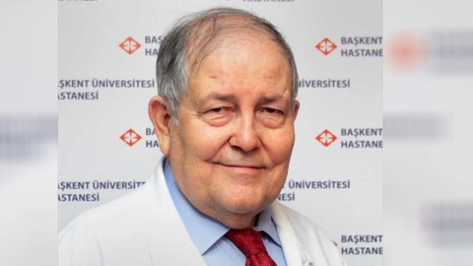
Disclosure
No conflict of interest

Slide 3
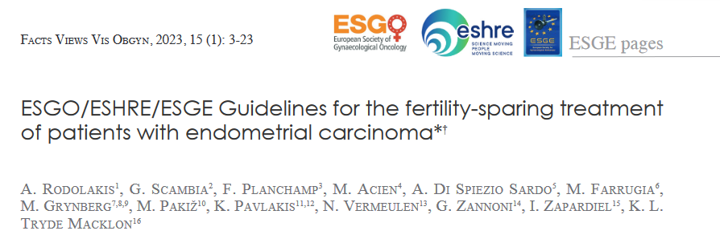
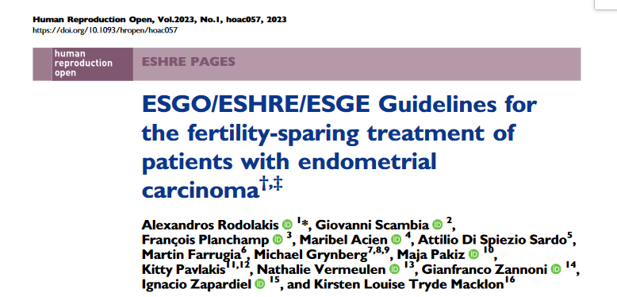
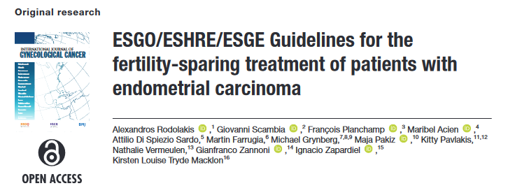
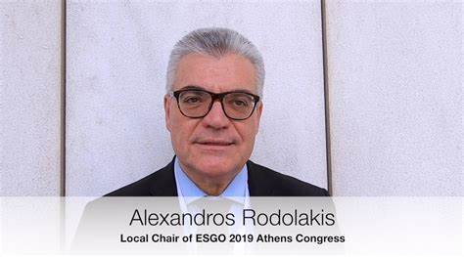
Brief history
More than half a decade…
Strong collaboration between 3 societies
First project (during COVID pandemia) on FSM in EC
Wish to extend to OCs (including BOTs) and CCs including topics about infertility and post FSM management

Slide 4
N Abu-Rustum, M Acien, A Arena,
S Brucker, Y Cheong, P Collinet, F Fanfani,
F Filippi, AG Zahl Eriksson, S Gouy,
P Harter, X Matias-Guiu, G Pados, M Pakiz,
D Querleu, A Rodolakis, C Rousset-Jablonski, A Stepanyan, AC Testa, KL Tryde Macklon, D Tsolakidis, M de Vos

Slide 6
DEVELOPMENT PROCESS
1
STEP 1 - Nomination of multidisciplinary international development group
2
CHAIRS
Philippe Morice (ESGO)
gyn. onc (France)
Michael Grynberg (ESHRE)
reprod. med, onc. Fert (France)
Giovanni Scambia (ESGE)
endosc., gyn. onc (Italy)
EXPERTS
Nadeem Abu-Rustum (ESGO), gyn. onc (United States of America)
Sara Brucker (ESGE), gyn. onc (Germany)
Francesco Fanfani (ESGE), gyn. onc (Italy)
Francesca Filippi (ESHRE), gyn. (Italy)
Alexandros Rodolakis (ESGO), gyn. onc (Greece)
Kirsten Louise Tryde Macklon (ESHRE), onc. fertil. (Denmark)
Maribel Acien (ESHRE), reprod. surg (Spain)
Alessandro Arena (ESHRE), gyn. (Italy)
Pierre Collinet (ESGE), gyn. (France)
Michel De Vos (ESHRE), reprod. med (Belgium)
Ying Cheong (ESHRE), reprod. med (United Kingdom)
Ane Gerda Eriksson (ESGO), gyn. onc (Norway)
Sebastien Gouy (ESHRE), gyn. onc (France)
Philipp Harter (ESGO), gyn. onc (Germany)
Xavier Matias-Guiu (ESGO), pathol. (Spain)
George Pados (ESHRE), obs. & gyn (Greece)
Maja Pakiz (ESGO), gyn. onc (Slovenia)
Denis Querleu (ESGE), gyn. onc (France)
Christine Rousset-Jablonski (ESGO), med. onc, fertil. (France)
Artem Stepanyan (ESGO), gyn. onc (Armenia)
Antonia Carla Testa (ESGE), gyn. onc (Italy)
Dimitri Tsolakidis (ESGE), obs. & gyn (Greece)
3
4
5
METHODOLOGIST
François Planchamp (ESGO)
(France)

Slide 7
Five-step development process
1
Nomination of multidisciplinary international development group
2
Identification of scientific evidence
3
Formulation of guidelines
4
External evaluation of guidelines (international review)
5
Integration of international reviewers’ comments

Slide 8
DEVELOPMENT PROCESS
1
STEP 3 - Formulation of guidelines
2
Available evidence
Consensus
3
Clinical expertise
4
5

Slide 9
DEVELOPMENT PROCESS
1
STEP 4 - External evaluation of guidelines (international review)
Quantitative evaluation (clinical relevance & feasibility in practice)
Qualitative evaluation (comments)
120 clinicians & patients independents from the international development group
40 countries worldwide
2
3
Specialties
Gynecologic oncology | Obstetric & gynecology
Reproductive medicine | Radiation oncology
Oncofertility | Pathology
Medical oncology | Nursing
Embryology | Reproductive genetics
4
5

Slide 10
General recommendations
• The aim of fertility sparing surgery is to enable patients to get natural or assisted pregnancies with their uterus and own or donated oocytes
• Should be performed exclusively by teams with a strong collaboration between gynecologic oncologists and reproductive medicine specialists
• Pathologic expert review is recommended in all patients if the diagnosis and associated treatment could impair fertility

Slide 11
Color codes tables ovarian tumours
Favorable oncologic selection criteria for fertility sparing management as defined in the text (based on the favorable survival and/or recurrence rates observed in cohorts and/or comparative studies (radical versus conservative) of patients treated with such characteristics)
Oncologic selection criteria acceptable in selected cases (insufficient or conflicting data to evaluate accurately the results of the ovarian preservation in this subgroup of patients)

Slide 12
BOTs & LG Epithelial Ovarian Cancers
IA
IB
IC1
IC2
IC3
II-IV
 | BOT
IA
IB
IC1
IC2
IC3
II-IV
LGSC | LGEC
MC_{expansile}

Slide 13
HG Epithelial Ovarian Cancers
IA
IB
IC1
IC2
IC3
II-IV
MC_{infiltrative}
 | CCC
IA
IB
IC1
IC2
IC3
II-IV
HGSC | HGEC

Slide 14
Epithelial Ovarian Cancers & BOTs
 | BOT | LGSC | LGEC | MC_{exp} | CCC | HGSC | HGEC | MC_{inf}
IA
IB
IC1
IC2
IC3
II-IV

Slide 15
General recommendations Surgery
• If bilateral oophorectomy needed, uterine-sparing surgery can be considered assuming normal endometrial and serosal evaluation
Salpingo-oophorectomy vs. cystectomy in selected S(m)BOT cases
Bilateral ovarian cystectomy in serous and sero-mucinous borderline ovarian tumours can be considered
Unilateral salpingo-oophorectomy and cystectomy are both acceptable strategies for unilateral serous and sero-mucinous borderline ovarian tumour
In case of cystectomy, patients should be counseled about the risk of local/ovarian recurrence of up to 30% with no impact on overall survival, but better fertility results.

Slide 16
When to give the “oncological authorization” to the patients/couple?
Patients with epithelial ovarian cancer might be advised to become pregnant 1 year after the completion of treatment with negative follow-up
Regardless of cancer type, patients should be advised that they are not limited to one pregnancy

Slide 17
Infertility management in EOCs I
Ovarian stimulation followed by egg retrieval can be offered to patients with ovarian cancer with favourable prognostic factors considering histological diagnosis, hormone sensitivity, cancer stage, and oncological prognosis
Ovarian stimulation followed by egg retrieval for fertility preservation is not recommended before final histological confirmation of a possibly malignant mass

Slide 18
Infertility management in EOCs II
For primary ovarian neoplasms, it is recommended that ovarian stimulation and oocyte cryopreservation be performed after completing staging surgery and determining the histological diagnosis, hormone sensitivity, cancer stage, and oncological prognosis
The timing of ovarian stimulation and egg retrieval when adjuvant chemotherapy for ovarian cancer is planned depends on multidisciplinary discussion and can be performed ideally before chemotherapy or in rescue at least 6 months after chemotherapy
In cases of low-grade serous or ovarian endometrioid adenocarcinoma, the ovarian stimulation protocol based on co-treatment with aromatase inhibitors should be a first choice

Slide 19
Epithelial Ovarian Cancers & BOTs
 | BOT | LGSC | LGEC | MC_{exp} | CCC | HGSC | HGEC | MC_{inf}
IA
IB
IC1
IC2
IC3
II-IV

Slide 20
FU in EOCs
Follow-up is recommended every 3-4 months for 2 years, every 6 months for another 3-5 years, and then annually for at least 10 years
Follow-up should consist of physical examination and ultrasound examination by an experienced ultrasonographer
Pelvic and abdominal CT or MRI should be performed at 6 months and then annually until the fifth year
Measurement of cancer antigen-125 concentration or other tumour markers according to histotype is only recommended when initially elevated or when presurgical markers are missing
PET-CT is only indicated in cases of suspicion of recurrence.

Slide 21
Need for a completion surgery after childbearing HRT
Routine completion surgery (remaining ovary)
is recommended in patients with family history of and/or genetic high risk epithelial ovarian tumours
could be considered on a case-by-case basis in patients with epithelial ovarian tumours
is not recommended in patients with germ-cell tumours
in all other non-epithelial tumours, offered on a case-by-case basis. In case of granulosa cell tumours, additional hysterectomy has to be considered

Slide 22
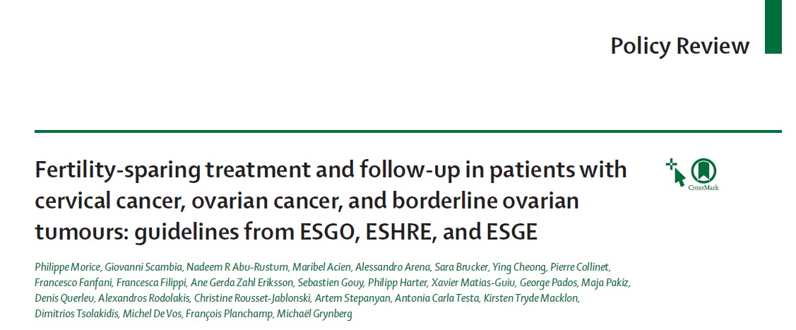

Slide 23
ACKNOWLEDGEMENTS
EXTERNAL REVIEWERS: Adoke Kasimu, pathology (Nigeria); Aliyev Shamistan, gynecologic oncology, oncofertility, obstetrics & gynecology, reproductive medicine (Azerbaijan); Altamirano Roberto, gynecologic oncology (Chile); Aluloski Igor, gynecologic oncology, obstetrics & gynecology (North Macedonia); Amant Frederic, gynecologic oncology (Belgium); Anghel Beatrice, radiation oncology (Romania); Anna Protasova, gynecologic oncology, oncofertility (Russia); Ata Baris, obstetrics & gynecology, reproductive medicine (United Arab Emirates); Atallah David, gynecologic oncology (Lebanon); Ataseven Beyhan, gynecologic oncology (Germany); Badía Agustí Paloma, gynecologic oncology, obstetrics & gynecology (Spain); Bart Joost, pathology (Netherlands); Bats Anne-Sophie, gynecologic oncology (France); Bernardino Margarida, gynecologic oncology (Portugal); Bishtawi Mazen, gynecologic oncology (Qatar); Bizzarri Nicolò, gynecologic oncology (Italy); Bjørge Line, obstetrics & gynecology (Norway); Bozanovic Tatjana, obstetrics & gynecology (Serbia); Bozdag Gurkaan, reproductive medicine (Türkiye); Bucau Margot, pathology (France); Burchardt Ewa, medical oncology, radiation oncology (Poland); Calhaz-Jorge Carlos, reproductive medicine (Portugal); Caretto Marta, gynecologic oncology, oncofertility (Italy); Cazorla Eduardo, gynecologic oncology (Spain); Coonen Edith, reproductive medicine, clinical embryology, reproductive genetics (Netherlands); Cotton Hilde, reproductive medicine, nursing (Norway); Coza Ovidiu Florin, medical oncology, radiation oncology (Romania); D'Amuri Alessandro, pathology (Italy); D'Angelo Arianna, oncofertility, reproductive medicine (United Kingdom); Daniilidis Angelos, obstetrics & gynecology, reproductive medicine (Greece); De Sanctis Vitaliana, radiation oncology (Italy); Diaz-Feijoo Berta, gynecologic oncology (Spain); Ditto Antonino, gynecologic oncology (Italy); Domingo Santiago, gynecologic oncology (Spain); du Bois Andreas, gynecologic oncology (Germany); Elnashar Aboubakr, obstetrics & gynecology, reproductive medicine (Egypt); Eyjólfsdóttir Brynhildur, gynecologic oncology, obstetrics & gynecology (Norway); Falcone Tommaso, oncofertility, reproductive medicine (United States of America); Felix Ana, pathology (Portugal); Ferrero Annamaria, gynecologic oncology, obstetrics & gynecology (Italy); Ghatage Prafull, gynecologic oncology (Canada); Golfier François, obstetrics & gynecology (France); Gorostidi Mikel, gynecologic oncology (Spain); Gregory Deborah, radiation oncology (United Kingdom); Guani Benedetta, gynecologic oncology (Switzerland); Gultekin Murat, gynecologic oncology (Türkiye); Haller Herman, gynecologic oncology (Croatia); Hellman Kristina, gynecologic oncology (Sweden); Henry Laurie, oncofertility, reproductive medicine (Belgium); Hernandez Cortes Gines, gynecologic oncology (Spain); Ignacio Lete, gynecologic oncology (Spain); Iyibozkurt Ahmet Cem, gynecologic oncology (Türkiye); Kalogiannidis Ioannis, gynecologic oncology (Greece); Kesić Vesna, gynecologic oncology (Serbia); Kiran Gurkan, gynecologic oncology (Türkiye); Kjölhede Preben, gynecologic oncology, obstetrics & gynecology (Sweden); Kocian Roman, gynecologic oncology (Czech Republic); Köhler Christhardt, gynecologic oncology (Germany); Koskas Martin, gynecologic oncology, oncofertility (France); Lancellotta Valentina, radiation oncology (Italy); Landoni Fabio, gynecologic oncology (Italy); Laufer Joel, gynecologic oncology (Uruguay); Lok Christianne, gynecologic oncology (Netherlands); Lorusso Domenica, gynecologic oncology (Italy); Lössl Kristina, radiation oncology (Switzerland); Maañón Di Leo José Claudio, gynecologic oncology (Spain); Maggino Tiziano, gynecologic oncology (Italy); Majercakova Katarina, radiation oncology (Spain); Mandic Aljosa, gynecologic oncology (Serbia); Martinelli Fabio, gynecologic oncology (Italy); Mateoiu Claudia, pathology (Sweden); Mathevet Patrice, gynecologic oncology (Switzerland); Matias-Guiu Xavier, pathology (Spain); Mereu Liliana, gynecologic oncology (Italy); Mlynček Miloš, gynecologic oncology (Slovakia); Morales Fernández David Alejandro, gynecologic oncology (Colombia); Murshudova Sabina, gynecologic oncology (Azerbaijan); Myriokefalitaki Eva, gynecologic oncology (United Kingdom); Naik Raj, gynecologic oncology (United Kingdom); Niehoff Peter, radiation oncology (Germany); Niine-Roolaht Eva-Maria, gynecologic oncology, obstetrics & gynecology (Estonia); Nordhoff Verena, embryology (Germany); Nowosielski Krzysztof, gynecologic oncology (Poland); Oberlechner Ernst, gynecologic oncology, obstetrics & gynecology (Germany); O'Donnell Dearbhaile, medical oncology (Ireland); Oliver-Perez Mª Reyes, gynecologic oncology (Spain); Perrone Anna Myriam, gynecologic oncology (Italy); Pessini Suzana, gynecologic oncology (Brazil); Petignat Patrick, gynecologic oncology (Switzerland); Petousis Stamatios, gynecologic oncology (Greece); Ramirez Pedro, gynecologic oncology (United States of America); Reed Nicholas, medical oncology, radiation oncology (United Kingdom); Restraino Stefano, gynecologic oncology (Italy); Rovirosa Angeles, radiation oncology (Spain); Sacristan Andres, gynecologic oncology (Spain); Sanci Muzaffer, gynecologic oncology, obstetrics & gynecology (Türkiye); Santiago Garcia Francisco Javier, gynecologic oncology (Spain); Schettini Sergio, oncofertility, reproductive medicine (Italy); Segev Yakir, gynecologic oncology (Israel); Shah Duru, obstetrics & gynecology, reproductive medicine (India); Simon Philippe, gynecologic oncology (Belgium); Simsek Tayup, gynecologic oncology, obstetrics & gynecology (Türkiye); Sioulas Vasileios, gynecologic oncology (Greece); Sismondi Piero, gynecologic oncology, obstetrics & gynecology (Italy); Stolnicu Simona, pathology (Romania); Strömsholm Eva-Maria, patient (Finland); Tharavichitkul Ekkasit, radiation oncology (Thailand); Toptas Tayfun, gynecologic oncology (Türkiye); Trihia Helen, pathology (Greece); Ulrikh Elena, gynecologic oncology, oncofertility, obstetrics & gynecology (Russia); Valgma Margit, radiation oncology (Estonia); van der Velden Jacobus, gynecologic oncology (Netherlands); Veleva Zdravka, obstetrics & gynecology (Finland); Vereczkey Attila, oncofertility, obstetrics & gynecology, reproductive medicine (Hungary); Vranes Boris, gynecologic oncology, oncofertility, obstetrics & gynecology (Serbia); Vsn Driel Willemien, gynecologic oncology (Netherlands); Wilczynski Jacek, gynecologic oncology, obstetrics & gynecology (Poland); Yıldırım Nuri, gynecologic oncology (Türkiye); Zannoni Gian Franco, pathology (Italy); Zapardiel Ignacio, gynecologic oncology (Spain); Zola Paolo, gynecologic oncology (Italy).

