Slide 1


Oncology Unit, “Aretaieion” University Hospital
Adjuvant and Maintenance Treatment in
Epithelial Ovarian Cancer (Stages III and IV)
Christos Papadimitriou
Professor of Medical Oncology

Slide 2
Maintenance Treatment in the First-Line Setting: Strategies
Antiangiogenesis only
PARP inhibition only
Combining antiangiogenesis and PARPi

Slide 3
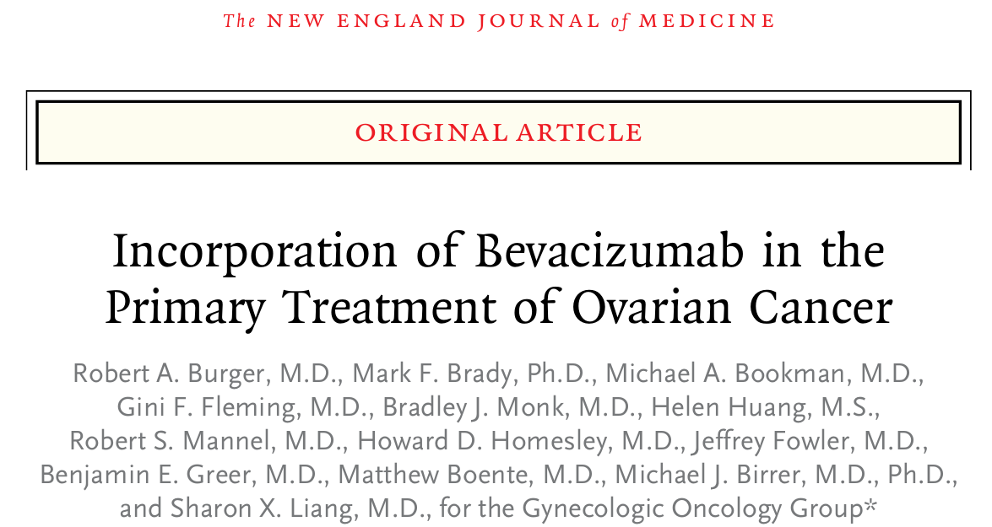
GOG 218

Slide 4
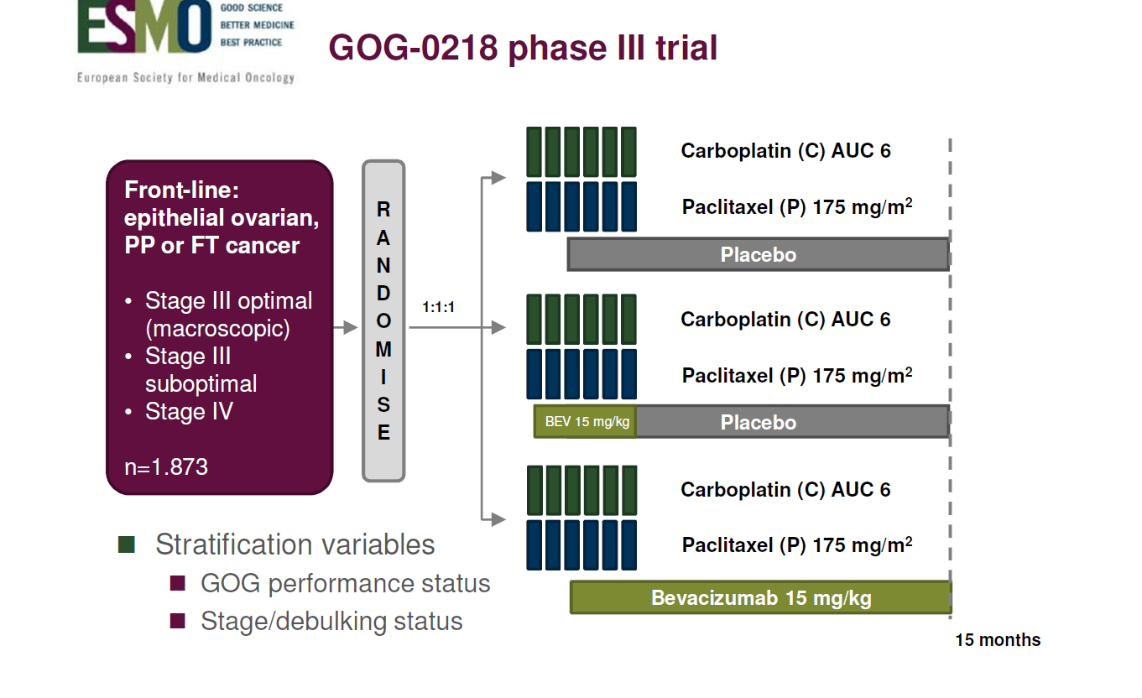

Slide 5
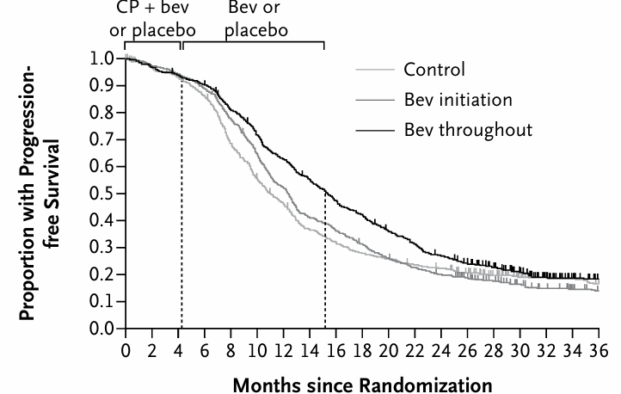
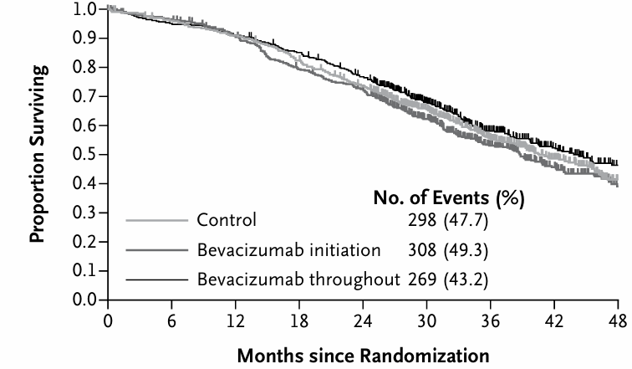
GOG-218: PFS and OS

Slide 7
Outcome (months) | Control | BEV-initiation | BEV-throughout
Median OS, stage III | 44.3 | 42.9 | 44.2 HR of death 0.96 (p=0.53)
Median OS, stage IV | 32.6 | 34.5 | 42.8 HR of death 0.75 (p<0.05)

Slide 8
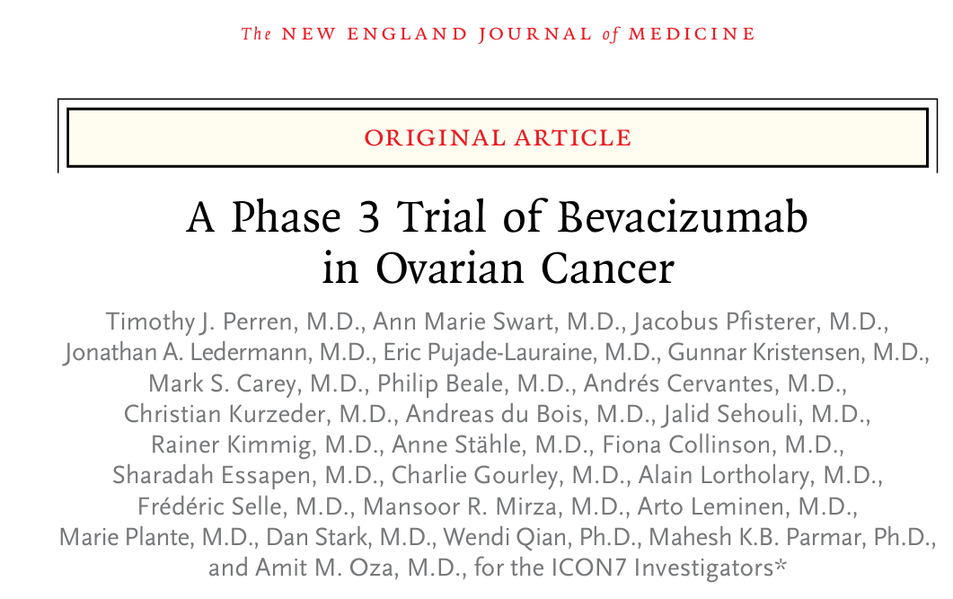
ICON7

Slide 9
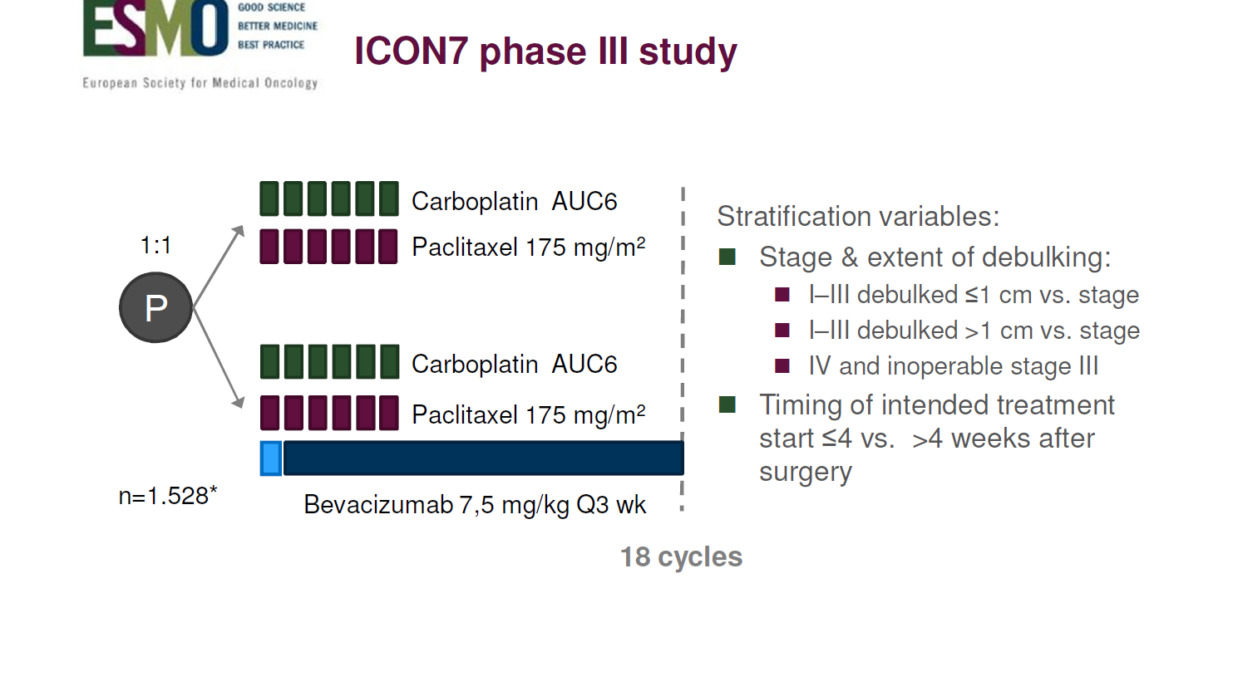

Slide 10
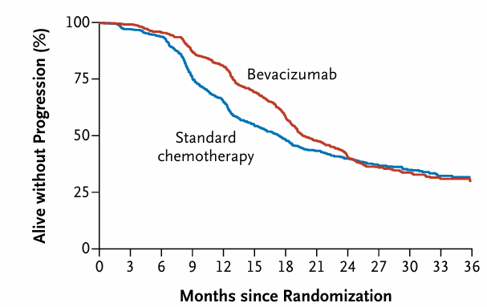
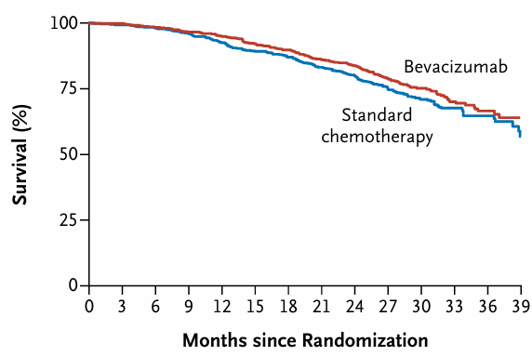
ICON7: PFS and OS in the Overall Population

Slide 11
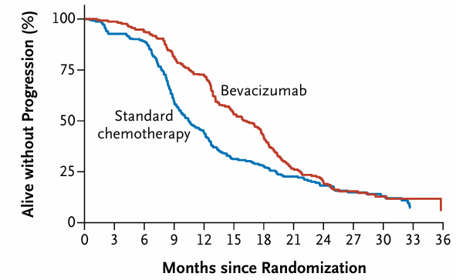
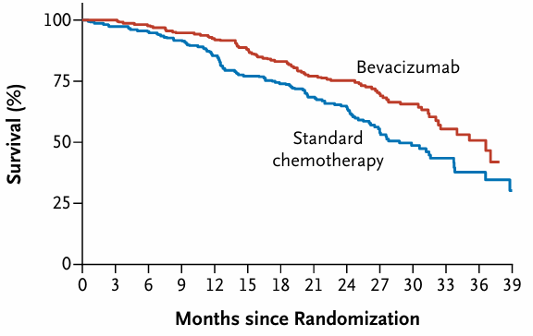
ICON7: PFS and OS in High Risk Patients
Inoperable, Stage III with Residuum >1 cm, Stage IV

Slide 12
Adding BEV to front-line chemotherapy improves PFS irrespective of stage/residual disease.
In high risk patients (stage III with >1 cm residuum, stage IV or inoperable disease), this is translated into an OS benefit.

Slide 13
Maintenance Treatment in the First-Line Setting: Strategies
Antiangiogenesis only
PARP inhibition only
Combining antiangiogenesis and PARPi

Slide 14
Phase III Studies that Investigated PARPis in 1st Line
Trial | Type of Trial | Population | Experimental Arm Treatment | Endpoints
SOLO1 | Phase III, randomized, double blind | Newly diagnosed, stage III–IV, BRCAmut, CR/PR after platinum-based chemotherapy, regardless of clinical risk | Olaparib 300 mg bid for up to 2 years or until PD | Primary: PFS Secondary: PFS2, OS, TFST, QoL
PRIMA | Phase III, randomized, double blind | Newly diagnosed, stage III–IV, CR/PR after platinum-based chemotherapy, regardless of biomarker status, higher clinical risk | Niraparib 300 mg (FSD), or 200 or 300 mg (ISD) for 36 months or until PD | Primary: PFS Secondary: OS, TFST, PFS2, QoL
VELIA | Phase III, randomized, placebo-controlled | Newly diagnosed, stage III-IV who completed chemotherapy without disease progression | Veliparib 150 mg bid during chemotherapy then 300 mg bid followed by 400 mg bid | Primary: PFS Secondary: OS, TFST, PFS2, QoL
ATHENA-MONO | Phase III, randomized, double blind | Newly diagnosed, stage III–IV, CR/PR after platinum-based chemotherapy, regardless of biomarker status and clinical risk | Rucaparib tablets 600 mg bid for up to 2 years or until PD | Primary: PFS Secondary: OS, ORR, DOR, FACT
PRIME | Phase III, randomized, double blind | Chinese patients, newly diagnosed, stage III–IV, CR/PR after platinum-based chemotherapy, regardless of biomarker status and clinical risk | Niraparib 200 or 300 mg ISD until PD or unacceptable toxicity | Primary: PFS Secondary: OS

Slide 15
SOLO1 Trial

Slide 16
SOLO1 (NCT01844986) Phase III Study
Maintenance with Olaparib after 1st Line Chemotherapy
in BRCAmut OC
RANDOMI
ZAT
I
ON
Placebo
391 women with BRCAmut, stage III-IV ovarian, fallopian tube, or primary peritoneal HGSC or endometrioid ovarian cancer having recently completed platinum-based 1st line chemotherapy with response or NED
2:1 Proportion
Olaparib 300 mg twice daily (up to 2 years)
Within 8 weeks after completion of chemotherapy

Slide 17
SOLO1
Key Publications
Moore K, et al. Maintenance Olaparib in Patients with Newly Diagnosed Advanced Ovarian Cancer. N Engl J Med. 2018 Dec 27;379(26):2495-2505.
Banerjee S, et al. Maintenance olaparib for patients with newly diagnosed advanced ovarian cancer and a BRCA mutation (SOLO1/GOG 3004): 5-year follow-up of a randomised, double-blind, placebo-controlled, phase 3 trial. Lancet Oncol. 2021 Dec;22(12):1721-1731.
DiSilvestro P, et al. Overall Survival With Maintenance Olaparib at a 7-Year Follow-Up in Patients With Newly Diagnosed Advanced Ovarian Cancer and a BRCA Mutation: The SOLO1/GOG 3004 Trial. J Clin Oncol. 2022;41(3):609-617.

Slide 18
SOLO1 Trial: Final PFS and OS Results
J Clin Oncol. 2022;41(3):609-617
Outcome (Survival) | Median, months
 | Olaparib (N=260) | Placebo (N=131) | Between-group difference | HR (95% CI) P value
PFS | 56.0 | 13.8 | 42.2 | 0.30 (0.23-0.41) P<0.0001
OS | NR | 75.2 | NC | 0.55 (0.40-0.41) P=0.0004
Time to 1st subsequent therapy (TFST) | 64.0 | 15.1 | 48.9 | 0.37 (0.28-0.48) P<0.0001
Time to 2nd subsequent therapy (TSST) | 93.2 | 40.7 | 52.5 | 0.50 (0.37-0.67) P=0.0002

Slide 19
PRIMA Trial

Slide 20
PRIMA/ENGOT-OV26/GOG-3012 Phase III Study
Maintenance with Niraparib after 1st Line Chemotherapy in both HRD and HRP Patients
RANDOMI
ZAT
I
ON
Placebo
733 women with stage III-IV, EO, fallopian tube, or primary peritoneal cancer having recently completed platinum-based 1st line chemotherapy with response or NED
2:1 Proportion
Niraparib 300 mg or 200 mg
(if BW <77 kg, PLT <150,000/μL) once daily
(up to 3 years)

Slide 21
PRIMA
Key Publications
González-Martín A, et al. Niraparib in Patients with Newly Diagnosed Advanced Ovarian Cancer. N Engl J Med. 2019 Dec 19;381(25):2391-2402.
O’Cearbhaill RE, er al. Efficacy of niraparib by time of surgery and postoperative residual disease status: A post hoc analysis of patients in the PRIMA/ENGOT-OV26/GOG-3012 study. Gynecol Oncol. 2022 Jul;166(1):36-43.
González-Martín A, et al. Progression-free survival and safety at 3.5years of follow-up: results from the randomised phase 3 PRIMA/ENGOT-OV26/GOG-3012 trial of niraparib maintenance treatment in patients with newly diagnosed ovarian cancer. Eur J Cancer. 2023 May 3:S0959-8049(23)00225-3.
Monk BJ, et al. Niraparib first-line maintenance therapy in patients with newly diagnosed advanced ovarian cancer: final overall survival results from the PRIMA/ENGOT-OV26/GOG-3012 trial. Ann Oncol. 2024 Nov;35(11):981-992.

Slide 22
PRIMA Trial: Final PFS Results
Eur J Cancer. 2023 May 3:S0959-8049(23)00225-3
Outcome (Survival) | Median, months
 | Niraparib (N=487) | Placebo (N=246) | Between-group difference | HR (95% CI) P value
PFS, overall population | 13.8 | 8.2 | 5.6 | 0.66 (0.56-0.79) P<0.001
PFS, BRCAmut patients | 31.5 | 11.5 | 20.0 | 0.45 (0.32-0.64)
PFS, HRD patients | 24.5 | 11.2 | 13.3 | 0.52 (0.40-0.68) P<0.001
PFS, HRD/BRCAwt patients | 19.4 | 10.4 | 9.0 | 0.66 (0.44-1.00)
PFS, HRP patients | 8.4 | 5.4 | 3.0 | 0.65 (0.49-0.87)

Slide 23
PRIMA Trial: Final OS Results
Ann Oncol. 2024 Nov;35(11):981-992
Outcome (Survival) | Median, months
 | Niraparib (N=487) | Placebo (N=246) | Between-group difference | HR (95% CI) P value
OS, overall population | 46.6 | 48.8 | -2.2 | 1.01 (0.56-0.79) P=0.8834
OS, HRD patients | 71.9 | 69.8 | 2.1 | 0.95 (0.70-1.29)
OS, HRP patients | 36.6 | 32.2 | 4.4 | 0.93 (0.89-1.26)

Slide 24
No difference in OS was observed between treatment arms in the overall population or by HRD/BRCA status.
A higher rate of subsequent PARPi therapy was observed in patients who received placebo: 38% and 48% in the overall and HRD populations, respectively.
Subsequent PARPi therapy was received by 12% and 16% of niraparib patients in the overall and HRD populations.

Slide 25
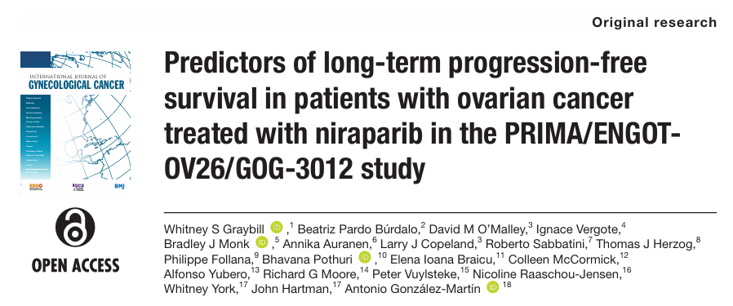

Slide 26
PRIMA Trial: Predictors of long-term PFS
BRCA1/2mut tumors
HRD/BRCA1/2wt tumors
FIGO stage III disease (versus IV)
0-1 non target lesions (versus ≥2)

Slide 27
Maintenance Treatment in the First-Line Setting: Strategies
Antiangiogenesis only
PARP inhibition only
Combining antiangiogenesis and PARPi

Slide 28
Trial | Type of Trial | Population | Experimental Arm Treatment | Endpoints
PAOLA-1 | Phase III, randomized, double blind | Newly diagnosed, stage III–IV, NED/CR/PR after platinum-based chemotherapy regardless of biomarker status or clinical risk | Olaparib 300 mg bid for up to 2 years plus Bevacizumab 15 mg/kg for up to 15 months | Primary: PFS Secondary: PFS2, OS, TFST, QoL
OVARIO | Phase II, single-arm, open-label, multicenter | Newly diagnosed, stage III–IV, NED/CR/PR after platinum-based chemotherapy, irrespective of biomarker status | Niraparib 200 or 300 mg (ISD) for up to 36 months plus Bevacizumab 15 mg/kg for up to 15 months | Primary: PFS Secondary: OS, TFST, TSST

Slide 29
PAOLA-1 Trial

Slide 30
PAOLA-1/ENGOT-ov25 Phase III Study
Maintenance after 1st Line Chemotherapy
in both HRD and HRP Patients
RANDOMI
ZAT
I
ON
Bevacizumab 15 mg/kg
q 3 weeks
(for up to 15 months)
+
Placebo
806 women with stage III-IV ovarian, fallopian tube, or primary peritoneal cancer having recently completed platinum-based 1st line chemotherapy with response or NED
2:1 Proportion
Bevacizumab 15 mg/kg
q 3 weeks
(for up to 15 months)
+
Olaparib 300 mg twice daily
(for up to 24 months)

Slide 31
PAOLA-1 Trial
Key Publications
Ray-Coquard I, et al. Olaparib plus Bevacizumab as First-Line Maintenance in Ovarian Cancer. N Engl J Med. 2019 Dec 19;381(25):2416-2428. doi: 10.1056/NEJMoa1911361
González-Martín A, et al. Maintenance olaparib plus bevacizumab in patients with newly diagnosed advanced high-grade ovarian cancer: Main analysis of second progression-free survival in the phase III PAOLA-1/ENGOT-ov25 trial. Eur J Cancer. 2022 Oct;174:221-231.
Ray-Coquard I, et al. Olaparib plus bevacizumab first-line maintenance in ovarian cancer: final overall survival results from the PAOLA-1/ENGOT-ov25 trial. Ann Oncol. 2023 May 19:S0923-7534(23)00686-5.

Slide 32
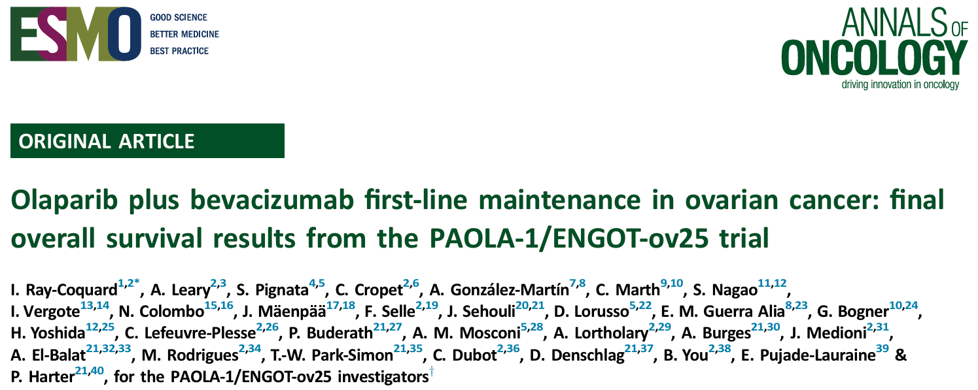
Annals of Oncology 2023, Volume 34, Issue 8, 681 - 692

Slide 33
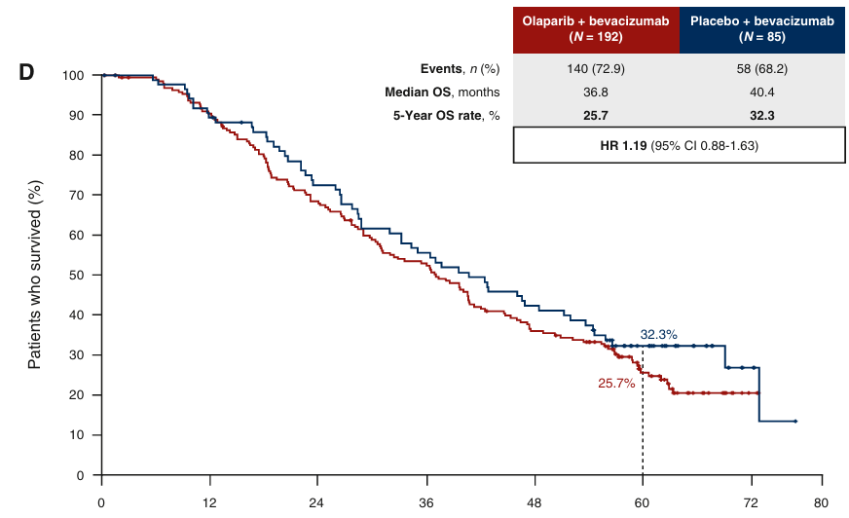
PAOLA-1 Trial: Final OS Results in the HRP Population
Ann Oncol. 2023 May 19:S0923-7534(23)00686-5

Slide 34
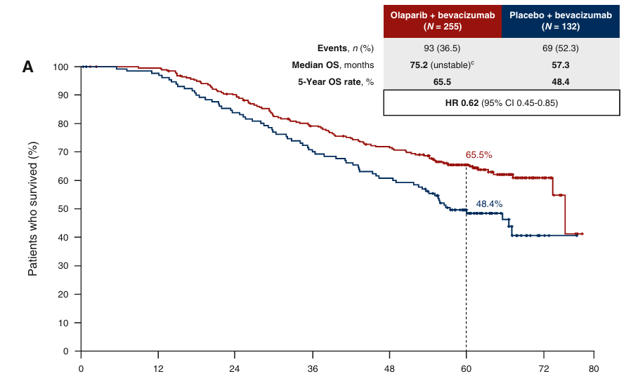
PAOLA-1 Trial: Final OS Results in the HRD Population
Ann Oncol. 2023 May 19:S0923-7534(23)00686-5

Slide 35
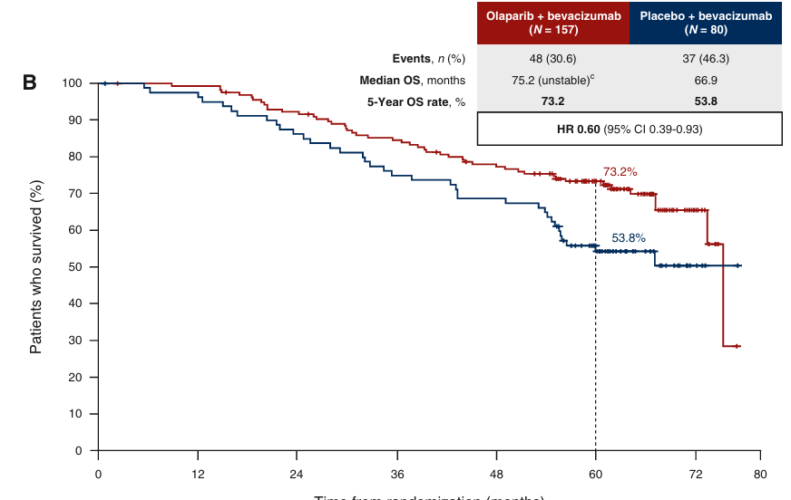
PAOLA-1 Trial: Final OS Results in the BRCAmut Population
Ann Oncol. 2023 May 19:S0923-7534(23)00686-5

Slide 36
PAOLA-1 Trial: Final PFS and OS Results
Ann Oncol. 2023 May 19:S0923-7534(23)00686-5
Outcome (Survival) | Median, months
 | Olaparib plus Bevacizumab (N=537) | Placebo plus Bevacizumab (N=269) | Between-group difference | HR (95% CI) P value
PFS, ITT population | 22.9 | 16.6 | 6.3 | 0.63 (0.53-0.74) P<0.001
OS, ITT population | 56.5 | 51.6 | 4.9 | 0.92 (0.76-1.12)
PFS, HRD patients | 46.8 | 17.6 | 29.2 | 0.41 (0.32-0.54) P<0.001
OS, BRCAmut patients | 75.2 | 66.9 | 8.3 | 0.60 (0.39-0.93) P<0.001
ΟS, HR proficient patients | 36.8 | 40.4 | -3.6 | 1.19 (0.88-1.63)

Slide 37
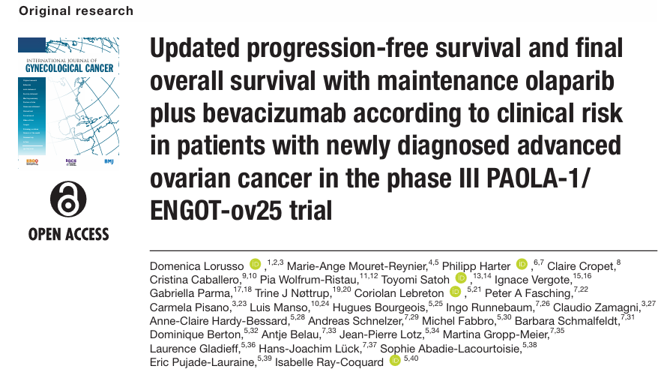
PAOLA-1: PFS and OS according to Clinical Risk

Slide 38
PAOLA-1 Trial: High Risk Category
Int J Gynecol Cancer. 2024;34:550-558
Stage III disease with residual tumor after initial debulking surgery
Patients who had received NACT
Stage IV disease

Slide 39
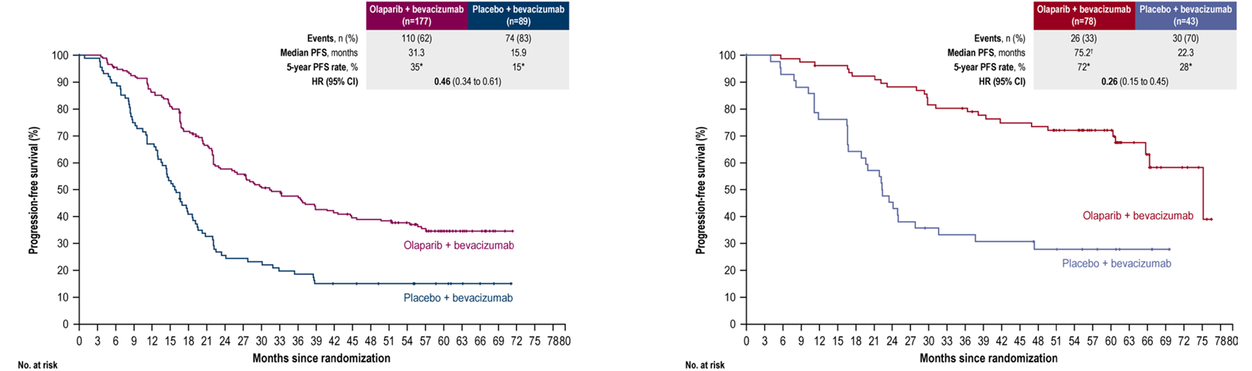
PAOLA-1: PFS in Patients with HRD-Positive Tumors
Int J Gynecol Cancer. 2024;34:550-558
Higher-risk patients
Lower-risk patientss

Slide 40
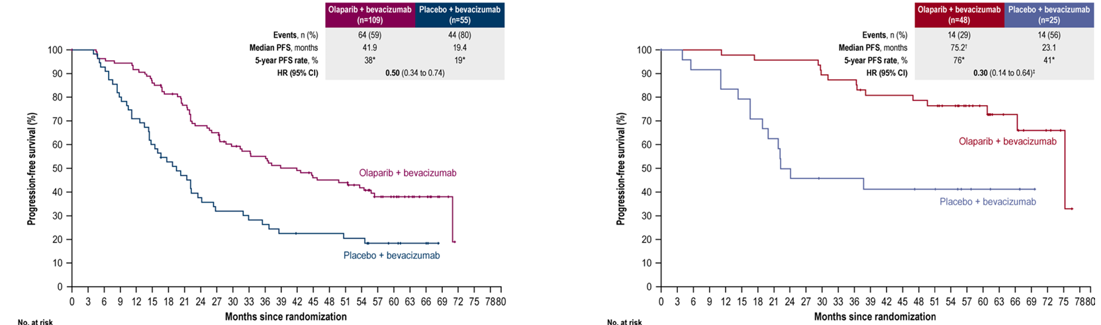
PAOLA-1: PFS in Patients with BRCA-mut Tumors
Int J Gynecol Cancer. 2024;34:550-558
Higher-risk patients
Lower-risk patients

Slide 41
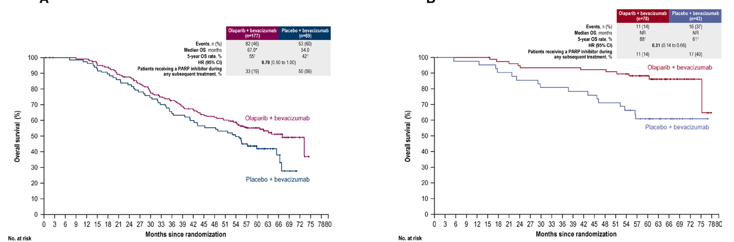
PAOLA-1: OS in Patients with HRD-Positive Tumors
Int J Gynecol Cancer. 2024;34:550-558
Higher-risk patients
Lower-risk patients

Slide 42
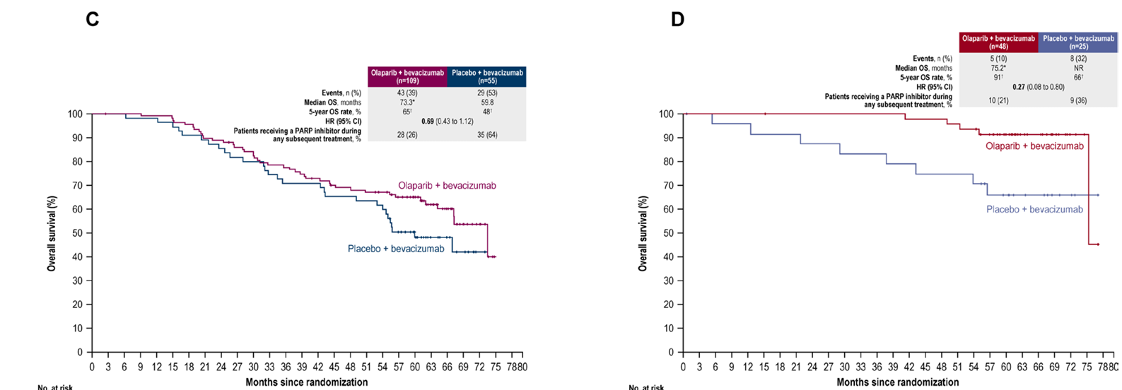
PAOLA-1: OS in Patients with BRCA-mut Tumors
Int J Gynecol Cancer. 2024;34:550-558
Higher-risk patients
Lower- risk patients

Slide 43
The Emerging Role of Immunotherapy in Ovarian Cancer

Slide 44
  Ovarian cancer is an immunogenic malignancy, although the trials of immune-checkpoint inhibitors (ICIs) performed so far have had modest response rates

Slide 45
Strategies to Enhance the Efficacy of Immunotherapy in Ovarian Cancer

Slide 46
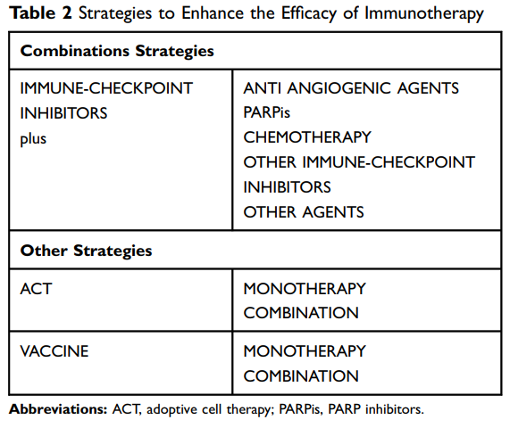

Slide 47
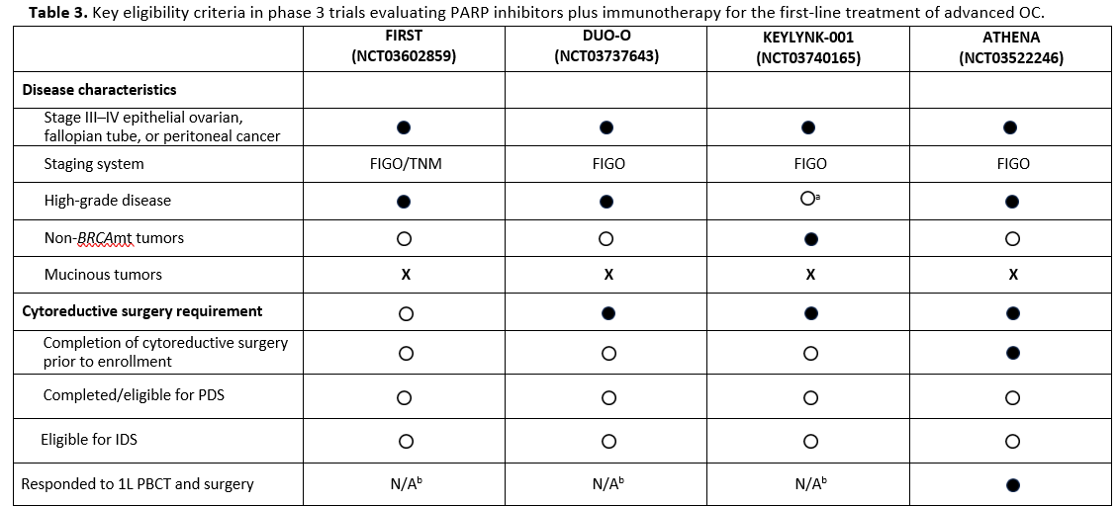
Selected Phase III Studies Evaluating PARPis plus Immunotherapy in the First Line Setting

Slide 48
ENGOT-OV44/FIRST study
Arm 1 discontinued after Amendment 4 following publication of SOLO1 results
± Bevacizumab
1228 patients with newly diagnosed FIGO stage III (with residual disease, CC0 high risk, or planned neoadjuvant therapy) or stage IV, non-mucinous epithelial OC
Dostarlimab Placebo
BRCAwt
Chemotherapy
X 6 cycles
Niraparib
RANDOMI
ZAT
I
ON
± Bevacizumab
Dostarlimab Placebo
Chemotherapy
X 6 cycles
Niraparib
gBRCAmut
2:1
± Bevacizumab
Dostarlimab
Chemotherapy
X 6 cycles
Niraparib

Slide 49
DUO-O Study Design (Non-BRCAmut Patients)
RANDOMI
ZAT
I
ON
Bevacizumab 15 mg/kg
15 months
Durvalumab Placebo
24 months
Patients with newly diagnosed Stage III-IV high grade epithelial ovarian cancer including high grade serious, high grade endometriod, clear cell ovarian cancer or carcinosarcoma, primary peritoneal cancer and/or fallopian-tube cancer
Chemotherapy
X 6 cycles
Olaparib Placebo
24 months
1:1:1
Bevacizumab 15 mg/kg
15 months
Durvalumab
24 months
Chemotherapy
X 6 cycles
Olaparib Placebo
24 months
Bevacizumab 15 mg/kg
15 months
Durvalumab
24 months
Chemotherapy
X 6 cycles
Olaparib 300 mg BID
24 months

Slide 50
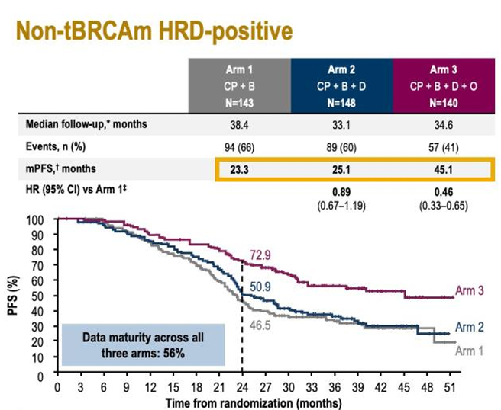
J Clin Oncol 41, no. 17_suppl (June 10, 2023)

Slide 51
ENGOT-OV43/KEYLYNK-001 (Non-BRCAmut Patients)
RANDOMI
ZAT
I
ON
Bevacizumab at investigator’s discretion
Pembrolizumab Placebo
for 35 infusions
1:1:1
Chemotherapy
X 5 cycles
Olaparib Placebo
for 24 months
Patients with stage III or IV non-BRCAmut EOC, primary peritoneal cancer, or fallopian tube cancer
Bevacizumab at investigator’s discretion
One lead-in chemotherapy cycle
Pembrolizumab
for 35 infusions
Chemotherapy
X 5 cycles
Olaparib Placebo
for 24 months
Bevacizumab at investigator’s discretion
Pembrolizumab
for 35 infusions
Chemotherapy
X 5 cycles
Olaparib 300 mg BID
for 24 months

Slide 52
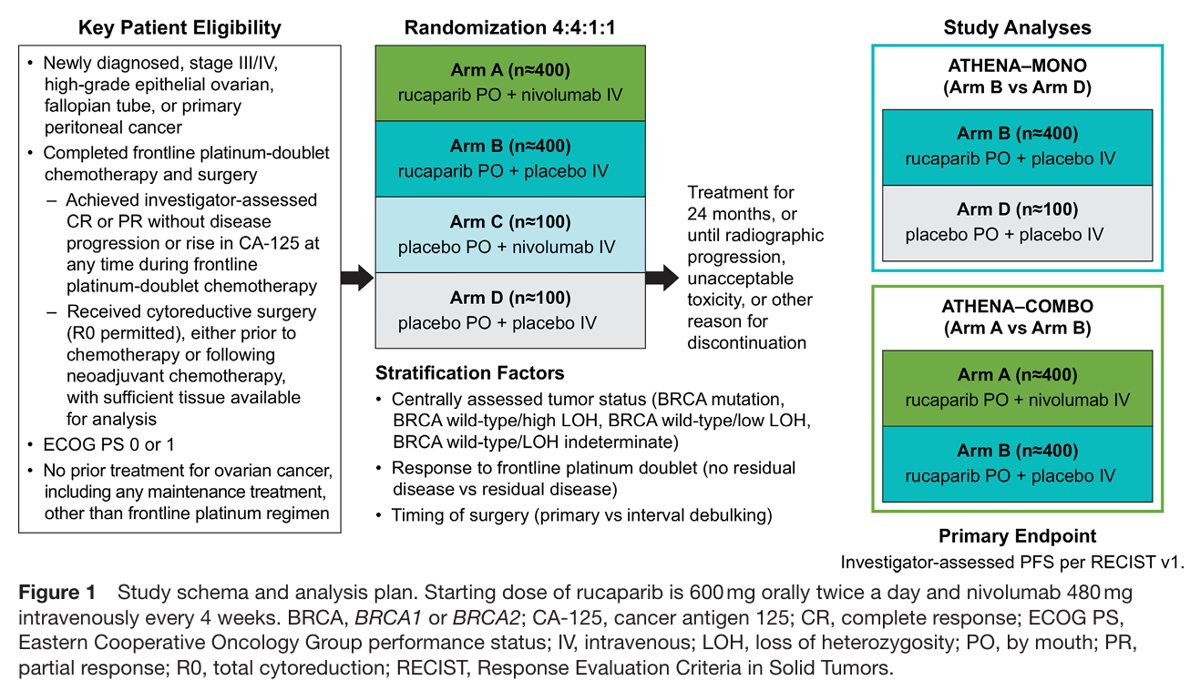

Slide 53
Building a Therapeutic Algorithm for 1st Line Maintenance in Advanced Ovarian Cancer

Slide 54
Survival Outcomes (months) | GOG 218 | ICON7 | SOLO1 | PRIMA | PAOLA-1
PFS Overall Population Placebo | 11.2 BEV concurrent | 17.3 (10.5) |  | 8.2 | 16.6
PFS Overall Population Experimental | 14.1 BEV concurrent + maintenance | 19.0 (15.9) |  | 13.8 | 22.9
OS Overall Population Placebo | 42.9 (34.5) BEV concurrent | 48.4 (34.5) |  | 48.8 | 51.6
OS Overall Population Experimental | 44.2 (42.8) BEV concurrent + maintenance | 49.7 (39.3) |  | 46.6 | 56.5
PFS HRD Placebo |  |  |  | 11.2 | 17.6
PFS HRD Experimental |  |  |  | 24.5 | 46.8
OS HRD Placebo |  |  |  | 69.8 | 57.3
OS HRD Experimental |  |  |  | 71.9 | 75.2
PFS BRCA1/2 mutated Placebo |  |  | 13.8 | 11.5 | 21.7
PFS BRCA1/2 mutated Experimental |  |  | 56.0 | 31.5 | 60.7
OS BRCA1/2 mutated Placebo |  |  | 75.2 |  | 66.9
OS BRCA1/2 mutated Experimental |  |  | Not Reached |  | 75.2
PFS HRP Placebo |  |  |  | 5.4 | 16.2
PFS HRP Experimental |  |  |  | 8.4 | 16.6
OS HRP Placebo |  |  |  | 32.2 | 40.4
OS HRP Experimental |  |  |  | 36.8 | 36.8

Slide 55
Newly diagnosed advanced ovarian carcinoma
HRD Germline/Somatic BRCA1/2 testing
Clinical trial
Neoadjuvant chemotherapy ± BEV
Primary cytoreductive surgery
Interval debulking surgery
ADJUVANT PLATINUM- AND TAXANE-BASED CHEMOTHERAPY ± BEV
Stage III with >1cm residuum, stage IV or inoperable disease
MAINTENANCE TREATMENT
NIRAPARIB (PRIMA) BEVACIZUMAB
(GOG 218, ICON7)
HRP
Lower risk disease
HRP
BRCA1/2mut
HRD/BRCA1/2wt
BRCA1/2mut
HRD/BRCA1/2wt
BEVACIZUMAB (GOG 218, ICON7)
NIRAPARIB (PRIMA)
OLAPARIB + BEVACIZUMAB
(PAOLA-1)
OLAPARIB (SOLO-1)
NIRAPARIB (PRIMA)
OLAPARIB + BEVACIZUMAB
(PAOLA-1)
NIRAPARIB (PRIMA)
OLAPARIB (SOLO-1)
OLAPARIB + BEVACIZUMAB
(PAOLA-1)
NIRAPARIB (PRIMA)
OLAPARIB + BEVACIZUMAB
(PAOLA-1)
NIRAPARIB (PRIMA)

Slide 56
Newly diagnosed and relapsed epithelial ovarian cancer: ESMO Clinical Practice Guideline for diagnosis, treatment and follow-up
Ann Oncol. 2023;34(10):833-848

Slide 57
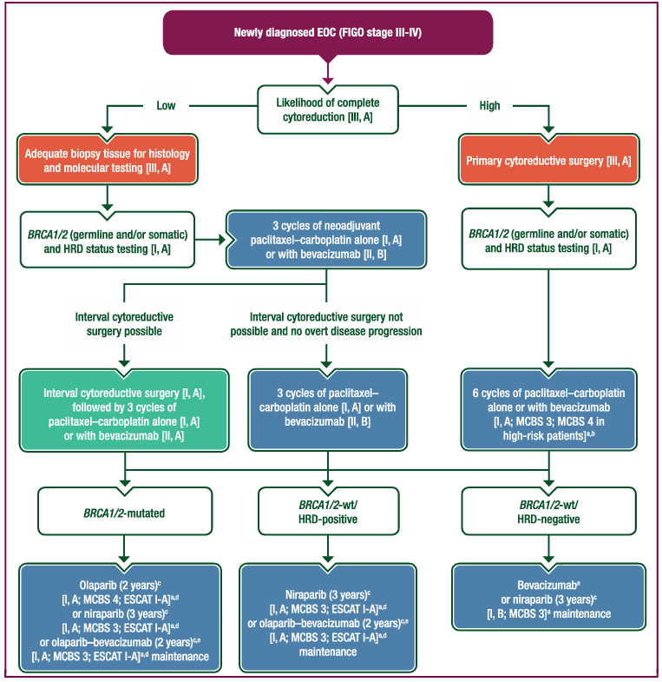

Slide 58



