Slide 1
Cervical cancer: adjuvant treatment for surgically treated patients
Stamatios Petousis, ΜD, MSc, PhD
Assistant Professor of Obstetrics and Gynaecology
Gynaecologic Oncologist (ESGO Diploma)
2nd Department of Obstetrics and Gynaecology
Medical School, A.U.Th.

Slide 2
Declare no conflict of interest

Slide 3
BASIC PRINCIPLES OF TREATMENT

Slide 4
Basic prognostic factors
FIGO staging
Depth of stromal invasion
Margin status
LVSI
Nodal/distant metastases

Slide 5
Surgical management of
IA disease

Slide 6
Surgical management of
IA disease
Conization and simple hysterectomy definitive treatment
No need for adjuvant treatment for IA1, IA2 (* adequate LN staging)

Slide 7
Surgical management of
Ib1, Ib2 and IIa1 tumors

Slide 8
INDICATIONS FOR ADJUVANT TREATMENT

Slide 9
Adjuvant treatment for IB1, IB2, IIA1
Basic pylon of therapeutic treatment should be monotherapy
“either we operate or we chemoradiate”

Slide 10
When should we give adjuvant treatment for IB1, IB2, IIA1 ?
Adjuvant radiotherapy possibly in combination of risk factors
Chemoradiation for nodal involvement, parametria involvement and positive margins

Slide 11
When should we give adjuvant treatment for IB1, IB2, IIA1 ?

Slide 12
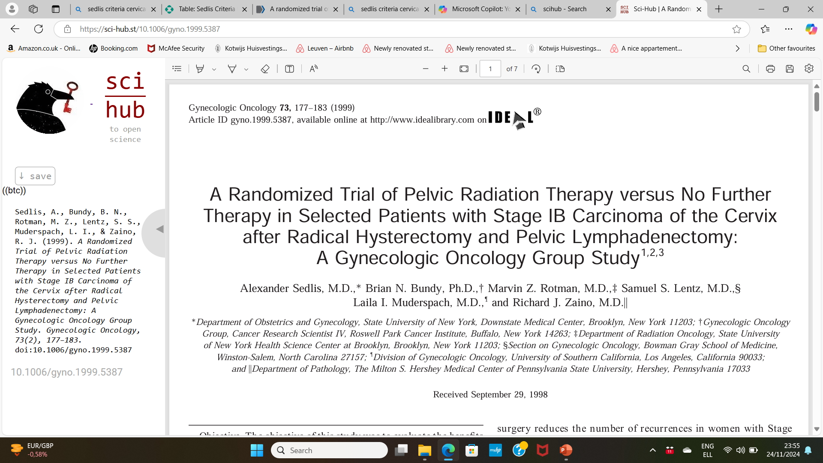
When adjuvant radiotherapy? Sedlis criteria

Slide 13
When adjuvant radiotherapy? Sedlis criteria

Slide 14
Is adjuvant treatment beneficial for surgically treated patients?
Low risk: similar OS, worse PFS
No
Intermediate risk: similar OS, better PFS
Yes

Slide 15
Is addition of chemotherapy to radiotherapy beneficial?
Beneficial in high-risk patients
Not beneficial in intermediate-risk

Slide 16
Can we omit adjuvant therapy in intermediate risk patients?
… potentially in some cases but we still need evidence…

Slide 17
Can we omit adjuvant therapy in
high risk patients?
10.3% false
frozen section
NO
Adjuvant treatment improved survival outcomes but also increased complications

Slide 18
Why should we avoid combination of therapies ?
6% grade 3–4 adverse events vs. 2.1% in the no further therapy group
Sedlis et al 1999
Similar results reported from Peters et al 2000 and Kim et al 2020
J Gynecol Oncol. 2020 May;31(3):e35
J Clin Oncol 2000. 18:1606-1313
However, other yet retrospective studies report similar rates (e.g.
Sandadi et al 2013, 5% vs. 4%, respectively; p = 0.999)
Int J Gynecol Cancer. 2013; 23(3): 553–558

Slide 19
How many IB2 patients receive adjuvant treatment?
51% of patients received adjuvant treatment

Slide 20
STRATEGY TO ACHIEVE MONOTHERAPY

Slide 21
How may we achieve monotherapy?
FIGO staging
Clinical examination, preoperative work-up
LVSI
conization
Depth of invasion
conization
Nodal status
SLN, pelvic lymphadenectomy
Tumor size
MRI
Preoperative MRI, conization and staging lymphadenectomy may only give the overall spectrum of parameters BEFORE OPERATING to achieve monotherapy

Slide 22
How may we achieve monotherapy?
CC case
Tumour size (MRI)
> 4 cm
≤ 4 cm
Conization & staging lymphadenectomy
Positive nodes
Negative nodes
Low-risk Sedlis
Sedlis factors
Definitive CR
Surgery

Slide 23
How may we achieve monotherapy?
LACC case
Tumour size (MRI)
> 4 cm
≤ 4 cm
Conization & staging lymphadenectomy
Positive nodes
Negative nodes
Low-risk Sedlis
Sedlis factors
Definitive CR
Surgery
2nd Dpt A.U.Th
64 CC patients, 2021-2024
3/64 combined treatment (4.7%)

Slide 24
SPECIAL ISSUES

Slide 25
Is there need for adjuvant chemotherapy apart from chemoradiation?
Not clearly significant benefit from adjuvant chemotherapy

Slide 26
Is there a role for only chemotherapy instead of chemoradiation?
Non-inferior survival outcomes

Slide 27
Case presentation

Slide 28
…case presentation…
46-year-old patient, Pap smear test HSIL
Biopsy diagnosis: adenocarcinoma, MRI tumour size: 3.2 cm, negative nodes, clinically negative parametria
Conization: LVSI (+), perineural invasion, squamous histology, depth of stromal invasion 10 mm with minimum stroma left intact
What should be the next step?

Slide 29
…take home messages…
Need to achieve monotherapy in CC treatment
No need for adjuvant treatment in IA1, IA2 cases
No need for adjuvant treatment in low-risk IB1, IB2, IIA1 cases
Need for adjuvant radiation in intermediate-risk IB1, IB2, IIA1 cases, observation might be alternative option
Need for chemoradiation in high-risk cases
MRI, conization and possibly surgical staging as the first step to achieve monotherapy
PRINCIPAL ROLE OF MTB and SPECIALIZED CENTERS

Slide 30
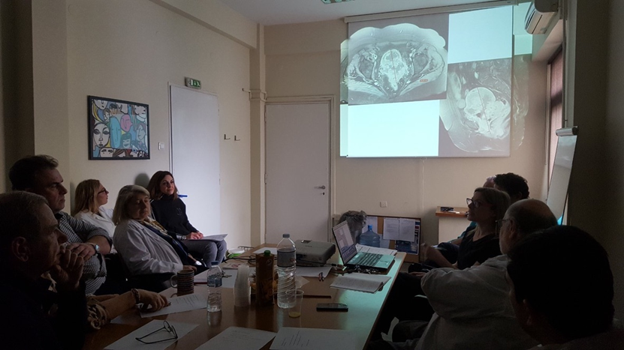
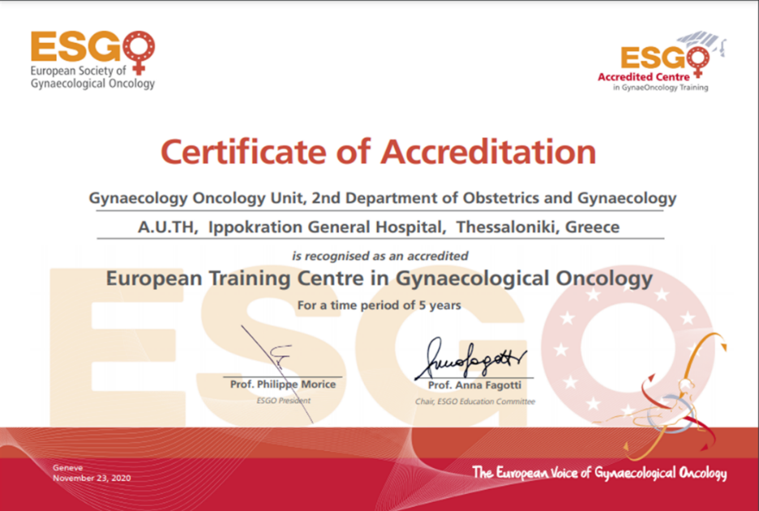
Thank you!

