Slide 1
HIPEC in the frontline management of EOC
Cagatay Taskiran, M.D., Professor
Chair, Koc University School of Medicine,
Department of Gynecologic Oncology
Video Demonstration of Different Vascular Challenges & Laparotomy
Notes:
Chairmen , dear colleagues, first of all I would like to

Slide 2
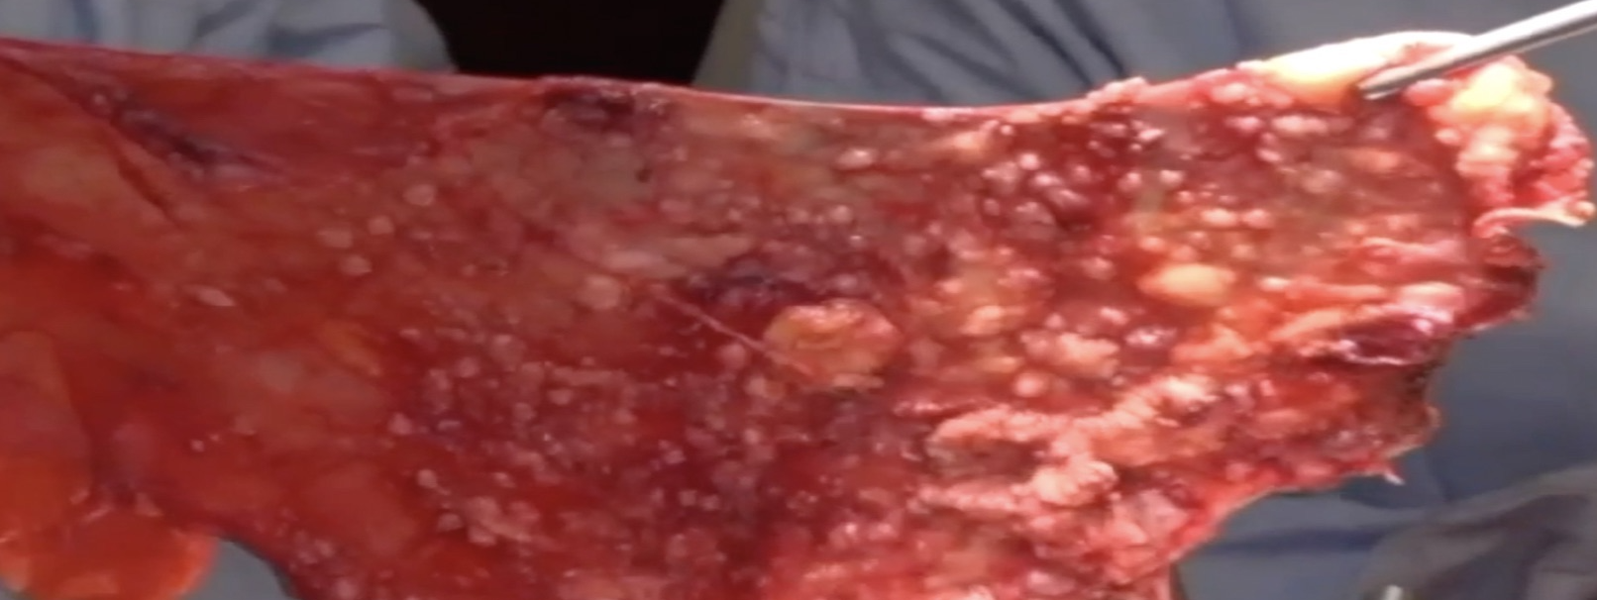
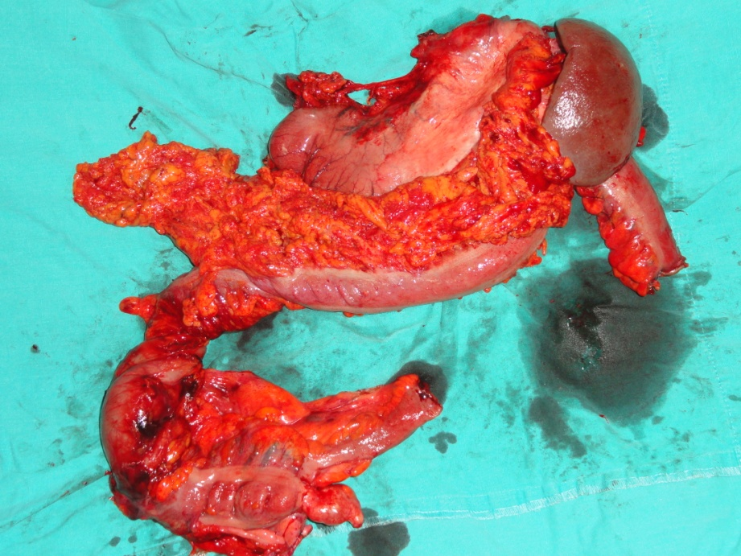
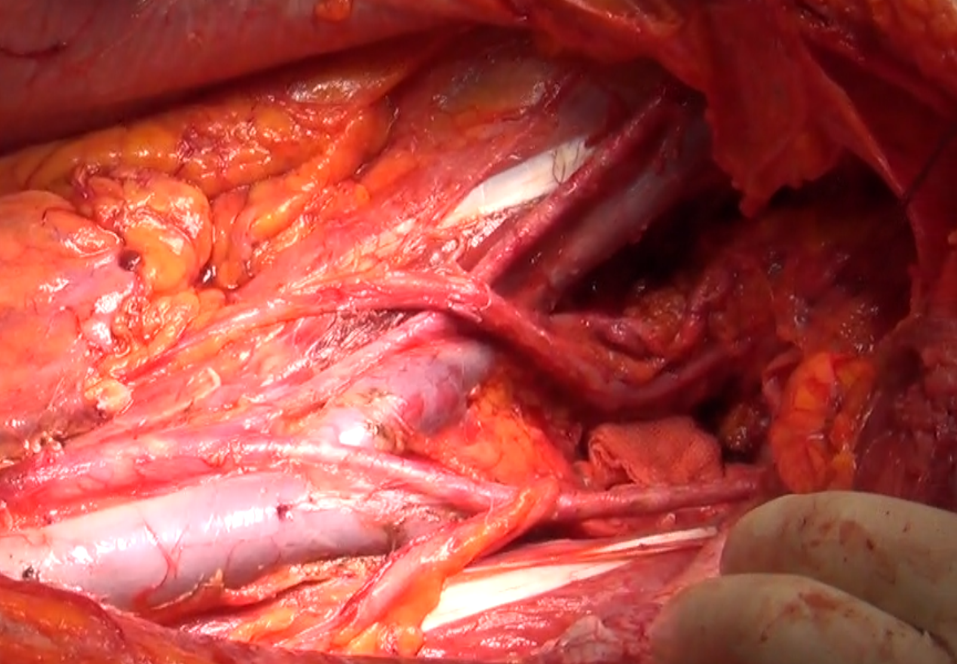
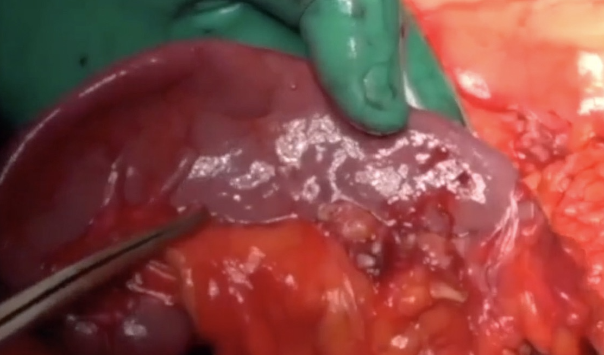
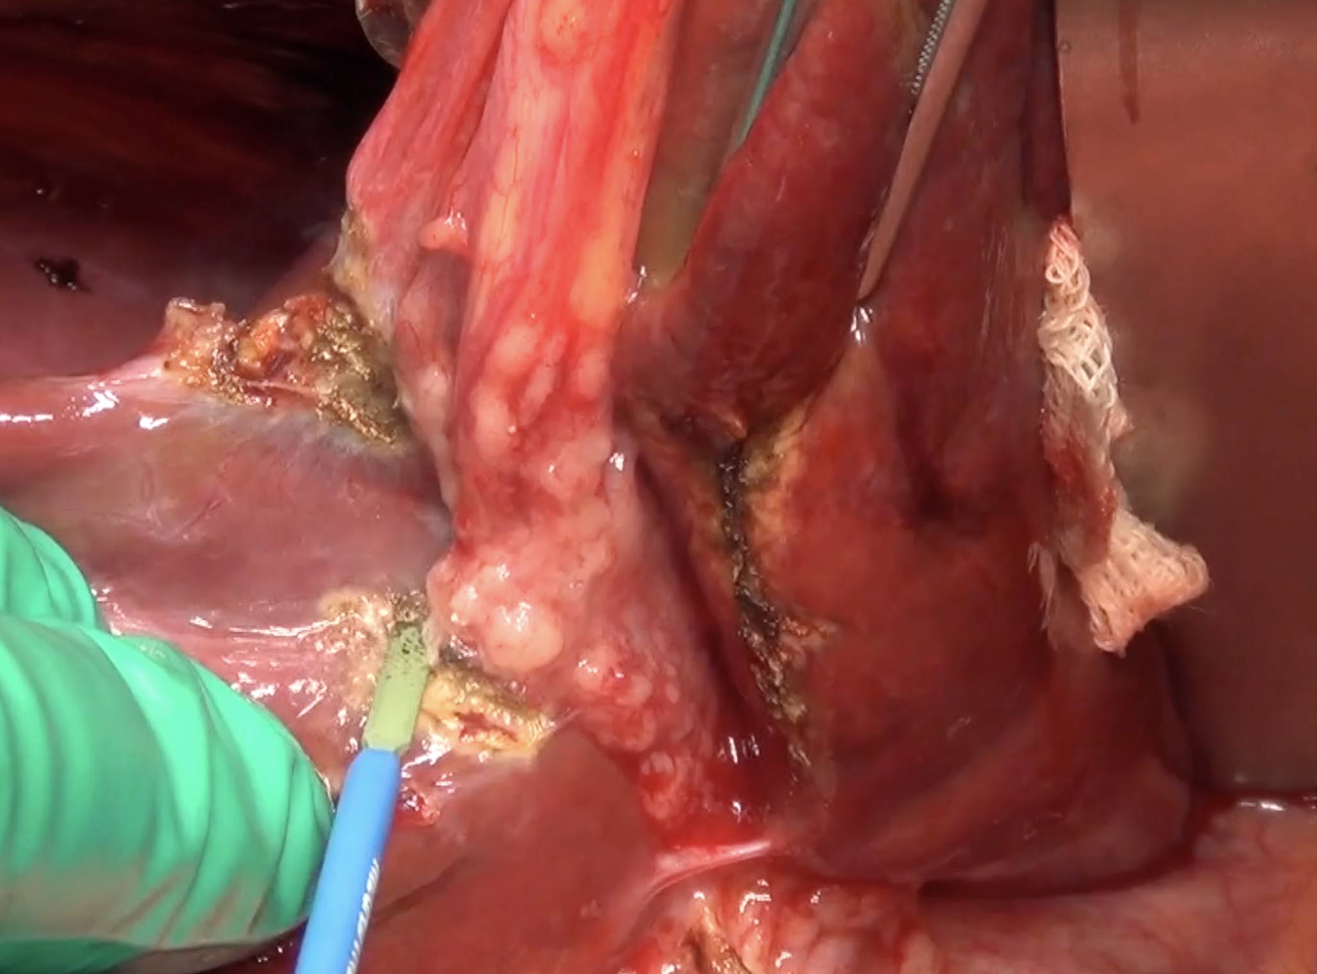
Ovarian Cancer & Peritoneal Spread
Peritoneal spread
High recurrence rate
Short survival.
70% of ovarian cancer patients

Slide 3
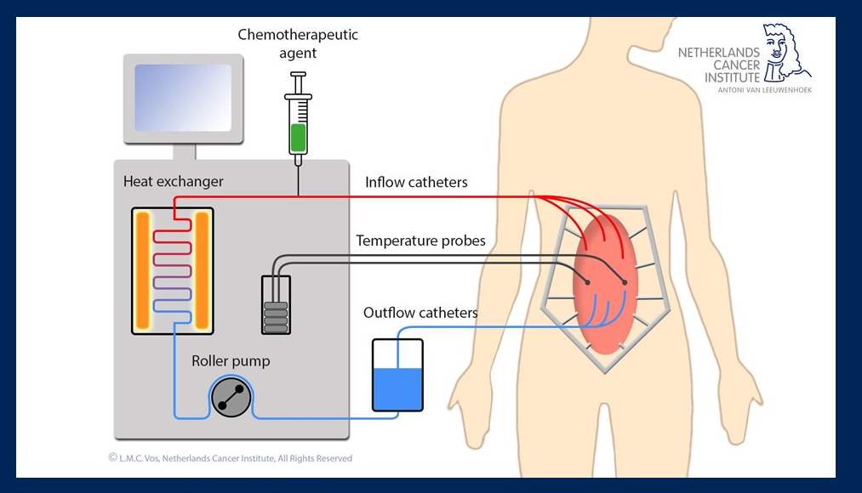
Ovarian Cancer & Locoregional Disease
Locoregional Treatment
Cytoreductive Surgery
Intraperitoneal Chemotherapy

Slide 4
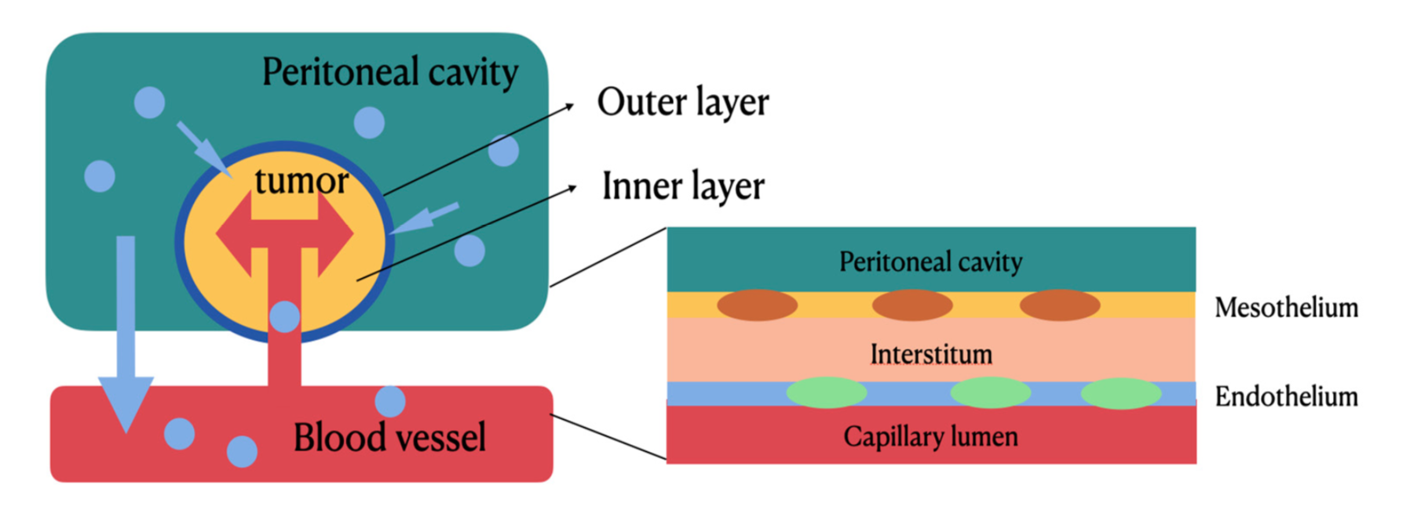
Regional and Intravenous Therapy
The outer layer of the tumor can achieve a high concentration of drug levels by direct exposure.
The drug can reach the inner core layer of the tumor by microcirculation through systemic circulation.
Peritoneal-plasma barrier can decrase drug clearance rate from peritoneal cavity to systemic circulation.
Lim et al. Int. J. Mol. Sci. 2022, 23, 10078.

Slide 5
RATIONALE
Targets peritoneal disease
No barriers of postoperative adhesions
No interval between CRS and chemotherapy (intraoperative)
Higher concentration of chemotherapy at disease site
Limits systemic toxicity
Hyperthermia enhances effect of chemotherapeutic agents by increasing tumor penetration and DNA-crosslinking.

Slide 6
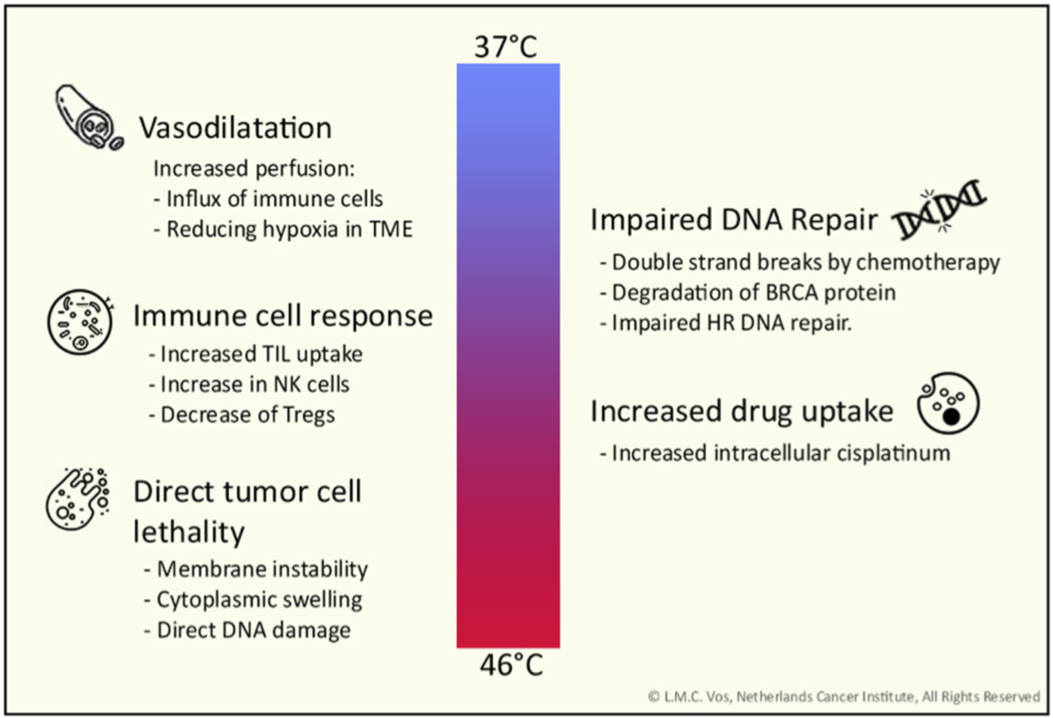
Impact of HIPEC Appears to be Temperature-Dependent
Vos LMC, et al. Best Pract Res Clin Obstet Gynaecol. 2022;78:86-102.

Slide 7
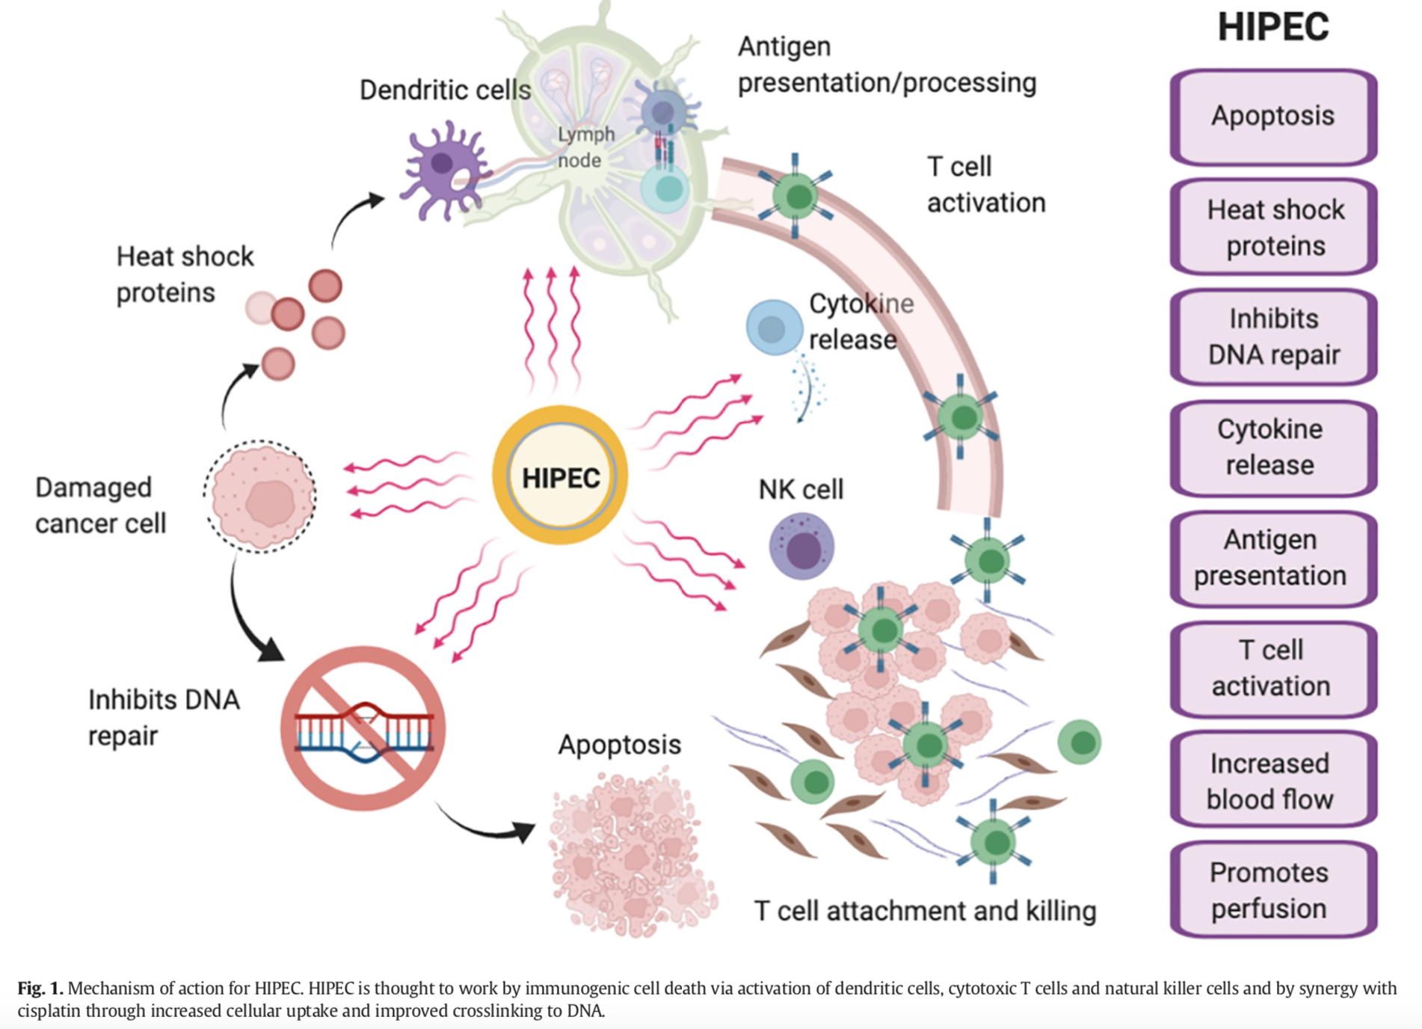
Effect of Hyperthermia
Dellinger TH, et al. Gynecol Oncol. 2021;160(2):364-8.

Slide 8
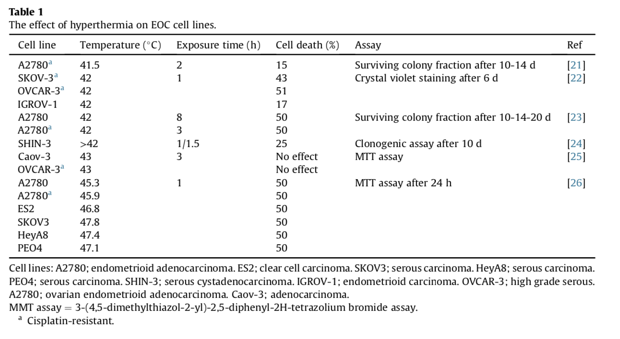
In Vitro Experiments & Different Cell Lines and Subtypes
Hyperthermia – Chemotherapy Synergy?
Conversion of Platinum-resistant to Sensitive
Vos LMC, et al. Best Pract Res Clin Obstet Gynaecol. 2022;78:86-102.

Slide 9
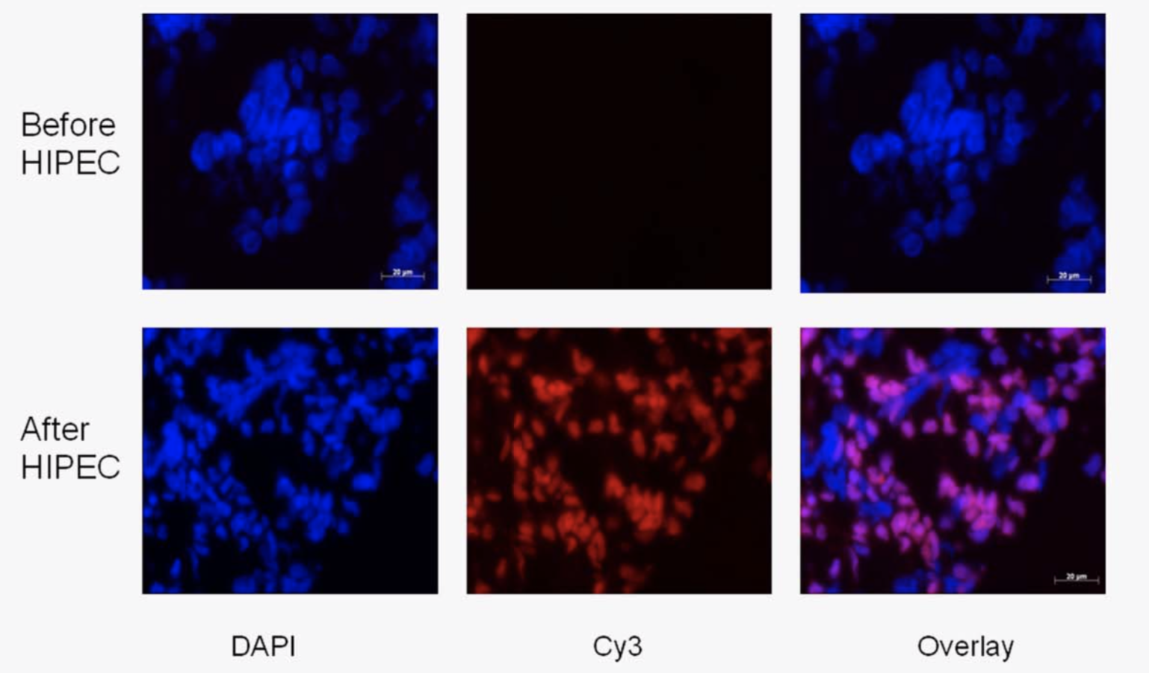
HIPEC: Cisplatin DNA Adduct Formation
HIPEC ROC I: a phase I study of cisplatin administered as hyperthermic intraoperative intraperitoneal chemoperfusion followed by postoperative intravenous platinum-based chemotherapy in patients with platinum-sensitive recurrent epithelial ovarian cancer
Zivanovic O, et al. Int J Cancer. 2015;136(3):699-708.

Slide 10

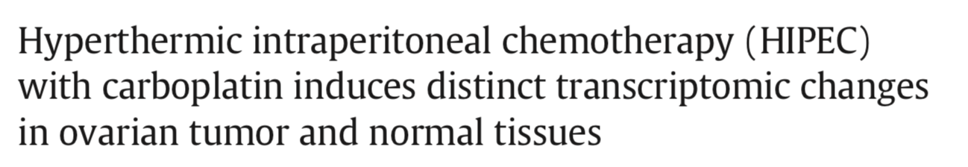
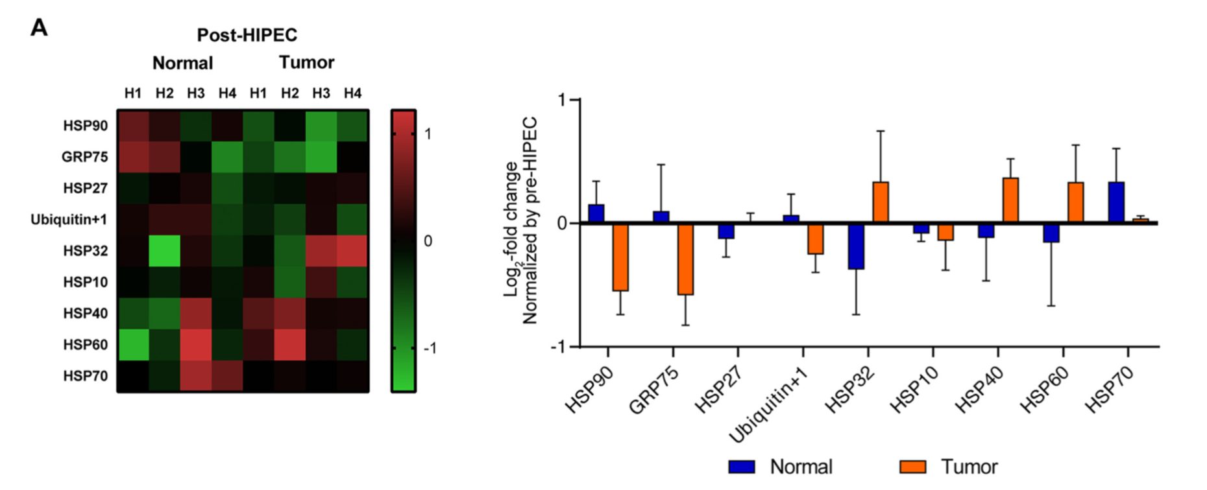
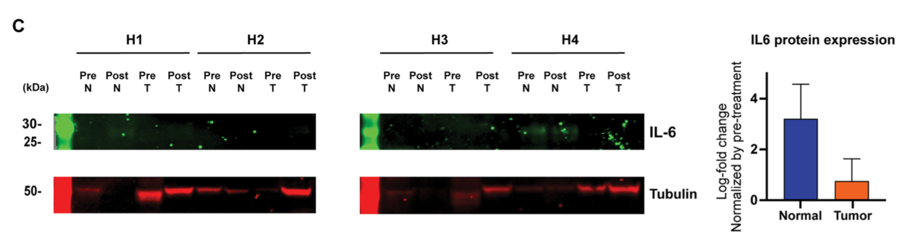
Transcriptomic Changes in HIPEC & MSKCC
→ HIPEC with carboplatin resulted in;
An upregulation of heat shock-related genes in both normal and tumor tissue.
An additional immune response gene induction in normal and protein folding in tumor tissue.
HIPEC administration may suffice to induce gene expression changes in residual tumor cells and raises a biological basis for the consideration of combinatorial treatments with HSP inhibitors.
Moukarzel LA, et al. Gynecol Oncol. 2022;165(2):239-47.

Slide 11
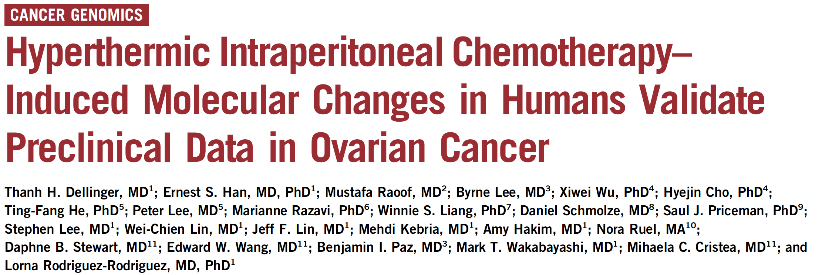
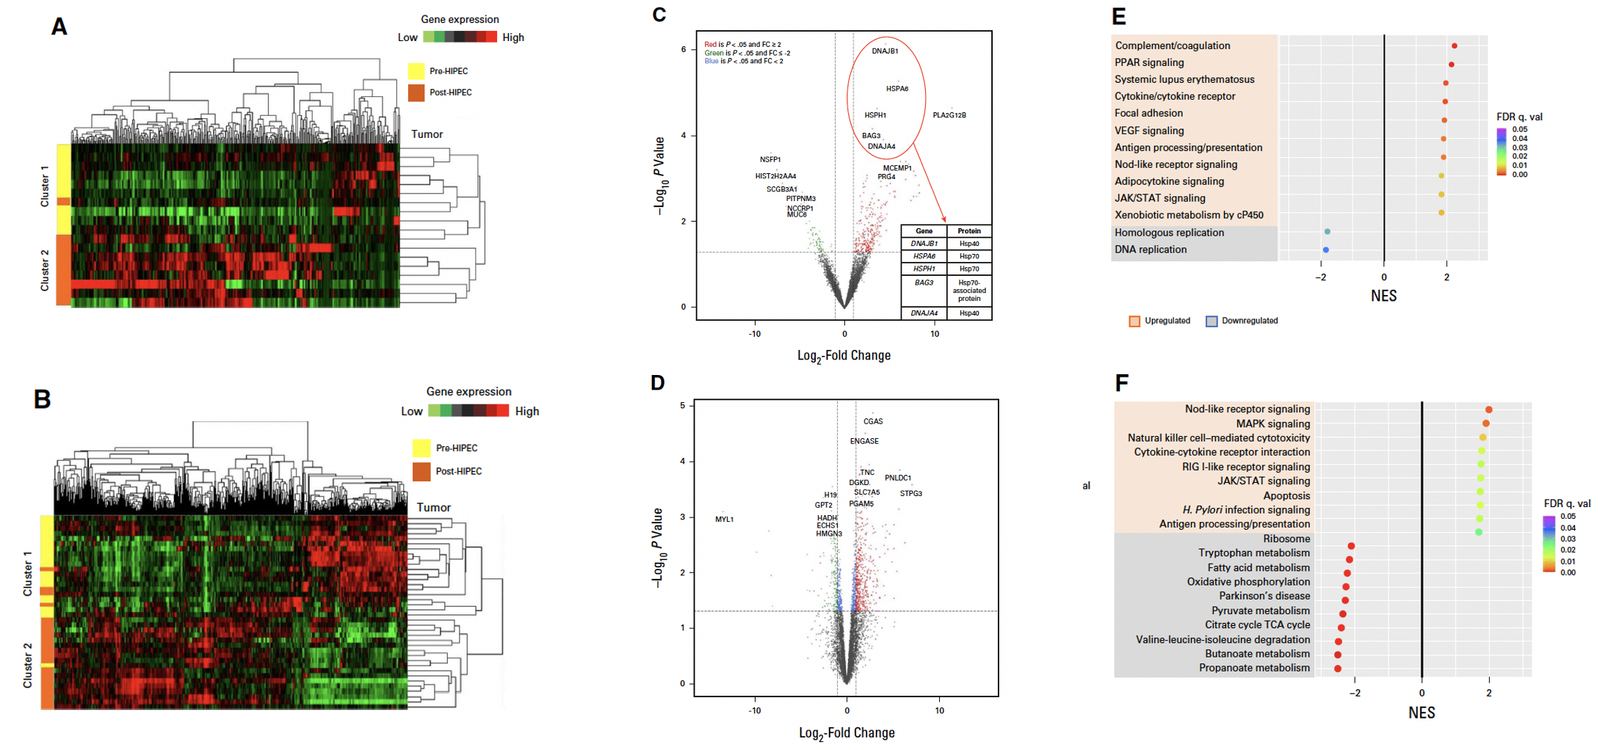
Good Responders to HIPEC and HIPEC
Induced Molecular Changes
FIG 5. Gene and pathway changes of pre- and post-HIPEC in metastatic tumor and normal patient samples. (A and B) Hierarchical clustered analysis of (A) differentially expressed genes in metastatic tumors and (B) normal samples. Cluster 1 was enriched for pre-HIPEC; cluster 2 was enriched with post-HIPEC. (C) Volcano plot displaying gene expression post-HIPEC by log2-fold change (x-axis) and minus log10 P value (y-axis) in tumor samples. Significantly upregulated genes of ≥ 2-fold expression are in red while statistically significantly downregulated genes of ≥ 2-fold expression are in green. The top five differentially expressed genes with fold change (post- v pre-HIPEC) and P value shown for tumor samples are shown. (D) Volcano plot displaying gene expression post-HIPEC by log2-fold change (x-axis) and minus log10 P value (y-axis) in normal samples. (E and F) Kegg pathway gene set enrichment analysis of (E) HIPEC metastatic tumors and (F) normal samples demonstrating the top significantly upregulated and downregulated pathways (FDR , 0.05). Several immune-related pathways are upregulated, and DNA replication pathways are downregulated in tumor samples. Normal HIPEC samples demonstrate significant downregulation of metabolic pathways. FC, fold change; FDR, false discovery rate; HIPEC, hyperthermic intraperitoneal chemotherapy; NES, normalized enrichment score; q. val., q value; TCA, tricarboxylic acid.
Dellinger, Thanh H., et al. JCO Precision Oncology, 2022

Slide 12
How about the literature ?

Slide 13

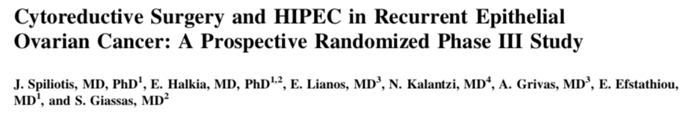
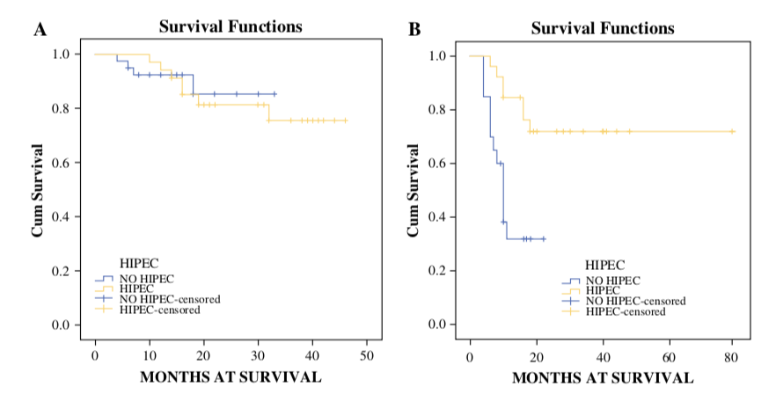
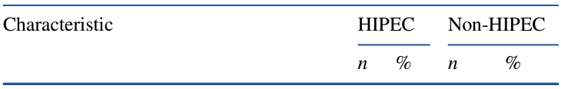
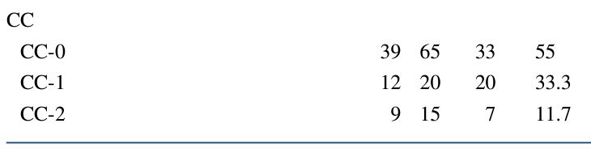
Recurrent Ovarian Cancer & HIPEC & 2015
HIPEC: 60 pts / No HIPEC: 60 pts
Stage IIIc-IV, Randomized preoperatively
Platinum-sensitive disease (n=34):
  Cisplatin 100 mg/m2 and paclitaxel 175 mg/m2
  60 min at 42.5 °C
Platinum- resistant disease (n = 26):
  Doxorubicin 35 mg/m2
  Paclitaxel 175 mg/m2 or mitomycin 15 mg/m2
  60 min at 42.5 °C.
Open: n=40 / Closed: n=20
Platinum-sensitive
Platinum-resistant
No-HIPEC: 15.2
HIPEC: 26.8
HIPEC: 26.6
p=0.035
p=NS
No-HIPEC: 10.2
Spiliotis J, et al. Ann Surg Oncol. 2015;22(5):1570-5.

Slide 14
Randomized Controlled Trials
Primary Cytoreduction
Interval Cytoreduction
Recurrent Cytoreduction
Platinum-sensitive
Platinum-resistant
OVHIPEC-1
Spiliotis J
Korean
Study
MSK
Antonio CCP
CHIPOR
HORSE

Slide 15
Randomized Controlled Trials
Primary Cytoreduction
Interval Cytoreduction
Recurrent Cytoreduction
Platinum-sensitive
Platinum-resistant
OVHIPEC-1
Spiliotis J
Korean
Study
MSK
Antonio CCP
CHIPOR
HORSE

Slide 16

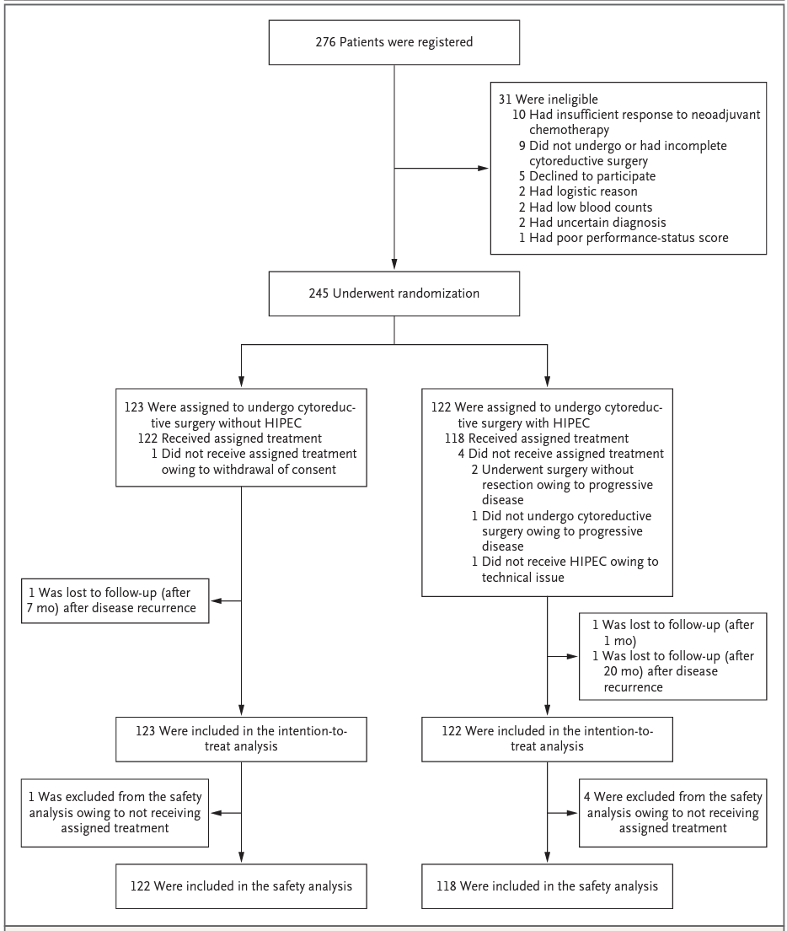
OVHIPEC-1 – IDS & 2018
Stage III
NACT (x 3 cycles)
Cisplatin (100 mg/m²) + sodium thiosulphate
90 minutes, open technique, 40⁰C,
Randomization at the time of surgery
No residual tm or ≤ 10 mm
No HIPEC
HIPEC
n=123
n=122
Van Driel WJ et al., New Engl J Med 2018

Slide 17
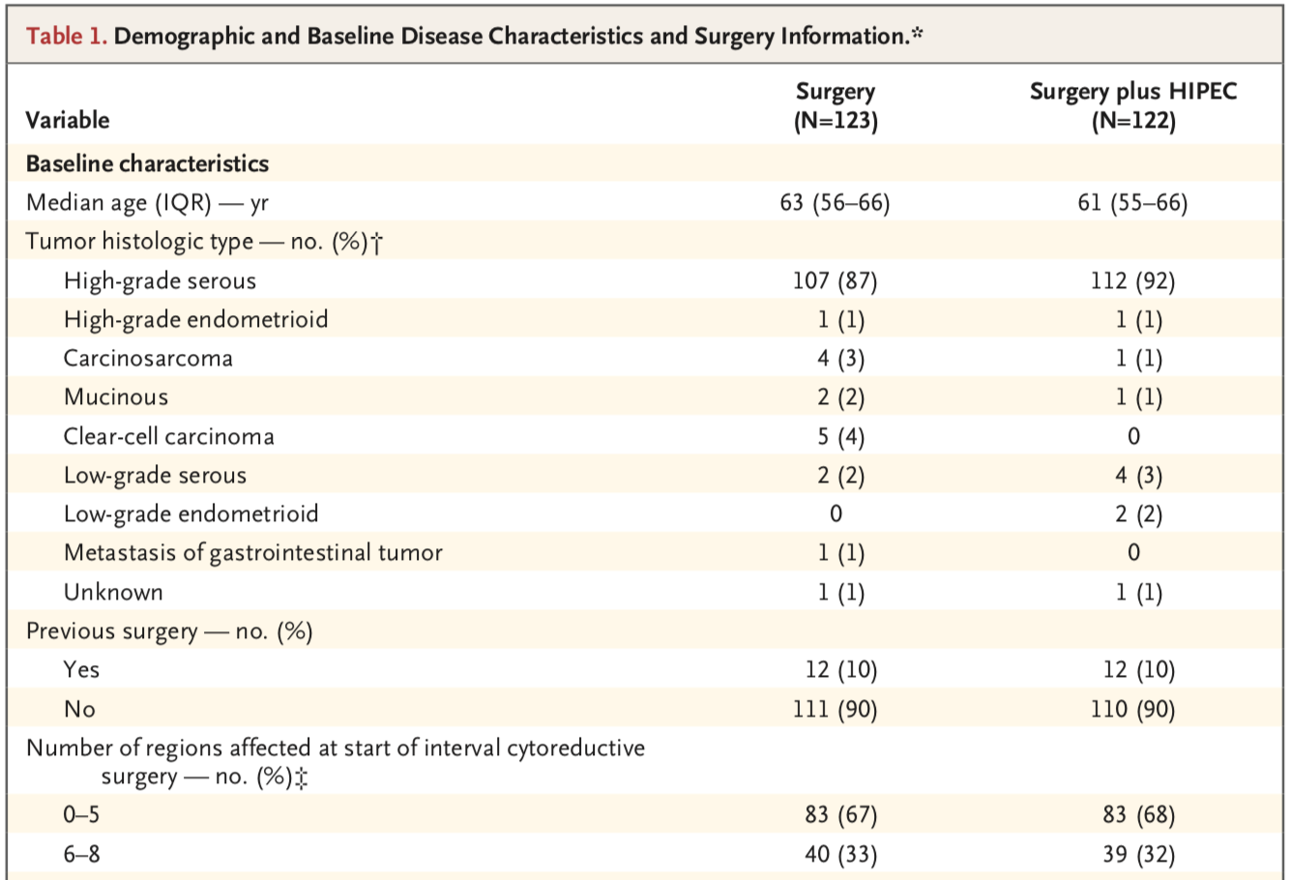
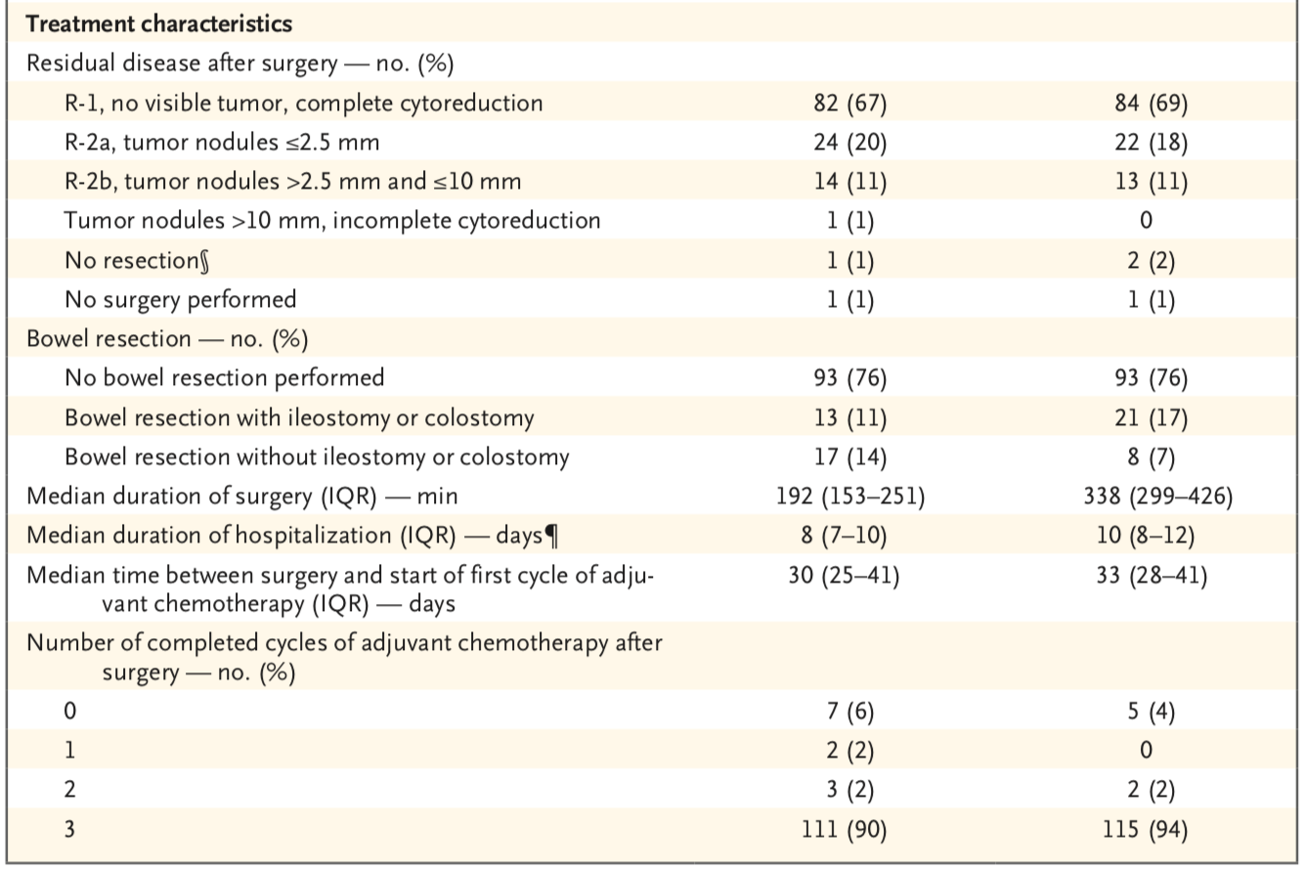
OVHIPEC-1 – IDS & 2018
Van Driel WJ et al., New Engl J Med 2018

Slide 18
OVHIPEC-1 – IDS & 2018
Van Driel WJ et al., New Engl J Med 2018

Slide 19
OVHIPEC-1 – IDS & 2018
87%
Van Driel WJ et al., New Engl J Med 2018

Slide 20
OVHIPEC-1 – IDS & 2018
!
25%
24%
Van Driel WJ et al., New Engl J Med 2018

Slide 21
OVHIPEC-1 – IDS & 2018
Van Driel WJ et al., New Engl J Med 2018

Slide 22
OVHIPEC-1 – IDS & 2018
Van Driel WJ et al., New Engl J Med 2018

Slide 23
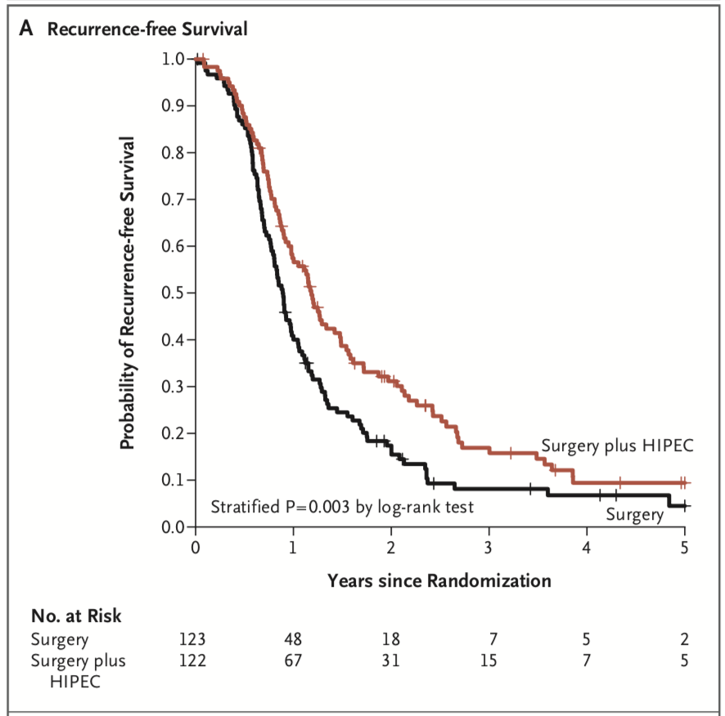
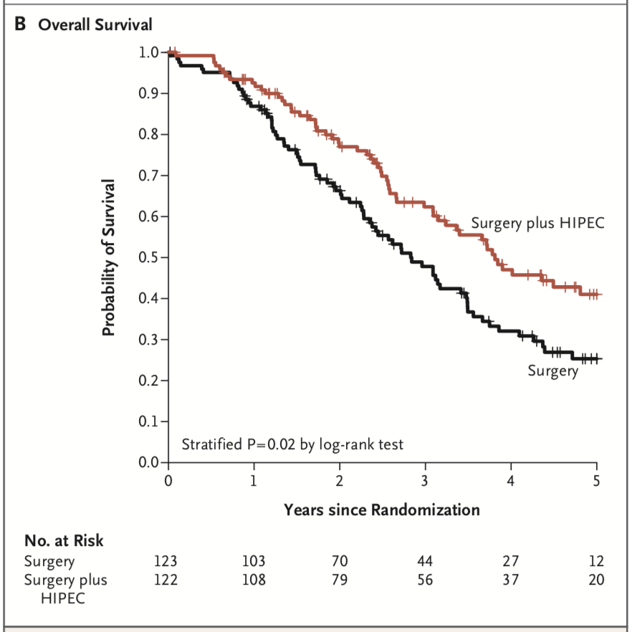
OVHIPEC-1 – IDS & 2018
Survival Advantage for both RFS and OS
RFS
OS
p=0.02
p=0.003
HIPEC: 45.7
HIPEC: 14.2
No HIPEC: 33.9
No HIPEC: 10.7
Van Driel WJ et al., New Engl J Med 2018

Slide 24
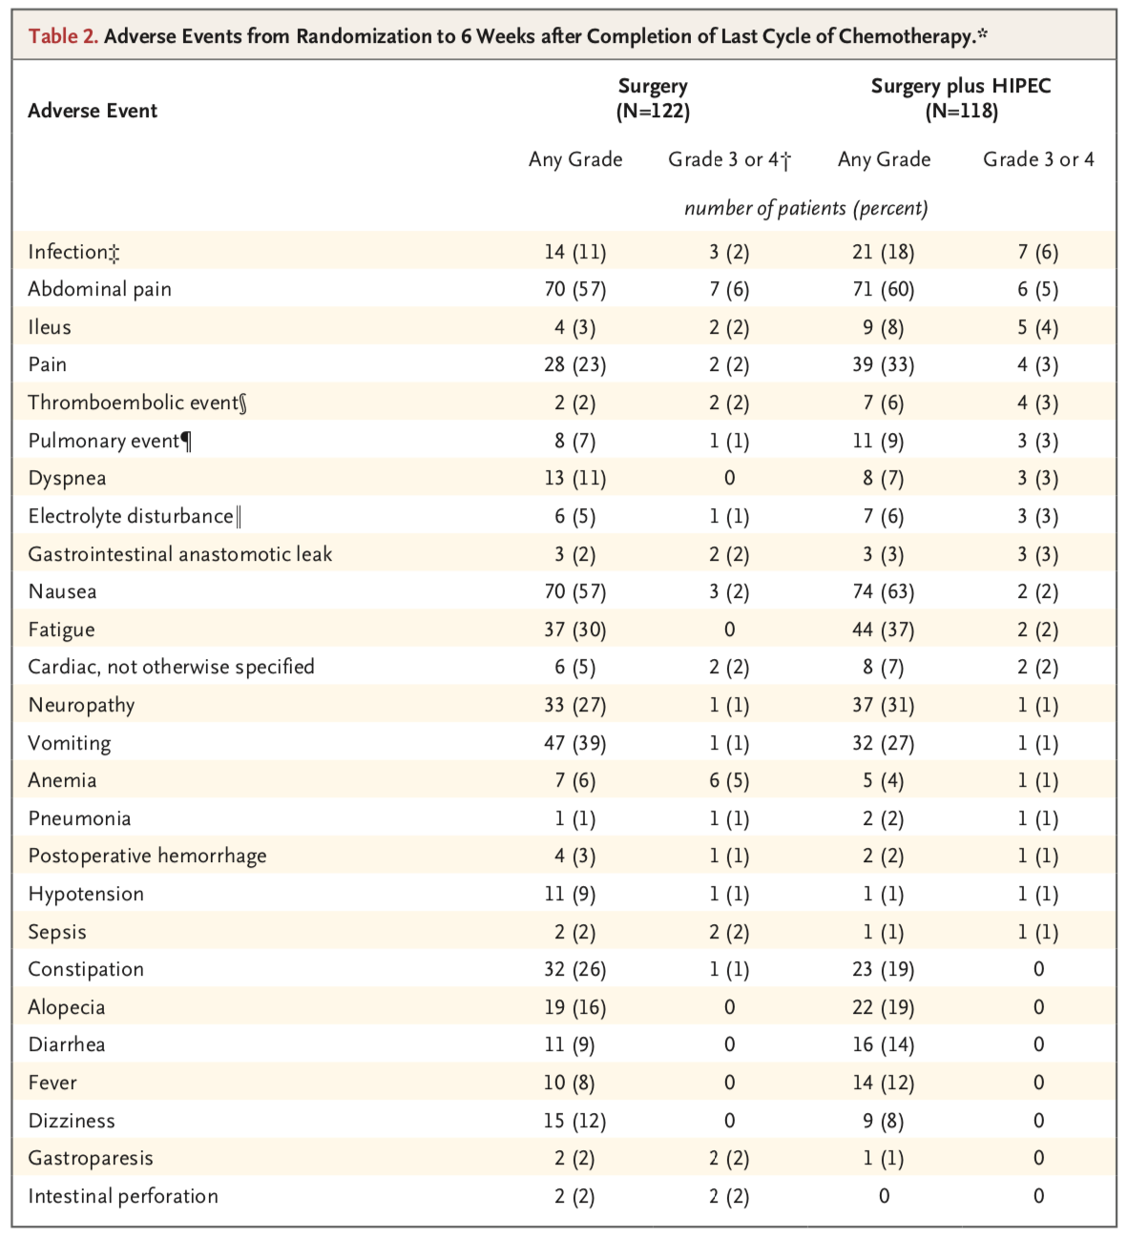
OVHIPEC-1 – Adverse Events & 2018
25%
27%
p=0.76
Van Driel WJ et al., New Engl J Med 2018

Slide 25
PROBLEMS before OVHIPEC - 1
Many studies not performed in gynecologic oncology centers
Mainly retrospective data (on P-sensitive and P-resistant disease)
Poor quality of data (different drugs, temperature, techniques)
Remarkable or poorly reported toxicity
Some interesting data of a potential activity (mainly from case-control studies)

Slide 26
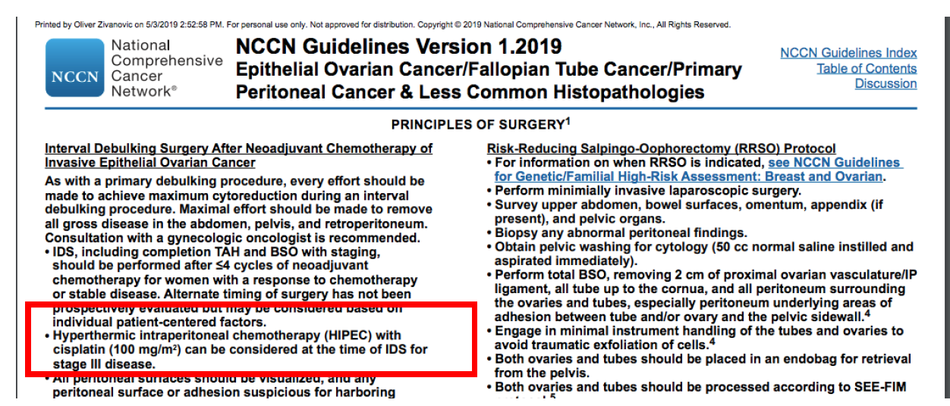
NCCN & HIPEC & IDS - 2019

Slide 27

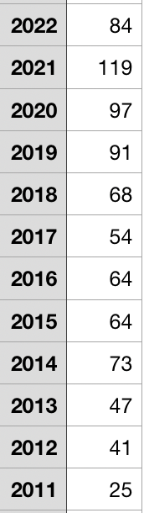
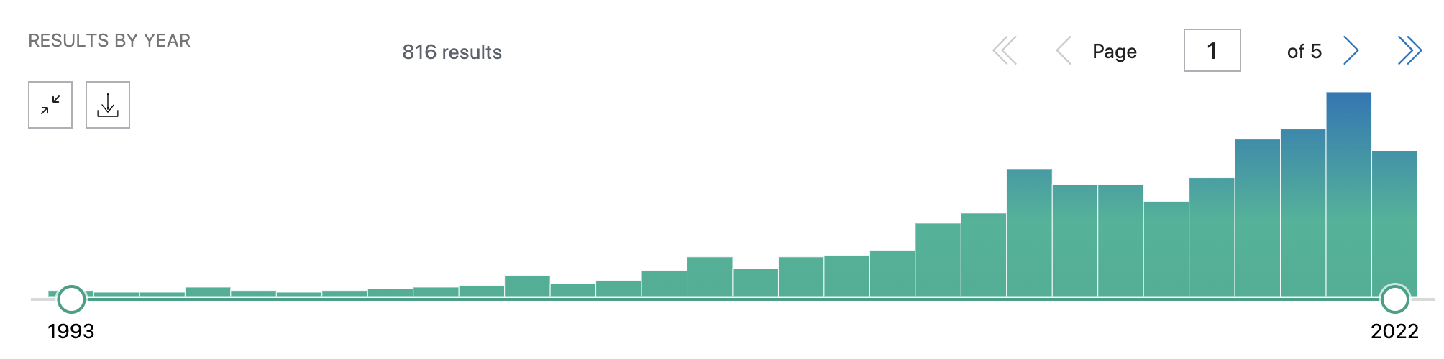
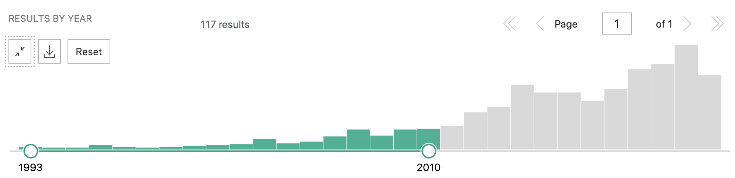
Number of Publications
(HIPEC & Ovarian Cancer)

Slide 28
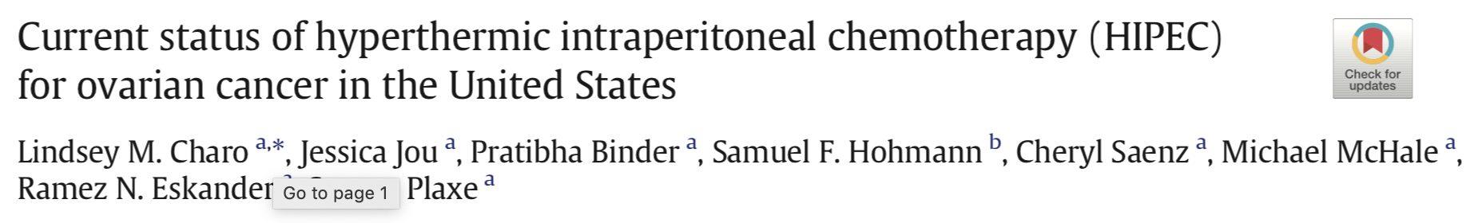
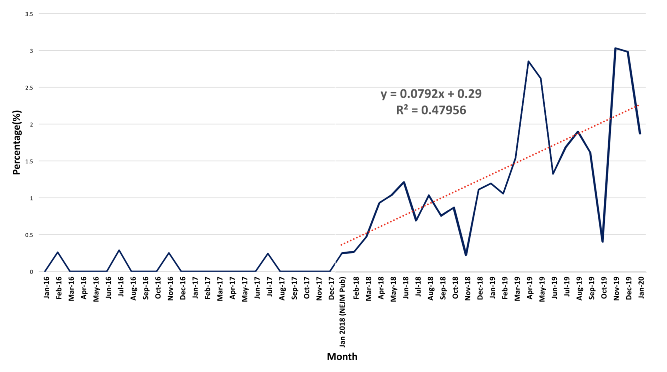
Increased HIPEC usage in USA after OVHIPEC 1
Use of HIPEC increased in the US after publication of a phase III clinical trial in a high-impact journal, though the absolute number of cases remains modest.
NEJM 2018
Charo LM, et al. Gynecol Oncol. 2020;159(3):681-6.

Slide 29




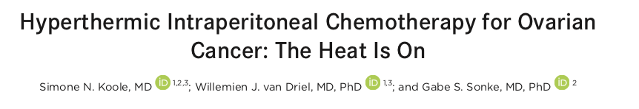



Slide 30
OVHIPEC-1 trial: Major criticisms
Primary end point →
Sample size calculation →
Recruitment →
Timing of randomization →
Selection of patients →
Selection of centres →
Differences in histology →
Complications’ rate →
Number of ostomies →
PFS instead of OS
Too small, changes in the design
Too long, risk of hyperselection
Before completion of surgery
No defined criteria for NACT
Based on HIPEC equipment
More unfavorable in the surgery group
Too high although not significant
Unacceptably high
Van Driel WJ et al., New Engl J Med 2018

Slide 31
Sample Size
Highlighting a small random imbalance in one baseline characteristic ignores the general principle that randomization ensures equality of prognosis on the basis of all known and unknown prognosticators combined.
The trial is hampered by its small size (245 patients), which resulted in a between-group difference of only 15 deaths.
Van Driel WJ et al., New Engl J Med 2018

Slide 32
Sample Size
The sample size calculation was based on a median PFS in the conventional arm of 18 months.
The authors expected an increase in the median PFS of at least 50% and anticipated that 280 patients would be needed to detect a hazard ratio of 1.5 with a 2-sided significance level of .05. Later, the trial was amended to reduce the sample size from 280 to 240 because of too slow accrual.
The PFS was only 10.7 months in the standard arm instead of the expected 18 months and only 14.2 months in the HIPEC arm instead of the expected 24 months.
In 2012 it became clear that the accrual was slower than expected.
As a result, participating patients contributed longer follow-up time and hence fewer patients were needed to reach the same number of events.
Therefore the total number of patients needed in the trial to reach its primary endpoint was reduced from 280 to 245.

Slide 33
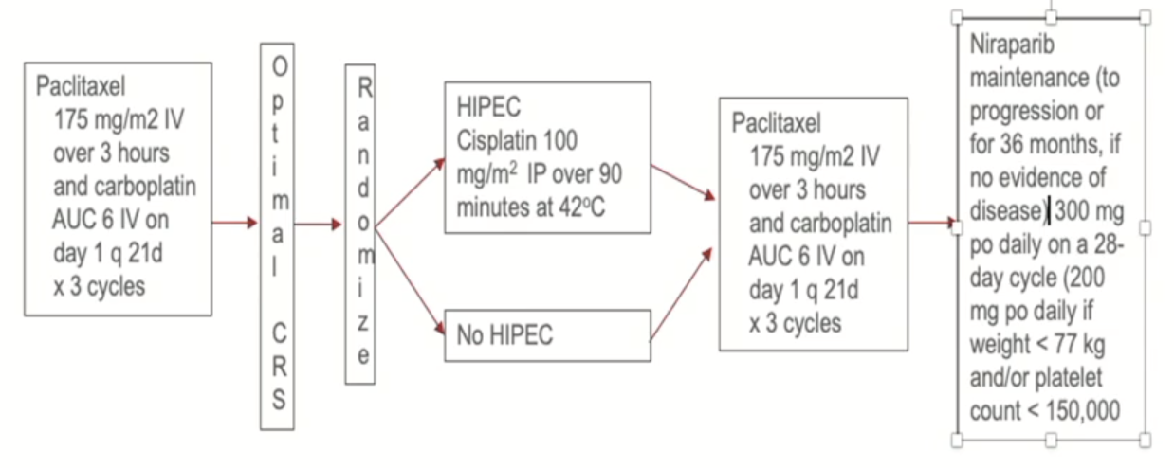
GOG-3068/HIPEC & IDS
A phase III randomized trial of hyperthermic intraperitoneal chemotherapy (HIPEC) with cisplatin versus no HIPEC at the time of optimal interval cytoreductive surgery followed by niraparib maintenance in patients with newly diagnosed stage III and IV ovarian, primary peritoneal, and Fallopian tube cancer.
N=230
Primary endpoint: PFS
Stratification:
HRD status
Residual disease (no gross residual or gross residual <1 cm
Stage (III vs. IV)

Slide 34
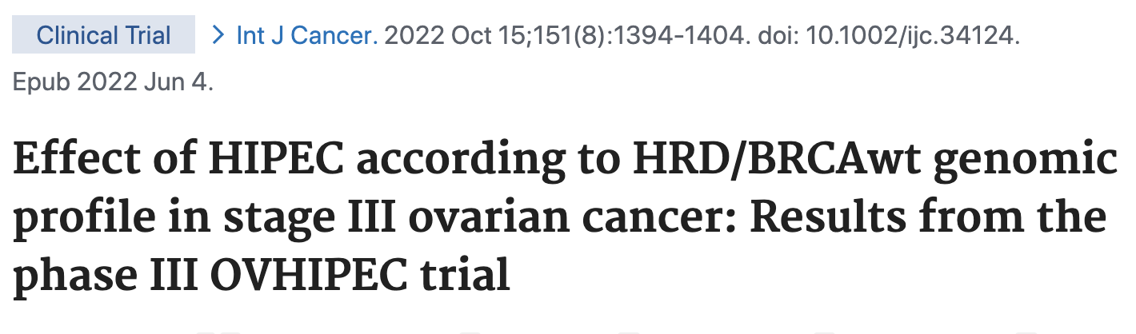
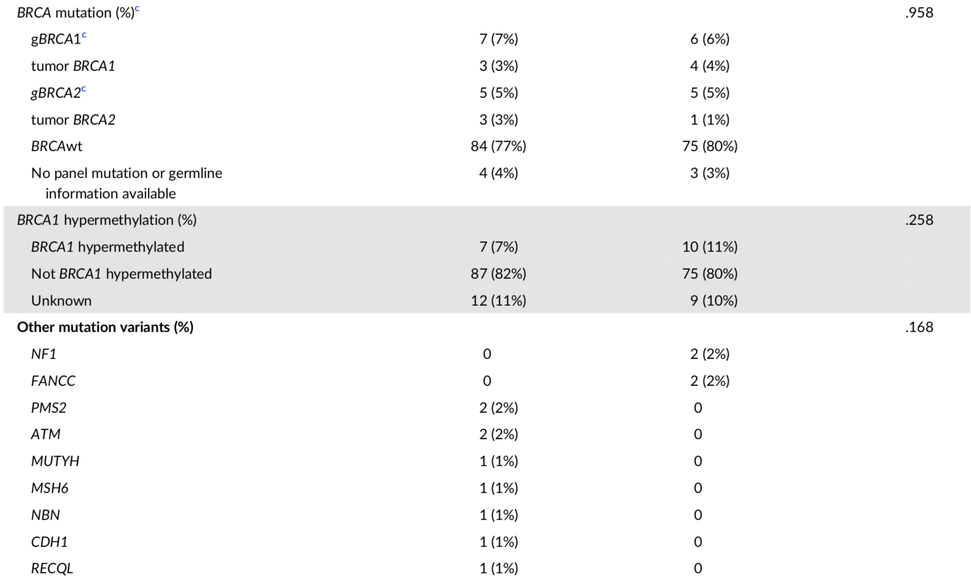
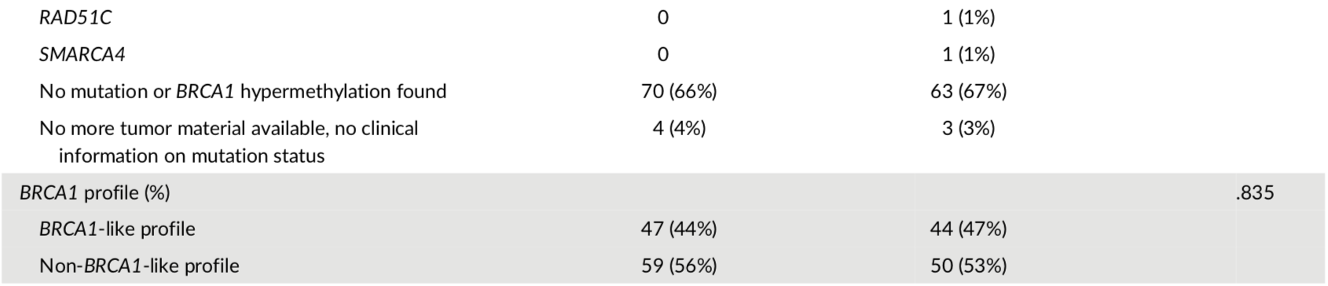
BRCA Mutation Status in OVHIPEC-1
Koole SN, et al. Int J Cancer. 2022;151(8):1394-1404.

Slide 35
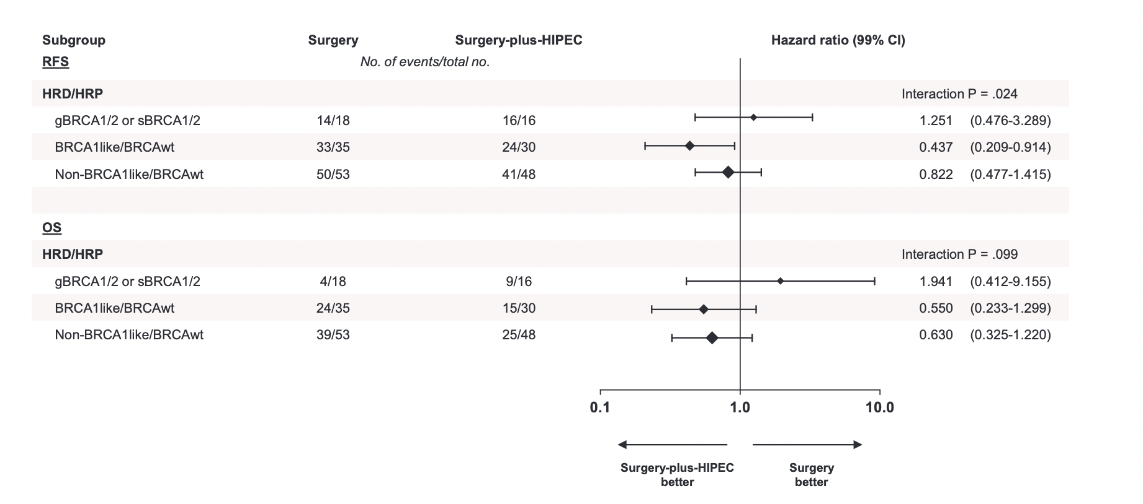
BRCA Mutation Status in OVHIPEC-1
HRD/BRCAwt: Benefit more
Koole SN, et al. Int J Cancer. 2022;151(8):1394-1404.

Slide 36
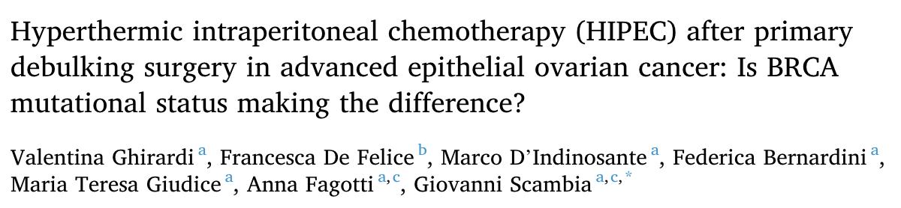

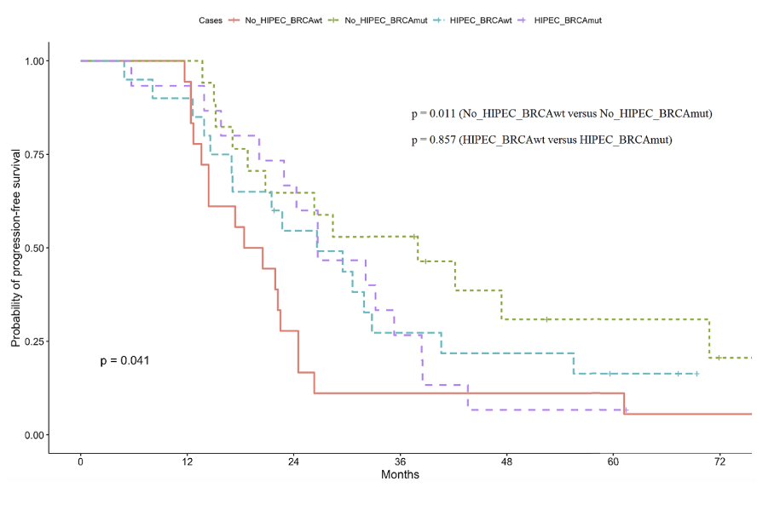
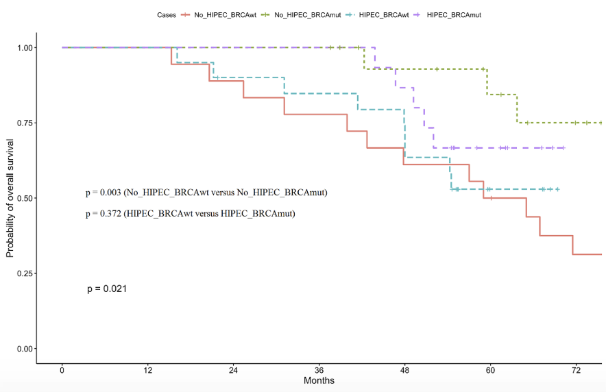
BRCA & Gemelli 2022
PFS
OS
p=0.041
p=0.021
Ghirardi, Valentina, et al. Cancer Treatment and Research Communications,2022

Slide 37
Hyperthermia
HRD/BRCAwt
with impaired / intermediate BRCA1/2 protein function
Sensitizes cells to DNA damage caused by
Platinum based chemotherapy & PARP-i
Induces BRCA1/2 protein degradation
Degrade BRCA1 and 2 protein function

Slide 38
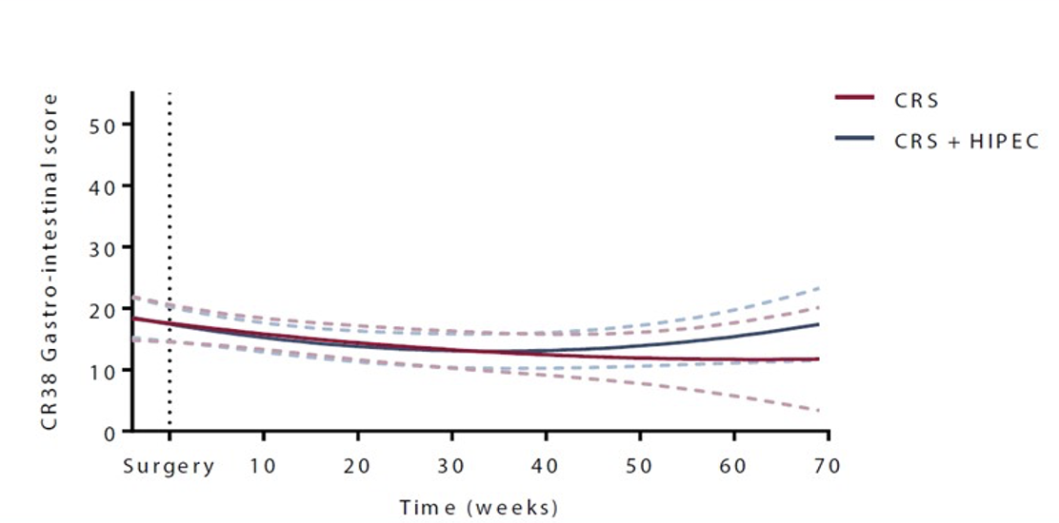
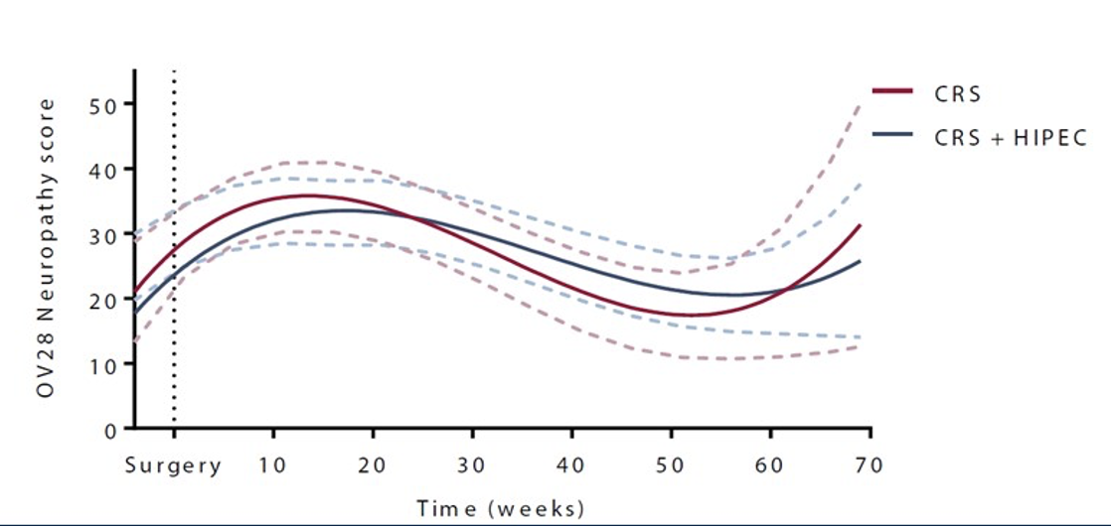
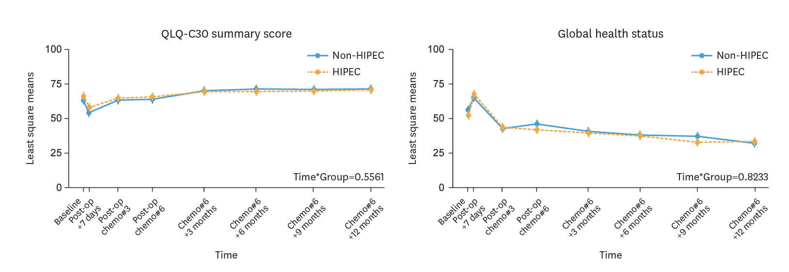
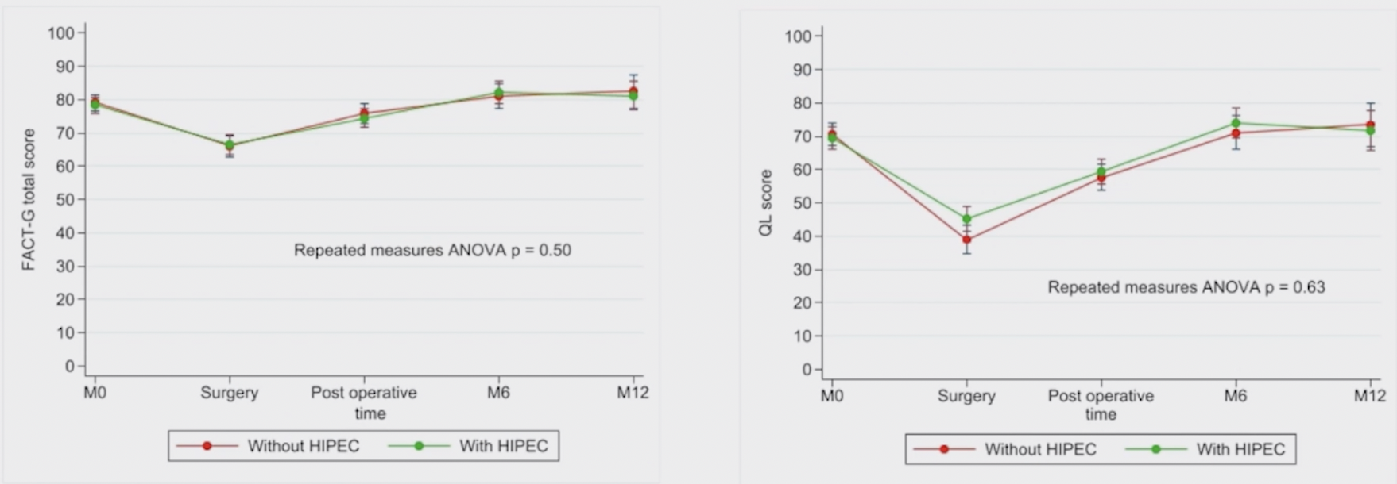
Quality of Life – OVHIPEC-1
Quality of Life & KOV-HIPEC-01 & 2022
QLQ-C30 gastrointestinal score
QLQ-C30 neuropathy score
Koole et al, Eur J Surg Oncol, 2021
Kim JH, et al. J Gynecol Oncol. 2022;33(4):e54.
Chipor Study & Quality of Life
SGO, 2023, Tampa & HOT
STUDY: NCT 02124421
No long-term impairment of HRQL was observed after adjusting for age and tumor burden (Estimated Marginal Means [EMM] method)

Slide 39
OVHIPEC-1 – Adverse Events & 2018
25%
27%
p=0.76
Van Driel WJ et al., New Engl J Med 2018

Slide 40

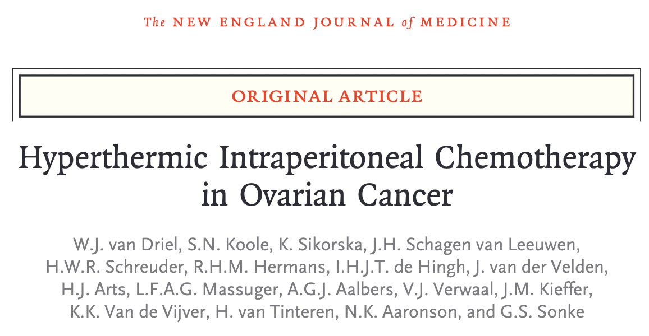
Nephroprotection with Sodium Thiosulfate
Protocol in OVHIPEC-1
9 g/m² in 200 ml (i.v. bolus) - At the start of perfusion
12 g/m² in 1000 ml (infusion) - Over 6 hours
van Driel WJ, et al. N Engl J Med. 2018 Jan 18;378(3):230-240.

Slide 41

Kidney Failure & Chipor Study
No. of patients (%) | No HIPEC (n=208) | HIPEC (n=207)
Severe kidney failure | 3 (1.4%) | 21 (10%)
Before Thiosulfate amendmentª | 1/154 (0.7%) | 19/156 (12%)
After Thiosulfate amendmentª | 2/54 (3.7%) | 2/51 (3.9%)
ªThiosulfate amendment, June 2018

Slide 42
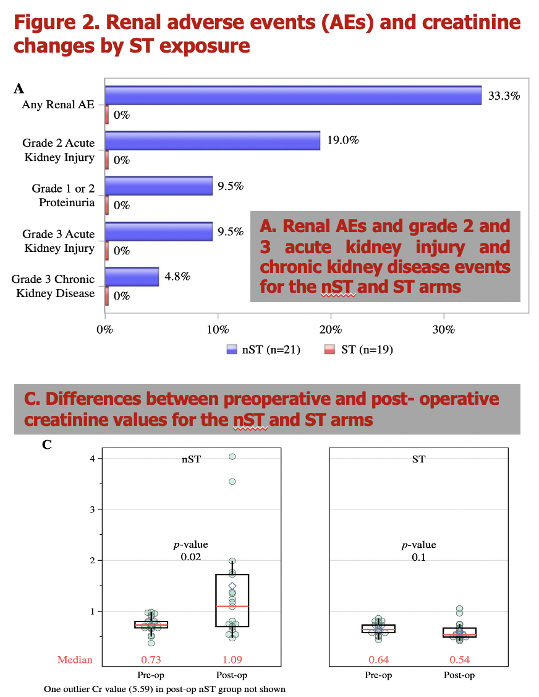
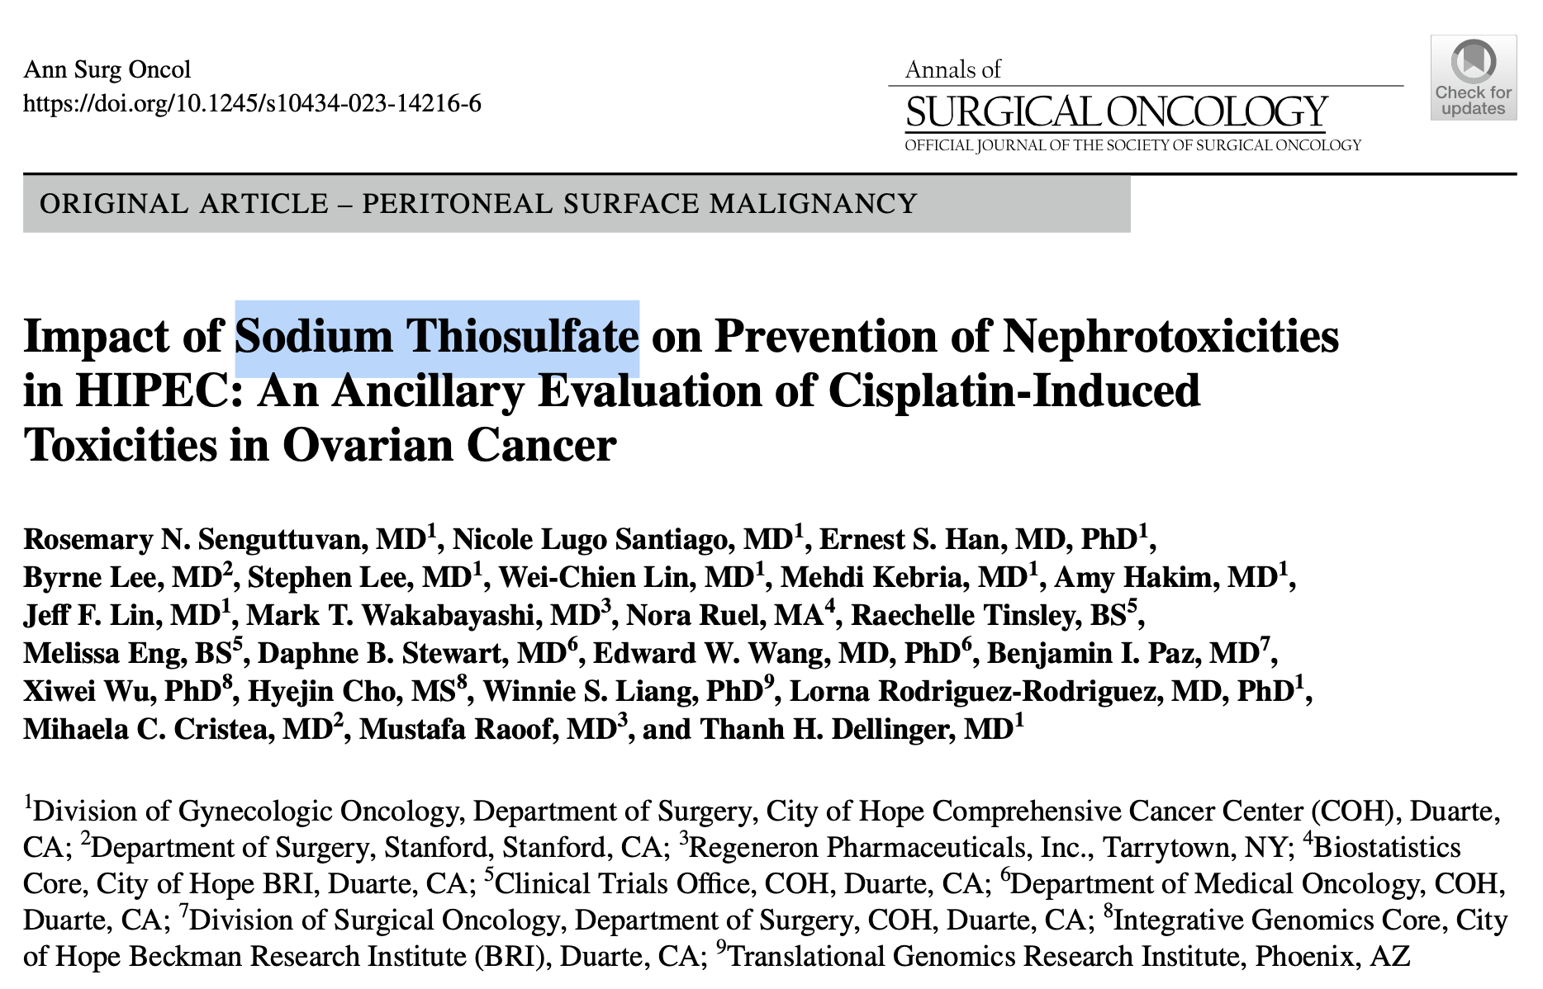
Sodium Thiosulfate
Senguttuvan, Rosemary N., et al. Annals of Surgical Oncology, 2023

Slide 43
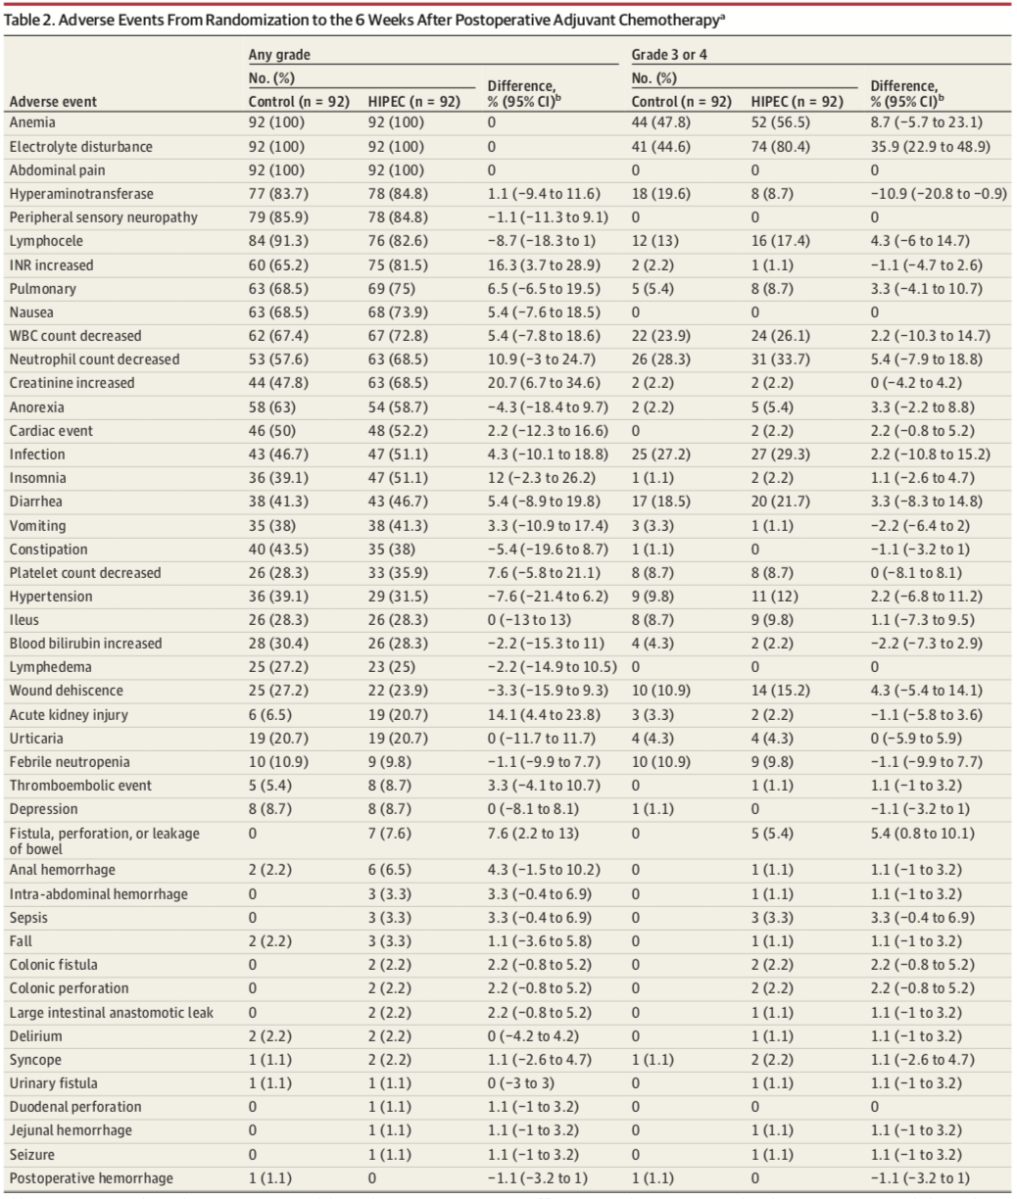
Korean RCT & PDS + IDS & 2022
Grade 3 or 4 adverse events,
  86 patients (93.5%) in the HIPEC group
  80 patients (87.0%) in the control group.
No unresolved serious HIPEC-related adverse events were found in either group.
Lim MC, JAMA Surg. 2022;157(5):374-383.

Slide 44
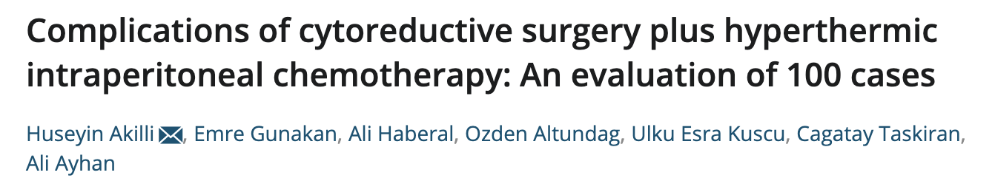


Grade 3-4 complication → 11%
Akilli H, et al. Int J Gynaecol Obstet. 2022;156(3):560-565.

Slide 45
  High Stoma Rate in OVHIPEC - 1
  HIPEC 21/29 = 72%
  No HIPEC 13/30 = 43%
Stoma Rate | Stoma
Author, year | HIPEC | No HIPEC
Ghirardi V, 2020 | 13.5% | 23.5%
Ayhan A, 2021 | 14.3%
Zivanovic O, 2021 | No difference
Akilli H, 2022 | 19%
Lim MC, 2022 | 7.6% | 6.5%
Antonio CCP, 2022 | 0% | 2.8%
Our Data | 22.4% | 21.9%

Slide 46

Anastomotic Leak Rate & Cleveland Clinic
No protective ileostomy!!
There was no significant difference in anastomotic leak rate for women who underwent IDS with HIPEC (9.5%, n = 2) versus without HIPEC (7.5%, n = 3) (p = 0.99).
HIPEC was not associated with increased risk for anastomotic leak at the time of IDS with colorectal resection and re-anastomosis.
Gruner M, et al. Gynecol Oncol. 2021;162(3):645-51.

Slide 47

Hospitalization
HIPEC resulted in longer hospitalizations than surgery alone.

Slide 48


Cost-effectiveness
Additional cost

Slide 49




Cost-effectiveness & USA – 2022
HIPEC at the time of primary CRS can be considered cost-effective regardless of residual disease status when using a standard willingness to pay threshold.
Penn CA, et al. Gynecol Oncol Rep. 2022;41:101009.
Notes:
Our findings provide preliminary data to support that HIPEC at the time of primary cytoreductive surgery can be considered cost-effective regardless of residual disease status when using a standard willingness to pay threshold.

Slide 50


Cost Effectiveness of Interval Surgery (KOV-HIPEC-01)
Conclusion:
The findings of the study suggest that ICS followed by HIPEC, is cost-effective with a significant gain in QALYs.
These results may support the current reimbursement of HIPEC from Korean insurance services and the management of long-term conditions.
Figure 2. Incremental cost-effectiveness scatterplot
Kim, Ji Hyun, et al. Gynecologic Oncology, 2023

Slide 51


Peritoneal Recurrence & OVHIPEC - 1
Less peritoneal recurrences following HIPEC
Koole SN, et al. Int J Gynecol Cancer. 2020;30(12):1928-34.

Slide 52



IDS & HIPEC & KGOG 3042 – 2022
Comparative Effectiveness of HIPEC Following Interval Cytoreductive Surgery in Patients with Advanced-stage Ovarian Cancer Undergoing Neoadjuvant Chemotherapy: Multi-center, Prospective, Cohort Study (KGOG 3042)
Presented by: Yong Jae Lee

Slide 53
OVHIPEC-1 trial: Major criticisms
Primary end point →
Sample size calculation →
Recruitment →
Timing of randomization →
Selection of patients →
Selection of centres →
Differences in histology →
Complications’ rate →
Number of ostomies →
PFS instead of OS
Too small, changes in the design
Too long, risk of hyperselection
Before completion of surgery
No defined criteria for NACT
Based on HIPEC equipment
More unfavorable in the surgery group
Too high although not significant
Unacceptably high
Van Driel WJ et al., New Engl J Med 2018

Slide 54



OVHIPEC-1 & 10-Year Follow-up
Aronson SL, et al. Lancet Oncol. 2023 Oct;24(10):1109-1118.

Slide 55

Editorial to OVHIPEC-1 10 yr Follow-up Study
After follow-up periods of 10·1 years (95% CI 8·4–12·9) in the surgery group (n=123) and 10·4 years (9·5–13·3) in the surgery-plus-HIPEC group (n=122), with 10-year progression-free survival being 6·6% (95% CI 3·4–13·0) versus 10·1% (5·8–19·7) and 10-year overall survival being 10·9% (6·5–18·0) versus 16·1% (10·3–25·2).
Moreover, although the proportion of patients with platinum-resistant disease seemed to be lower in the surgery-plus-HIPEC group (32 [26%]) than in the surgery group (49 [40%]).
Ghirardi V, et al. Lancet Oncol. 2023 Oct;24(10):1057-1059.

Slide 56



HIPEC at IDS of Stage IV and 6 Cycles of NACT
Ghirardi V, et al. Ann Surg Oncol. 2024 May;31(5):3350-3360.

Slide 57

HIPEC at IDS of Stage IV and 6 Cycles of NACT
Assessed the perioperative outcomes and PFS of FIGO stage IV and/ or patients receiving up to 6 cycles of NACT undergoing IDS+HIPEC.
No difference in PFS was identified neither between FIGO stage III and IV patients (p = 0.44), nor between 3 and 4 versus > 4 cycles of NACT (p = 0.85).
Conclusions: Because of the absence of additional complications and positive survival outcomes, HIPEC administration can be considered in selected FIGO stage IV and patients receiving > 4 cycles of NACT.
Ghirardi V, et al. Ann Surg Oncol. 2024 May;31(5):3350-3360.

Slide 58
Randomized Controlled Trials
Primary Cytoreduction
Interval Cytoreduction
Recurrent Cytoreduction
Platinum-sensitive
Platinum-resistant
OVHIPEC-1
Spiliotis J
Korean
Study
MSK
Antonio CCP
CHIPOR
HORSE

Slide 59

Korean RCT & PDS + IDS & 2022
75 mg/m2 of cisplatin
41.5 °C, 90 min
Closed technique
FIGO Stage III/IV
Random at the end of CRS
Residual tumor ≤ 10 mm
Bowel surgery
  73.9% - No HIPEC
  79.4% - HIPEC
No HIPEC
n=92
HIPEC
n=92
Lim MC, JAMA Surg. 2022;157(5):374-383.

Slide 60

Korean RCT & PDS + IDS & 2022
!! No survival advantage
PFS
No HIPEC: 61.3
OS
P=0.52
HIPEC: 19.8
P=0.43
HIPEC: 69.5
No HIPEC: 18.8
Lim MC, JAMA Surg. 2022;157(5):374-383.

Slide 61

Korean RCT & PDS + IDS & 2022
Primary CRS Subgroup Analysis
PFS
No HIPEC: NA
OS
P=0.29
HIPEC: 23.9
HIPEC: 71.3
P=0.51
No HIPEC: 29.7
Lim MC, JAMA Surg. 2022;157(5):374-383.

Slide 62

Korean RCT & PDS + IDS & 2022
Interval CRS Subgroup Analysis
PFS
OS
HIPEC: 61.8
HIPEC: 17.4
P=0.04
P=0.04
No HIPEC: 48.2
No HIPEC: 15.4
Lim MC, JAMA Surg. 2022;157(5):374-383.

Slide 63
Randomized Controlled Trials
Primary Cytoreduction
Interval Cytoreduction
Recurrent Cytoreduction
Platinum-sensitive
Platinum-resistant
OVHIPEC-1
Spiliotis J
Korean
Study
MSK
Antonio CCP
CHIPOR
HORSE

Slide 64




DFS
OS
p=0.12
p=0.19
HIPEC: 52
HIPEC: 18
No HIPEC: 12
No HIPEC: 45
Conclusion: CRS and HIPEC was associated with better DFS and OS.
Antonio CCP, et al. Ann Surg Oncol. 2022;29(4):2617-25.

Slide 65

CRS alone = 36 patients
CRS with HIPEC = 35 patients
Cisplatin
  75 mg/m2
  60 min at 42 °C
Median follow-up = 32 months
Antonio CCP, et al. Ann Surg Oncol. 2022;29(4):2617-25.

Slide 66



Korean Multicenter Prospective Study
Lee JY, et al. JAMA Surg. 2023 Nov 1;158(11):1133-1140.

Slide 67
Reviews and Meta-analyses

Slide 68




2015 - Luis Chiva Review
22 studies, 1450 patients
In 493 patients, HIPEC in the first-line setting
In 957 patients, secondary debulking surgery.
The authors concluded that their systematic review had failed to show a survival benefit that justified the use of HIPEC as a standard daily practice.
Chiva LM, Gynecol Oncol. 2015;136(1):130-5.

Slide 69


Umbrella Review of 6 Meta-Analyses & 2022
Hyperthermic Intraperitoneal Chemotherapy and Cytoreductive Surgery in Ovarian Cancer: An Umbrella Review of Meta-Analyses
OS
Primary CRS
P<0.001
Secondary CRS
P<0.001
Souadka A, et al. Front Oncol. 2022;12:809773.

Slide 70


Umbrella Review of 6 Meta-Analyses & 2022
Hyperthermic Intraperitoneal Chemotherapy and Cytoreductive Surgery in Ovarian Cancer: An Umbrella Review of Meta-Analyses
DFS
PFS
Primary CRS
Primary CRS
P<0.001
P<0.001
Secondary CRS
Secondary CRS
P=0.0002
P=0.004
Souadka A, et al. Front Oncol. 2022;12:809773.

Slide 71



Filis P, et al. ESMO Open. 2022;7(5):100586.

Slide 72


Meta-analysis
15 studies
  10 case-control
  5 RCT
1861 EOC patients
  1057 pts – HIPEC
  804 pts – No HIPEC
Recent Exposure to CT Prior to CRS and HIPEC
Within 6 Months
Vs.
6 Months or Longer
Kim SI, et al. Gynecol Oncol. 2022 Oct 20:S0090-8258(22)01887-X.

Slide 73


Recent Meta-analysis
Recent Exposure to CT (+)
PFS
OS
Kim SI, et al. Gynecol Oncol. 2022 Oct 20:S0090-8258(22)01887-X.

Slide 74


Recent Meta-analysis
Recent Exposure to CT (–)
PFS
OS
Kim SI, et al. Gynecol Oncol. 2022 Oct 20:S0090-8258(22)01887-X.

Slide 75



104 ROC patients
Median age: 57 years
Median follow‐up: 15 months (range: 5–69 months)
HIPEC:
R0
Closed technique
Inflow rate: 500–700 ml/min
Outflow rate: 300–400 ml/min
4000 ml of Ringer's lactate solution
41.5 C
Cisplatin at 75mg/m2 or carboplatin at 300 mg/m2.
Ayhan A, et al. J Surg Oncol. 2022 Oct 20. Epub ahead of print. PMID: 36264620.

Slide 76

Ayhan A, et al. J Surg Oncol. 2022 Oct 20. Epub ahead of print. PMID: 36264620.

Slide 77



HIPEC in Rare Ovarian Cancers (Mucinous Ovarian CA)
DFS
210 pts , Median FU: 43.5 months
Mucinous Ov Ca (Cisplatin, Mitomycin C, Oxaliplatin)
DFS: 53.8 months, OS: 69.8 months
Mucinous
Mercier F et al., Ann Surg Oncol,2018

Slide 78

Recurrent Mucinous Ovarian Cancer and HIPEC
2 pts with advanced or recurrent primary mucinous OC
treated with secondary CRS with HIPEC
No additional chemotherapy administered po
Both pts achieved a complete and durable response, with no evidence of recurrence at 21 and 27 months, respectively, after CRS with HIPEC.
Conley AB, et al. 2023 Apr 6.

Slide 79
L/S Cytoreduction

Slide 80



L/S Cytoreduction + HIPEC in EOC & Review of 42 pts
Ronsini, Carlo, et al. Medicina, 2023

Slide 81



L/S Interval Cytoreduction with HIPEC
n=53.
14 patients were treated by interval L-CRS−HIPEC and 39 by interval O-CRS−HIPEC.
The L-CRS−HIPEC group had a shorter hospital stay (5.6 ± 1.9 vs. 9.7 ± 9.8 days; p < 0.001) and a shorter time to return to systemic chemotherapy (4.3 ± 1.9 vs. 10.3 ± 16.8 weeks; p = 0.003).
There were no significant differences in postoperative complications between both groups.
The 2-year OS and DFS was 100% and 62% in the L-CRS−HIPEC group versus 92% and 60% in the O-CRS−HIPEC group, respectively (p = 0.96; p = 0.786).
Durán-Martínez M, et al. Surg Endosc. 2024 Jan;38(1):66-74.

Slide 82


L/S Cytoreduction + HIPEC and PSOGI Registry
Results:
A total of 215 patients were included in the L-CRS + HIPEC group.
The median peritoneal cancer index (PCI) was 3 (3–5). The median length of stay was 7 days (5-10) and the major morbidity (Clavien-Dindo ≥3) was 6.1% after 30 days.
The 5- year disease-free survival (DFS) per tumor origin was: 94% for PMP-LG, 85% for PMP-HG, 100% for benign multicyst peritoneal mesothelioma (MPM), 37.4% for colonic origin, and 54%(at 3 years) for ovarian origin.
The 5 years overall survival (OS) per tumor origin was: 100% for PMP-LG, PMP-HG and MPM; 61% for colonic origin, and 74% (at 3 years) for ovarian origin.
The median length of stay was 5 days (4–6) and the major morbidity was 6% after 30 days.
Arjona-Sanchez, A., et al. European Journal of Surgical Oncology, 2023

Slide 83
Ongoing Studies

Slide 84
Ongoing Studies
Setting | Acronym | Principal investigator | Country | Accrual patient | Drug
Primary CRS | OVHIPEC-2 | Van Driel | Netherland | 538 | Cisplatin
Primary CRS | HOT | Sardi A | USA | 48 | Carboplatin
Primary CRS | N/A | Cui S | China | 214 | Docetaxel, Cisplatin
Primary CRS | HIPECOC | Jiong MA | China | 202 | Paclitaxel, Carboplatin
Primary CRS | EHTASEOCCS (HIPEC-04) | Shuzhong C | China | 310 | Docetaxel, Cisplatin
Interval CRS | GOG 3068 |  |  | 230 | Cisplatin
Interval CRS | N/A | Cui S | China | 184 | Paklitaxel, Cisplatin
Interval CRS | CHORINE | Ansaloni L | Italy | 94 | Cisplatin, Paclitaxel
Interval CRS | N/A | Salcedo-Hernandez RA | Mexico | 100 | Cisplatin, Doxorubicin
Interval CRS | EHNPCTASEOC (HIPEC-03) | Shu-Zhong C | China | 263 | Cisplatin, Paclitaxel
Interval CRS | NHIPEC | Jing L | China | 80 | Docetaxel, Cisplatin
Interval CRS | CisCon | Van Driel | Netherland | 40 | Cisplatin
Primary/Interval CRS | N/A | Park SY | Korea | 184 | Cisplatin
Primary/Interval CRS | CHIPPI | Narducci F | France | 432 | Cisplatin
C
Secondary CRS | CHIPOR | Classe JM | France | 444 | Cisplatin
Secondary CRS | HIPOVA-01 | Bakrin N | France | 132 | Cisplatin
Secondary CRS | HIPECOV | N/A | China | 112 | Lobaplatin
Secondary CRS | HORSE | Scambia G | Italy | 158 | Cisplatin
Secondary CRS | N/A | Chi D | USA | 98 | Carboplatin
Secondary CRS | KOV-HIPEC-02 | Lim MC | Korea | 140 | Doxorubicin, Mitomycin
Primary/Secondary CRS | HIPECOVA | Villarejo C | Spain | 60 | Paclitaxel
Primary/Secondary CRS | OvIP1 | Wim P C | Belgium | 48 | Cisplatin
Primary/Secondary CRS | N/A | Hongbing CAI | China | 280 | Lobaplatin

Slide 85

OVHIPEC-2 – HIPEC & PDS
Open or closed technique
90 minutes
100 mg/m² cisplatin
Sodium thiosulphate
Beva
in adjuvant CT
Beva or PARPi
in maintenance
Randomization:
At the end of the surgery
n=538 pts
Stage 3
With resectable umbilical, spleen, or local bowel lesions

Slide 86
GOG-3068/HIPEC & IDS
A phase III randomized trial of hyperthermic intraperitoneal chemotherapy (HIPEC) with cisplatin versus no HIPEC at the time of optimal interval cytoreductive surgery followed by niraparib maintenance in patients with newly diagnosed stage III and IV ovarian, primary peritoneal, and Fallopian tube cancer.
N=230
Primary endpoint: PFS
Stratification:
HRD status
Residual disease (no gross residual or gross residual <1 cm
Stage (III vs. IV)

Slide 87
TRSGO HIPEC DATA-CENTERS -433 CASES
 | PRIMARY | INTERVAL | RECURRENT
KUH | 50 | 21 | 48
ANKARA BAŞKENT | 9 | 3 | 95
ADANA BAŞKENT | 1 | 15 | 11
ACIBADEM | 14 | 9 | 0
DEÜ | 7 | 24 | 26
TEPECİK EAH | 16 | 33 | 2
İTF | 1 | 5 | 14
OMÜ | 0 | 5 | 2
HACETTEPE | 0 | 0 | 9
DİYARBAKIR EAH | 5 | 3 | 5
TOPLAM | 103 | 118 | 212

Slide 88
…Methodology is everything… for HIPEC the technique is so crucial but so different throughout the studies

Slide 89

HIPEC TECHNIQUE
Van Driel et al. utilized an open technique with hyperthermia to 40 °C and cisplatin 100 mg/ m2 perfused over 90 min with split dosing (50% given initially, 25% at 30 min, 25% at 60 min). They then drained as much of the chemotherapy as possible¹
Lim et al. used a closed technique with cisplatin 75 mg/m2 perfused over 90 min to a target temperature of 41.5 °C²
Zivanovic et al. utilized a closed technique with carboplatin 800 mg/m2 perfused for 90 min at 41–43 °C; they then drained the abdomen and irrigated with 3 liters of normal saline³.
Chipor study: Cisplatin, 75 mg/m2, 60 min, 41 °C
Gelissen, Julia H., et al. Annals of Surgical Oncology, 2023

Slide 90


TECHNIQUE UPDATE
OPEN VS CLOSED
Tsuyoshi et al. J Obstet GynaecolRes. 2020.

Slide 91
Open vs. Closed Techniques for HIPEC
Open technique
  Advantages:
  Even distribution of heated CT
  Disadvantages:
  Risk of exposure
  Risk of spillage
  Time consuming
  Accelerated heat loss
Closed technique
  Advantages:
  Minimal heat loss
  Easy to get to IP temp
  Reduced spillage risk
  Improved drug penetration ?
  Disadvantages:
  Unequal intraabdominal distribution
  Higher concentration of drug in the blood.
Mishra M, et al. Cureus. 2021;13(6):e15563.

Slide 92




Thermal Variation
Löke, Daan R., et al. Frontiers in Oncology, 2023

Slide 93


Closed Better ??
Frankinet, Lisa, et al. Annals of surgical oncology, 2023

Slide 94







Ideal Chemotherapy for HIPEC?
Drugs used for HIPEC and their dosage
Mean peak peritoneal cavity
Drugs used for HIPEC and their dosage
Mean peak peritoneal cavity
Zivanovic O, et al. Int J Cancer. 2015;136(3):699-708.
Mishra M, et al. Cureus. 2021;13(6):e15563.

Slide 95
Several factors are adjusted to obtain optimal chemo-perfusion
Temperature
Goal outflow temperature of
41-42 degrees Celcius
Fluid
Lactated ringers or 1.5%
Peritoneal dialysis fluid
Flow Rate
Goal flow rate between
600-1500 mL/min
Adequate Hypertermic
Chemoperfusion
Duration
Duration depends on
Chemotherapeutic agent
Dosage and Timing
Dosage and timing depends
on chemotherapeutic agent
Volume
Between 2-4L of
chemoperfusion
Vining et al. J Surg Oncol.,2020

Slide 96




Standardization & Delphi Consensus & Learning Curve
Cytoreductive surgery and hyperthermic intraperitoneal chemotherapy: Technical considerations and the learning curve
van Stein RM, et al. Gynecol Oncol Rep. 2022;39:100945.
Vining CC, et al. J Surg Oncol. 2020;122(1):85-95.

Slide 97
In Conclusion

Slide 98

NCCN Guideline 2024

Slide 99




ESGO-ESMO-ESP Guideline 2024
No Consensus for newly diagnosed OvCa
Ledermann JA, et al. Ann Oncol. 2024 Mar;35(3):248-266.

Slide 100
Conclusion
Methodology is very important: open or closed but temperature, fluid media, volume, flow rate, and trouble-shooting
Standardization of the technique and safety measurements for chemo exposure
No increment in overall morbidity or mortality in RCTs
Concern about acute kidney injury: anesthesiology, hydration, sodium thiosulphate
No increase in stoma or leak rate
Electrolyte imbalance and hematologic abnormalities
Now it is option for frontline setting after NACT

Slide 101


Thank You…

Slide 102
Randomized Controlled Trials
Primary Cytoreduction
Interval Cytoreduction
Recurrent Cytoreduction
Platinum-sensitive
Platinum-resistant
OVHIPEC-1
Spiliotis J
Korean
Study
MSK
Antonio CCP
CHIPOR
HORSE

Slide 105






Suggested Articles

Slide 106
Nephroprotection with Sodium Thiosulfate
Protocol in OVHIPEC-1
9 g/m² in 200 ml (i.v. bolus) - At the start of perfusion
12 g/m² in 1000 ml (infusion) - Over 6 hours
van Driel WJ, et al. N Engl J Med. 2018 Jan 18;378(3):230-240.

Slide 107
Kidney Failure & Chipor Study
No. of patients (%) | No HIPEC (n=208) | HIPEC (n=207)
Severe kidney failure | 3 (1.4%) | 21 (10%)
Before Thiosulfate amendmentª | 1/154 (0.7%) | 19/156 (12%)
After Thiosulfate amendmentª | 2/54 (3.7%) | 2/51 (3.9%)
ªThiosulfate amendment, June 2018

Slide 108
Sodium Thiosulfate
Senguttuvan, Rosemary N., et al. Annals of Surgical Oncology, 2023

Slide 109
Prevention of Kidney Injury
Patient selection: Age, comorbidity, possible previous renal injury, DM, HT, drugs, chemo
Bowel preparation, ascites, preoperative dehydration
Intraoperative hypotension, renal perfusion, urine output
Hydration before to start HIPEC and maintenance of good urine output
Sodium thiosulphate
Postoperative hydration

Slide 110
Randomized Controlled Trials
Primary Cytoreduction
Interval Cytoreduction
Recurrent Cytoreduction
Platinum-sensitive
Platinum-resistant
OVHIPEC-1
Spiliotis J
Korean
Study
MSK
Antonio CCP
CHIPOR

Slide 111
Recurrent Ovarian Cancer & HIPEC & 2015
HIPEC: 60 pts / No HIPEC: 60 pts
Stage IIIc-IV, Randomized preoperatively
Platinum-sensitive disease (n=34):
  Cisplatin 100 mg/m2 and paclitaxel 175 mg/m2
  60 min at 42.5 °C
Platinum- resistant disease (n = 26):
  Doxorubicin 35 mg/m2
  Paclitaxel 175 mg/m2 or mitomycin 15 mg/m2
  60 min at 42.5 °C.
Open: n=40 / Closed: n=20
Platinum-sensitive
Platinum-resistant
No-HIPEC: 15.2
HIPEC: 26.8
HIPEC: 26.6
p=0.035
p=NS
No-HIPEC: 10.2
Spiliotis J, et al. Ann Surg Oncol. 2015;22(5):1570-5.

Slide 112
Randomized Controlled Trials
Primary Cytoreduction
Interval Cytoreduction
Recurrent Cytoreduction
Platinum-sensitive
Platinum-resistant
OVHIPEC-1
Spiliotis J
Korean
Study
MSK
Antonio CCP
CHIPOR

Slide 113

Secondary Cytoreduction & MSK Team Ovary & 2021
Secondary Cytoreduction and Carboplatin Hyperthermic Intraperitoneal Chemotherapy for Platinum-Sensitive Recurrent Ovarian Cancer: An MSK Team Ovary Phase II Study
Sec. Cytoreduction
Carboplatin (800 mg/m²)
90 minutes
41-43 ⁰C
Residual tumor ≤ 5 mm
Random at the end of CRS
Age
Stage
Histology
BRCA status
Prior CT
DFS
HIPEC
n=49
No HIPEC
n=49
No Difference
Zivanovic O, J Clin Oncol. 2021;39(23):2594-604.

Slide 114

Secondary Cytoreduction & MSK Team Ovary & 2021
Secondary Cytoreduction and Carboplatin Hyperthermic Intraperitoneal Chemotherapy for Platinum-Sensitive Recurrent Ovarian Cancer: An MSK Team Ovary Phase II Study
PFS
OS
HIPEC: 52.5
P=0.31
No HIPEC: 15.7
P=0.05
No HIPEC: 59.7
HIPEC: 12.3
Zivanovic O, J Clin Oncol. 2021;39(23):2594-604.

Slide 115

Secondary Cytoreduction & MSK Team Ovary & 2021
Secondary Cytoreduction and Carboplatin Hyperthermic Intraperitoneal Chemotherapy for Platinum-Sensitive Recurrent Ovarian Cancer: An MSK Team Ovary Phase II Study
HIPEC with carboplatin was well tolerated but did not result in superior clinical outcomes.
Zivanovic O, J Clin Oncol. 2021;39(23):2594-604.

Slide 116
Randomized Controlled Trials
Primary Cytoreduction
Interval Cytoreduction
Recurrent Cytoreduction
Platinum-sensitive
Platinum-resistant
OVHIPEC-1
Spiliotis J
Korean
Study
MSK
Antonio CCP
CHIPOR

Slide 117




CHIPOR Study & Sensitive Recurrence & After 6 Cycles of Chemo plus Cytoreductive Surgery
Classe, Jean-Marc et al. The Lancet Oncology, Online first, November 13, 2024

Slide 118


CHIPOR Study
Classe, Jean-Marc et al. The Lancet Oncology, Online first, November 13, 2024

Slide 121
CONCLUSION - 2
MECHANISM
ADVERSE EFFECTS
TO WHOM?
Experimental Studies
Human Studies
No more Complications
No delay of subsequent CT
Bowel resection-Stoma/Leak Rate
HIPEC can be offered to patients at IDS
New prospective data on the role of HIPEC in primary and recurrent settings and in relation to BRCA mutational status or other predictive biomarkers are awaited
PARPi/IO after HIPEC
Notes:
In conclusion: Survial improvement has been demonstraed with high quality prospective data only at IDS with one single trial. On the other hand, there are multiple evidence showing that hipec at the time of IDS neither ead to an increased number of complications nor delays chemotherapy initiation. Therefore the question to whom we should deliver HIPEC is in our opinion and at this point in time easily answered: Only at the IDS and in dedicated and certified centers. New prospective data on the role of HIPEC in primary and recurrent settings and in relation to BRCA mutational status or other predictive biomarkers are awaited to expand the pool of patients who may benefit from this promising treatment.

Slide 122


28 September – 01 October 2023, Istanbul/TURKEY

Slide 123
CONCLUSION - 1
Primary Cytoreduction
Interval Cytoreduction
Recurrent Cytoreduction
Platinum-sensitive
Platinum-resistant
Lei Z
OVHIPEC-1
Spiliotis J
Korean
Study
MSK
KGOG 3042
Antonio CCP

Slide 124


Slide 126

NCCN & HIPEC & IDS - 2022

Slide 128

Current Literature
(HIPEC & Ovarian Cancer)

Slide 129
Misconceptions and Strong Believes
HIPEC sounds fancy
Patients often associate HIPEC with high-tech
Believe that this is cutting edge technology in OR
Surgeons and hospitals sell HIPEC for ovarian cancer as a cure
Some experts recommend using HIPEC in the primary and recurrent setting
Some experts see no use in HIPEC at all and reecommend against it

Slide 130



Patients Travel Long Distance for HIPEC & Cleveland Clinic Data 2022
Chambers, Laura M., et al. Gynecologic Oncology Reports, 2022

Slide 131


GOG 252 & GOG 172: Long-Term OS

Slide 132


OV21/PETROC: a randomized Gynecologic Cancer Intergroup phase II study of intraperitoneal versus intravenous chemotherapy following neoadjuvant chemotherapy and optimal debulking surgery in epithelial ovarian cancer
IDS & IP vs. IV Chemotherapy – GCIG – Phase II
Provencher DM, Ann Oncol. 2018;29(2):431-8.

Slide 136


Current Literature
(HIPEC & Ovarian Cancer)

Slide 137
OVHIPEC-1 Trial – IDS & HIPEC – Adverse Events
No significant differences
  Except the rate of ileostomy / colostomy among the patients who had a bowel resection (p = 0.04).
No significant differences in adverse event of any grade.
Van Driel WJ et al., New Engl J Med 2018

Slide 138
OVHIPEC-1 Trial – IDS & HIPEC
Conclusion:
HIPEC plus complete or optimal interval cytoreductive surgery resulted in longer PFS and OS than cytoreductive surgery alone.
The time between surgery and the start of adjuvant chemotherapy did not differ between arms
The numbers of patients receiving treatment for recurrent disease were comparable
Toxicity was not increased by HIPEC administration.
Van Driel WJ et al., New Engl J Med 2018

Slide 139
OVHIPEC-1 trial: Major criticisms
Primary end point →
Sample size calculation →
Recruitment →
Timing of randomization →
Selection of patients →
Selection of centres →
Differences in histology →
Complications’ rate →
Number of ostomies →
PFS instead of OS
Too small, changes in the design
Too long, risk of hyperselection
Before completion of surgery
No defined criteria for NACT
Based on HIPEC equipment
More unfavorable in the surgery group
Too high although not significant
Unacceptably high
Van Driel WJ et al., New Engl J Med 2018

Slide 140


DESKTOP III
SCS
YES
N=206
SCS
NO
N=201
OVHIPEC-1
94 patients (47 in each group, 22.7%) received BEV.
8 patients (3.9%) in the surgery group and 12 patients (5.9%) in the no-surgery group received a PARPi.
No PARPi
No BEV
Van Driel WJ et al., New Engl J Med 2018
Harter P, et al. N Engl J Med. 2021;385(23):2123-31.

Slide 141
DESKTOP III
SCS
YES
N=206
SCS
NO
N=201
OVHIPEC-1
Harter P, et al. N Engl J Med. 2021;385(23):2123-31.
Van Driel WJ et al., New Engl J Med 2018

Slide 142
Van Driel – HIPEC & Toxicity
Adverse Events any Grade % | NONHIPEC | HIPEC | Relative Diff
Infection | 11 | 18 | + 63 %
Ileus | 3 | 8 | + 166 %
Pain | 23 | 33 | + 44 %
Thrombembolic event | 2 | 6 | + 200 %
Fatigue | 30 | 37 | +23 %
Alopecia | 16 | 19 | ????? IP !!
Diarrhea | 9 | 14 | + 56 %
Fever | 8 | 12 | + 50 %
Vergote I, et al. J Clin Oncol. 2019;37:2420-24

Slide 143


IDS + HIPEC & Complication
HIPEC;
No increasing perioperative complications
No effect on a patient’s recovery or time to start adjuvant chemotherapy.
Ghirardi V., et al. Cancer 2020

Slide 144

Learning Curve

Slide 145

Recurrence Pattern
The rate of recurrence of peritoneal disease among patients treated with HIPEC was 29 percentage points lower than the rate among those in the surgery group (14% vs. 43%, P = 0.03). This finding could suggest an interpretation of the effect of HIPEC on survival not only in improving progression-free survival but also in influencing the pattern of recurrence. Can the authors provide data about the recurrence pattern?
Similar RFS
Less peritoneal recurrences following HIPEC.
Ceresoli M, et al. J Gynecol Oncol 2018; 29:e53.
Koole S, Int J Gynecol Cancer. 2020;30(6):888-92.

Slide 146
The role of HIPEC in Ovarian Cancer
Cagatay Taskiran, M.D.,
Chair, Koc University School of Medicine,
Department of Gynecologic Oncology
Video Demonstration of Different Vascular Challenges & Laparotomy
Notes:
Chairmen , dear colleagues, first of all I would like to

