Slide 1
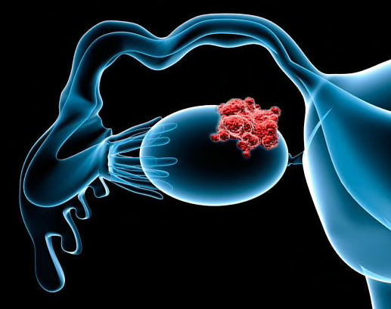
Immunotherapy and ADCs in Ovarian cancer : How far are we from clinical application ?
Georges Chahine, MD
Professor and former Chief of Hematology-Oncology Department
Hotel Dieu de France, Beirut, Lebanon
November 2024

Slide 2
OUTLINE
EPIDEMIOLOGY OF OVARIAN CANCER / HRD AND BRCA
HISTORY OF OVARIAN CANCER
NEW OPTIONS IN OVARIAN CANCER
  ADC
    FR⍺
      FORWARD 1
      SORAYA
      MIRASOL
    OTHER ONGOING STUDIES
  IMMUNOTHERAPY
    DUO-O TRIAL
    ANITA/ENGOT TRIAL
    BOUQUET TRIAL
SUMMARY
Notes:
COULEUR

Slide 3

OVARIAN CANCER IS THE LEADING CAUSE OF DEATH FROM GYNECOLOGICAL CANCERS
> 150 000 WOMEN DIE ANNUALY FROM OVARIAN CANCER
Almost 300,000
women were diagnosed with ovarian cancer in 2022
30–50%
5-year survival for newly diagnosed advanced ovarian cancer^{4,5}
  At least 60% of newly diagnosed women will have advanced disease²
~70% of women relapse
within 3 years of first-line treatment^{3,4}
There is a significant need for better first-line treatment to improve outcomes
for women with ovarian cancer^{3–8}

Slide 4
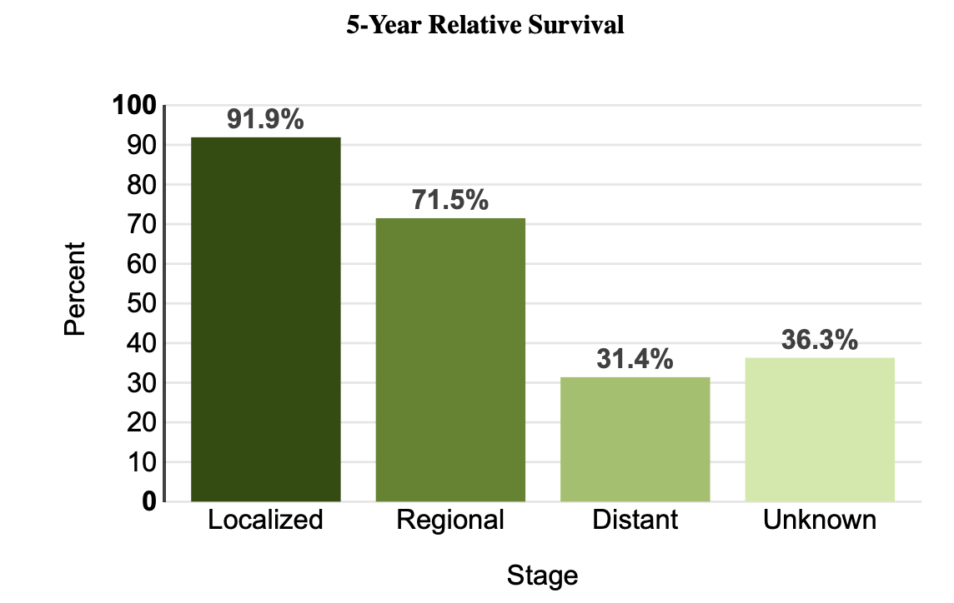
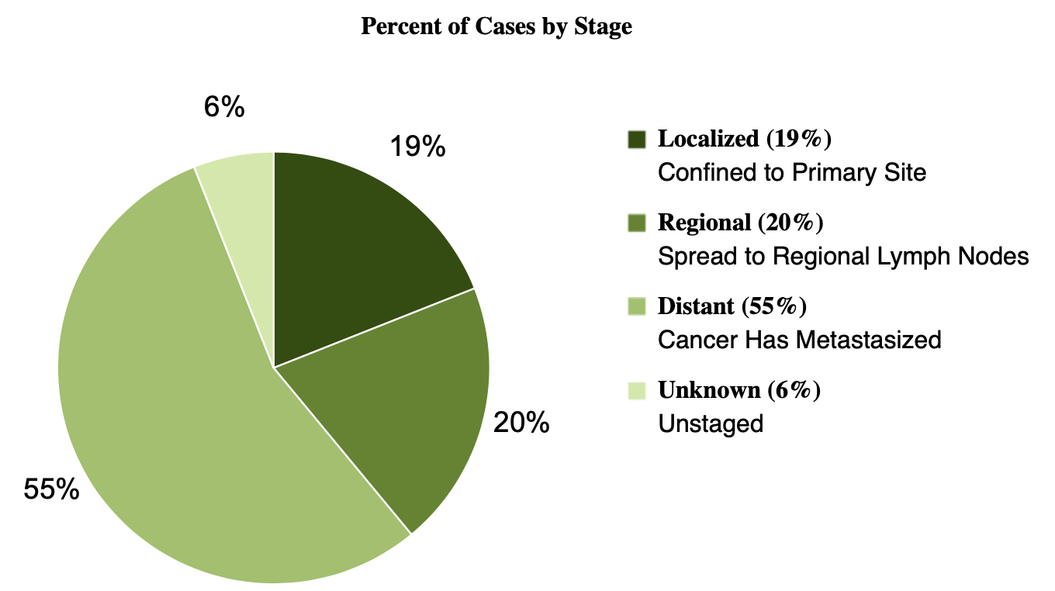
Advanced Ovarian Cancer Is Associated With Poor Survival Outcomes
Stage at Diagnosis, %
Localized
19%
Regional
20%
Distant
55%
Surveillance, Epidemiology, and End Results Program. https://seer.cancer.gov/statfacts/html/ovary.html. 2022.
Notes:
Talking Points
Most patients (79%) are diagnosed with regional or distant disease
Patients diagnosed with advanced ovarian cancer have a much poorer survival outcome compared with patients diagnosed with localized or regional ovarian cancer
The 5-year relative survival with metastatic disease is 29.2% compared with 74.5% with regional disease and 92.3% with localized disease
Reference
Surveillance, Epidemiology, and End Results Program. Cancer stat facts: ovarian cancer. https://seer.cancer.gov/statfacts/html/ovary.html. Accessed December 17, 2018.
Speaker notes are for internal use only and are not to be shown or disseminated outside of AstraZeneca

Slide 5
Natural history of advanced ovarian cancer
Disease relapse
First-line
chemotherapy
± bevacizumab maintenance
± PARP inhibitor
Second-line platinum
chemotherapy ± bevacizumab maintenance
Third-line platinum
chemotherapy
Non-platinum chemotherapy ± bevacizumab
Surgery
*
Tumour volume expressed in CA -125 level (MU/mL)
Ileus
Symptoms
4+ months
PFI: median 12–24 months
Mainly depending
on outcome of
first surgery
Median 8–20 months
Mainly depending on
PFI1 and surgery
(DESKTOP)
Disease-free survival (months)
CA-125, cancer antigen 125; PFI, progression-free interval
Adapted from: Giornelli GH. Springerplus 2016;5:1197​

Slide 6
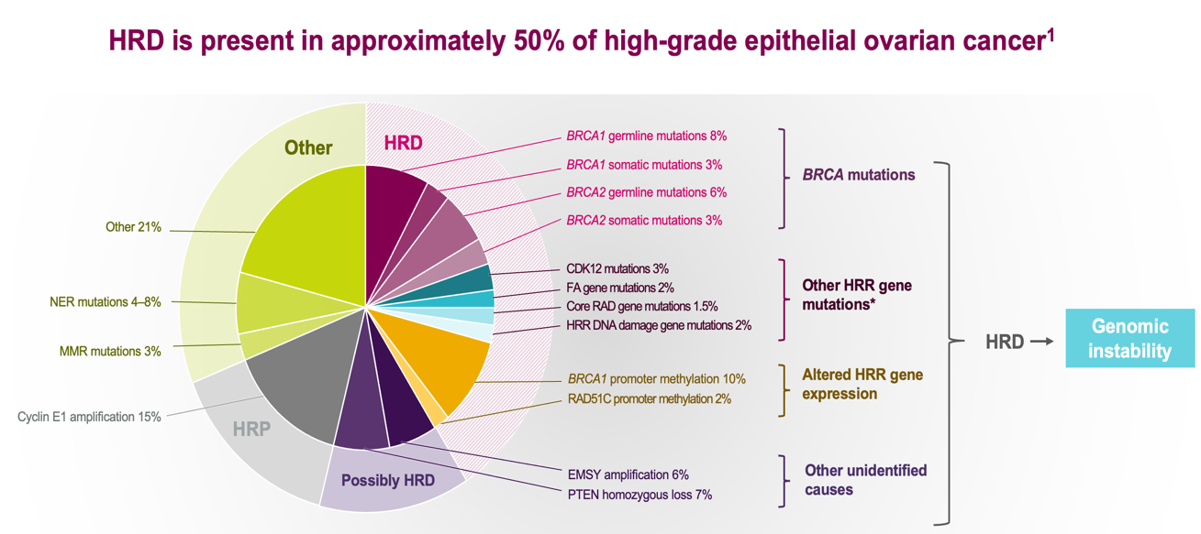
Importance of BRCA and HRD Testing
Patients with ovarian cancer^{1,2}
All women diagnosed with epithelial ovarian cancer should have germline genetic testing for HRD and BRCA1/2²
15%
gBRCAm
7%
sBRCAm
No BRCA mutation
BRCA, breast cancer susceptibility gene; BRCAm, breast cancer susceptibility gene mutation; gBRCAm, germline breast cancer susceptibility gene mutation; sBRCAm, somatic breast cancer susceptibility gene mutation.
Pal T, et al. Cancer. 2005;104(12):2807-2816. 2. Pennington KP, et al. Clin Cancer Res. 2014;20(3):764-775. 3. Vergote I, et al. Facts Views Vis Obgyn. 2016;8(3):161-167. 4. Hennessy BT, et al. J Clin Oncol. 2010;28(22):3570-3576. 5. Hoskins PJ, Gotlieb WH. CA Cancer J Clin. 2017;67(6):493-506.
https://www.nccn.org/patients/guidelines/content/PDF/ovarian-patient.pdf
Notes:
Impoirtance of BRCA testing HRD in all patients with OC – Recommendation
https://ascopubs.org/doi/10.1200/JCO.19.02960
Talking Points
Approximately 15% of women with ovarian cancer have gBRCAm¹ and nearly 7% have sBRCAm²
With germline testing alone, 1 out of 3 women with BRCAm ovarian cancer would not be identified^{3,4}
Up to 40% of BRCAm ovarian cancer may be missed if testing is only performed in women with a family history of breast or ovarian cancer⁵
References
Pal T, Permuth-Wey J, Betts JA, et al. BRCA1 and BRCA2 mutations account for a large proportion of ovarian carcinoma cases. Cancer. 2005;104(12):2807-2816.
Pennington KP, Walsh T, Harrell MI, et al. Germline and somatic mutations in homologous recombination genes predict platinum response and survival in ovarian, fallopian tube, and peritoneal carcinomas. Clin Cancer Res. 2014;20(3):764-775.
Vergote I, Bours V, Blaumeiser B, Baurain JF. New perspective on maintenance therapies for platinum- sensitive recurrent ovarian cancer in women with germline and somatic mutations in BRCA1 and BRCA2 genes. Facts Views Vis Obgyn. 2016;8(3):161-167.
Hennessy BT, Timms KM, Carey MS, et al. Somatic mutations in BRCA1 and BRCA2 could expand the number of patients that benefit from poly (ADP ribose) polymerase inhibitors in ovarian cancer. J Clin Oncol. 2010;28(22):3570-3576.
Hoskins PJ, Gotlieb WH. Missed therapeutic and prevention opportunities in women with BRCA-mutated epithelial ovarian cancer and their families due to low referral rates for genetic counseling and BRCA testing: A review of the literature. CA Cancer J Clin. 2017;67(6):493-506.
Speaker notes are for internal use only and are not to be shown or disseminated outside of AstraZeneca

Slide 7
300K WOMEN ANNUALY
IMPORTANCE OF R0 SURGERY
PLATINUM BASED CHEMOTHERAPY +/- PARPi/BEV Maintenance for HRD + and mBRCA
PLATINUM-SENSITIVE DISEASE MORE THAN 6 MONTHS AFTER PLATINUM TREATMENT
In Summary…
PLATINIUM – RESISTANT/REFRACTORY
AND HRD NEGATIVE (>50% of patients)
URGENT NEED TO FIND NEW OPTIONS
PER 100,000 PERSONS

Slide 8
NEW OPTIONS IN OVARIAN CANCER IN 2024
Immunotherapy (STILL DISAPPOINTING)
ADC – THE RISING STAR
Notes:
CHANGE THE FORM

Slide 9
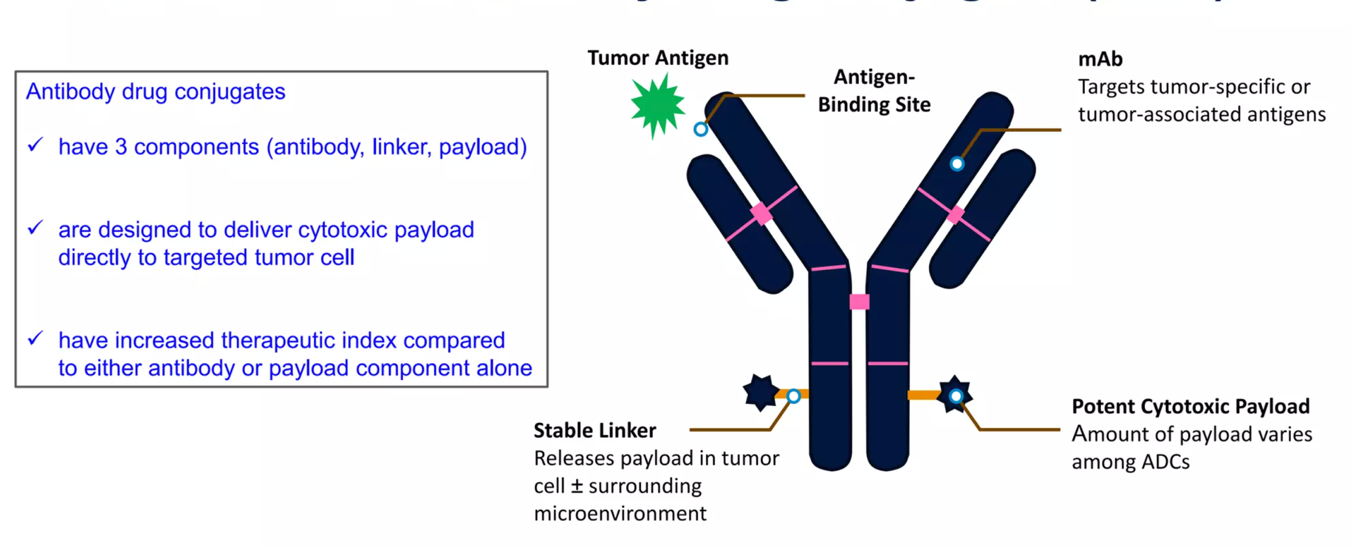
WHAT IS ADC
Notes:
Importance

Slide 10

Antigens exploited for ADC development in OC¹
MSLN
TROP-2
HER-2
NaPi2b
CDH6
TF
FRα
MUC-16
Reported expression in OC | 60–100% | 70% | 5–60% | 55–100% | 80–90% | 95% | 25–100% | 70–90%
Some ADCs may only demonstrate efficacy in higher expression levels of the target antigen.^{2,3}
Domenica Lorusso, MD, PhD
Content of this presentation is copyright and responsibility of the author. Permission is required for re-use.
1. Chelariu-Raicu A, et al. Int J Gynecol Cancer. 2023 2. Moore KN, et al. European Society for Medical Oncology (ESMO) Annual Meeting. 2019; Presentation 992O. 3. Meric-Bernstam F, et al. J Clin Oncol. 2024.

Slide 11
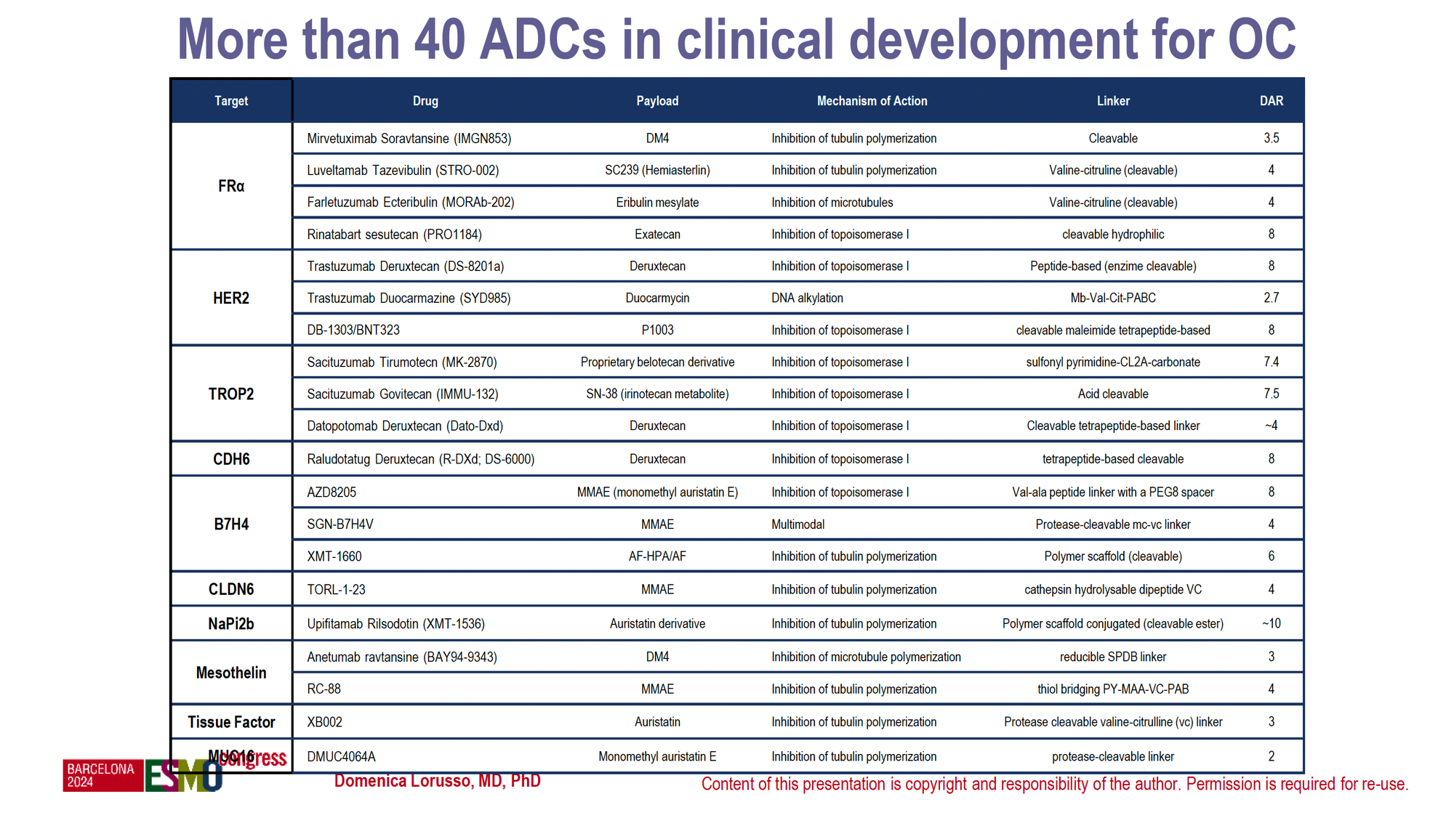

Slide 12
Most important antigens explored in ovarian cancer
FR⍺
- Mesothelin
- HER 2, TROP2, Cadherin 6, Claudin 6, B7-H4, NaPi2b…

Slide 13
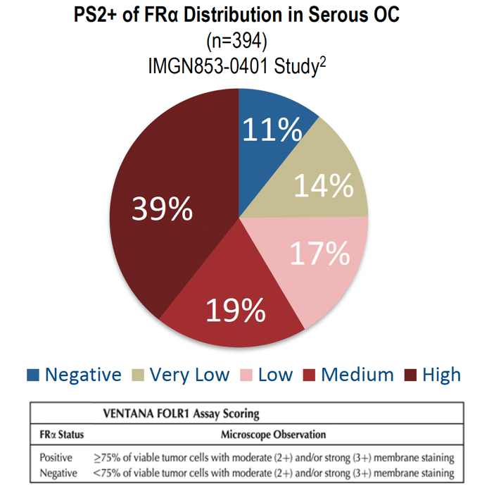
FR⍺ : An ideal biomarker in ovarian cancer
FR⍺ is a cell surface glycoprotein encoded by the FOLR1 gene
Determination of patient tumor FR⍺ levels may be important for treatment success
2. ImmunoGen. 2021 Data on File
Notes:
LEVELS
REFERENCE
39 + 19 in bold

Slide 14
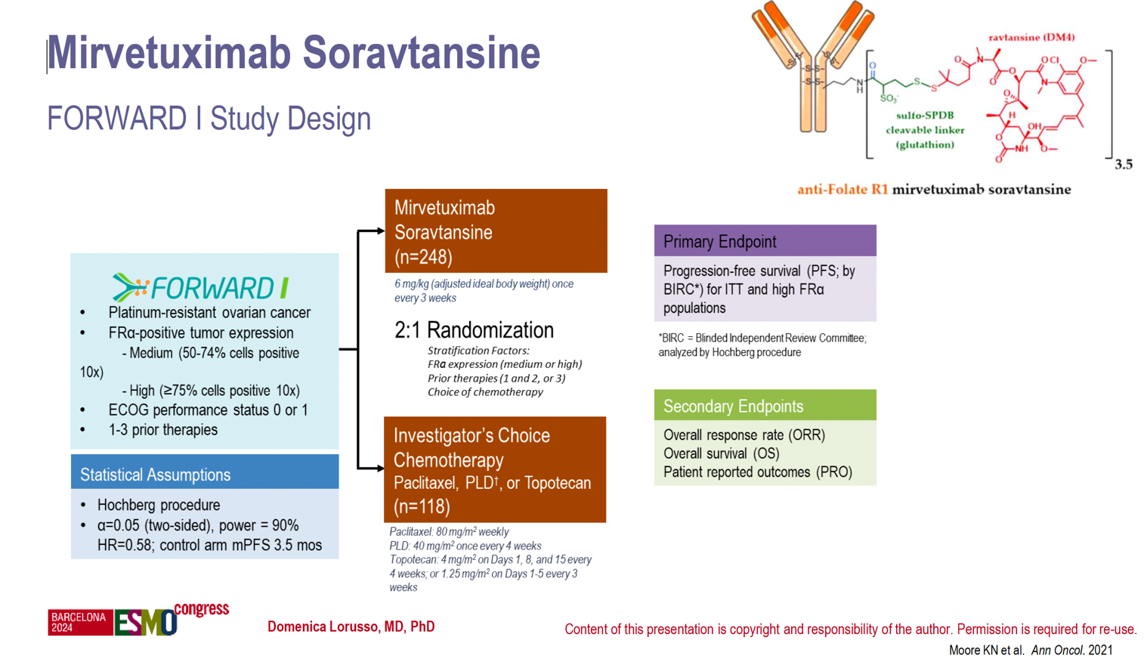
FORWARD 1
Notes:
FORWARD 1

Slide 15
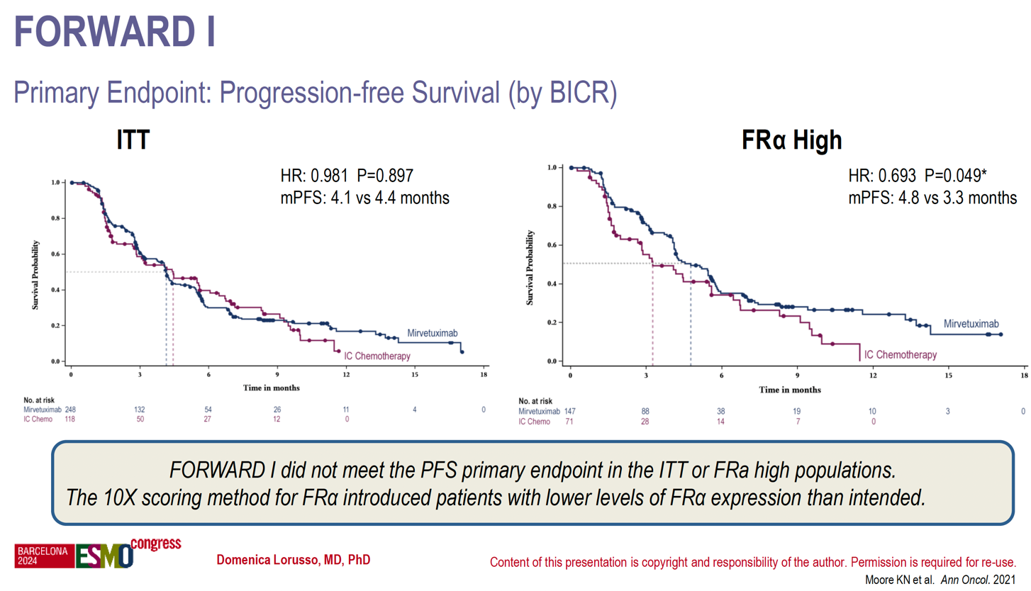
NEGATIVE RESULT BECAUSE OF SCORING METHOD ?

Slide 16
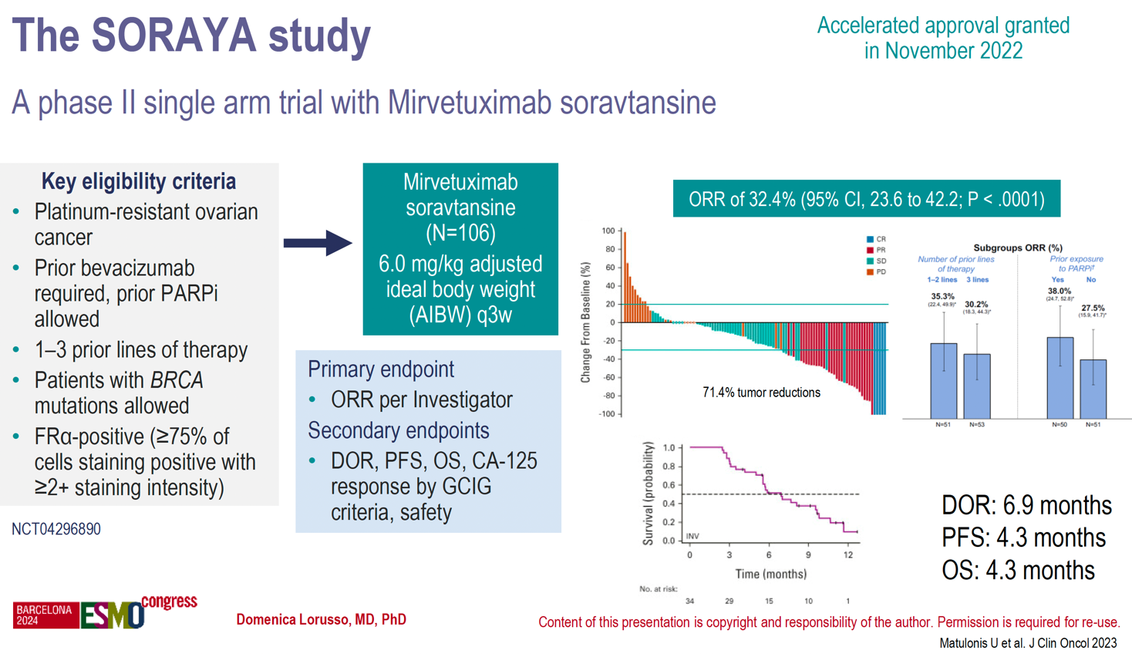
SORAYA

Slide 17
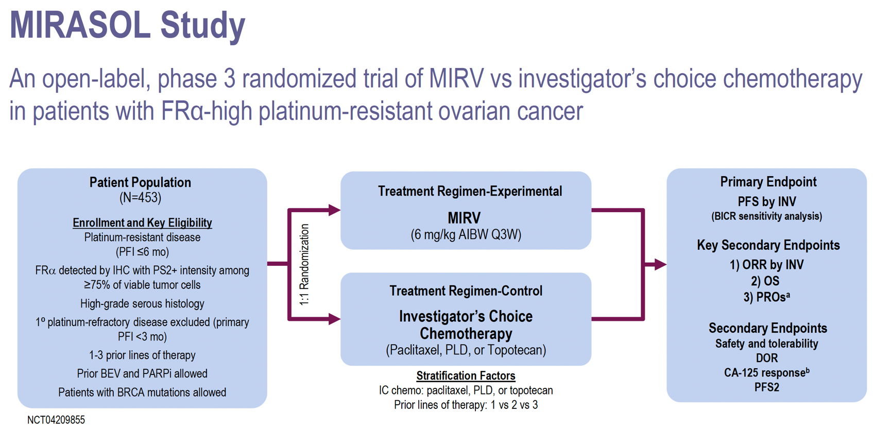
Notes:
FR alfa plus que 75%

Slide 18
Characteristics | Mirvetuximab Soravtansine (n = 227) | Chemotherapy (n = 226)
Median age, yr (range) | 63 (32-88) | 62 (29-87)
Stage at initial diagnosis, n (%) I-II III IV | 9 (4) 137 (60) 76 (33) | 9 (4) 147 (65) 65 (29)
BRCA mutation, n (%) | 29 (13) | 36 (16)
Prior systemic therapies, n (%) 1 2 3 | 29 (13) 90 (40) 108 (48) | 34 (15) 88 (39) 104 (46)
Prior exposure, n (%) Bevacizumab PARP inhibitor Taxanes | 138 (61) 124 (55) 227 (100) | 143 (63) 127 (56) 224 (99)
Primary platinum-free interval, n (%) ≤12 mo/>12 mo | 146 (64)/80 (35) | 142 (63)/84 (37)
Platinum-free interval, n (%) ≤3 mo/>3 to ≤6 mo | 88 (39)/138 (61) | 99 (44)/124 (55)
Notes:
COULEUR

Slide 19
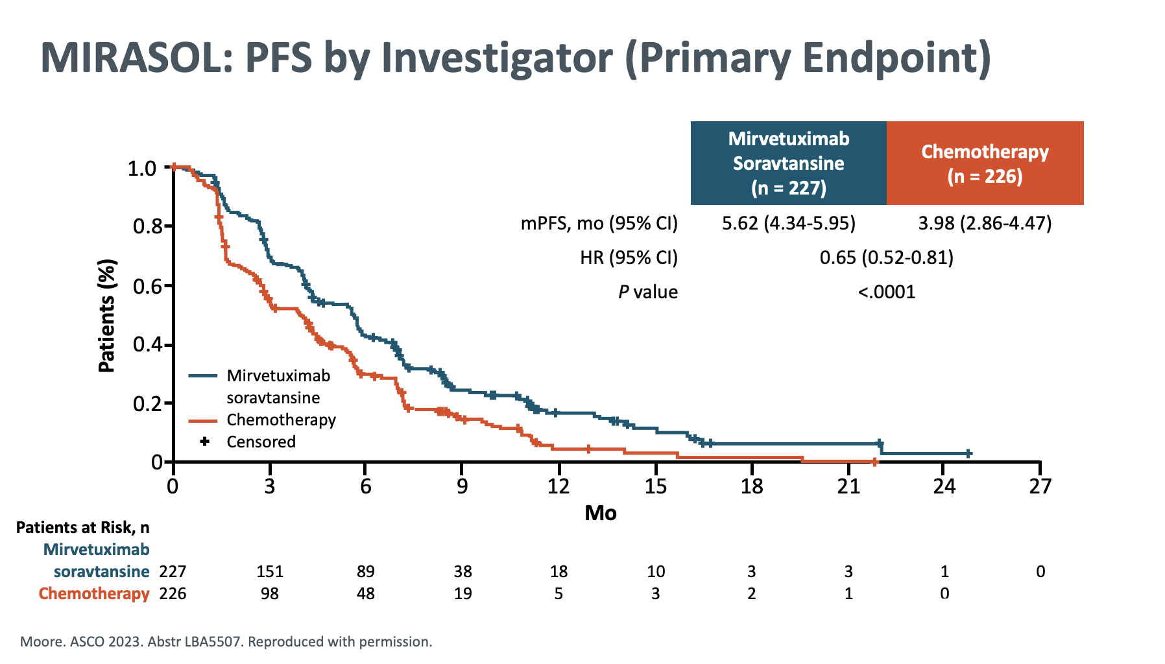

Slide 20
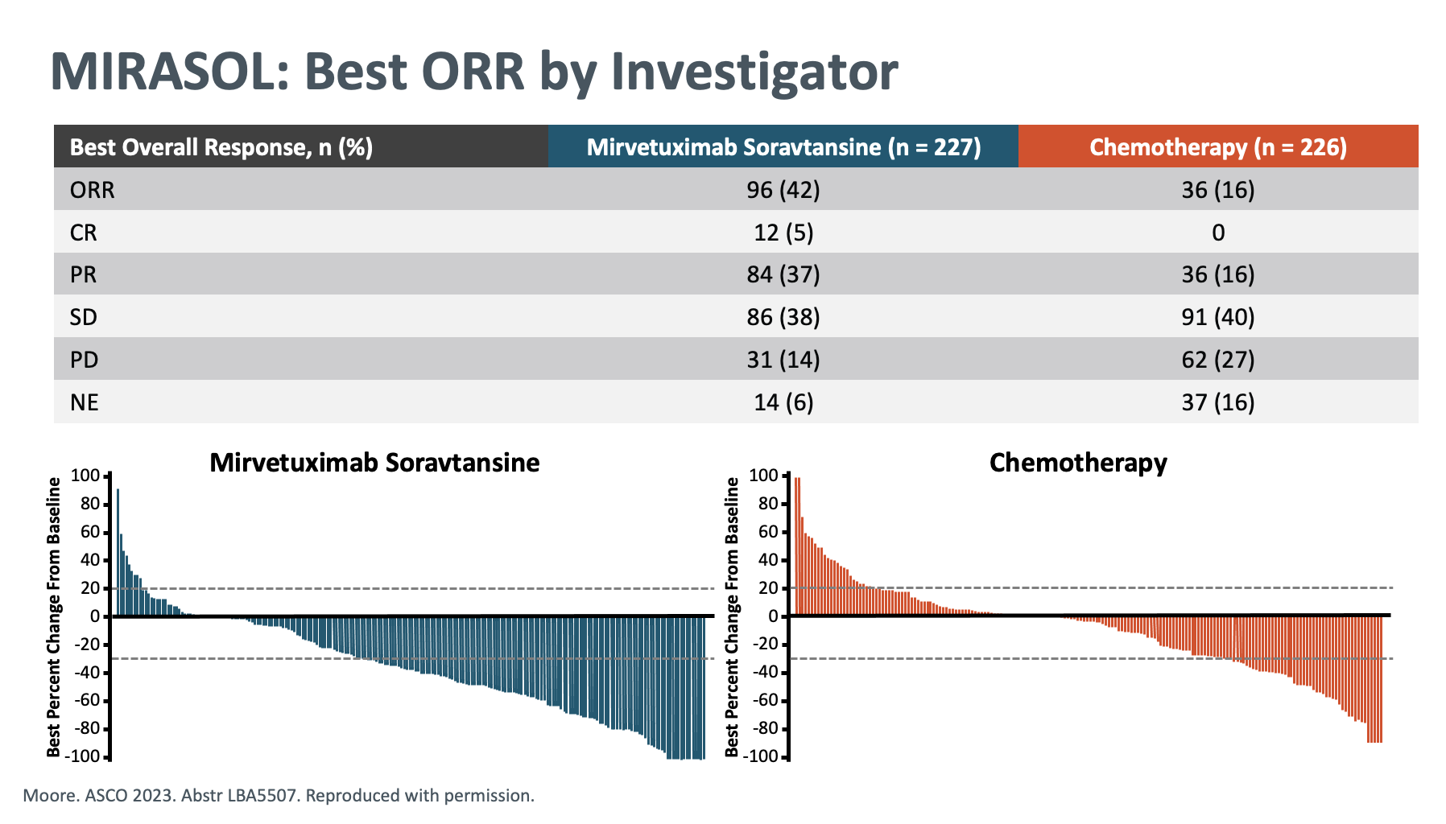

Slide 21
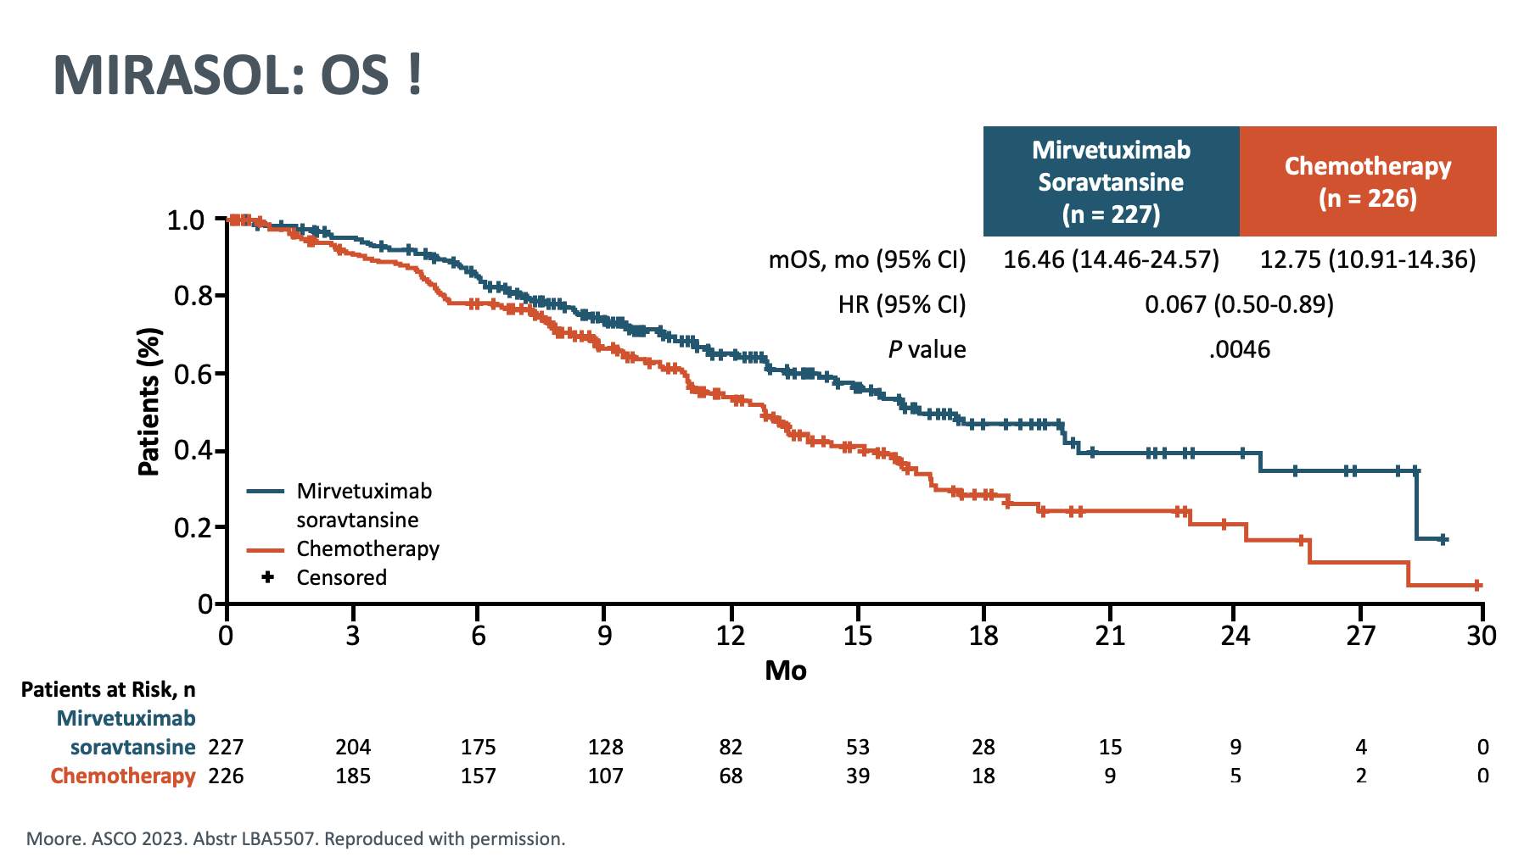

Slide 22
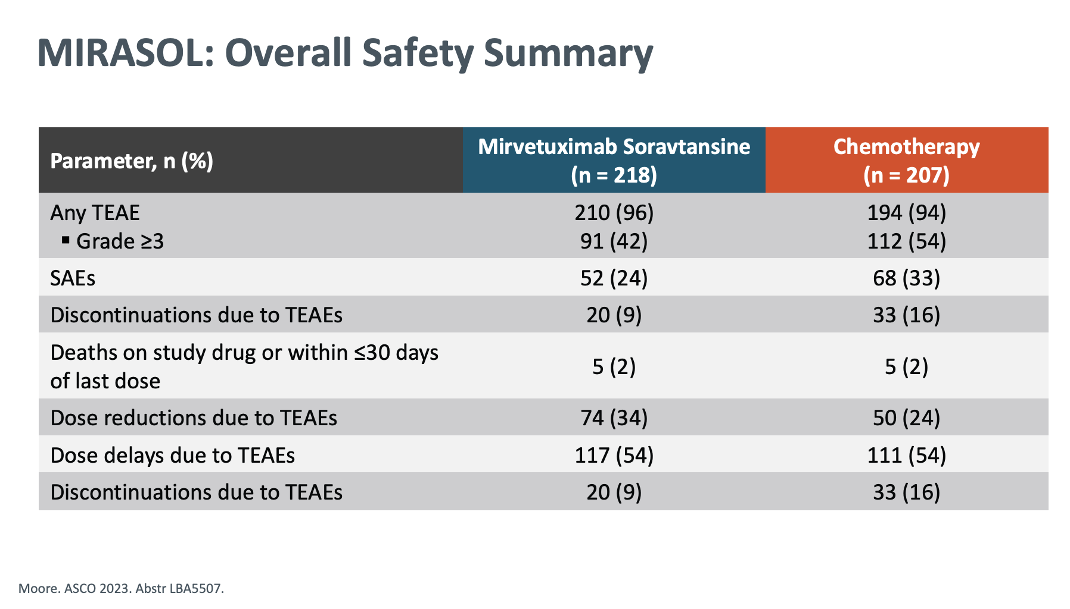

Slide 23
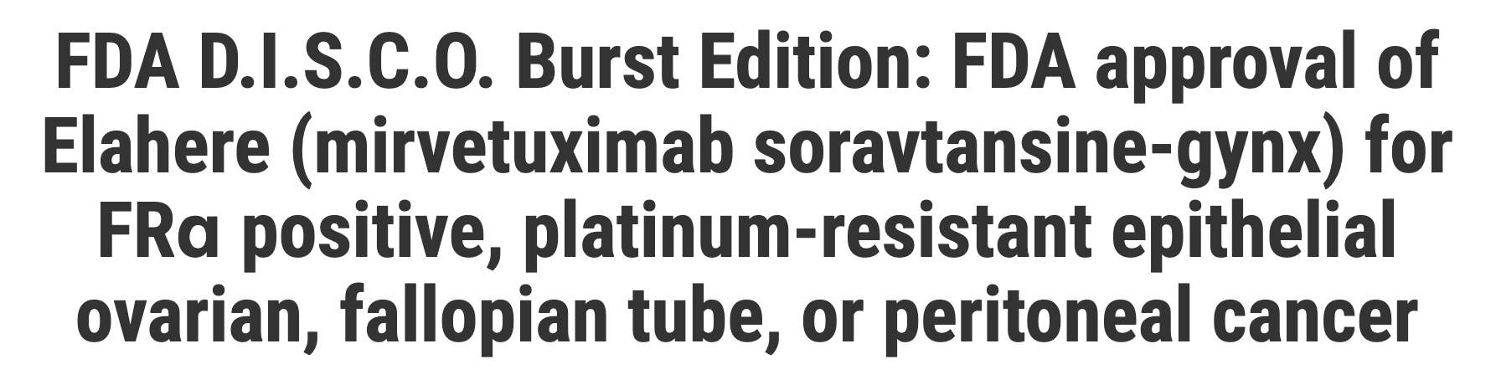
Mirvetuximab soravtansine
Meaningful Improvements in PFS/OS/ORR
Efficacy and Safety
NOVEMBER 2022
Notes:
DATE NOVEMBRE 2022
As of November 2022, Elahere SOC FRα+, platinum resistant OC

Slide 24
FR⍺ Ongoing Studies
FORWARD 1
Phase III
NEGATIVE STUDY
SORAYA
Phase II
Mirvetuximab Soravtansine Accelerated approval granted in November 2022
MIRASOL
Phase III
Primary End-point PFS
Mirvetuximab Soravtansine VS Chemotherapy in platinum-resistant OC
SCORING METHOD PROBLEM ?
DOR 6.9 months PFS 4.3 months OS 4.3 months
MIRV VS Chemotherapy
As of November 2022, Elahere SOC FRα+, platinum resistant OC
Notes:
Standard of CARE in MIRASOL

Slide 25
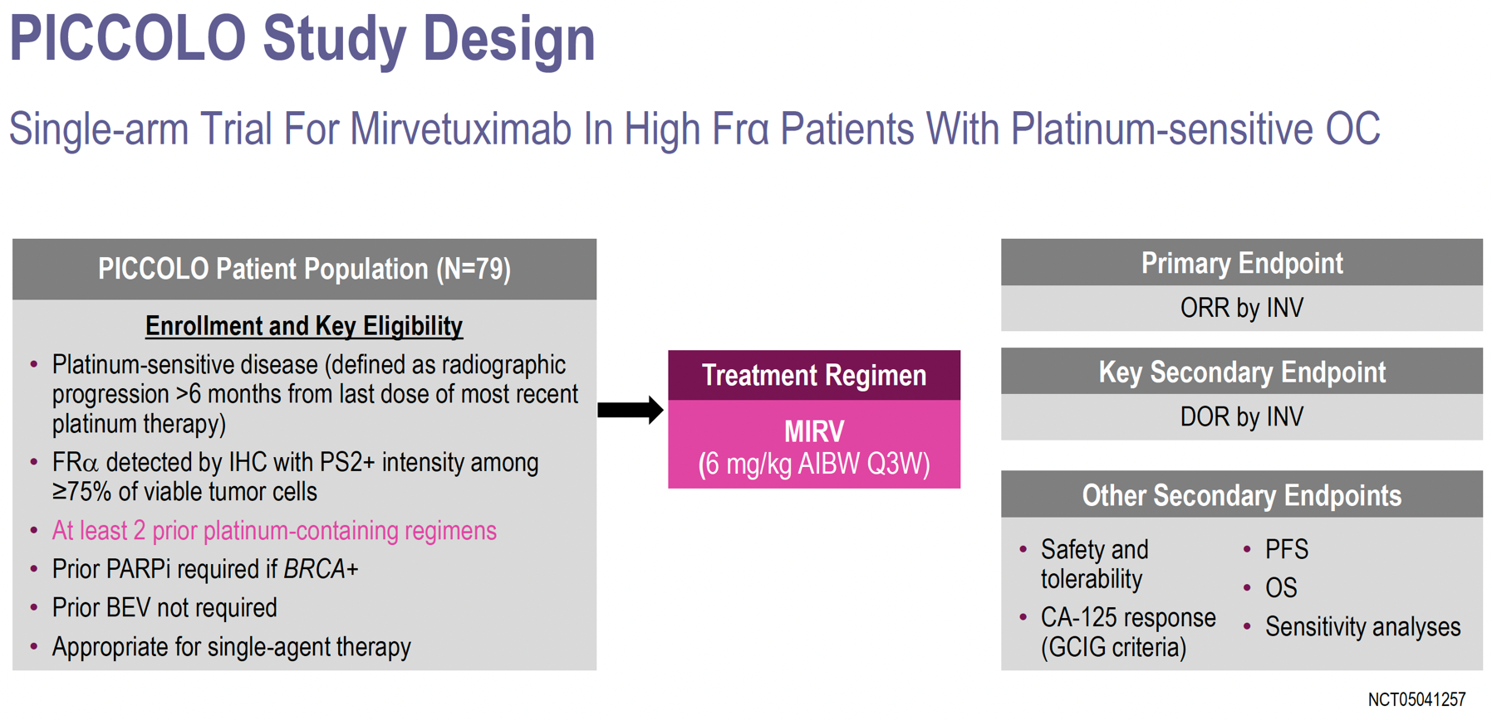
ONE STEP FURTHER…
The study met its primary endpoint with an objective response rate (ORR) of 51.9% (95%CI 40.4 – 63.3%)
The median duration of response (DOR), a key secondary endpoint, was 8.25 months¹
1. https://news.abbvie.com/2024-06-06-AbbVie-Announces-Positive-Topline-Results-from-Phase-2-PICCOLO-Trial-Evaluating-Mirvetuximab-Soravtansine-ELAHERE-R-for-High-Folate-Receptor-Alpha-FR-Expressing-Platinum-Sensitive-Ovarian-Cancer
Notes:
https://news.abbvie.com/2024-06-06-AbbVie-Announces-Positive-Topline-Results-from-Phase-2-PICCOLO-Trial-Evaluating-Mirvetuximab-Soravtansine-ELAHERE-R-for-High-Folate-Receptor-Alpha-FR-Expressing-Platinum-Sensitive-Ovarian-Cancer
HIGHLIGHT FOR PLATINUM SENSITIVE
REFERENCE in the slide

Slide 26
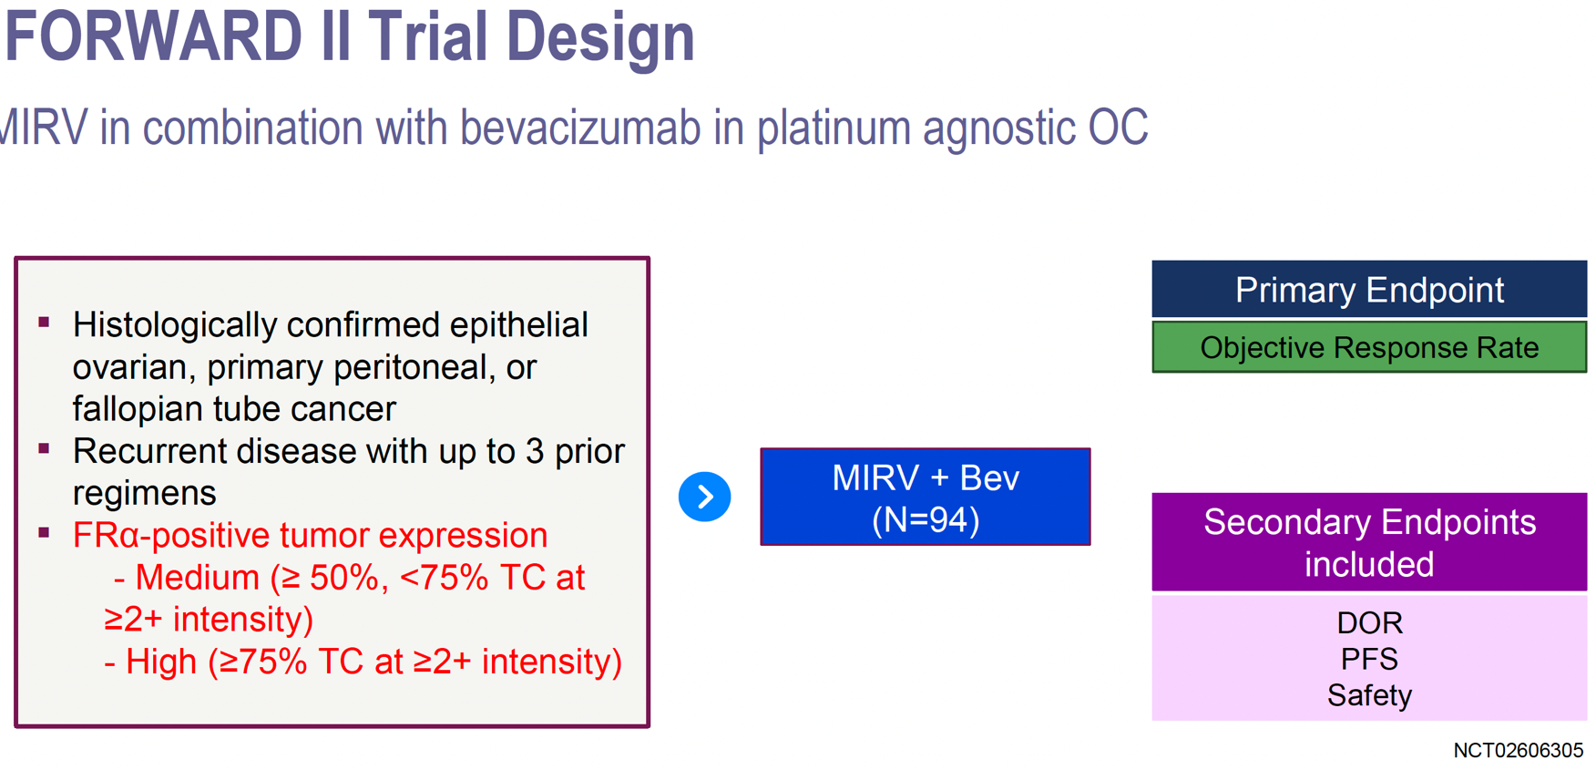
ONE STEP FURTHER…

Slide 27
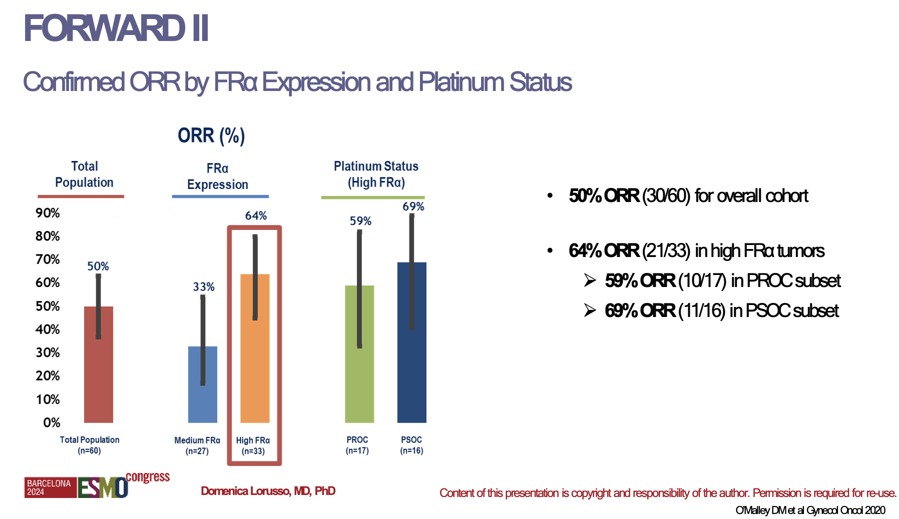
ONE STEP FURTHER…

Slide 28
ONGOING TRIALS of FR⍺ targeted ADC …
Luveltamab tazevibulin (STRO-002) : REFR⍺ME-O1 phase 3 study
Farletuzumab ecteribulin (MORAb-202) : CA116-001 phase 2 study
Notes:
ONGOING TRIALS…

Slide 29
MSLN
TROP-2
HER-2
NaPi2b
CDH6
TF
FRα
MUC-16
Reported expression in OC | 60–100% | 70% | 5–60% | 55–100% | 80–90% | 95% | 25–100% | 70–90%
Some ADCs may only demonstrate efficacy in higher expression levels of the target antigen.^{2,3}
Domenica Lorusso, MD, PhD
Content of this presentation is copyright and responsibility of the author. Permission is required for re-use.
1. Chelariu-Raicu A, et al. Int J Gynecol Cancer. 2023 2. Moore KN, et al. European Society for Medical Oncology (ESMO) Annual Meeting. 2019; Presentation 992O. 3. Meric-Bernstam F, et al. J Clin Oncol. 2024.
Notes:
Highlight MSTLN

Slide 30
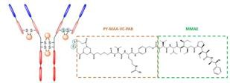
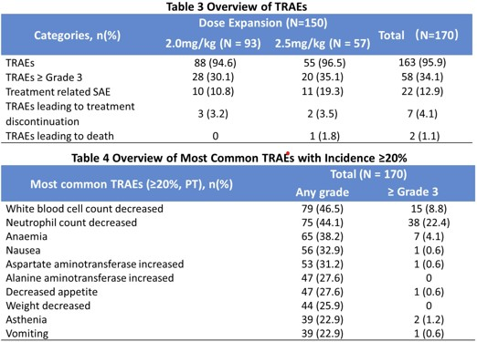
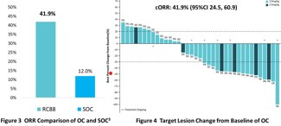
Mesothelin (MSLN)
U.S. FDA has granted RC88 Fast Track Designation in PROC in Jan 2024
Mesothelin, a protein that activates downstream oncogenic pathways for cell proliferation, survival and invasion.
RC88
Payload: MMAE (monomethyl auristatin)
Linker: site-specific thiol bridging PY-MAA-VC-PAB
DAR: 4
MSLN expression in OC: 98.8%
164 pts with advanced solid tumor
O C Efficacy: ORR 41.9%
Safety
Domenica Lorusso, MD, PhD
Content of this presentation is copyright and responsibility of the author. Permission is required for re-use.
Liu Y et al. JCO 2024
Notes:
Other Target

Slide 31
Immunotherapy in OC
ENGOT-Ov41/GEICO 69-O/ANITA Trial (ESMO 2023)
DUO-O trial (ESMO 2024)
ENGOT-GYN2/GOG-3051/BOUQUET (ESMO 2023)
Notes:
Lot of studies done DISAPPOINTING
AND STILL ARE ONGOING

Slide 32
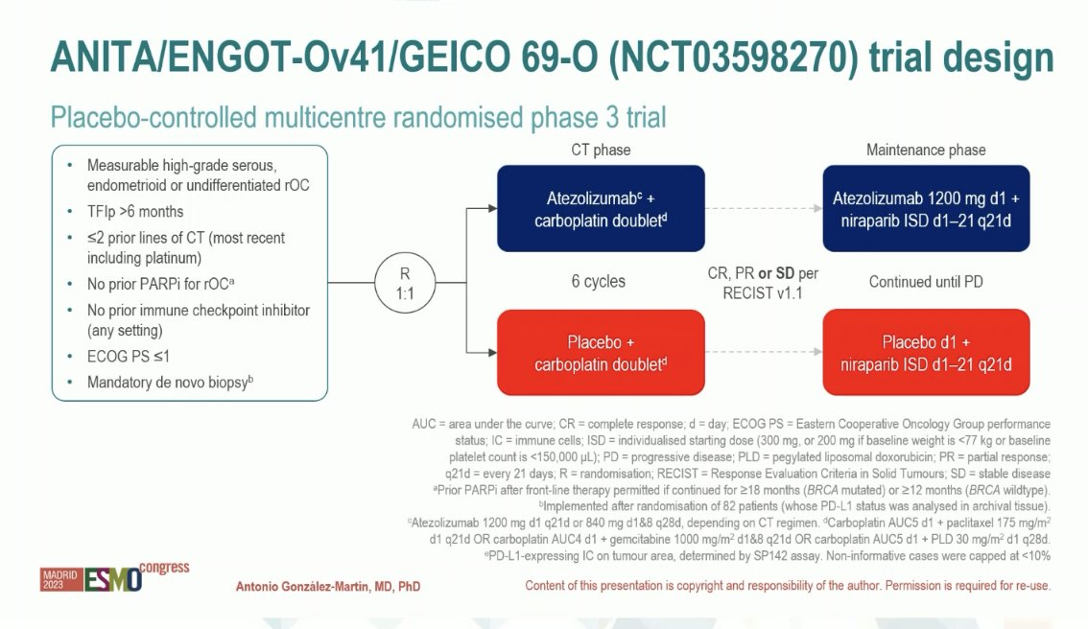
Notes:
INADEQUATE Surgery ?
Niraparib
Why negative
NEGATIVE TRIAL
NUMBER OF participants
ALLOWED PATIENTS WITH SD (40%) Vs NOVA (Niraparib alone) : NOVA CR PR only

Slide 33
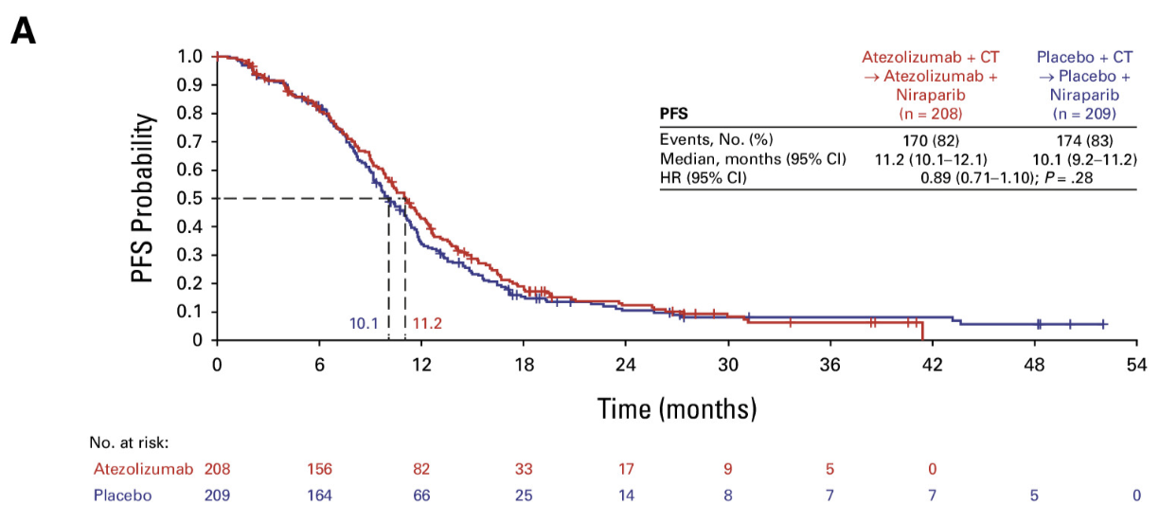
Combining atezolizumab with CT and maintenance niraparib for late-relapsing recurrent ovarian cancer did NOT improve PFS or the ORR

Slide 34
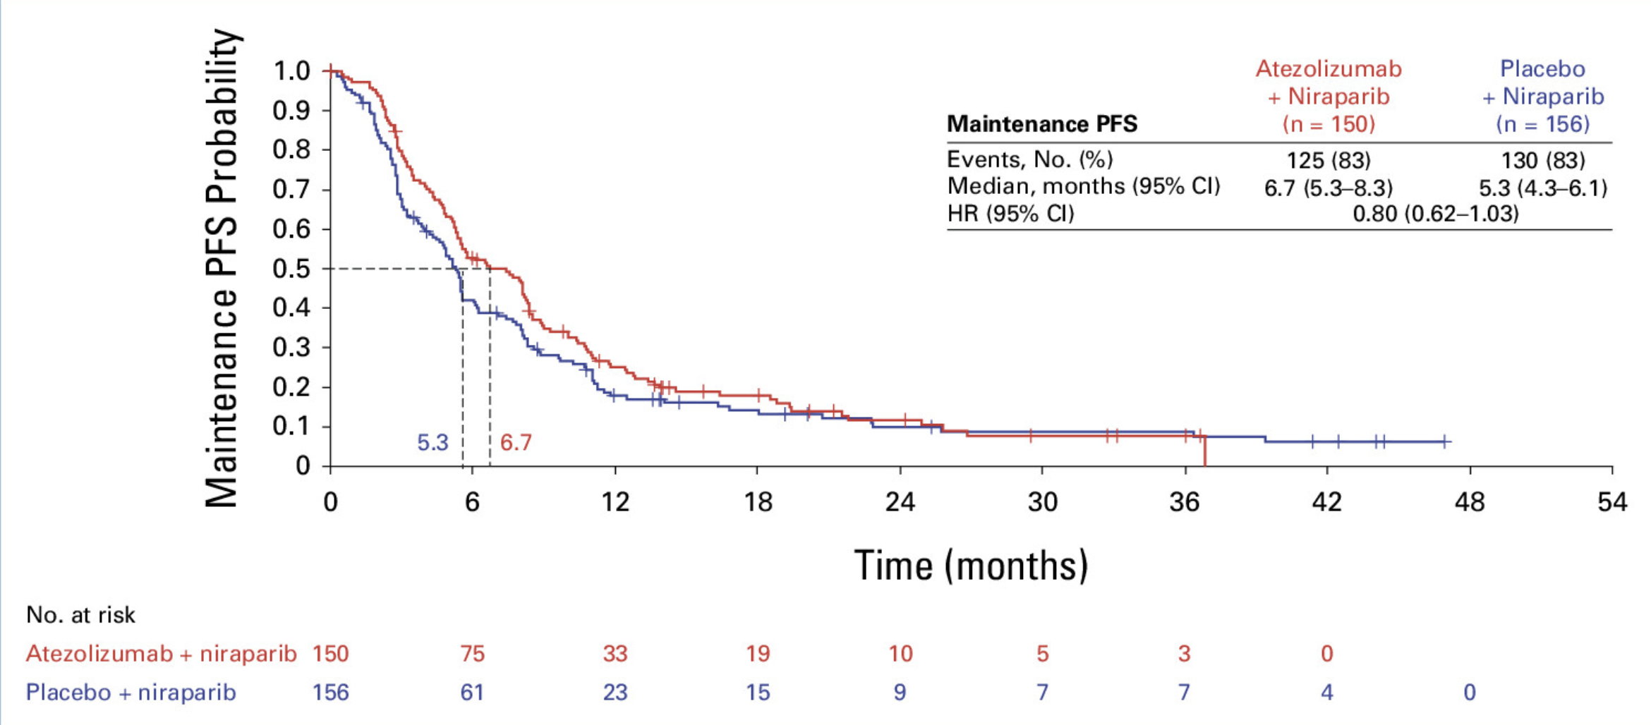
Median Maintenance PFS
Published in: Antonio González-Martín; María Jesús Rubio; Florian Heitz; René Depont Christensen; Nicoletta Colombo; Toon Van Gorp; Margarita Romeo; Isabelle Ray-Coquard; Lydia Gaba; Alexandra Leary; Luis Miguel De Sande; Coriolan Lebreton; Andrés Redondo; Michel Fabbro; Maria-Pilar Barretina Ginesta; Philippe Follana; J. Alejandro Pérez-Fidalgo; Manuel Rodrigues; Ana Santaballa; Renaud Sabatier; Maria José Bermejo-Pérez; Jean-Pierre Lotz; Beatriz Pardo; Gloria Marquina; Luisa Sánchez-Lorenzo; María Quindós; Purificación Estévez-García; Eva Guerra Alía; Luis Manso; Victoria Casado; Stefan Kommoss; Germana Tognon; Stéphanie Henry; Ilan Bruchim; Ana Oaknin; Frédéric Selle JCO 2024 09-18
DOI: 10.1200/JCO.24.00668
Copyright © 2024 American Society of Clinical Oncology

Slide 35
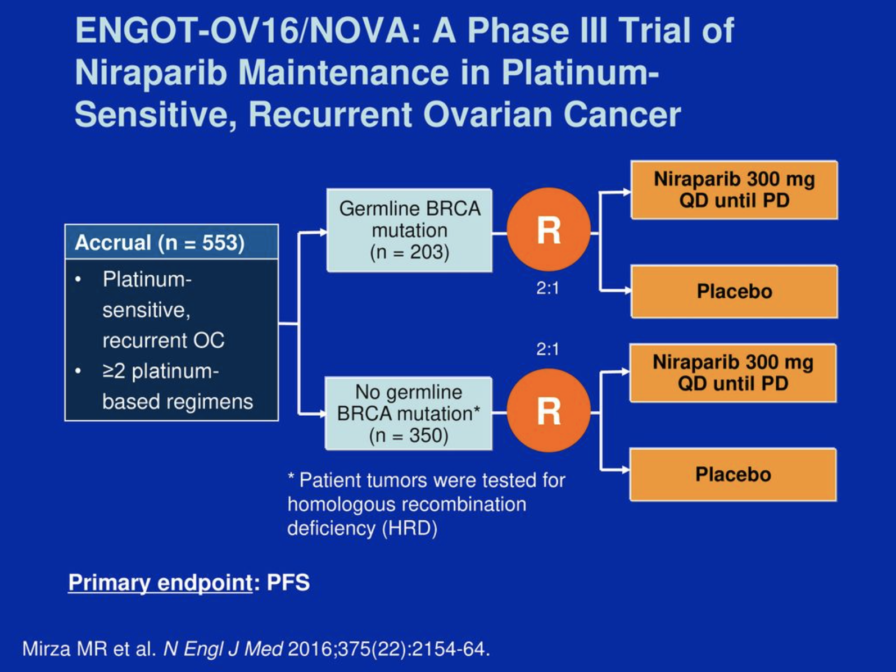
Notes:
DIFFERENT DESIGN

Slide 36
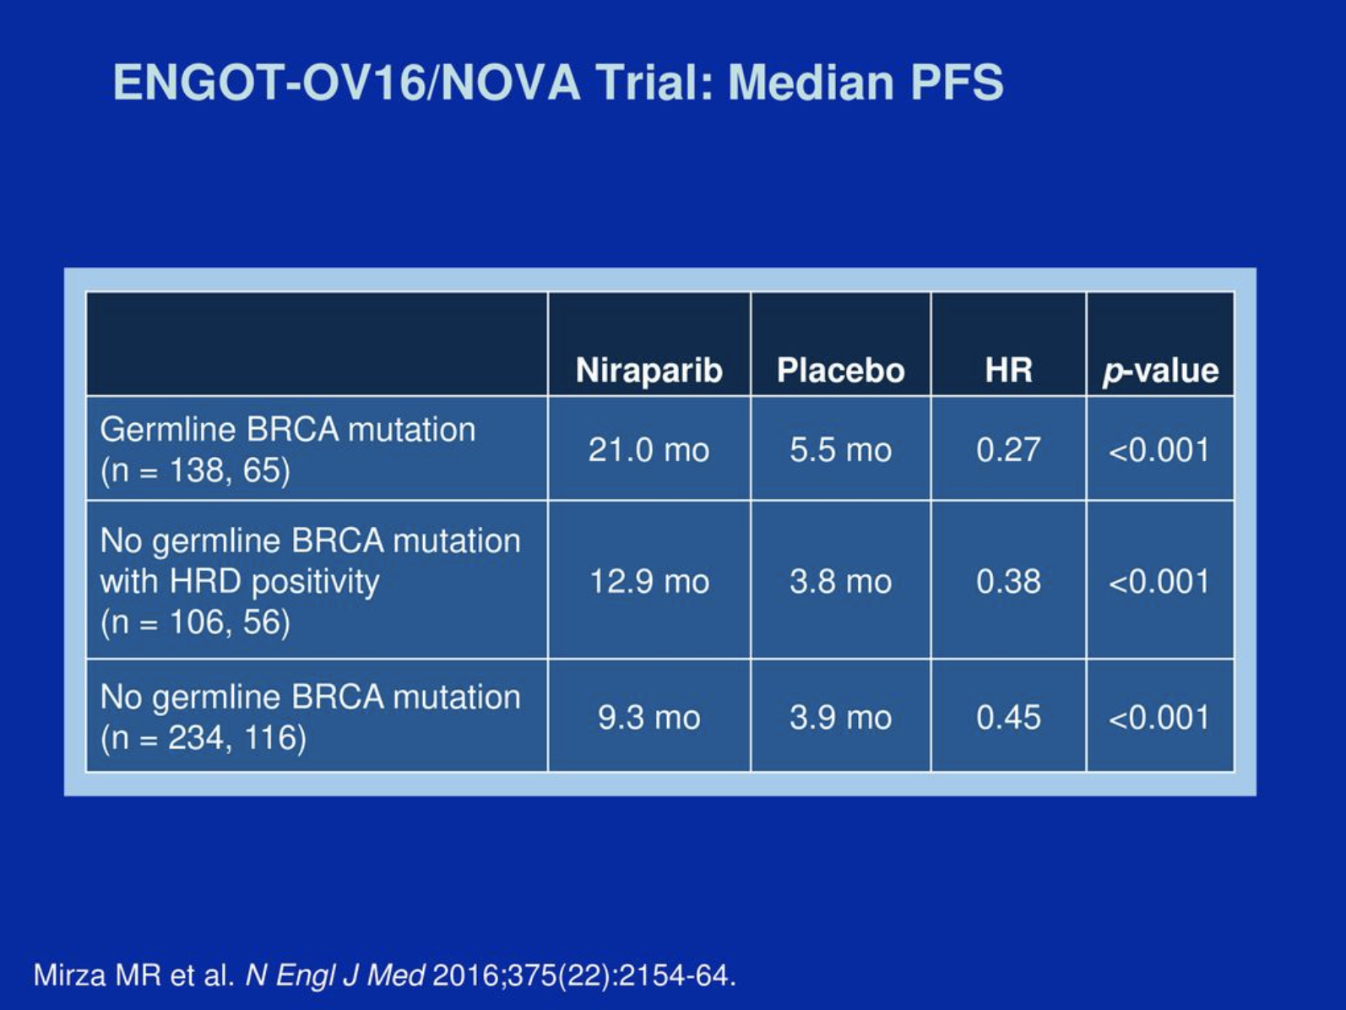
5.3 months PFS in ANITA
Notes:
DIFFERENT DESIGN
An important difference between the ANITA trial and the NOVA trial,⁴ which established maintenance niraparib as a standard of care in platinum-sensitive ovarian cancer, is that ANITA allowed patients with SD (45% of randomly assigned patients) as well as responding patients to continue to maintenance therapy. By contrast, to be eligible for NOVA, patients had to be in CR or PR after platinum-based CT. This may have contributed to the shorter maintenance PFS in the control arm of the present trial (median 5.3 months compared with 21.0 and 9.3 months in the BRCA-mutated and non–BRCA-mutated populations, respectively, of the niraparib arm in the NOVA trial). In the present trial, median PFS in both treatment groups was considerably shorter in the subgroup of patients with SD as best response compared with CR or PR.

Slide 37
WHY THE DISCREPENCY ?
5.3 months PFS in ANITA
Notes:
DIFFERENT DESIGN
An important difference between the ANITA trial and the NOVA trial,⁴ which established maintenance niraparib as a standard of care in platinum-sensitive ovarian cancer, is that ANITA allowed patients with SD (45% of randomly assigned patients) as well as responding patients to continue to maintenance therapy. By contrast, to be eligible for NOVA, patients had to be in CR or PR after platinum-based CT. This may have contributed to the shorter maintenance PFS in the control arm of the present trial (median 5.3 months compared with 21.0 and 9.3 months in the BRCA-mutated and non–BRCA-mutated populations, respectively, of the niraparib arm in the NOVA trial). In the present trial, median PFS in both treatment groups was considerably shorter in the subgroup of patients with SD as best response compared with CR or PR.

Slide 38
ANITA allowed patients with SD
45% of patients recruted had SD
Strict patient selection in NOVA
PR was defined as residual tumor less than 2cm AND Ca-125 decreased of at least 90%
WHY THE DISCREPENCY ?
5.3 months PFS in ANITA
Notes:
DIFFERENT DESIGN
An important difference between the ANITA trial and the NOVA trial,⁴ which established maintenance niraparib as a standard of care in platinum-sensitive ovarian cancer, is that ANITA allowed patients with SD (45% of randomly assigned patients) as well as responding patients to continue to maintenance therapy. By contrast, to be eligible for NOVA, patients had to be in CR or PR after platinum-based CT. This may have contributed to the shorter maintenance PFS in the control arm of the present trial (median 5.3 months compared with 21.0 and 9.3 months in the BRCA-mutated and non–BRCA-mutated populations, respectively, of the niraparib arm in the NOVA trial). In the present trial, median PFS in both treatment groups was considerably shorter in the subgroup of patients with SD as best response compared with CR or PR.

Slide 39
DUO-O TRIAL ESMO 2024
DUO-O trial - Frontline CT + Bev ± Durva → Maintenance Bev ± Durva ± Ola in OC With NO-BRCAm
POSITIVE TRIAL

Slide 40
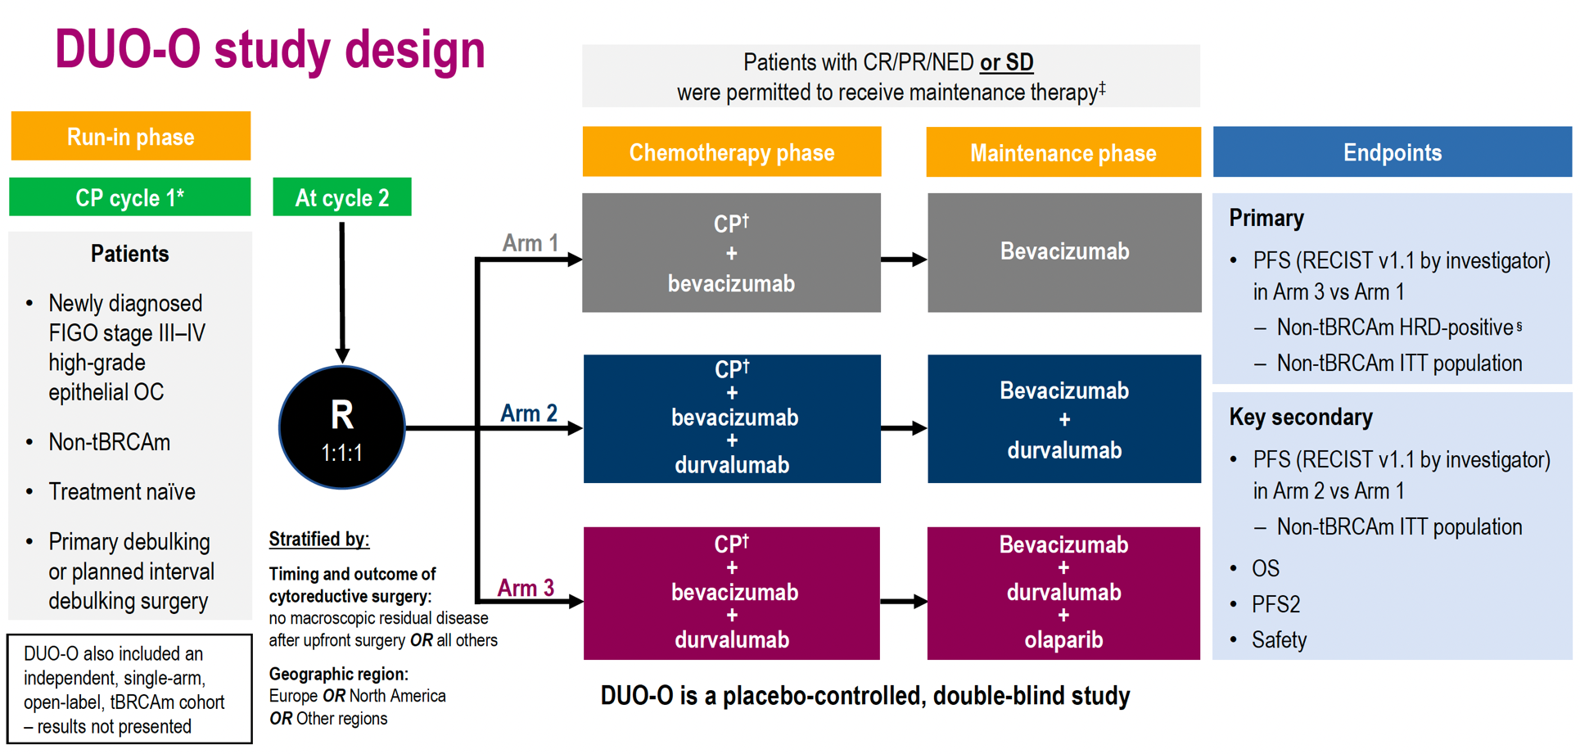
DUO-O TRIAL ESMO 2024

Slide 41
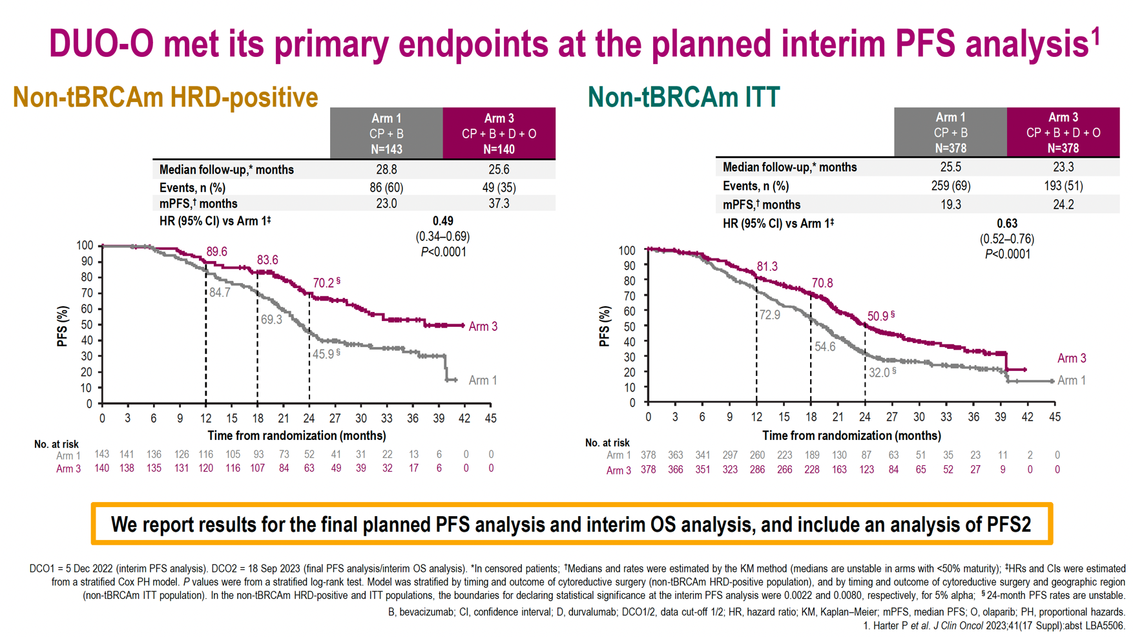

Slide 42
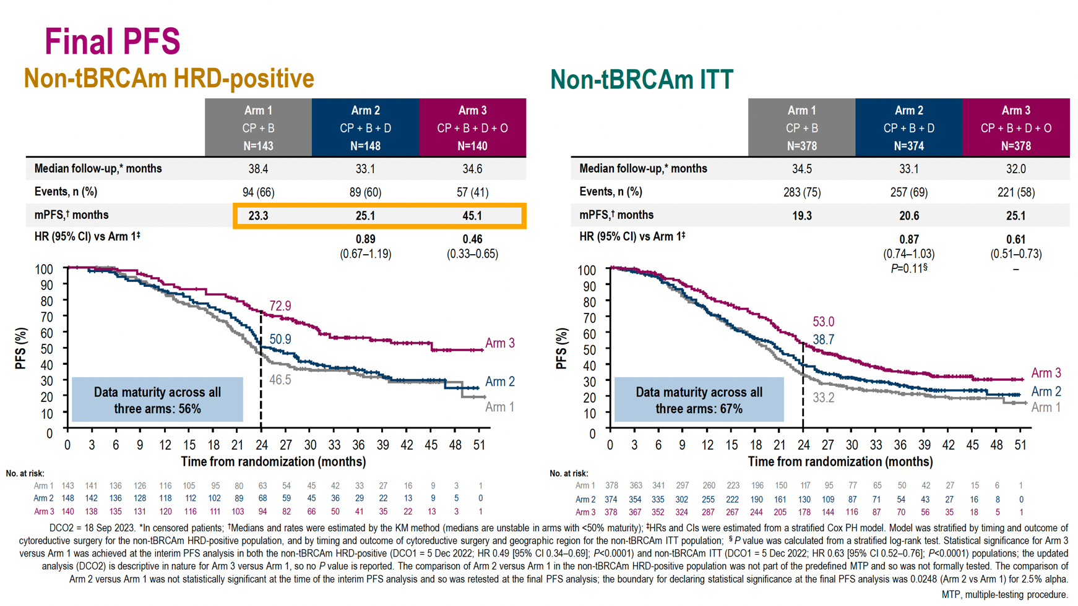
PFS BENEFIT

Slide 43
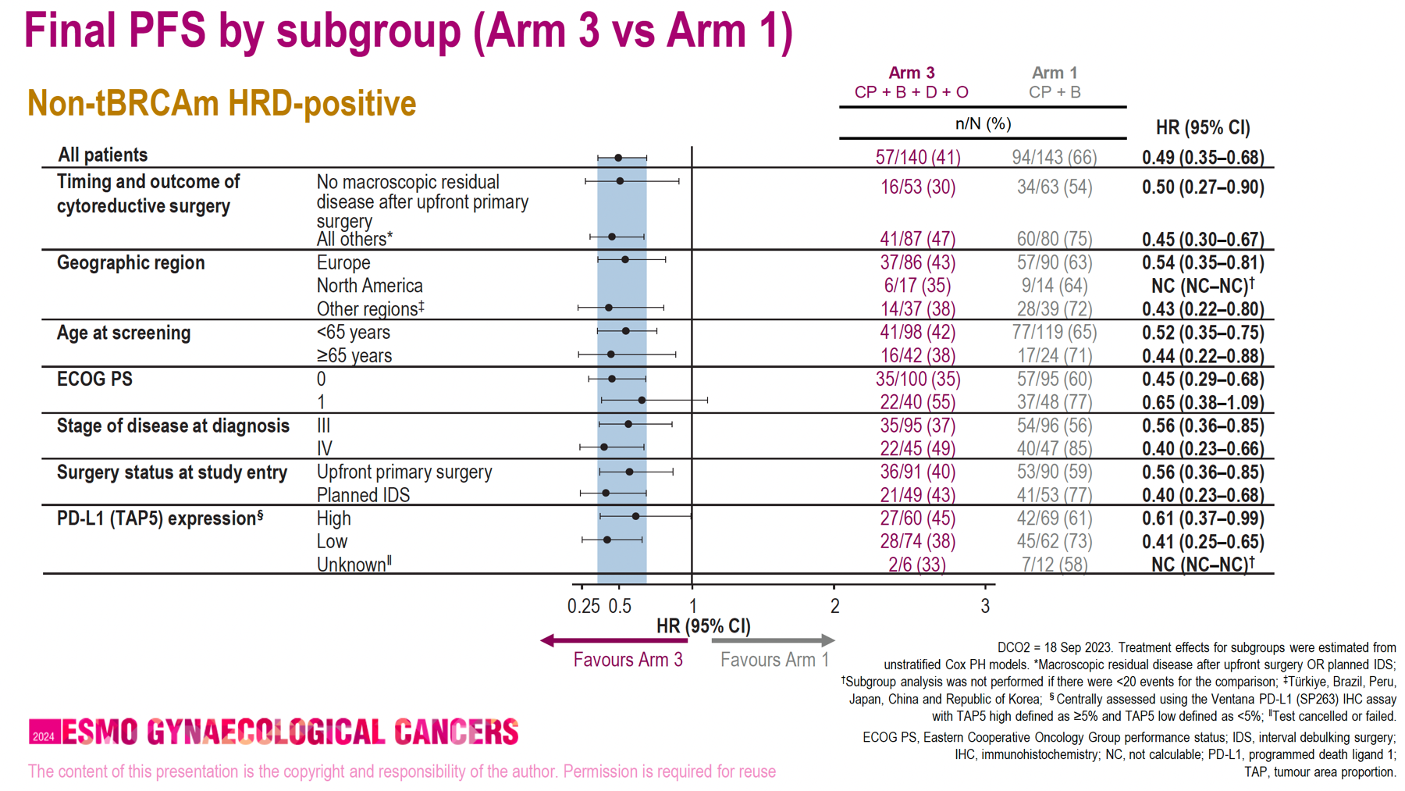
PFS BENEFIT

Slide 44
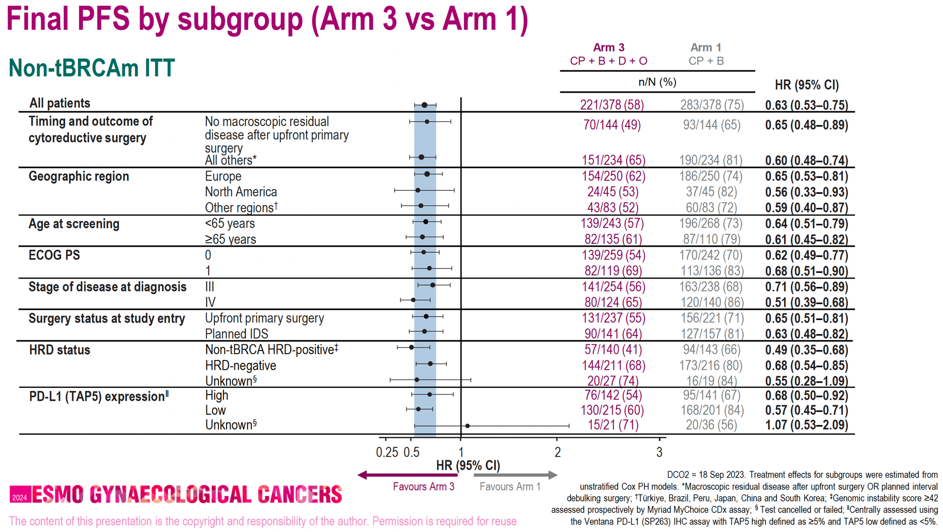
PFS BENEFIT

Slide 45
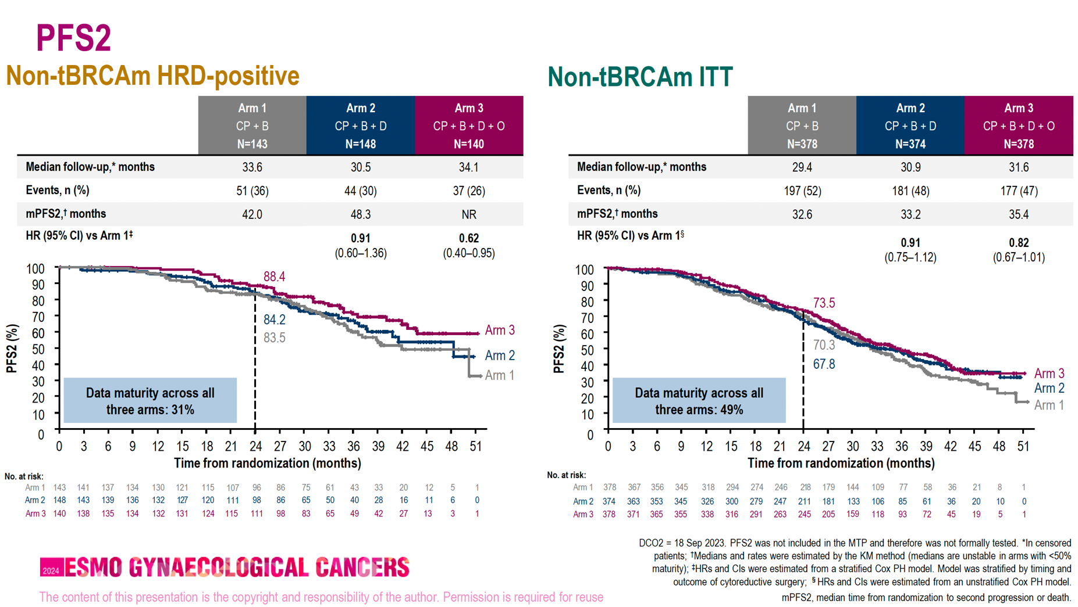
PFS2 FAVORS ARM3

Slide 46
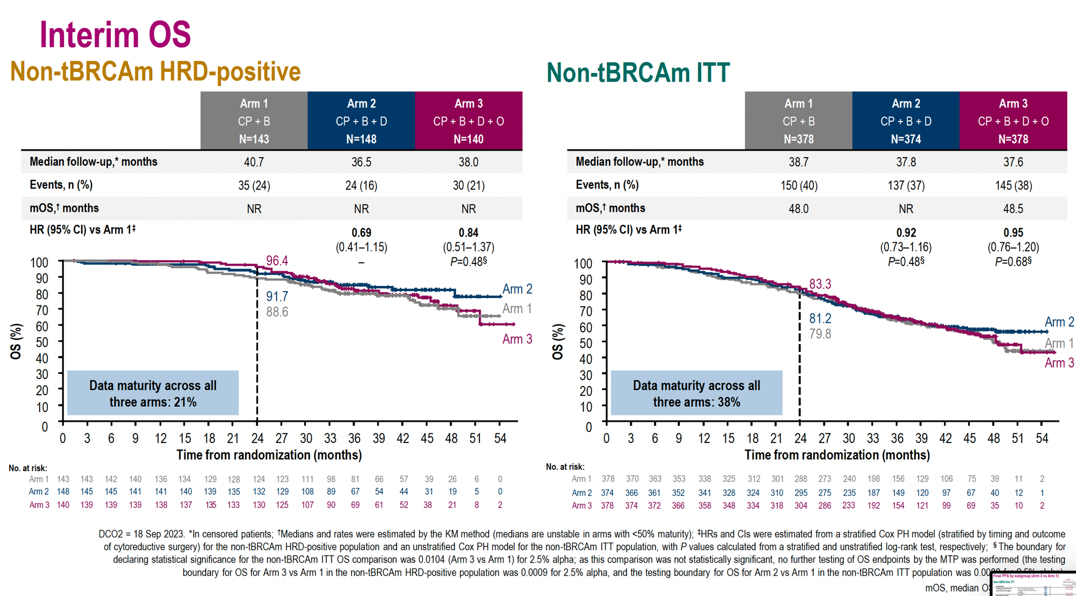
NO OS BENEFIT AT THIS INTERIM

Slide 47
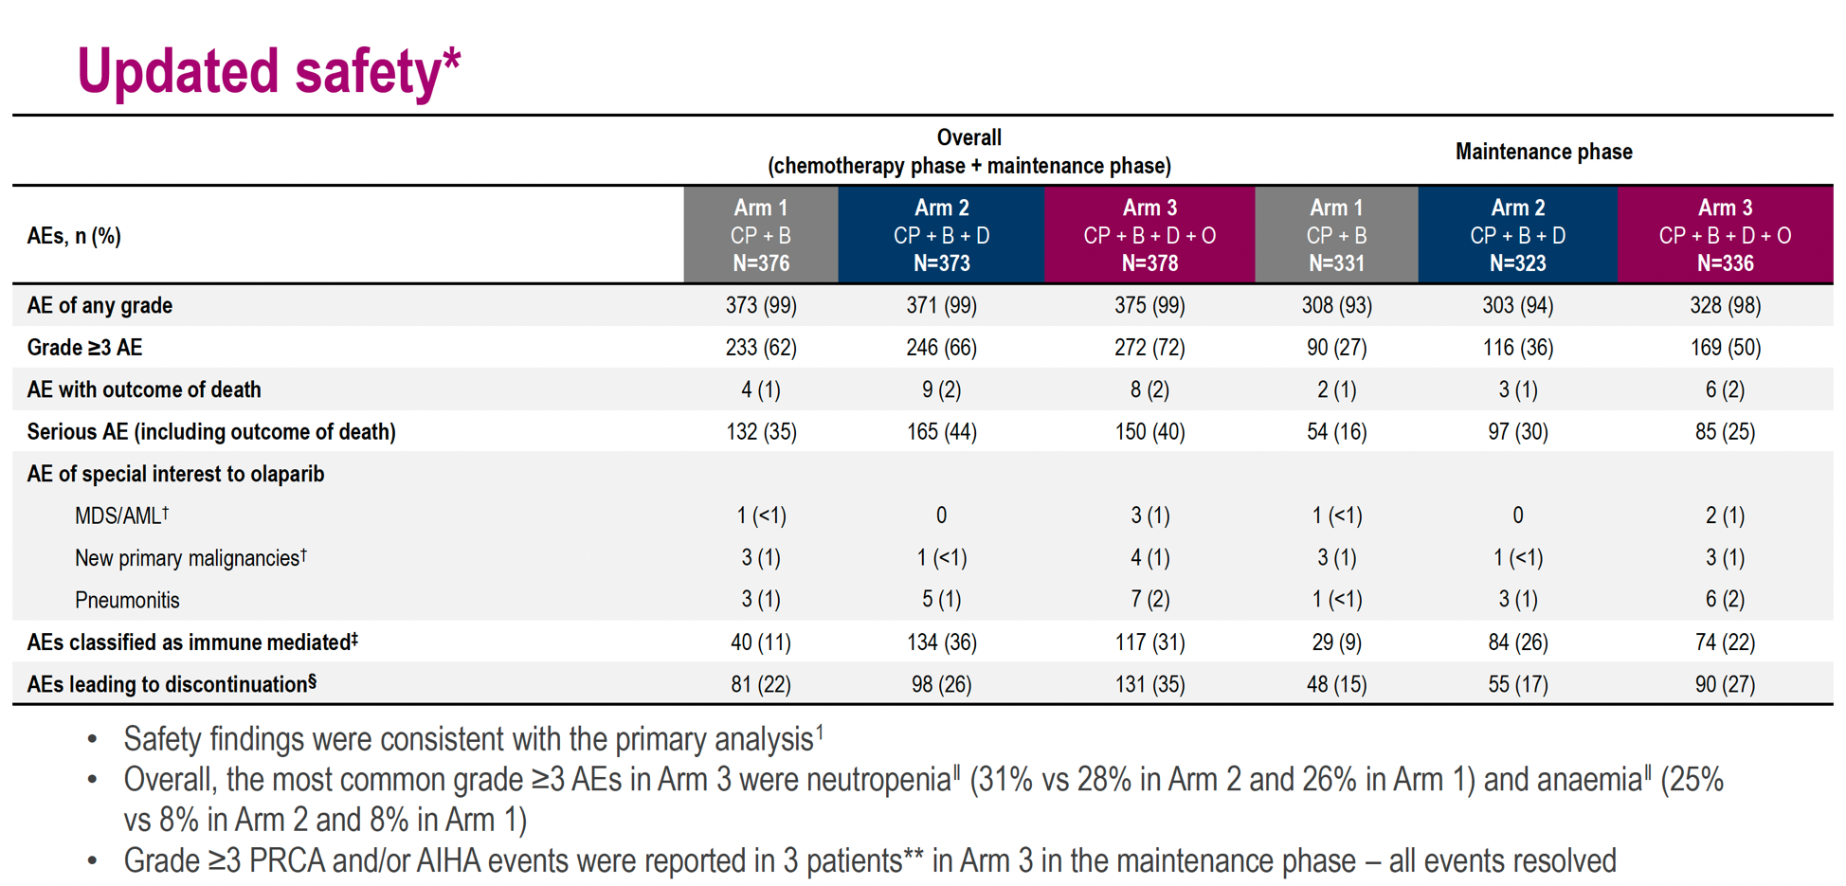
SAFETY ???

Slide 48
IN CONCLUSION
TOXIC COST !!!!!!
PFS BENEFIT
NO OS BENEFIT AT THIS INTERTIM
SAFETY CONSISTENT WITH PRIMARY ANALYSIS

Slide 49
BOUQUET TRIAL
NEW
IMPORTANCE OF BOUQUET TRIAL
A PROOF OF CONCEPT OF BIOMARKER DIRECTED THERAPY FOR FUTURE STUDIES

Slide 50
Cobi or Atezo + Bev in Persistent/Recurrent Rare EOC* (ENGOT-GYN/GOG-3051/BOUQUET): Study Design
NEW
First results from phase II biomarker-directed platform study with assigned treatments based on
tumor-specific molecular alterations
  Nonmatched arms are designated for tumors without corresponding biomarkers
Patients with measurable persistent or recurrent platinum-resistant EOC*;
1-4 previous lines of nonhormonal systemic therapy; ECOG PS ≤1;
available tumor sample
(N = 20 per arm; may expand to n = 50)
Prescreening
Arm-Specific Screening†
Biomarker testing
F1CDx and
ER IHC
Pathology
BRAF/KRAS/NRAS-activating
mutation and/or NF1 LOF alteration
Cobimetinib 60 mg/day,
Days 1–21 Q4W
Nonmatched
Atezolizumab 1200 mg Q3W + bevacizumab 15 mg/kg Q3W
Primary endpoints: investigator-assessed cORR per RECIST v1.1
Secondary endpoints: TBD
*LGSOC, clear-cell, mucinous, undifferentiated or grade 1/2 endometrioid carcinoma, carcinosarcoma, malignant Brenner tumor or mesonephric-like adenocarcinoma.
†Other arms for PTEN LOF alteration and/or PIK3CA-or AKT1-activating mutation: ERBB2-amplified and/or mutated → trastuzumab emtansine; ER+ → giredestrant + abemaciclib; PIK3CA-activating mutation → inavolisib + palbociclib or inavolisib + bevacizumab; ER+ and PIK3CA-activating mutation → inavolisib + palbociclib + letrozole or inavolisib + giredestrant; nonmatched inavolisib + olaparib or atezolizumab + bevacizumab + cyclophosphamide.
Notes:
NEW CONCEPT
Details not important

Slide 51

BOUQUET: Efficacy Summary With Cobimetinib
Best Overall Response
Sustained Clinical Benefit (>6 mo)
Progressive disease
Stable disease
Confirmed partial response
Stable disease
Partial disease
Complete response
80
Confirmed complete response
First complete/partial response
Disease progression
Treatment ongoing
60
LGSOC + MLA (n = 9)
cORR: 33%; DCR: 89%
Discontinued treatment
40
20
No. of Prior Treatment Lines | Histology | MAPK Alteration
4 | LGSOC | BRAF v600E
1 | LGSOC | KRAS G12D
3 | LGSOC | BRAF v600E
3 | MLA | KRAS G12A
4 | LGSOC | BRAF v600E
4 | LGSOC | KRAS G12V
4 | LGSOC | BRAF v600E
3 | LGSOC | NF1S557fs*11
2 | LGSOC | KRAS G12A
Best Change From
Baseline in SLD (%)
0
-20
30%
-40
cORR: 3/19* (16%; 95% CI: 3%-40%)
DCR: 8/19* (42%; 95% CI: 20%-67%)
6-mo PFS rate: 41% (95% CI: 18%-63%)
-60
-80
-100
KRAS Amp | KRAS G12A | KRAS G12D | KRAS G12C | KRAS Q61L | KRAS G12D | KRAS G12D | KRAS G17 BRAF GABRA | KRAS G12D | BRAF V600E | NF1 S557fs*11 | KRAS G12V | KRAS G12V | BRAF V600E | BRAF V600E | KRAS G12A | BRAF V600E
CC | CC | CC | MUC | MUC | CC | CS | MUC | LGSOC | LGSOC | LGSOC | LGSOC | LGSOC | LGSOC | LGSOC | MLA | LGSOC
3 | 2 | 4 | 1 | 2 | 4 | 2 | 4 | 1 | 4 | 3 | 4 | 2 | 4 | 4 | 3 | 3
MAPK pathway alteration
Histology
No. of prior treatment lines
0
2
4
6
8
10
*No measurable disease at baseline in 1 patient; death before response assessment in 2 patients (both with MUC).
Mo
Promising activity observed for cobimetinib in LGSOC and MLA
Ray-Coquard. ESMO 2023. Abstr 747MO. Reproduced with permission.
Notes:
CC, clear cell; cORR, confirmed objective response rate; CS, carcinosarcoma; DCR, disease control rate; LGSOC, low-grade serous ovarian cancer; MLA, mesonephric-like adenocarcinoma; MUC, mucinous PFS, progression-free survival; SLD, sum of the longest diameters.

Slide 52
BOUQUET: Efficacy Summary With Atezo + Bev
Best Overall Response
40
Progressive disease
Stable disease
Confirmed partial response
20
CC
LGSOC
0
-20
Best Change From Baseline in SLD (%)
30%
-40
cORR: 3/21 (14%; 95% CI: 3%-36%)
DCR: 15/21 (71%; 95% CI: 48%-89%)
6-mo PFS rate: 75% (95% CI: 56%-94%)
-60
-80
-100
Histology
PD-L1 IC by SP142
No. of prior treatment lines
MUC | MUC | CC | LGSOC | LGSOC | LGSOC | LGSOC | LGSOC | LGSOC | LGSOC | LGSOC | LGSOC | CC | LGSOC | LGSOC | LGSOC | LGSOC | CC | LGSOC | LGSOC
NA | 25% | 0.5% | 0 | 0.5% | 0 | 1% | 0 | 0.5% | 0.5% | 0 | 0 | 0.5% | 3% | 0 | 0 | 0 | 0 | 0.5% | 0.5%
2 | 3 | 2 | 2 | 1 | 4 | 2 | 2 | 3 | 1 | 2 | 2 | 3 | 3 | 3 | 5 | 3 | 1 | 2 | 4
PD-L1 IC
≥1%
<1%
Ray-Coquard. ESMO 2023. Abstr 747MO. Reproduced with permission.
Notes:
Atezo, atezolizumab; Bev, bevacizumab; CC, clear cell; cORR, confirmed objective response rate; DCR, disease control rate; IC, immune cell; LGSOC, low-grade serous ovarian cancer;; MUC, mucinous carcinoma; PFS, progression-free survival; SLD, sum of the longest diameters.

Slide 53
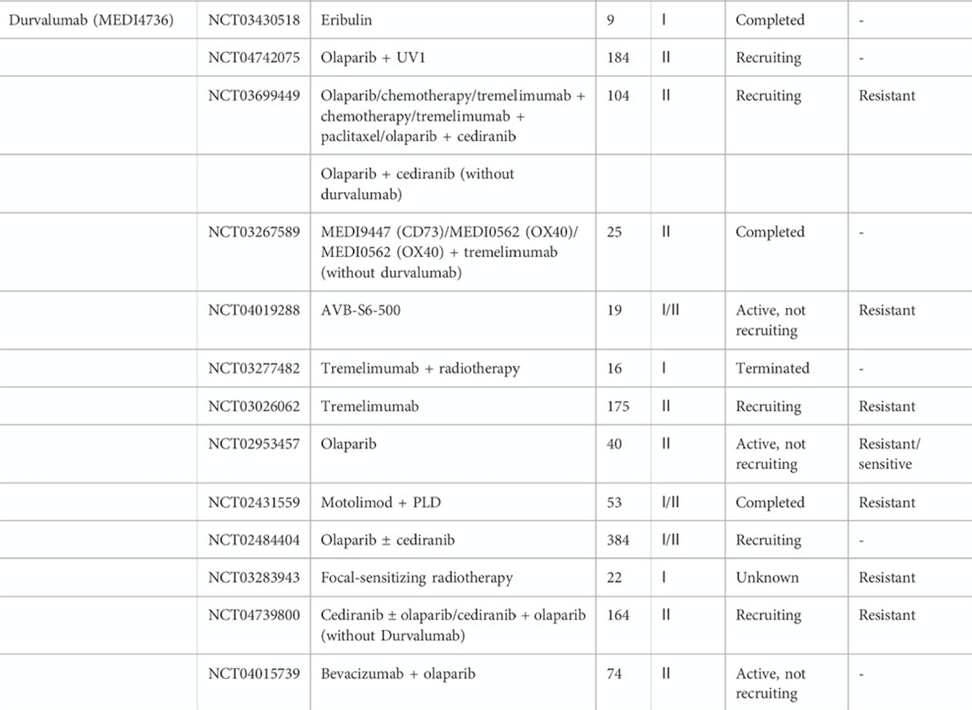
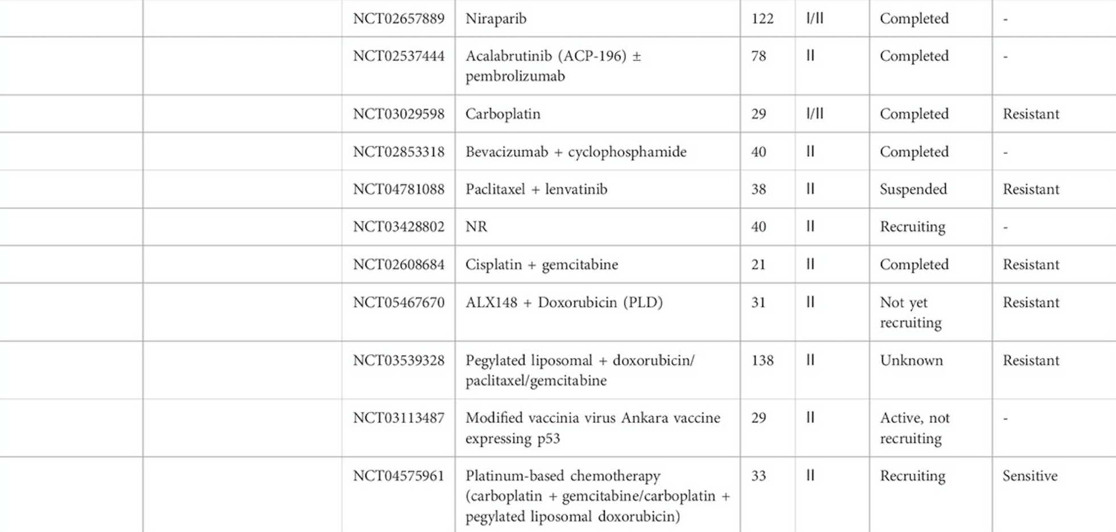
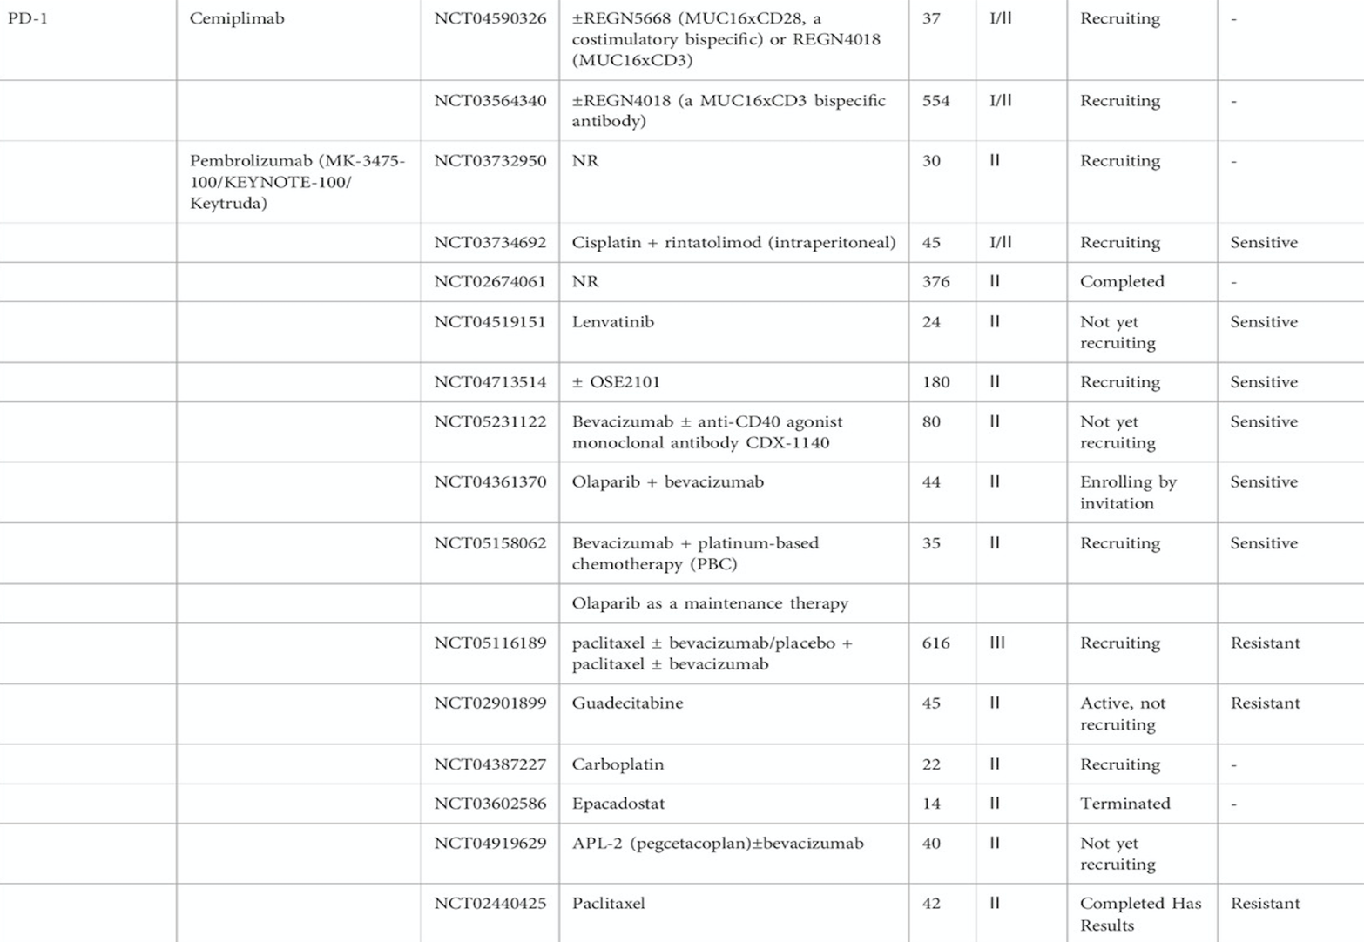
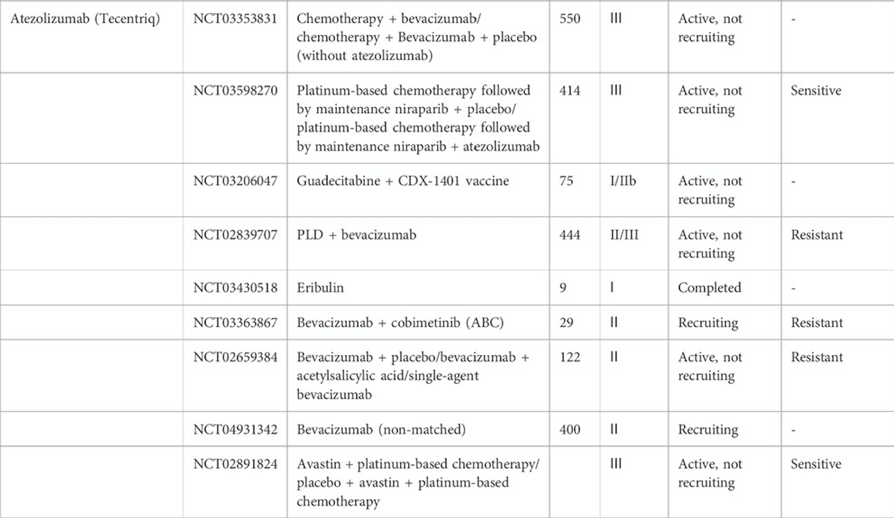
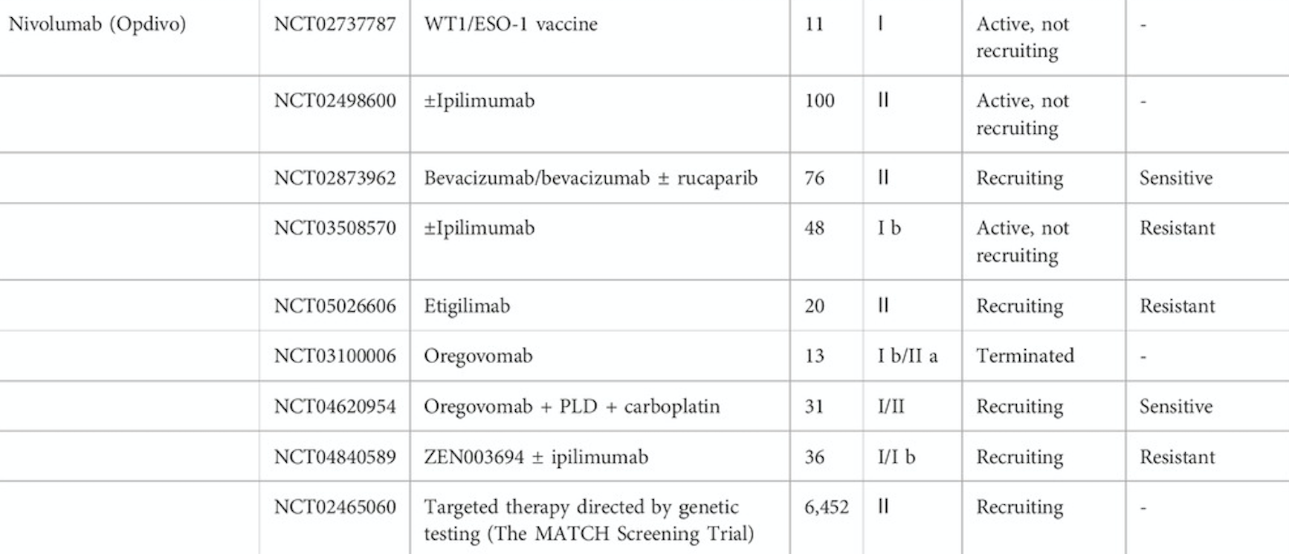
And many other ongoing phase 1 and 2 trials with immunotherapy !!
With pembrolizumab, nivolumab, ipilimumab, atezolizumab, durvalumab, cemiplimab, avelumab…
Notes:
Anti PDL1 Anti PD1 AntiCTLA-4
IMagyn050 trial
ATALANTE

Slide 54
ADDITIONAL BENEFIT IN OVARIAN CANCER TREATMENT …
2023
2022
2019
2018
2011
1996
1985
2010 EORTC 55971 – 2015 CHORUS std – Lion 2019

Slide 55
Optimal Surgery R0
Carbo Taxol Doublet
Carbo Taxol + BEVACIZUMAB
Median Survival doubled 17 mo to 39 mo¹
38 mo VS 24 mo OS for Cisplat + Cytoxan
GOG 158 GOG 111²
14.1 mo VS 10.3 mo PFS
GOG 218 ICON 7³
Olaparib in mBRCA
22.1 mo VS 16.6 mo in PFS⁴
PAOLA-1
UNMET NEED IN PATIENTS WITH PLATINUM RESISTANT HRD NEGATIVE PATIENTS
NEED OF PRECISION THERAPY
1- Fader, A. N., & Rose, P. G. (2007). Role of surgery in ovarian carcinoma. Journal of Clinical Oncology, 25(20), 2873–2883. https://doi.org/10.1200/jco.2007.11.0932
2- McQuire WP, et al, N Engl J Med 196:1-6
3- Burger RA et al. N Engl J Med 2011 Perren TJ et al. N Engl J Med. 2011.
4- Ray-Coquard et al. N Engl J Med 2019
Notes:
Optimal Surgery : median survival can be approximately doubled from 17 months to 39 months
Reference : https://ascopubs.org/doi/pdfdirect/10.1200/JCO.2007.11.0932
Carbo Taxol doublet : GOG 158 GOG #111 : Cisplat + Paclitaxel VS Cisplat + Cytoxan 38 mo OS VS 24 mo OS McQuire WP, et al, N Engl J Med 196:1-6
Carbo Taxol Bevacizumab : GOG 218 ICON 7
14.1 mo VS 10.3 mo in PFS
Burger RA et al. N Engl J Med 2011 Perren TJ et al. N Engl J Med. 2011.
Olaparib in mBRCA
Ray-Coquard et al. N Engl J Med 2019
22.1 vs 16.6 mo in PFS

Slide 56
Optimal Surgery R0
Carbo Taxol Doublet
Carbo Taxol + BEVACIZUMAB
Median Survival doubled 17 mo to 39 mo¹
38 mo VS 24 mo OS for Cisplat + Cytoxan
GOG 158 GOG 111²
14.1 mo VS 10.3 mo PFS
GOG 218 ICON 7³
Olaparib in mBRCA
22.1 mo VS 16.6 mo in PFS⁴
PAOLA-1
UNMET NEED IN PATIENTS WITH PLATINUM RESISTANT HRD NEGATIVE PATIENTS
NEED OF PRECISION THERAPY
ARE WE STILL SO FAR FROM ADC AND IMMUNOTHERAPY IN OVARIAN CANCER ???
MAYBE NOT …
1- Fader, A. N., & Rose, P. G. (2007). Role of surgery in ovarian carcinoma. Journal of Clinical Oncology, 25(20), 2873–2883. https://doi.org/10.1200/jco.2007.11.0932
2- McQuire WP, et al, N Engl J Med 196:1-6
3- Burger RA et al. N Engl J Med 2011 Perren TJ et al. N Engl J Med. 2011.
4- Ray-Coquard et al. N Engl J Med 2019
Notes:
Optimal Surgery : median survival can be approximately doubled from 17 months to 39 months
Reference : https://ascopubs.org/doi/pdfdirect/10.1200/JCO.2007.11.0932
Carbo Taxol doublet : GOG 158 GOG #111 : Cisplat + Paclitaxel VS Cisplat + Cytoxan 38 mo OS VS 24 mo OS McQuire WP, et al, N Engl J Med 196:1-6
Carbo Taxol Bevacizumab : GOG 218 ICON 7
14.1 mo VS 10.3 mo in PFS
Burger RA et al. N Engl J Med 2011 Perren TJ et al. N Engl J Med. 2011.
Olaparib in mBRCA
Ray-Coquard et al. N Engl J Med 2019
22.1 vs 16.6 mo in PFS

Slide 57
In Summary
Still holds highest mortality rate among gynecological cancers
Moving to precision and personalized medicine is a MUST
ARE WE STILL SO FAR FROM ADC AND IMMUNOTHERAPY IN OVARIAN CANCER IN 2024 ???
MAYBE NOT …
Notes:
MAXIMUM PFS for each therapy
Still unmet need for patients with HRD – platinum resistant
More and more targeted therapy are under investigation. Moving to precision and personalized medicine.

Slide 58

THANK YOU FOR YOUR ATTENTION
HOPING FOR THE BEST…

