Slide 1
Non Invasive, Medical Treatment of HPV
Chicken or the Egg : Contraversies, objections and clinical data
Murat Gultekin, MD, Prof
ESGO Prevention Commitee Chair
Ankara, TURKIYE

Slide 2
SHOULD HPV BE TREATED ?

Slide 3







Natural HPV Infection Biology
Clearence
HPV+
95% Clearence
80%
80% of Sexually Active Females Will Be İnfected
20%
Clearence
HPV+ low grade lesions
50%
10-15%
Clearence
HPV+ high grade lesions
30%
Cervical Cancers
20%
3-5% Cancer
+15 Years
Bruni L, Albero G, Serrano B, Mena M, Collado JJ, Gómez D, Muñoz J, Bosch FX, de Sanjosé S. ICO/IARC Information Centre on HPV and Cancer (HPV Information Centre). Human Papillomavirus and Related Diseases in the World. Summary Report 22 October 2021

Slide 4
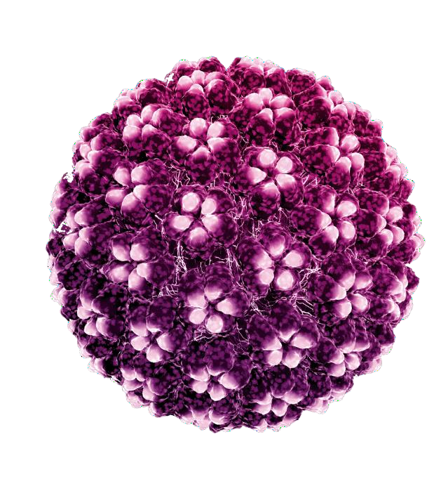
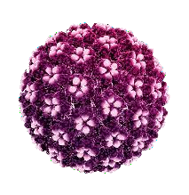
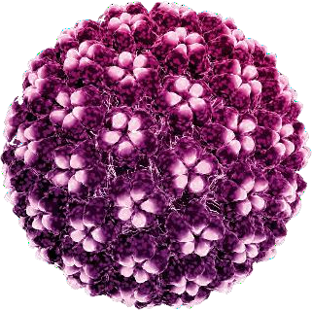
Basics
Most common genital infection (Life time 70-80%) ¹.
  Primary infection
  Re-infection
  Re-activation
Most important carcinogenic virus in the world²
  604.000 new cases of cervical cancer, leading 4th. cancer in females.
    Almost responsible for 100% of cervical cancer cases
  Also responsible for other ano-genital cancers
Unique cancer that can be prevented and eliminated in the world
  (WHO Cervical Cancer Elimination Program)
de Martel, Catherine et al. “Worldwide burden of cancer attributable to HPV by site, country and HPV type.” International journal of cancer vol. 141,4 (2017): 664-670. doi:10.1002/ijc.30716
World Health Organization. Human papillomavirus (HPV) and cervical cancer. Available at: https://www.who.int/news-room/fact-sheets/detail/human-papillomavirus-(hpv)-and-cervical-cancer. Accessed May 21, 2020

Slide 5
Some Benchmarks
Mean time for HPV Clearence : 16 Mo
  For HPV 16 18.3 Mo
After 1 year follow up Clearence: 29-44%
Risk of CIN2+ increase after 12 mo persistence
Even if HPV becomes negative, it can re-activate or re-infections is possible
Risk of CIN3 in 5 years for HPV positive and cytology normal patients 5%

Slide 6




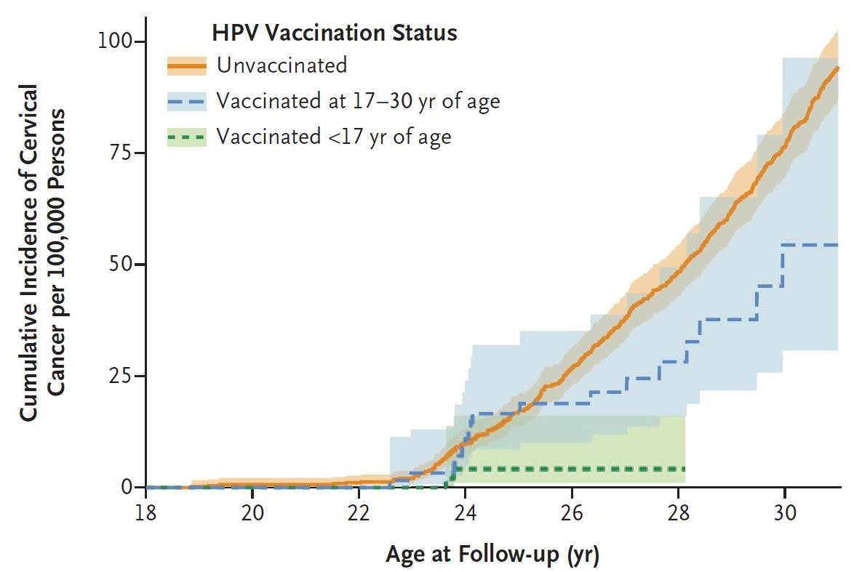


PREVENTION: HPV Vaccines Can Prevent a Great Majority of Cervical Cancers
Sweden : National Cancer Registry
1,672,983 girls and young females
Altough vaccination is extremely effective, we still have some limitations
Less effective when we vaccinate over age 17
54:100,000
Vaccination coverage over age 35 is very low
4:100,000
Vaccines are not effective in all HPV types
Lei, Jiayao et al. “HPV Vaccination and the Risk of Invasive Cervical Cancer.” The New England journal of medicine vol. 383,14 (2020): 1340-1348. doi:10.1056/NEJMoa1917338

Slide 7
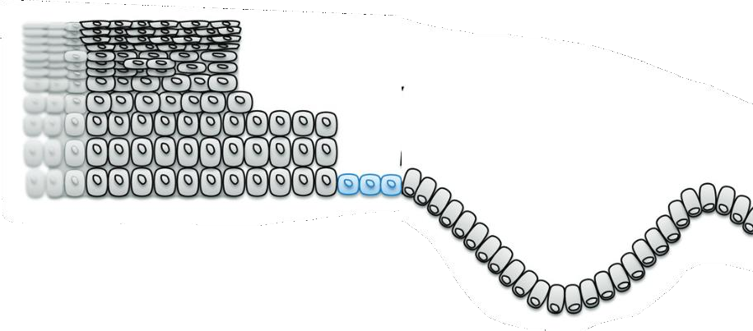
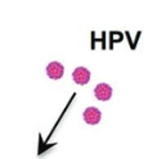
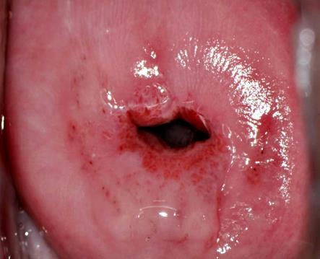
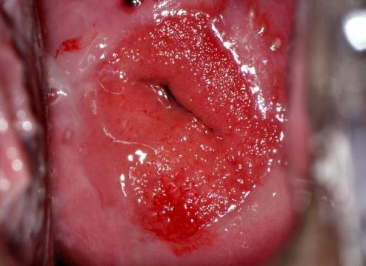
A well-epithelialized cervix is an unsuitable environment for HPV colonization
Ectopia: Extensive TZ
Sexually active women
Reproductive age group
Use of hormonal contraceptives
IUDs
Several deliveries
Endocervix
Reepithelialization
Ectocervix
Limited Transformation zone
A well-epithelialised cervix with squamous epithelium and limited or no transformation zone would provide an unsuitable environment for integrative, and thus potentially oncogenic, HPV colonisation.
1) Mirkovic, Jelena et al. “Carcinogenic HPV infection in the cervical squamo-columnar junction.” The Journal of pathology vol. 236,3 (2015): 265-71. doi:10.1002/path.4533 2) Aggarwal P, Ben Amor A. Cervical Ectropion. [Updated 2023 May 31]. In: StatPearls [Internet]. Treasure Island (FL): StatPearls Publishing; 2024 Jan-. Available from: https://www.ncbi.nlm.nih.gov/books/NBK560709/

Slide 8
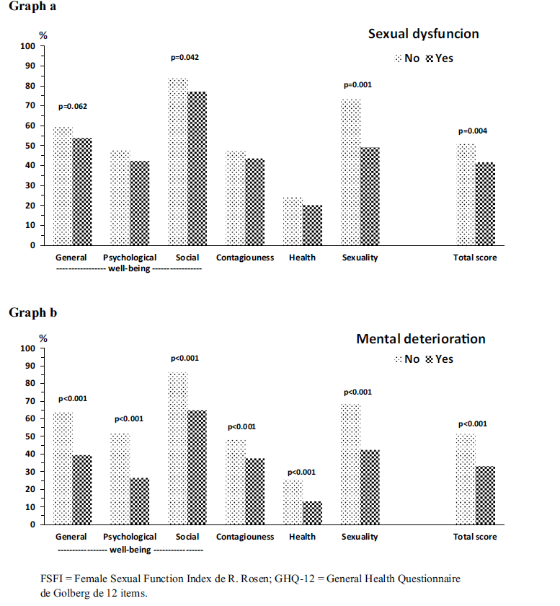
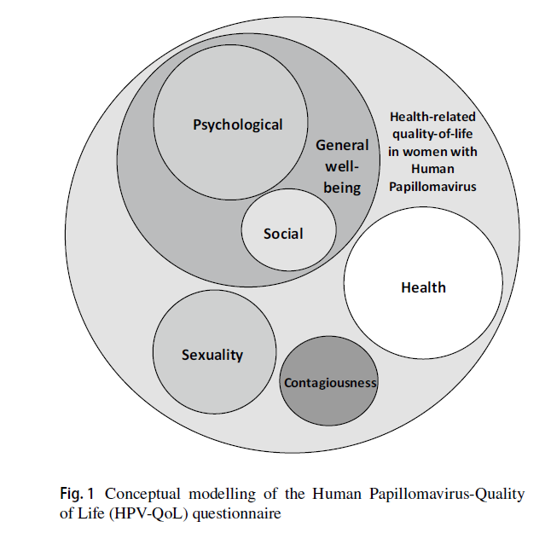
HPV-QoL Scale
N= 251 women with HR-HPV
Coronado PJ et al. Arch Gynecol Obstet. 2022;305(5)

Slide 9

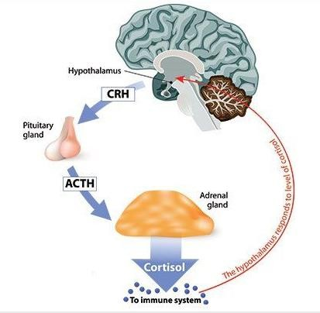

AFFECT of THE POSITIVE DIAGNOSIS TO THE PATIENTS?
THE STRESS WORKS IN DOUBLE MEANING: BENEFIT THE HPV AND IT’S BENEFITED FOR THE HPV
DISTRESS/STRESS
HPV+ test cause distress and stres
Meta-analysis. 33 studies// N: 12,789 women, 18- 65 years of age //4,305 HPV positive
Stres
Stres favors the HPV persistence
Adolescents 19 years (N = 333) //Follow-up 11 years//HPV testing and questionnaire
Immune System
McBride E, Tatar O, Rosberger Z, Rockliffe L, Marlow LAV, Moss-Morris R, Kaur N, Wade K, Waller J. Emotional response to testing positive for human papillomavirus at cervical cancer screening: a mixed method systematic review with meta-analysis. Health Psychol Rev. 2020 May 24:1-35.
Pediatric Academic Societies 2016 Meeting

Slide 10
SHOULD HPV BE TREATED ?
YES
But to WHOM

Slide 11

Risk factors or cofactors associated to cancer progression
VIRAL COFACTORS
  HPV type
  Viral load
HOST COFACTORS
  Age
  Endogenous hormones
  Genetic factors
  Others related to immune response (HIV, immunosuppression due to organ transplant or autoimmune disease treatment)
ENVIRONMENTAL OR EXOGENOUS FACTORS
  Smoking
  Oral contraceptives
  High parity
  Microbiota? (under study)
Smoking
Immunesupression
Number of partners
Flora
HPV
CLEARANCE
HPV
CERVICAL CANCER
Notes:
Number of partners? Can you send me a reference for that one? I might need to update the course accordingly

Slide 12
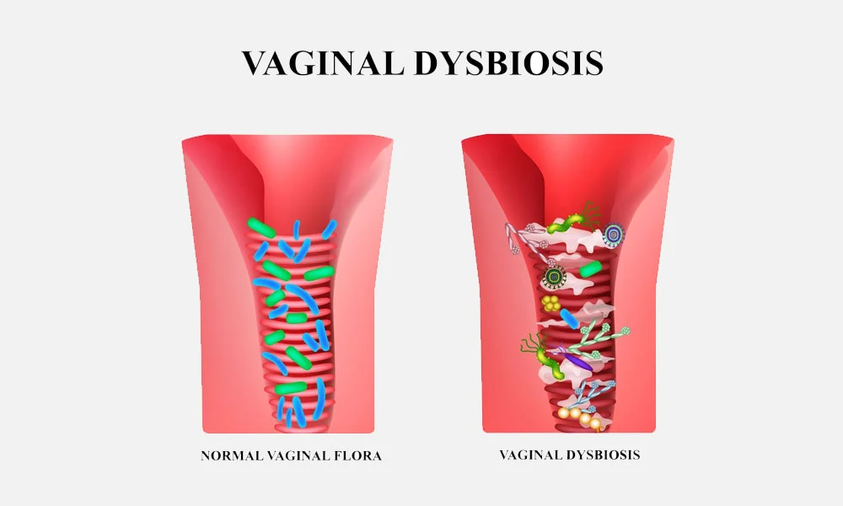


RESISTANT HPV CASES FOR CLEARENCE
PREDICTIVE FACTORS OF MAJOR VIRAL PRESISTENCE
Viral genotype
Age
Dysbiosis

Slide 13

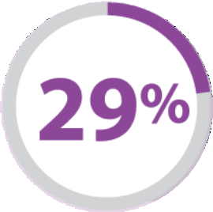


NON MODIFICABLE FACTORS: Viral genotype
Persistence of HR-HPV in women with low grade cytology lesions¹
Natural Immunity
29% of cases can clear the virus at 6 monts
491 patients
Mean Age: 38,3
Prospektif, RCT
Cytology ASCUS or LSIL
HR-HPV
71% persistance at 6 months
59% persistance at 18 months
HPV 16
91% at 6 months(P<0,0001)
81% at 18 months(P<0,0001)
(1) Bulkmans NW, Berkhof J, Bulk S, et al. High-risk HPV type-specific clearance rates in cervical screening. Br J Cancer. 2007;96(9):1419-1424. doi:10.1038/sj.bjc.6603653

Slide 14
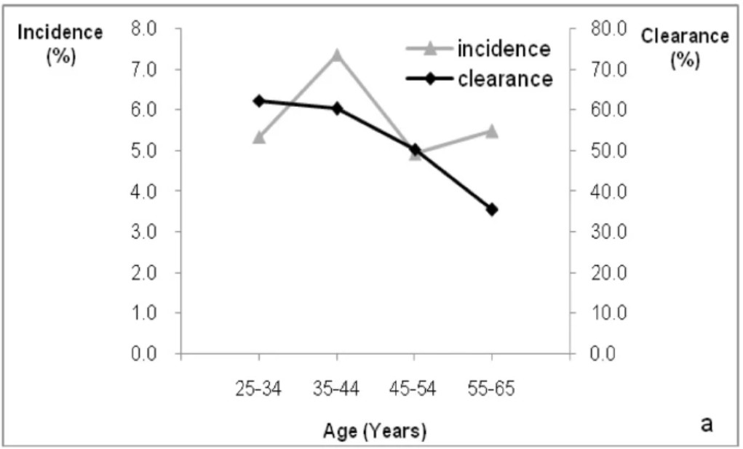
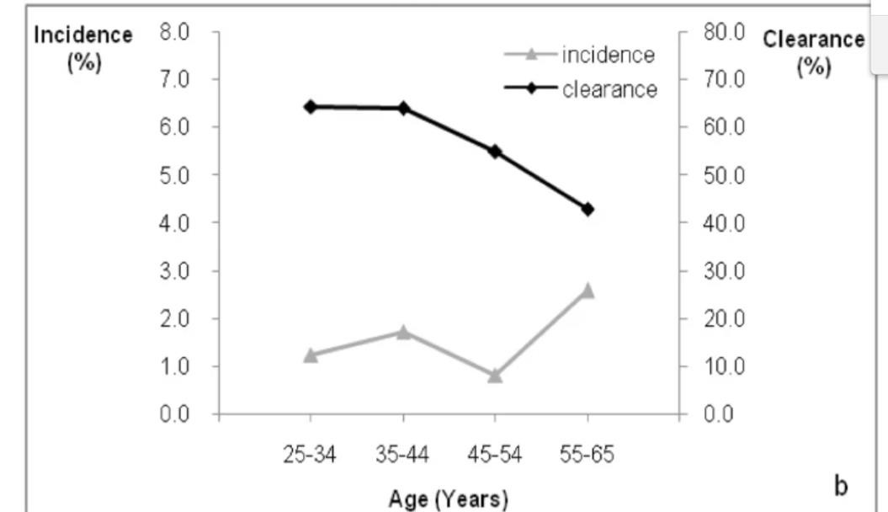
NON MODIFICABLE FACTOR: AGE
Normally, older woman are on higher risk of HPV persistence and therefore on higher risk
to develop cervical intraepithelial neoplasia.
HPV
HPV 16/18/45
n=7397
1, Kang, LN., Castle, P.E., Zhao, FH. et al. A prospective study of age trends of high-risk human papillomavirus infection in rural China. BMC Infect Dis 14, 96 (2014). 6

Slide 15

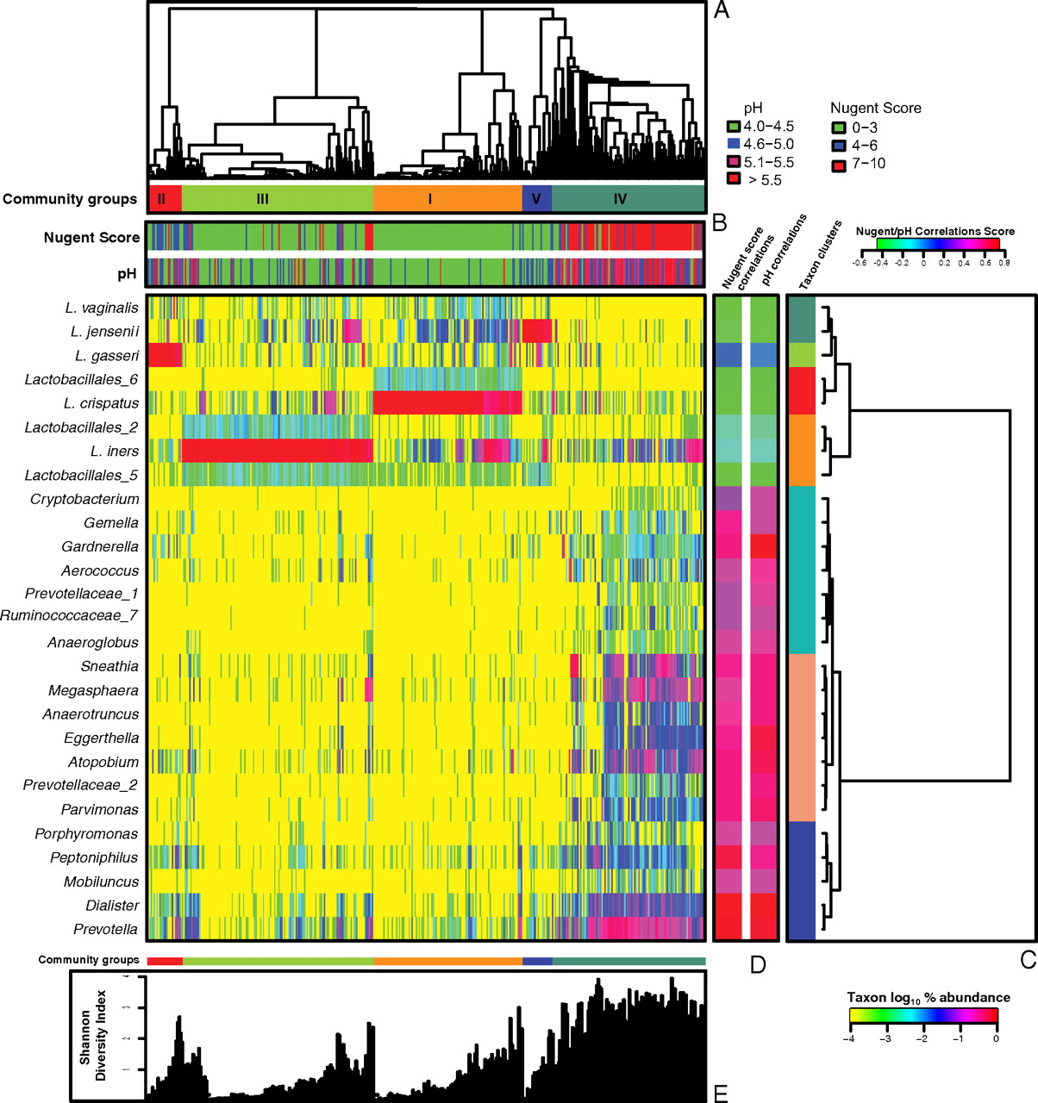
PNAS 2011 108(1):4680-7
CST – Community State Type
396 non symptomatic sexually active women.
CST I – L. crispatus (26.2%)
CST II – L. gasseri (6.3%)
CST III – L.iners (34.1%)
CST IV – No (or almost absent) Lactobacillus spp., high diversity (27%)
CST V – L. jensenii (5.3%)
Notes:
CST4 - BV
CST3 - STABILITY

Slide 16
L Gasseri
L. Crispatus rarely coexists with other bacterial species: its either absent, or strongly dominant. CST I is inversely related to CIN.
CST II
CST V
CST I
L Jensenii
Women with L. Crispatus have the lowest vaginal pH (they produce hydrogen peroxide and D-lactate), and they are the most resistant to bacterial and viral intrusions.
L Crispatus
Prevotella, Megasphaera, Estreptococo, G. Vaginalis Fusobacterium Necrophorum
Sneathia
CST III
NO Lactobacillus
L Iners
CST IV
INERS IS LESS CAPABLE OF INHIBIT THE GROWING OF OTHER BACTERIA
AND
INERS IS MORE RESILIENT TO DIFFICULT METABOLICAL AND pH ENVIRONMENTS
They produce INEROLYSIN that makes pores on vaginal epithelium
High Diversity

Slide 17
Effect of Vaginal Flora

Slide 18
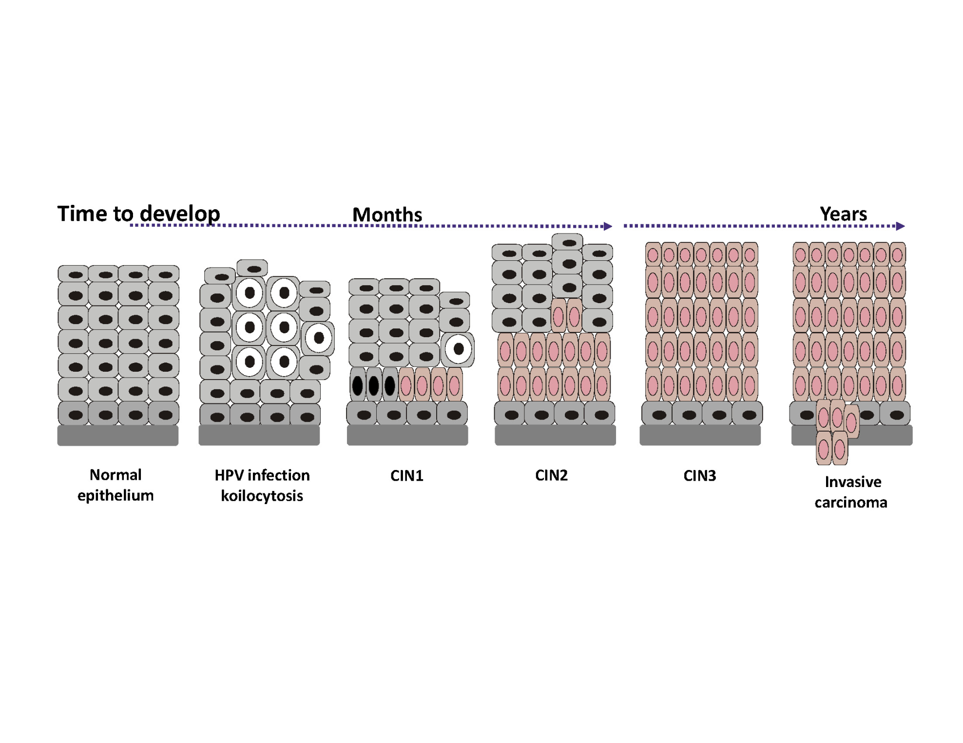

2015, CERVICAL DYSPLASIA
Cervical intraepithelial neoplasia disease progression is associated with increased vaginal microbiome diversity
A.Mitra, D.A.MacIntyre, Y.S.Lee, A.Smith, J.R.Marchesi, B.Lehne, R.Bhatia, D.Lyons, E.Paraskevaidis, J.V.Li, E.Holmes, J.K.Nicholson, P.R.Bennett & M.Kyrgiou
High diversity
10%
21%
28%
40%
Low diversity (CST-IV)
LSIL
HSIL
n=20
n=52
n=92
n=5
Sci Rep 2015;5:16865

Slide 19
Meta-Analysis from Sweden at BJOG
Vaginal Flora Dominated By Non-Lactobacillus or By L. Iners
2-3 Times More Risk for Persistant HPV and Cervical Dysplasia

Slide 20
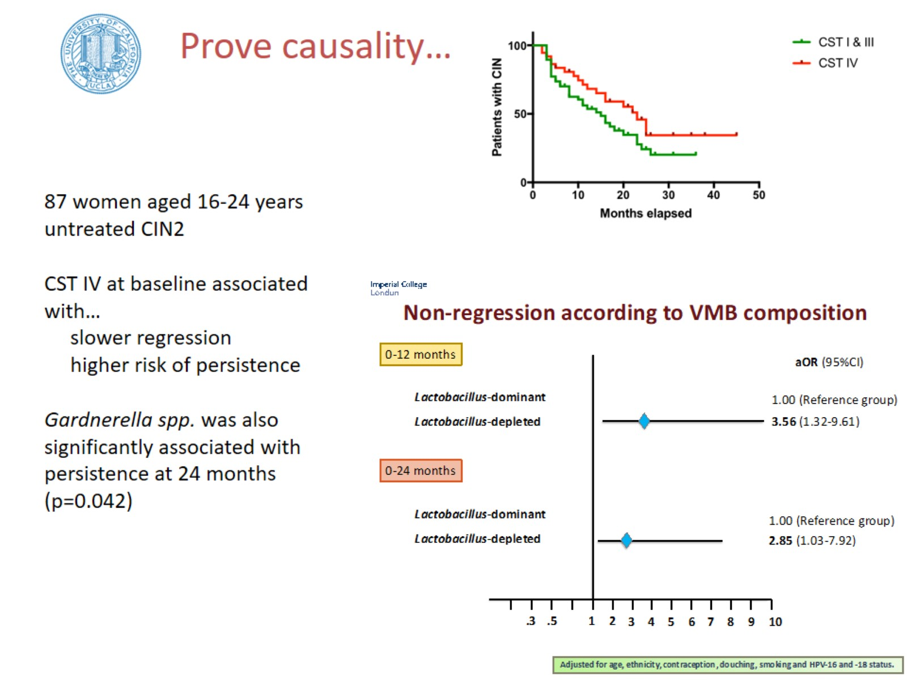
2020, CIN2 Regression
NATURE COMMUNICATIONS | (2020) 11:1999

Slide 21
SHOULD HPV BE TREATED ? YES….TO WHOM ?
Individual Risks
Smoking, Partner Number,
HPV Positivity Duration
HPV Genotype
Patient Age
Dysbiosis

Slide 22
Should HPV Treated ? Yes
To whom? At least for Selected Cases
But by which drugs?
Therapeutic Role for
Pre or Probiotics ?

Slide 23
Genital Tract Microbiome and the use of Pre- and Probiotics in Gynaecologic Cancers: The European Society of Gynaecological Oncology (ESGO) Prevention Committee Statement

Slide 24
What is Pre What is Pro Biotic ?
Probiotics are defined by the World Health Organisation as “live microorganisms that, when administered in adequate amounts, confer a health benefit on the host.” They have the potential to be used to manipulate microbiota composition towards a healthier state that is associated with better disease outcomes.
Prebiotics are indigestible carbohydrates, including the fructo-oligosaccharide (FOS) and gluco-oligosaccharide (GOS) families, which promote the growth of healthy bacteria already present in the body
Other non-pharmacological agents

Slide 25
Other non-pharmacological agents
Compound | Number of Studies
AHCC® (Active Hexose Correlated Compound) | 1
Beta-carotene | 2
3,3′-diindolylmethane (DIM) | 3
Epigallocatechin gallate (EGCG) | 2
Indole-3-carbinol (I3C) | 1
Praneem polyherbal tablet | 1
Deflagyl (Silicon dioxide with sodium selenite and citric acid) | 2
Zinc | 2

Slide 26
BUT……Some Benchmarks
Mean time for HPV Clearence : 16 Mo
  For HPV 16 18.3 Mo
6 months HPV Clearence 29-44%
After 12 months follow up: 35-56% Still (+)
Risk of CIN2+ increase after 12 mo persistence
Even if HPV becomes negative, it can re-activate
Risk of CIN3 in 5 years for
  HPV positive and cytology normal patients 5%

Slide 27
Take Care About
Sample Size, Study Design
Age of the Patient and Personal Risks
Duration of HPV Persistence
HPV Genotypes
Subjective Outcomes
  Pap-Smear Normalization
  Colposcopic Apperence
Objective Outcomes
  HPV DNA Testing (Which Kits?)
  Histological Regression

Slide 28
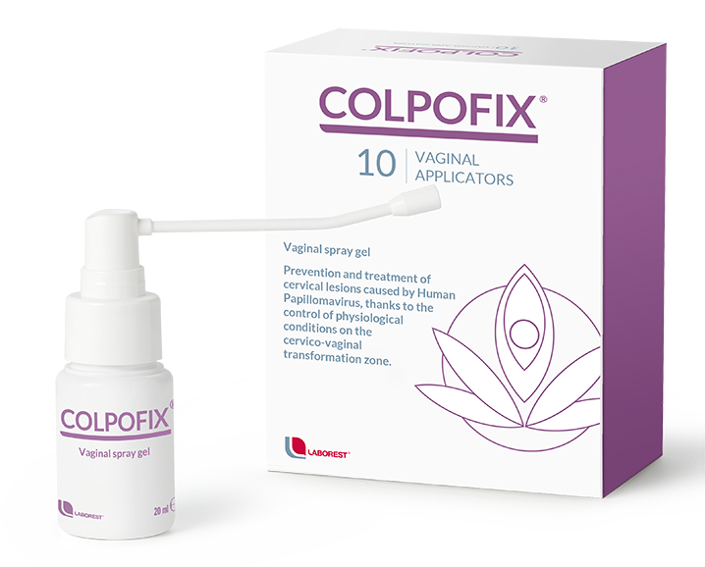
Prebiotics-1
Spray containing polycarbophil and carboxymethyl beta-glucan (prebiotic).
3 Studies

Slide 29
Prebiotics-2: Special Attention
Coriolus versicolor–based vaginal gel containing
Hyaluronic acid (moisturing agent),
Nisosomes de beta-glucan (an anti-inflammatory agent),
Bioecolia® (prebiotic agent),
Centella asiatica (fitosomes®) (tissue regenerating agent),
Azadirachta indica extract (Neem) (re-epithelizing agent), and
Aloe vera.
4 Studies

Slide 30
PAPILLOCARE..More ıs Coming
PAPILLOCAN
PALOMA 2
GENITAL WART STUDIES

Slide 31
OVERALL PRE-BIOTICS COMPARATIVE TRIALS
 | HPV Clearence | Cytological Regression | Colposcopic Regression | Histological Regression
COLPO-FIX | 1 out of 3 Studies 39.9% vs. 16.5% | 3 out of 3 Studies 83.5% vs. 60.0% 37.1% vs. 15.2% 96.0% vs.78.0% | 3 out of 3 Studies 43.4% vs. 18.2% 50.3% vs. 26.2% 96.8% vs. 78.0% | 2 out of 3 Studies No Difference 37.4% vs. 10.8%
PAPILOCARE Paloma and Papılos | 2 out of 4 Studies 67.0% vs. 37.2% 75.9% vs. 41.9% | 2 Out of 4 Studies 70.4% vs. 34.8% 84.9% vs. 64.5% | 1 out of 4 Studies 60.9% vs. 40.8% | None of the Studies
The studies apear encouraging.
HPV Clearence: Three of the four studies (3 / 4) demonstrated a higher rate of clearance of HPV infections
Cytological and colposcopic clearance: All showed positive results (5 / 5)
Histological outcomes: One study assessed histological outcomes and demonstrated a higher rate of histological clearance with treatment.
Use of these prebiotic-containing preparations ranged from 2 to 12 months.
None of the studies included a placebo arm or reported on the VMB composition of subjects either before or after treatment.

Slide 32
Probiotics-Lactobacilli
Online, 20-30 euros

Slide 33
OVERALL PRO-BIOTICS COMPARATIVE TRIALS
 | HPV Clearence | Cytological Regression | Colposcopic Regression | Histological Regression
Lactobacillus casei Shirota | 1 Study No Difference 29.2% vs. 19.2% | 1 Study 60.0% vs. 30.7% | NR | NR
Lactobacillus rhamnosus BMX 54 probiotic | 1 Study 31.2% vs. 11.5% | 1 Study 79.4% vs. 37.5% | NR | NR
Lactobacillus reuteri RC-14 probiotic and Lactobacillus rhamnosus GR-1 | 1 Study No Difference 58.1% vs. 54.2% | 1 Study Significant Reduction | NR | NR
Lactobacillus crispatus M247 probiotic | 2 Out of 2 Study 71.1% Became Negative No Difference 9.3% vs. 15.3% | 1 out of 2 Study 61.5% % vs. 41.3% | NR | NR

Slide 34
OTHERS

Slide 35
OVERALL OTHER AGENTS COMPARATIVE TRIALS
 | HPV Clearence | Cytological Regression | Colposcopic Regression | Histological Regression
AHCC® (Active Hexose Correlated Compound) | 63.6%. 10.5% | NR | NR | NR
Beta-carotene | 1/5 Studies No Effect | 4/5 Studies No Effect | NR | 4/5 Studies No Effect
3,3′-diindolylmethane (DIM) | 1/3 Studies No Difference | 1/3 Studies No Diference (50% vs. 55%) | 1/3 Studies No Difference | 3/3 Studies No Difference (84% s. 72%) No Difference (8% vs 12%) Significant (100% vs. 61%)
Epigallocatechin gallate (EGCG) | 1 / 2 Studies No Difference | 2 /2 Studies No Difference Significant Cytologic and Histologic Mixed Results (69% vs 10%) | NR | 1 /2 Studies Significant Cytologic and Histologic Mixed Results (69% vs 10%)
Indole-3-carbinol (I3C) | 1 Study No Difference | NR | NR | Significant RR:0.5
Praneem polyherbal tablet | 1 Study No Difference | NR | NR | NR
Deflagyl (Silicon dioxide with sodium selenite and citric acid) | 2 out of 2 Study NR 54.3% vs. 10.6% | 1 out of 2 Study (Cytologic and Pathologic) 76.5% vs. 36.4% | NR | 1 out of 2 Study (Cytologic and Pathologic) 76.5% vs. 36.4%
Zinc | 2 out of 2 Study 64.%5 vs. 15.2% 57.5% 15.0% | 2 out of 2 Study No Difference 52.5% vs. 25.0% | NR | NR

Slide 36
BUT
Pathophysiological Phase I studies are lacking
Whilst some results are encouraging, the studies are
  Commonly small,
  of varying study design,
  lack a placebo-treated group
  do not report on long-term outcomes or whether VMB composition did in fact change following pre- or probiotic administration.
There is heterogeneity
  in the type of probiotic used and
  data to inform dosing and also
  duration of treatment is lacking and
  mechanistic work on how oral preparations may impact on the VMB is absent.

Slide 37
Genital Tract Microbiome and the use of Pre- and Probiotics in Gynaecologic Cancers: The European Society of Gynaecological Oncology (ESGO) Prevention Committee Statement
There is an emerging interest in the role of the female genital tract (FGT) microbiome in gynaecological cancers. Previous studies have demonstrated that a high-diversity microbiome deplete of Lactobacillus has been consistently associated with pre-invasive and invasive disease states of the genital tract but evidence on causality is lacking. Although some longitudinal data associate the microbiota to the outcome of cervical pre-invasive disease, it remains unclear whether the disease is the driver of those changes or whether it is the microbiome that drives the disease. A number of pre-, probiotics and other agents have claimed a therapeutic role in cervical disease and infection from oncogenic HPV subtypes. Although some document some benefit, the studies are small or varying design and a high-quality evidence base to support their use is lacking. This ESGO consensus statement summarises the evidence on the FGT microbiota in gynaecological cancers, and the use of pre- & probiotics, and other non-clinician prescribed agents.

Slide 38
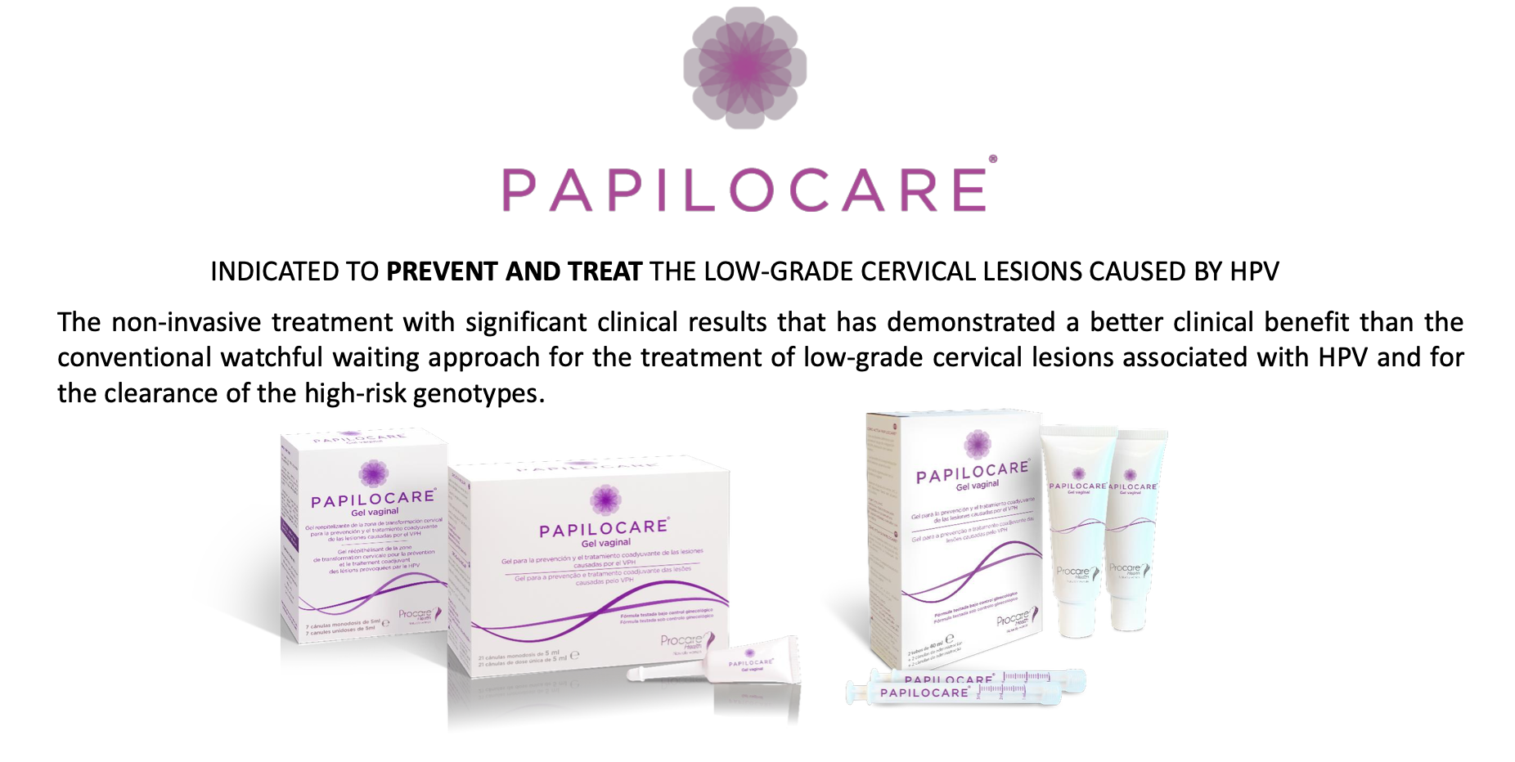
Special Care for Papillocare

Slide 39
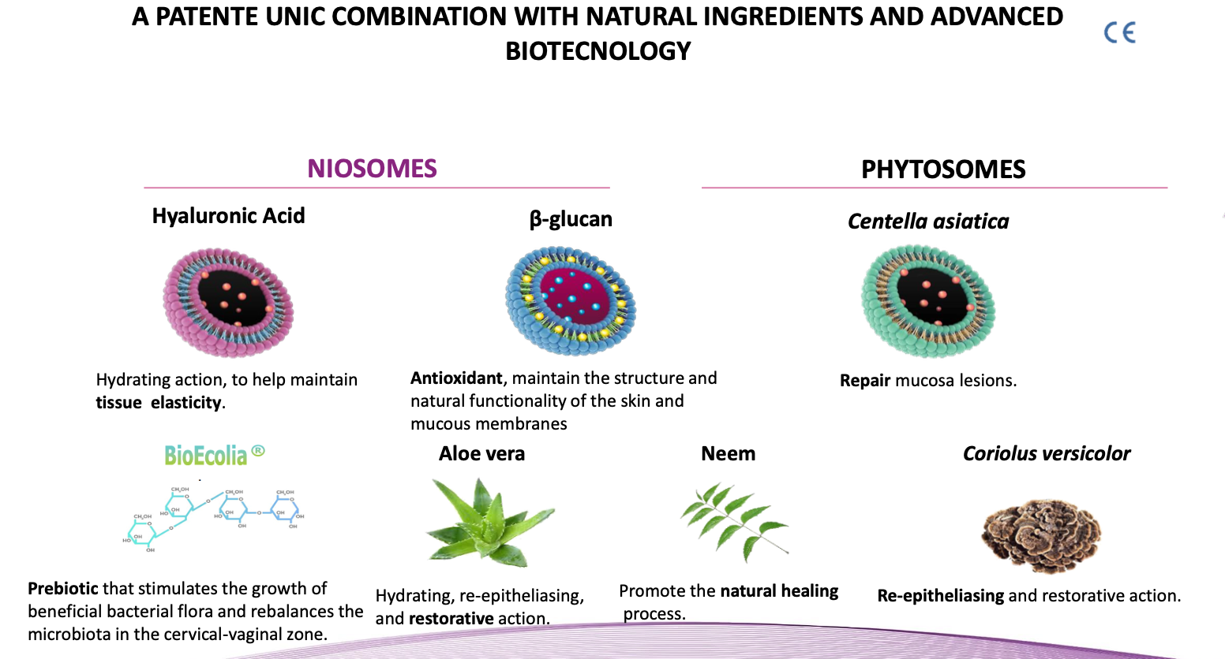
PAPILLOCARE: COMPOSITION

Slide 40
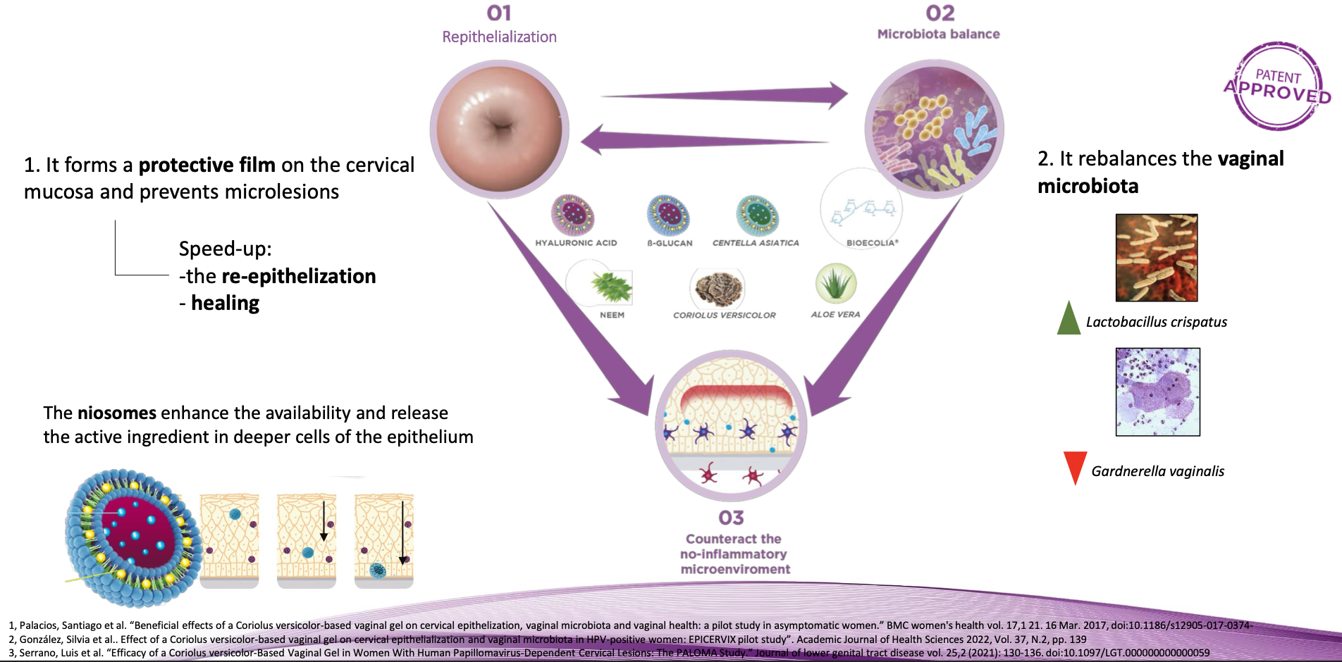
Mechanism of Action

Slide 41



PA P I LOC A R E
CLINICAL DEVELOPMENT
MORE THAN 1,000 PATIENTS
PHASE IV at INDEPENDENT PUBLIC UNIVERSITARY HOSPITALS and PRIVATE CENTERS
183 patients

Slide 42

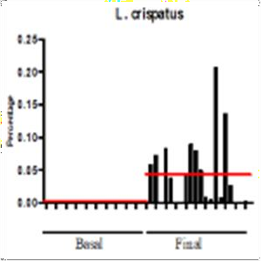
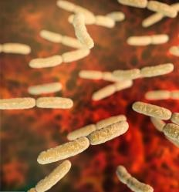
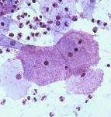
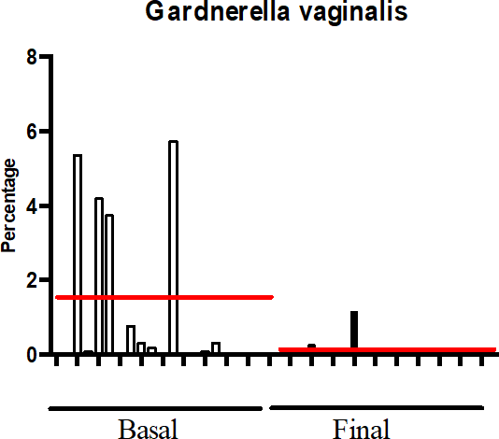
EFFICACY ON VAGINAL MICROBIOTA of PAPILOCARE: SIGNIFICANT RESULTS
SHANNON INDEX
SHANNNON INDEX
5
*
4
3
2
*
*
1
0
BASAL FI NAL
<2 Low diversity | 2-3 Normal | >3 High diversity
* p<0.005 (T-test)
Microbiota evaluated by 16S rRNA gene pyrosequencing*
Significant shiftment of
L. crispatus
* p< 0.005
Significant reduction of
G. vaginalis
* p< 0.005
Significant reduction of the
vaginal microbiota diversity
Significant changes in both
L. crispatus and G. vaginalis
*CIBER-EHD, Department of Pharmacology, ibs. GRANADA, Center for Biomedical Research (CIBM), University of Granada, Granada, Spain
(1) Gonzalez S, et al. Effect of a Coriolus versicolor based vaginal gel on cervical epithelialization and vaginal microbiota in HPV-positive women: EPICERVIX pilot study. Academic Journal of Health Science. 2022/37 (2):139-145. doi:10.3306/ AJHS.2022.37.02.139

Slide 43

PA P I LOC A R E
CLINICAL DEVELOPMENT
MORE THAN 1,000 PATIENTS
PHASE IV at INDEPENDENT PUBLIC UNIVERSITARY HOSPITALS and PRIVATE CENTERS
183 patients

Slide 44
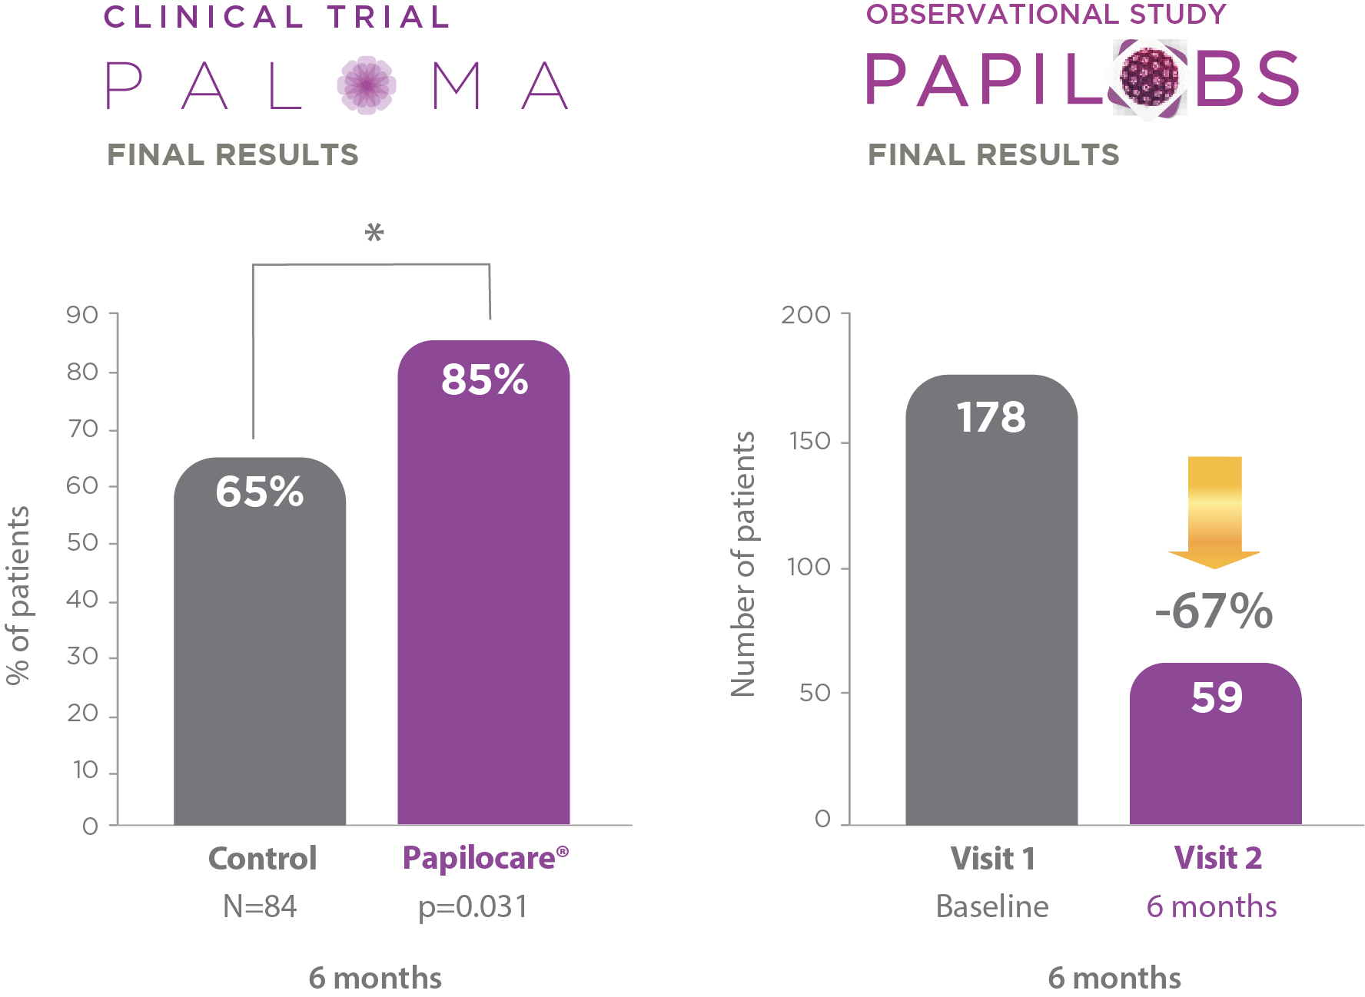
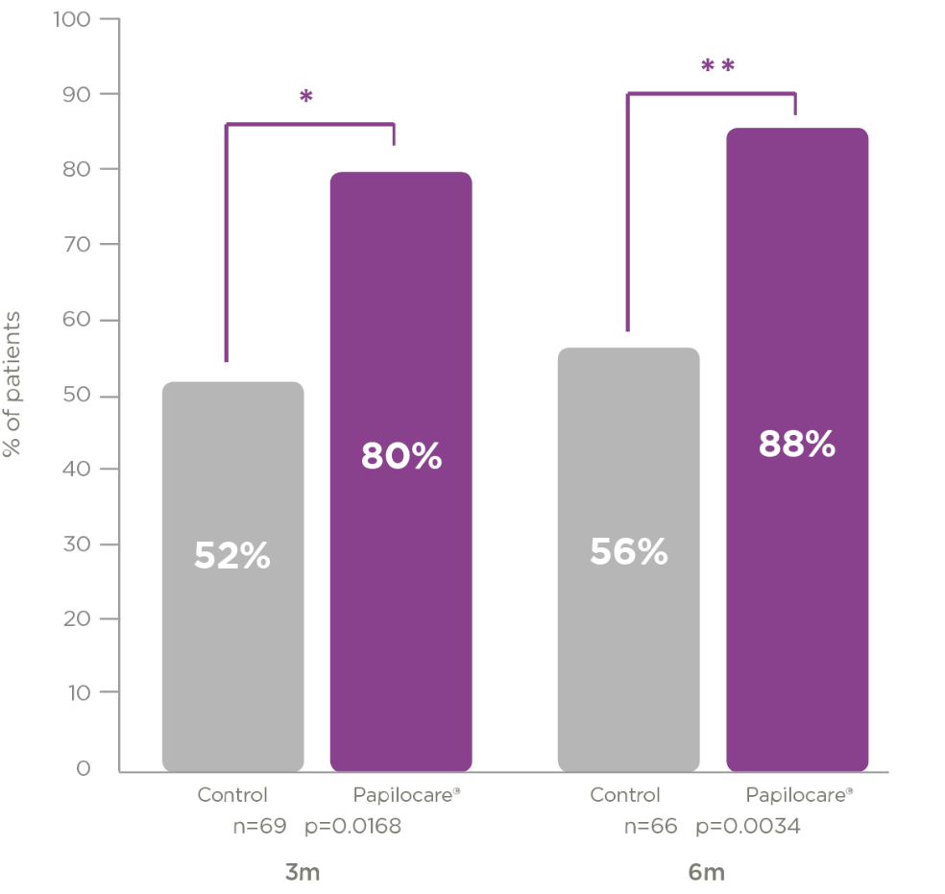
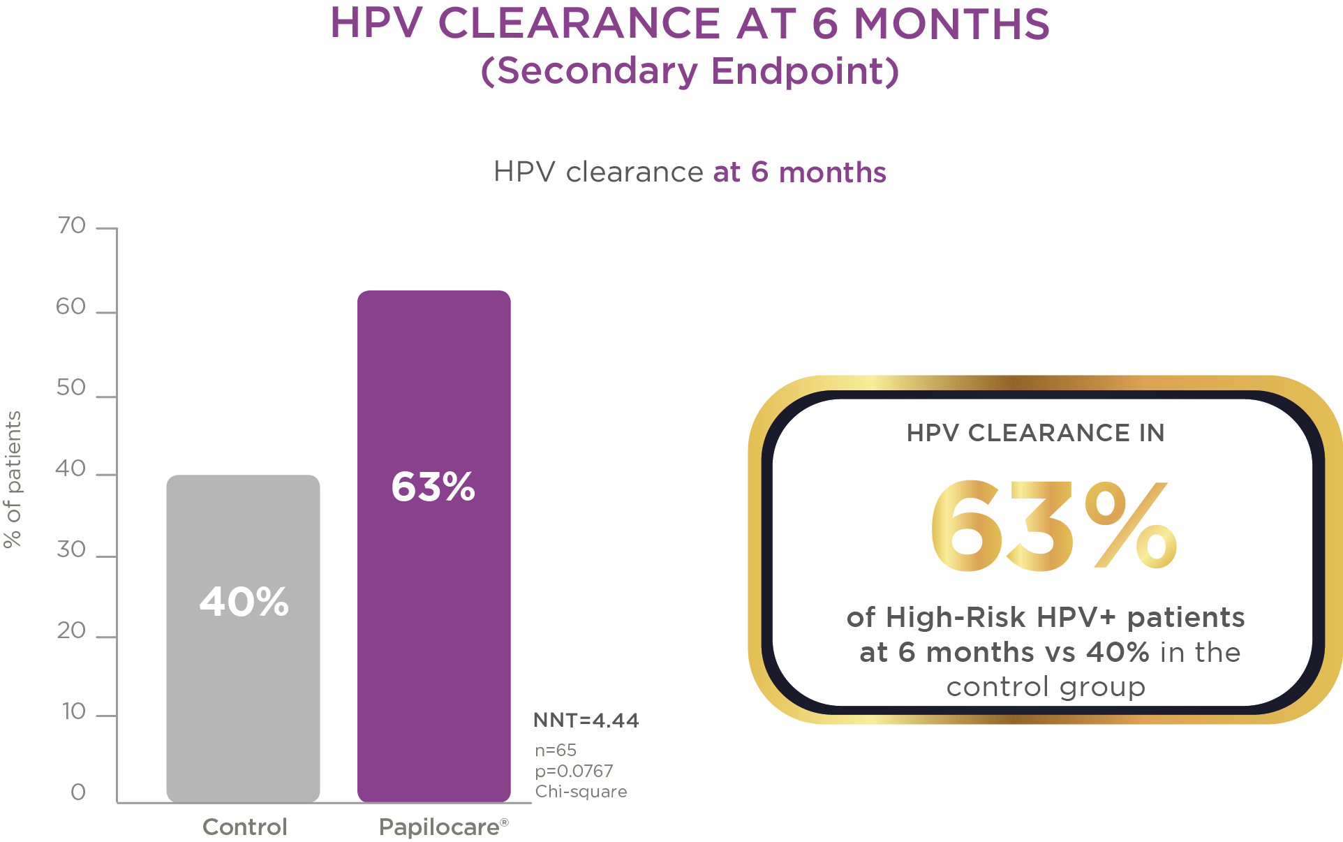


RESULTS PALOMA STUDY: HR-HPV PATIENTS
HR-HPV Subpopulation¹
Clearance HR-HPV
HR-VPH: 16,18,31,33,35,39,45,51,52,56,58,59,68
Cytological normalization with concordant colposcopy at 3 months and 6 months vs. control
NCT 04002154
FINAL RESULTS
Mean age:
41,4 years (treated)
38,8 years (control)
28%
32%
(1) Serrano L, López AC, González SP, Palacios S, Dexeus D, Centeno-Mediavilla C, Coronado P, de la Fuente J, López JA, Vanrell C, Cortés J. Efficacy of a Coriolus versicolor-Based Vaginal Gel in Women With Human Papillomavirus-Dependent Cervical Lesions: The PALOMA Study. J Low Genit Tract Dis. 2021 Apr 1;25(2):130-136

Slide 45
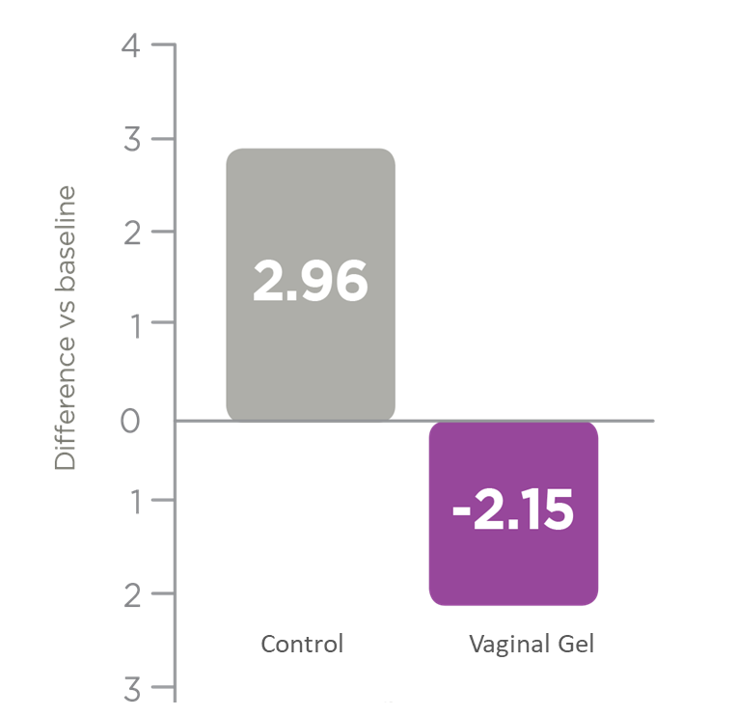

Results for QoL, safety, and adherence
Stress evolution at 6 months
Measure with PSS14 Scale
NCT 04002154
FINAL RESULTS
93.4% of patients had correct adherence to treatment at 6 months.
87% of patients reported some degree of satisfaction.
None of them were dissatisfied.
- 7 possibly treatment-related AEs, 6 of them classified as mild/moderate.
- No serious treatment-related AE’s.
PAPILOCARE®
58% of patients treated with PAPILOCARE® improved their level of perceived stress.

Slide 46
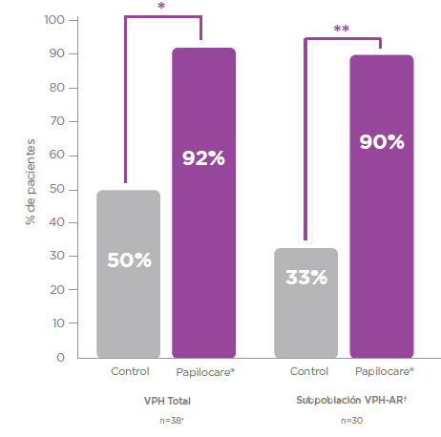
NCT 04002154
FINAL RESULTS
REGRESSION of CYTOLOGICAL LESIONS in HR-HPV PATIENTS >40 Years¹
Subpopulation of >40 years and HR-HPV+ patients
Cytological normalization with concordant colposcopy at 3 months and 6 months vs. control
Mean age 47,7 years (±5,56)
42%
57%
% of Patients
*p=0,0066; **p=0,0031
^{ϯ} HR-HPV: 16,18,31,33,35,39,45,51,52,56,58,59, 68
HPV +
HR HPV Subpopulation
Gil-Antuñano, S.P.; Serrano Cogollor, L.; López Díaz, A.C.; González Rodríguez, S.P.; Dexeus Carter, D.; Centeno Mediavilla, C.; Coronado Martín, P.; de la Fuente Valero, J.; López Fernández, J.A.; Vanrell Barbat, C.; et al. Efficacy of a Coriolus versicolor-Based Vaginal Gel in Human Papillomavirus-Positive Women Older Than 40 Years: A Sub-Analysis of PALOMA Study. J. Pers. Med. 2022, 12, 1559.

Slide 47

PA P I LOC A R E
CLINICAL DEVELOPMENT
MORE THAN 1,000 PATIENTS
PHASE IV at INDEPENDENT PUBLIC UNIVERSITARY HOSPITALS and PRIVATE CENTERS
183 patients

Slide 48


PAPILOBS STUDY: FINAL RESULTS
Normalization and clearance in the HR-HPV
NCT 04199260
Cytologic normalization with concordant colposcopy
HPV Clearance
Visit 1
Visit 2
Visit 3
67%
76%
57%
71%
67%
14
Cortés Bordoy, J.; de Santiago García, J.; Agenjo González, M.; Dexeus Carter, D.; Fiol Ruiz, G.; García Ferreiro, C.; González Rodríguez, S.P.; Gurrea Soteras, M.; Martínez Lamela, E.; Palacios Gil-Antuñano, S.; et al. Effect of a Multi-Ingredient Coriolusversicolor- Based Vaginal Gel in Women with HPV–Dependent Cervical Lesions: The Papilobs Real-Life Prospective Study. Cancers 2023, 15, 3863.

Slide 49
PAPILOBS STUDY: FINAL RESULTS
Normalization and clearance in > 40 years with HR-HPV
Cytologic normalization with concordant colposcopy
NCT 04199260
HPV Clearance
Visit 1
Visit 2
74%
81%
60%
74%
Visit 3
67%
Cortés Bordoy, J.; de Santiago García, J.; Agenjo González, M.; Dexeus Carter, D.; Fiol Ruiz, G.; García Ferreiro, C.; González Rodríguez, S.P.; Gurrea Soteras, M.; Martínez Lamela, E.; Palacios Gil-Antuñano, S.; et al. Effect of a Multi-Ingredient Coriolusversicolor- Based Vaginal Gel in Women with HPV–Dependent Cervical Lesions: The Papilobs Real-Life Prospective Study. Cancers 2023, 15, 3863.

Slide 50
PAPILOBS STUDY: FINAL RESULTS
NCT 04199260
Satisfaction level and tolerability of Papilocare®
Satisfaction scale* | Visit 2 (n= 191) | Visit 3 (n= 61)
Average | 7.9 | 7.5
Patients
> 5 points | 179 | 58
> 7 points | 153 | 47
> 9 points | 81 | 19
67%
*Visual Analogue Scale (VAS) from 0 (non satisfied) to 10 (very satisfied)
Safety data
A total of 8 patients reported 8 adverse effects. A total of 3 adverse effects were related to Papilocare®. All of them were solved by the end of the study.
Cortés Bordoy, J.; de Santiago García, J.; Agenjo González, M.; Dexeus Carter, D.; Fiol Ruiz, G.; García Ferreiro, C.; González Rodríguez, S.P.; Gurrea Soteras, M.; Martínez Lamela, E.; Palacios Gil-Antuñano, S.; et al. Effect of a Multi-Ingredient Coriolusversicolor- Based Vaginal Gel in Women with HPV–Dependent Cervical Lesions: The Papilobs Real-Life Prospective Study. Cancers 2023, 15, 3863.

Slide 51
Comparison of PALOMA vs. PAPILOBS
Study design | Randomized, multicenter, open-label, prospective, controlled study with routine clinical practice | Observational, multicenter, prospective, non-comparative clinical study
Study timeline | 6 months | 6 or 12 months
Number of Patients | 101 | 192
Primary endpoint | Repair of HPV-induced cervical lesions | Repair of HPV-induced cervical lesions in real life
Average age (yrs) | 41.4 (Treated) and 38.8 (Control) | 38.7
HPV vaccination (%) | 0% | 17.6%
HR-HPV patients (%) | 74.5% (treated) | 93.2% (treated)
Normalization of LSIL in HR-HPV patients | 88% | 76%
HR-HPV Clearance | 63% | 71%
Normalization of LSIL in > 40 years patients with HR-HPV | 90% | 81%
HPV Clearance in > 40 years patients with HR-HPV | 67% | 74%
67%

Slide 52


PA P I LOC A R E
CLINICAL DEVELOPMENT
MORE THAN 1,000 PATIENTS
PHASE IV at INDEPENDENT PUBLIC UNIVERSITARY HOSPITALS and PRIVATE CENTERS
183 patients

Slide 53
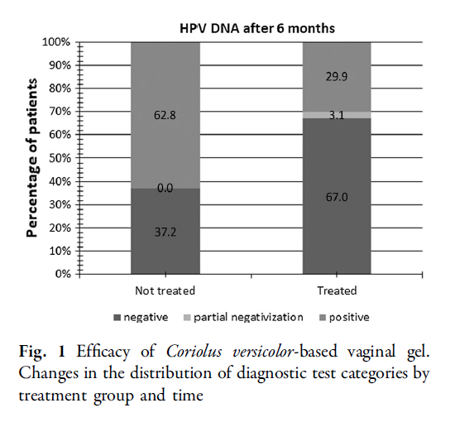
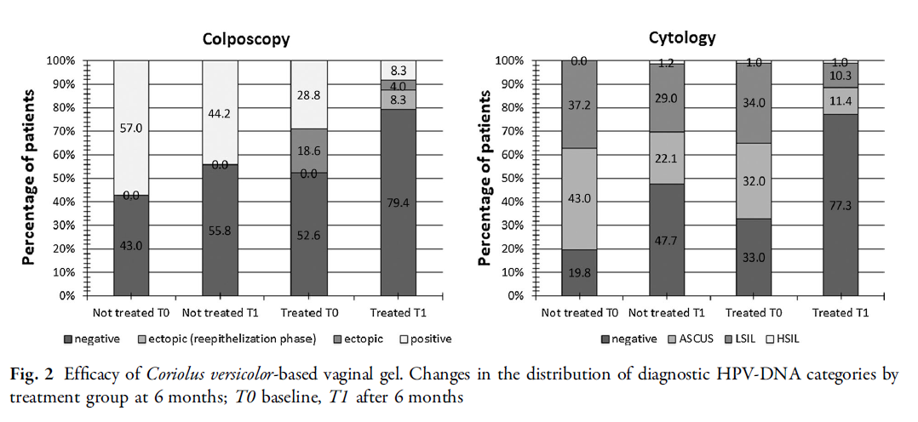
RESULTS FROM ROMA STUDY: PATIENTS WITH HR-HPV
OR for clearance: 4,8 (2,4-9,6)
.
Treatment scheme of Coriolus versicolor-based vaginal gel: 1 cannula/day for 21 consecutive days in the first month; then, 1 cannula to be used in alternate days (except in the presence of the menstrual cycle) during the next 2 months.
1 Criscuolo AA, Sesti F, Piccione E, Mancino P, Belloni E, Gullo C, Ciotti M. Therapeutic Efficacy of a Coriolus versicolor-Based Vaginal Gel in Women with Cervical Uterine High-Risk HPV Infection: A Retrospective Observational Study. Adv Ther. 2021 Feb;38(2):1202-1211. doi: 10.1007/s12325-020-01594-6. Epub 2020 Dec 26. PMID: 33367986.

Slide 54

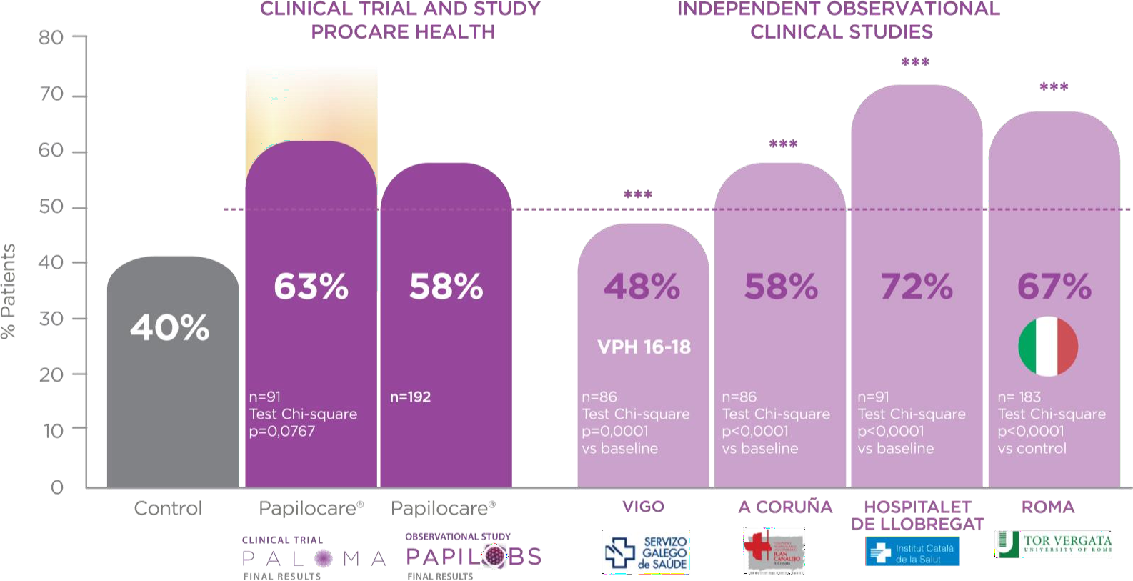
63% HR-HPV CLEARENCE
(6 Clinical Studies 700 PATIENTS)
CORROBORATED RESULTS in 6 INDEPENDENT STUDIES: HIGH-RISK HPV CLEARANCE at 6 MONTHS ^{1,2}
3
Natural Clerence at 6. Months
Criscuolo AA, Sesti F, Piccione E, Mancino P, Belloni E, Gullo C, Ciotti M. Therapeutic Efficacy of a Coriolus versicolor-Based Vaginal Gel in Women with Cervical Uterine High-Risk HPV Infection: A Retrospective Observational Study. Adv Ther. 2021 Feb;38(2):1202-1211. doi: 10.1007/s12325-020-01594-6. Epub 2020 Dec 26. PMID: 33367986.
Cortés J, Dexeus D, Palacios S, et al626 Efficacy of a multi-ingredient coriolus versicolor-based vaginal gel in high-risk HPV infected patients: results of 7 different studiesInternational Journal of Gynecologic Cancer 2021;31:A313.
Bulkmans, N W J et al. “High-risk HPV type-specific clearance rates in cervical screening.” British journal of cancer vol. 96,9 (2007): 1419-24. doi:10.1038/sj.bjc.6603653

Slide 55
PAPILOBS GREECE

Slide 56
Study Design
Overview
Multicenter, non-interventional, perspective, observational clinical study
44 Sites in Greece:
  10 Obstetrics and Gynecology Clinics in General and University Hospitals
  34 private sites(Gynecologists)
524 Patients enrolled in the study who met the eligibility criteria
Study Duration: 20 months (Sep 2021 - Apr 2023)
  Enrollment period: 8 months
  Treatment period: 12 months

Slide 57
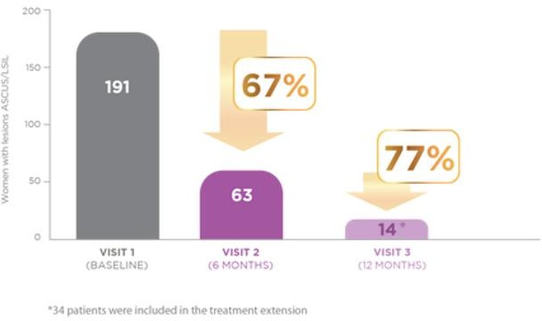








Study Results - Total Population
Primary Endpoint: Repair of Cervical HPV- Dependent Lesions
Papilobs Spain results
*Cytology Normalization with concordant colposcopy
72%
76%
450
400
350
300
250
200
150
100
50
0
Patients
481
481
34%
134
116
53 35
Baseline 6 months
6 months 12 months
Baseline By the
end of the study (6
or 12
months)

Slide 58
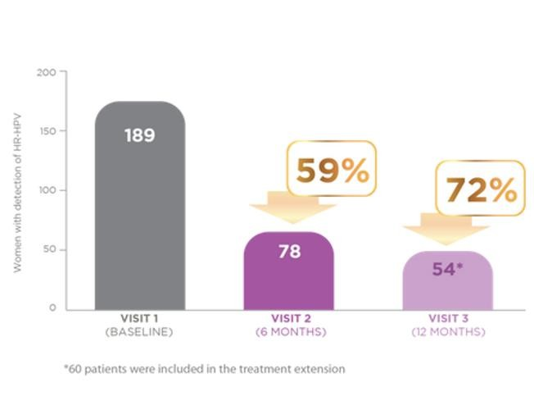








Study Results - Total Population
Additional Endpoints: Assessment of HPV Clearance
Papilobs Spain results
53%
58%
250
200
150
Patients
232
236
100
48%
50
110
99
0
31
16
Baseline 6 months
Baseline or 12 months 6 months
Baseline
Total (6 or
12 months)

Slide 59







Study Results - Subgroup Age > 40
Primary Endpoint: Repair of Cervical HPV- Dependent Lesions
*Cytology Normalization with concordant colposcopy
140
120
78%
100
72%
80
Patients
60
125
125
40
44%
20
35
27
18
10
0
Baseline
6 months
6 months
12 months
Baseline
By the end of the study (6
or 12 months)

Slide 60
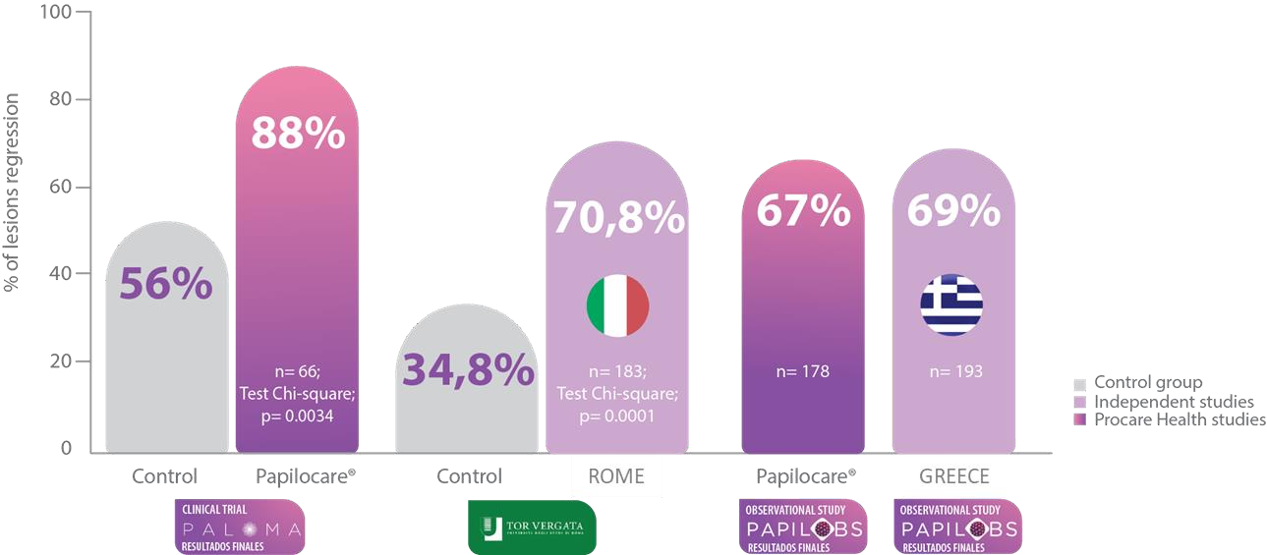


Consistent results across 4 independent studies: Regression of lesions in HR-HPV population at 6 months^{1,2,3}
71%
Lesion regression in HR-HPV
population
(4 different studies with >600 patients)
(1) Serrano, Luis et al. J Low Genit Tract Dis 2021;25: 130-136. DOI: 10.1097/LGT.0000000000000596
(2) Cortés Bordoy, J.; de Santiago García, J.; Agenjo González, M.; Dexeus Carter, D.; Fiol Ruiz, G.; García Ferreiro, C.; González Rodríguez, S.P.; Gurrea Soteras, M.; Martínez Lamela, E.; Palacios Gil-Antuñano, S.; et al. Effect of a Multi-Ingredient Coriolusversicolor- Based Vaginal Gel in Women with HPV–Dependent Cervical Lesions: The Papilobs Real-Life Prospective Study. Cancers 2023, 15, 3863.
(3)Criscuolo AA, et al. Therapeutic Efficacy of a Coriolus versicolor-Based Vaginal Gel in Women with Cervical Uterine High-Risk HPV Infection: A Retrospective Observational Study. Adv Ther. 2021 Feb;38(2):1202-1211. doi: 10.1007/s12325-020-01594-6. Epub 2020 Dec 26. PMID: 33367986.

Slide 61
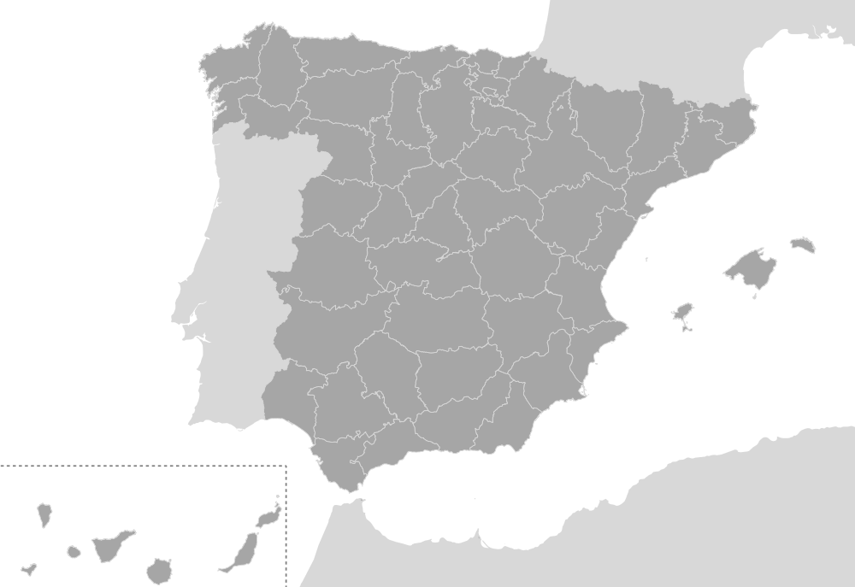




















PALOMA 2
19
Hospital Universitario Basurto (Bilbao)
Hospital Universitario Donostia
Hospital Álvaro Cunqueiro (Vigo)
PUBLIC HOSPITALS
ASSIR La Torrassa (L’Hospitalet de Llobregat)

Slide 62


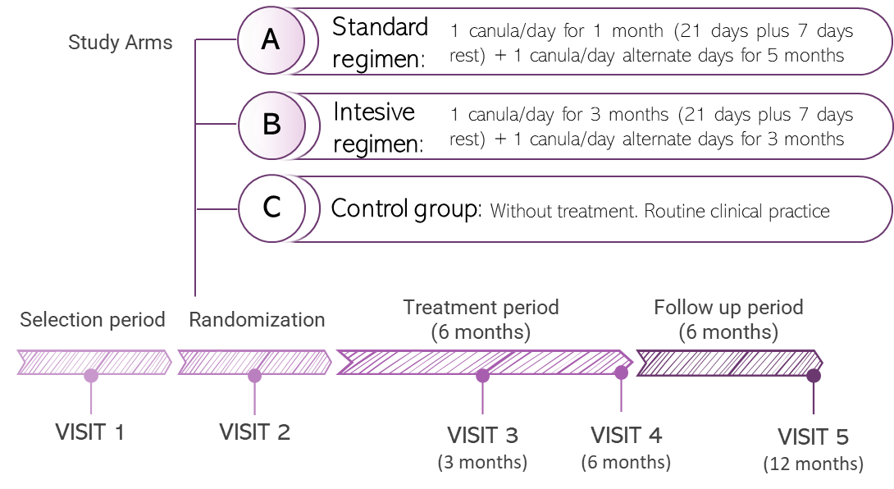


PALOMA 2
Randomised, multicentre, open-label, prospective, prospective, controlled phase II clinical trial with routine
clinical practice.
Study aims Design
Primary endpoint
To assess the degree of cervical mucosal repair in HR- HPV-positive women with ASCUS/LSIL cytology and concordant colposcopy at 6 months.
Normal cytology and concordant colposcopy
N=155
Secondary endpoints
Assess HR-HPV clearance.
Degree of re-epithelialisation.
Vaginal health status.
Patient-perceived stress.
Safety and tolerability.
Degree of satisfaction.
Treatment compliance

Slide 63
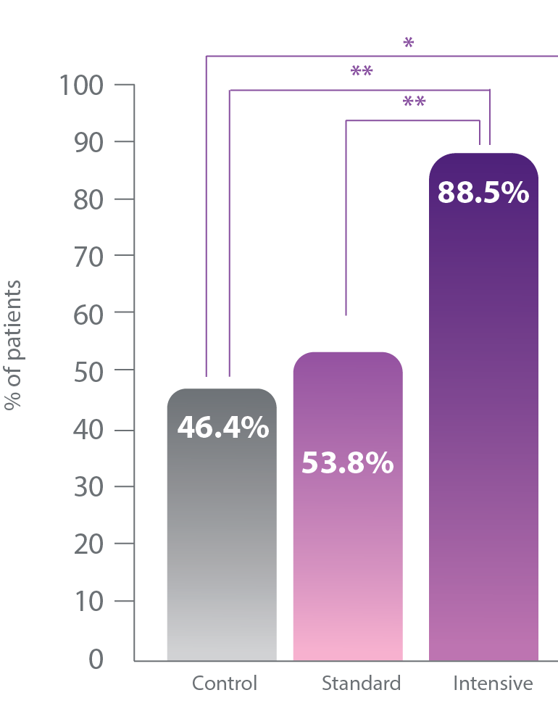
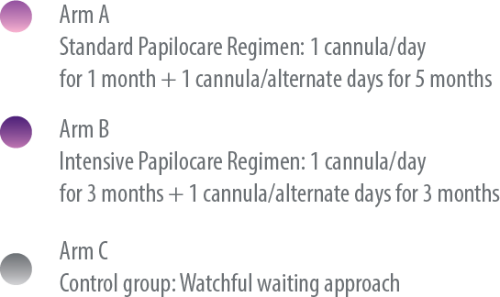
PALOMA 2
Randomised, multicentre, open-label, prospective, prospective, controlled phase II clinical trial with routine
clinical practice.
Preliminary results in HR-HPV clearance at 6 months
We see a dose-dependent effect, because the
higher the dose is, the greater the effect.
N=155
Intensive posology >> standard posology> without treatment
Average age= 40,89 years
88,5%
57,7%
46,4%
x 2
x 1,2
p(AvsC)= 0,4078; p(BvsC)= 0,0011;
p(A+BvsC)= 0,0180 ; p(AvsB)= 0,0124

Slide 64


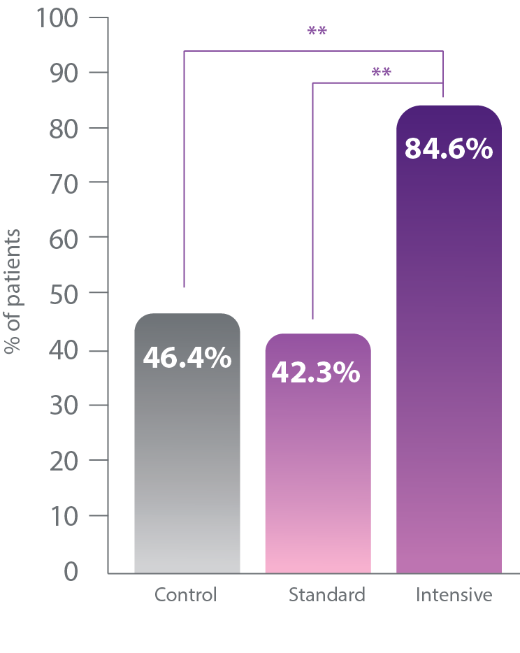
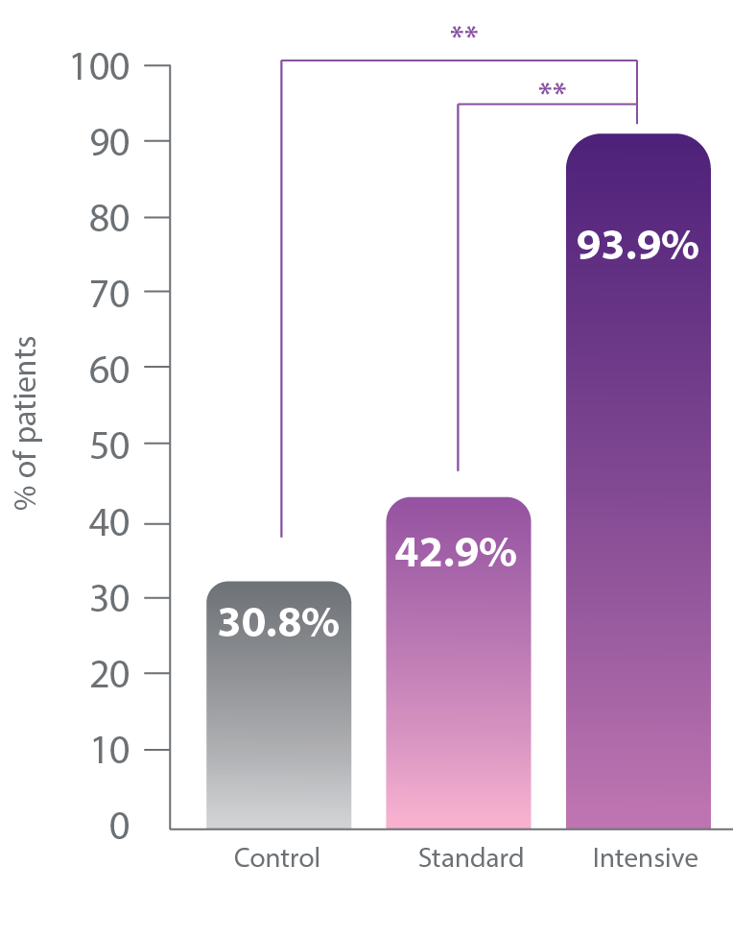
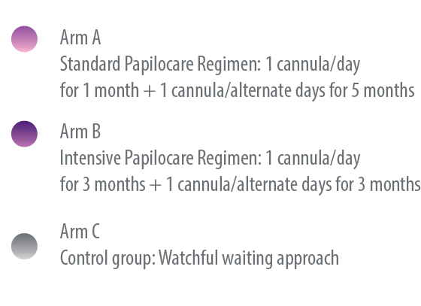
PALOMA 2
Regression of cervical lesions and viral clearance in
HR-HPV positive population at 6 months
Regression of cervical lesions and viral clearance in
HPV 16, 18, 31 positive population at 6 months
Average age= 40,89 years
Average age= 42,52 years
n=109 p(AvsB)=0 ,0015 p(BvsC)=0,0033
n=56
p(AvsB)=0 ,0011 p(BvsC)=0,0033

Slide 65
