Slide 1
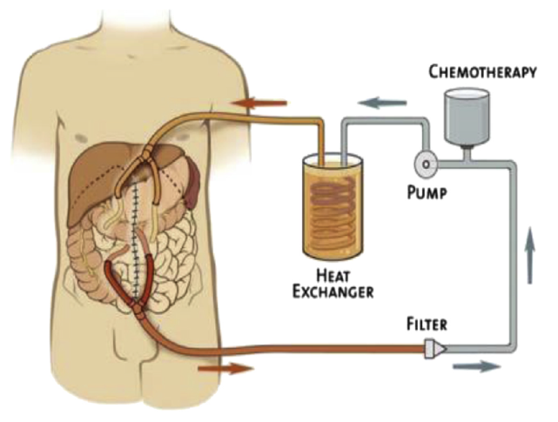
DEBATE HIPEC in the frontline management of EOC? (CON)
Theo Panoskaltsis
MD, PhD, FRCOG, CCST (UK), ESPSO

Slide 2
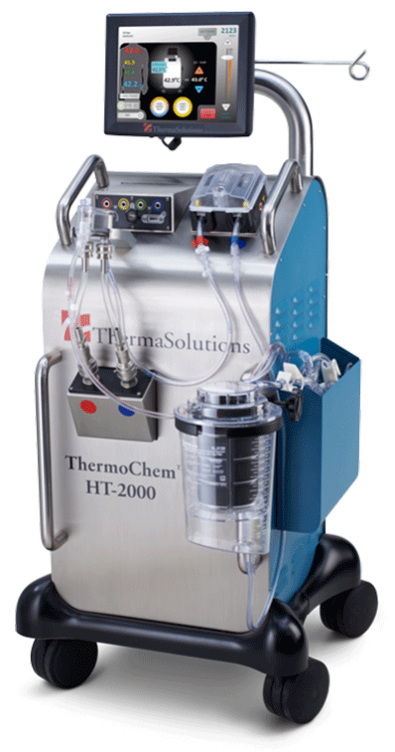
How to access the role of HIPEC in Peritoneal Carcinomatosis?
Evidence from randomized trials
Complications, is it harmful?
Incorporation in Guidelines

Slide 3
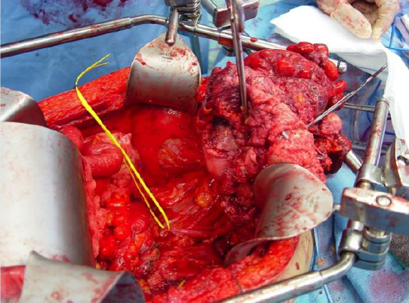
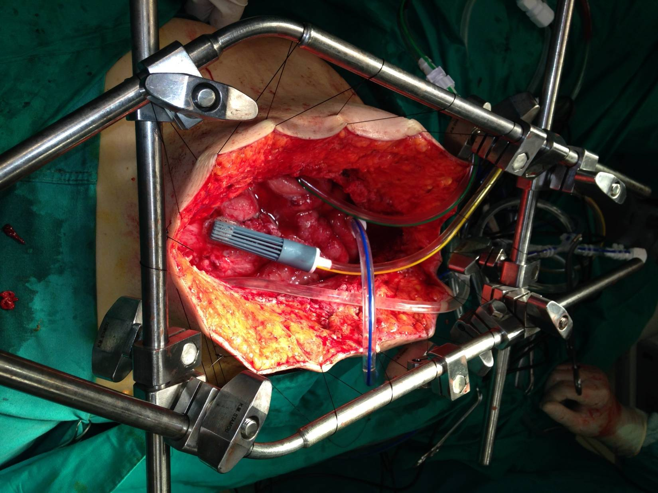
Paul Sugarbaker, Washington DC The father of advanced peritoneal carcinomatosis surgery

Slide 4
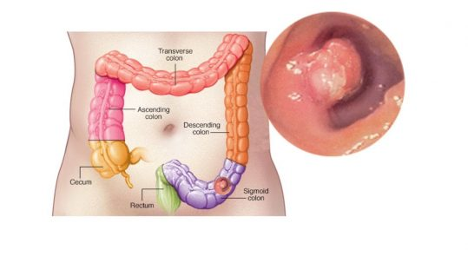
2. Evidence from Randomised trials
Bowel Cancer

Slide 5
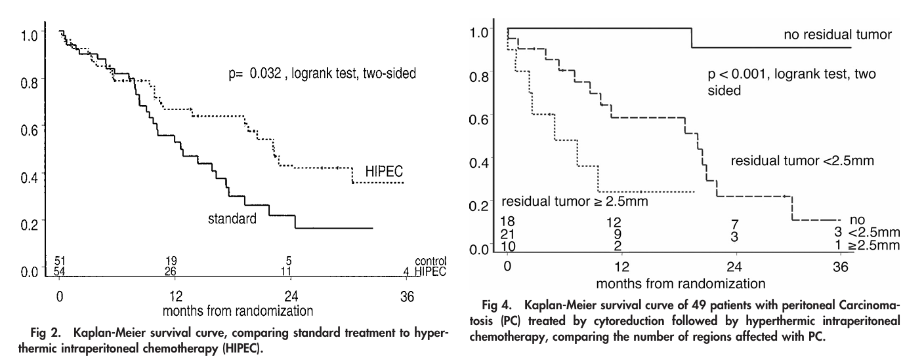

Slide 6
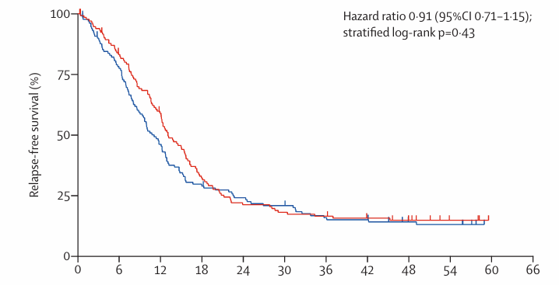
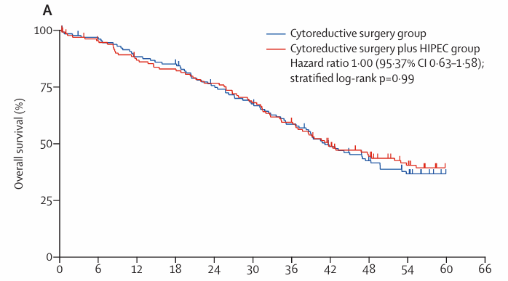
Lancet Oncol
2021; 22: 256–66

Slide 7
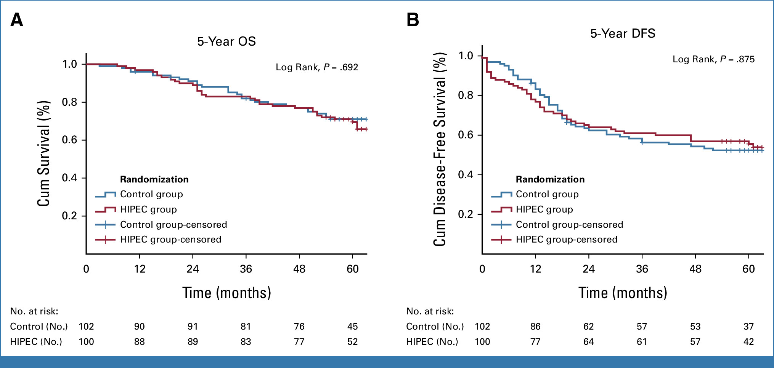

Slide 8
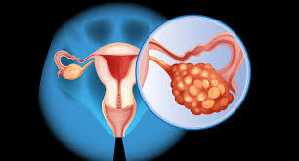
How to access the role of HIPEC in Ovarian Ca?
Evidence from randomized trials
Complications, is it harmful?
Incorporation in Guidelines

Slide 10
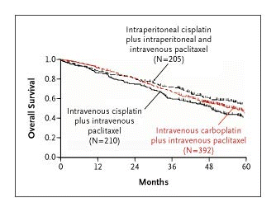

Slide 11
Why IP ChemoTx did not work? COMPLICATIONS!! ONLY 42% IN GOG252 COMPLETED 6 CYCLES
Infection, fever
Pain, nausea, vomiting
Haematological,
Metabolic,
Neurologic toxicity

Slide 12
2. Evidence from Randomised trials Primary Debulking in Advanced Ovarian Cancer
OVHIPEC-2 completion in 2026

Slide 13
PDS or IDS + HIPEC – CHIPPI trial French RCT to 2028

Slide 14
2. Evidence from Randomised trials Interval Debulking in Advanced Ovarian Cancer
Multicentric, phase 3 trial
245 patients, all Neo-adjuvant chemo
HIPEC with ONLY Cisplatin (100mg/m2)
Death Hazard Ratio: 0,66
Mean survival difference: 12 months (46-34 m)

Slide 16
Van Driel trial regime

Slide 17
Anticipated 280 patients would be needed to detect a hazard ratio of 1.5 and a power of 80%
Because of slow accrual, sample size reduced from 280 to 240
The PFS was only 10.7 months in the standard arm instead of the expected 18 months
The PFS was only 14.2 months in the HIPEC arm instead of the expected 24 months
PFS was shorter than anticipated, even though approximately 70% had a surgical complete resection

Slide 18
Timing of randomization might have biased the surgeons
performing IDS in favor of the HIPEC arm
In the 2006 protocol, the inclusion was planned before the first chemotherapy cycle
According to amended protocol of 2012, inclusion was allowed both before the first chemotherapy course and before IDS

Slide 19
The study was small (n = 245), and this might have led to possible bias
Difference in death events was only 15 patients
Recruitment period was 9 years, 3 patients per center per year
Selection of sites and surgeons was not quality- assured

Slide 20
At the largest center (National Cancer Institute in Amsterdam; n = 105 pts), no difference was observed in favor of HIPEC
At the smaller centers (which included 18-36 patients), a hazard ratio in favor of HIPEC of 0.65 or lower was observed
Heterogeneity of the results, with the largest effect shown at the smaller centers

Slide 21
Imbalance in patients with non–high-grade serous ovarian cancer
In the control arm, 13 patients with unfavorable non–high-grade serous ovarian cancer (carcinosarcoma, 4; mucinous carcinoma, 2; clear cell carcinoma, 5; metastasis of gastrointestinal tumor, 1; and high-grade endometrioid carcinoma, 1)
Only 3 were included in the HIPEC arm (carcinosarcoma, 1; mucinous carcinoma, 1; and high grade endometrioid carcinoma, 1)
In the HIPEC arm, 6 patients with low-grade cancers were included, whereas only 2 were included in the standard arm
3 patients in the HIPEC arm were excluded because of intraoperative diagnosis of progressive disease, whereas none were excluded because of progression in the standard arm

Slide 22
Were adverse events reported completely?
Rate of anemia was as low as 6%
Rates for leukopenia, neutropenia, and thrombocytopenia were <10%
Only 19% and 16% of the patients had any grade of alopecia in the HIPEC and control arms
Specific data for postoperative complications such as relaparotomies were not reported

Slide 23
Complications in HIPEC and control arms
Rates of any grade of infection were 18% and 11%
Rates of bowel obstruction were 8% and 3%
Rates of thromboembolic events were 6% and 2%
Rates of fever were 12% and 8%
Rate of colostomy was 72% in the HIPEC arm and 43% in the control arm

Slide 24
The trial was not stratified for important prognosticators:
FIGO III substage
Response to neoadjuvant chemotherapy (CRS)

Slide 25
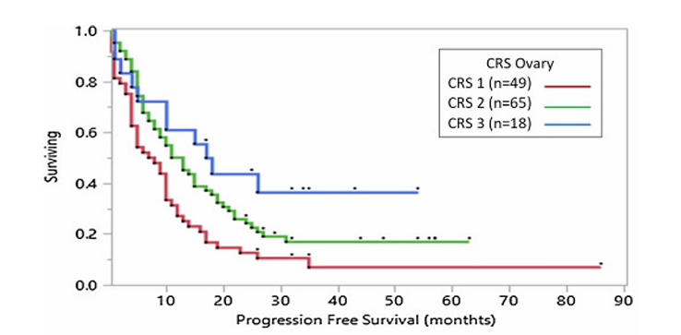
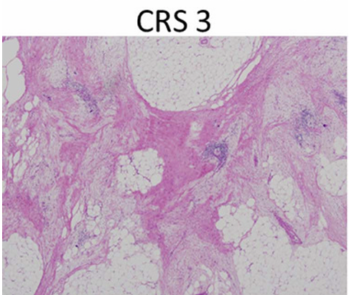
November 2018

Slide 26
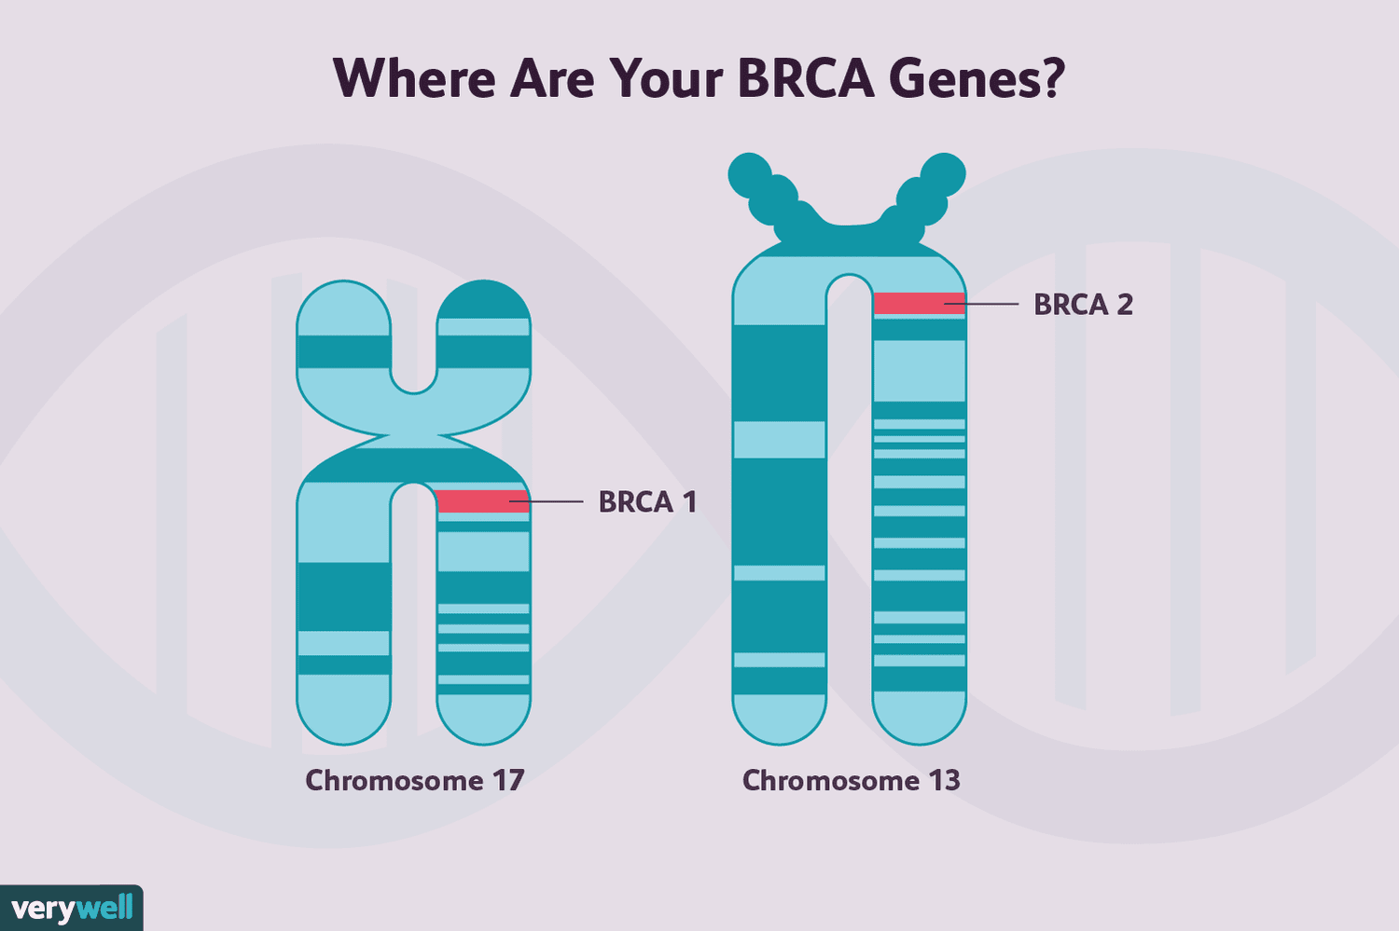
The trial was not stratified for important prognosticators:
BRCA status

Slide 27
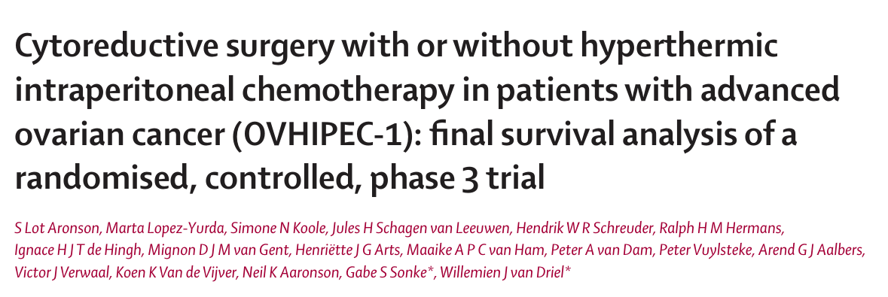
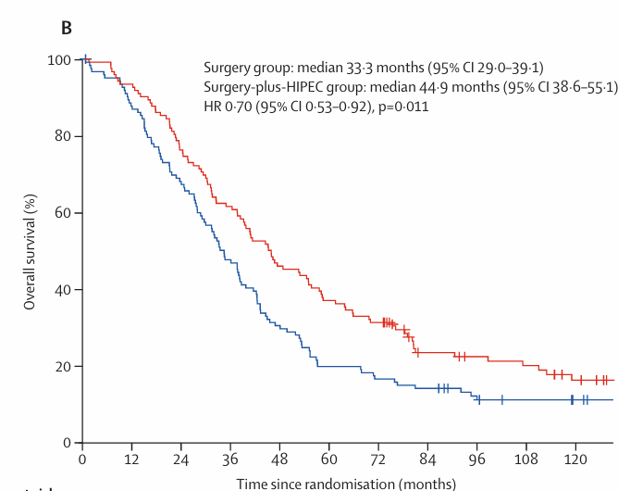
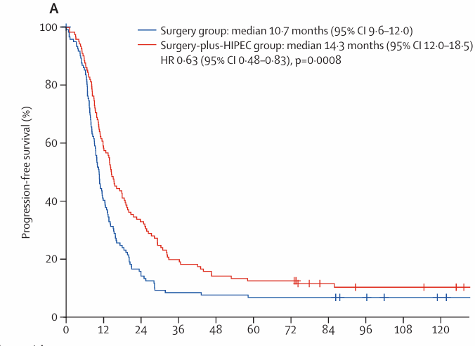

Slide 28
Possible explanations:
1. The impaired DNA repair in HRD tumours without pathogenic BRCA1/2 mutations are compromised by the depleting effect of hyperthermia on BRCA1 and BRCA2 protein function, making these tumours more sensitive to chemotherapy.
2. HIPEC might not further improve survival in BRCA1/2 carriers, who are already particularly sensitive to systemic chemotherapy.

Slide 29
2. Evidence from Randomised trials Secondary Debulking in Advanced Ovarian Cancer

Slide 30
No evidence of survival benefit with HIPEC at Secondary Cytoreduction

Slide 32
HIPEC significantly improves OS and PFS of women with EOC treated with second-line platinum-based CT
followed by secondary complete cytoreductive surgery

Slide 33
CHIPOR trial ASCO 2023

Slide 34
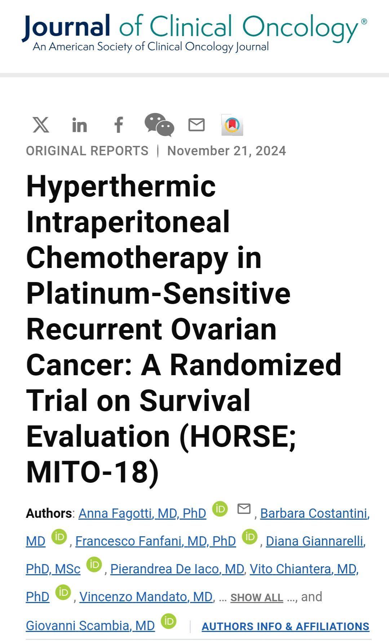
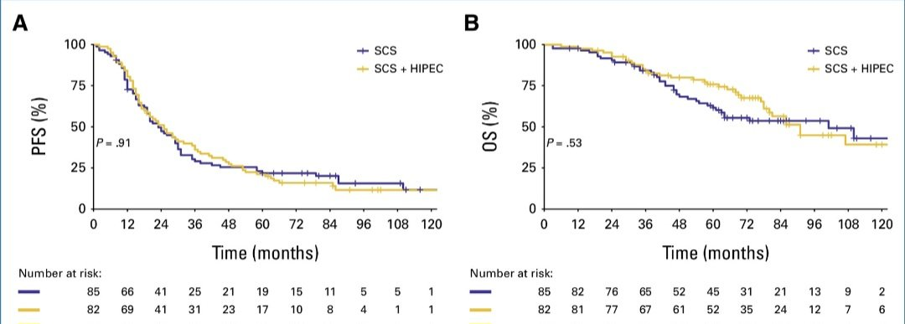

Slide 35
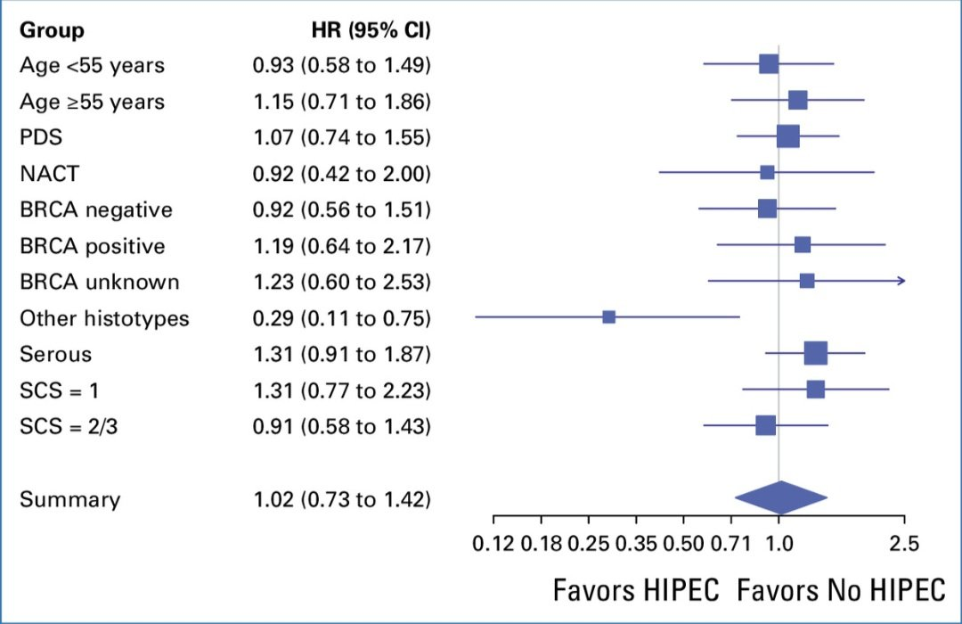

Slide 36
How to access the role of HIPEC in Peritoneal Carcinomatosis?
Evidence from randomized trials
Complications, is it harmful?
Incorporation in Guidelines

Slide 37
Why Postoperative IP Chemo did not work? COMPLICATIONS!! ONLY 42% IN GOG252 COMPLETED 6 CYCLES
Infection, fever
Pain, nausea, vomiting
Haematological,
Metabolic,
Neurologic toxicity

Slide 38
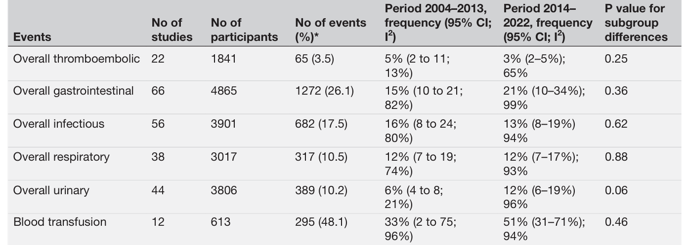
5000 patients from 69 studies

Slide 39
Frequency in anastomotic leak 4%
Ostomy 22%
Renal failure 8%
Intensive care unit admission 49%
Re- operation 7%
Post- operative death rate 3%
5000 patients from 69 studies

Slide 40
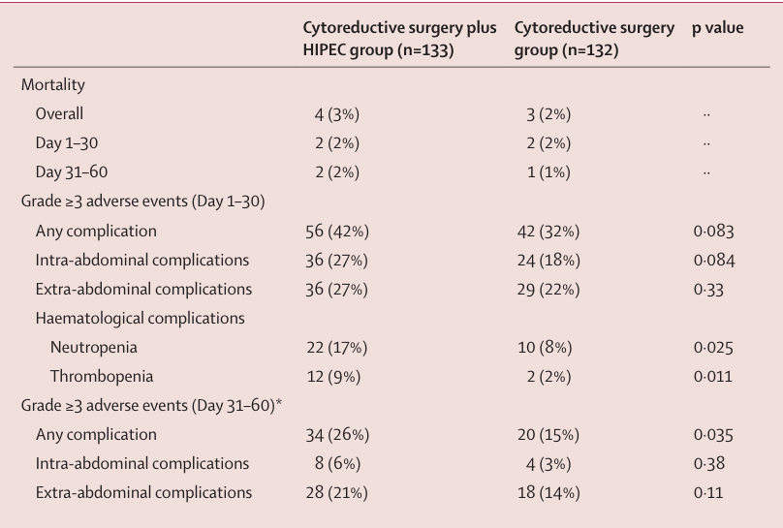
Lancet Oncol
2021; 22: 256–66
Higher Mortality
Higher Grade ≥3 Morbidity

Slide 41
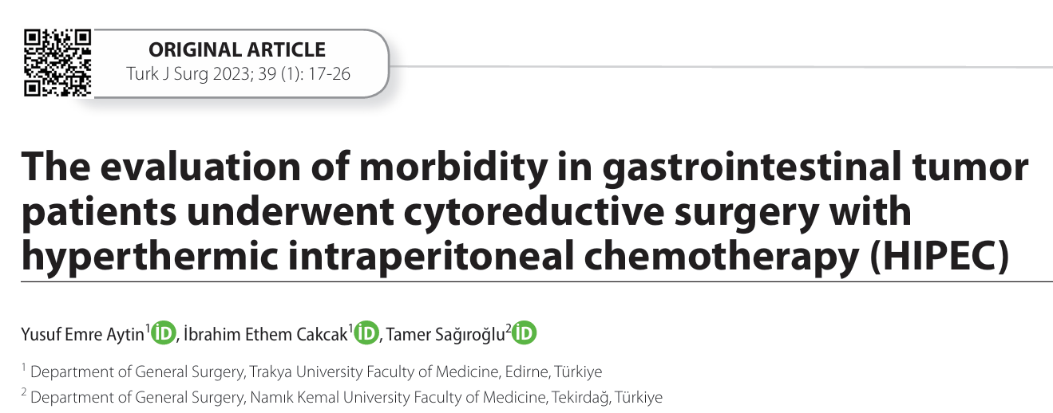
Mild morbidity 46.6%
Severe morbidity 36.6%
Mortality 11.66%

Slide 42
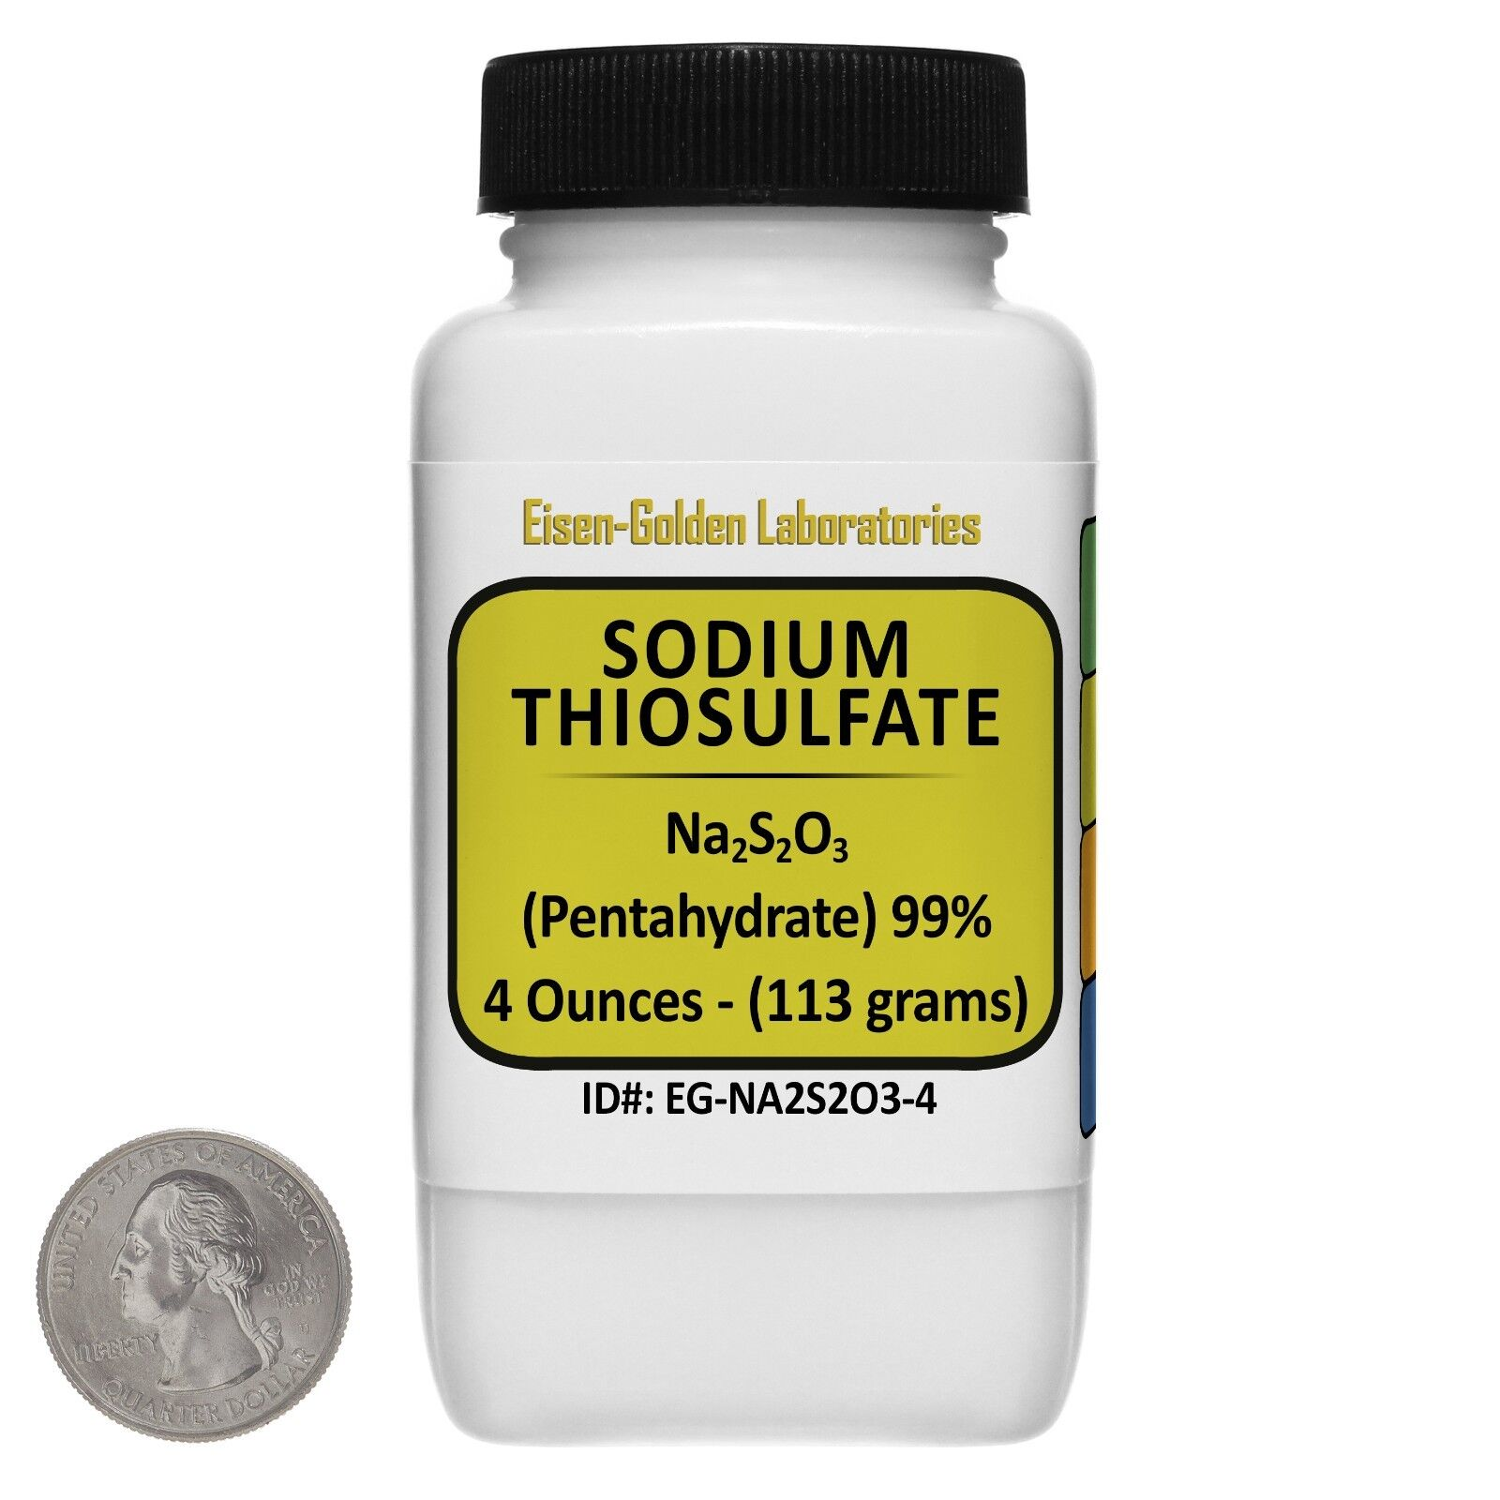
3. Complications, is HIPEC harmful?
Cisplatin is nephrotoxic

Slide 43
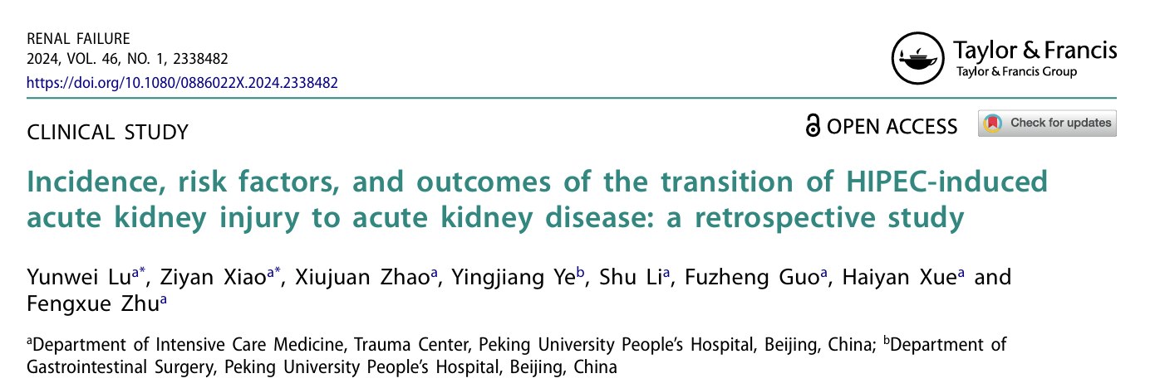
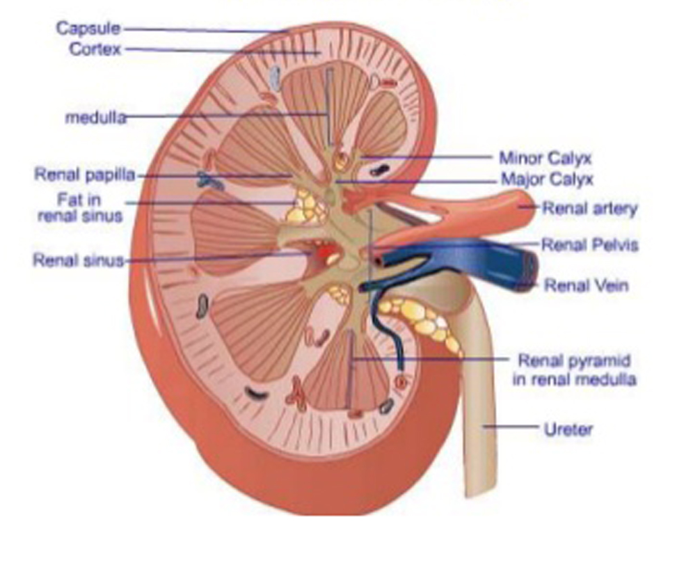
AKI 21.5%
Progression to AKD 13.3%
AKD cohort risk of 30 day in-hospital mortality 14.3%
AKD cohort risk CKD progression 42.8%

Slide 44
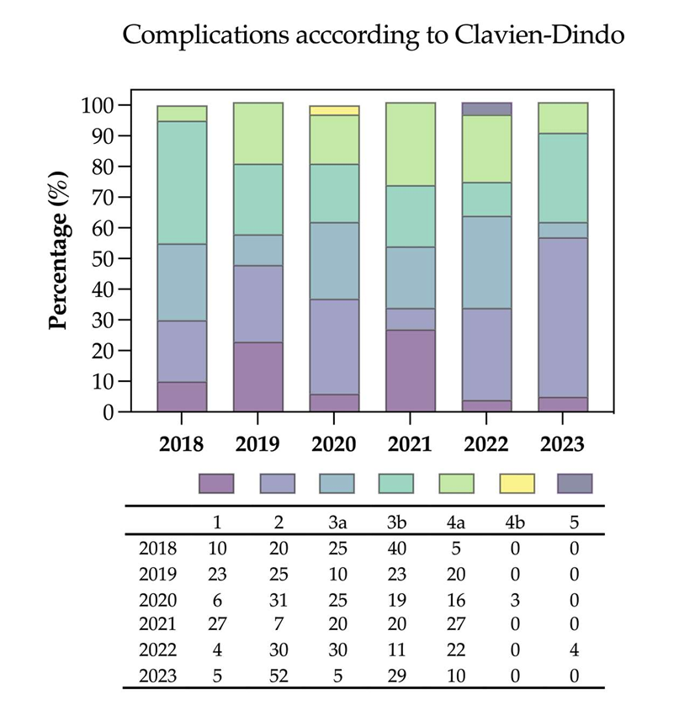
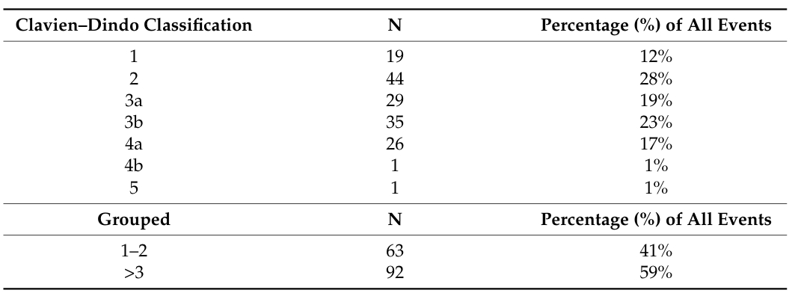

Slide 45
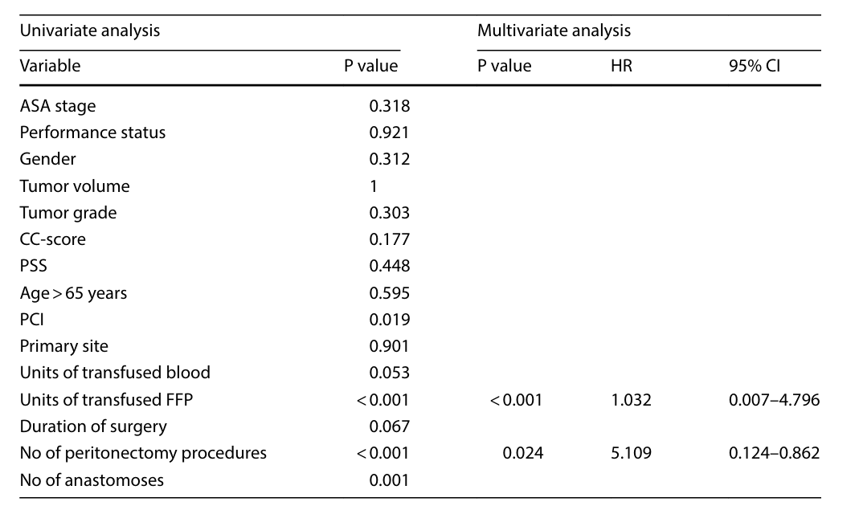
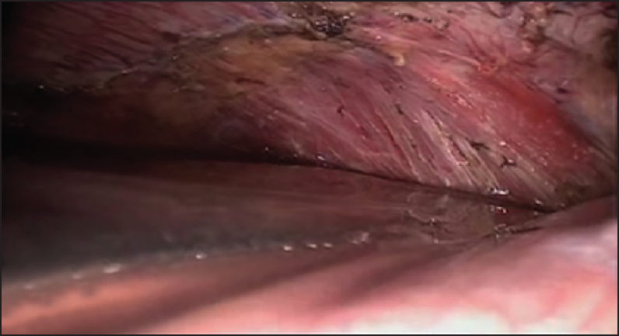
Discover Oncology
(2024) 15:106
Units of transfused FFP
No of peritonectomy procedures

Slide 46
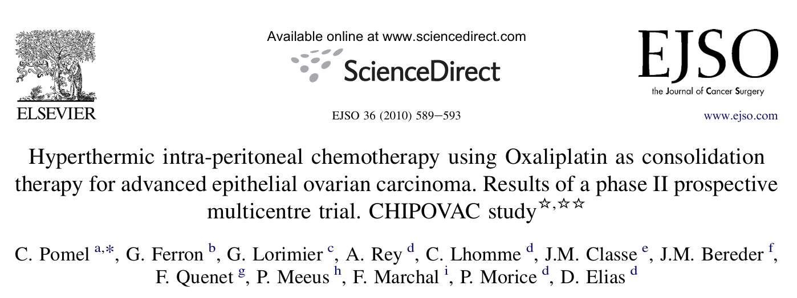
Pomel et al
EJSO 36 (2010)
Grade 3 morbidity rate was 29%
9 patients experienced a total of 13 exploratory laparotomies for bleeding after HIPEC
2-year disease free and overall survival were 27% and 67%
As a result of high level of morbidity the trial was closed

Slide 47
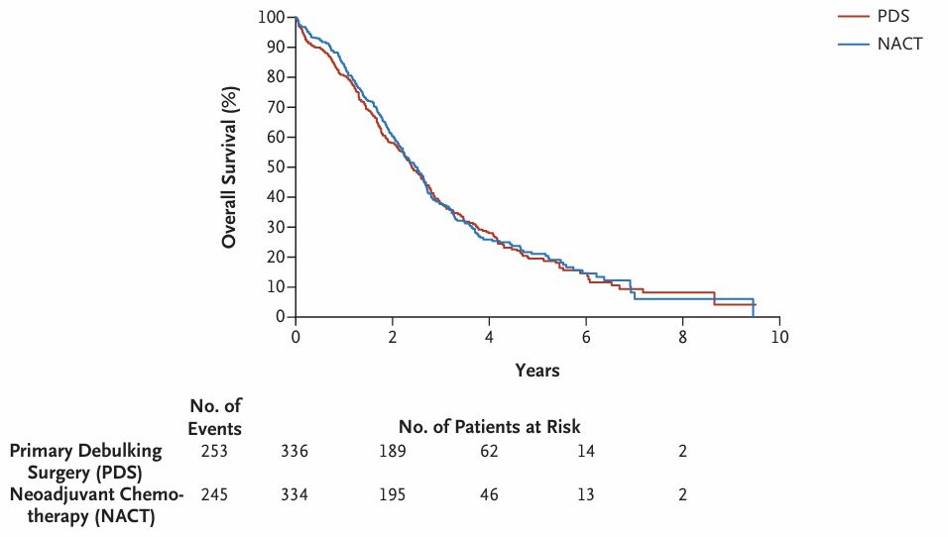
Mortality rate 0,7%

Slide 48
5. Incorporation in Guidelines

Slide 49
No consensus on the role of HIPEC and ICS was reached, which reflects current difference in opinion among participants

Slide 50
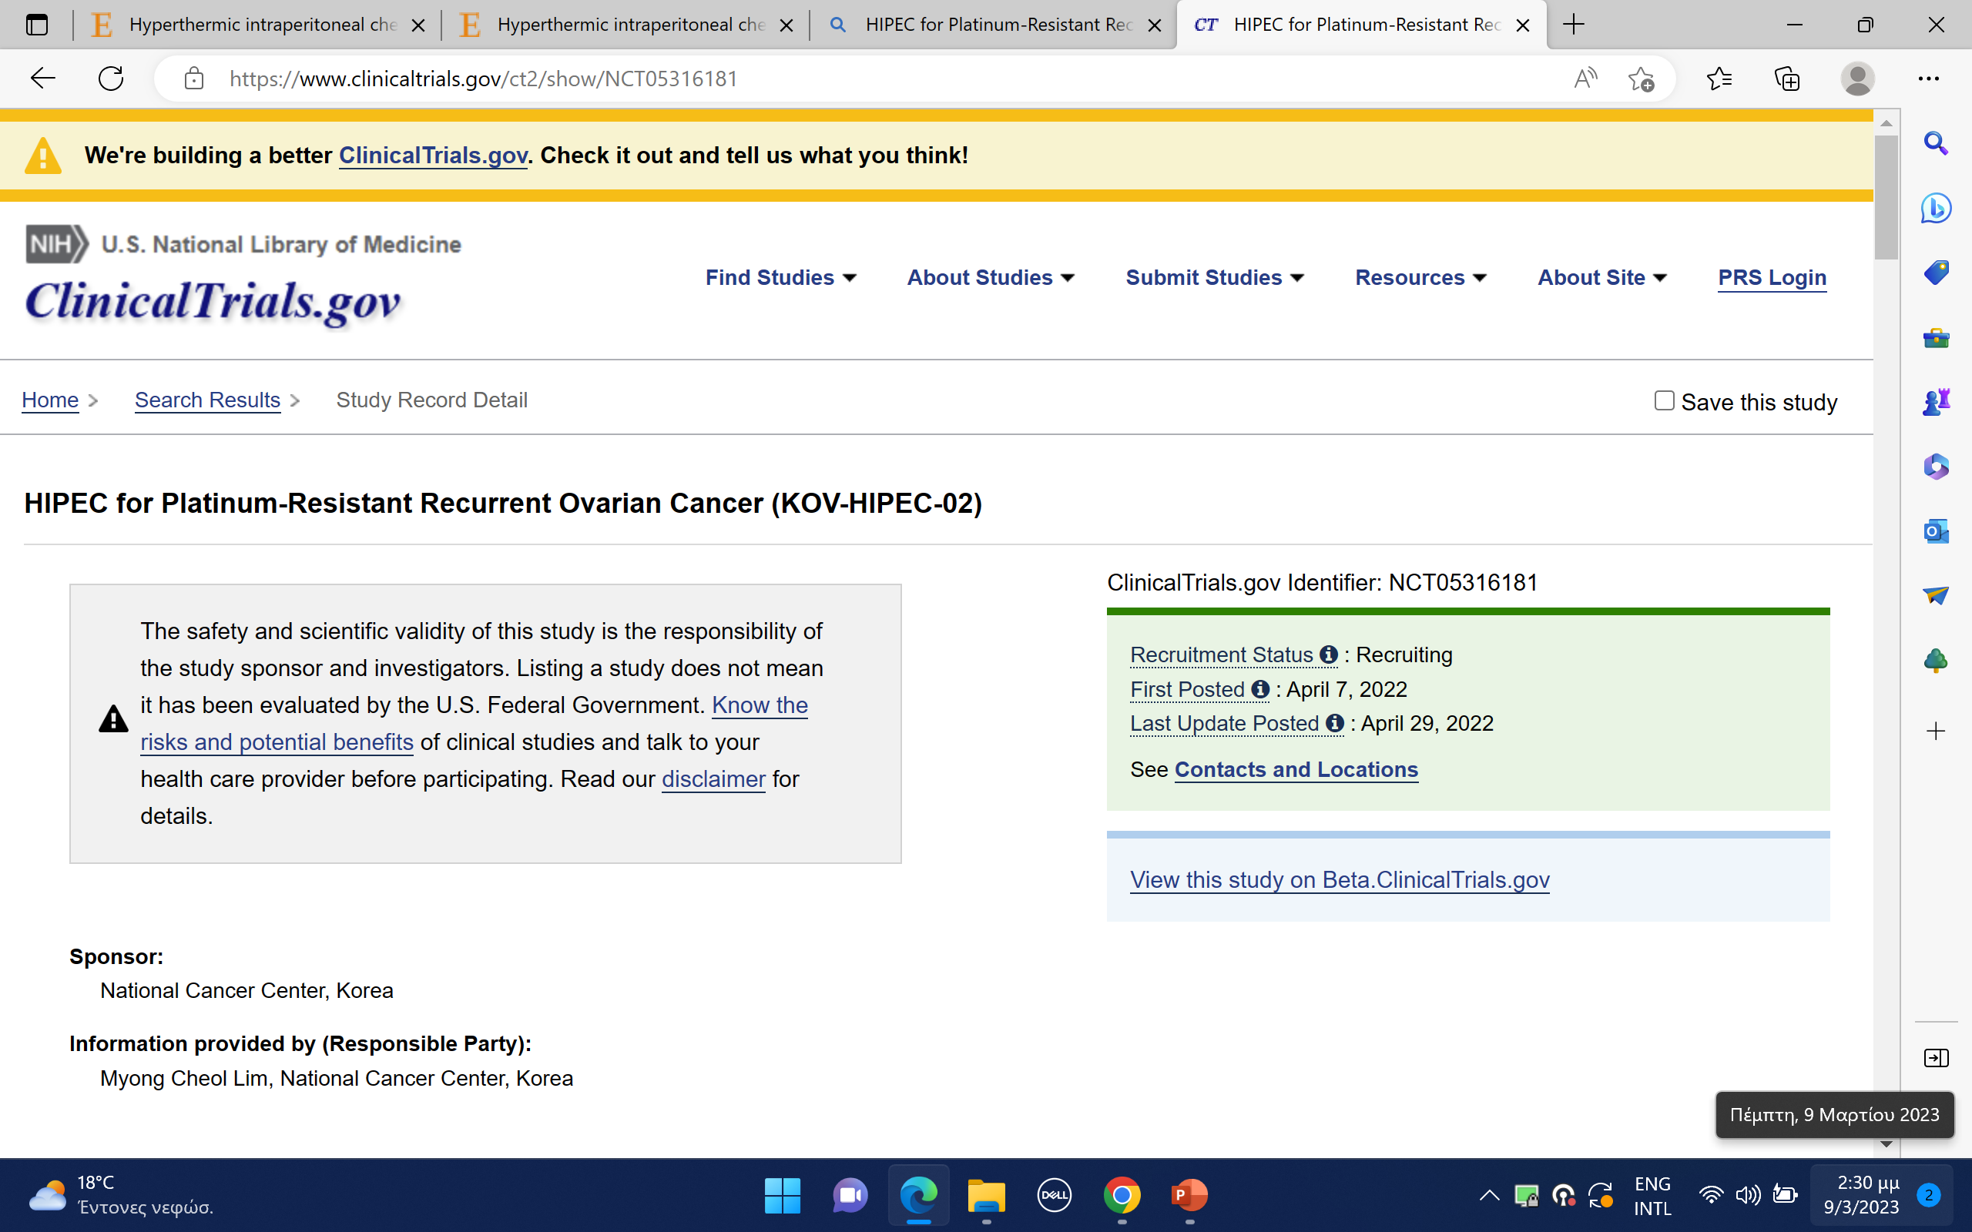

Slide 51
Platinum-resistant population HIPOVA-01

Slide 52
Platinum-sensitive Recurrent OC RCT French CHIPOR trial

Slide 53
On-going clinical trials on HIPEC in Ovarian Cancer

Slide 54
Way forward for HIPEC
Further use of HIPEC should be limited to prospective trials??
These trials should be large enough
Avoid bias by randomising patients to HIPEC or heated saline in a double-blind manner and assigning the arms at the very moment of the completion of the surgery and not before
Does IP heated chemotherapy truly have an impact or results are due to the heat or the cleansing effect of the hyperthermic solution

Slide 55
Improve the Survival of Ovarian Cancer Patients

Slide 57
Gynaecological Oncology Unit
2nd Academic Dept OBGYN, Aretaieion University Hospital
Athens, Greece

