Slide 1
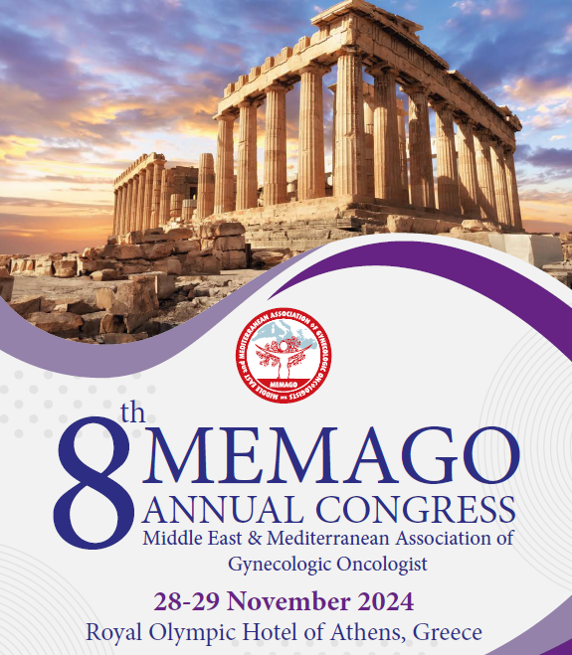
TREATMENT of Stage IB2/IB3 Cervical Cancer Neoadjuvant Chemotherapy (NACT)
Özden Altundağ, MD
Başkent University, Medical Oncology, Ankara/Türkiye
November 28, 2024 Athens

Slide 2
Can We Use NACT Stage IB2/IB3 Cervical Cancer?
For ≥ 2 decades CRT has been the SoC in locally advanced disease
The application of NACT is remains controversial?
Increasing the pathological complete RR of NACT was found the be key factor in improving pts survival:
PCR rates of PC were ony 10-17% in previous studies
GOG204: ORR 29% (CR 2.9% , PR 26.2%)
GOG240: Significant survival benefits with 1st-line BEV+Chemo for metastatic CC (48% RR)
KN 826: +Pembrolizumab (69% RR)
NACT cannot be a stand-alone treatment- It must be followed by some local treatment/which one?
Can NACT be a treatment in special situations?
To preserve fertility
In a pregnant patient with CC
Metastatic disease
RECIST
Notes:
(Lack of predictive biomarkers)

Slide 3
Common Goal: Optimize Therapeutic Ratio
Eradicate gross tumor
Address local disease
Address distant micrometastatic disease
Minimize toxicity (acute/long term)
Pretreatment staging accuracy is essential to plan treatment
Surgical extent
Radiation extent/dosing
Lack of RT in low-income countries
Surgery performed non-trained GYN-Oncologist

Slide 4
NACT Cannot be a Stand-Alone Treatment
It must be followed by some local treatment:
NACT followed by surgery, followed if required, by adjuvant RT or CTRT???
NACT followed by RT
NACT followed by CTRT
Why are new or alternative treatment strategies needed?
To increase cure rates and survival
To reduce toxicity & enhance the QoL
When the ideal treatment is not accessible

Slide 5
NACT for LACC: a Systematic Review and Meta-analysis of Individual Patient Data From 21 Randomised Trials
Two key comparisons examined:
NACT + RT vs RT alone:
Data from 18 trials
Key factors influencing outcomes:
Chemotherapy cycle length (shorter cycles show benefit with NACT: ≤14-day cycles (HR: 0.83)
Cisplatin dose intensity (higher dose intensity trends towards benefit with NACT: ≥25 mg/m²/wk (HR 0.91)
NACT + Sx vs RT alone:
Data from 5 trials
Significant survival benefit with NACT + surgery (HR 0.65)
Neoadjuvant chemotherapy for locally advanced cervical cancer meta-analysis collaboration. EJC 2003

Slide 6
Demographic Characteristics of 6 Old RCT Studies
Author | FIGO Stage | No of Comparison | Regimen of NAC | Cycles of NAC
Sardi (1997) | IB | NAC+RT (102) Surgery+RT (103) | CDDP+VCR+BLM | 10 days/3 cycles
Napolitano (2003) | IB/IIIB | NAC±RT (106) Surgery±RT (86) | CDDP+VCR+BLM | 21 days/3 cycles
Cai (2006) | IB | NAC±RT (52) Surgery±RT (54) | CDDP+5-FU | 21 days/2 cycles
Katsumoto (2013) | IB2/IIB | NAC±RT (29) Surgery±RT (33) | BLM+MMC | 21 days/2 cyles
Eddy (2007) | IB2 | NAC±RT (145) Surgery±RT (143) | CDDP+VCR | 10 days/2 cycles
Chen (2008) | IB2/IIB | NAC±RT (72) Surgery±RT (70) | CDDP+MMC | 14 days/2 cycles

Slide 7
OLD RCT TRIALS
Long-Term Follow-up of the First Randomized Trial Using Neoadjuvant Chemotherapy in Stage Ib Squamous Carcinoma of the Cervix:
The Final Results SARDI JE-Gynecol Oncol 1997
NACT can improve survival because of increased operability with free survival margins and a decrease in pathologic risk factors in unselected, bulky >4 cm IB
OS at 4 yrs 63% vs 37%
The Role of Neoadjuvant Chemotherapy for Squamous Cell Cervical Cancer (Ib-IIIb): A Long-term Randomized Trial.
NAPOLITANO U-Eur J Gynaecol Oncol 2003
NACT contributed to prolonged survival in stage IB-IIB cases, but there was no significant difference in stage IIB cases.
Randomized study of preoperative chemotherapy versus primary surgery for stage IB cervical cancer.
CAI HB J Obstet Gynaecol Res 2006
NACT significantly prolongs long-term survival through suppression of lymph node metastasis and reduction of poor pathological prognostic factors.
Clinical efficacy of modified preoperative neoadjuvant chemotherapy in the treatment of locally advanced (stage IB2- IIB) cervical cancer: randomized study. CHEN H Gynecol Oncol 2008
The modified preoperative NAC is well tolerated and beneficial in reducing tumor size, eliminating pathological risk factors, and improving prognosis for responders. Avoids the delay of effective treatment for non-NAC responders.
Phase III randomised controlled trial of neoadjuvant chemotherapy plus radical surgery vs radical surgery alone for stages IB2, IIA2, and IIB cervical cancer: a Japan Clinical Oncology Group trial (JCOG 0102)
KATSUMATA N Br J Cancer 2013
This study was prematurely terminated at the first planned interim analysis because OS in the NACT group was inferior to that in the RS group.
NACT with BOMP regimen before RS did not improve OS. But reduced the number of patients who received postoperative RT.

Slide 8
NACT + Surgery vs Surgery for CC Cochrane Database of Systemic Reviews
This review was based on 6 trials, included 1072 pts
Surgery after NACT:
OS benefit HR: 0.85, p=0.17
PFS benefit HR: 0.76, p=0.01
Path. resp. LN HR: 0.54, p<0.0001
Path.parametria HR: 0.58, p=0.002
Local rec. HR: 0.76, p=0.21
Distant rec. HR: 0.68, p=0.13
Outcome trending to be in favour NACT
Rydzewska L,Cochrane Database and Systematic Reviews 2010

Slide 9
Efficacy of NACT in patients with FIGO stage IB1-IIA CC: An international collaborative meta-analysis
Searched PubMed, Embase, and Cochrane Library (Jan 1987 - Sep 2010).
Included 5 RCTs and 4 observational studies (total 1784 patients) out of 523 potentially relevant studies due to limited RCT availability.
NACT benefits:
Reduced large tumor size (≥4cm) (OR: 0.22)
Decreased lymph node metastasis (OR: 0.61)
Lowered need for adjuvant radiotherapy (OR: 0.57)
Reduced distant metastasis (OR: 0.61)
No Significant Difference:
Overall and loco-regional recurrence
Progression-free survival
Poorer overall survival in observational studies: HR: 1.68
Kim HS. EJSO 2013

Slide 10
Incremental Survival Gains While Using Combinations to Treat Metastatic/Recurrent CC
GOG 204 established the global standart with a mOS of 12.9 mos, ORR: 29%
Chemotherapy backbone: Platinum+Taxane
Monk BJ. JCO 2009
GOG 240 adding Bevacizumab with a mOS of 17.5 mos
KN-826 adding Pembrolizumab in PD-L1(+) with a mOS of 28.6 mos
ORR:48%
0
ORR:69%
0
Tewari KS. Lancet 2017
Monk BJ. JCO 2023

Slide 11
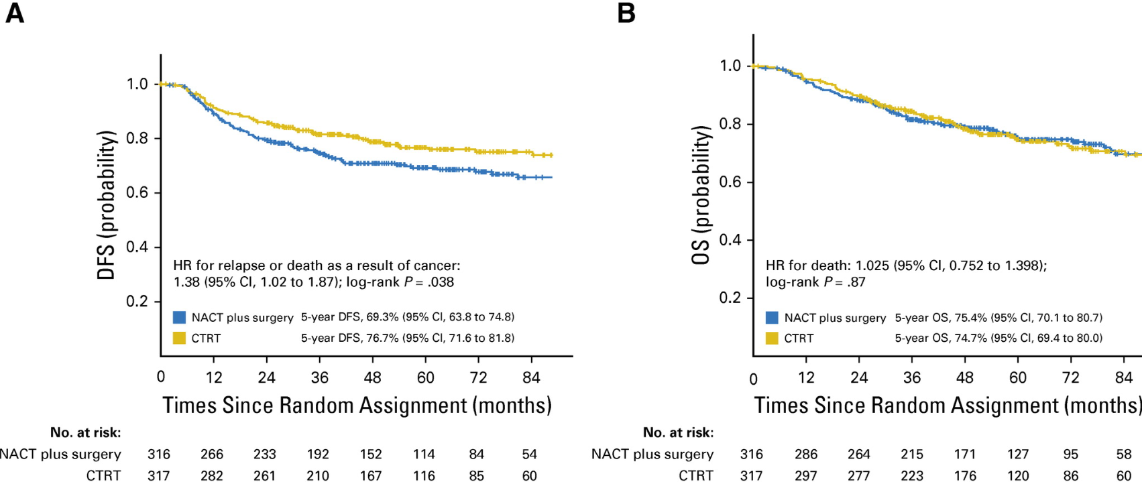
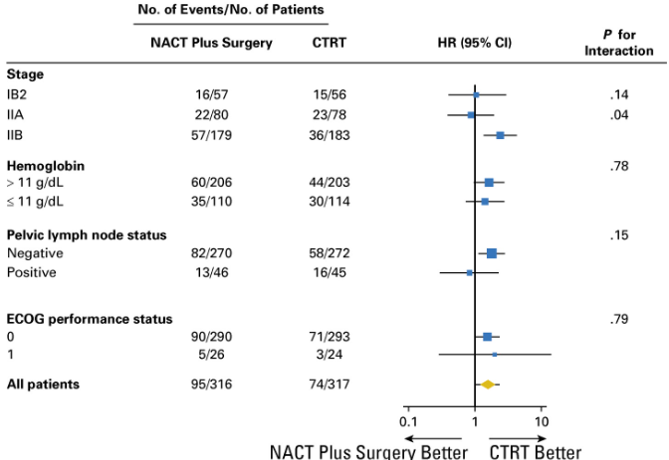
NACT Followed by Radical Surgery Vs CCRT in Patients With Stage IB2, IIA, or IIB Squamous CC: RCT
This study answered a long-lasting and important question in the treatment of pts with LACC.
3 cycles of NACT (Paclitaxel/Carboplatin every 3 weeks)
Current IB3
HR:1.03
CCRT significantly increased DFS, Not OS
The results of this study suggest that concomitant CRT should be the standart treatment in pts with LACC.
Stage IB2 (current IB3): HR: 1.03
Long term toxicity in favor of NAC + RH
Gupta S. JCO 2018

Slide 12
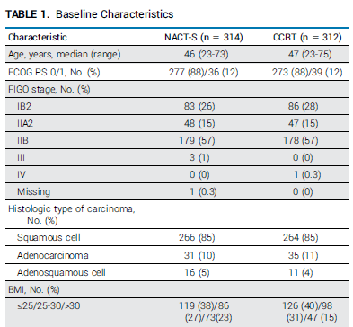
Randomized Phase III: Comparing NACT Followed by Surgery Vs CRT in Stage IB2-IIB CC EORTC-55994
May 2002-Jan 2014, 26 pts, FIGO 2009, Median f/u of 8.7 years
Half of pts, received Cisplatin monotherapy, rest received combination with Paclitaxel and ifosfamide (3 cycles/3 weekly)
Current IB3
Kenter GG. JCO 2023

Slide 13
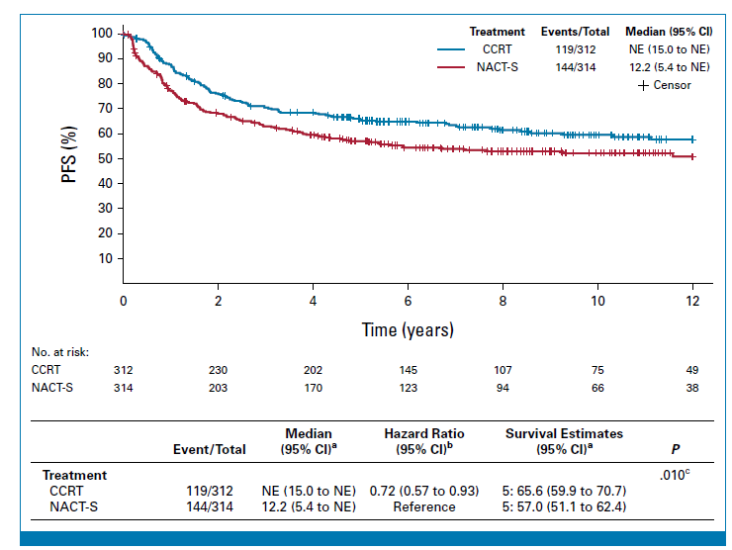
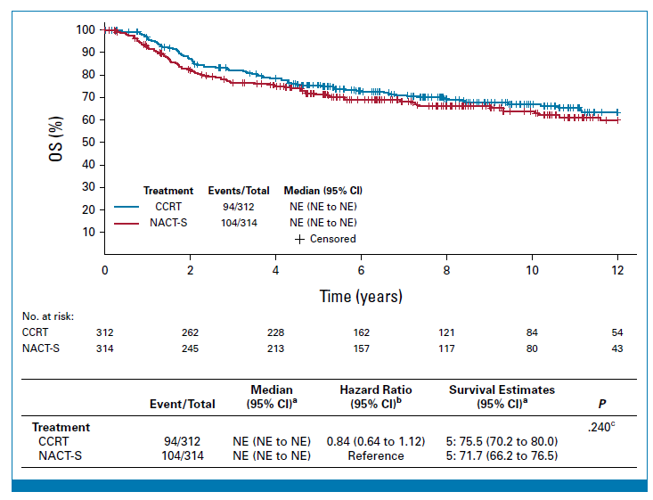
Randomized Ph III: Comparing NACT Followed by Surgery Vs CRT in Stage IB2-IIB CC EORTC-55994
May 2002-Jan 2014, 26 pts, FIGO 2009, Median f/u of 8.7 years
Half of pts, received Cisplatin monotherapy, rest received combination with Paclitaxel and ifosfamide (3 cycles/3 weekly)
5 yr PFS: (p:0.011)
CCRT: 66%
NACT+S: 57%
5 yr OS: (p:0.291)
CCRT: 76%
NACT+S: 72%
Non-inferior OS
PFS subgroup analysis: Trend for better PFS after CCRT compared with NACT-S for pts with FIGO stage IIB
Subgroup analyses for OS showed no treatment difference according to the FIGO stage
Kenter GG. JCO 2023

Slide 14
Randomized Ph III: Comparing NACT Followed by Surgery Vs CRT in Stage IB2-IIB CC EORTC-55994
48% of patients in the NACT-Sx arm received RT
TOXICITY:
Long-term Chassagne ≥ Grade 3 toxicity was seen in the 15% in the NACT arm and 21% in the CCRT arm
We must care about the long-term effects of our treatments
Pts who receive NACT-Sx fare better with respect to vaginal and bowel toxicities which impact their QOL.
Kenter GG. JCO 2023

Slide 15
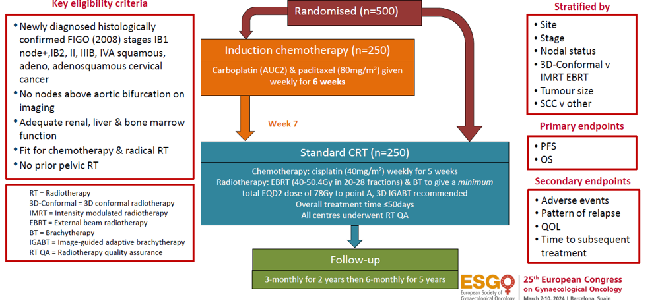
A Randomised Phase III Trial of Induction CT followed by CRT Compared with CRT alone in LACC The GCIG INTERLACE trial
UK, Mexico, India, Italy & Brazil
McCormack M. Lancet 2024

Slide 16
A Randomised Phase III Trial of Induction CT followed by CRT Compared with CRT alone in LACC The GCIG INTERLACE trial
(Current IB3)
McCormack M. Lancet 2024

Slide 17
A Randomised Phase III Trial of Induction CT followed by CRT Compared with CRT alone in LACC The GCIG INTERLACE trial
HR:0.65
HR:0.61
Induction CTx prior to CRT led to a 9% improvement in PFS and an 8% improvement in OS @5 yrs
McCormack M. Lancet 2024
Notes:
IB2/IB3 constitutes 10% of patients

Slide 18
A Randomised Phase III Trial of Induction CT followed by CRT Compared with CRT alone in LACC The GCIG INTERLACE trial
Induction CTx prior to CRT led to a 9% improvement in PFS and an 8% improvement in OS @5 yrs
PFS: HR: 0.65, p=0.013
OS: HR: 0.61, p=0.04 (Follow up continues)
OS in the standard CRT arm is similar to that in the recent published literature.
Hematological toxicity was greater in the IC/CRT arm but this did not compromise the delivery of RT
Induction chemotherapy with weekly Paclitaxel/Carboplatin before CRT should be considered the new standard in LACC and is feasible across diverse healthcare settings!!
McCormack M. Lancet 2024

Slide 19
Incremental Survival Gains While Using Combinations to Treat Metastatic/Recurrent CC
GOG 204 established the global standart with a mOS of 12.9 mos, ORR: 29%
Chemotherapy backbone: Platinum+Taxane
Monk BJ. JCO 2009
GOG 240 adding Bevacizumab with a mOS of 17.5 mos
KN-826 adding Pembrolizumab in PD-L1(+) with a mOS of 28.6 mos
ORR:48%
0
ORR:69%
0
Tewari KS. Lancet 2017
Monk BJ. JCO 2023

Slide 20
Combination of Weekly Paclitaxel-Carboplatin plus BEV as NACT in stage IB–IIB CC
Retrospective, FIGO 2018 stage IB–IIB cervical cancer, #30 pts
NACT/PC (weekly/9 weeks) & bevacizumab (15 mg/kg every 3 weeks)
RECIST results: 7 (23%) CR; 23 (77%) PR
After radical hysterectomy, optimal pathological response:
9 pts (29%) pCR and 2 pts (8 %) pPR
6 pts (20%) received postop adjuvant CRT
Bevacizumab in addition to weekly PC showed a 100% radiological RECIST response and an optimal pathological response of 37%
Maene C. IJGC 2021

Slide 21
Incremental Survival Gains While Using Combinations to Treat Metastatic/Recurrent CC
GOG 204 established the global standart with a mOS of 12.9 mos, ORR: 29%
Chemotherapy backbone: Platinum+Taxane
Monk BJ. JCO 2009
GOG 240 adding Bevacizumab with a mOS of 17.5 mos
KN-826 adding Pembrolizumab in PD-L1(+) with a mOS of 28.6 mos
ORR:48%
0
ORR:69%
0
Tewari KS. Lancet 2017
Monk BJ. JCO 2023

Slide 22
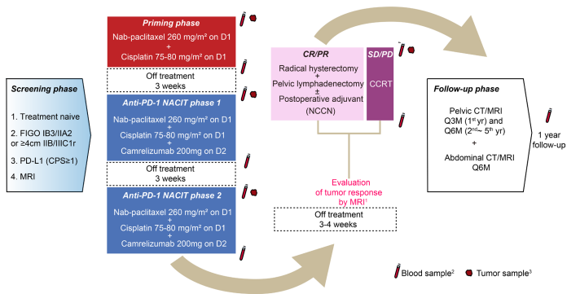
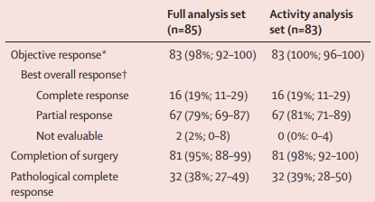
NACT plus Camrelizumab for LACC (NACI study): A Multicentre, Single-arm, Phase 2 Trial
FIGO 2018: 1B-IIIC1r, 85 pts
Tumour Response to NAChemo-IO according to RECIST & Pathological Response
RR: ~ 100%
pCR: ~ 40%
Li K. Lancet Oncol 2024

Slide 23
MITO CERV3-phase II study on PC-Pembrolizumab in NACT of LCC
Single arm, multicenter, phase II
Pembrolizumab + Chemotherapy in stage IB2-IIB (FIGO 2009) CC patients.
3 cycles of NACT PC + Pembrolizumab 200 mg q21, followed by RS in non-progressing pts
After surgery, only patients with clinicopathological high risk factors will receive 3 more cycles of adjuvant chemotherapy + Pembrolizumab, followed by Pembrolizumab for up to 35 cycles.
The primary endpoint will be PFS.
Salutari V. IGCS 2022 #1533
Notes:
maintenance until progression or unacceptable toxicity or

Slide 24
Can NACT be a Treatment in Special Situations? To Preserve Fertility/In a Pregnant Patient With CC
NACT Prior Fertility-Sparing Surgery in pts with FIGO 2018 stage IB2 CC: A systematic review
Review of literature: Jan 2005-Dec 2020
114 pts with IB2 (2-4 cm) (FIGO 2018)
Possible candidates for NACT prior to FS surgery
Cisplatin, ifosfamide and paclitaxel/Cisplatin, Epirubicin and Paclitaxel
Uterin conservation rate: 76.7%
Radical trachelectomy: 20.5%
Conisation: 36.1%
Optimal pathological response to NACT in 60.9%
4.6% died of disease
Buda A. Cancers 2022

Slide 25
Can NACT be a Treatment in Special Situations? To Preserve Fertility/In a Pregnant Patient With CC
DD NACT followed by SLNB and laparoscopic PLND and simple trachelectomy in CC:
Prospective
IB2/IB3 (FIGO 2018)
40 pts (28 IB2 and 12 IB3)
3 cycles of NACT in 10 days interval (Cisplatin/Ifosfamide, Cisplatin/Doxorubicin)
SLNB LAP PLND If negative, simple trachelectomy after one week
Fertility saved: 29 pts (72.5%)
Recurrence: 5 (17.2%), 4 local/1 distant
Death: 3 (10.3%)
Pregnancies: 19 (live births: 15/18)
Oncological results are accceptable (mortality rate 10.3%) and pregnancy results are excellent (90%)
Robova H. IJGC 2019
Notes:
DD NACT followed by sentinel node mapping and laparoscopic pelvic lympadenectomy and simple trachelecetomy in CC:

Slide 26
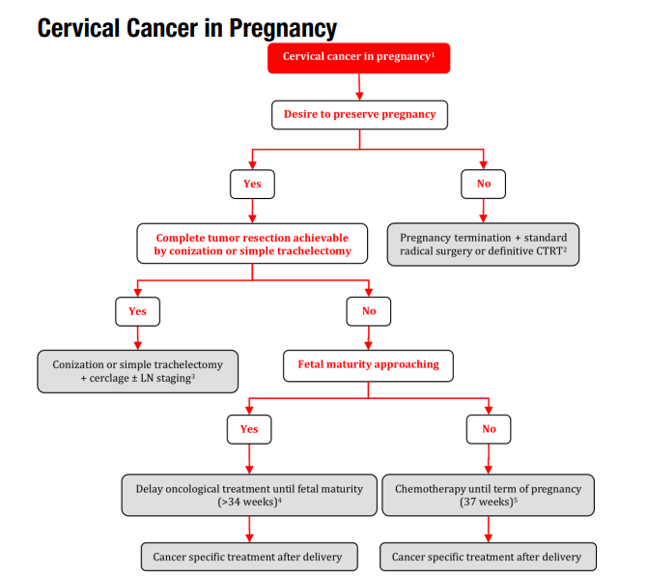
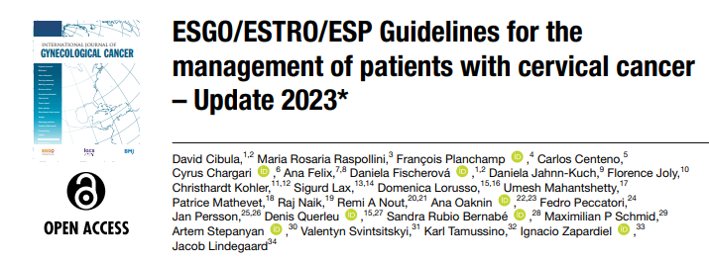
Can NACT be a Treatment in Special Situations? In a Pregnant Patient with CC
Cibula D. Int J Gynecol Cancer 2023
Notes:
fetal maturity is not complete

Slide 27
Can NACT (followed by surgery) be Used When Optimal RT Resources are Unavailable?
Management and care of pts with invasive CC: ASCO Resource-Stratified Clinical Practice Guideline
Chuang LT. J Glob Oncol 2016
Notes:
Still valid

Slide 28
Conclusion
NACT should not be performed outside clinical trials?
NACT (followed by surgery) can be used in some pts with stage IB2 and IB3 (N negative) disease:
As an alternative to CRT after discussion with patients to reduce long-term toxicities, being aware that about 1/3 of them will need RT
For fertility preservation in some pts with stage IB2 disease and some pregnant pts
In setting with limited RT resources
Induction weekly PC before CRT could be considered the new standard in LACC and is feasible across diverse healthcare settings (INTERLACE)
New treatments (ICI combinations)?

Slide 29
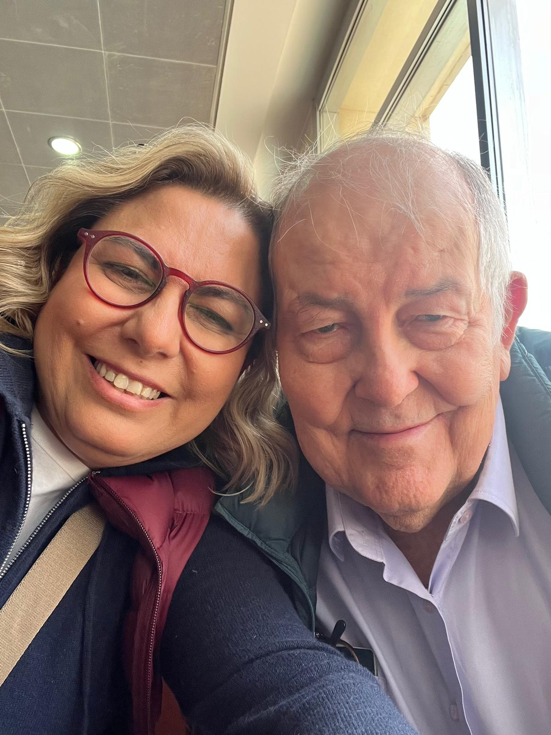
Dec 9, 2023
After 7th MEMAGO @Cairo
With ALI AYHAN

