Slide 1
Treatment of Low Grade Serous Ovarian Carcinoma (LGSOC)
Dimitrios Haidopoulos
Gynecological Oncologist

Slide 2
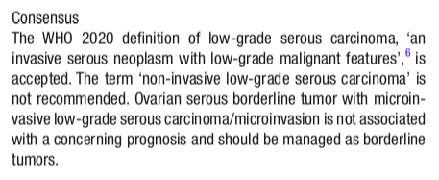

Slide 3
Up to 10% of pts with peritoneal carcinomatosis do not have
Primary peritoneal/fallopian/ovarian cancer
LGSOC: rare disease – always diagnosis by biopsy
Dood et al IJGC 2019

Slide 4
Epidemiology
Rare subtype (less than 10%) of Epithelial Ovarian Cancer
Distinct histopathological features, molecular background and clinical behavior
Younger age at diagnosis and slower tumor growth
Not associated with BRCA mut
Resistance to platinum-based chemo

Slide 5
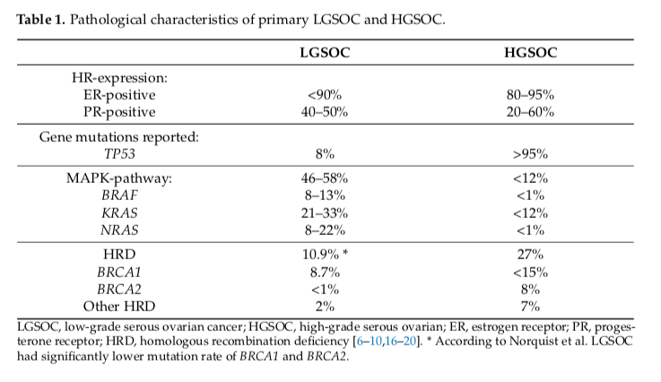

Slide 6
Risk factors
Poor prognosis
- residual disease at the end of primary therapy
- younger age
Improved prognosis
- MAPK (Mitogen-Activated Protein Kinase) alteration

Slide 7
Resistance to chemo
4-23% for 1st line therapy
2,1-4,9% for 2nd line therapy
9,1-15,5 for paclitaxel mono-chemotherapy
Response rate data extracted from retrospective data – small series
Mainstay in treatment remains PCS + chemo (carbo+taxol)
Try to avoid NACT

Slide 8
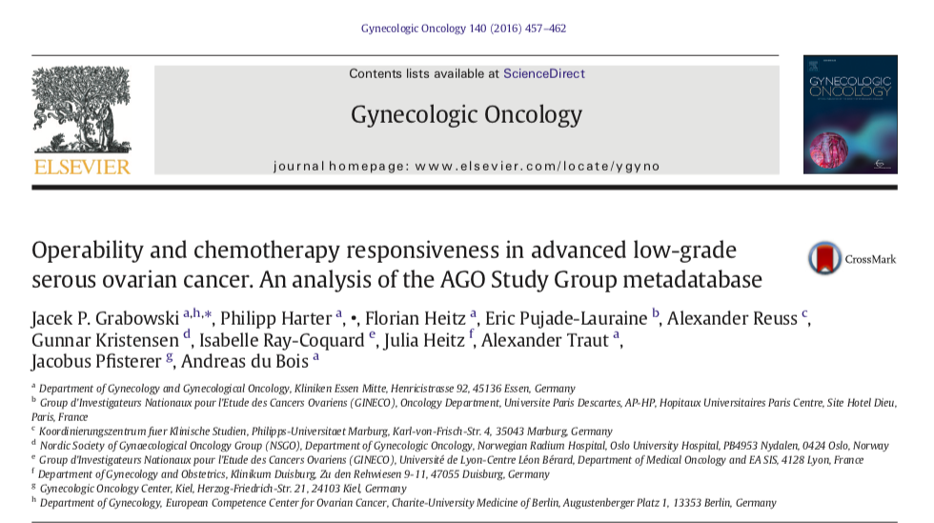

Slide 9
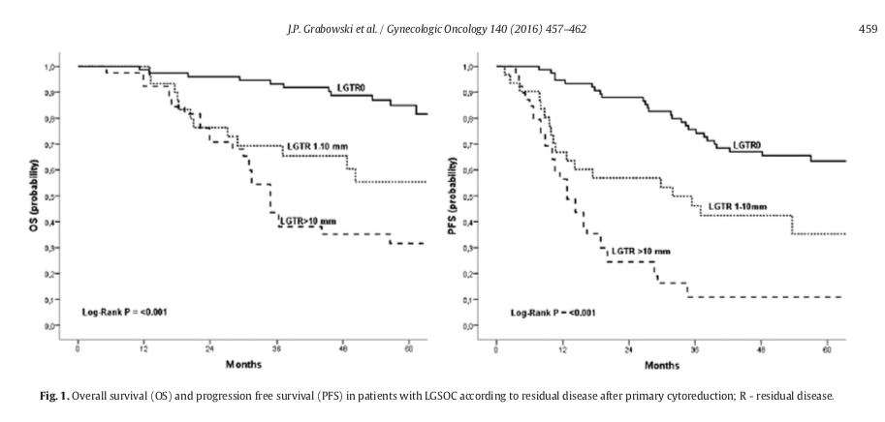

Slide 10
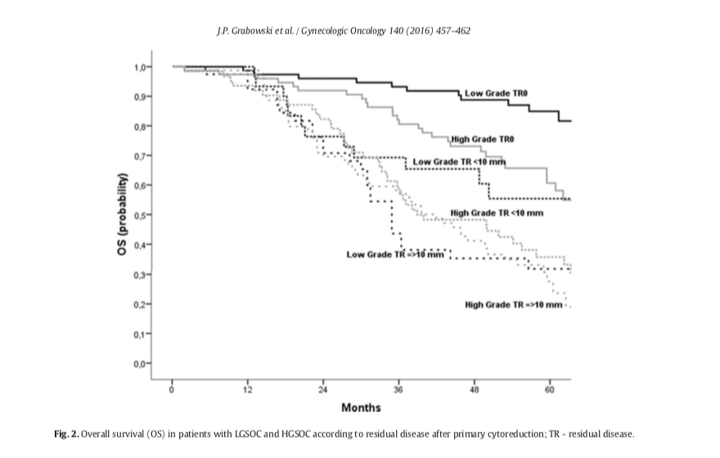

Slide 12
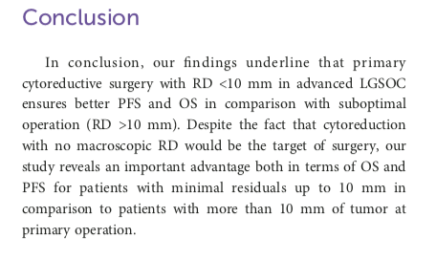
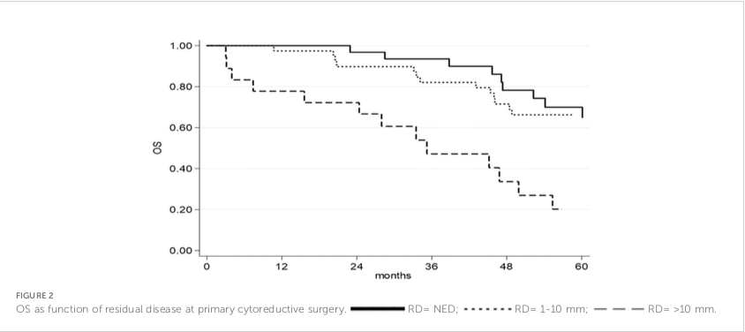

Slide 13
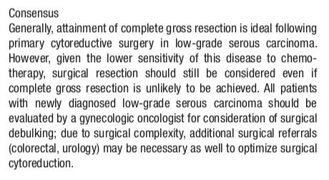

Slide 14
Adjuvant chemo following PCS
Chemo for stages Ib-Ic: uncertain...
- 6 cycles of carbo monotherapy or 3 cycles carbo – taxol for st Ib
- 6 cycles carbo – taxol for st Ic
NCCN
- no adjuvant chemo for st Ib
- 3-6 cycles carbo – taxol for st Ic
All other stages: carbo – taxol 6 cycles

Slide 15
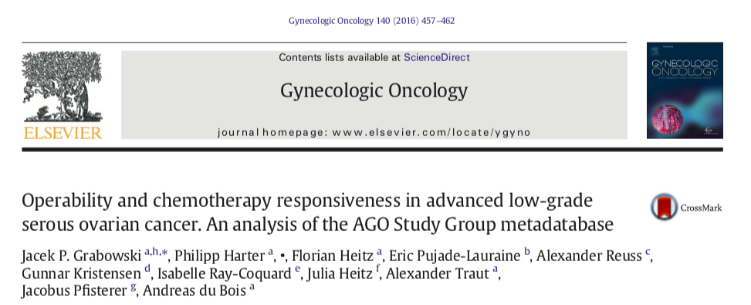
….Despite that, limited effectiveness of chemo…
AGO confirmed the difference in response rates of
platinum based chemo in advanced HGSOC and LGSOC with
RD following PDS (90% vs 23%, p<0.001)

Slide 16
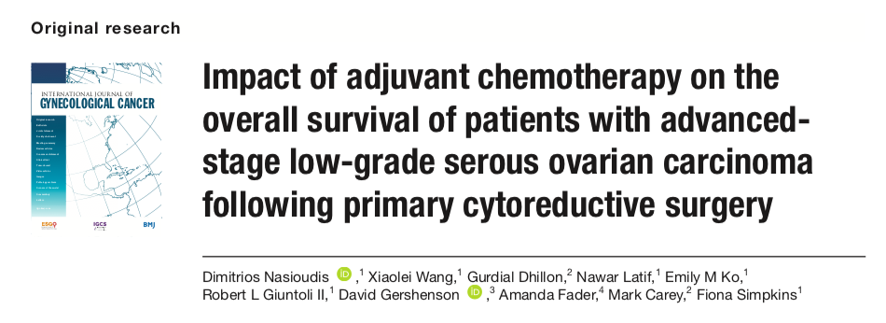
….probably no gain from adjuvant chemo..
National Cancer Database
618 pts with LGSOC st II-IV
501 pts (81,1%) received adjuvant chemo
117 pts (18,9%) no chemo
No difference in OS !!!!
Int J Gynecol Cancer 2023

Slide 17
The role of Bevacizumab
ICON 7: no gain
GOG-0218: prolonged PFS
MITO-22: prolonged PFS
Overall RR 47,5% (recurrent setting..)
“Could be considered an additional therapeutic option in
addition to adjuvant chemo”

Slide 18
Hormonal therapy in LGSOC
High expression of estrogen (90%) and progesterone (40-50%)
receptors
Strong rationale for potential therapeutic effect

Slide 19
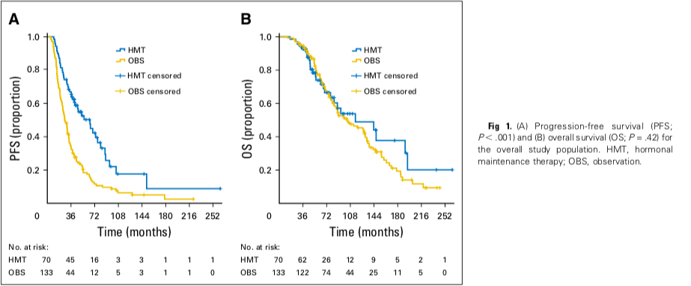

Slide 20
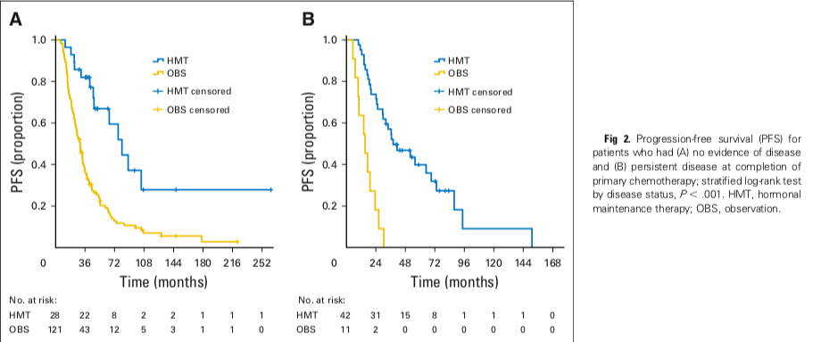

Slide 21
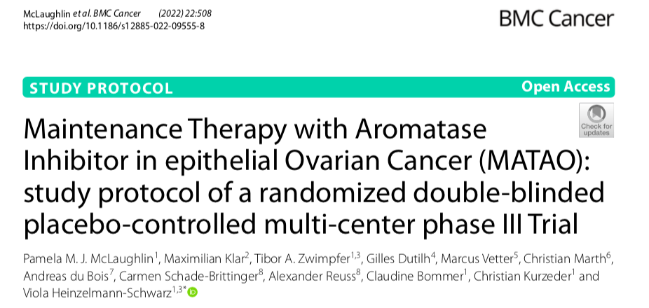
Ongoing trials for endocrine therapy in LGSOC
randomized double-blinded placebo-controlled multi-center phase III Trial
540 pts w HGSOC, LGSOC, endometrioid, st II-IV
PDS or IDS followed by at least 4 chemo (platinum-based) +/- letrozole or placebo
Inclusion criterion: Estrogen Receptor Expression >1%

Slide 22
Ongoing trials for endocrine therapy in LGSOC
Randomized controlled phase III trial NRG GY-019
450 patients LGSOC FIGO stages II–IV after primary cytoreductive
surgery
Addition of letrozole to adjuvant carbo/taxol chemo
+ letrozole maintenance therapy

Slide 23
Ongoing trials for endocrine therapy in LGSOC
Randomized phase III LEPRE trial
Pts with primary cytoreductive surgery in stages III-IV,
ER-positive LGSOC’s
Letrozole vs carbo/paclitaxel as adjuvant therapy

Slide 24
Management of recurrent disease
80% of pts w advanced LGSOC will recur
Options
- Secondary cytoreductive surgeries
- Targeted therapies
Endocrine
Anti-VEGF
Anti-MAPK

Slide 25
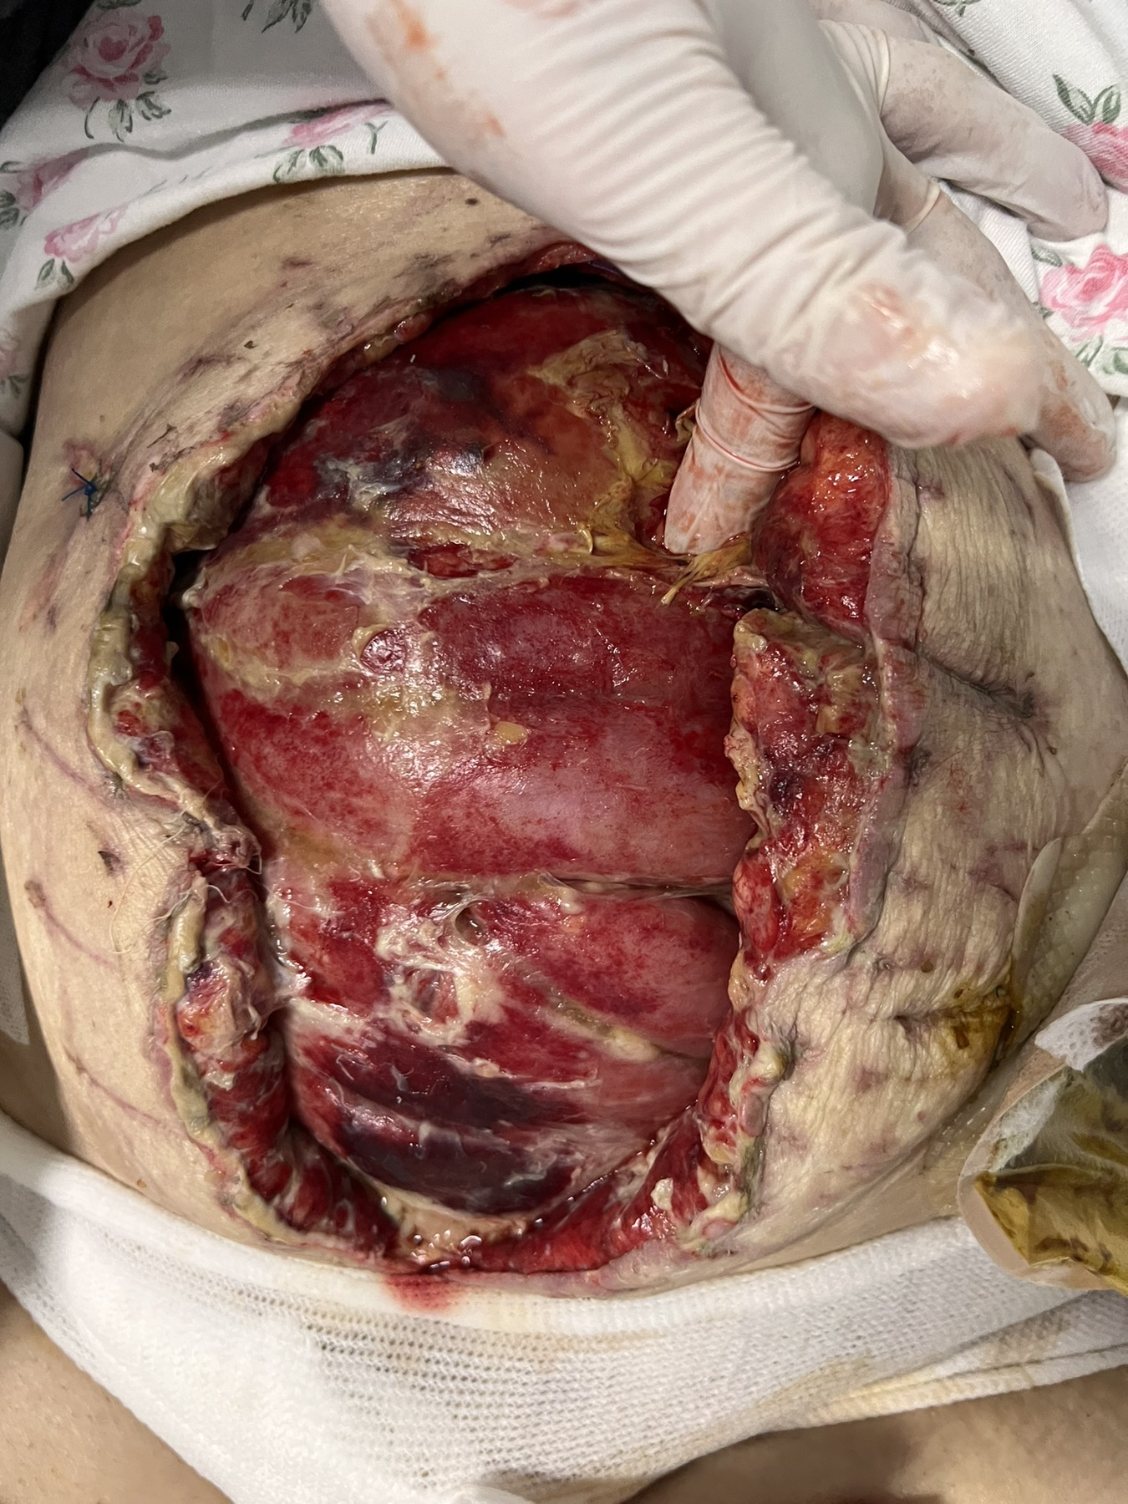
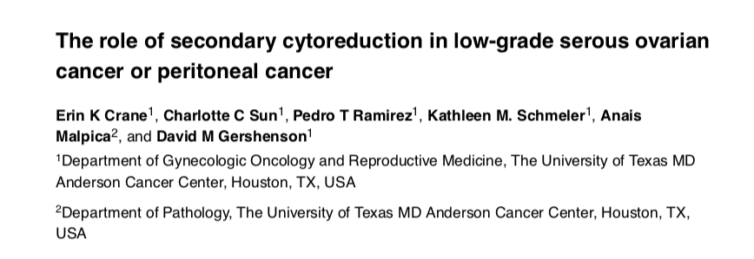
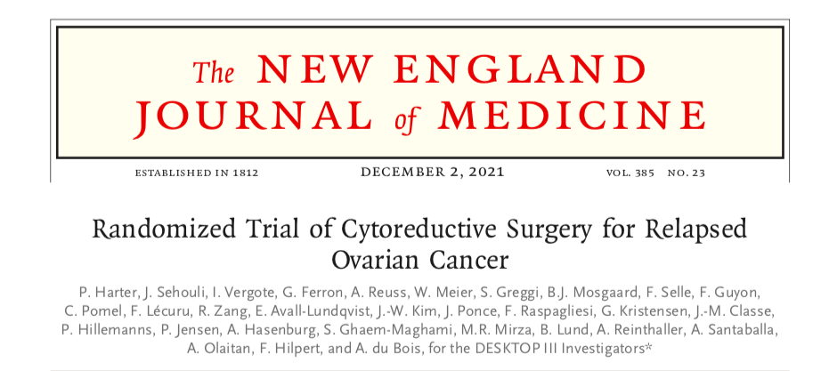
Secondary cytoreduction for recurrent LGSOC
DESKTOP III: OS benefit for secondary cytoreduction – only 10/407 pts w LGSOC…
Complete resection in pts w relapsed LGSOC: longer PFS (60,3 vs 10,7 months)…
Higher surgical complexity, multiple bowel resections

Slide 26
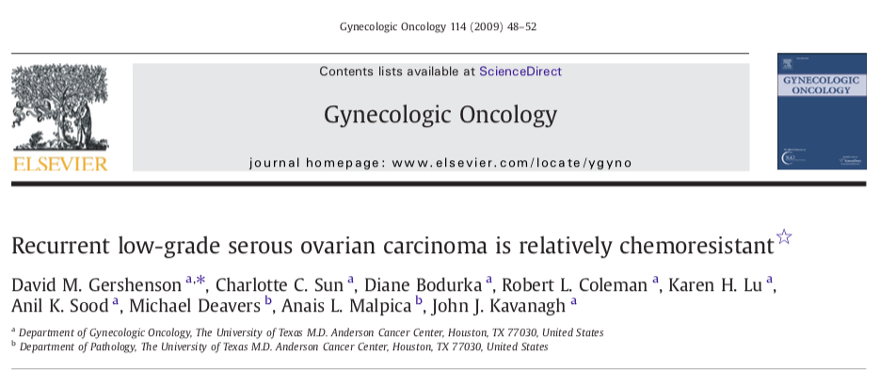
Cytotoxic chemo for recurrent LGSOC
Recurrent LGSOC is chemoresistant
Overall response
- 4,9% for platinum-sensitive
- 2,1% for platinum-resistant
- 108 combinations of different chemo regimens!!!!

Slide 27
Bevacizumab for recurrent LGSOC
Beva + singe agent chemo
Improved PFS
Overall response rate of 47,5% to beva with or without chemo

Slide 28
Novel strategies and future directions
Endocrine therapy in adjuvant and recurrent setting
Integration of approaches to block the MAPK-pathway
Tumor genome sequencing

Slide 29
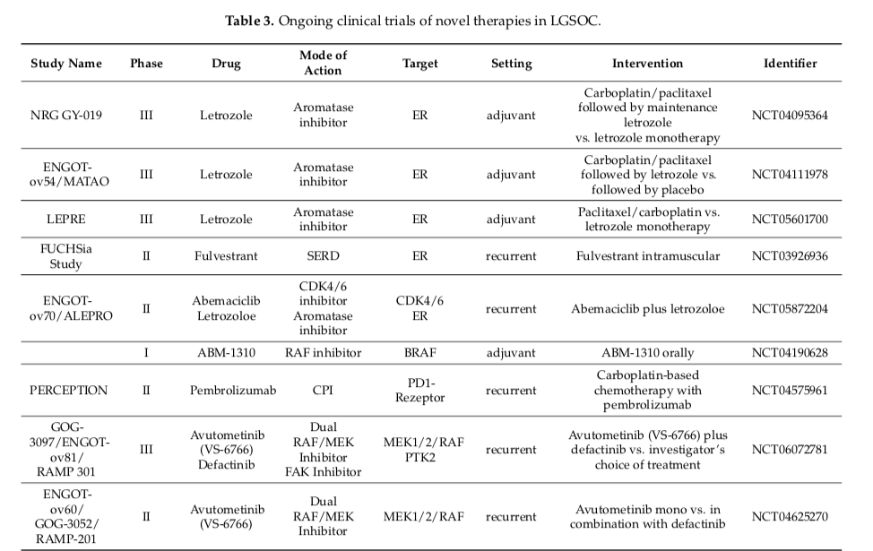

Slide 30
Endocrine therapy
Results from MATAO, NRG GY-019, LEPRE trials are awaited
to define the role of letrozole
Role of mutations in the ESR gene (encodes the ER)
Fulvestrant ?? (Selective ER downregulator)

Slide 31
MAPK blockade
The mitogen-activated protein kinase (MAPK) pathway is a critical signaling cascade regulating cell growth, proliferation, and survival
Mutations in the genes encoding the components of the MAPK pathway, such as KRAS, NRAS, and BRAF, are frequently observed in LGSOCs, driving uncontrolled cell proliferation and tumor development
MEK1/2, a central kinase within the MAPK pathway, is essential for transmitting the signals that promote tumor growth
MEK inhibitors disrupt this pathway

Slide 32
MEK-inhibitors
Binimetinib
Selumetinib
Trametinib
Avutometinib

Slide 33
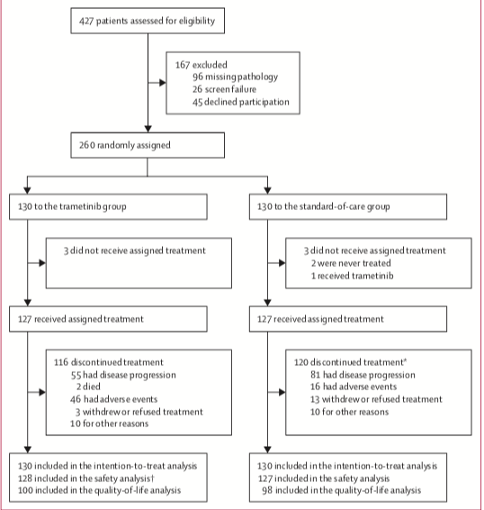

Slide 34
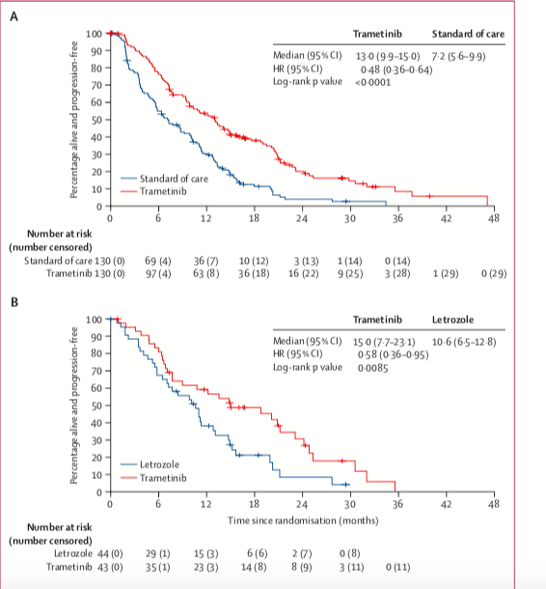
Trametinib reduced the risk of disease
progression or death by 52%
Trametinib associated with a 4-fold
increase in the probability of response
to therapy

Slide 35
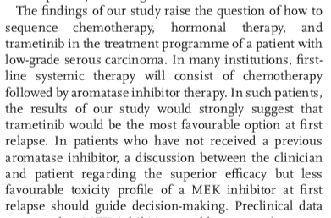

Slide 36
Other novel therapies
CDK4/6 blockade
BRAF inhibitors
Immunotherapy
Antibody drug conjugates (ADC’s)

Slide 37
Conclusions
Surgery is the cornerstone of treatment
Chemo + endocrine treatment + bevacizumab are considered for 1st line therapy
In the recurrent setting: secondary cytoreduction + endocrine + beva
Trametinib could be an option as monotherapy
Centralization

Slide 38
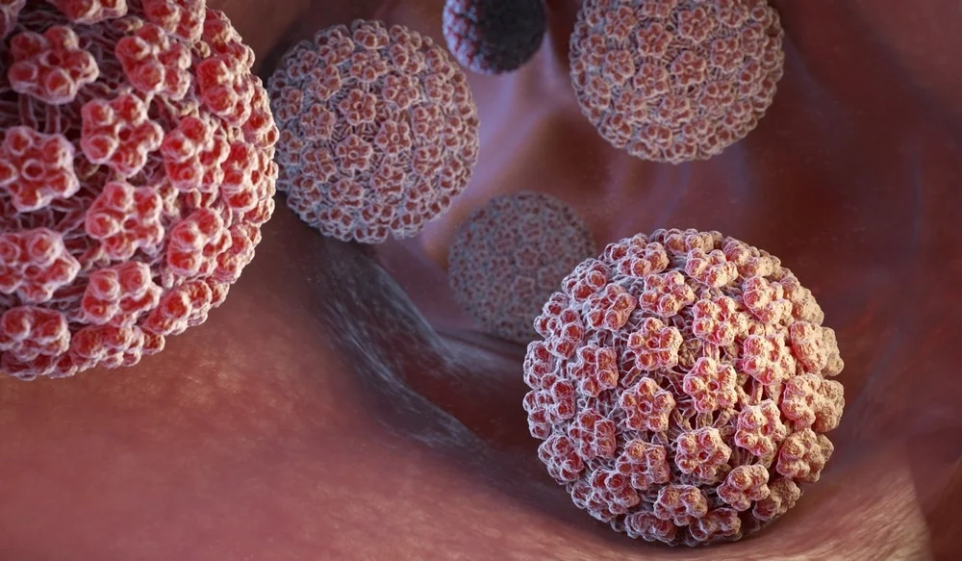
Thank you

