Slide 1

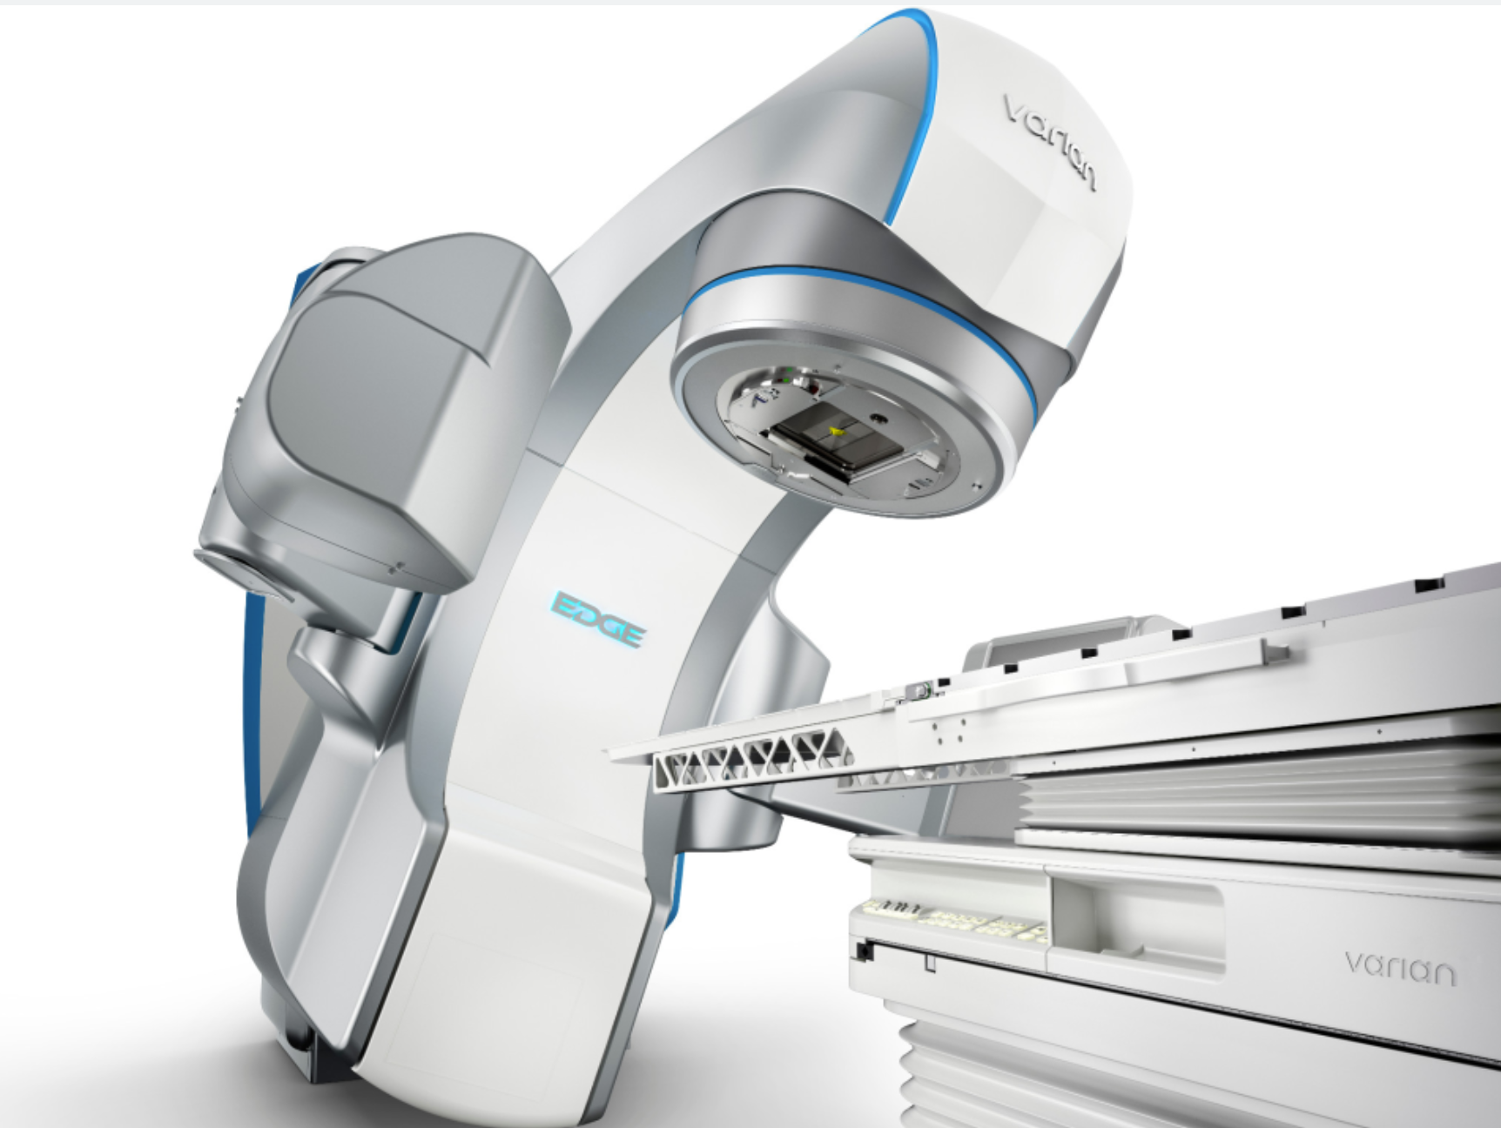



TREATMENT OF STAGE IB2/IB3 CERVICAL CANCER
CONCURRENT CHEMORADIATION THERAPY
JOHANNES C. ATHANASIOS DIMOPOULOS
MEDICAL DIRECTOR RADIATION ONCOLOGY DEPARTMENT
METROPOLITAN HOSPITAL ATHENS
VENIA DOCENDI MEDICAL UNIVERSITY OF VIENNA
FMR ESTRO FACULTY MEMBER

Slide 2
Review of Existing (important) Guidelines
NCCN Guidelines V. 4.2022
ESGO Guidelines V. 2018
ESMO Guidelines
American Brachytherapy Society Guidelines
Belgian National Practice Guidelines-KCE
ACR Appropriateness Criteria
Scottish Intercollegiate Guidelines Network - A National Clinical Guideline
Malaisian National Guidelines
Royal College of Radiologists
Clinical Practice Guidelines –Alberta Health Services
Evidence Based Management Guidelines - Tata Memorial Hospital
Best Cinical Practice Guidelines – Greater Metropolitan Clinical Taskforce
And many others (medical associations and societies etc.)
“Clear landscape – Almost no changes over last decades”

Slide 3
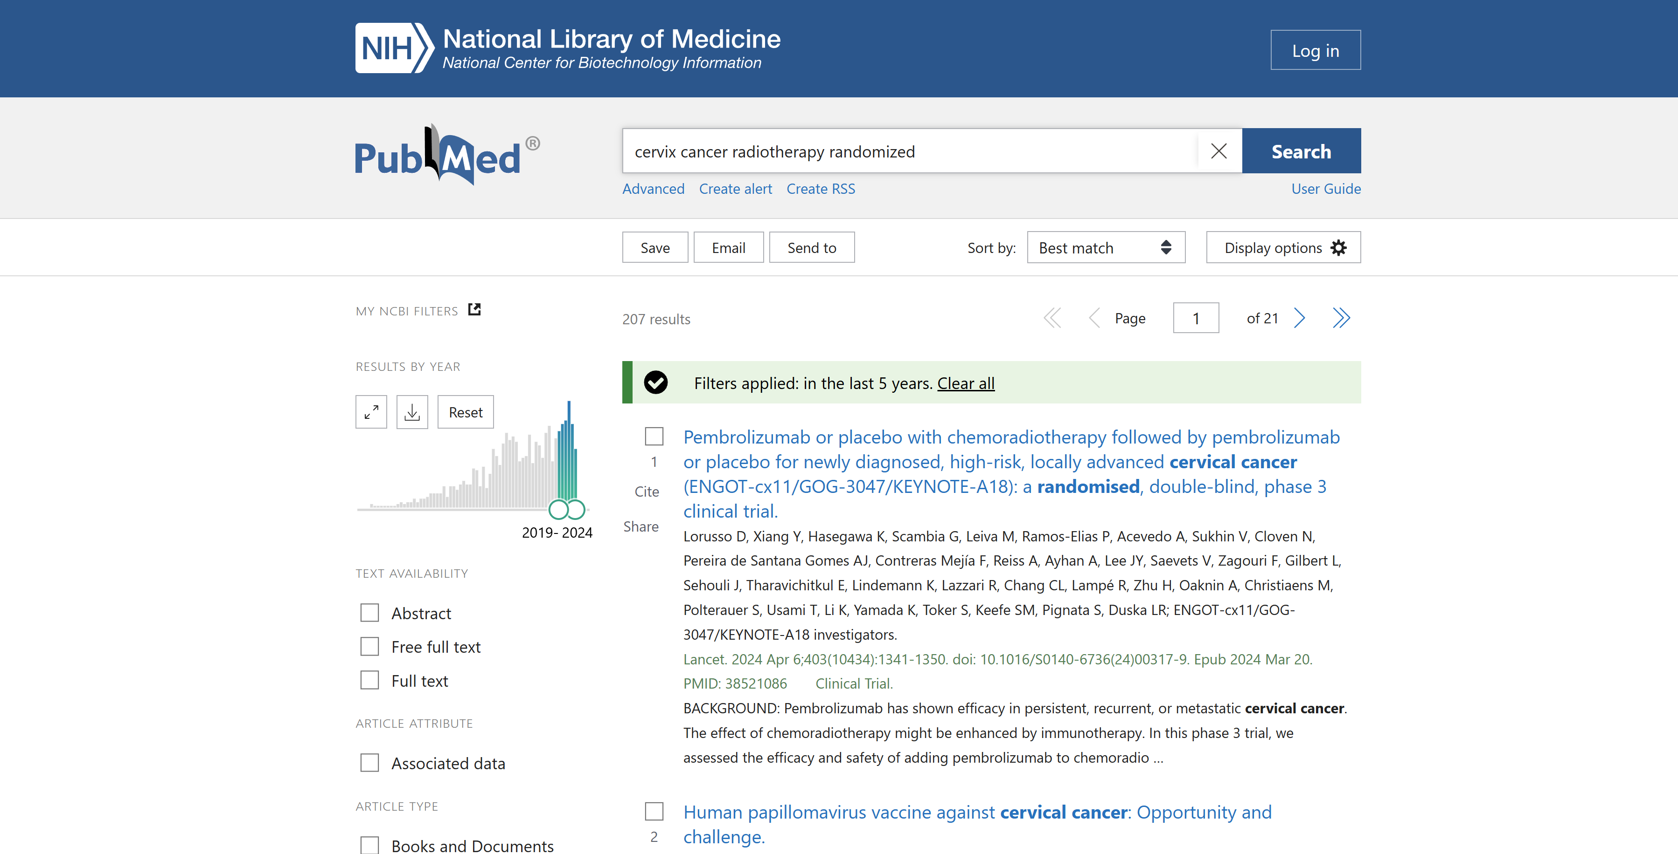
LATEST NEWS:
… SOME RANDOMIZED CONTROLLED TRIALS
ARE AT LEAST PARTLY CHANGING CLINICAL PRACTICE FOR LACC
207

Slide 4
TREATMENT OF CERVICAL CANCER
STAGE IB2-IB3

Slide 5
STAGE IB2
DOGMA FOR STAGE IB2
TREATMENT WITH SURGERY
UNLESS ADJUVANT THERAPY IS ANTICIPATED

Slide 6
STAGE IB3
DOGMA FOR STAGE IB3
TREATMENT WITH RADIOCHEMOTHERAPY

Slide 7
STAGE IB2
LOCALLY LIMITED DISEASE STAGE IB – IIA
STAGE IB3
LOCALLY ADVANCED DISEASE STAGE IB3 – IVA

Slide 8
1
TREATMENT OF CERVICAL CANCER
LOCALLY LIMITED DISEASE STAGE IB – IIA
Radical Radiotherapy versus Radical Hysterectomy

Slide 9

Radiotherapy characteristics:
EBRT(18 MV) median TD 47 Gy (40-53 Gy); 1.8-2 Gy per fx
BT LDR, median TD to point A 76 Gy (70-90 Gy)
64% of patients from surgery arm had adjuvant radiotherapy!
*
*Crude rates are given!
Landoni et al 1997

Slide 10
HOWEVER, STAGING, SURGICAL AND RADIOTHERAPEUTICAL TECHNIQUES
HAVE CHANGED SIGNIFICANTLY OVER THE LAST 25 YEARS
*Grade 2 - major symptoms requiring prolonged therapies or hospitalization
for diagnosis and medical management
Grade 3 - severe morbidity requiring invasive or surgical procedures
Landoni et al 1997

Slide 11
2
TREATMENT OF CERVICAL CANCER ACCORDING TO STAGE
LOCALLY LIMITED DISEASE STAGE IB – IIA
ADJUVANT TREATMENT AFTER SURGERY
INTERMEDIATE RISK PATIENTS
RADIOTHERAPY

Slide 12
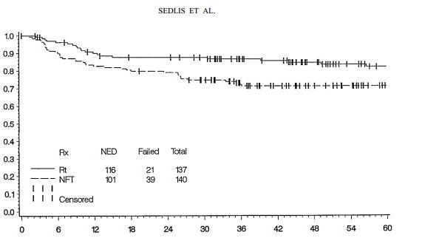
HE + RADIOTHERAPY vs.
HE + OBSERVATION
ADJUVANT RADIOTHERPAPY
277 patients
Stage IB, N0 with
≥ 2 of the risk factors:
>1/3 stromal invasion
LVSI
Tumour ≥ 4 cm
137 HE+RT vs 140 HE
Recurrences
15% vs 28%
p=0.008
No brachytherapy
INTERMEDIATE RISK patients after Hysterectomy
The addition of radiotherapy is required
Sedlis et al 1999

Slide 13
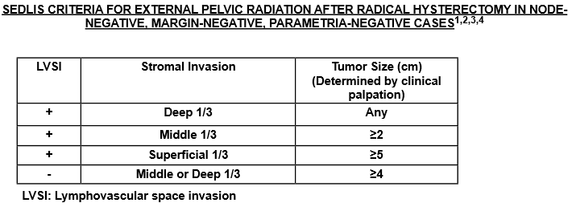
INCLUSION CRITERIA OF SEDLIS STUDY
SEDLIS CRITERIA!!!
Siegel et al. Cancer J Clin 2015
Barnholtz-Sloan et al. Cancer Causes Control 2009
Wang et al. Cancer 2010
Howe et al. Cancer 2006

Slide 14
3
TREATMENT OF CERVICAL CANCER ACCORDING TO STAGE
LOCALLY LIMITED DISEASE STAGE IB – IIA
ADJUVANT TREATMENT AFTER SURGERY
HIGH RISK PATIENTS
RADIOCHEMOTHERAPY

Slide 15
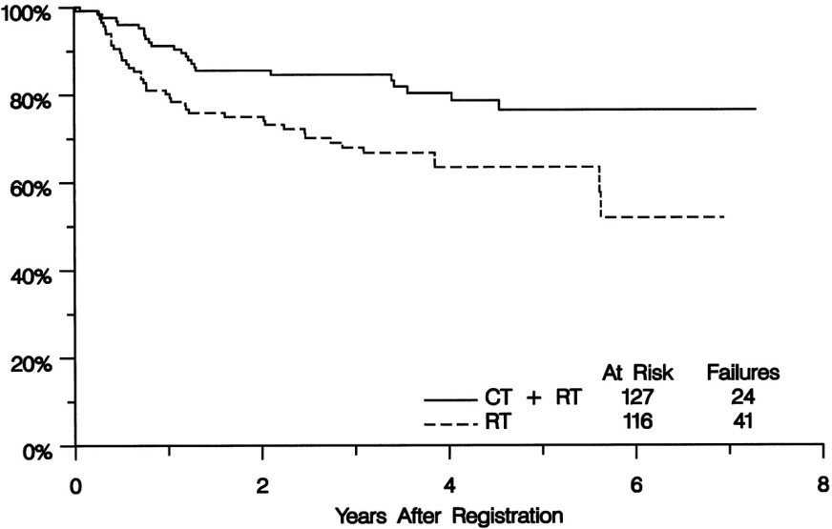
HE + RADIOTHERAPY vs.
HE + RADIOCHEMOTHERAPY
ADJUVANT RADIOCHEMOTHERAPY
243 patients
Stage IA2,IB, IIA with:
Positive margins
Positive lymph nodes
Parametrial invasion
HE + RCT HE + RT
3y PFS 87% 77%
3y OS 81% 71% (SS)
HIGH RISK patients after Hysterectomy
The addition of radiochemotherapy is required
PETERS et al 2000

Slide 16
TREATMENT OF CERVICAL CANCER ACCORDING TO STAGE
DOGMA FOR STAGE IB2
TREAT THE PATIENT WITH SURGERY BUT …
IN THE ERA OF PET-CT AND MULTIPARAMETRIC MRI WE ARE ABLE TO PREDICT WHETHER A PATIENT HAS THE PREVIOUSLY MENTIONED INTERMEDIATE OR HIGH RISK FACTORS
THESE PATIENTS SHOULD BE TREATED IN AN INDIVIDUALIZED MANNER DOUBLE OR TRIPLE TREATMENT COMBINATIONS
SHOULD BE AVOIDED

Slide 17
STAGE IB2 WITH RISK FACTORS
LOCALLY ADVANCED DISEASE STAGE IB3 – IVA
STAGE IB3

Slide 18
RADIOCHEMOTHERAPY STANDARD OF CARE SINCE 2000…
Stage IB3-IVA
American National Cancer Institute
„Definitive Radiochemotherapy is the Standard of Care for
Locally Advanced (Stage IB3-IVA) Cervical Cancer“
Standard defined by 5 Randomized Studies

Slide 19
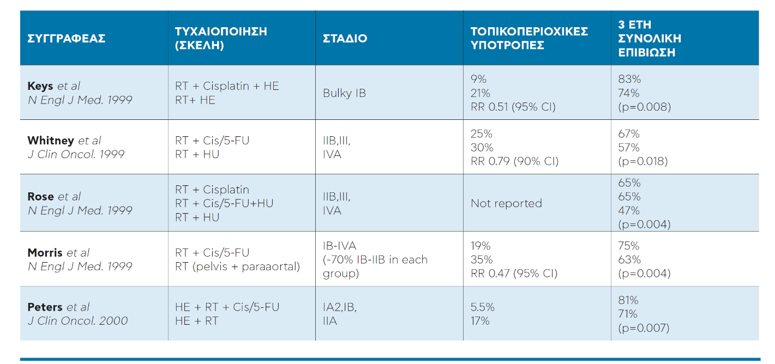
RESULTS RADIOCHEMOTHERAPY

Slide 20
AUTHOR | RANDOMISATION ARMS | STAGE | LOCOREGIONAL RECURRENCE | 3 YEAR OVERALL SURVIVAL
Keys et al N Engl J Med. 1999 | RT + Cisplatin + HE RT+ HE | Bulky IB | 9% 21% RR 0.51 (95% CI) | 83% 74% (p=0.008)
Whitney et al J Clin Oncol. 1999 | RT + Cis/5-FU RT + HU | IIB,III, IVA | 24.9% 30.4% RR 0.79 (90% CI) | 67% 57% (p=0.018)
Rose et al N Engl J Med. 1999 | RT + Cisplatin RT + Cis/5-FU+HU RT + HU | IIB,III, IVA | Not reported | 65% 65% 47% (p=0.004)
Morris et al N Engl J Med. 1999 | RT + Cis/5-FU RT (pelvis + paraaortal) | IB-IVA (~70% IB-IIB in each group) | 19% 35% RR 0.47 (95% CI) | 75% 63% (p=0.004)
Peters et al J Clin Oncol. 2000 | HE + RT + Cis/5-FU HE + RT | IA2,IB, IIA | 5.5% 17% | 81% 71% (p=0.007)
Pearcey et al J Clin Oncol. 2002 | RT+Cisplatin RT | IB-IVA | Not reported | 69% 66% (p=0.42)
RESULTS RADIOCHEMOTHERAPY
SURVIVAL AND RECURRENCE AFTER CONCOMITANT CHEMOTHERAPY AND RADIOTHERAPY FOR CANCER OF UTERINE CERVIX: A SYSTEMATIC REVIEW AND META-ANALYSIS
3656 patients (19 studies)
LOCAL RECURRENCE RATE WAS SIGNIFICANTLY REDUCED BY CHEMORADIATION
OR 0.61, 95% CI 0.51-0.73, p< 0.0001
RCHT
RT
OS
52%
40%
PFS
63%
47%
Toxicity Grade 3-4
Haematological
Gastrointestinal
16%
9%
8%
4%
Green et al. Lancet 2001;358:781-86

Slide 21
… LATEST NEWS … 3 IMPORTANT RECENT TRIALS
OUTBACK
INTERLACE
KEYNOTE A-18

Slide 22
… LATEST NEWS … 3 IMPORTANT RECENT TRIALS
OUTBACK
INTERLACE
KEYNOTE A-18

Slide 23
ADJUVANT CHEMOTHERAPY AFTER CONCOMITANT RCHT
Disease Progression after Radical Radio-Chemotherapy: 20-30%
Distant Relapses Major Issue in Locally Advanced Cervical Cancer after Definitive RChT

Slide 24
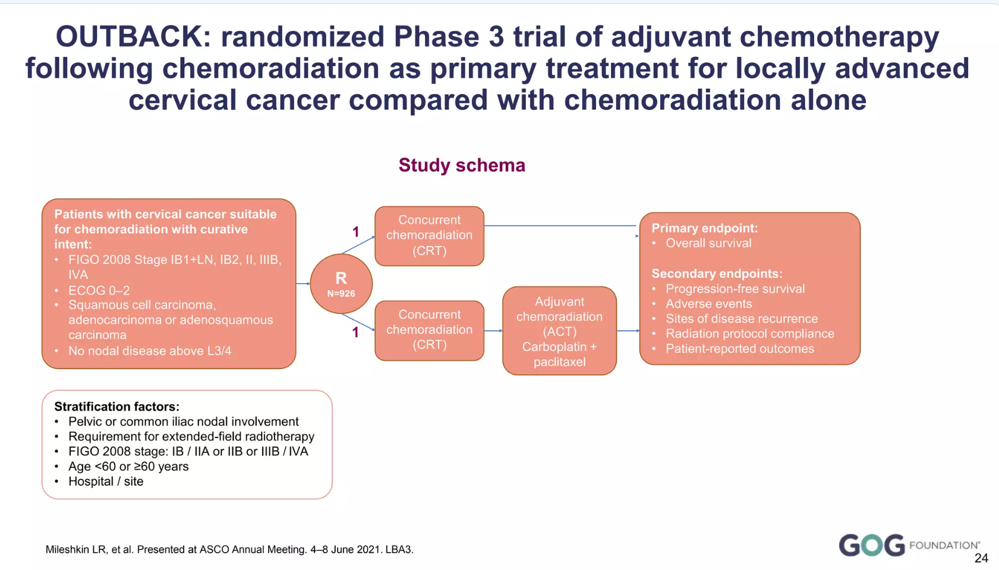
Cisplatin based concurrent
chemoradiation Vs CCRT followed
by Paclitaxel + Carboplatin x 3 cycles

Slide 25
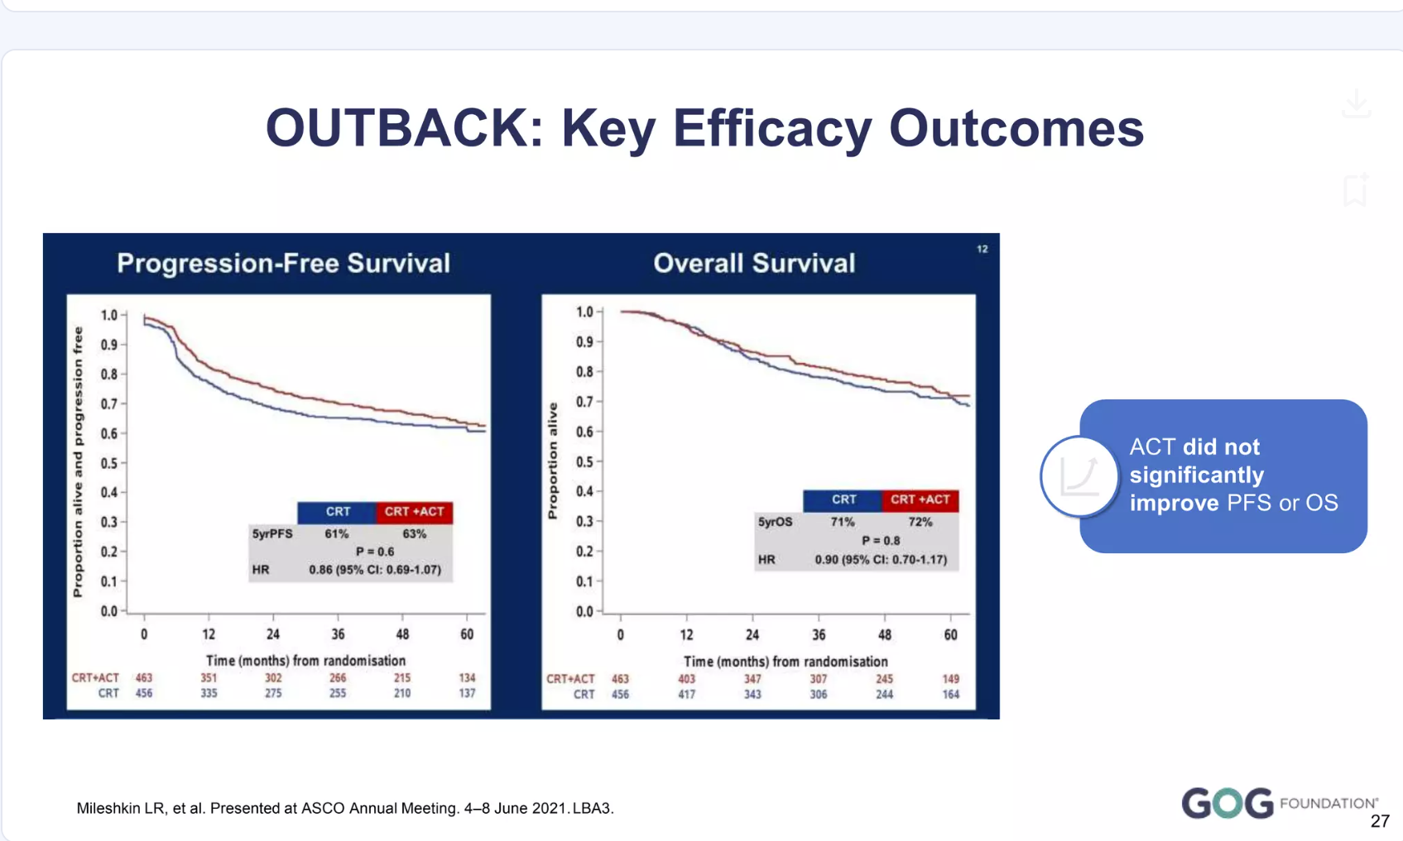
OUTBACK: KEY EFFICACY OUTCOMES
PFS
OS
ADJUVANT CHT DID NOT IMPROVE PFS AND OS

Slide 26
ADJUVANT CHEMOTHERAPY AFTER CONCOMITANT RCHT
OUTBACK TRIAL MULTICENTRIC PHASE III STUDY
Median follow-up: 60 months
OS at 5 years: 72% vs 71% (95% CI -6 to +7; p=0.91)
Hazard ratio for OS was 0·91 (95% CI 0.70 to 1.18)
PFS at 5 years: 63% vs 61% (95% CI -5 to +9; p=0.61)
Hazard ratio for PFS was 0·87 (95% CI 0.70 to 1.08)
AE Grade 3-5 within a year of randomization: 81% versus 62%

Slide 27
… LATEST NEWS … 3 IMPORTANT RECENT TRIALS
OUTBACK
INTERLACE
KEYNOTE A-18

Slide 28
INDUCTION CHEMOTHERAPY PRIOR CONCOMITANT RCHT
INTERLACE TRIAL
Induction chemotherapy followed by standard chemoradiotherapy versus standard chemoradiotherapy alone in patients with locally advanced cervical cancer (GCIG INTERLACE): an international, multicentre, randomised phase 3 trial.
McCormack et al. Lancet 2024

Slide 29
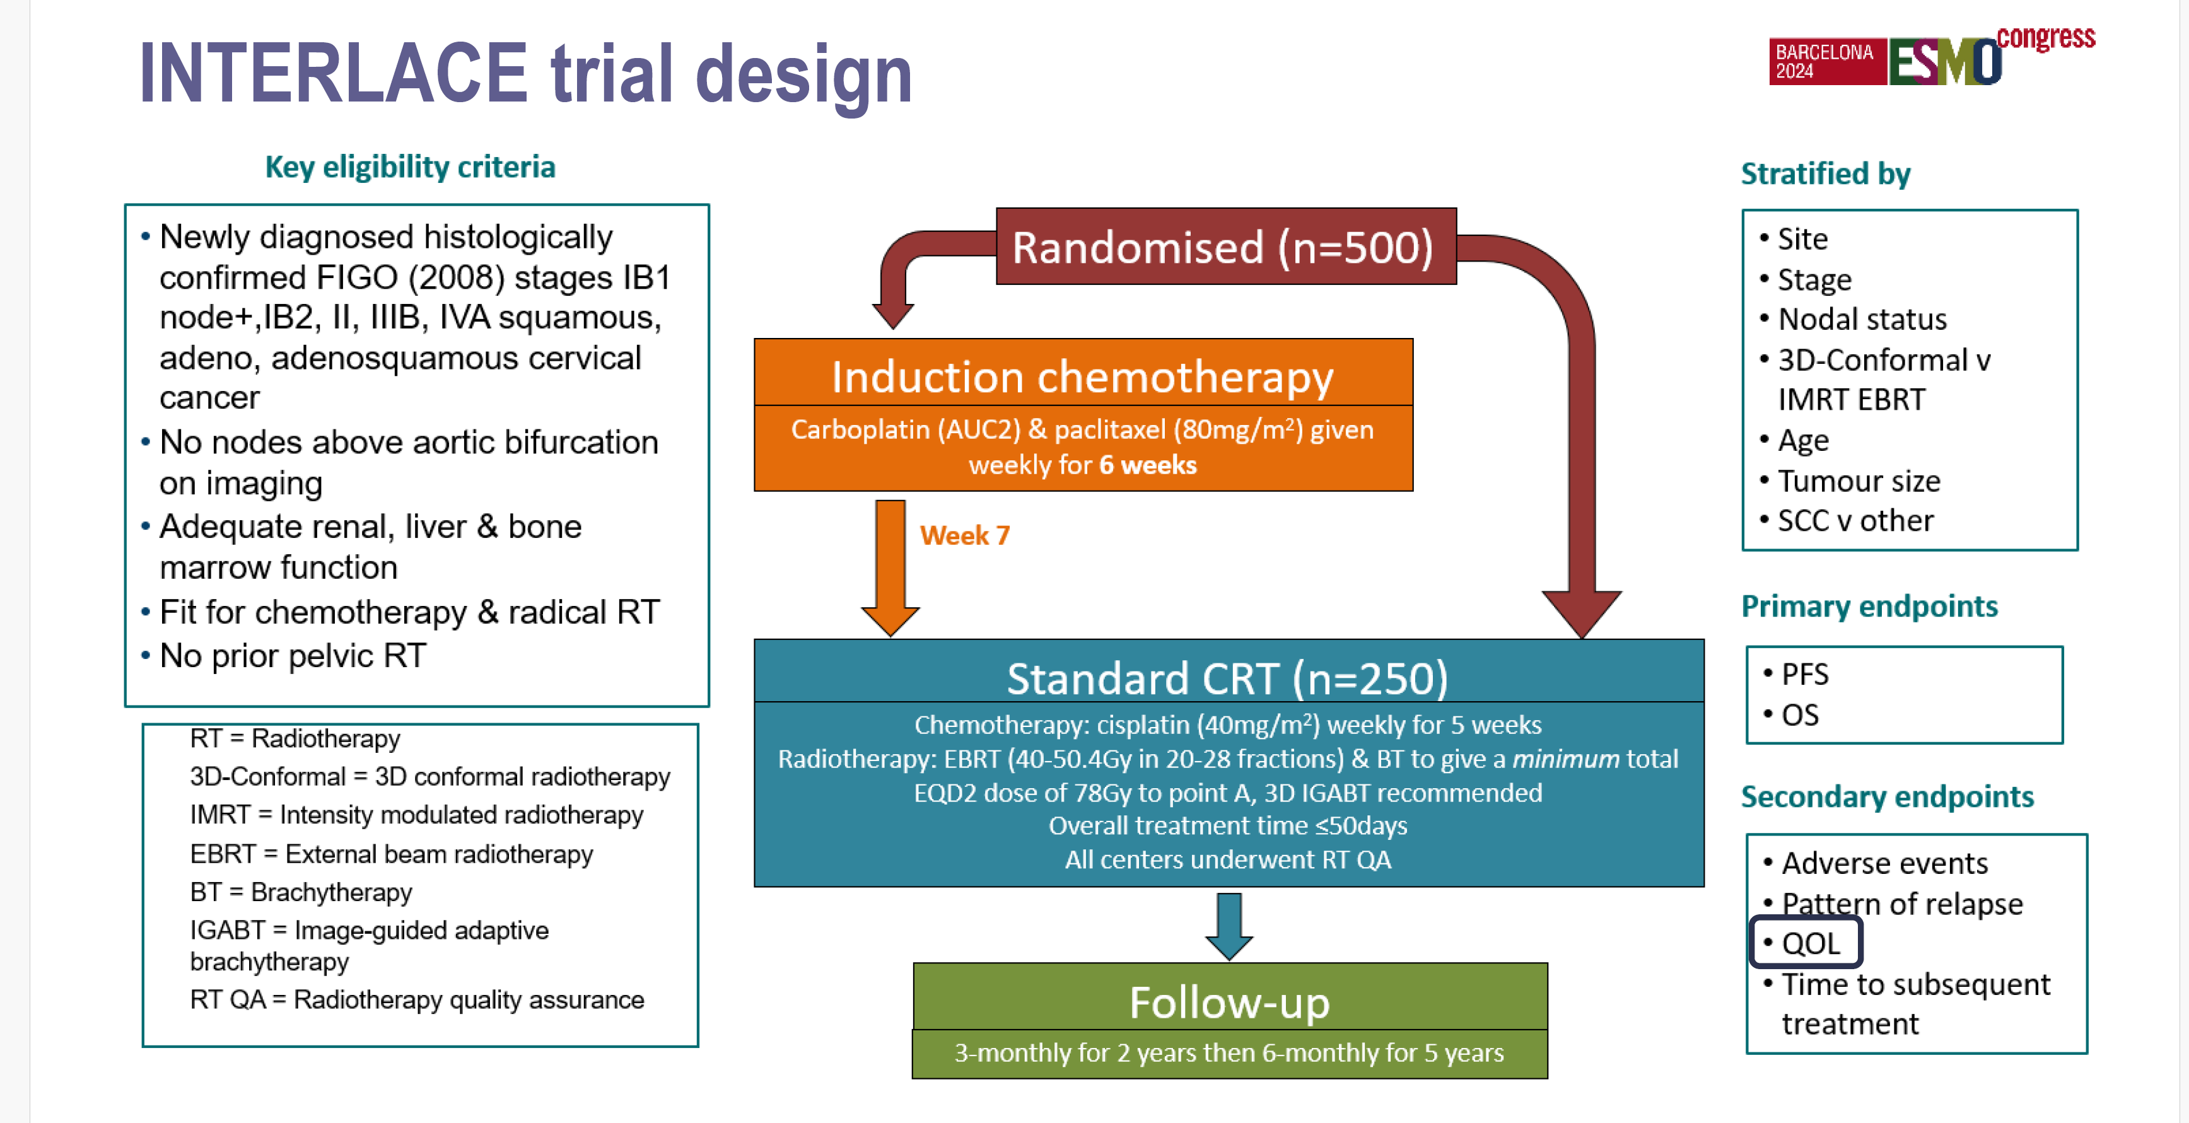
INDUCTION CHEMOTHERAPY PRIOR CONCOMITANT RCHT
McCormack et al. Lancet 2024

Slide 30
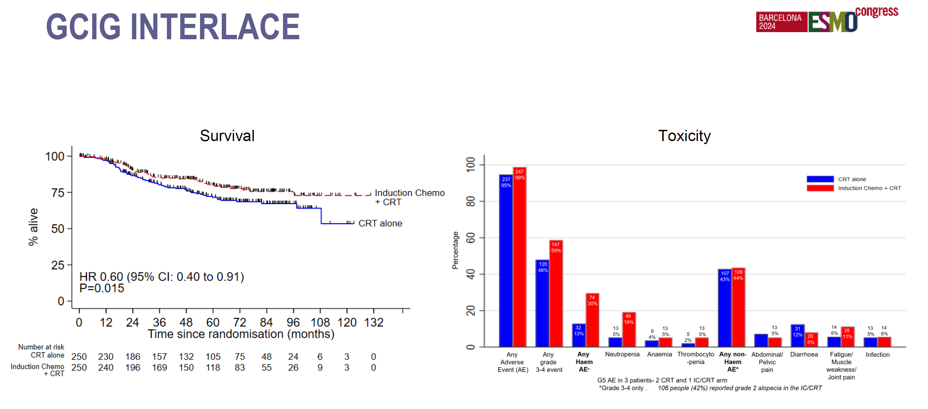
INDUCTION CHEMOTHERAPY PRIOR CONCOMITANT RCHT
McCormack et al. Lancet 2024

Slide 31
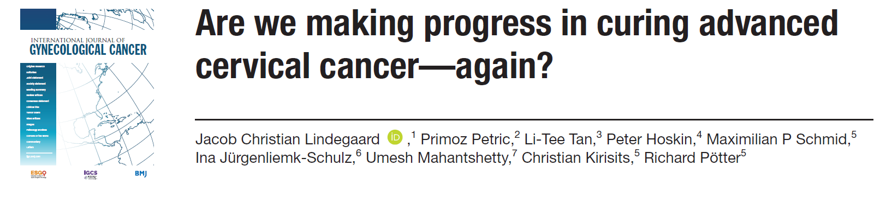
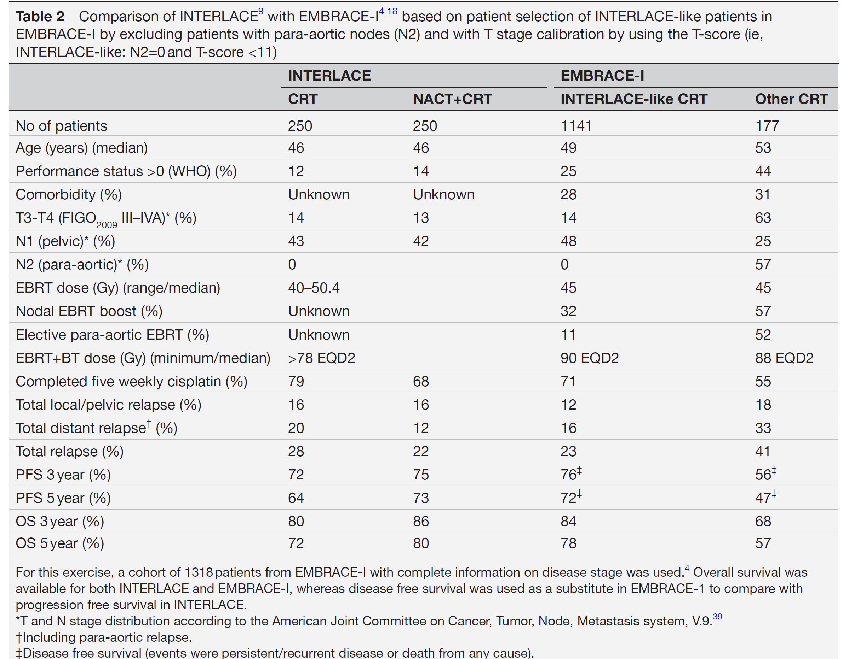
INDUCTION CHEMOTHERAPY PRIOR CONCOMITANT RCHT CRITICISM
COMPARISON WITH STATE OF THE ART RADIOTHERAPY OF EMBRACE I
INTERLACE LIMITATIONS
NO RADIOTHERAPY QA
LOW MIDDLE INCOME COUNTRIES
POINT A 70%
3D-CRT 60%
FEWER LACC PATIENTS
NO PARAAORTIC LN
LONG PATIENT RECRUITMENT PERIOD
PREVIOUS INDUCTION TRIALS ALL NEGATIVE

Slide 32
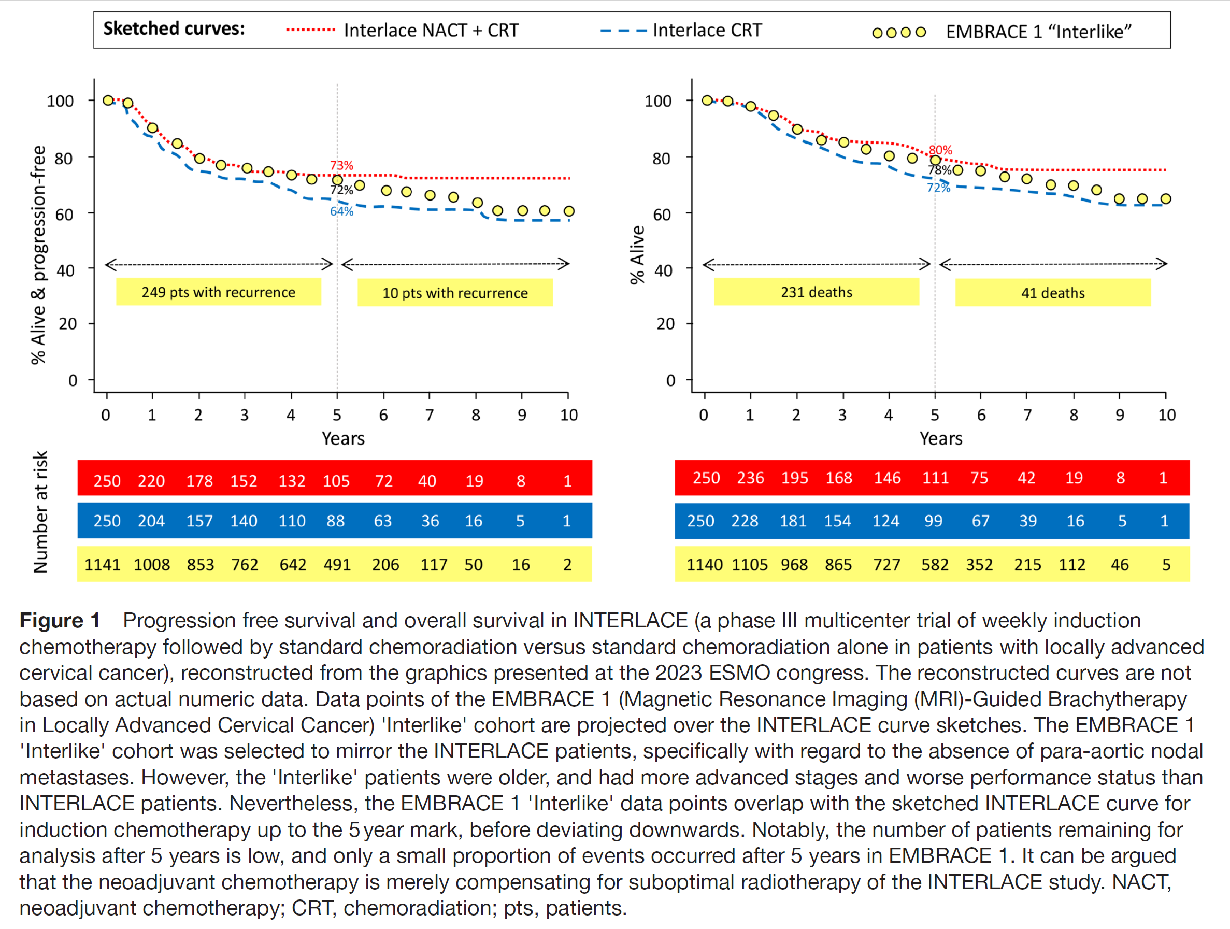
INDUCTION CHEMOTHERAPY PRIOR CONCOMITANT RCHT CRITICISM
COMPARISON WITH STATE OF THE ART RADIOTHERAPY OF EMBRACE I
INTERLACE CRT MUCH WORSE
THAN EMBRACE CRT
INTERLACE INDUCTION + CRT
EQUAL TO EMBRACE CRT

Slide 33
… LATEST NEWS … 3 IMPORTANT RECENT TRIALS
OUTBACK
INTERLACE
KEYNOTE A-18

Slide 34
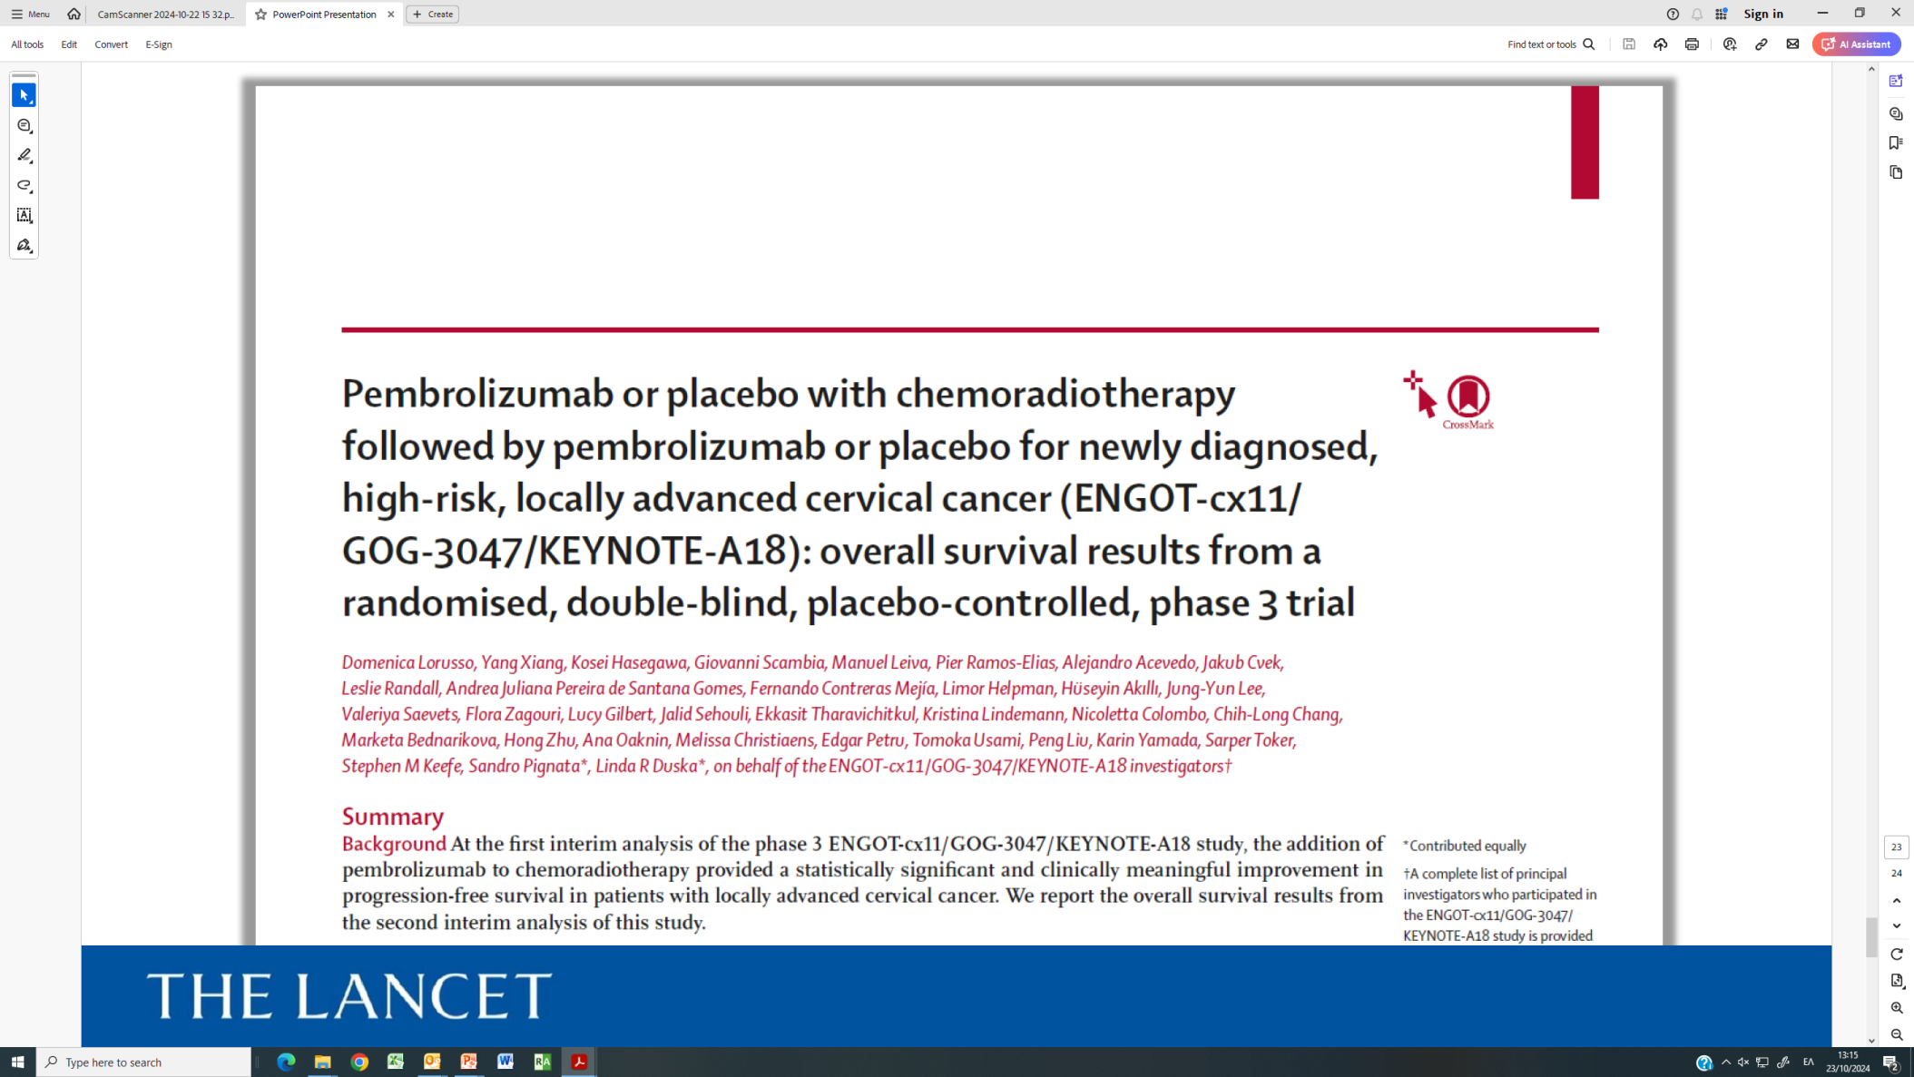
IMMUNOTHERAPY PLUS CONCOMITANT RCHT

Slide 35
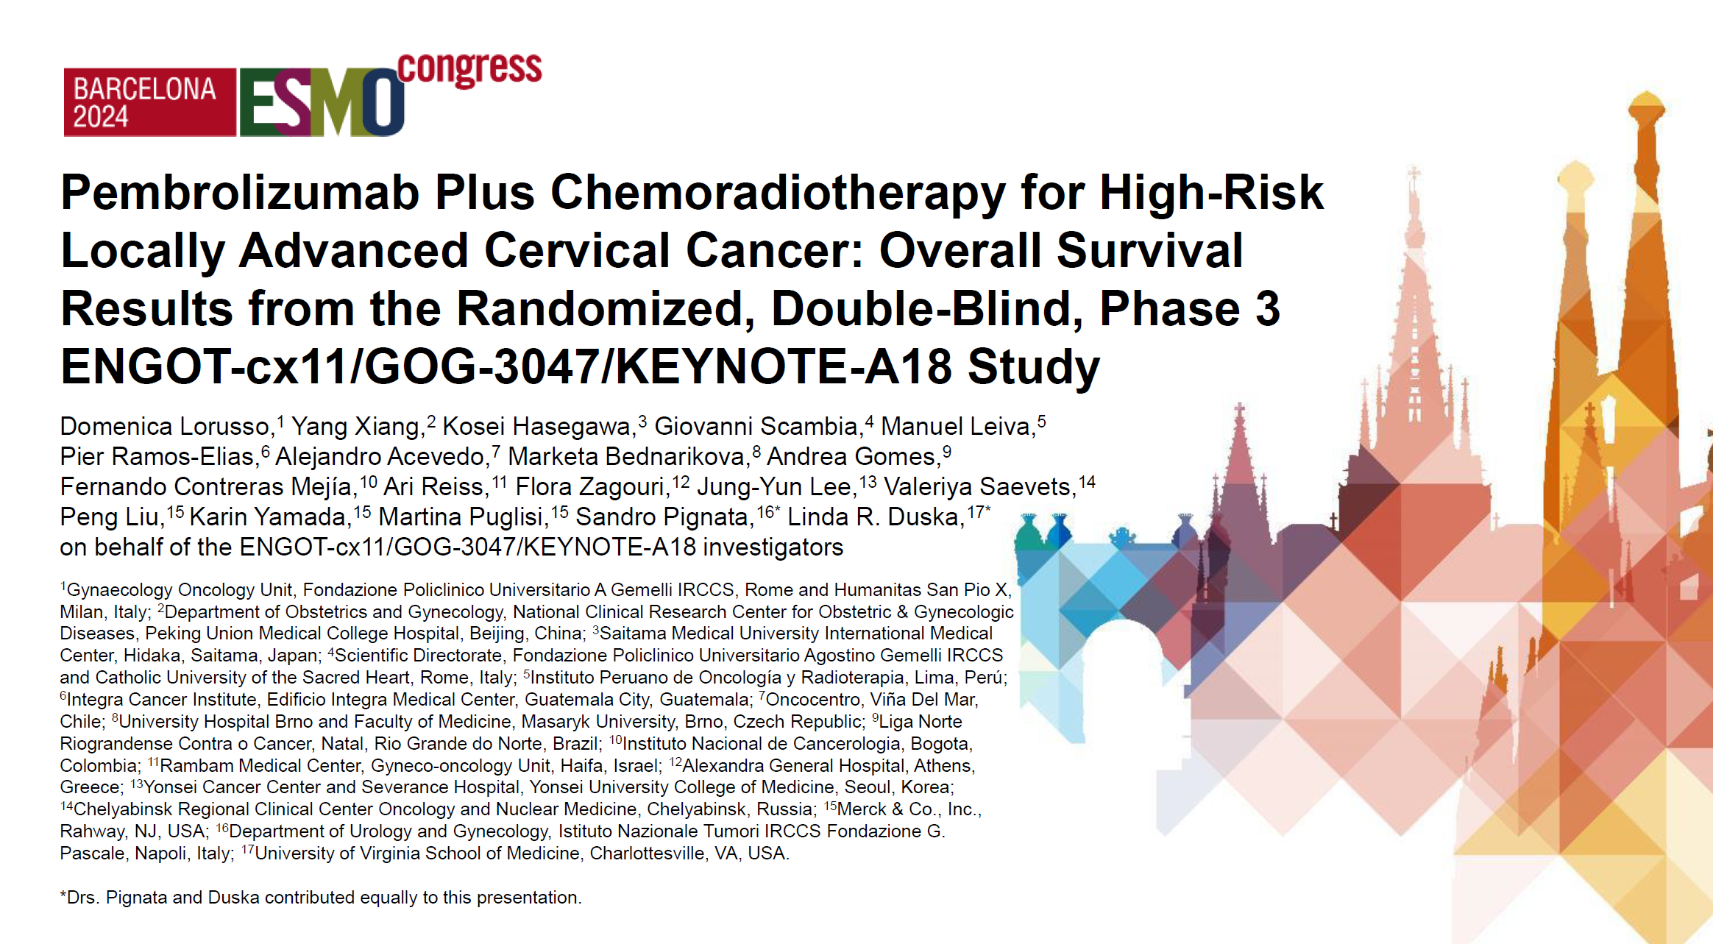
IMMUNOTHERAPY PLUS CONCOMITANT RCHT

Slide 36
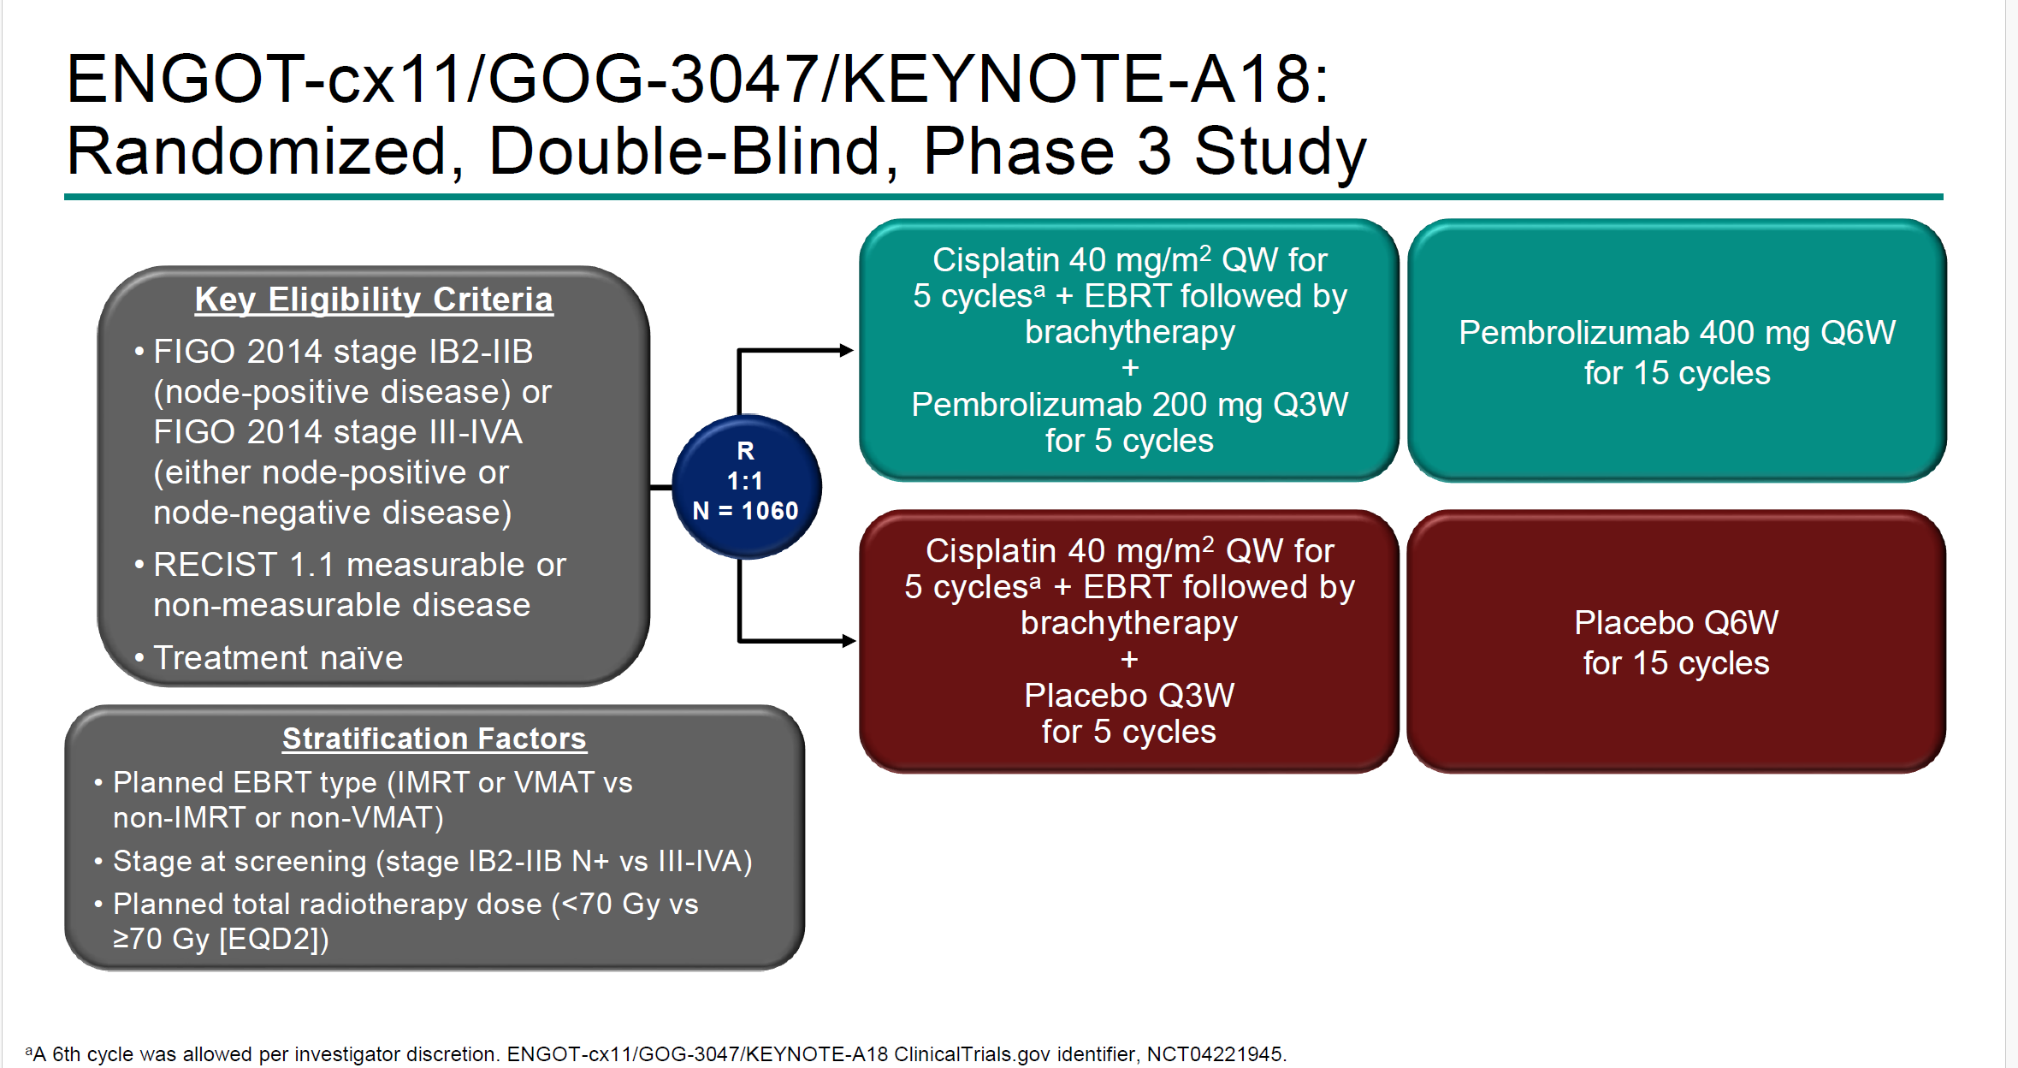
IMMUNOTHERAPY PLUS CONCOMITANT RCHT

Slide 37
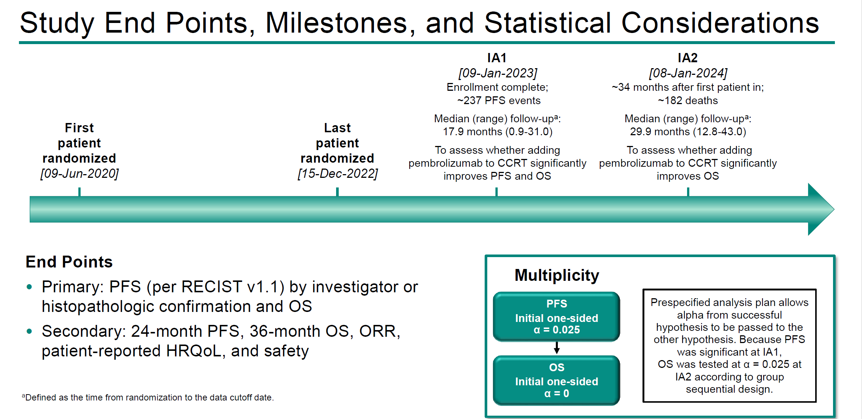
IMMUNOTHERAPY PLUS CONCOMITANT RCHT

Slide 38
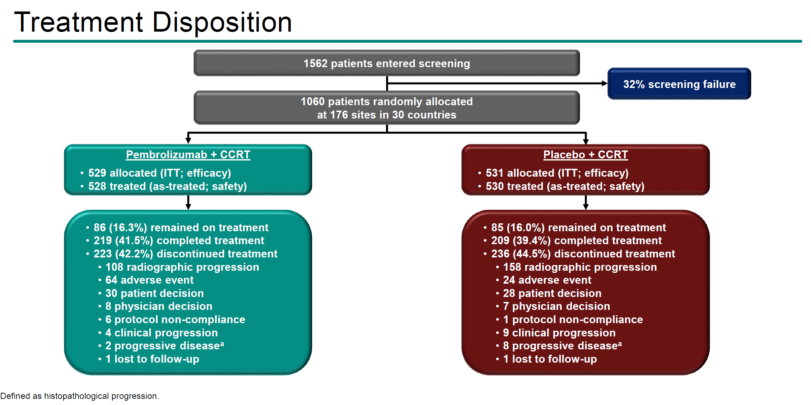
IMMUNOTHERAPY PLUS CONCOMITANT RCHT

Slide 39
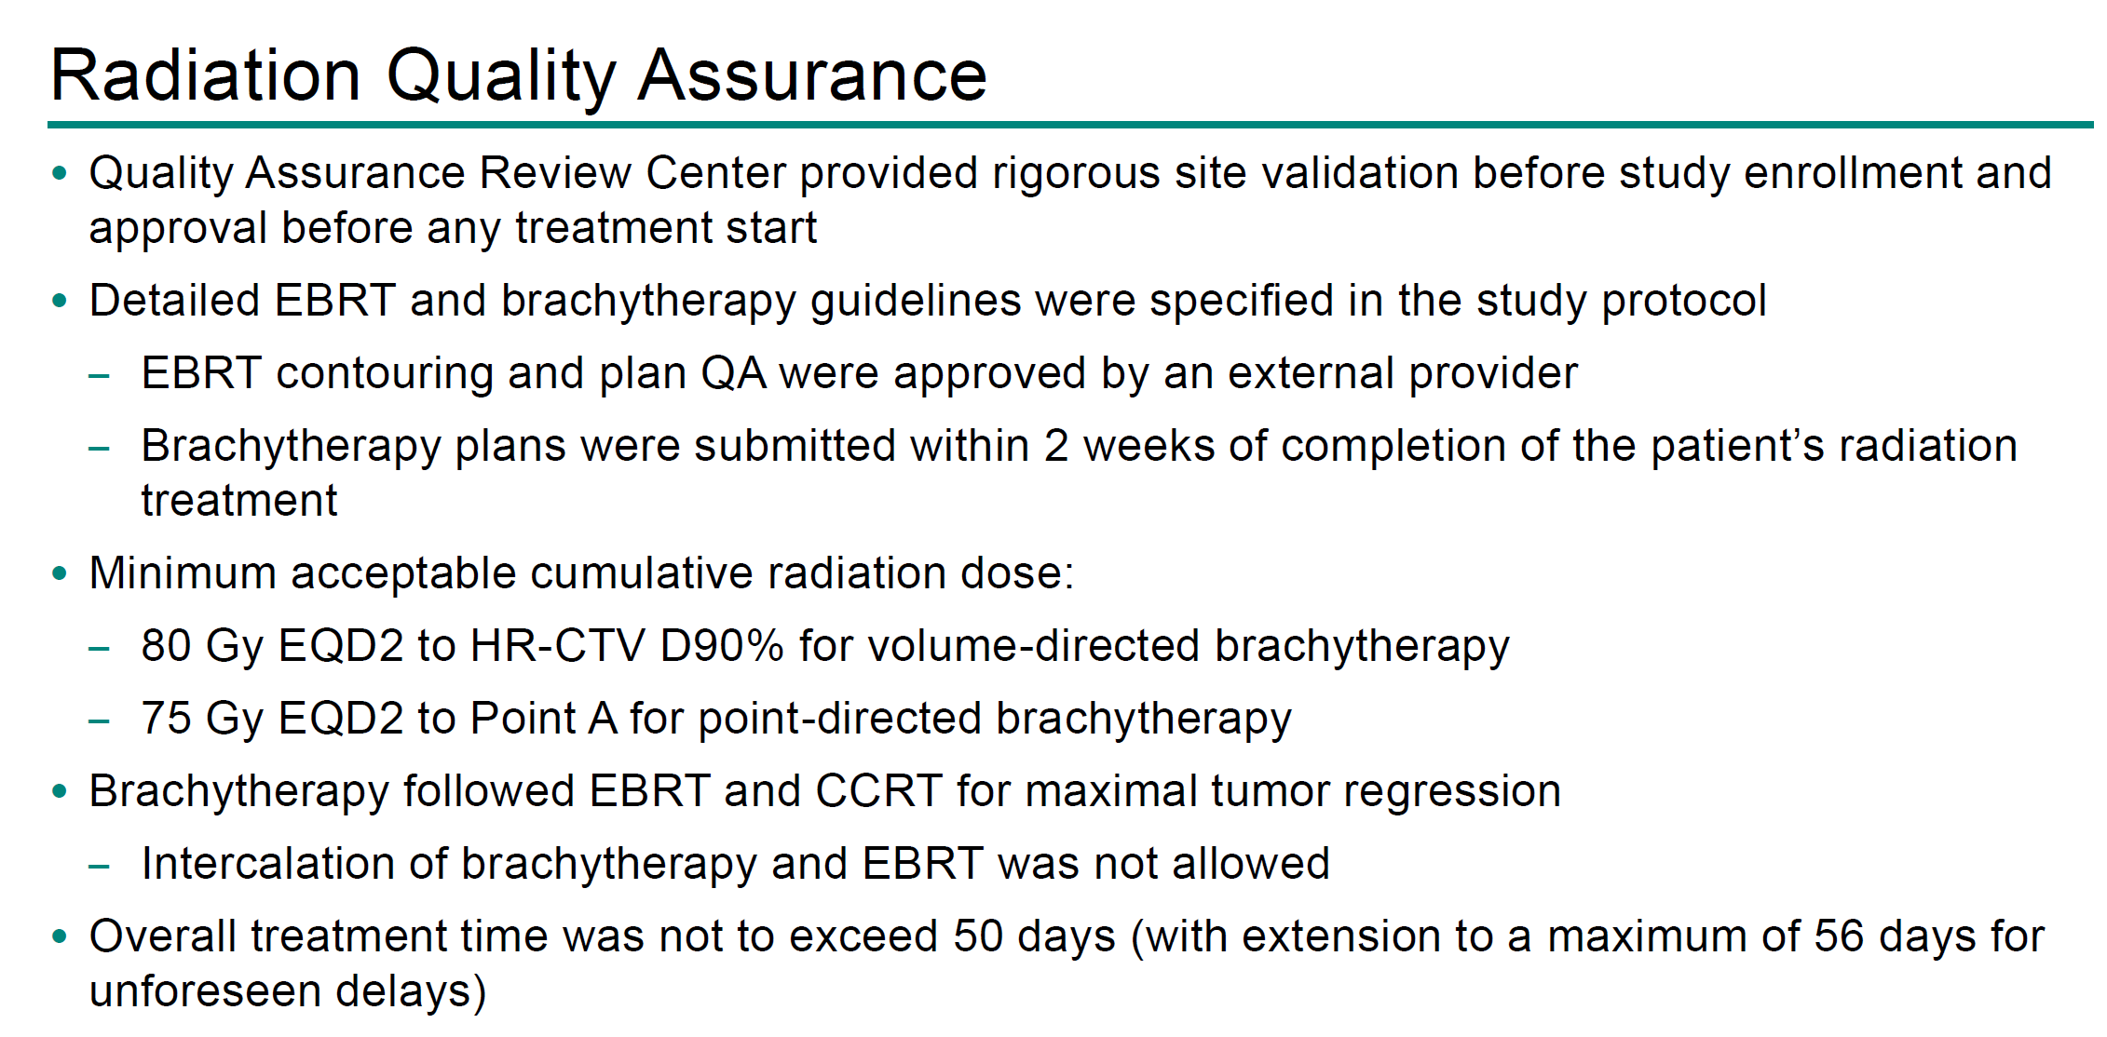
IMMUNOTHERAPY PLUS CONCOMITANT RCHT

Slide 40
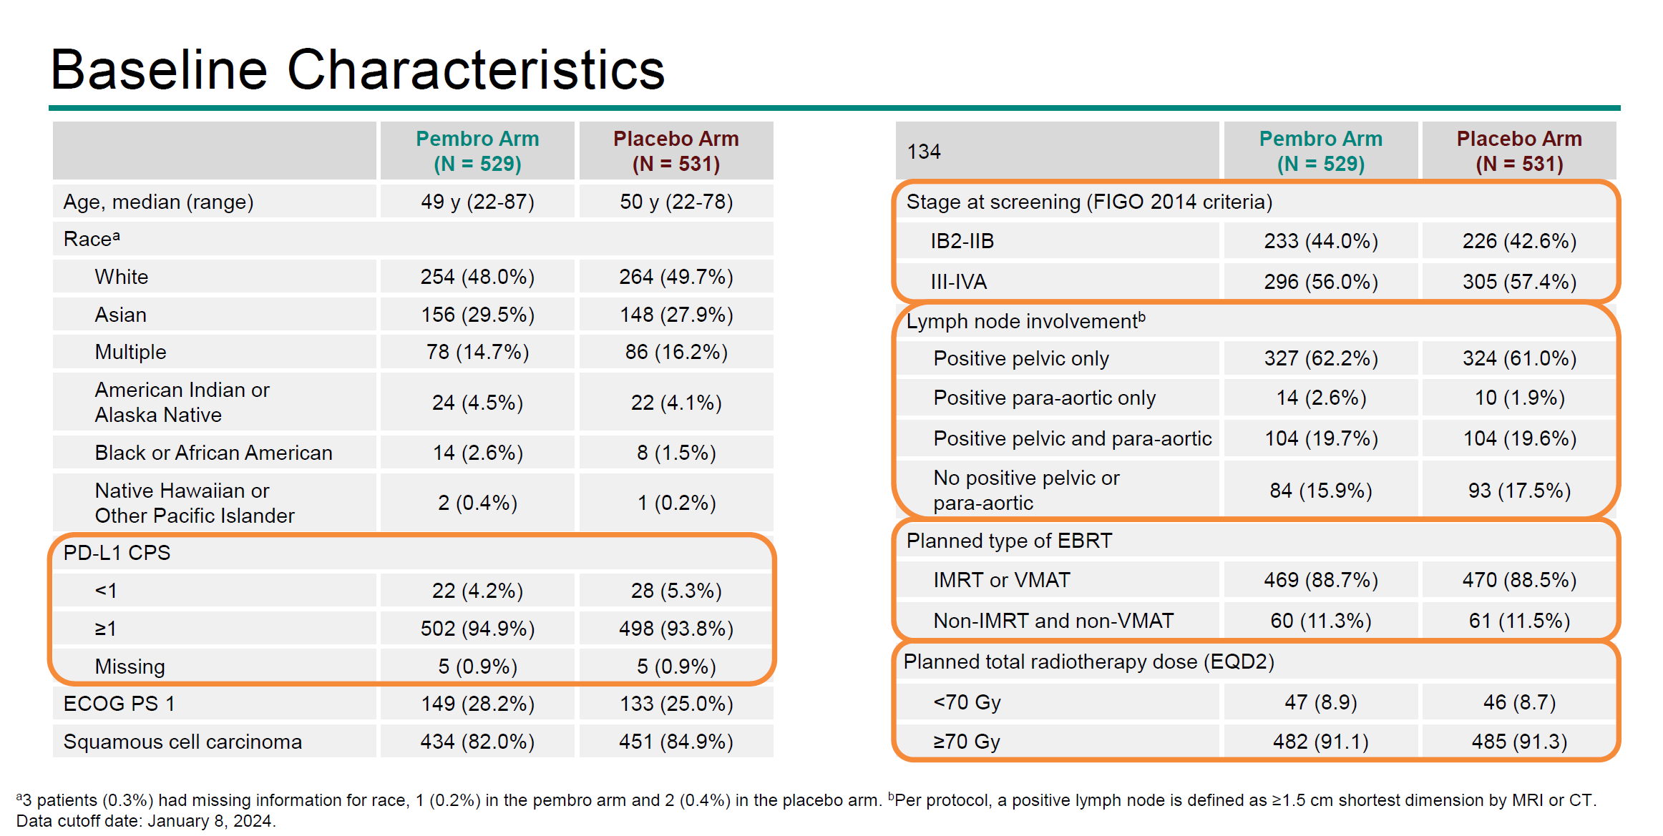
IMMUNOTHERAPY PLUS CONCOMITANT RCHT

Slide 41
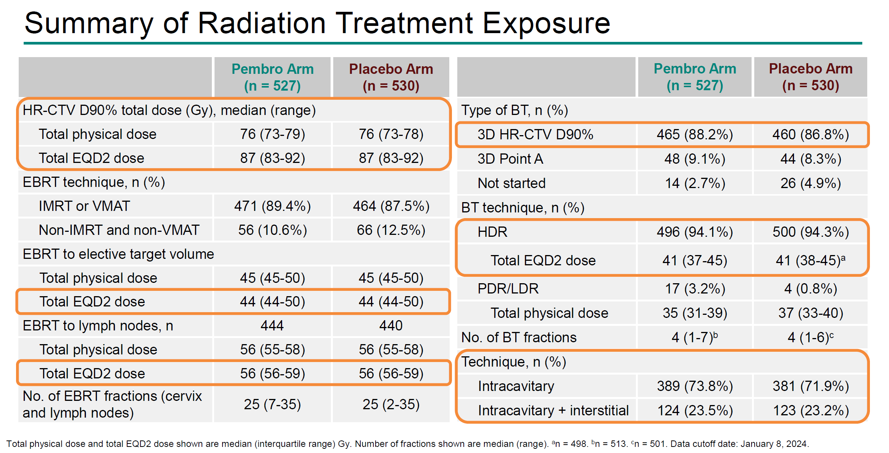
IMMUNOTHERAPY PLUS CONCOMITANT RCHT

Slide 42
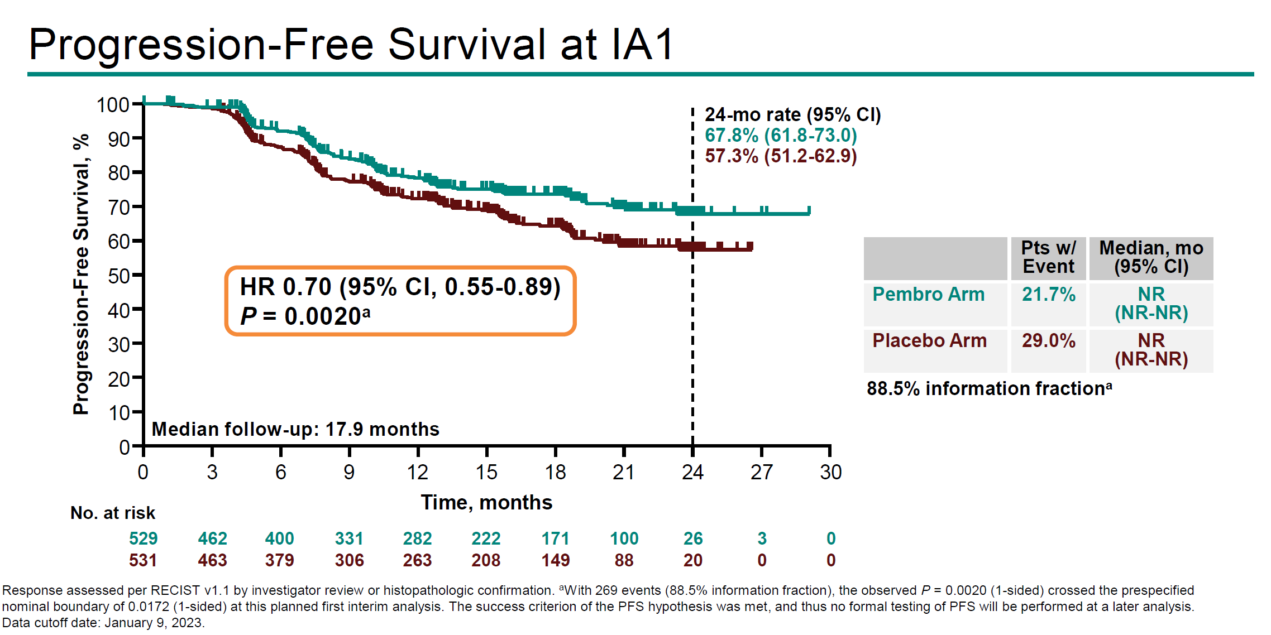
IMMUNOTHERAPY PLUS CONCOMITANT RCHT

Slide 43
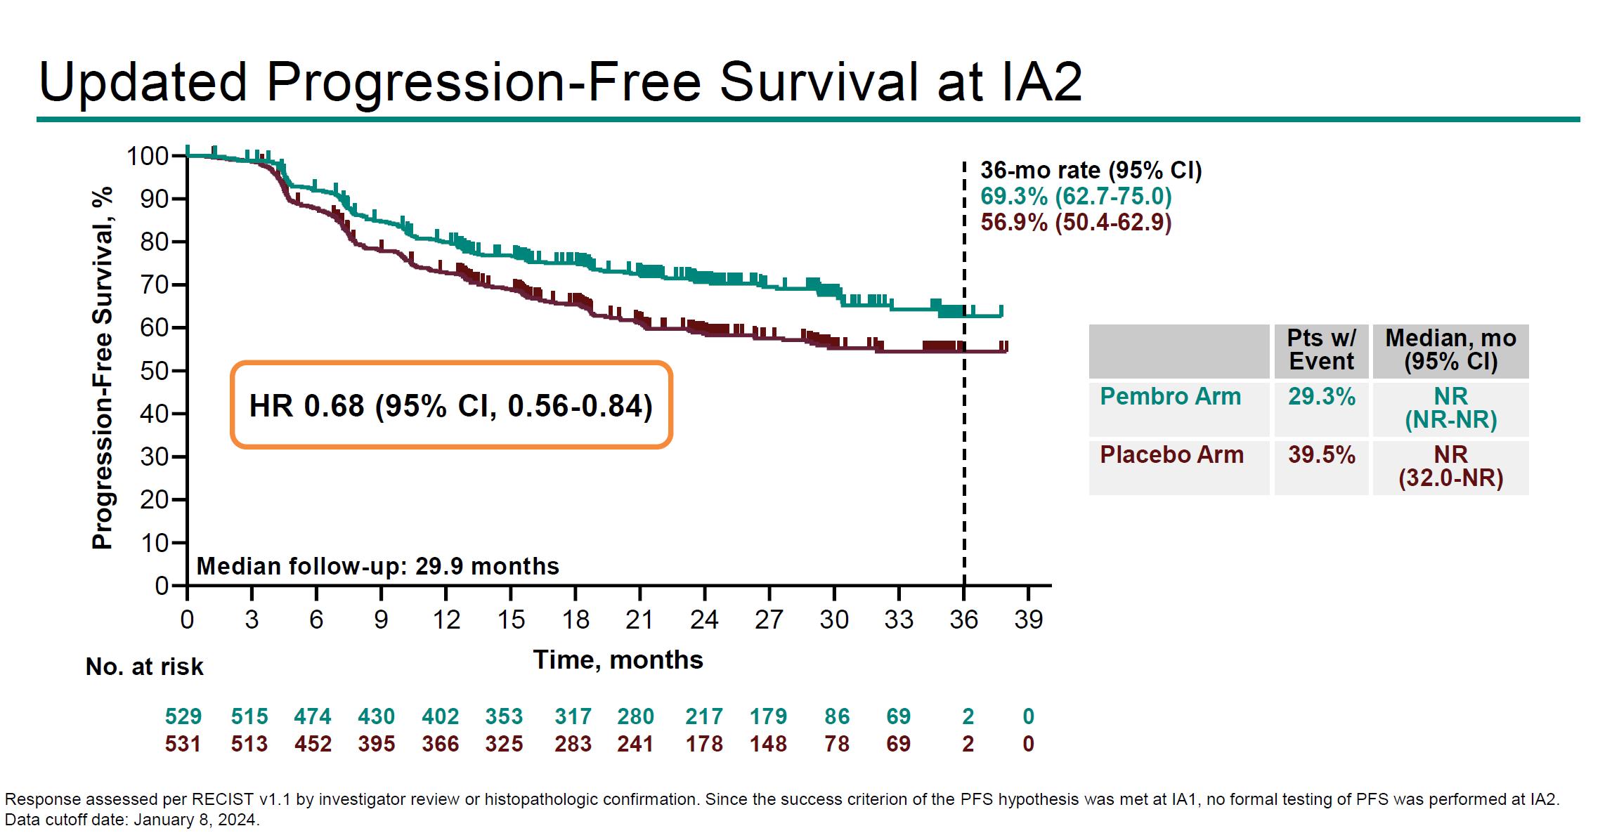
IMMUNOTHERAPY PLUS CONCOMITANT RCHT

Slide 44
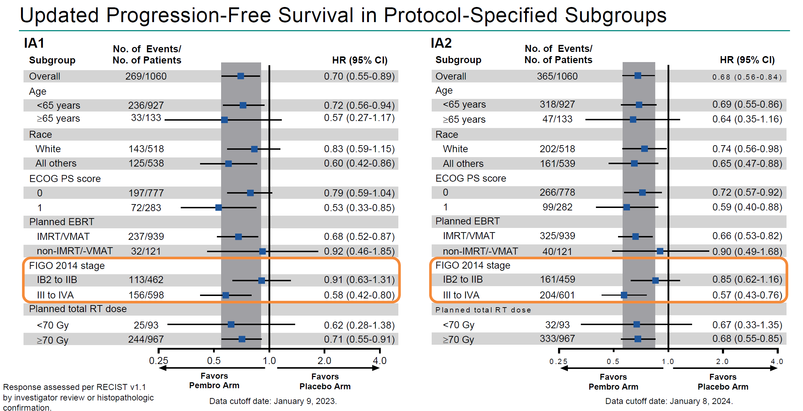
IMMUNOTHERAPY PLUS CONCOMITANT RCHT

Slide 45
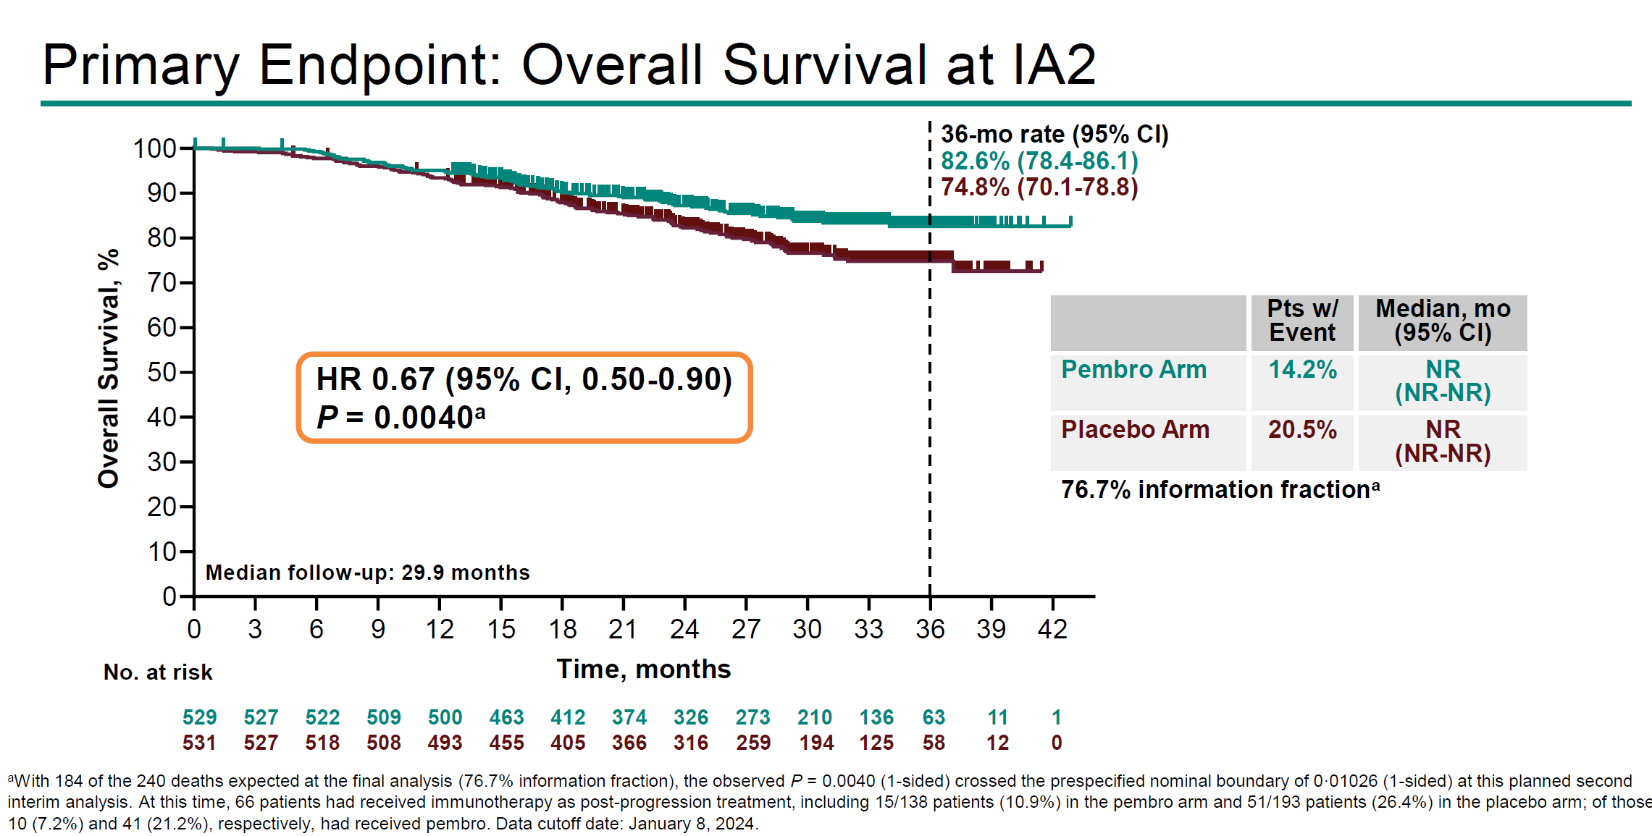
IMMUNOTHERAPY PLUS CONCOMITANT RCHT

Slide 46
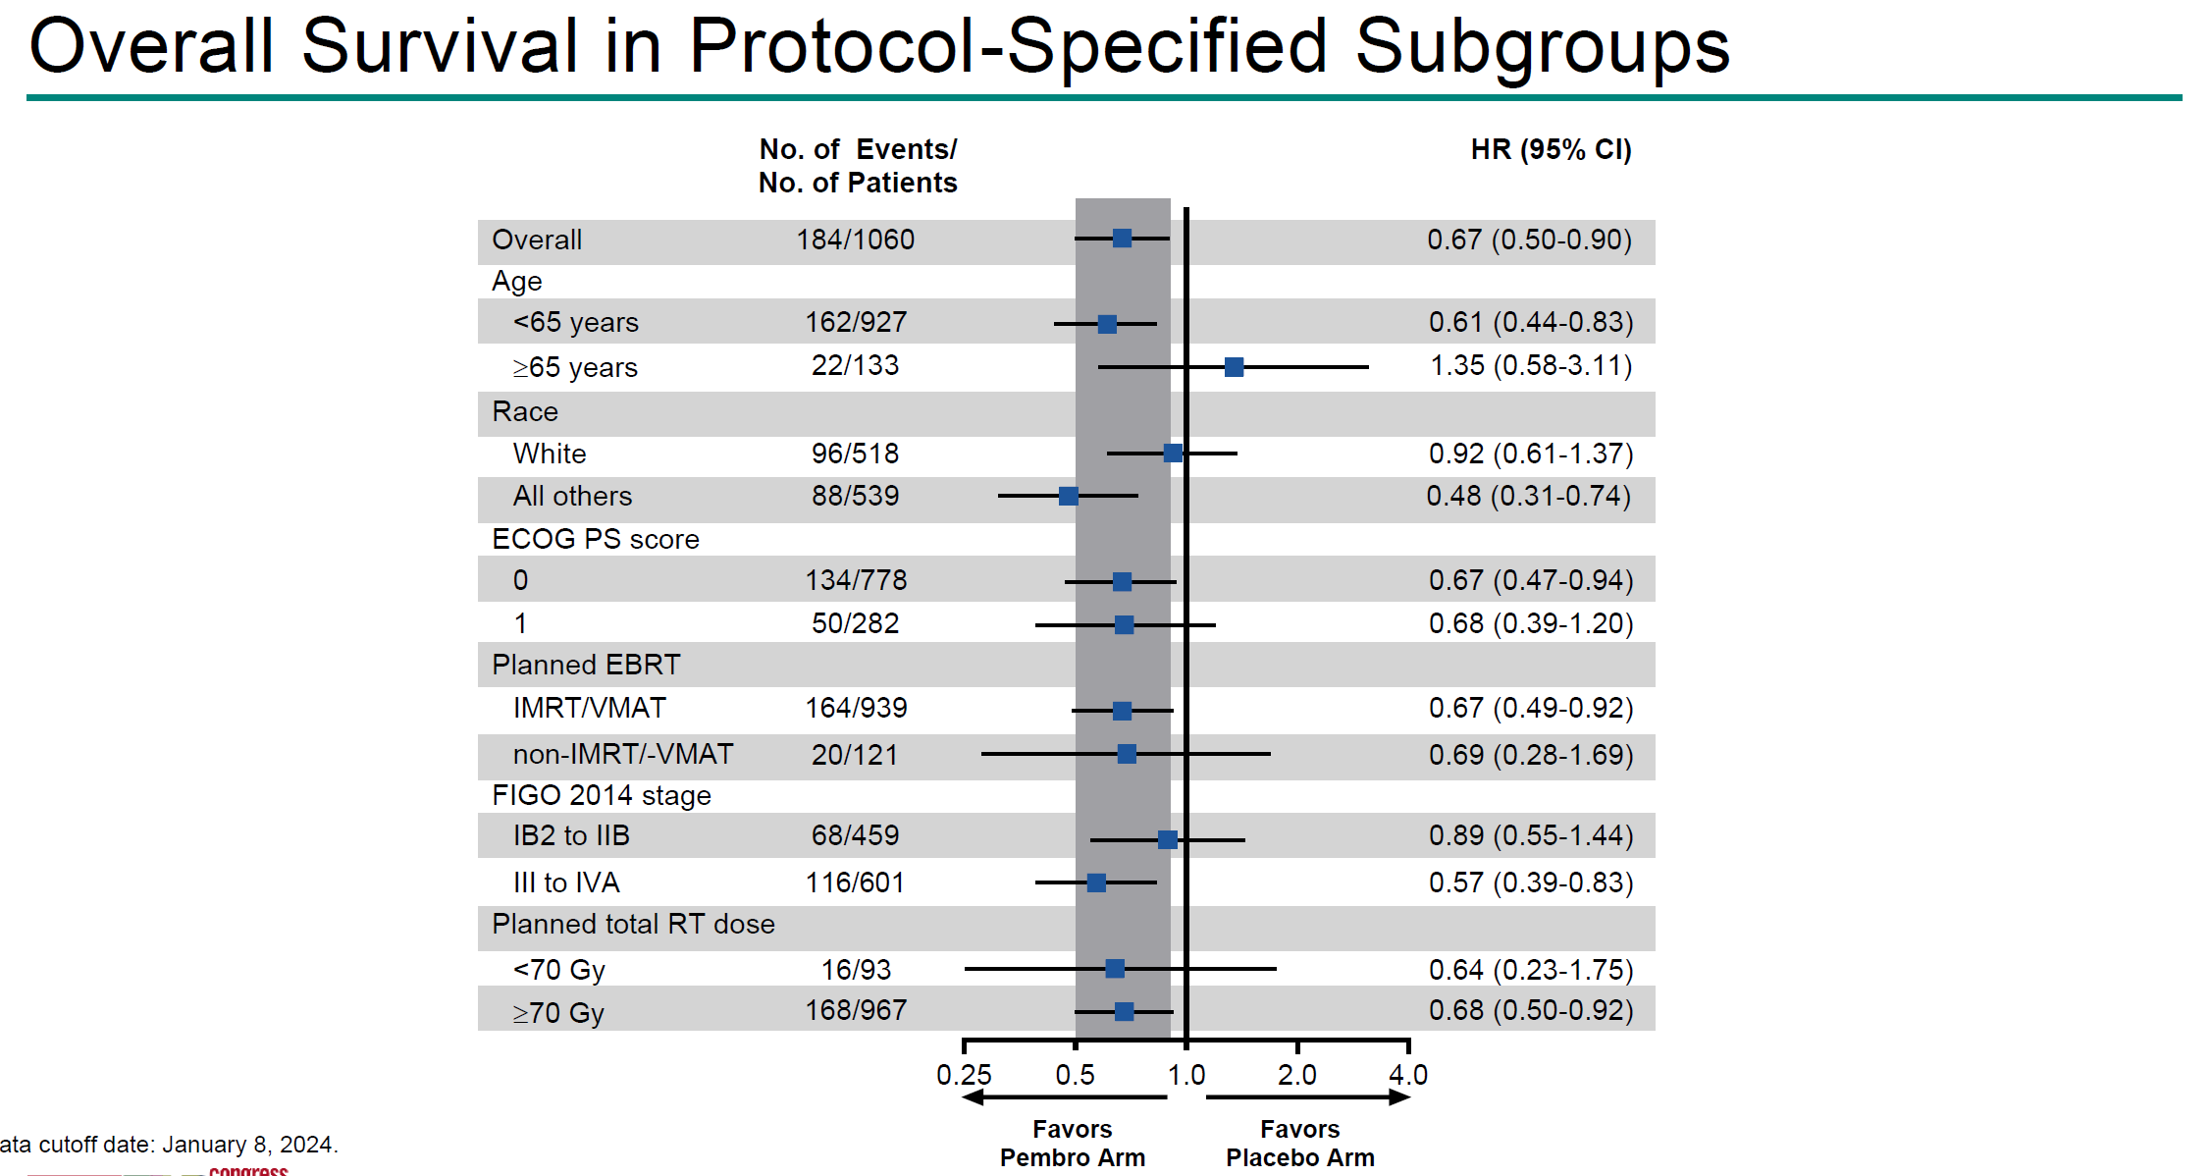
IMMUNOTHERAPY PLUS CONCOMITANT RCHT

Slide 47
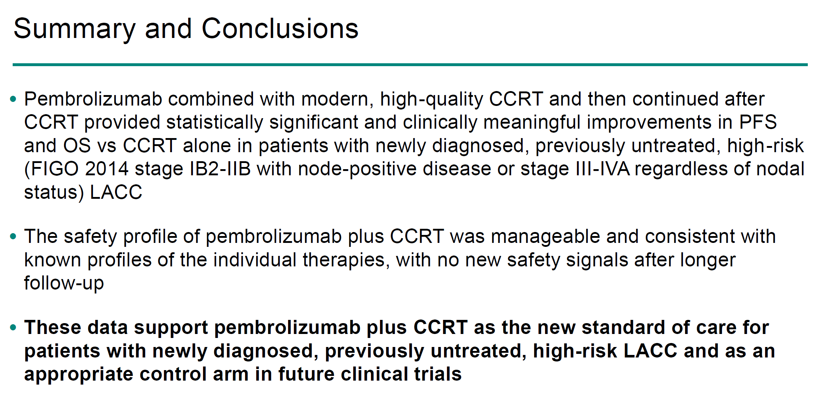
IMMUNOTHERAPY PLUS CONCOMITANT RCHT

Slide 48
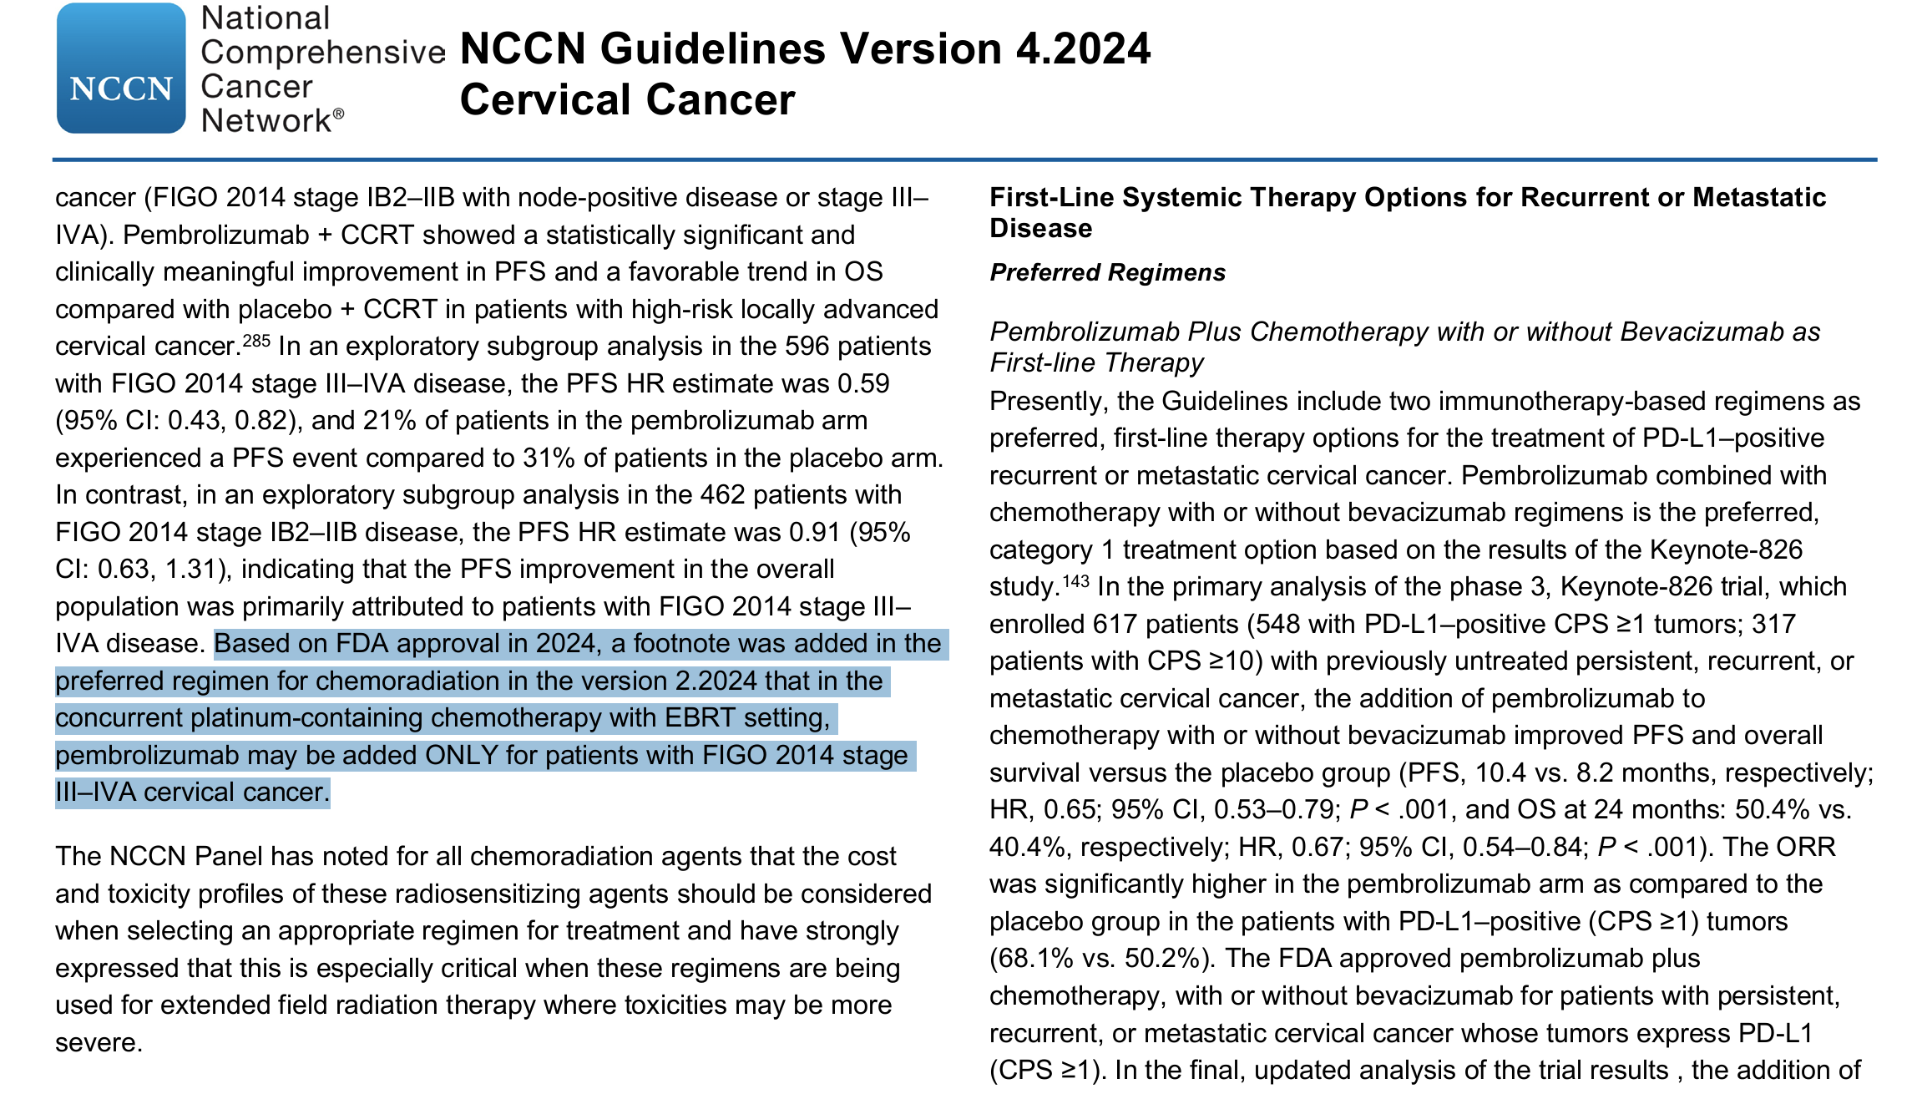
KEYNOTE A-18 / INTERPRETATION OF DATA AWAITED

Slide 49
CONCLUSION LOCALLY ADVANCED DISEASE
ADJUVANT CHT AFTER CRT: RESULTS OF OUTBACK TRIAL NEGATIVE Ǿ
INDUCTION CHT APPROACHES: INTERLACE MAJOR LIMITATIONS Ǿ
IMMUNOTHERAPY: KEYNOTE A18 NEW STANDARD OF CARE FOR LACC ???
CONCOMITANT CHEMO-RADIATION REMAINS STANDARD FOR NODE NEGATIVE LACC
POTENTIAL NEW STANDARD OF CARE
-CRT RECOMMENDED FOR FIGO STAGE IB2 – IIB, N0
-CRT + PEMBROLIZUMAB FOR FIGO STAGE I-II, N1
-CRT + PEMBROLIZUMAB FOR FIGO STAGE III-IVA

Slide 50
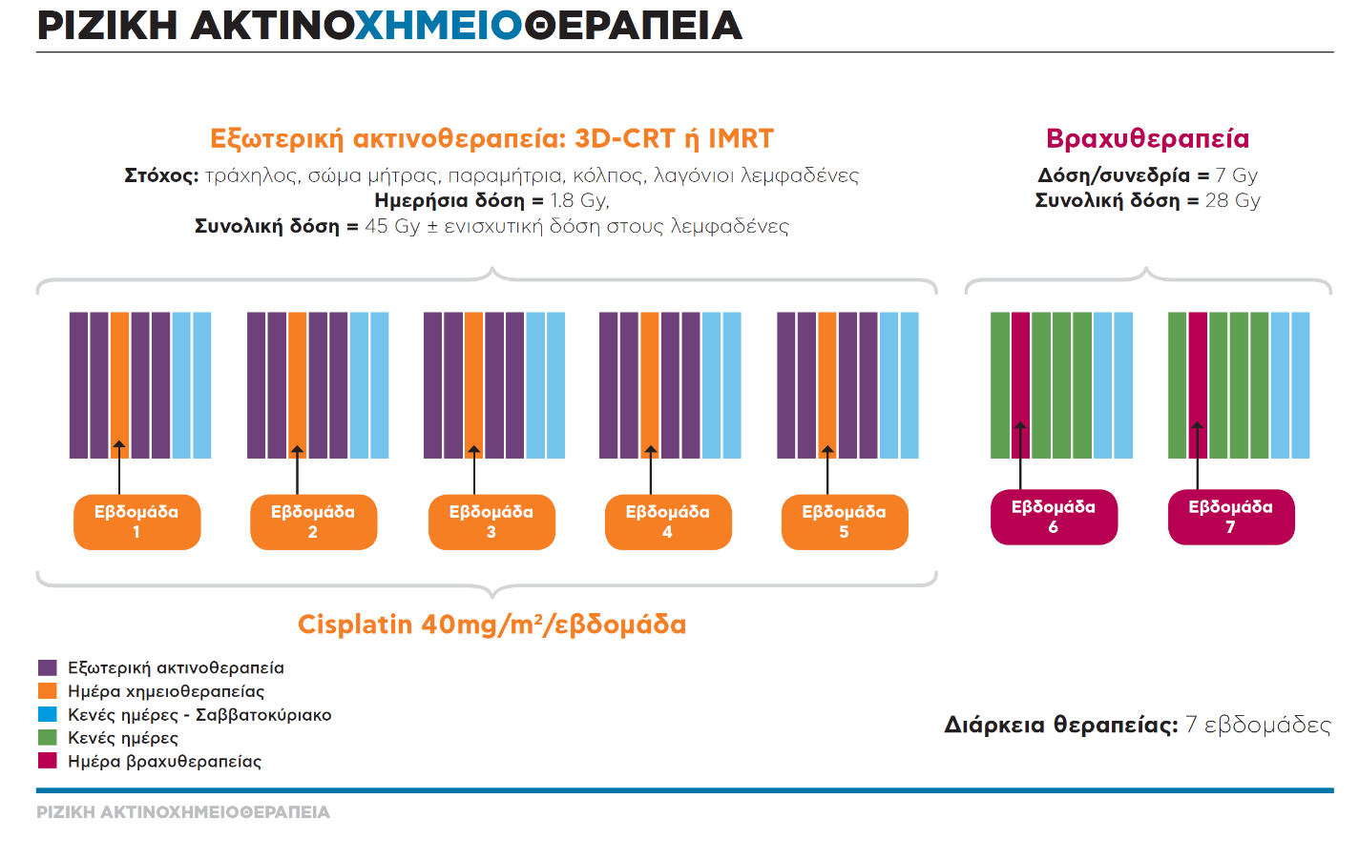
PROCEDURE OF RADICAL RADIOTHERAPY!
ΜΕ ΕΝΣΩΜΑΤΟΣΗ ΤΗΣ IGABT
± PEMBROLIZUMAB

Slide 51
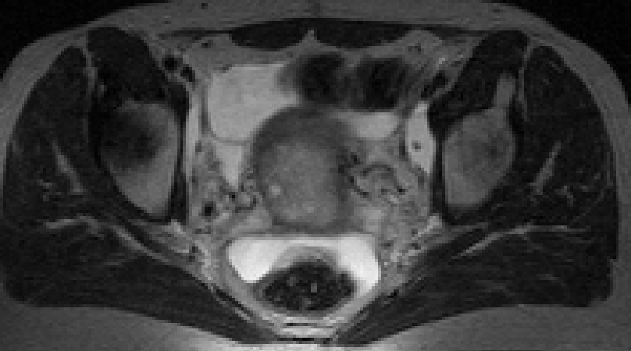
Image-Guided Adaptive Radiotherapy for Cervical Cancer
Limitations of 2D X-ray based BT: Point A!
External Beam Radiotherapy
The first component of definitive cervical cancer treatment
„simple“ integration of 3D EBRT and Brachytherapy
45 Gy EBRT + 4 x 7 Gy BT = 84 Gy (EQD2)

Slide 52
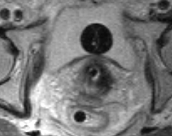
Image-Guided Adaptive Radiotherapy for Cervical Cancer
Limitations of 2D X-ray based BT: Point A!
Brachytherapy
The secondcomponent of definitive cervical cancer treatment
„simple“ integration of 3D EBRT and Brachytherapy
45 Gy EBRT + 4 x 7 Gy BT = 84 Gy (EQD2)
B
84 Gy
GTV
HR-CTV
60 Gy
R

Slide 53
PROCEDURE OF RADICAL RADIOTHERAPY!
„VMAT for External Beam Radiotherapy“
„MR-Image Guided interstitial Brachytherapy“

Slide 54
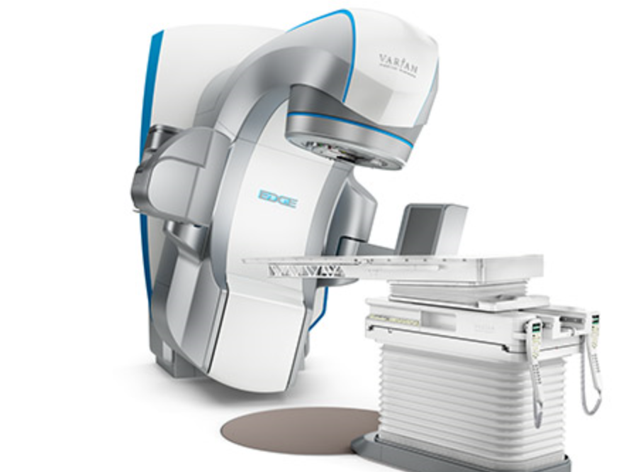
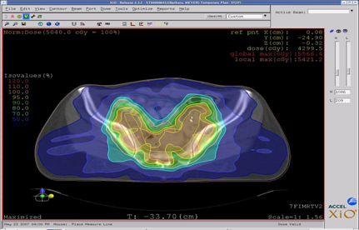
EXTERNAL BEAM RADIOTHERAPY
EBRT with IMRT
Bowel and Bladder protection
Notes:
54

Slide 55
EXTERNAL BEAM RADIOTHERAPY
The EDGE SYSTEM for Stereotactic RadioSurgery and Stereotactic Radiotherapy with Extra-fine 2.5mm MLC leaves, highest Dosage Rates (2400 MU/minute), Management and Monitoring of Respiration and Movement.
The IDENTIFY SYSTEM for Surface Guidance of Positioning and Intrafraction Motion Management.
REAL-TIME POSITION MANAGEMENT WITH RESPIRATION SYNCHRONIZED TREATMENT AND PRETREATMENT FLUOROSCOPIC VERIFICATION OF GATING
The 6D ROBOTIC COUCH enables accurate tumor targeting.

Slide 56
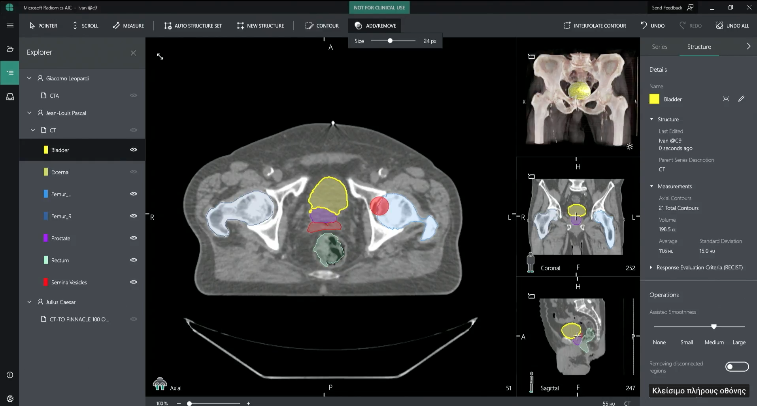
ARTIFICIAL INTELLIGENCE - AUTOSEGMENTATION
AUTOSEGMENTATION TOOL FOR TARGET AND ORGANS

Slide 57
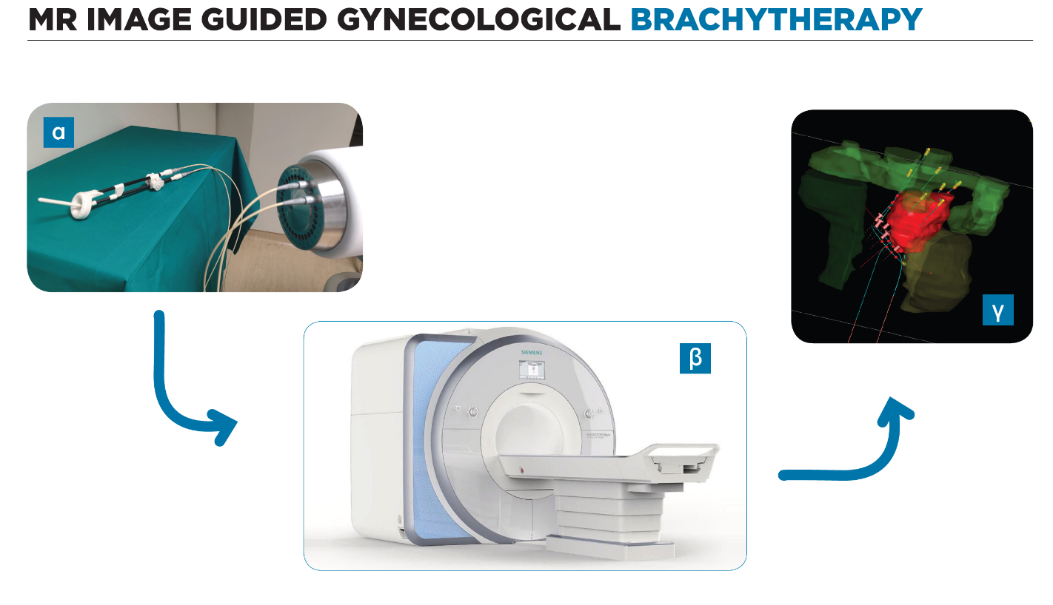
MR IMAGE GUIDED BRACHYTHERAPY

Slide 58
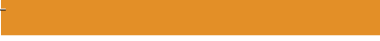
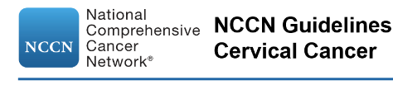
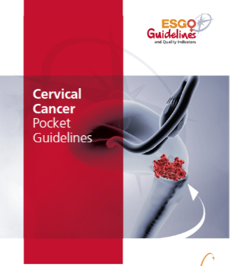

TODAY’S STATE OF THE ART BRACHYTHERAPY
MR IMAGE-GUIDED
INTERSTITIAL BRACHYTHERAPY

Slide 59
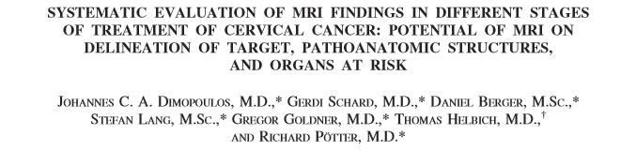
DEVELOPMENT OF MR IMAGING PROTOCOLS
at diagnosis
without vaginal
marking
at diagnosis
with vaginal
marking
at brachytherapy
with specific protocol
Dimopoulos et al IJROBP 2006; 64(5): 1380-1388

Slide 60
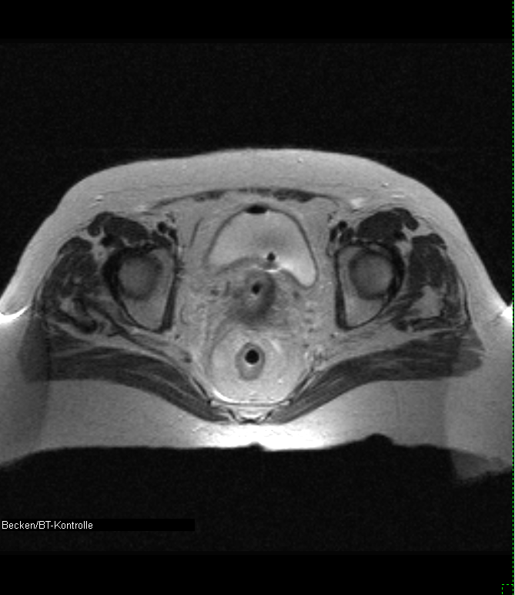
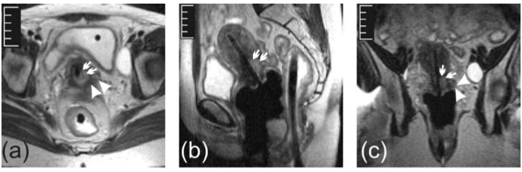
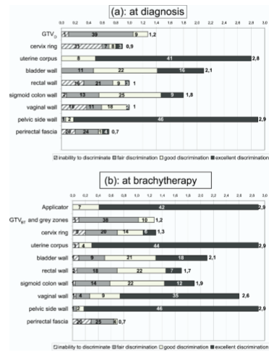
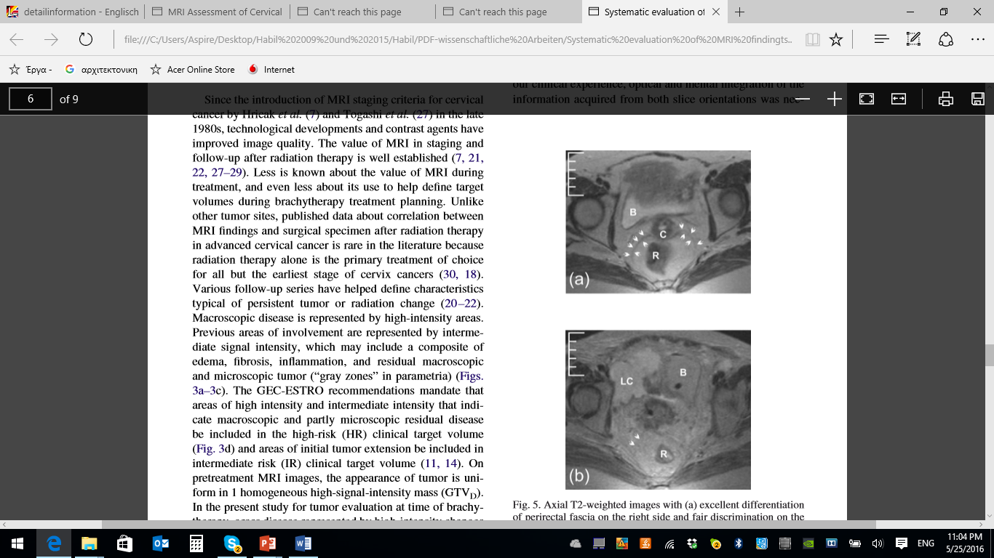
EVALUATION OF IMAGING FINDINGS
HR CTV
Gross tumour
HR CTV
Gross tumour
sagittal
sagittal
Cervix
Grey zone
Cervix
Grey zone
Dimopoulos et al IJROBP 2006; 64(5): 1380-1388

Slide 61
THE VIENNA APPLICATOR
Intracavitary / Interstitial
Tandem-Ring Applicator
MODIFIED APPLICATOR
HOLES DRILLED INTO RING TO INSERT NEEDLES PARALLEL TO TANDEM
Kirisits et al Int J Radiat Oncol Biol Phys 2006; 65(2): 624-630
Dimopoulos et al. Int J Radiat Oncol Biol Phys 2006; 66(1): 83-90
Radiother Oncol 2009; 93(2): 347-351

Slide 62
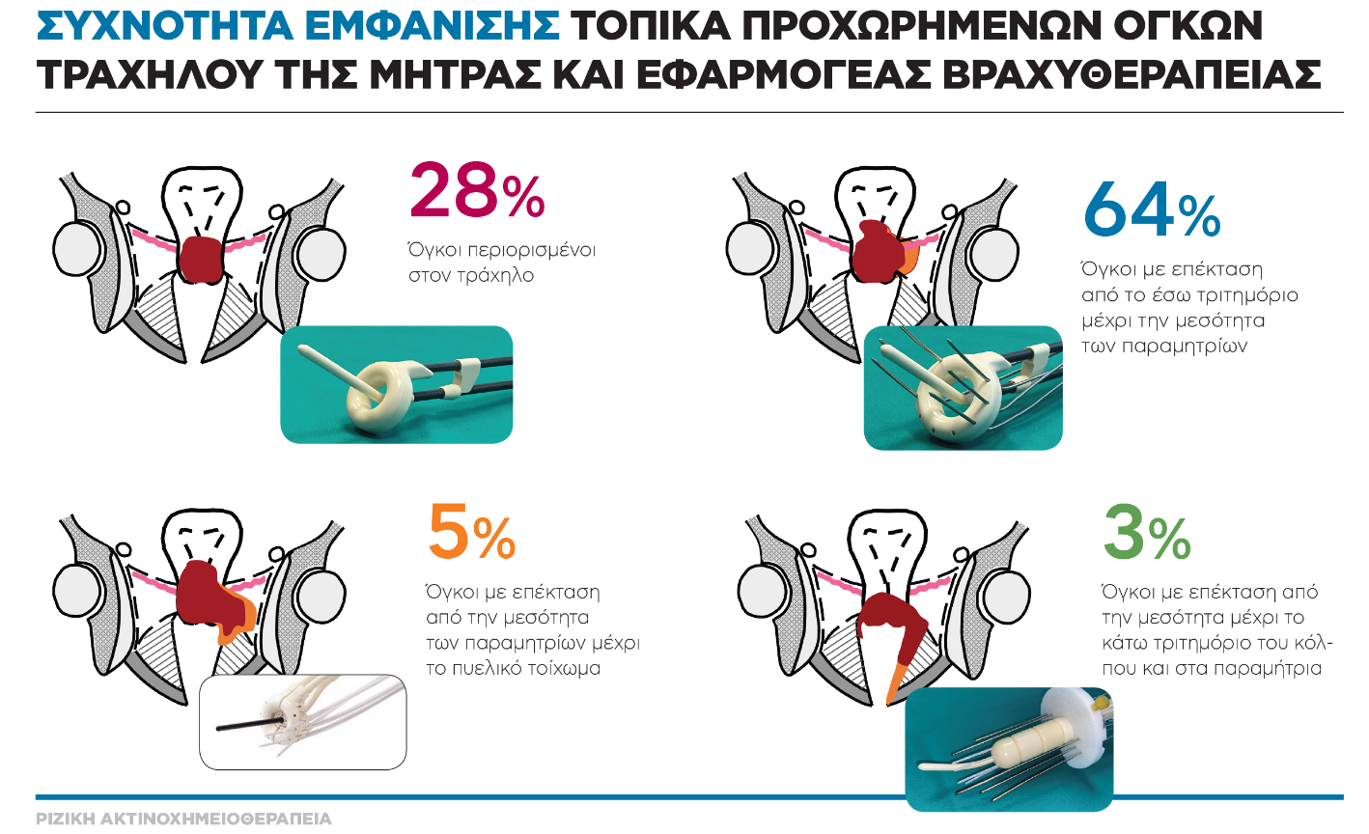
INTERSTITIAL APPLICATORS DISTRIBUTION OF APPLICATION
Notes:
62

Slide 63
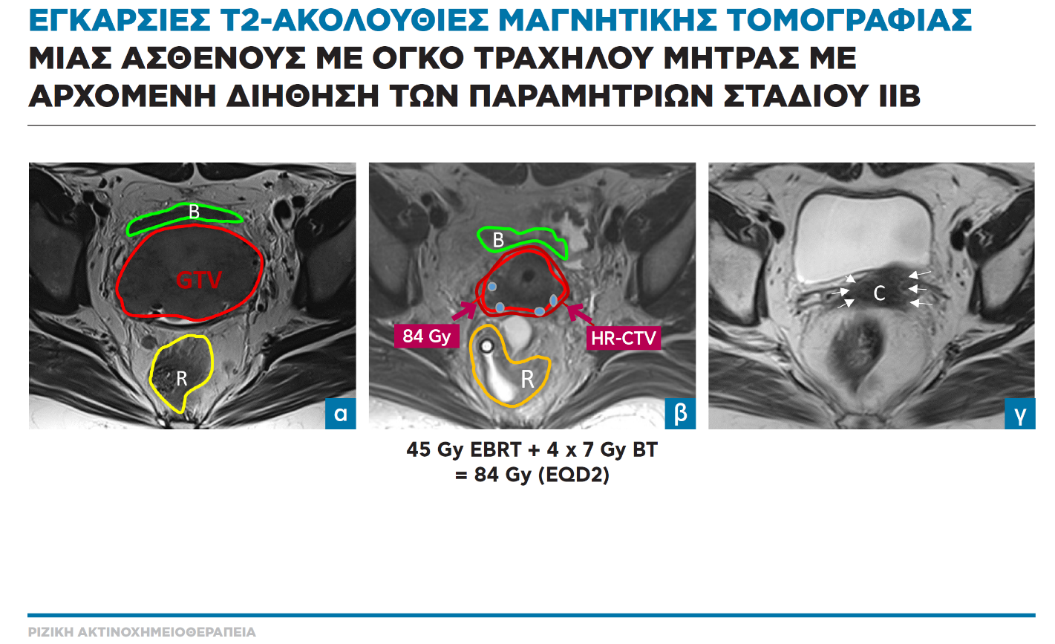
MR IMAGE GUIDED BRACHYTHERAPY

Slide 64
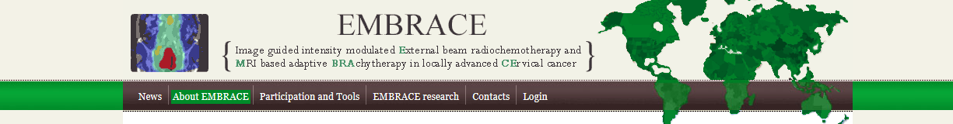
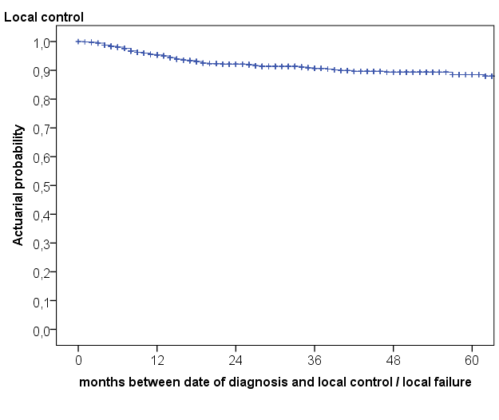
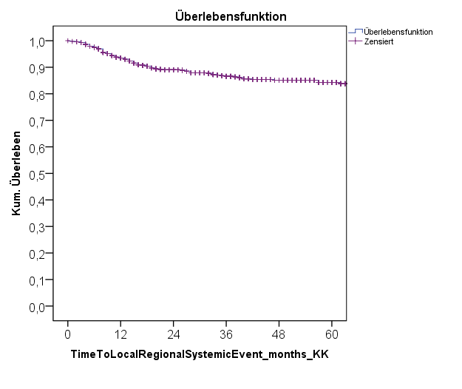
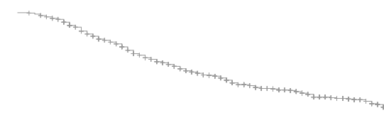
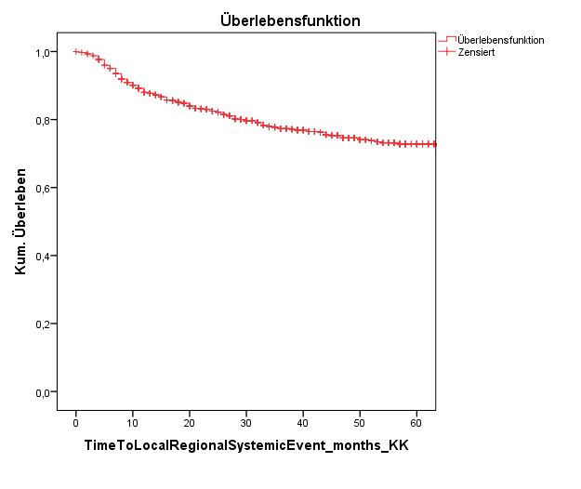

RetroEMBRACE MULTI CENTER RESULTS
Local, Pelvic, Distant Control, CSS, OS
11%
Actuarial probability
 | events | 3y | 5y | N
Local control | 69 | 91% | 89% | 731
Pelvic control | 96 | 87% | 84% | 731
Distant control | 176 | 77% | 73% | 731
Cancer specific survival | 178 | 79% | 73% | 731
Overall survival | 255 | 74% | 65% | 731
16%
27%
Months
Sturdza et al. Radiat Oncol 2016

Slide 65

RetroEMBRACE MULTI CENTER RESULTS
Local Control by Stage
Local control by FIGO stages
Stage | Events | 3y | 5y | N
1B | 2 | 98% | 98% | 123
2A | 3 | 97% | 94% | 42
2B | 28 | 93% | 91% | 368
3A | 5 | 71% | 71% | 23
3B | 28 | 79% | 75% | 145
4A | 3 | 76% | 76% | 23
Results traditional techniques
Mean 5 year local control rates
distal IIB 77%
IIIB 44-65%
IVA 18-48%
months between date of diagnosis and local control / local failure
Sturdza et al. Radiat Oncol 2016

Slide 66
PROSPECTIVE MULTI CENTER STUDIES
Prospective Multi Center Observational Study
(EMBRACE I) (accrual closed 1416 pts.)
Reporting on key clinical treatment and
outcome parameters
Prospective Multi Center Interventional Study
(EMBRACE II) (Results will be presented at ESTRO 2025)
Interventional prospective multicenter study
with some areas for observational research

Slide 67

EMBRACE I MULTI CENTER RESULTS
Local Control
Overall > 90% local control
Pötter et al. Lancet Oncol 2021

Slide 68
TAKE HOME MESSAGES ADVANCED RT
VMAT COMBINED WITH MODERN RADIOTHERAPY TOOLS
FOR EXTERNAL BEAM RADIOTHERAPY:
DECREASE OF BLADDER, BOWEL AND RECTUM SIDE EFFECTS
MR IMAGE-GUIDED INTERSTITIAL BRACHYTHERAPY:
INCREASE OF ~ 20-30% FOR LOCAL CONTROL FOR
TUMORS > 5 cm
DECREASE OF ~ 5-10% FOR SERIOUS ADVERSE LATE
EFFECTS
EMBRACE I AND II:
CONFIRM THESE RESULTS AND REFINE THE METHOD
OF MR IMAGE GUIDED BT
THE METHODS CAN BE APPLIED FOR OTHER GYN MALIGNANCIES
SIDE EFFECTS
LOCAL CONTROL

Slide 69

…THANK YOY
FOR YOUR ATTENTION

