Slide 1
Fertility sparing surgery for Stage IB2 cervical cancer
Alexandros Rodolakis
Professor of Gynecologic Oncology
Athens University , Greece

Slide 2
VERBAL DISCLOSURE
I have nothing to disclose

Slide 3
Changes in Cervical cancer surgical approach - Stage I
Stage I
Cervical Cancer
Uterine Preservation
Trachelectomy
Vaginal
2001
Conization
2005
Nodal Assessment
SLN 2003
Algorithm 2010
Abdominal
2004

Slide 4
Less“ radical fertility sparing surgery in early cervical cancer
Is it safe?
Oncological outcome:
  the methods should preserve oncological safεty of standard procedures
Complication rate (early, late)
Quality of life – sexual, lymphedema …..
  Limited data (Alexander-Sefre F., Gynecol Oncol, 2006, Halaska ESGO 2011 – poster No 263)
Fertility sparing surgery + fertility outcome:
  it is necessary to evaluate the number of women who
  a) conceive, b) deliver at term, c) deliver prematurely
  by different risk groups

Slide 5
CERVICAL CANCER & FERTILITY PRESERVATION
CaCx Stage IB1
Traditional approach: Radical Hysterectomy (type II-III) and pelvic lymphadenectomy
ALTERNATIVE : FERTILITY – SPARING APPROACH
Radical trachelectomy
Vaginal (RVT) Abdominal(RAT)

Slide 6
RADICAL TRACHELECTOMY (RVT - ART)
GENERAL ELIGIBILITY CRITERIA
Lesion size < 2 cm or < 3 cm if exophytic
Istologically proven squamous, Adeno- or Adenosquamous carcinoma
FIGO stages IA – IB1 disease
Patient < 40 years of age
Strong desire to preserve fertility
No clinical evidence of impaired fertility
No evidence of upper endocervical canal involvement
No evidence of lymph node metastasis
Schneider A, Int J Gynecol Cancer 2012.
Leitao M, Oncologist 2005.
Maltaris Th, Gynecol Oncol 2006.

Slide 7

ESGO Fertility Preservation Task Force
Clinical Recommendation Radical Trachelectomy for Fertility Preservation
in Patients With Early-Stage Cervical Cancer
Achim Schneider, Evrim Erdemoglu, Vito Chiantera, Nicholas Reed,
Philippe Morice, Alexandros Rodolakis, Dominik Denschlag, Vesna Kesic.
(Int J Gynecol Cancer 2012;22: 659-666)

Slide 8
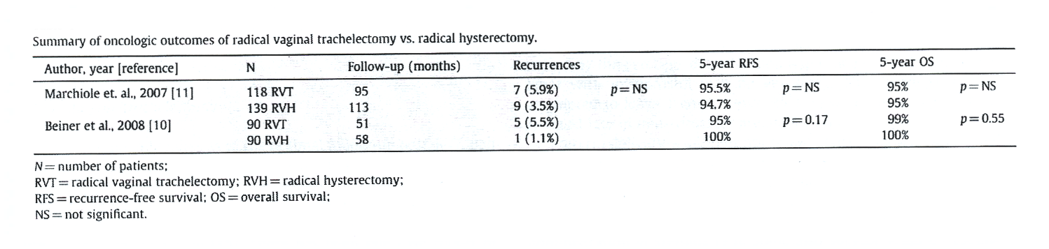
Oncological outcome RVT vs RH
No significant difference on
- reccurence rate
5year disease free survival
overall survival

Slide 9
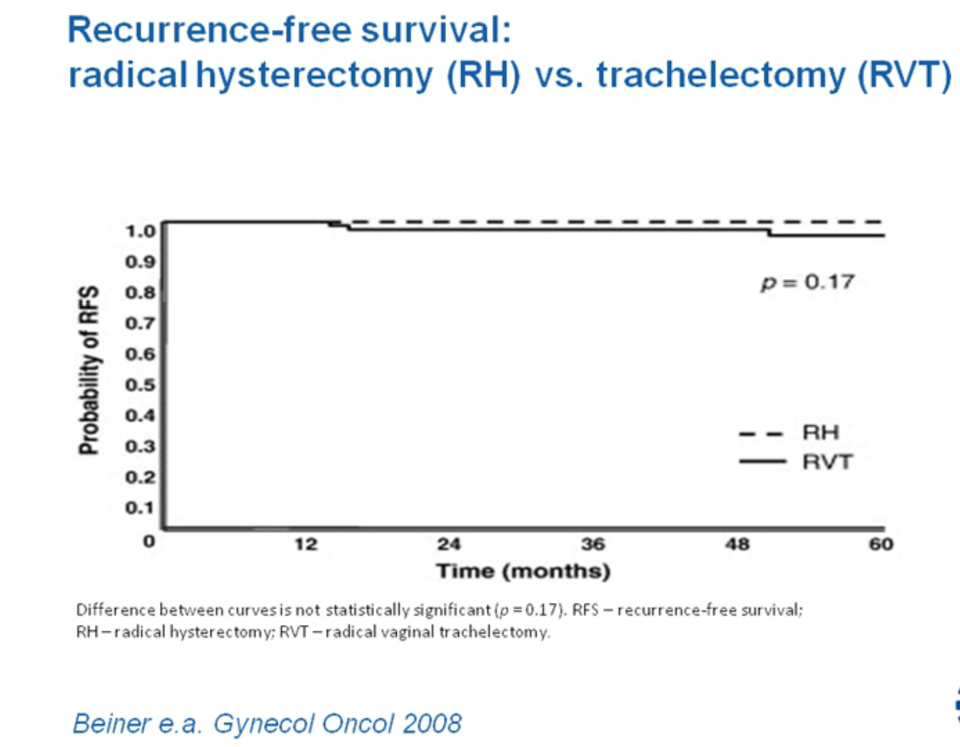

Slide 10
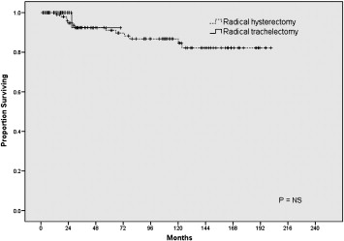
Oncologic Outcome of Radical Trachelectomy vs. Radical Hysterectomy for Stage IB1 Cervical Cancer
MSKCC Survival Data
Diaz JP, et al. Gynecol Oncol 2008

Slide 11
SIMILARITIES OF RADICAL VAGINAL & ABDOMINAL TRACHELECTOMY
Same criteria of patients’ selection
Same criteria of abandoning the procedure
Same methodology of surgical approach (Lymphadenectomy -> trachelectomy)
Same complications
Same efficacy
Schneider A, Int J Gynecol Cancer 2012.
Ungar C, BJOG 2005.
Pel Priore G, Obstet Gynecol 2006.
Li J, Gynecol Oncol 2011.

Slide 12
DIFFERENCES BETWEEN RADICAL VAGINAL ΑND
ABDOMINAL TRACHELECTOMY
RAT may result in wider parametrial resection (> 50%)
RAT for bigger (2 – 4 cm) tumors
RVT requires a high expertise in radical vaginal surgery
Expertise in Laparoscopic lymphadenectomy not necessary for RAT
Increased blood losses for RAT
Schneider A, Int J Gynecol Cancer 2012.
Covens A, Cancer 1999.
Abu – Rustum NR, Gynecol Oncol 2006.
Einstein MH, Gynecol Oncol 2009.

Slide 13
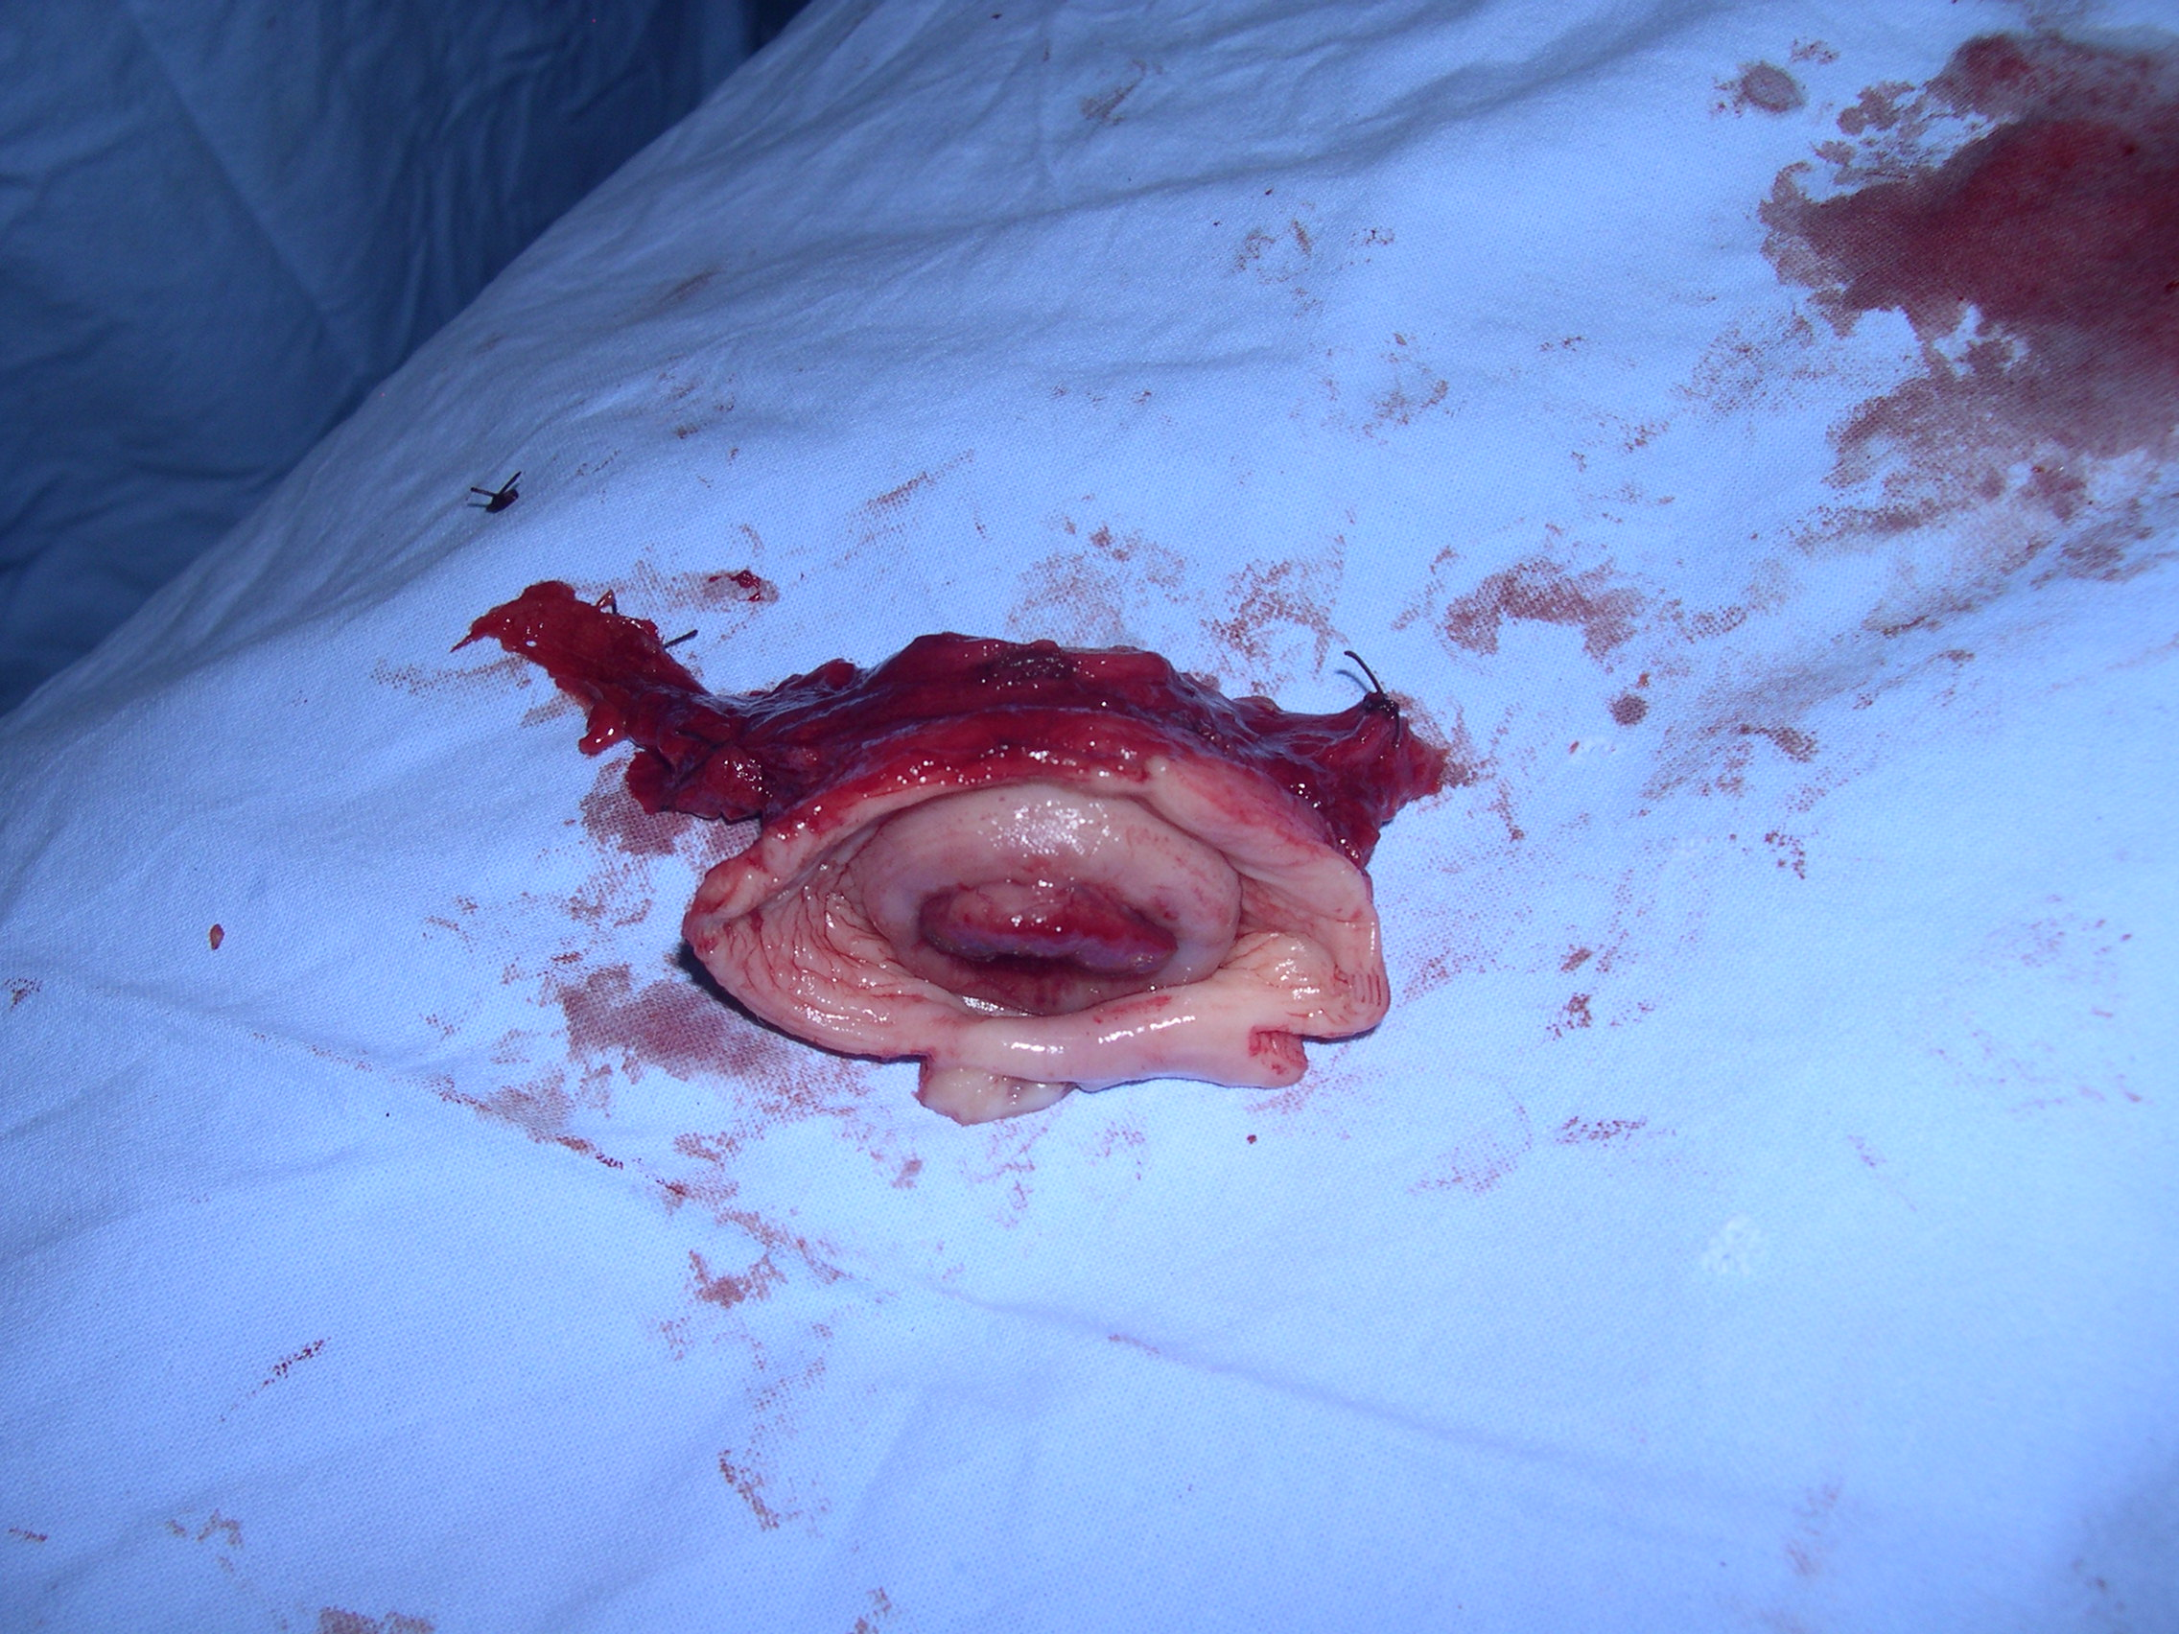
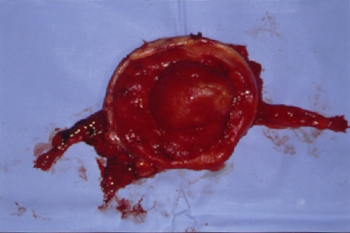
Radical Abdominal Trachelectomy
(RAT)
Radical Vaginal Trachelectomy
(RVT)

Slide 14
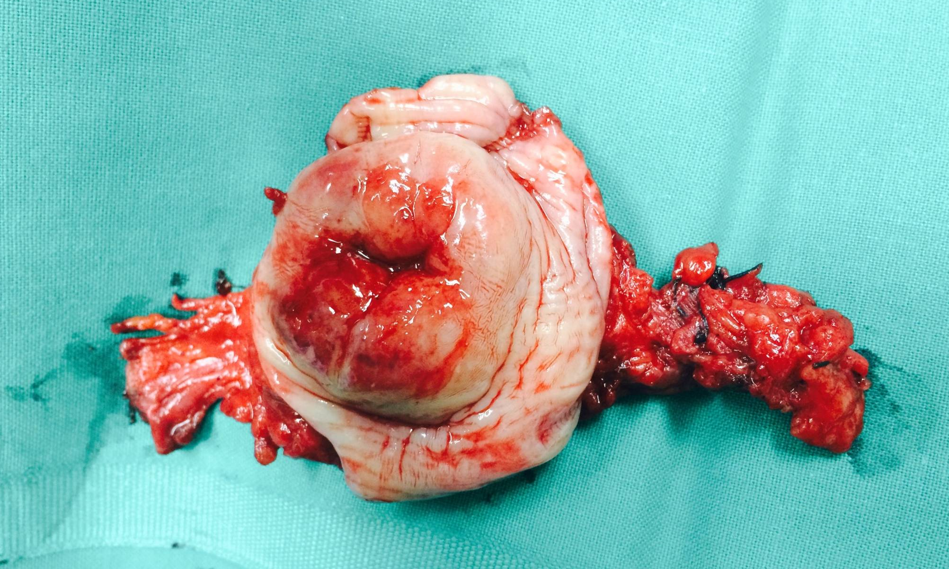
Abdominal Radical Trachelectomy (ART)

Slide 15
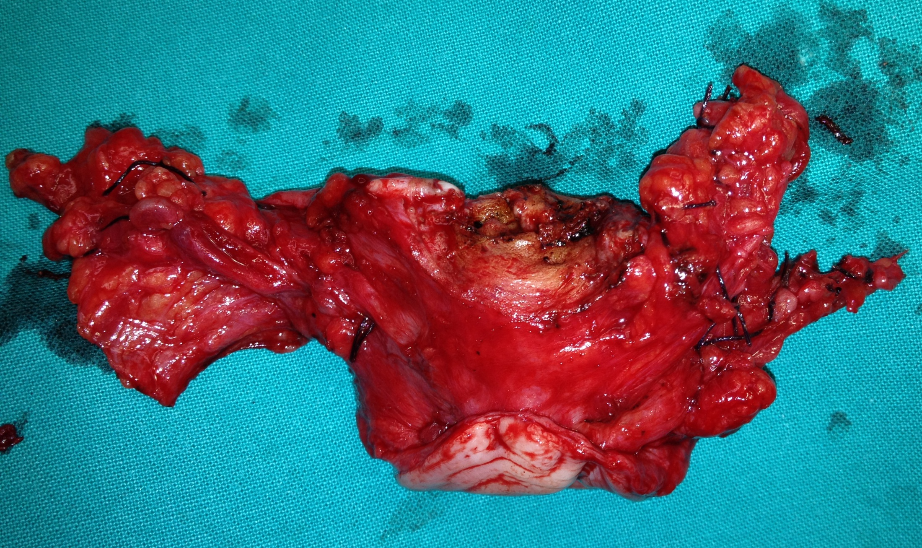
Abdominal Radical Trachelectomy (ART)
( Nerve sparing approach )

Slide 16
Abdominal Radical Trachelectomy (ART)
Less stringent criteria than before
Tumor < 2 cm
Tumor-internal os margin of 1 cm
< 50% cervical stromal invasion
Tumor < 4 cm
Tumor – internal os margin < 1 cm
> 50% cervical stromal invasion
More extensive resection of parametria with ART
DiazJP, Gynecol Oncol 2008
Denschlag D , Rodolakis A, Curr Oncol Rep, 2012
Schneider A, Int J Gynecol Cancer, 2012
Rob L, Lancet Oncol, 2011
Abu – Rustum NR, J Natl Compr Cancer Netw, 2010

Slide 17

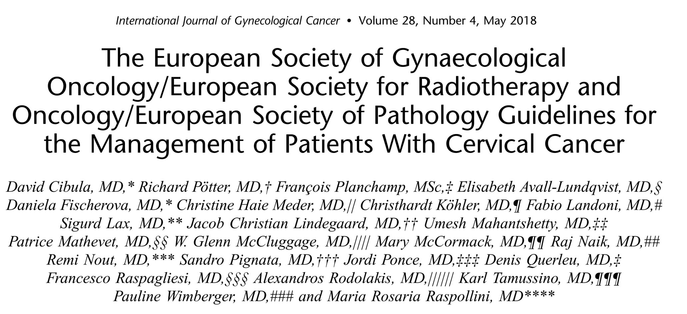

Slide 18
ESGO/ESTRO/ESP Guidelines for the Management of Patients With Cervical Cancer
International Journal of Gynecological Cancer 2018
Radical trachelectomy (type A)
can be considered for
stagesT1a1 and T1a2, lymph node negative, LVSI-positive patients.
Conization or simple trachelectomy is an option (grade B).
Radical trachelectomy (type B)
should be performed
for stage T1b1 equal to or less than 2 cm of the largest diameter,
lymph node negative,LVSIT (grade B).

Slide 19
ESGO/ESTRO/ESP Guidelines for the Management of Patients With Cervical Cancer
International Journal of Gynecological Cancer 2018
In case of intraoperatively proven lymph node involvement
Fertility-sparing surgery should be abandoned
The patient referred to definitive chemoradiotherapy .
The specific aim of fertility-sparing surgery must be
the resection of invasive tumor with adequate free margins and
preservation of the upper part of the cervix.
Intraoperative frozen section is a reliable way of assessing
the upper resection margin in trachelectomy specimen and
should be considered.

Slide 20
RADICAL TRACHELECTOMY FOR CERVICAL CANCER
OBSTETRICAL OUTCOME
43% tried to conceive
70% of those tried had a successful pregnancy
49% term – pregnancies
8% second trimester losses
16% first trimester losses
20% premature deliveries (< 36 weeks)
  Schneider A, Int J Gynecol Cancer 2012.
  Boss EA, Gynecol Oncol 2005.
Plante M, Gynecol Oncol 2005.
Abu-Rustum NR, Gynecol Oncol 2006.

Slide 21
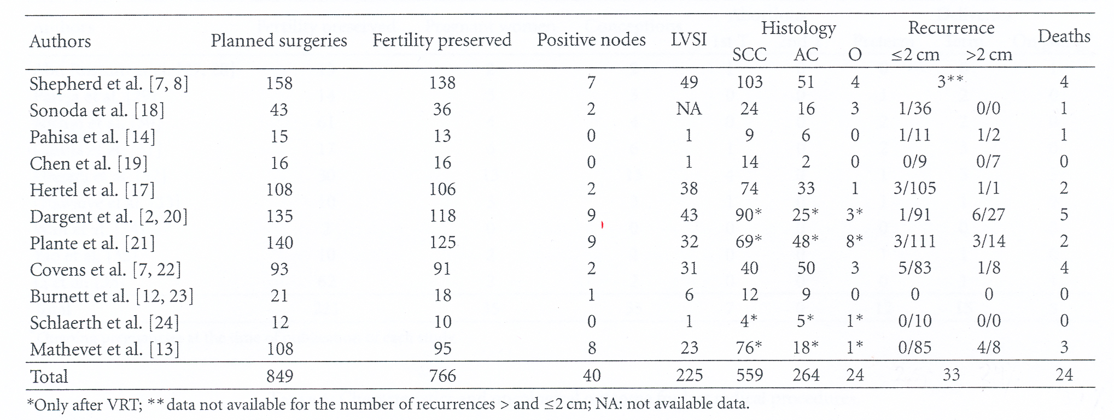
Oncological outcome RVT
849 / 83 (9,8%)
Reccurence rate 3,9%
2,6% < 2 cm
23,9% > 2 cm
Ribeiro AFR, et al. Int J Surg Oncol, 2012.

Slide 22
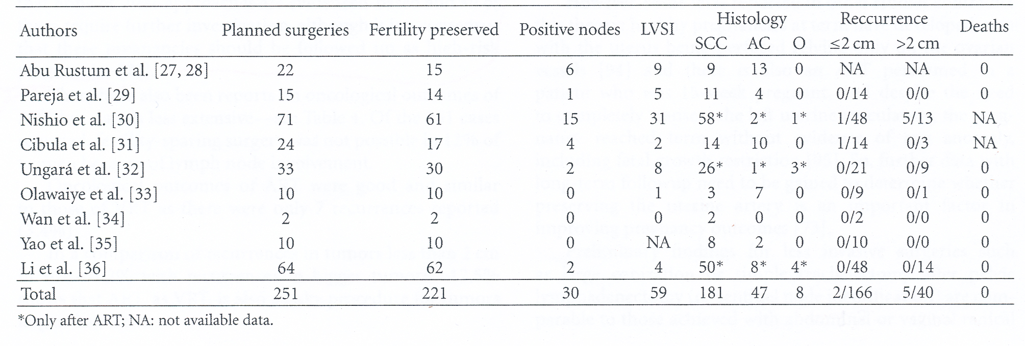
Oncological outcome ART
251 / 12%
Reccurence rate 3,4%
1,2% < 2 cm
12,5% > 2 cm
Ribeiro AFR, et al. Int J Surg Oncol, 2012.

Slide 23
RADICAL TRACHELECTOMY FOR CERVICAL CANCER
SAFETY & EFFICACY
Isthmic stenosis (DUB, subfertility, difficult follow-up)
Recurrence rate similar to that of Radical Hysterectomy (3-4%)
    - Careful selection of patients
    - Tumors < 2 cm
Recurrences usually among tumors > 3 cm
  Del Priore G, Gunecol Oncol 2004.
  Bader AA, Gynecol Oncol 2005.
  Einstein MH, Gynecol Oncol 2002.
  Schneider A, Int J Gynecol Cancer 2012.

Slide 24
Parametrial involvement for early stage Cervical cancer
Stage IA1 – IB1
Tumor size < 2cm
Lymph node status (-)
Depth of invasion < 10mm
LVSI (-)
Covens A, et al. Gynecol Oncol, 2002.
Stegeman M, et al. Gynecol Oncol, 2007.
Steed H, et al. Gynecol Oncol, 2006.
Wright JD, et al. Cancer, 2007.
Frumovitz M et al. Obstet Gynecol, 2009.
Thomakos N et al. Gynecol Oncol 2013;130(1):e54.
Parametrial involvement : < 0,6%

Slide 25
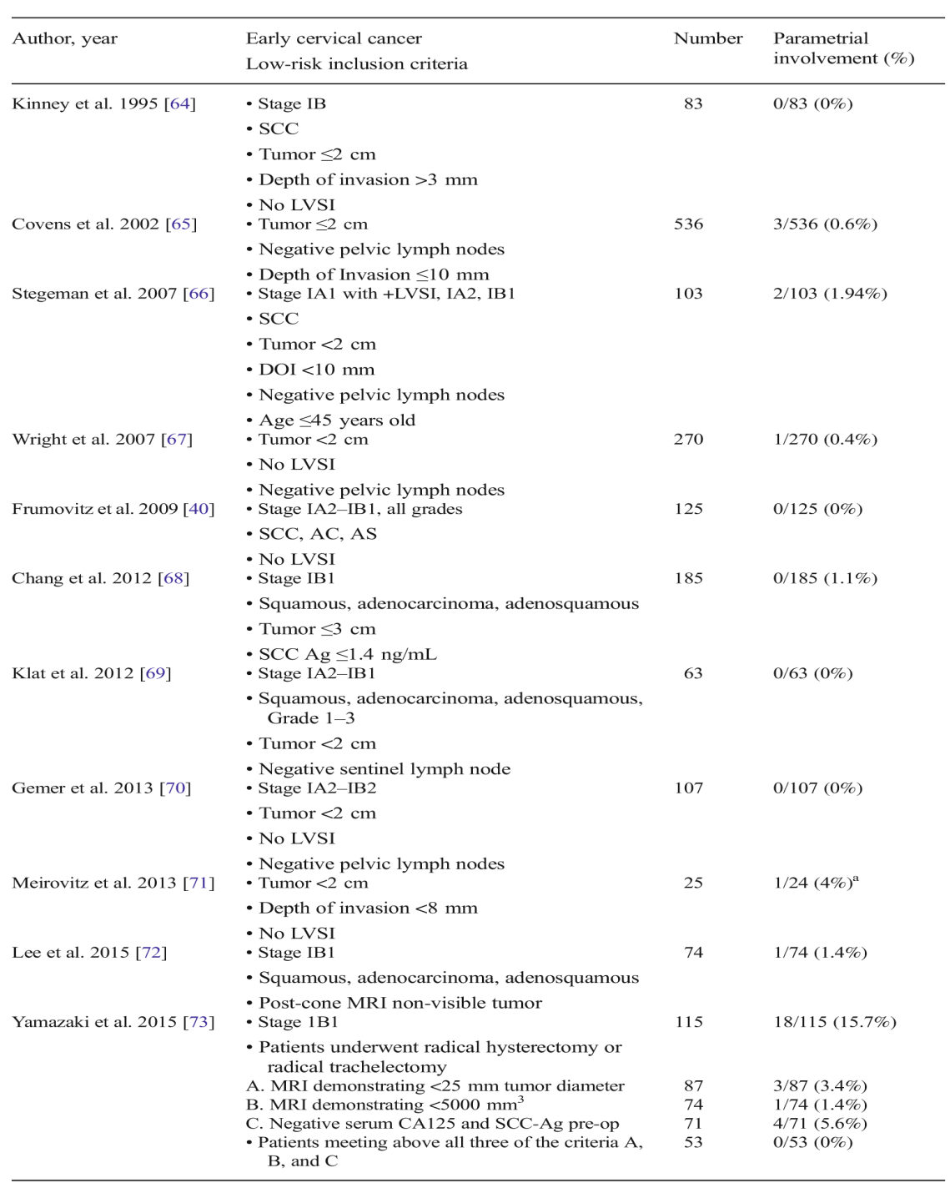
Parametrial involvement in low risk patients
Parametrial
involvement
0-1,9%
Zigras T, Covens A. Curr Oncol Rep, 2017.

Slide 26
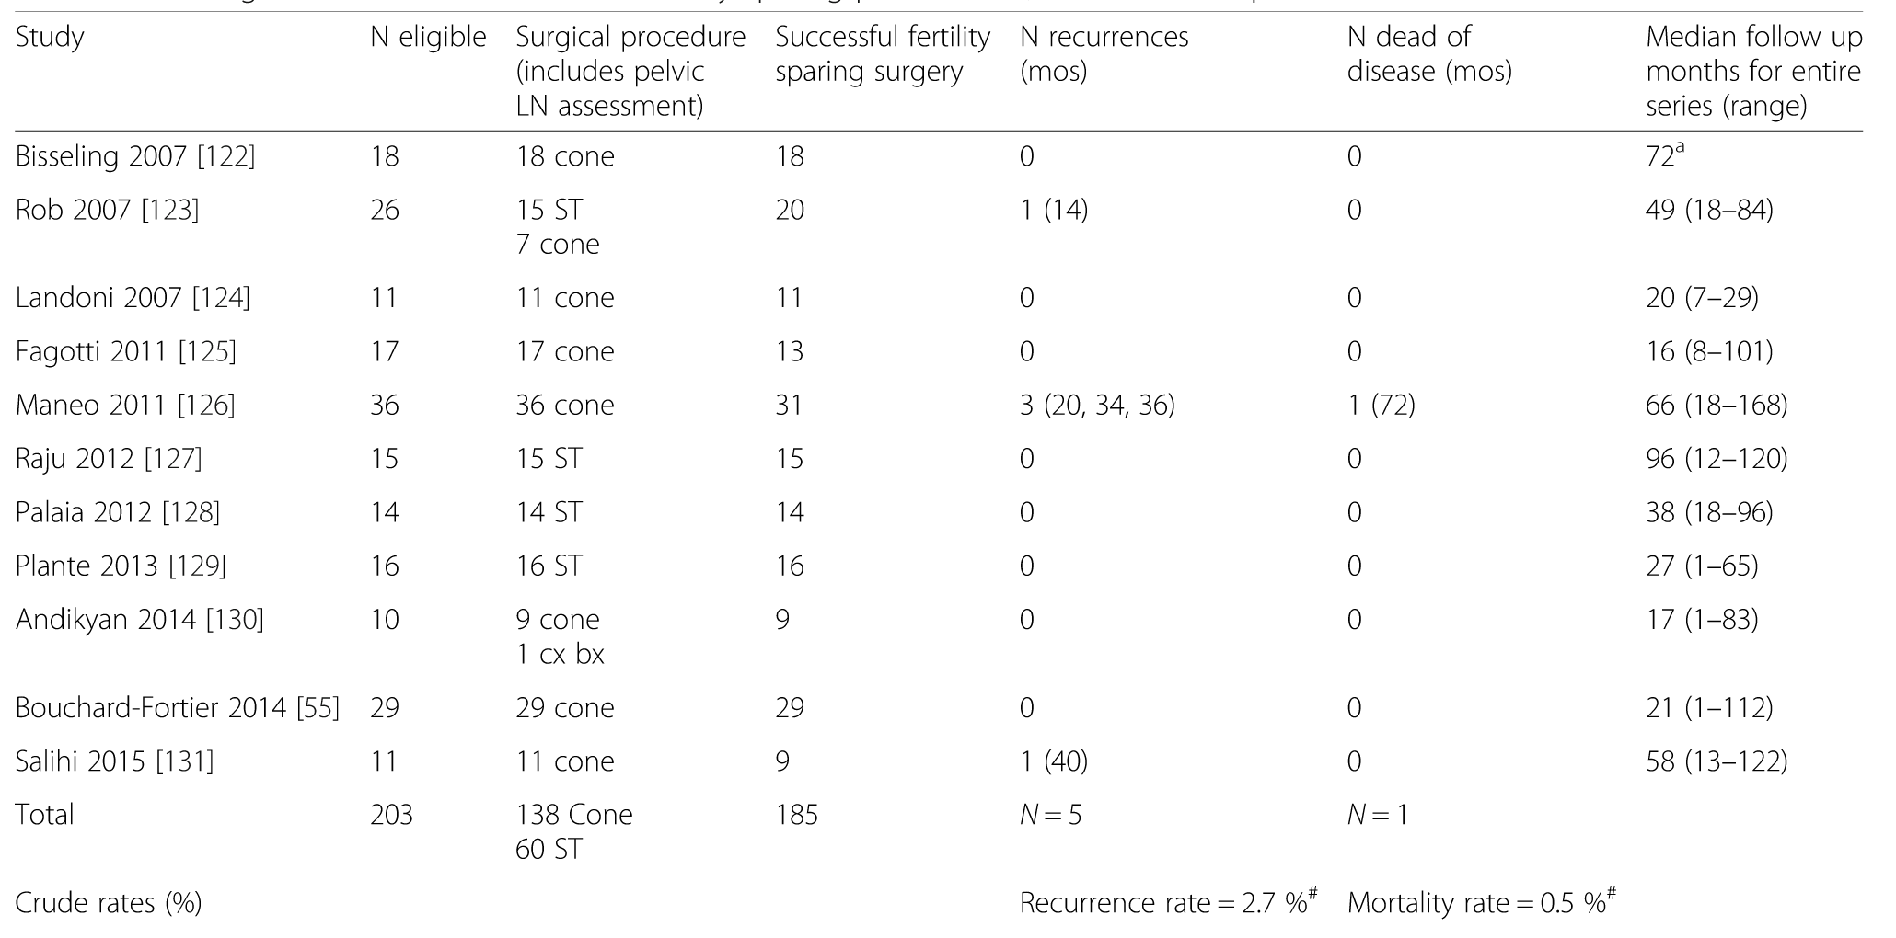
Conservative surgery
Oncological outcome
Simple trachelectomy – conization
Willows K, Lennox G, Covens A. Gynecol Oncol Res Pract, 2016.

Slide 27
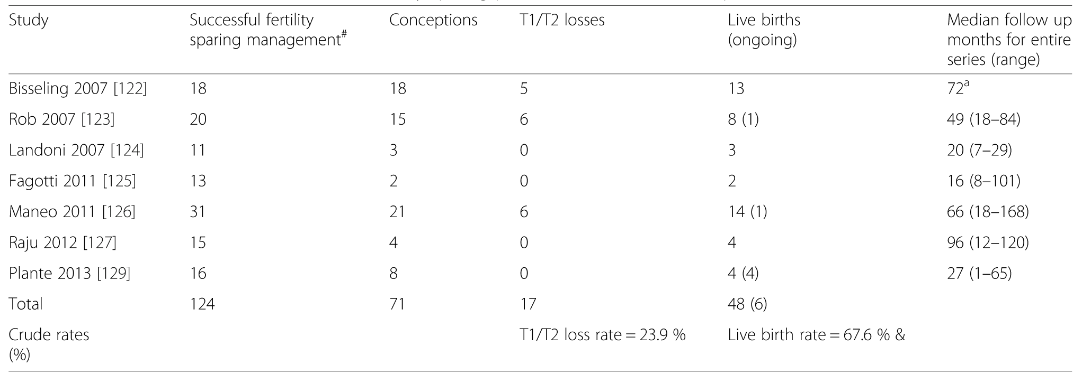
Conservative surgical approach
Obstetrical outcome
Non randomized trials
Favourable prognostic factors
Willows K, Lennox G, Covens A. Gynecol Oncol Res Pract, 2016.

Slide 28
SHAPE Trial
Simple Hysterectomy And Pelvic node dissection in Early CaCx
CaCx IA₂, IB₁
SCC, adenoCa, adenosquamous
≤ 2 cm
DOI < 10mm
All tumor grades
LVSI eligible
End point : Less radical surgery not inferior than gold standard (RH, RT)
Evaluation : QoL, Treatment Related Morbidity, cost-effectiveness
n=700
474 (68%) randomized
Prospective
RAD HYST/MY + PLND
vs
SIMPLE HYST/MY + PLND
Plante M. The SHAPE trial.

Slide 29
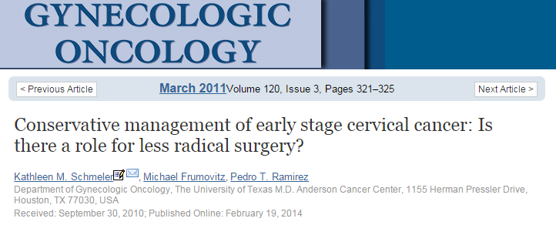
ConCerv Trial
Safety and feasibility of conservative surgery in early stage CaCx
Prospective , Multicenter, International
CaCx IA₂, IB₁
SCC
AdenoCa, gr. 1,2
≤ 2 cm
< 10 mm DOI
No LVSI
Conization + PLND
vs
Simple Hysterectomy + PLND

Slide 30
Type of fertility-sparing surgery
excellent oncologic and improved obstetrical outcome following simple trachelectomy or cone versus radical trachelectomy
Plante M, Renaud MC, Sebastianelli A, et al. A valuable fertility preserving option in early-stage cervical cancer. Int J Gynecol Cancer 2017;27:1021–7.
Bentivegna E, Maulard A, Pautier P, et al. Fertility results and pregnancy outcomes after conservative treatment of cervical cancer: a systematic
review of the literature. Fertil Steril 2016;106:1195–211.
simple trachelectomy or large cone would appear to be adequate surgery
in patients with complete/partial response (residual tumor <2 cm) following neo-adjuvant chemotherapy.
most of the available data on neo-adjuvant chemotherapy followed by fertility-sparing surgery come from
limited small retrospective studies using a variety of treatment approaches.
Thus, a standardized approach with regards to the optimal management of these patients is lacking.

Slide 32
Favorable oncological selection criteria
The following seven criteria should be met before considering fertility-sparing management:
assignment of patients to favorable selection criteria is based on all clinicopathological variables (IV, B)
confirmed histology on cervical biopsy or conisation is consistent with squamous cell carcinoma (all grades) or
usual-type HPV-associated adenocarcinoma (all grades) with no more than 10 mm stromal invasion (IV, B)
3) absence of LVSI is a favorable pathological biomarker (III, B)
4) no evidence of any metastasis is required (IV, A)
5) largest measurement of a tumor is 2 cm by imaging or clinical exam (IV, B)
6) free margins on final pathology are mandatory (III, A)
7) no evidence of tumor involvement of the internal cervical orifice and cranial extent of cervical tumour is 1 cm or more from
the internal cervical orifice on imaging (IV, B)

Slide 33
Unfavorable oncological selection criteria
At least one of the following criteria should be met:
Any histological type other than squamous cell carcinoma and usual-type HPV-associated adenocarcinoma (mucinous-type HPV – associated
carcinomas, gastric-type cervical adenocarcinoma, mesonephric carcinoma, small-cell neuroendocrine carcinoma, and clear cell carcinoma(IV C)
confirmed pelvic nodal involvement, extracervical tumor extension, evidence of tumor beyond the cervical ring, or metastasis (IV, B)
the largest tumor measurement is more than 4 cm by imaging or clinical exam (IV, B)
FIGO stage is IB3 or more (IV, B)
tumor cranial extent is less than 5 mm from, or involves, the internal cervical orifice or lower uterine segment by imaging (IV,B)
intraoperative frozen-section assessment of the resected cervical specimen for assessing the upper resection margin reveals a positive margin
from the internal cervical orifice with inability to achieve a wider margin (IV, B)
or histologically confirmed endocervical margin, endocervical curettage above resection, or endometrial involvement on final pathology (IV, B)

Slide 34
Oncological selection criteria acceptable in selected cases
At least one of the following criteria should be met:
Tumor size is 2–4 cm by exam or imaging (IV, C)
stromal invasion by conisation is more than 10 mm but has negative margins (IV, C)
evidence of deep cervical stromal invasion on MRI or sonography (IV, B)
tumor cranial extent is 5–10 mm from internal cervical orifice by imaging (IV, C)
trachelectomy specimen margin reveals a 5–10 mm tumor-free margin from the internal cervical orifice (IV, B)
Silva pattern C of HPV-associated usual-type adenocarcinoma (data are scarce on pattern B with LVSI (IV, C)

Slide 35
Selection of patients with cervical cancer for fertility-sparing treatment

Slide 36
Limitations (?) fertility sparing procedures
Tumours > 2 cm
Deep stromal invasion
Alternatives
ABDOMINAL RADICAL TRACHELECTOMY
NACT AND CONIZATION / SIMPLE TRACHELECTOMY

Slide 37
Neoadjuvant Chemotherapy / Surgery
Neoadjuvant Chemotherapy → ↓ size of the tumor
(downstaging) ↓ poor prognostic factors
(LNs, LVSI, param. invasion)
↓ need for post OP adj RT
Less radical surgery
Benedetti Panici PL, et al. Gynecol Oncol, 2007.
Neoadjuvant Chemotherapy for Locally Advanced Cervical Cancer
Meta-analysisCollaboration – 21 randomized trial. Eur J Cancer 2003.

Slide 38
Neo-Adjuvant Chemotherapy followed by Fertility-Sparing Surgery
Νeo-adjuvant chemotherapy followed by radical hysterectomy is effective in reducing the size of cervical cancer lesions
Kim HS, et al. Efficacy of neoadjuvant chemotherapy in patients with FIGO stage IB1 to IIA cervical cancer: an international collaborative meta
-analysis. Eur J Surg Oncol 2013;39:115–24.
A Cochrane meta-analysis of 1078 patients including bulky stage IB IIB and IIIB disease showed
that neo-adjuvant chemotherapy followed by surgery improves overall survival and progression-free survival compared
with surgery alone and is associated with a 23% reduction in the risk of death
Rydzewska L, et al. Neoadjuvant chemotherapy plus surgery versus surgery for cervical cancer. Cochrane Database Syst Rev 2012;12.
Νeo-adjuvant chemotherapy reduces the need for adjuvant radiotherapy, and is associated with decreased tumor size,
lymph node involvement, and distant metastases
Chen Z, Shi Y, Wang S, et al. Meta-analysis showing that early response to neoadjuvant chemotherapy predicts better survivalamong cervical
cancer patients. Oncotarget 2017;8:59609–17.
Chen H, Liang C, Zhang L, et al. Clinical efficacy of modified preoperative neoadjuvant chemotherapy in the treatment of locally advanced (stage
IB2 to IIb) cervical cancer: randomized study. Gynecol Oncol 2008;110:308–15.
Robova H, Rob L, Halaska MJ, et al. High-dose density neoadjuvant chemotherapy in bulky IB cervical cancer. Gynecol Oncol 2013;128:49–53.
Globally the reported response rate to neo-adjuvant chemotherapy is in the region of 70%
Suboptimal response to neo-adjuvant chemotherapy appears to be an independent prognostic factor of poorer outcome.
Li R, et al. Prognostic value of responsiveness of neoadjuvant chemotherapy before surgery for patients with stage IB(2)/IIA(2) cervical cancer.
Gynecol Oncol 2013;128:524–9.

Slide 39
Premature labor (infections, chorioamnionitis , PROMs)
↓ Pregnancy rate
Radical surgery
  Premature labor
  ↑ ART (Open 57%, L-scopic 50%, RVT 39%)
  ↓ NACT + conization / trachelectomy 15%
Bentivegna E et al. Fertil Steril, 2016
* 44% term pregnancies after VRT ( > 36w )
Plante. IJGC, 2013.

Slide 40
Neo-adjuvant chemotherapy was applied to young women who wished to preserve fertility in order to reduce the lesion size and subsequently allow fertility-sparing surgery
Review of five studies of neo-adjuvant chemotherapy followed by fertility-sparing surgery showed
a 71% response rate and better obstetrical outcome compared with upfront trachelectomy
Plante M. Bulky early-stage cervical cancer (2-4 cm lesions): upfront radical trachelectomy or neoadjuvant chemotherapy followed by fertility
-preserving surgery: which is the best option?. Int J Gynecol Cancer 2015;25:722–8.
Patients with sub-optimal chemotherapy response were at higher risk of recurrence and death, suggesting
that the lack of response to neo-adjuvant chemotherapy is a marker of worse outcome
Chen Z, Shi Y, Wang S, et al. Meta-analysis showing that early response to neoadjuvant chemotherapy predicts better survivalamong cervical
cancer patients. Oncotarget 2017;8:59609–17.
Chen H, Liang C, Zhang L, et al. Clinical efficacy of modified preoperative neoadjuvant chemotherapy in the treatment of locally advanced (stage
IB2 to IIb) cervical cancer: randomized study. Gynecol Oncol 2008;110:308–15.
Robova H, Rob L, Halaska MJ, et al. High-dose density neoadjuvant chemotherapy in bulky IB cervical cancer. Gynecol Oncol 2013;128:49–53.
good oncologic outcome in good chemo-responders
Obstetrical outcome is favorable following that approach and appears superior compared with patients undergoing
Upfront radical trachelectomy.
Bentivegna E, et al. Oncological outcomes after fertility-sparing surgery for cervical cancer: a systematic review. Lancet Oncol 2016;17:e240–53.
more radical surgery results in less favorable pregnancy outcome compared with less radical surgery
Laios A, et al. Obstetric outcomes in women with early bulky cervical cancer downstaged by neoadjuvant chemotherapy to allow for fertility-sparing surgery: a meta-analysis
and metaregression. Int J Gynecol Cancer 2018;28:794–801.

Slide 41
Chemotherapy agents
Italian studies have shown that the combination of paclitaxel, ifosfamide, and cisplatin compared with paclitaxel and cisplatin Is
more effective in locally advanced cervical cancer, but is clearly more toxic
Lissoni AA, et al. A phase II, randomized trial of neo-adjuvant chemotherapy comparing a three-drug combination of paclitaxel, ifosfamide, and cisplatin (TIP) versus paclitaxel and cisplatin (TP) followed by radical surgery in patients with locally advanced squamous cell cervical carcinoma: the Snap-Italian Collaborativ study. Ann Oncol 2009;20:660–5
dropped ifosfamide (alkylating agent) from the combination. potentially gonadotoxic
carboplatin represents a valid and less toxic alternative compared with cisplatin.
Lorusso D, Petrelli F, Coinu A, et al. A systematic review comparing cisplatin and carboplatin plus paclitaxel-based chemotherapy for recurrent or metastatic cervical cancer. Gynecol Oncol 2014;133:117–23.
A large Japanese randomized trial also showed that
3-weekly paclitaxel/carboplatin was not inferior to paclitaxel/cisplatin but was less toxic.
Kitagawa R, et al. Paclitaxel plus carboplatin versus paclitaxel plus cisplatin in metastatic or recurrent cervical cancer: the open-label randomized phase III trial JCOG0505. JCO 2015;33:2129–35.

Slide 42
Chemotherapy agents
weekly dose dense paclitaxel 80 mg/m2 with carboplatin AUC2 regimen has been studied in locally advanced cervical cancer with an objective response rate ranging between 68–87%.
McCormack M, et al. A phase II study of weekly neoadjuvant chemotherapy followed by radical chemoradiation for locally advanced cervical cancer. Br J Cancer 2013;108:2464–9.
a slightly modified regimen (weekly paclitaxel 60 mg/m2 with carboplatin AUC 2.7)
with a good response rate but with limited alopecia, a potentially important consideration for young women in terms of quality of life
Salihi R, et al. Neoadjuvant chemotherapy followed by large cone resection as fertility-sparing therapy in stage IB cervical cancer. Gynecol Oncol 2015;139:447–51.
the chemotherapy regimen will be based on platinum-paclitaxel therapy,
but sequence and platinum choice is left at the investigator’s discretion.

Slide 43
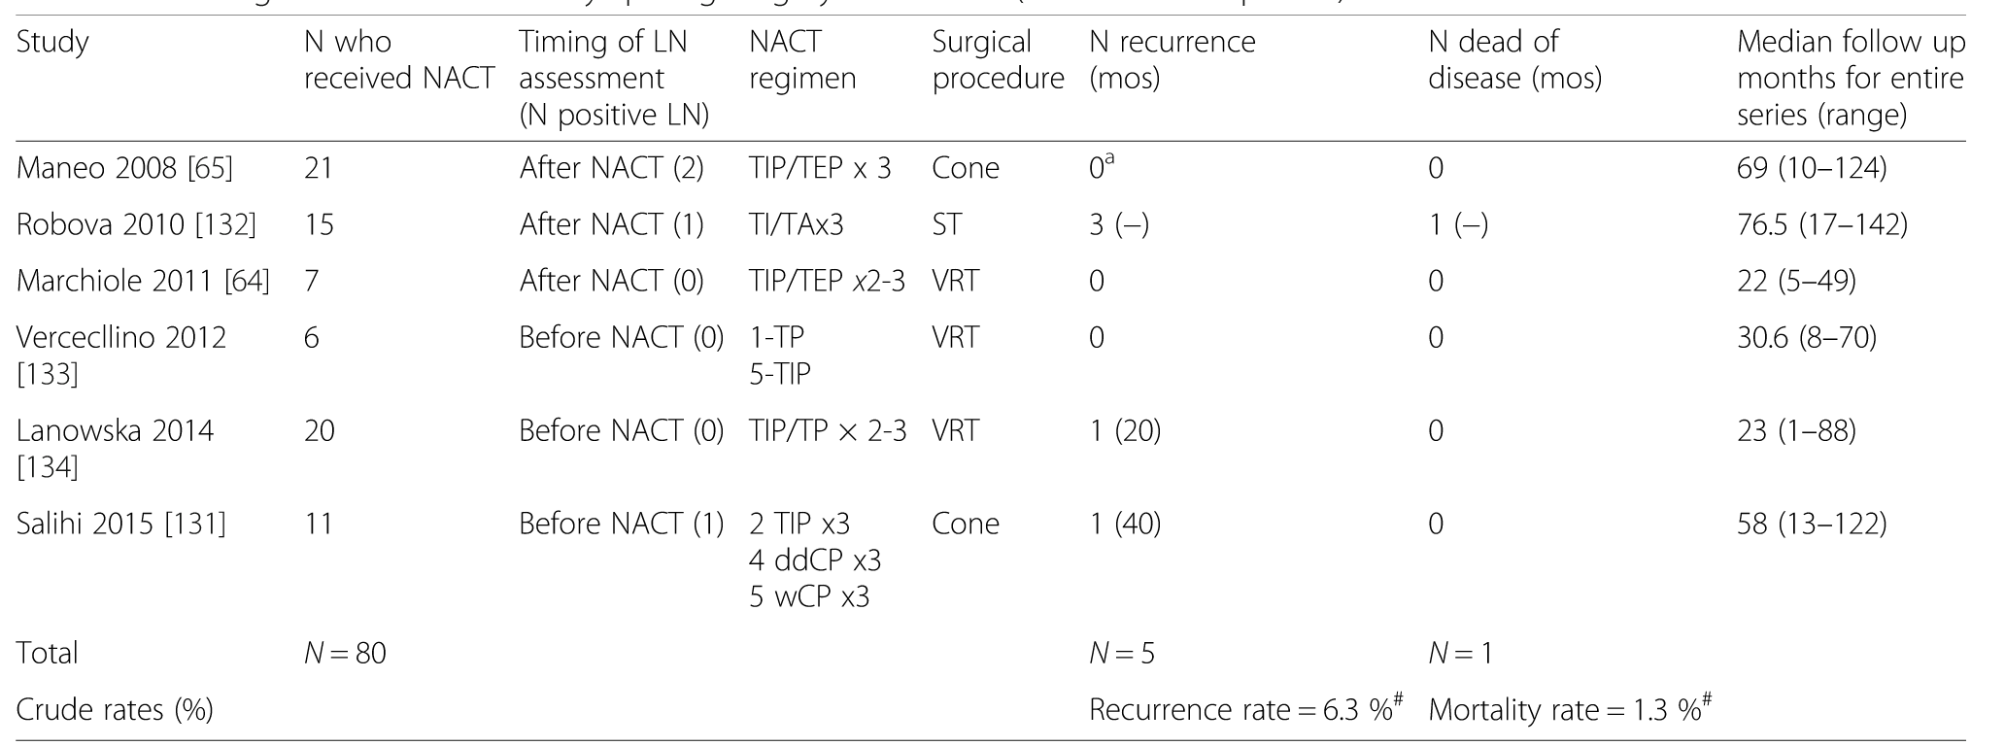
Conservative management after NACT
Oncological outcome
≥ 2cm, IB1-IIA
Willows K, Lennox G and Covens A. Gynecol Oncol Res Pract, 2016.

Slide 44
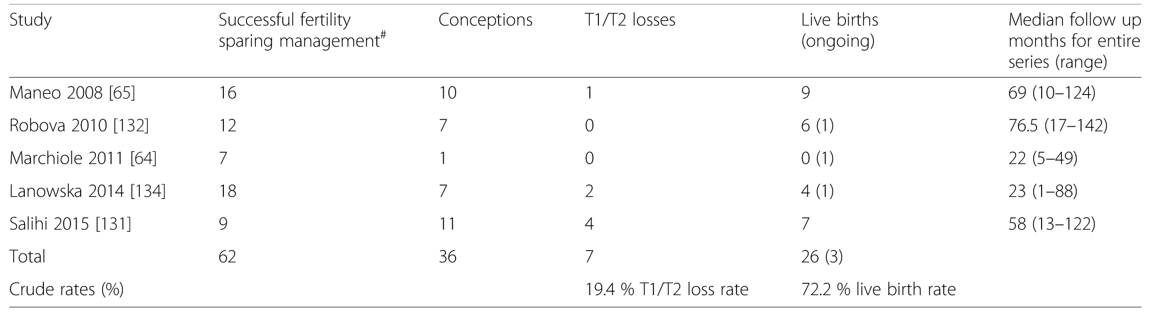
Conservative management after NACT
Obstetrical outcome
Willows K, Lennox G and Covens A. Gynecol Oncol Res Pract, 2016.

Slide 45
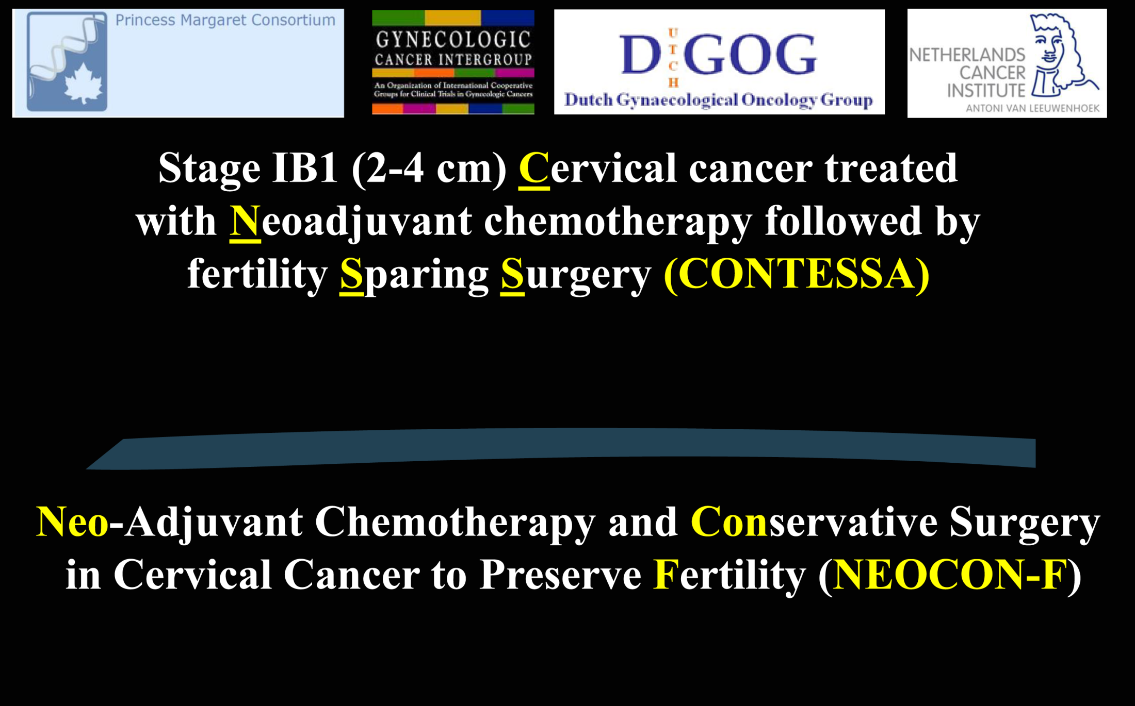

Slide 47
Inclusion criteria for neo-adjuvant chemotherapy:
Age >18 and ≤40 years old
Eastern Cooperative Group (ECOG) performance status ≤2
Invasive cervical cancer: adenocarcinoma, adenosquamous or squamous, grade 1, 2 and 3
Lymphovascular space invasion allowed
2018 FIGO stage IB2 measuring 2–4 cm (clinical exam and MRI)
Pathologically-negative pelvic nodes (based on pre-study lymph node dissection/sentinel lymph node mapping)
Patients must be pre-menopausal
Desire to preserve fertility potential
Inclusion criteria for fertility-preserving surgery:
Completed the planned three cycles of neo-adjuvant chemotherapy
Achieved complete or partial response (<2 cm residual lesion) following neo-adjuvant chemotherapy

Slide 48
Exclusion criteria for neo-adjuvant chemotherapy
Positive pelvic nodes
Uterine corpus and extra-uterine extension (MRI)
Lesions >4 cm
Other high-risk histology
Pregnant women
Patients who have had chemotherapy or radiotherapy for their cancer
Exclusion criteria for fertility-preserving surgery
Patients unable to complete three courses of neo-adjuvant chemotherapy
Suboptimal response to neo-adjuvant chemotherapy (≥2 cm residual lesion), stable disease or disease progression
following 3 courses of neo-adjuvant chemotherapy

Slide 52
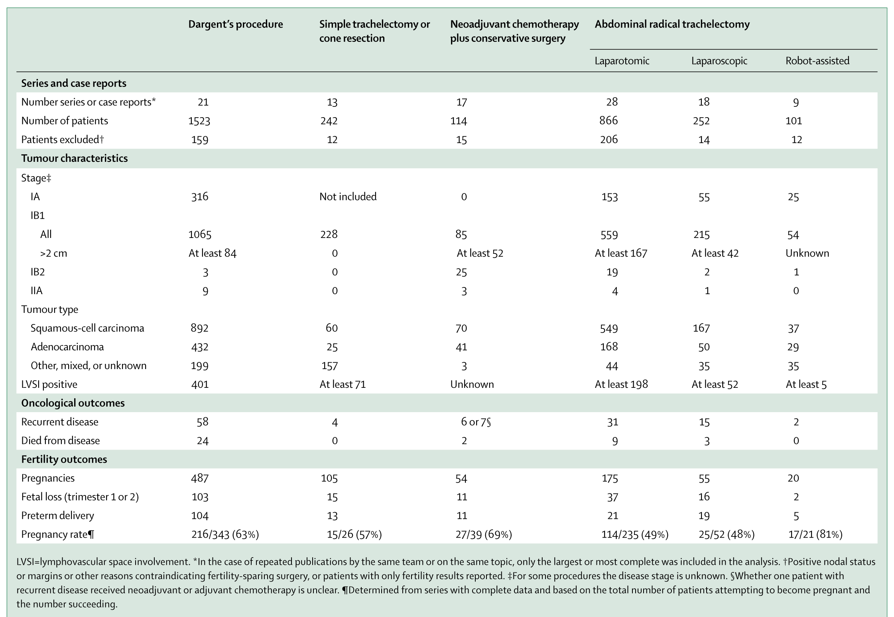
Bentivegna E et al. Lancet Oncology, 2016.

Slide 53
IB2 > 2cm - reccurence
VRT 17% (n=84) ART 5% (n=167) L-scopic 17% (n=42) NACT 6% (n=99)

Slide 54
Fertility-Sparing Treatment for Early-Stage Cervical Cancer > 2 cm
there is no consensus on the strategy to be adopted in the case of ECC >2 cm.
Bentivegna E, Gouy S, Maulard A, Chargari C, Leary A, Morice P. Oncological outcomes after fertility-sparing surgery for cervical cancer: a systematic review. Lancet Oncol. 2016;17(6): e240–53
of the five possible principal FSTs (conization, vaginal trachelectomy, minimally invasive trachelectomy, abdominal
trachelectomy, and neoadjuvant chemotherapy combined with conization or trachelectomy)
there is evidence of the inadequacy of the vaginal trachelectomy approach
Delgado G, Major F. Prospective surgical-pathological study of disease-free interval in patients with stage IB squamous cell carcinoma of the cervix: a Gynecologic Oncology Group study. Gynecol Oncol. 1990;38: 352–7.
Covens A, et al. How important is removal of the parametrium at surgery for carcinoma of the cervix? Gynecol Oncol. 2002;84:145–9.
No consensus on the gold standard between radical abdominal approaches and neoadjuvant chemotherapy (NACT).
more confusion is related to the fact that tumors > 2 cm in size are at higher risk of recurrence regardless of FST
FST should be considered a non-routine approach for the management of ECC > 2 cm and deserves further investigation

Slide 57
Oncological aspects of fertility-sparing strategies during the initial management of cervical cancer
Radical trachelectomy is recommended for stage IB2 disease
Αbdominal approach (eg, laparotomy or mini-invasive approaches [robotic-assisted or pure laparoscopic approaches] (IV, B)
Lymph node staging strategies for stage IB1 and IB2 diseases should follow the ESGO–ESTRO–ESP guidelines (IV, B)
Negative margins (a non-fragmented specimen, with at least 1 mm histological-free margin from carcinoma or dysplasia) are mandatory (III, A)
A non-fragmented cone is crucial for pathological evaluation
The base of the cone should encompass the visible gross lesion on the ectocervix with at least 1 mm histological margin called the 12 o’clock
suture ( IV, B)

Slide 58
Neoadjuvant chemotherapy as an alternative to radical trachelectomy for selected patients with stage IB2 (2–4 cm) CaCx(IV, C)
NACT to reduce cervical tumor burden and allow for a satisfactory resection of the primary tumor with conisation and simple
or radical trachelectomy (IV, C)
Abdominal radical trachelectomy has the lowest recurrence rate for patients with stage IB2 cervical cancer (IV, C)
Ongoing prospective trials with platinum and paclitaxel will clarify the validity of neoadjuvant chemotherapy in fertility- sparing treatment of
stage IB2 disease (IV, C)
Including patients with stage IB2 cervical cancer in ongoing trials is encouraged to evaluate the safety of neoadjuvant chemotherapy (V, B)
Confirming pathological-negative bilateral pelvic nodes (sentinel lymph node or lymphadenectomy) before starting
neoadjuvant chemotherapy allows for the most accurate staging and selection of appropriate candidates for neoadjuvant chemotherapy (IV,B)
Preoperative imaging with pelvic MRI and whole body PET-CT is favored (IV, B)

Slide 59
Frequencies of follow-up after fertility-sparing management
Follow-up is the same as for any patient with cervical cancer
every 3–4 months for 2 years, every 6 months for another 3–5 years, and then annually (IV, B)
Reduction of frequency of follow-up could be proposed in cases of negative HPV testing after conservative surgery (IV, C)
Follow-up procedures after fertility-sparing management
Physical examination should be performed, including bimanual pelvic examination every 3–4 months for the first 2 years, every
6 months thereafter until the fifth year, and then annually
Cytology plus HPV testing should be performed after 6 months, then annually (IV, B)
Colposcopy should be performed in cases of abnormalities at cytology and a biopsy sample should be taken for positive results
from HPV testing (IV, B)
HPV vaccination should be encouraged (V, B)
MRI (preferably evaluated by a dedicated gynaecological radiologist) is mandatory at 6 months and 12 months, and then when
clinically indicated thereafter (IV, A)
Transvaginal ultrasonography, with or without transrectal ultrasonography, is an option when performed by an experienced
sonographer (IV, C)
PET-CT can be considered in cases of suspicion of a recurrence (III, B)
There is no evidence to recommend the routine use of squamous cell carcinoma antigen in follow-up (V, C)

Slide 60
Fertility sparing issues in cervical cancer
Guidance for managing conservatively young patients with Ca Cx
but
never replace the basic rule of individualisation of care
- each patient has different characteristics, needs and expectations

