Slide 1
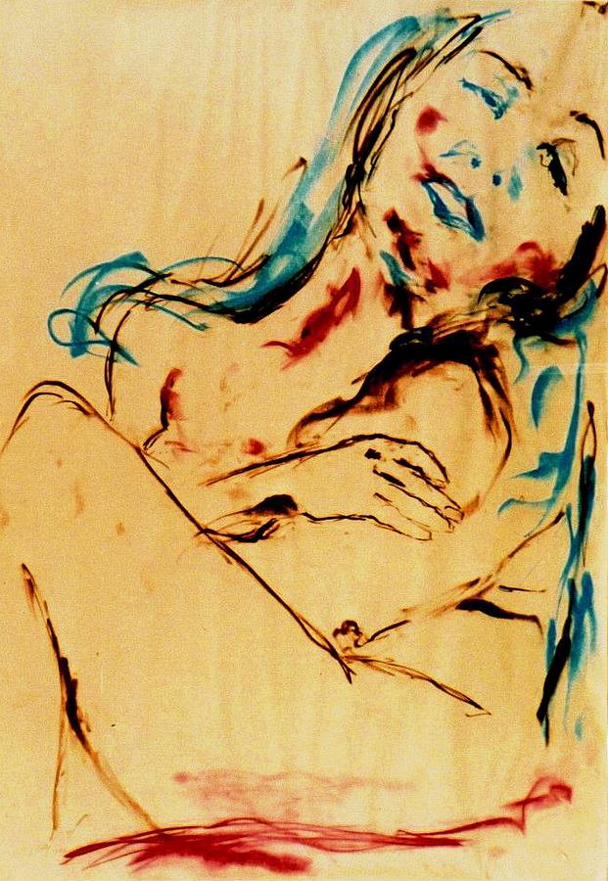
Sexuality after gynecologic cancer treatment in women
Nadine EL KASSIS, MD, MSc
Gynecologic oncology
Saint Joseph University, Beirut
Hotel Dieu de France

Slide 2
Do you ask your patients about their sexual health?

Slide 3
Do you tell your patients about cancer treatment effect on their sex life?

Slide 4
How do you manage sexual dysfunction in female cancer patients?

Slide 5
Sexual health is an integral part of human health and quality of life (QOL), and it cannot be separated from other aspects of life.
Sexuality is part of human personality and an activity that is engaged in individually and with partner(s).
It is a multidimensional phenomenon encompassing bio-psycho- social- Existential aspects of human health and can be a facilitator of well-being, self-esteem and general resilience
-World Health Organization, 2022
-Graugaard, 2017.

Slide 6
Sexual function
Biological, psychosocial, and sociocultural factors that may promote or inhibit sexual response
Sexuality refers to the total expression of who you are as a human being
Sexuality can include sexual activity, but it doesn’t have to

Slide 7
Sexual response cycle
Sexual desire
(libido)
physical and psychological health of the patient,
Arousal
neurovascular response to desire or sexual stimulation resulting in vascular congestion of the nipples/areolae and genitals
Lubrication
Hormonal status
Orgasm
marked feeling of sexual release followed by rhythmic contractions in the pelvic musculature
past sexual experiences,
sex education,
relationship concerns
personal beliefs about sex
Age
radiotherapy

Slide 8
Sexuality is a inherently human trait
Frequently unaddressed and neglected clinical concern.
Survey in Radiology oncology clinic : 87% of patients reported impacted sexual function or desire, Only 27.9% reported ever formally being asked about sexual health.
80% of patients with prostate cancer received information about sexual dysfunction after cancer treatment compared with 33% of patients with breast cancer
1-Taylor et al. Int J Radiat Oncol Biol Phys. 2020;108:S136.
2. Flynn et al. Psychooncology. 2012

Slide 9
Erogenous zones

Slide 10
How can gynecological cancers affect sexual function?

Slide 11
Cancer effect
Anxiety
Body image
Low self esteem
Depression
Fear of recurrence
Fear of death
Relationship issues
Location of the cancer
Katz et al. 2022 ASCO EDUCATIONAL BOOK

Slide 12
Treatment effect
Surgery effect:
Body image
Clitoris excision, wide surgical excision in vulvar cancer
Vaginal shortening in cervical cancer surgery
Loss of libido
Fatigue
Stoma presence
Adjuvant treatment effect:
Early menopause caused by chemotherapy or pelvic radiation
Vaginal dryness
Pain during intercourse
Genito urinary symptoms of menopause
Dyspareunia due to radiotherapy sequella

Slide 13
Society and the importance of the breasts through history
Chola Dynasty
(9-13th century India)
Hellenistic greece
Ancient egyptians
Ancient Romans
1600s Europe
The 2000’s
The 1950s
19th Century France
The 1980s

Slide 14
Body Image after Mastectomy
Breasts are identified as sign of femininity, beauty, motherhood and attraction.
After surgery many women described the site as “wretched, horrible, scary, ugly, crooked, and collapsed shape.”
Social identity affected after a mastectomy. Women felt “diminished as a women”, “half”, “abnormal” and “depressed.”

Slide 15
Breast cancer
Low self esteem
Altered body image, specially after mastectomy and axillary LND
Breast conserving surgery had better sexual adjustment , less impairment of sexual desire, arousal, and orgasm than women who underwent mastectomy.
Nipple-sparing mastectomy has been associated with better psychosocial and sexual well-being than skin-sparing mastectomy followed by nipple reconstruction
Fear of recurrence
-Aerts L, Breast 2014
-Dossett L.A, J. Surg. Oncol. 2016
-Wei C.H., Breast J. 2016
-Yoon-Flannery, K, J. Surg. Oncol. 2018

Slide 16
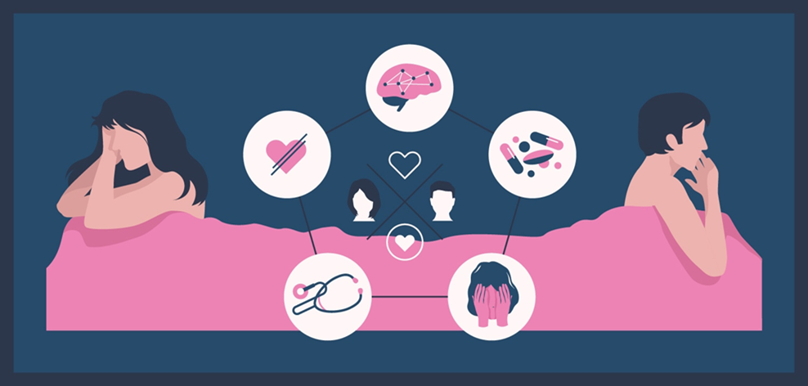
Breast cancer
Boswell & Dizon, 2015
83 breast cancer survivors, all 3 or more years post diagnosis
Surveyed using the female sexual function index (FSFI) and the female sexual distress scale-revised (FSDS-R)
Found that 77% qualified for the diagnosis of sexual dysfunction on the FSFI alone

Slide 17
Breast cancer
Vegunta, S. et al.J. Clin. Med. 2022

Slide 18
Vulvar cancer
Sexual health affected by physical changes.
For example, their internal and external genitalia are directly affected before, during and for a long time after VC treatment
70 % experience Wound breakdown, Open exfoliating and smelling wounds in the vulvar area.
Significant late side effects after surgery and after radiotherapy: pain, tearing, splitting, soreness, narrowness or tightness, heaviness, scarring, numbness and swelling in the vulvar region and the groin area, lymphedema
Negative impact on women's QOL, including body image and sexual functioning
Kobleder, Nikolic et al., 2016,
Kobleder, Raphaelis et al., 2016)

Slide 19
All stages of the sexual response cycle, including interest and desire (libido), arousal and orgasm are affected by VC diagnosis and treatment.
(Aerts et al., 2012)

Slide 20
Vulvar cancer and sexuality
89% of women who underwent radical vulvectomy had sexual complications
Sensitivity changes in the genitals
No orgasms
Urinary and digestive problems
Impossible penetration sometimes, dyspareunia
Less invasive local surgery with preservation of the clitoris led to increased sexual activity and better sexual function after treatment.
The lowest sexual activity rates compared to other gynecological cancers
Froeding et al. (2018)
Jefferies and Clifford (2011a)
Carter et al. (2021

Slide 21
Unmet needs and loneliness caused by taboos about sexual health
Fear of other peoples’ views and prejudices about VC being a sexually transmitted disease.
Many women delayed diagnostic examinations
iInsufficient information about their health and follow-up after treatment
Lack of information regarding the wound healing process intimate hygiene after treatment and how to adapt to a changed sexual life
Aerts et al., 2012, 2014;
Senn et al., 2011
Boden & Willis, 2019

Slide 22
Cervical cancer
Screening led to early stage CC diagnosis
Sexual dysfunction due to: vaginal symptoms and psychological and relationship issues
Vaginal sexual symptoms: shortened and tightened vagina, vaginal dryness (early menopause), and dyspareunia
Cervical cancer survivors treated with adjuvant radiotherapy are more likely at risk for impaired QoL (EORTC QLQ-CCM))
Greimel 2008

Slide 23
GRISS scores
Dysfunction, sexual dissatisfaction and a lower
level of quality of life in cervical cancer survivors
FSFI scores

Slide 24
Cervical cancer and sexuality
The Sexual Quality of Life Questionnaire score (SQOL) of cases was 60.12 ± 9.01 and controls was 78.92 ± 7.08.

Slide 25
Among sexually active participants, sexual distress correlated significantly with levels of
vaginal sexual symptoms,
sexual pain worry,
anxiety,
depression,
body image concerns,
relationship dissatisfaction

Slide 26
Endometrial cancer and sexuality
According to de Morais Siqueira et al. sexual dysfunction was present in 91%, after chemotherapy (EORTC-QLQ- EN24)
EC patients reported more sexual dysfunctions, including sexual desire dysfunction, arousal dysfunction, entry dyspareunia, and a reduced intensity of orgasm, compared to healthy individuals.
Lower overall well-being 1 year after surgical treatment.
Moreover, before treatment, quality of partner relationship was negatively associated with sexual arousal dysfunction and orgasm dysfunction.
- Morais Siquiera. Int Urogynecol J. 2022
- Aerts, J of sexual medicine. 2014

Slide 27
Endometrial cancer and Sexuality
Lavazzo 2015: sexuality issues may not be that important in the EC population: old patients, with comorbidities.

Slide 28
Ovarian Cancer and sexuality
75% diagnosed at an advanced stage
Extensive surgery then chemotherapy
Bad prognosis
“ Failure and loss of femininity and womanhood”, “Loss of the sexual self”
Relationship problems: “It feels strained. I feel like a burden [when] in treatment. And a ticking time bomb in between recurrences”, “I feel guilty”
‘My partner and I broke up after my hysterectomy and debulking surgery. The stress of my illness on him was too much for him to cope with’
Boding, Eur J Cancer Care. 2022

Slide 29
Ovarian cancer and sexuality
Loss of physical response, libido and arousal, due to hormonal changes after treatment and psychological factors.
Pain or fear of pain because of structural changes cause of loss of hormones
Less acts of intimacy
Most of Early ovarian cancer survivors experience sexual dysfunction
Less than 10 % reported either an interest in sex or were sexually active.
- Boding, Eur J Cancer Care. 2022
- Matulonis, Int J Gyn Cancer 2008

Slide 30
Young ovarian cancer survivors and Sexuality
Affected body image: hair loss, weight loss, stoma
Sexual discomfort: pain due to vaginal dryness , CT
Low sexual satisfaction
Decreased libido
Roland et al. Psycho-Oncology 2022

Slide 31
Importance of sexual health discussion
Left untreated, sexual problems are associated with reduced quality of life, depression, interpersonal conflicts, and often medication noncompliance
Early diagnosis of sexual difficulties followed by intervention leads to better sexual health outcomes and improved quality of life

Slide 32
Communication is key
With health care professionals:
Studies show that women are less likely to bring up the concern about gynecological cancers and sexuality with their health care professionals due to:
Lack of time and privacy during office visits
Perceived perception of the health care provider’s interest and/or knowledge in the topic.

Slide 33
How to address sexual health issues?
“Are you currently sexually active?” If not, “Does this concern you?”
“Many women have sexual concerns during cancer treatment. Do you have any concerns you would like to discuss today?”
“Have you noticed any change in your sexual interest?” If so, “Does this concern you?”
“Are you having any difficulty with vaginal lubrication or pain with sexual intercourse?”
“Do you have concerns about your sexual well-being?”

Slide 34
Brief sexual symptoms checklist

Slide 35
Health Care providers role
Health care professionals should be well mindful of sexual distress among Gyn cancers survivors, starting from the diagnosis, through the treatment and beyond
Time and the privacy needed to address sexual distress, irrespective of type of treatment and sexual activity.
Address vaginal sexual symptoms, by providing psychoeducation and practical advice.
Reduce worry about painful intercourse, decrease sexual avoidance, prevent relationship dysfunction, and address concerns about body image.
Bakker 2016

Slide 36
Possible interventions
Psychological interventions, such as online psychoeducational support
Mindfulness‐based cognitive behavioral
Involving the partner
Involving other professionals: psycologists, psychiatrists, sexologists,…
Exercise can help :
Improve sexuality
Improve body image
Reduce anxiety
Reduce depression

Slide 37
Genitourinary symptoms of the menopause

Slide 38
GSM
Vaginal dryness
Painful sex
Impossible penetration
Decreased sexual response

Slide 39
GSM Treatment: Moisturizers
OTC
hyaluronic acid, paraben-free, polycarbophilic
Regular use: 3/ week
Decrease vaginal dryness and dyspareunia
Loprinzi et al. J Clin Oncol. 1997

Slide 40
GSM treatment: Topical vulvo vaginal hormone
No level 1 data to support the safety of vaginal estrogens for patients with hormone receptor–positive breast cancer
No proof of increasing recurrence risk
Women’s Health Initiative Observational Study: no increase in endometrial and breast cancer incidence
No increased risk of cancer recurrence among tamoxifen users who used vaginal estrogen, even in aromatase inhibitors users
ACOG and ASCO endorse the use of vaginal estrogens after discussion with the patient
Carter et al. Clin Oncol. 2018
Le Rayet al. Breast Cancer Res Treat. 2012
American College of Obstetricians and Gynecologists. Obstet Gynecol. 2016

Slide 41
GSM treatment
Topical testosterone
Topical dehydroepiandrosterone (DHEA)
One randomized trial of cancer survivors showed no improvement in sexual function compared with placebo.
Short duration follow up
Topical testosterone vs estrogen ring
Elevated estrogen in 12 % of testo group
- Vaginal atrophy, sexual interest, and dysfunction were improved in both groups
Evaluated in breast or gynecologic cancer who could receive tamoxifen or aromatase inhibitors
3.25-mg/day
Beneficial
Normal estrogen levels
Barton et al. Natl Cancer Inst. 2007
Melisko et al, JAMA Oncol. 2017
Barton et al.Support Care Cancer. 2018

Slide 42
GSM treatment: Hormone replacement treatment
In a 2021 systematic review and meta-analysis that included four randomized trials involving breast cancer survivors (4,050 volunteers), HRT significantly increased the risk of recurrence compared with placebo in HR positive breast cancer
Contraindicated in HR breast cancer
Can be suggested in hormone independent patients: cervical, epithelial ovarian,
Poggio et al. Breast Cancer Res Treat. 2022
Eeles et al. J Clin Oncol. 2015
Ploch E. Gynecol Oncol. 1987

Slide 43
Loss of desire

Slide 44
Addressing the loss of desire : Primary
Intact arousal, pleasure, and orgasm, but without the drive or enthusiasm to partake in sexual activities.
Antidepressants, hormone blocking agents, histamine receptor blockers
Psychosexual counseling, cognitive behavioral therapy, hypnosis, mindfulness, and exercise
Flibanserin: serotonin 1A receptor agonist/serotonin 2A receptor antagonist that improved scores of sexual desire and increased satisfying sexual encounters.
Side effects: somnolence, dizziness, and nausea
Bremelanotide: injectable medication for premenopausal patients with hypoactive sexual desire disorder that improved sexual desire and reduced related distress.
Side effects: nausea, flushing and headeache
Katz et al. 2022 ASCO EDUCATIONAL BOOK

Slide 45
Addressing the loss of desire : secondary
Negative body image, changes in the sense of touch, and discomfort or genito-pelvic pain
Topical lidocaine: vestibular pain, reduction of pain from 88 to 33%
Pelvic floor physical therapy
Psycho/sexual counseling
Vaginal dilators for vaginismus, and vaginal stenosis, shortening, narrowing and atrophy
N.B. Vaginal stenosis (any grade) at 3 years postradiation has been reported in 50% of patients with endometrial cancer, 60% with cervical cancer, and 80% with anal cancer
- Goetsch et al. J Clin Oncol. 2015
Katz et al. 2022 ASCO EDUCATIONAL BOOK
Damast et al. Pract Radiat Oncol. 2019

Slide 46
Addressing the loss of desire
Primary
Secondary
Intact arousal, pleasure, and orgasm, but without the drive or enthusiasm to partake in sexual activities.
Antidepressants, hormone blocking agents, histamine receptor blockers
Psychosexual counseling, cognitive behavioral therapy, hypnosis, mindfulness, and exercise
Flibanserin
Bremelanotide
Negative body image, changes in the sense of touch, and discomfort or genito-pelvic pain
Topical lidocaine
Vaginal dilators
Pelvic floor physical therapy
Katz et al. 2022 ASCO EDUCATIONAL BOOK

Slide 47
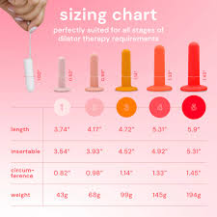
Vaginal dilators
women experiencing dyspareunia or vaginal tightness due to bodily tension associated with the fear of pain from vaginal penetration
Recommendations for vaginal dilators after Radiotherapy in Canada, US, Netherlands, UK
Constant and progressive
Bakker et al., 2014;
Cullen et al., 2013;
Huffman et al., 2016;
Katz, 2009;
Miles & Johnson, 2014

Slide 48
Summary of interventions
Katz et al. 2022 ASCO EDUCATIONAL BOOK

Slide 49
Low and middle income countries challenges
Sexuality is a taboo
Sexuality is not a priority
Cultural myths
Financial toxicity
Other priorities: treatment and complications management
Lack of professionals sexuality training
Working toward destigmatizing cancer and conversations about sexuality are the first steps in LMICs.
Holistic care of cancer
Katz et al. 2022 ASCO EDUCATIONAL BOOK

Slide 50
Sexuality in the Arab world
< 50% of cancer survivors participate in sexual activity following cancer with dyspareunia was the most common types of sexual dysfunction reported
very wide gap in communication and providing information on sexual health by care providers to female Arab cancer survivors.
Alananzeh et al. Eur J of cancer care 2022

Slide 51
Cancer and sexuality in sexual and gender minoritized patients (SGM)
Lack of knowledge of the HCP about their needs
Hostility/
discrimination
Lack of research
Sexual identity must be known to HCP
Information material must include SGM
Katz et al. 2022 ASCO EDUCATIONAL BOOK

Slide 52
Take home messages
Sexuality is a basic human right
Sexuality in gynecological cancer survivors is still neglected
Health care providers need to address this issue starting from the diagnosis
Cervical cancer , and vulvar cancer survivors are the most affected patients
Less invasive surgery when possible
Multidisciplinary approach and psychosexual counseling

